Slide 1
Bayesian Conditional Random Fields using Power EP
Tom Minka
Joint work with Yuan Qi and Martin Szummer

Slide 2
Why should you care?
New way to train Conditional Random Fields
  Significant improvement on small training sets
Demonstration of Bayesian methods
New computational scheme for Bayesian inference: Power EP
  Benefits of Bayes at little computational cost

Slide 3
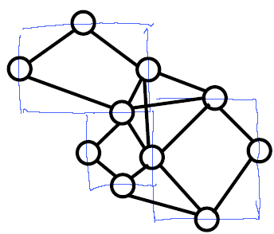
The task
FAQ text
Q
A
A
Q
A
A
A
Want to label structured data:
  Lines of text
  Hyperlinked documents
  Blocks of an image
  Fragments of an ink diagram
Ink

Slide 4
Independent classification
Classify each site independently, based on its features and those of its neighbors
Problems:
  Resulting labels may not make sense jointly
  Requires lots of features (self + neighbors)
  Performs redundant work in examining self + neighbors
Want classifiers which are local but linked

Slide 5



Conditional Random Field (CRF)
A linked set of classifiers
Object x, possible labels
g measures the three-way compatibility of the labels with the features and each other
w is parameter vector, E is linkage structure

Slide 6

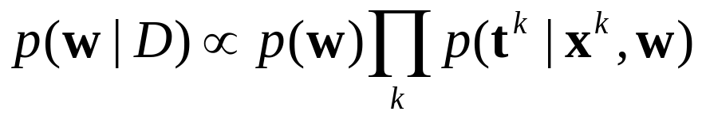
Training CRFs
Given labeled data we get a posterior
Old way: assume w = most probable value
  Easily overfits
New (Bayesian) way: weight each possible w by posterior, average the results for all w’s during testing
  No overfitting (no fitting at all)
Can this be done efficiently? Yes! (but approximately)
  Use Power EP

Slide 7
Bayesian procedure
Training: approximate the posterior of w
Testing: approximate the posterior of t
Power
EP
EP

Slide 8

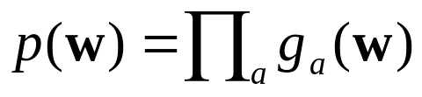






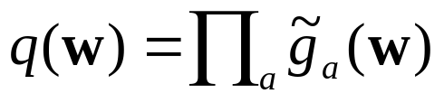



Expectation Propagation (EP)
A method to approximate
by

Slide 9




EP iteration
Initial guess
Delete
Include
Approximate

Slide 10
EP iteration
Initial guess
Delete
Include
Approximate

Slide 11

EP iteration
Initial guess
Delete
Include
Approximate

Slide 12
EP iteration
Initial guess
Delete
Include
Approximate

Slide 13

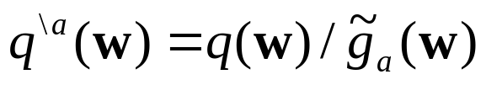



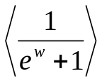

Approximating a factor
Requires computing under
Easy cases:
Hard cases:
Variational methods require
  Minimizes a different error measure
  “Exclusive” KL(q||p) vs. “Inclusive” KL(p||q)
  Doesn’t simplify the above cases

Slide 14
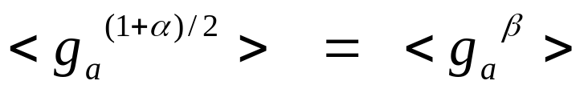



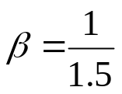
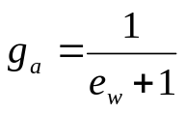

Power EP
Instead of minimizing KL, minimize alpha-divergence:
Only requires
Choose beta to make integrals tractable:

Slide 15
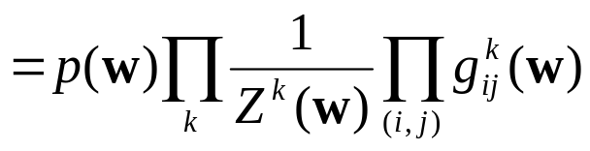
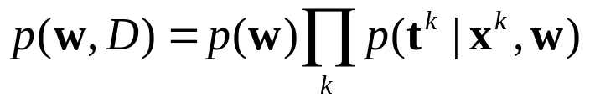


Power EP for CRFs
Want to approximate
(prior)(partition fcn)(interactions)
Process partition fcn using
is approximated by regular EP, where t is also a random variable

Slide 16
Algorithm structure
Competing EP processes for numerator and denominator terms
In numerator, t is known
In denominator, t is inferred
Helps to interleave the updates for each process, keeping them balanced
  Otherwise may spiral out of control
For testing, only one EP is required since denominator doesn’t come into play
  t is random in the numerator terms

Slide 17
Synthetic experiment
Each object has 3 sites, fully linked, 24 random features per edge
Labels generated from a random CRF
Same model trained via MAP or Bayes
Algorithm | Test error
 | 10 training objects | 30 train. | 100 train.
MAP | 16% | 12 | 10
Bayes | 11 | 10 | 9

Slide 18
FAQ labeling
Want to label each line of a FAQ list as being part of a question or an answer
19 training files, 500 lines on average, 24 binary features per line (contains question mark, indented, etc.)
Lines linked in a chain
MAP/Bayes used the same model and same priors
Algorithm | Test error
MAP | 1.4%
Bayes | 0.5

Slide 19
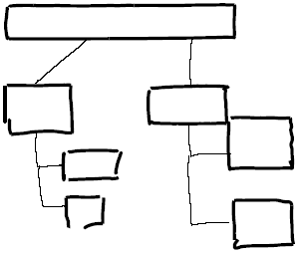
Ink labeling
Want to label ink as part of container or connector
14 training diagrams
Linkage by spatial proximity, probit-type interactions (except for MAP-Exp)
Algorithm | Test error
MAP | 6.0%
MAP-Exp | 5.2
Bayes | 4.4

Slide 20
Conclusions
Bayesian methods provide significant improvement on small training sets
Using power EP, additional cost is minimal
Power EP also provides model evidence, for hyperparameter selection (e.g. type of interactions)
Other places reciprocals arise: multiclass BPMs, Markov Random Fields
  Can use power EP to train them

