Slide 1
Expectation Propagation in Practice
Tom Minka
CMU Statistics
Joint work with Yuan Qi and John Lafferty

Slide 2
Outline
EP algorithm
Examples:
  Tracking a dynamic system
  Signal detection in fading channels
  Document modeling
  Boltzmann machines

Slide 3
Extensions to EP
Alternatives to moment-matching
Factors raised to powers
Skipping factors

Slide 4
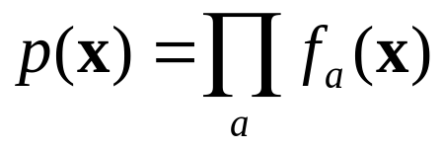
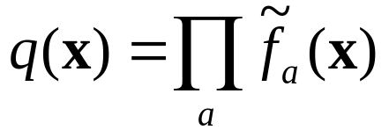
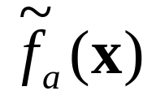
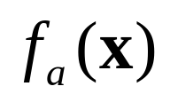
EP in a nutshell
Approximate a function by a simpler one:
Where each lives in a parametric, exponential family (e.g. Gaussian)
Factors can be conditional distributions in a Bayesian network

Slide 5
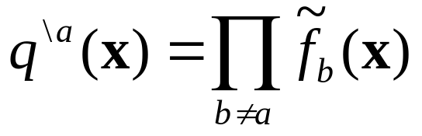
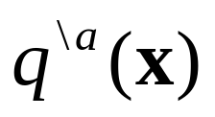

EP algorithm
Iterate the fixed-point equations:
specifies where the approximation needs to be good
Coordinated local approximations
where

Slide 6
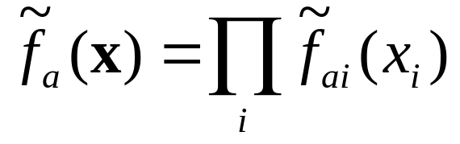
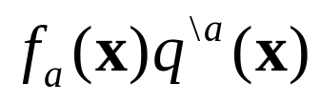
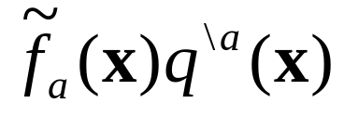
(Loopy) Belief propagation
Specialize to factorized approximations:
Minimize KL-divergence = match marginals of (partially factorized) and (fully factorized)
  “send messages”
“messages”

Slide 7
EP versus BP
EP approximation can be in a restricted family, e.g. Gaussian
EP approximation does not have to be factorized
EP applies to many more problems
  e.g. mixture of discrete/continuous variables

Slide 8
EP versus Monte Carlo
Monte Carlo is general but expensive
  A sledgehammer
EP exploits underlying simplicity of the problem (if it exists)
Monte Carlo is still needed for complex problems (e.g. large isolated peaks)
Trick is to know what problem you have

Slide 9








Example: Tracking
Guess the position of an object given noisy measurements
Object

Slide 10


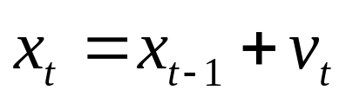
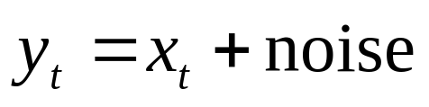
Bayesian network
e.g.
(random walk)
want distribution of x’s given y’s

Slide 11
Terminology
Filtering: posterior for last state only
Smoothing: posterior for middle states
On-line: old data is discarded (fixed memory)
Off-line: old data is re-used (unbounded memory)

Slide 12
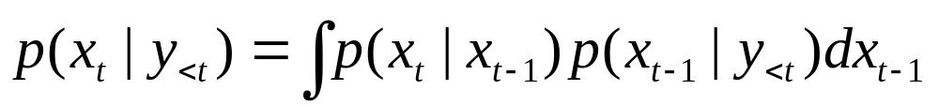
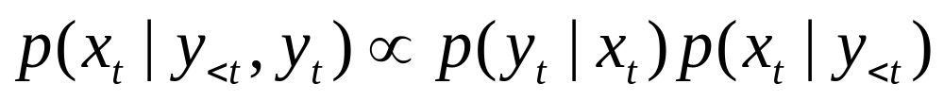
Kalman filtering / Belief propagation
Prediction:
Measurement:
Smoothing:

Slide 13
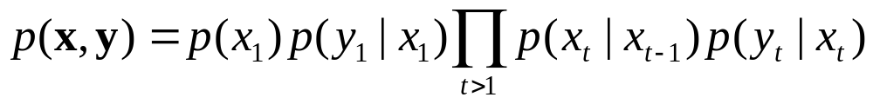
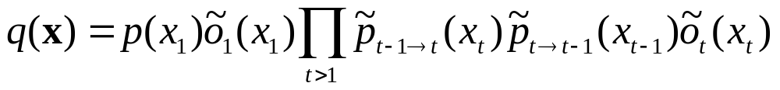
Approximation
Factorized and Gaussian in x

Slide 14
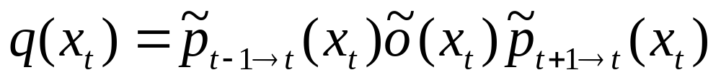
Approximation
= (forward msg)(observation)(backward msg)
EP equations are exactly the prediction, measurement,
and smoothing equations for the Kalman filter
- but only preserve first and second moments
Consider case of linear dynamics…

Slide 15
EP in dynamic systems
Loop t = 1, …, T (filtering)
  Prediction step
  Approximate measurement step
Loop t = T, …, 1 (smoothing)
  Smoothing step
  Divide out the approximate measurement
  Re-approximate the measurement
Loop t = 1, …, T (re-filtering)
  Prediction and measurement using previous approx

Slide 16
Generalization
Instead of matching moments, can use any method for approximate filtering
E.g. Extended Kalman filter, statistical linearization, unscented filter, etc.
All can be interpreted as finding linear/Gaussian approx to original terms

Slide 17
Interpreting EP
After more information is available, re-approximate individual terms for better results
Optimal filtering is no longer on-line

Slide 18

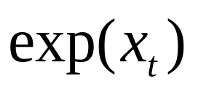
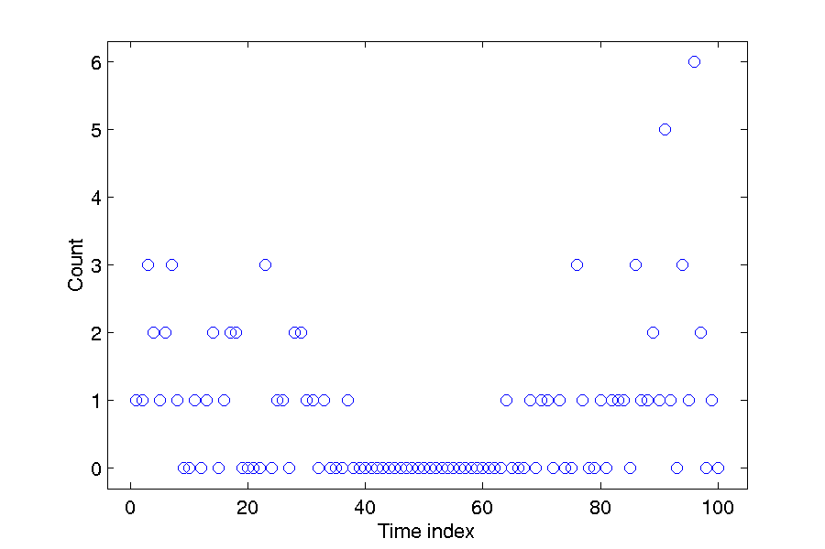
Example: Poisson tracking
is an integer valued Poisson variate with mean

Slide 19
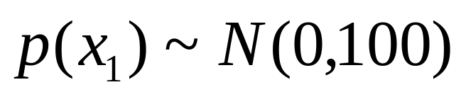
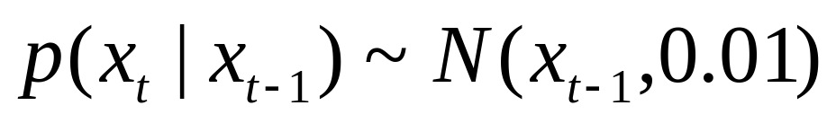
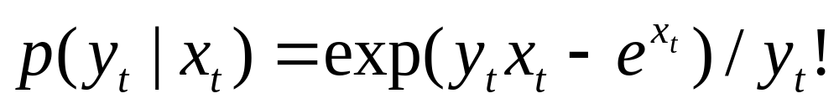
Poisson tracking model

Slide 20
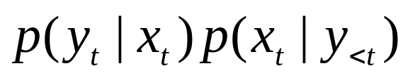
Approximate measurement step
is not Gaussian
Moments of x not analytic
Two approaches:
  Gauss-Hermite quadrature for moments
  Statistical linearization instead of moment-matching
Both work well

Slide 21
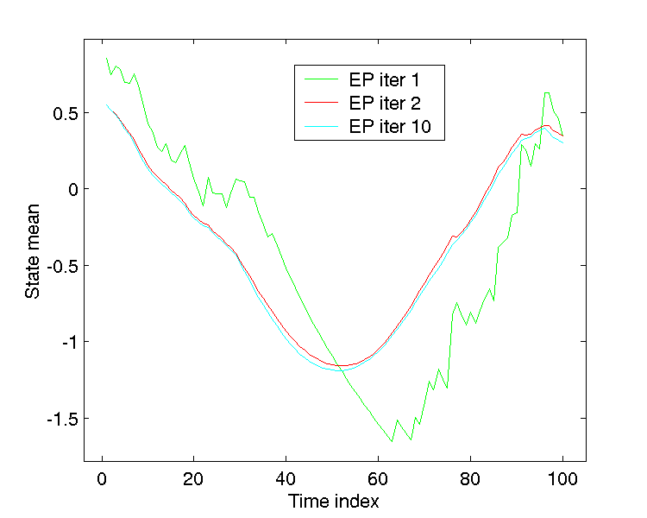

Slide 22
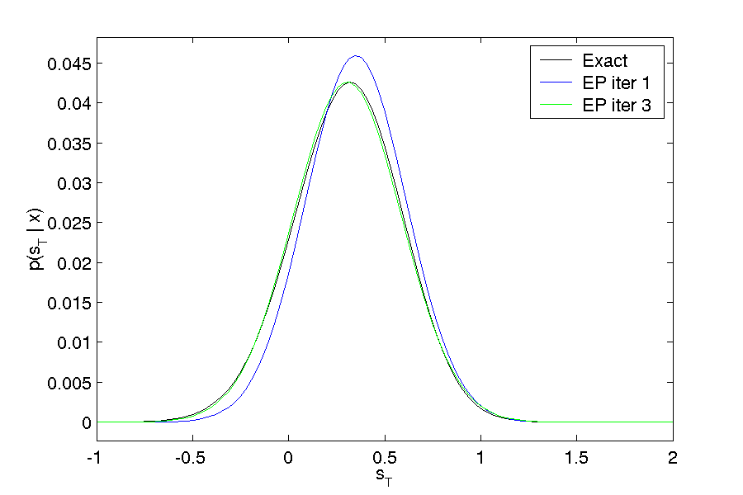
Posterior for the last state

Slide 23
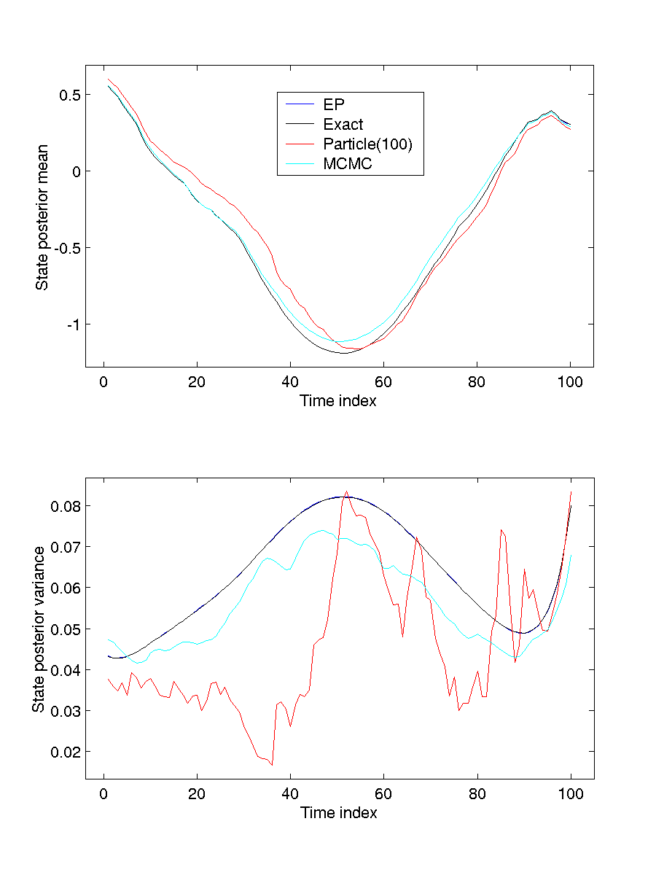

Slide 24
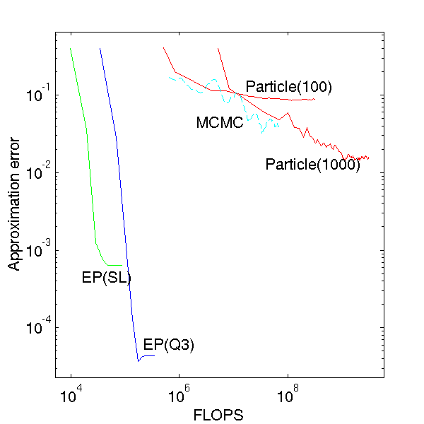

Slide 25
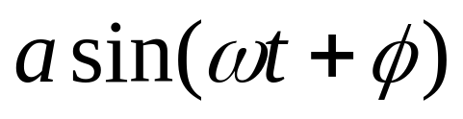

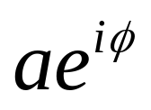


EP for signal detection
Wireless communication problem
Transmitted signal =
vary to encode each symbol
In complex numbers:
Im
Re

Slide 26
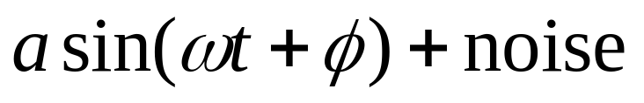
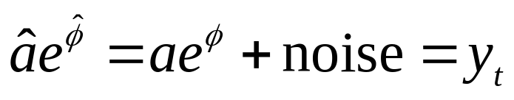



Binary symbols, Gaussian noise
Symbols are 1 and –1 (in complex plane)
Received signal =
Recovered
Optimal detection is easy

Slide 27
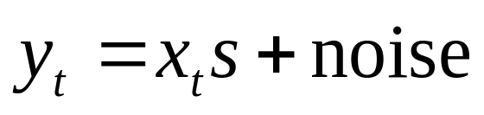



Fading channel
Channel systematically changes amplitude and phase:
changes over time

Slide 28


Differential detection
Use last measurement to estimate state
Binary symbols only
No smoothing of state = noisy

Slide 29




Bayesian network
Symbols can also be correlated (e.g. error-correcting code)
Dynamics are learned from training data (all 1’s)

Slide 30

On-line implementation
Iterate over the last measurements
Previous measurements act as prior
Results comparable to particle filtering, but much faster

Slide 31
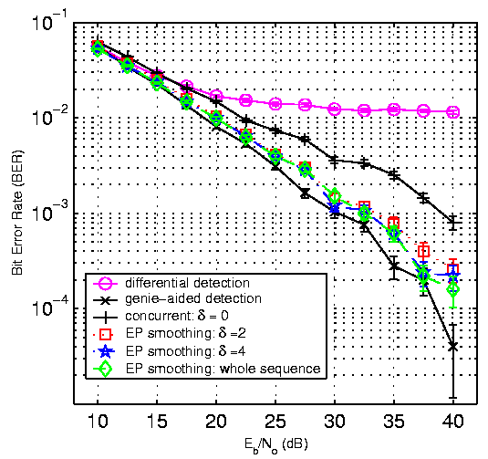

Slide 32
Document modeling
Want to classify documents by semantic content
Word order generally found to be irrelevant
  Word choice is what matters
Model each document as a bag of words
  Reduces to modeling correlations between word probabilities

Slide 33




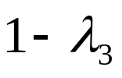

Generative aspect model
(Hofmann 1999; Blei, Ng, & Jordan 2001)
Each document mixes aspects in different proportions
Aspect 1
Aspect 2

Slide 34


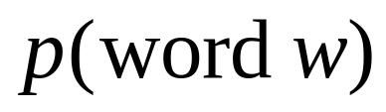
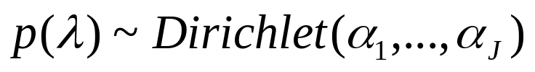
Generative aspect model
Aspect 1
Aspect 2
Multinomial sampling
Document

Slide 35

Two tasks
Inference:
Given aspects and document i, what is (posterior for) ?
Learning:
Given some documents, what are (maximum likelihood) aspects?

Slide 36
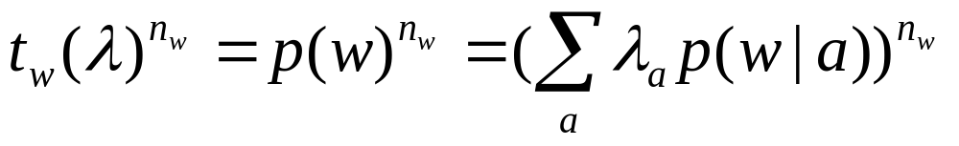
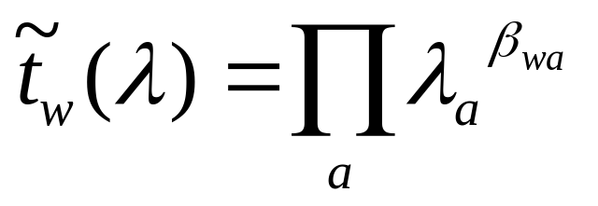
Approximation
Likelihood is composed of terms of form
Want Dirichlet approximation:

Slide 37
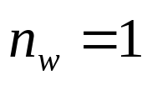

EP with powers
These terms seem too complicated for EP
Can match moments if , but not for large
Solution: match moments of one occurrence at a time
  Redefine what are the “terms”

Slide 38
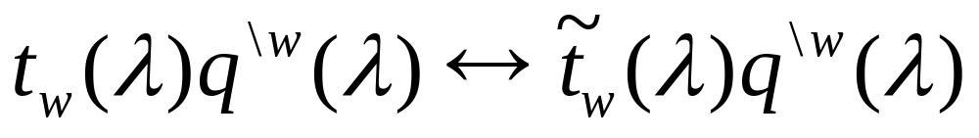
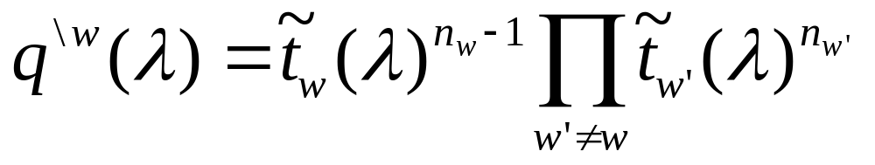

EP with powers
Moment match:
Context function: all but one occurrence
Fixed point equations for

Slide 39
EP with skipping
Context fcn might not be a proper density
Solution: “skip” this term
  (keep old approximation)
In later iterations, context becomes proper

Slide 40
Another problem
Minimizing KL-divergence of Dirichlet is expensive
  Requires iteration
Match (mean,variance) instead
  Closed-form

Slide 41
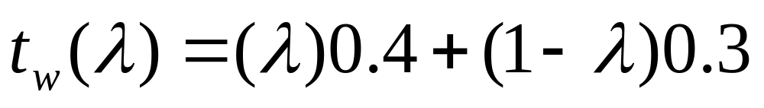
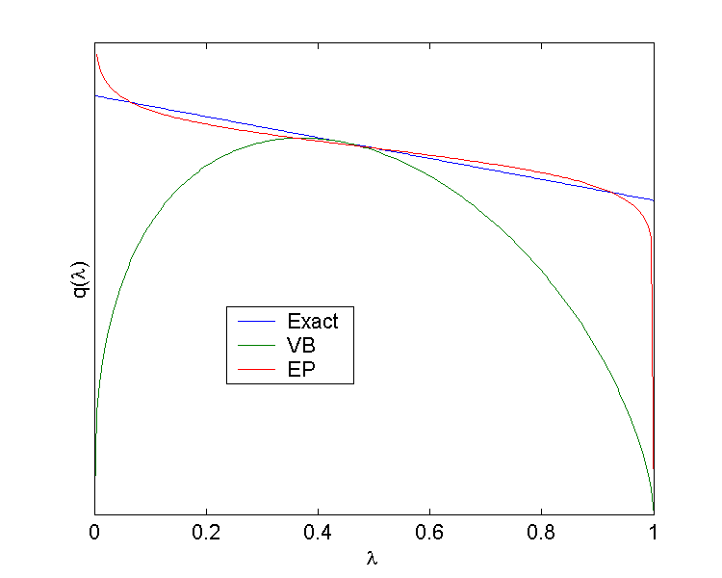
One term
VB = Variational Bayes (Blei et al)

Slide 42
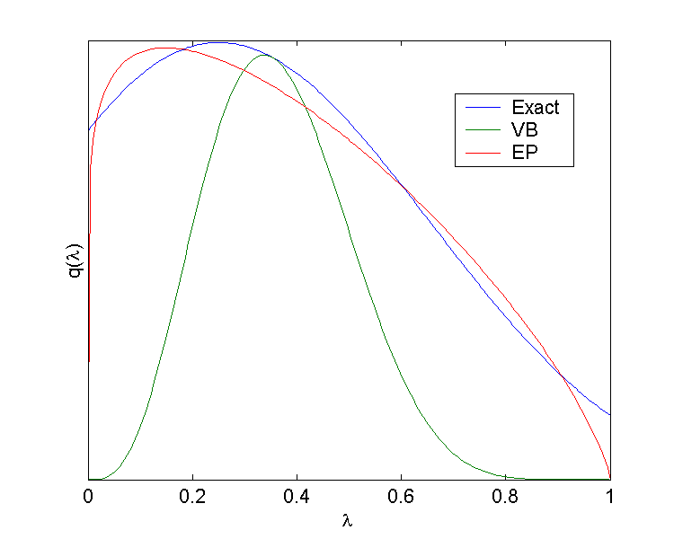
Ten word document

Slide 43
General behavior
For long documents, VB recovers correct mean, but not correct variance of
Disastrous for learning
  No Occam factor
Gets worse with more documents
  No asymptotic salvation
EP gets correct variance, learns properly

Slide 44
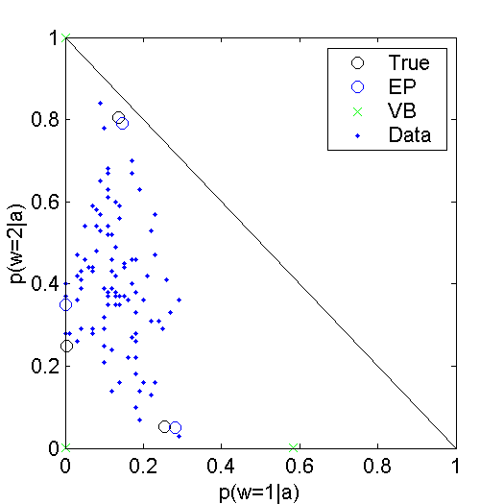
Learning in probability simplex
100 docs,
Length 10

Slide 45
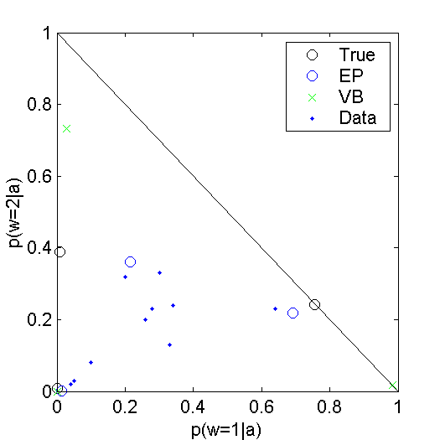
Learning in probability simplex
10 docs,
Length 10

Slide 46
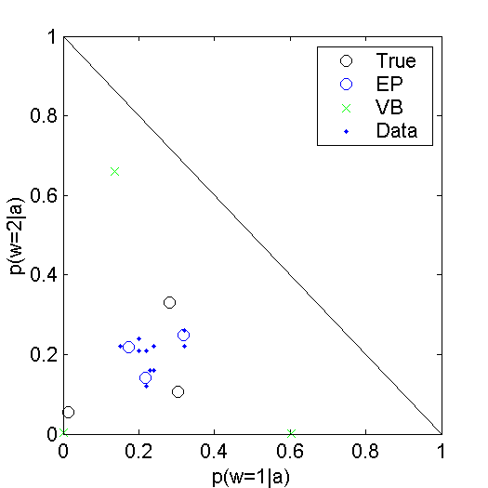
Learning in probability simplex
10 docs,
Length 10

Slide 47
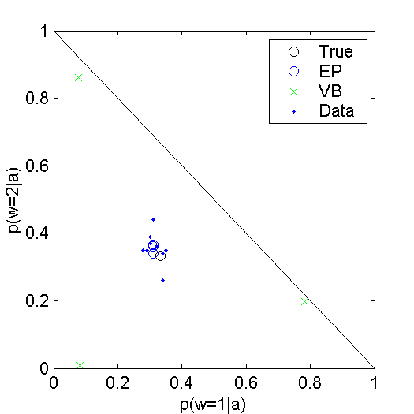
Learning in probability simplex
10 docs,
Length 10

Slide 48




Boltzmann machines
Joint distribution is product of pair potentials:
Want to approximate by a simpler distribution

Slide 49
Approximations
BP
EP

Slide 50
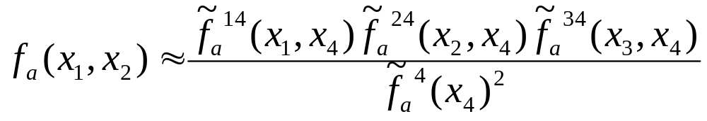
Approximating an edge by a tree
Each potential in p is projected onto the tree-structure of q
Correlations are not lost, but projected onto the tree

Slide 51
Fixed-point equations
Match single and pairwise marginals of
Reduces to exact inference on single loops
  Use cutset conditioning
and

Slide 52
5-node complete graphs, 10 trials
Method | FLOPS | Error
Exact | 500 | 0
TreeEP | 3,000 | 0.032
BP/double-loop | 200,000 | 0.186
GBP | 360,000 | 0.211

Slide 53
8x8 grids, 10 trials
Method | FLOPS | Error
Exact | 30,000 | 0
TreeEP | 300,000 | 0.149
BP/double-loop | 15,500,000 | 0.358
GBP | 17,500,000 | 0.003

Slide 54
TreeEP versus BP
TreeEP always more accurate than BP, often faster
GBP slower than BP, not always more accurate
TreeEP converges more often than BP and GBP

Slide 55
Conclusions
EP algorithms exceed state-of-art in several domains
Many more opportunities out there
EP is sensitive to choice of approximation
  does not give guidance in choosing it (e.g. tree structure) – error bound?
Exponential family constraint can be limiting – mixtures?

Slide 56
End

Slide 57
Limitation of BP
If the dynamics or measurements are not linear and Gaussian, the complexity of the posterior increases with the number of measurements
I.e. BP equations are not “closed”
  Beliefs need not stay within a given family
*
* or any other exponential family

Slide 58
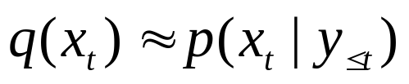
Approximate filtering
Compute a Gaussian belief which approximates the true posterior:
E.g. Extended Kalman filter, statistical linearization, unscented filter, assumed-density filter

Slide 59
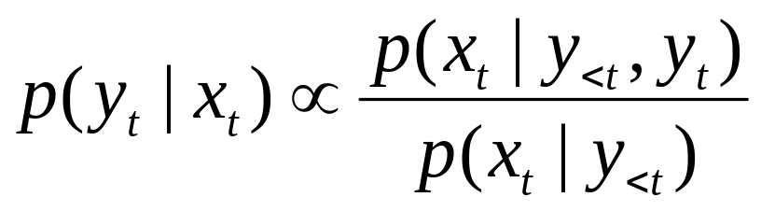
EP perspective
Approximate filtering is equivalent to replacing true measurement/dynamics equations with linear/Gaussian equations
Gaussian
implies
Gaussian

Slide 60




EP perspective
EKF, UKF, ADF are all algorithms for:
Nonlinear,
Non-Gaussian
Linear,
Gaussian

