Slide 1
Structured Region Graphs: Morphing EP into GBP
Max Welling
Tom Minka
Yee Whye Teh

Slide 2
GBP and EP
Approximate inference in large graphical models
Generalized belief propagation
  Minimize Kikuchi free energy
Expectation propagation
  Minimize local KL-divergence
Require choosing approximation structure
  Kikuchi clusters, exponential family
Need a constructive framework…
[Yedidia, Freeman, Weiss, NIPS 2000]
[Minka, UAI 2001]

Slide 3
Structured Region Graphs
A general representation for both GBP and EP approximations
Reveals equivalence between GBP/EP
  Can convert between equivalent GBP/EP algorithms
Simple tests ensure good performance: non-singularity, ∑_{R} c_{R} = 1, maximality
A framework for constructing good SRGs for any graphical model

Slide 4
A simple graphical model
1
4
7
2
5
8
3
6
9
Want single-variable marginals p(x₁), p(x₂), …

Slide 5


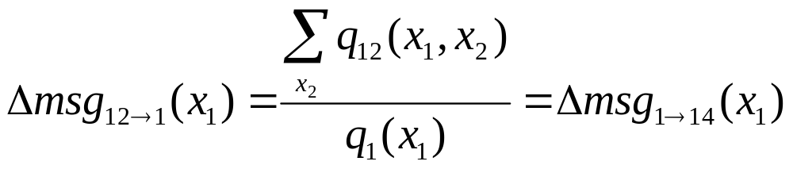
Belief propagation
1
2
8
1
4
2
5
2
3
9
1
2
3
4
9
Iterate until all marginals match

Slide 6

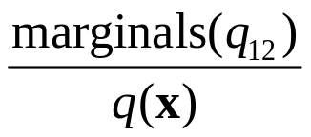

Fully-factorized EP
1
4
7
1
4
7
1
4
7
2
5
8
2
5
8
2
5
8
3
6
9
3
6
9
3
6
9
1
4
7
Iterate until all marginals match
2
5
8
3
6
9
Equivalent to BP

Slide 7



Generalized belief propagation
1
4
2
5
4
7
5
8
2
5
3
6
5
8
6
9
4
5
2
5
5
8
5
6
5

Slide 8
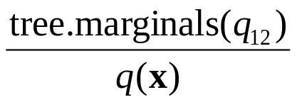
Tree-structured EP
1
4
7
1
4
7
2
5
8
2
5
8
3
6
9
3
6
9
1
4
7
Iterate until all pairwise marginals on the tree match
2
5
8
3
6
9
Equivalent to GBP on squares

Slide 9
Common theme
GBP and EP approximate p(x) in a distributed fashion
Factors are allocated to local regions
Each region has a distribution of a specific form, tied together by constraints
Regions pass messages until they meet the constraints

Slide 10
Approximation choices
Number of regions
Allocation of factors to regions
Number of parameters per region
Which regions to constrain
What type of constraints
How can we reason about these choices?

Slide 11
Outline
Structured region graphs
Equivalence operators
Design criteria
Design examples

Slide 12
Structured Region Graph
A general representation for GBP and EP approximations
A DAG of regions, each with a graph structure, and a set of factors
Graph structure defines the form of q_{R}(x_{R})
Links define constraints – parent and child have the same clique-marginals
Extends region graph formalism of [Yedidia,Freeman,Weiss, 2002]

Slide 13
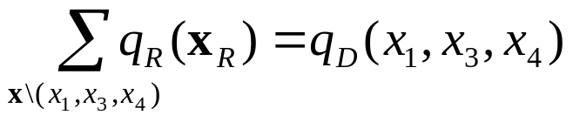
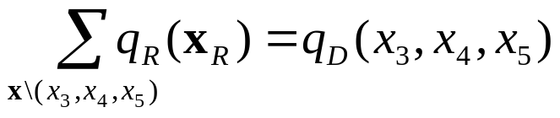
Structured Region Graph
q_{R} must match q_{D} on (1,3,4) and (3,4,5):
1
3
5
R
2
4
6
1
3
5
D
4
Parent must be super-graph of child
Cliques (1,3,4)(3,4,5)

Slide 14
GBP region graphs
All inner regions are complete [Yedida,Freeman,Weiss, 2002]
Thus q_{R}(x_{R}) is not factorized
1
3
5
3
5
Outer regions (no parents)
2
4
4
6
Original
graph
1
3
5
1
3
3
5
Inner regions
2
4
6
2
4
4

Slide 15
EP region graphs
Only one inner region
Every region contains all variables
1
3
5
1
3
5
2
4
6
2
4
6
Original
graph
1
3
5
1
3
5
2
4
6
2
4
6

Slide 16
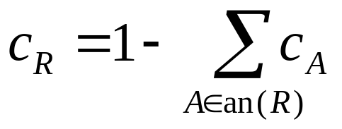
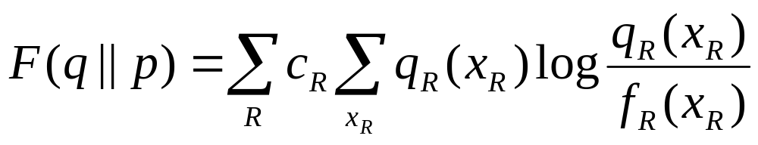
Free energy
Each region has counting number
Free energy:
subject to the parent-child marginal constraints
Applies to both GBP and EP (special cases)

Slide 17
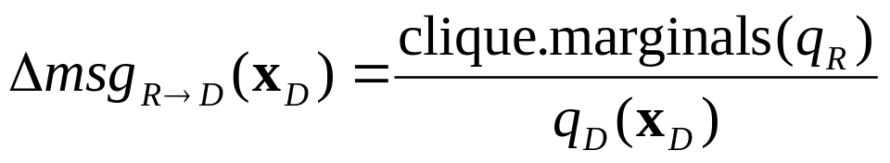
Generalized EP messages
Parent-child algorithm (for discrete variables):
D relays this to other parents
Iterate until all constraints satisfied
Fixed point of msg passing = critical point of free energy
1
3
5
R
2
4
6
1
3
5
D
4

Slide 18
Outline
Structured region graphs
Equivalence operators
Design criteria
Design examples

Slide 19
Equivalence operators
Graphical operators that preserve the critical points of the free energy:
  Region-Drop
  Region-Merge
  Region-Split
  Link-Death
  Clique-Grow/Shrink
  Factor-Move

Slide 20

Region Drop
A region with one parent can be dropped (replaced by direct links)

Slide 21
Region Merge
Linked regions with the same structure can be merged

Slide 22
Region split
Any region can be split into two regions plus a separator
Separator must be complete
Pieces must be super-graphs of children
3
5
3
5
5
5
4
6
4
4
4
6
3
5
3
5
5
5
4
6
4
4
4
6

Slide 23
Equivalence of BP and fully-factorized EP

Slide 24
Fully-factorized EP
1
4
7
1
4
7
1
4
7
2
5
8
2
5
8
2
5
8
3
6
9
3
6
9
3
6
9
1
4
7
2
5
8
3
6
9

Slide 25
SPLIT
1
4
7
1
4
7
1
4
7
2
5
8
2
5
8
2
5
8
3
6
9
3
6
9
3
6
9
1
4
7
2
5
8
3
6
9

Slide 26
MERGE
1
4
7
1
4
7
1
4
7
2
5
8
2
5
8
2
5
8
3
6
9
3
6
9
3
6
9
1
4
7
2
5
8
3
6
9

Slide 27
Belief propagation graph
1
2
8
1
4
2
5
2
3
9
1
2
3
4
9
BP and fully-factorized EP have the same fixed points

Slide 28
Equivalence of GBP-squares and tree-structured EP

Slide 29
Tree-structured EP
1
4
7
1
4
7
2
5
8
2
5
8
3
6
9
3
6
9
1
4
7
2
5
8
3
6
9

Slide 30
SPLIT
1
4
7
1
4
7
2
5
8
2
2
1
4
7
2
2
2
2
5
8
3
6
9
2
3
6
9
2
5
8
2
2
3
6
9

Slide 31
MERGE
1
4
7
1
4
7
2
5
8
2
2
1
4
7
2
2
2
2
5
8
3
6
9
2
3
6
9
2
5
8
2
2
3
6
9

Slide 32
SPLIT
1
4
7
2
5
8
1
1
4
4
4
7
1
1
4
4
4
7
2
2
5
5
5
8
2
5
8
2
2
5
5
5
8
3
6
9
2
2
5
5
5
8
3
3
6
6
6
9
3
3
6
6
6
9

Slide 33
DROP
1
4
4
4
7
2
5
5
5
8
2
5
5
5
8
2
5
5
5
8
3
6
6
6
9

Slide 34
GBP-squares region graph
1
4
4
4
7
2
5
5
5
8
2
5
5
5
8
2
5
5
5
8
3
6
6
6
9
The chosen TreeEP region graph has the same fixed points as GBP-squares
Extends to any grid

Slide 35
When does EP reduce to GBP?
When all variables are discrete, and inner region is triangulated (i.e. approximation family is decomposable)
E.g. TreeEP always reduces to GBP
Proof: split all inner regions, starting at the bottom, until only complete regions are left
But EP is often faster
  (10x faster in [Minka & Qi, NIPS 2003])

Slide 36
Outline
Structured region graphs
Equivalence operators
Design criteria
Design examples

Slide 37
Good region graphs
Consider 2 extreme cases:
  maximally correlated variables (strong factors)
  uniform variables (weak factors)
Want approx to be exact in (at least) these cases [Yedidia,Freeman,Weiss, 2004]
none
(uniform)
maximal
(deterministic)
Factor strength:
SRG exact iff:
Non-singular
∑_{R} c_{R} = 1

Slide 38
Non-singularity
Def: All fixed points are uniform when the factors are uniform
Not true for all region graphs
Equivalent def: No ‘redundant’ regions
  create spurious fixed points
  analogous to singular matrix
E.g. all triples in K₄ = singular

Slide 39
Simple test for non-singularity
Non-singularity is preserved by equivalence operators
Theorem: SRG is non-singular iff reduces to single-variable regions when all factors are removed

Slide 40
Example: Squares graph
Remove factors
1
4
4
4
7
2
5
5
5
8
2
5
5
5
8
2
5
5
5
8
3
6
6
6
9

Slide 41
Example: Squares graph
Remove factors
Split
4
4
1
4
7
5
5
2
5
5
5
8
2
5
5
5
8
2
5
5
5
8
5
5
7
6
9
6
6

Slide 42
Example: Squares graph
Remove factors
Split
Merge
Clique-shrink
Remove factors
Split
Merge
1
4
7
5
2
5
5
5
8
5
3
6
9

Slide 43
Example: Squares graph
Remove factors
Split
Merge
Clique-shrink
Split & merge
1
4
7
2
5
8
3
6
9
The squares graph is non-singular

Slide 44
Example: An extra loop
Adding any extra loop (and overlap edges) to the squares graph makes it singular
Squares graph is maximal wrt loops
1
4
4
4
7
1
4
2
5
5
5
8
2
5
+
= Singular
2
5
5
5
8
3
6
2
5
5
5
8
3
6
6
6
9

Slide 45
General results
Every acyclic SRG (no cycles of regions) is non-singular and has ∑_{R} c_{R} = 1
  EP-graphs are acyclic
If all regions contain at most one loop, then non-singular & ∑_{R} c_{R} = 1 implies maximal wrt loops
  E.g. squares graph
Makes it easy to construct good RGs

Slide 46
Outline
Structured region graphs
Equivalence operators
Design criteria
Design examples

Slide 47
Region graph design
Join graph method [Dechter et al, UAI 2002] does not ensure ∑_{R} c_{R} = 1
Want non-singular, ∑_{R} c_{R} = 1, maximal
Two approaches:
Start with EP-graph and reduce
Start with BP-graph and add regions (region pursuit)

Slide 48
Star graph
Non-singular, ∑_{R} c_{R} = 1, maximal
Closed under intersection
Very effective on dense graphs
Original
graph

Slide 49
Region pursuit
Start with edge regions only
Greedily add the most “significant” cluster
  changes free energy the most
  [Welling, UAI 2004]
Performs poorly when too many clusters are added
New twist: Skip clusters which would make the graph singular (tested automatically)

Slide 50
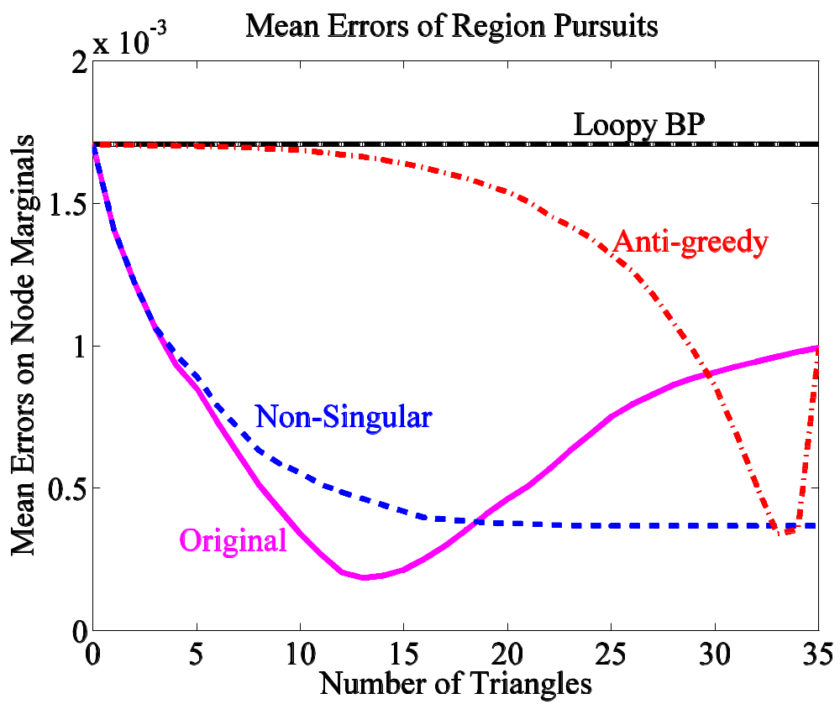
7-node complete graph

Slide 51
Summary
A general formalism for GBP and EP approximations
Equivalence operators between SRGs
  equivalences between EP and GBP
Simple tests ensure good performance: non-singularity, ∑_{R} c_{R} = 1, maximality

Slide 52
Future work
More design principles
  strength of actual factors
  closed under intersection
General test for maximality
Generalized EP on continuous variables [Heskes & Zoeter, AISTATS 2003]

Slide 53
Junk
1
4
7
1
4
7
1
4
7
2
5
8
2
5
8
2
5
8
3
6
9
3
6
9
3
6
9
1
4
7
Iterate until all marginals match
2
5
8
3
6
9
Equivalent to BP

