Slide 1
Above-Water Remote-Sensing Reflectance & GIOP Inversion
Selawik & Hotham Inlet, Alaska · 2026-08-17 · 5 stations, 71 scans
NaturaSpec Plus, FLENS8 8° · overcast, choppy · angle-matched sky pairing, NIR-similarity glint correction, GIOP (tmittal22/giop-workbench)

Slide 2
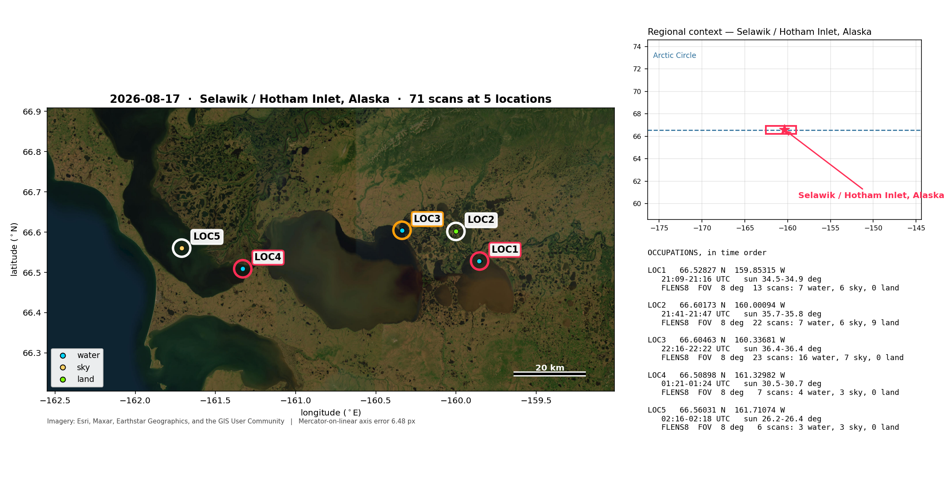
Where: Selawik River, Selawik Lake, Hotham Inlet
Stations numbered in time order · LOC1-3 afternoon (overcast), LOC4-5 evening · LOC1 drifted 308 m

Slide 3
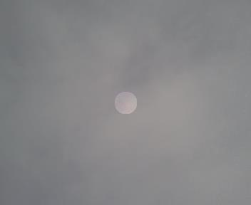
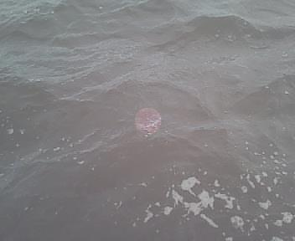
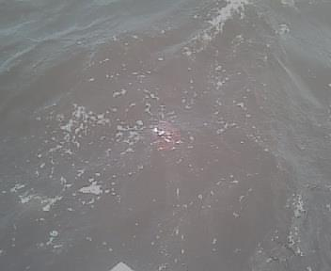
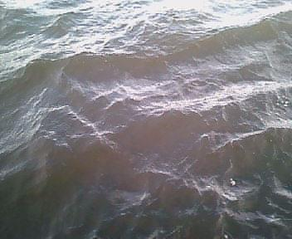
Conditions: overcast and choppy
What the instrument camera saw (red dot = 8° field of view)
Overcast sky: no Rayleigh blue
LOC1 chop, whitecaps
LOC3 open-lake chop
LOC5 sunlit chop
• Grey cloud has blue/green ≈ 1.15 (Rayleigh sky ≈ 2) and NIR/VIS ≈ 0.57, so the shape classifier called all 19 overcast sky scans 'land'. Fixed: sky = no red edge, blue/green > 1, L_t/L_ref > 0.3. All 60 Aug-16 roles unchanged.
• Chop: every deviant water scan at LOC1-3 tested as correctable glint, none as a different water body. NIR similarity (Ruddick et al. 2006) applied at every station.
• Transmittance at LOC4 (0.21) and LOC5 (0.39) is below the clear-sky check's 0.4 floor: heavy evening cloud, not a unit error.

Slide 4
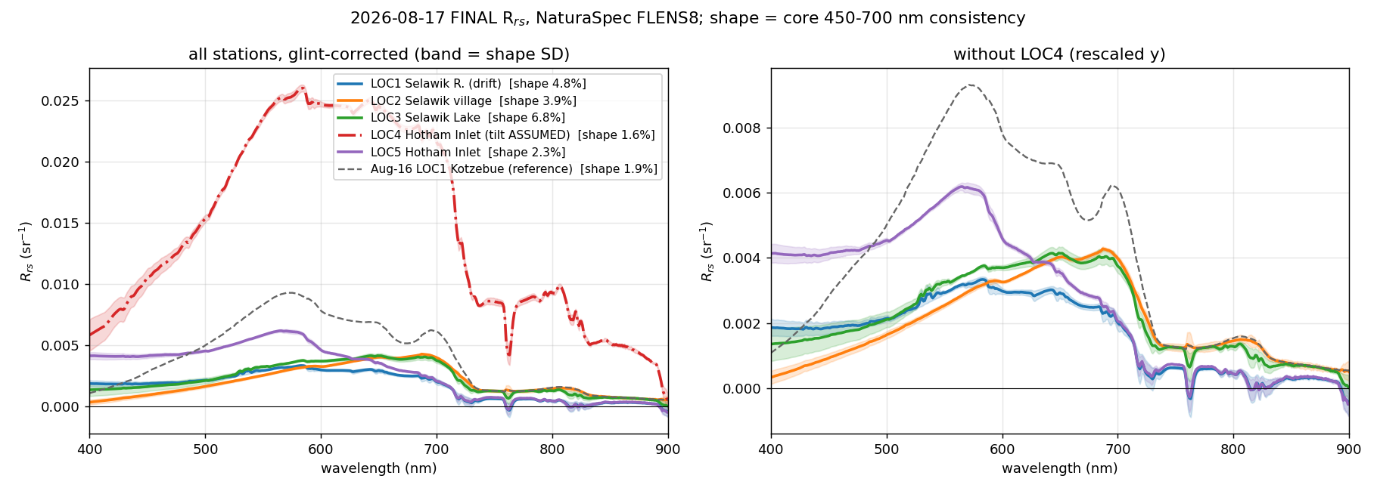
Three water types in one day
Final R_rs, all stations, glint-corrected; Aug-16 Kotzebue LOC1 for reference
• Humic (LOC1-3, Selawik): blue suppressed, maximum 580-690 nm. LOC2/LOC3 peak in the red.
• Hotham Inlet (LOC5): green peak at 565 nm, like Kotzebue on Aug 16.
• Very high sediment (LOC4): R_rs(555) 4x LOC5 and 8-9x LOC2/LOC3, strong 810 nm feature. Absolute level rests on an ASSUMED view angle.
• Shape = core-band (450-700 nm) consistency of the amplitude-normalised mean.

Slide 5
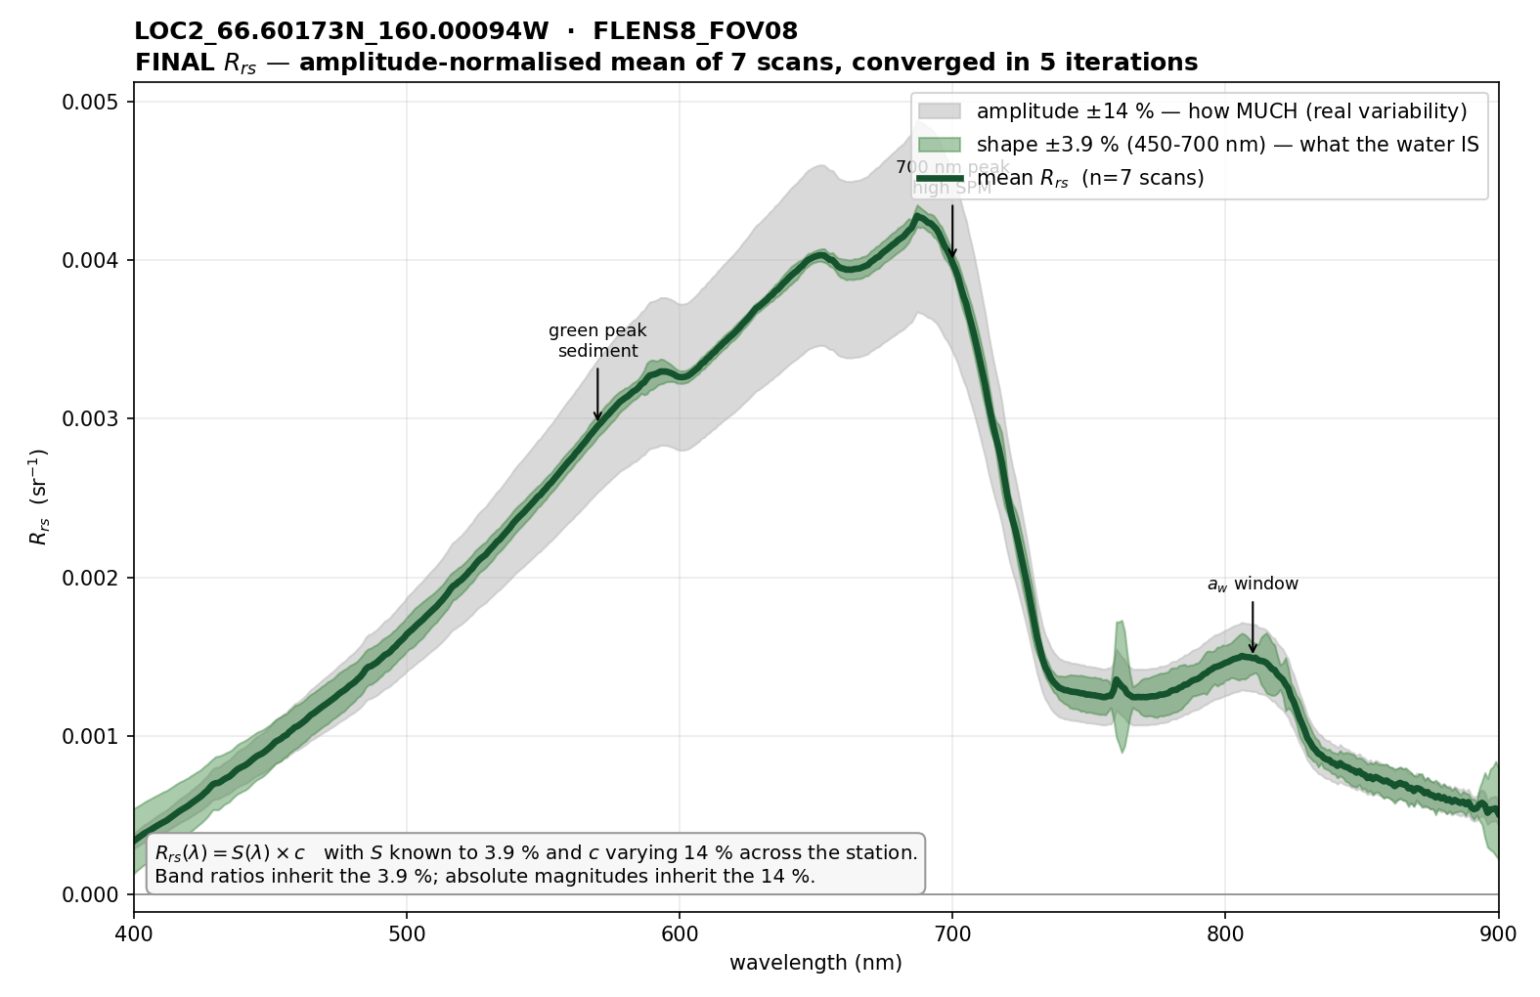
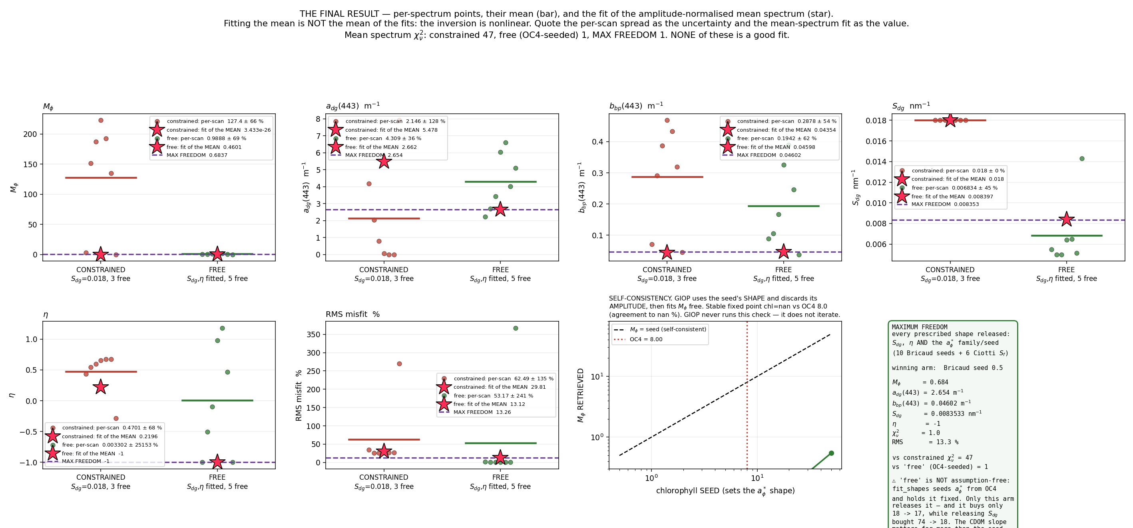
LOC2: Selawik village
66.60173 N 160.00094 W · 22 scans: 7 water, 6 sky, 9 land/bank · calm, at the dock
Final R_rs (arrow labels are template annotations)
GIOP final result (ignore the green text box: Aug-16 text)
• R_rs(555) = 0.00264 sr⁻¹, maximum at 687 nm · shape 3.9 %, amplitude 14.1 %
• GIOP (free): a_dg(443) = 2.66 m⁻¹ (±36 % per scan), S_dg = 0.0084 nm⁻¹, b_bp(443) = 0.046 m⁻¹
• Fixed S_dg = 0.018 fails: χ²_ν 47, RMS 30 %, M_φ driven to 0. Best fit still misses by 13 % RMS; η pinned at its −1 bound.
• A 670 nm dip shows chlorophyll-a is present, but M_φ is not identifiable. Do not quote chlorophyll.

Slide 6
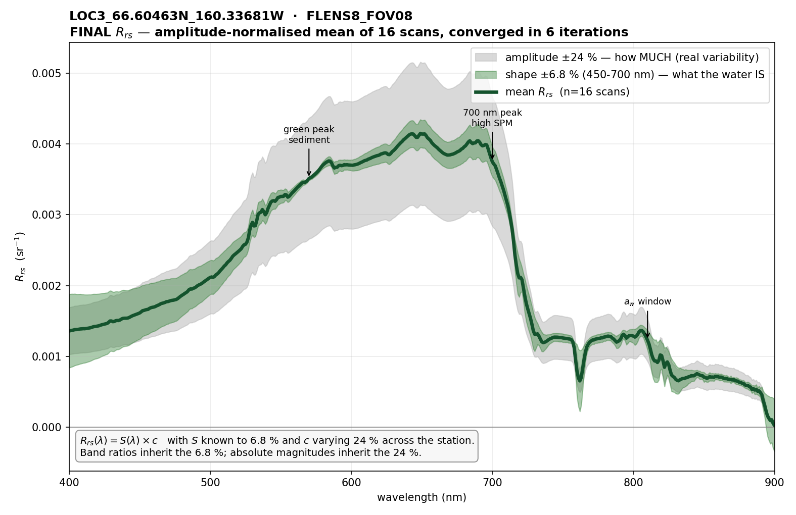
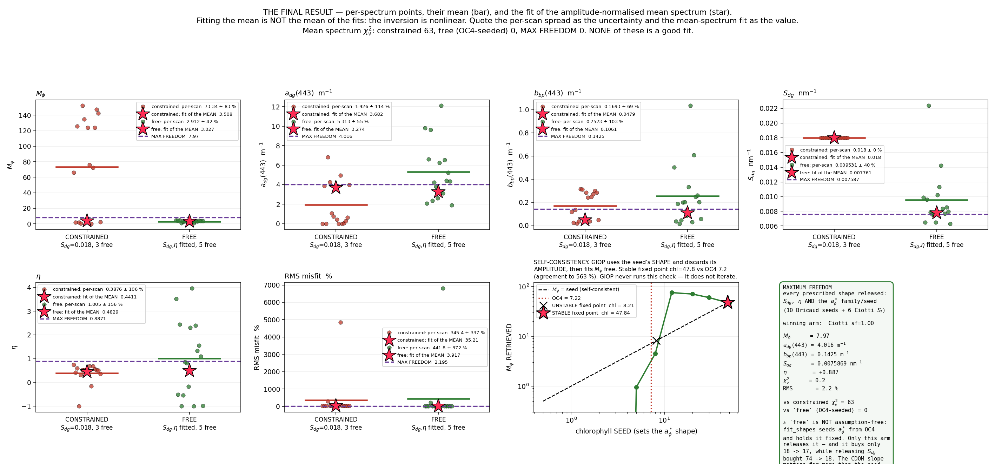
LOC3: Selawik Lake, west
66.60463 N 160.33681 W · 23 scans: 16 water, 7 sky · open-lake chop
Final R_rs (arrow labels are template annotations)
GIOP final result (ignore the green text box: Aug-16 text)
• R_rs(555) = 0.00325 sr⁻¹, maximum at 649 nm · shape 6.8 %, amplitude 24.3 %
• GIOP: a_dg(443) = 3.3-4.0 m⁻¹ (±55 % per scan), S_dg = 0.0076-0.0078 nm⁻¹, b_bp(443) = 0.11-0.14 m⁻¹ (≈2.5x LOC2)
• Freeing S_dg: RMS 35 % to 3.9 % (2.2 % max freedom). Same flat slope as LOC2, 15 km away.
• Per-scan R_rs(400) varies 6x; that is where ρ·L_sky error dominates and where a_dg is set. Depth not measured.

Slide 7
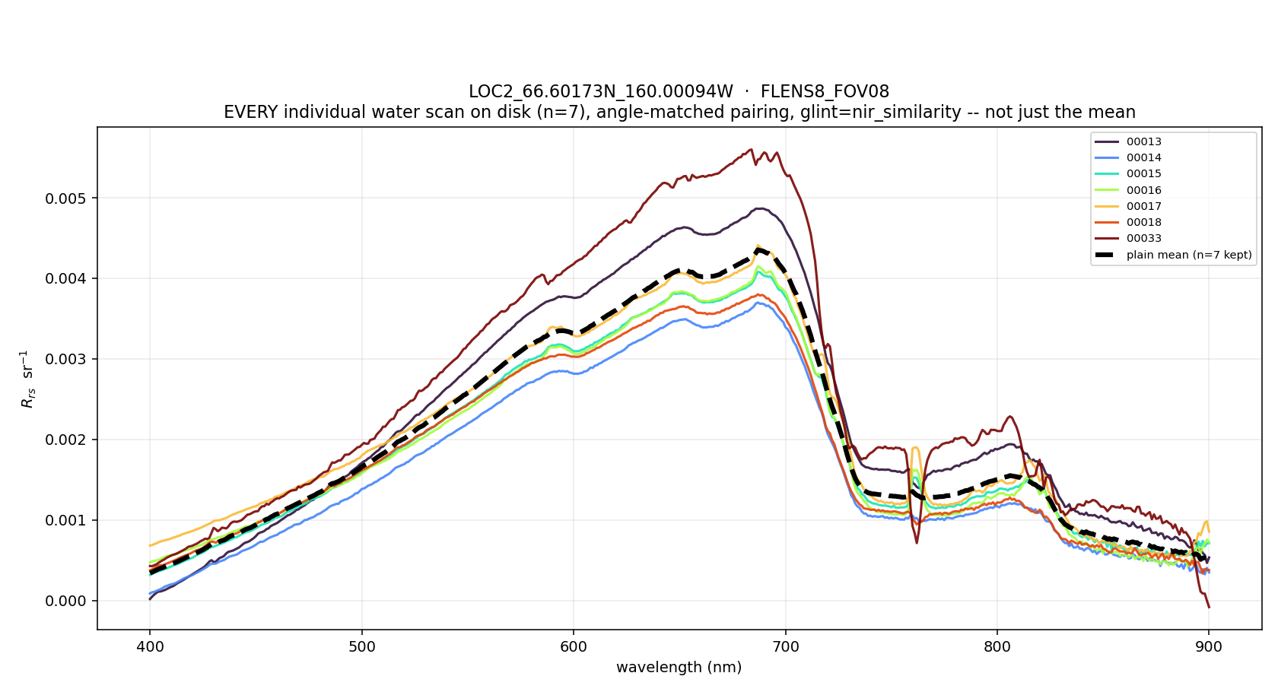
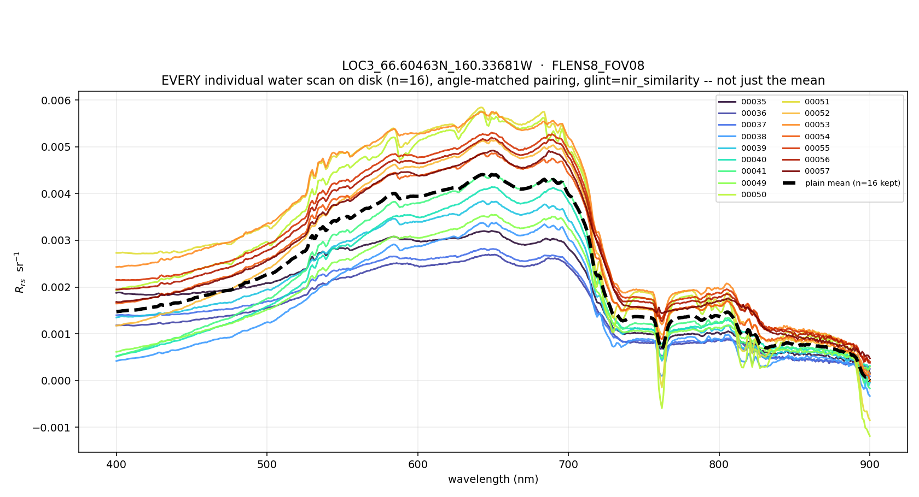
Selawik: CDOM-dominated, unusually flat CDOM slope
Every individual water scan, LOC2 (left) and LOC3 (right)
• a_dg(443) 2.7-4.0 m⁻¹, 3-12x the Aug-16 Kotzebue stations (0.33-0.78 m⁻¹)
• Fitted S_dg ≈ 0.008 nm⁻¹ at both stations vs the usual 0.014-0.020. Candidates, not separated here: humic terrestrial DOM, detrital absorption folded into a_dg, or model error absorbed by the slope.
• Fine steps near 527 and 589 nm line up with the Fe E and Na D Fraunhofer lines: probably sky/water wavelength misregistration, not water. Unverified.

Slide 8
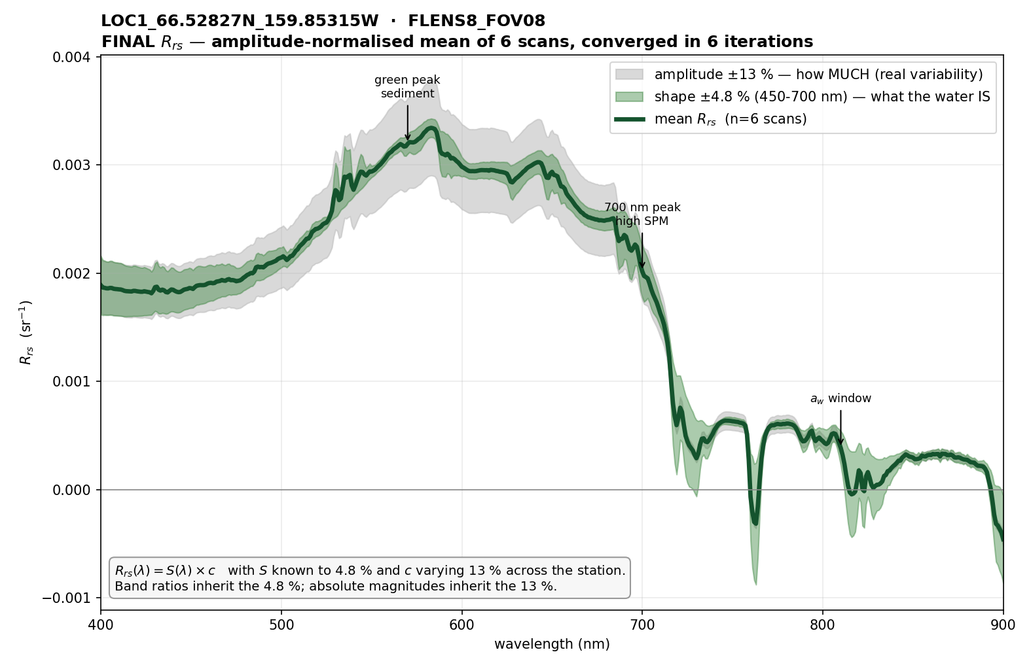
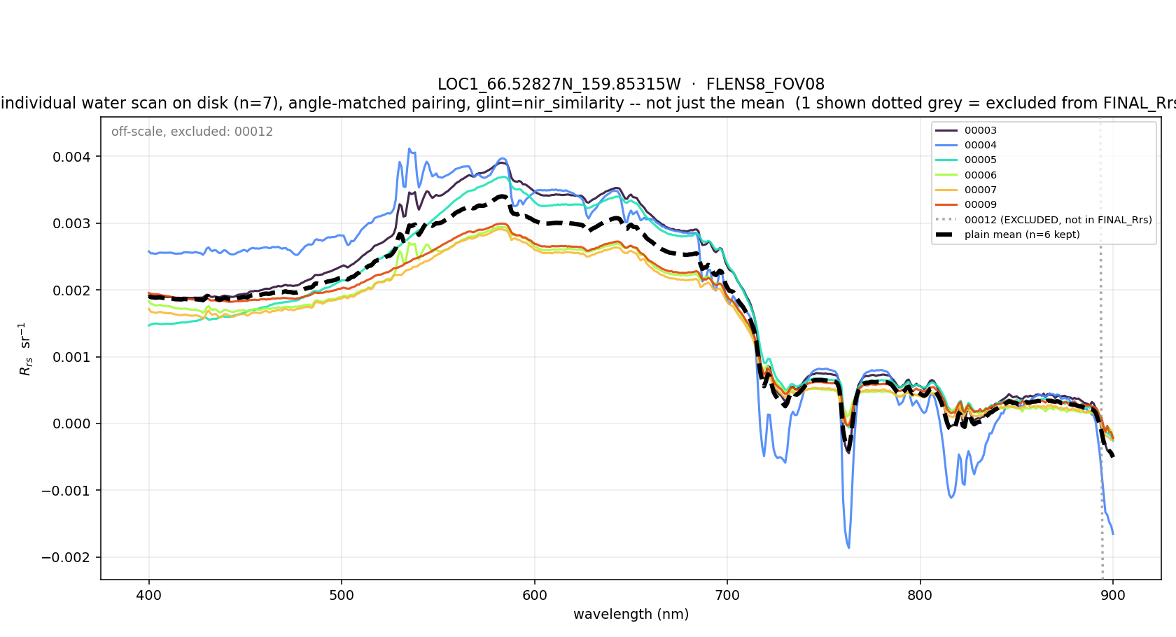
LOC1: Selawik River, drifting
66.52827 N 159.85315 W · 13 scans: 7 water, 6 sky · boat drifted 308 m in 7 min
Final R_rs, 6 water scans
Every scan, 00012 shown but excluded
• R_rs(555) = 0.00301 sr⁻¹, maximum at 583 nm · shape 4.8 %, amplitude 13.1 %
• 00012 excluded: its white reference was taken on a dark target (L_ref = 0.005), giving R_rs(555) = 0.21
• Usable with caveats: spread over 3 panel-reference blocks and a 308 m drift (--max-span-m 350). GIOP not triaged.
• 00004 dips negative in the 720/760/820 nm atmospheric bands: a sky/panel mismatch, the noisiest scan of the six.

Slide 9
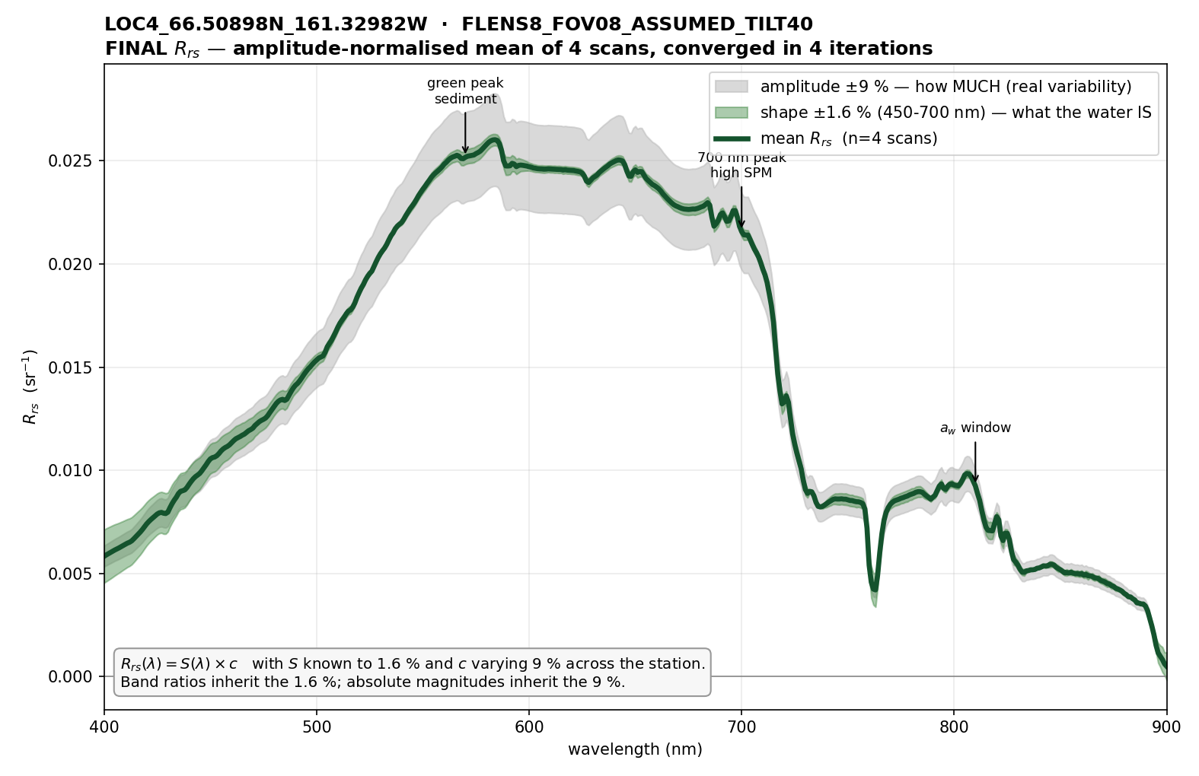
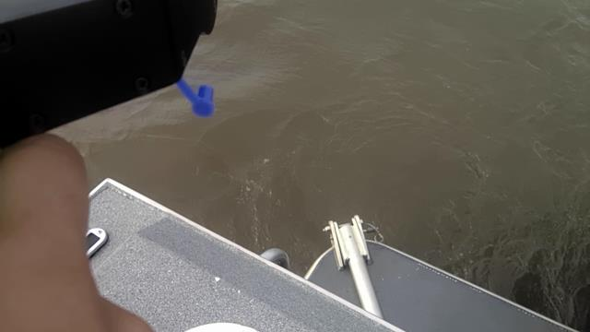
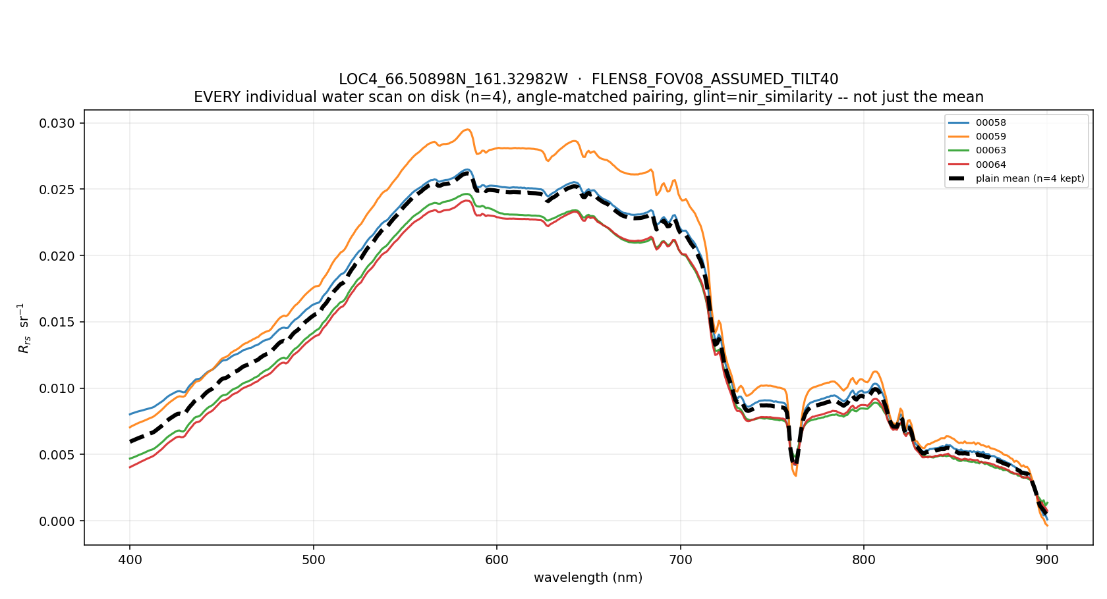
LOC4: Hotham Inlet, very turbid, tilt ASSUMED
66.50898 N 161.32982 W · 7 scans: 4 water, 3 sky · hand-held, tilt sensor logged n/a
Final R_rs at an assumed 40° view angle
00059: hand-held, brown water
Every scan
• R_rs(555) = 0.0243 sr⁻¹ · shape 1.6 %, amplitude 8.6 % · strong 810 nm feature = very high sediment
• Derived copies with Tilt (Y) = 40° (the protocol angle) in FLENS8_FOV08_ASSUMED_TILT40/; raw files untouched
• Glint correction removed 0.014 sr⁻¹, 5x LOC5's offset: ρ·L_sky likely under-subtracted (arm in sky photos). Use the shape; the absolute level is tentative.

Slide 10
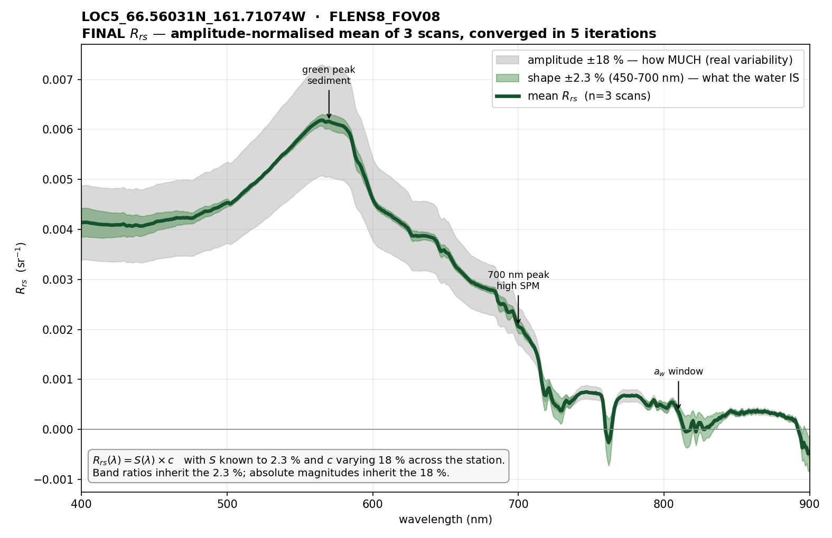
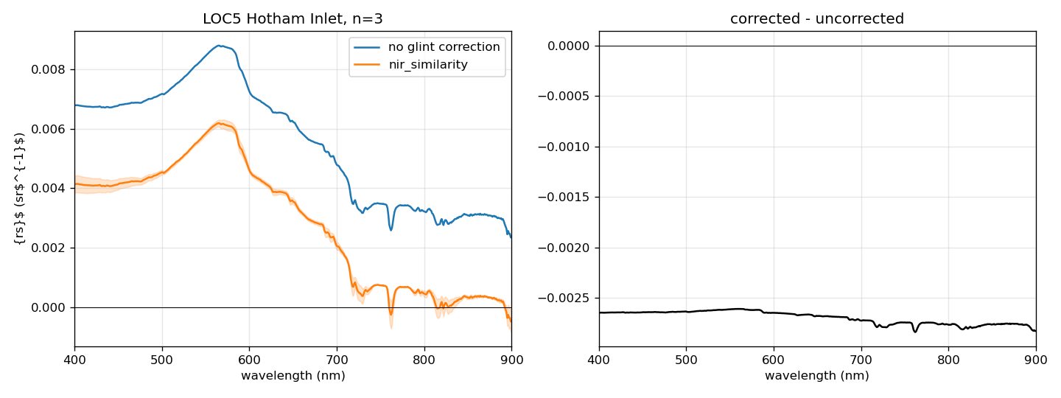
LOC5: Hotham Inlet, glint correction tested
66.56031 N 161.71074 W · 6 scans: 3 water, 3 sky · sunlit chop, partly cloudy
Final R_rs, glint-corrected
Before / after NIR similarity, and the difference
• Correction is a flat −0.0027 sr⁻¹ (spectral SD 6e-5): an additive surface term. R_rs(555) 0.0086 to 0.0060.
• Kept: scan-to-scan amplitude scatter halves (33.6 % to 17.9 %), shape 2.7 % to 2.3 %.
• n = 3: green peak at 565 nm, close to Kotzebue Aug 16. GIOP not triaged.

Slide 11
Open items
• Measure depth at Selawik Lake (LOC3)
  – A bottom contribution would move a_dg and b_bp; no photo shows the bottom, which argues against it but does not exclude it.
• Check the tilt sensor before hand-held scans
  – LOC4 lost its geometry entirely; its absolute R_rs depends on an assumed angle.
• Retake the white reference if the panel is not in view
  – LOC1 00012's reference was a dark target and the scan had to be dropped.
• Explain the flat CDOM slope
  – A lab a_CDOM spectrum from a Selawik water sample would separate humic DOM from detrital absorption.
• Triage GIOP at LOC1, LOC4, LOC5; test the Fraunhofer-line hypothesis for the 527/589 nm steps

