Slide 1
Kotzebue Sound, river by river
A sequential walkthrough of every SWOT measurement in the basin
From "what counts as a river" through gauge validation, main stem versus delta distributaries, and on into Hotham Inlet and Selawik Lake.
Noatak · Kobuk · Selawik

Slide 2
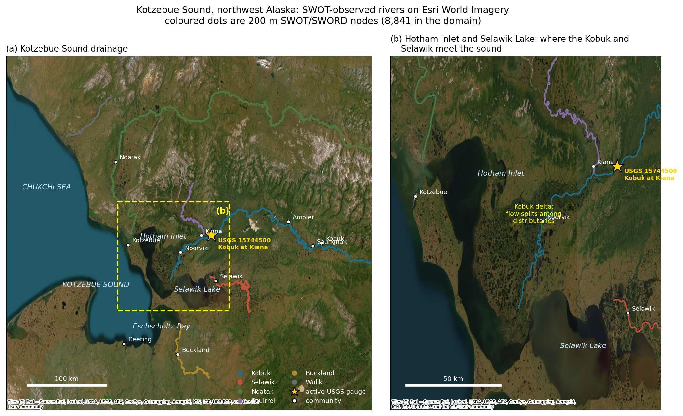
ORIENTATION
0
The area, and what drains into it
Three large rivers reach the sound. The Kobuk and Selawik empty into the Hotham Inlet / Selawik Lake complex; the Noatak enters the sound directly at Kotzebue.
31,000
km2 Kobuk
32,000
km2 Noatak
8,160
km2 Selawik

Slide 3
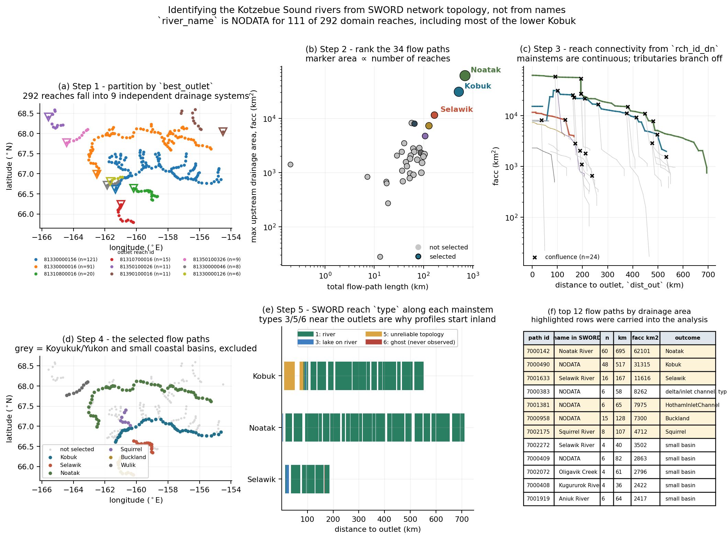
STEP 1
1
What counts as a river here?
292 SWORD reaches sit in the box, across 9 drainage systems and 34 flow paths. river_name is NODATA for 111 of them, including most of the lower Kobuk, so names cannot do this.
best_outlet -> drainage system
main_path_id + facc -> rank paths
rch_id_dn -> the reach graph
dist_out -> order along the stem
type -> what is usable
Noatak, Kobuk and Selawik separate cleanly from everything else by drainage area.

Slide 4
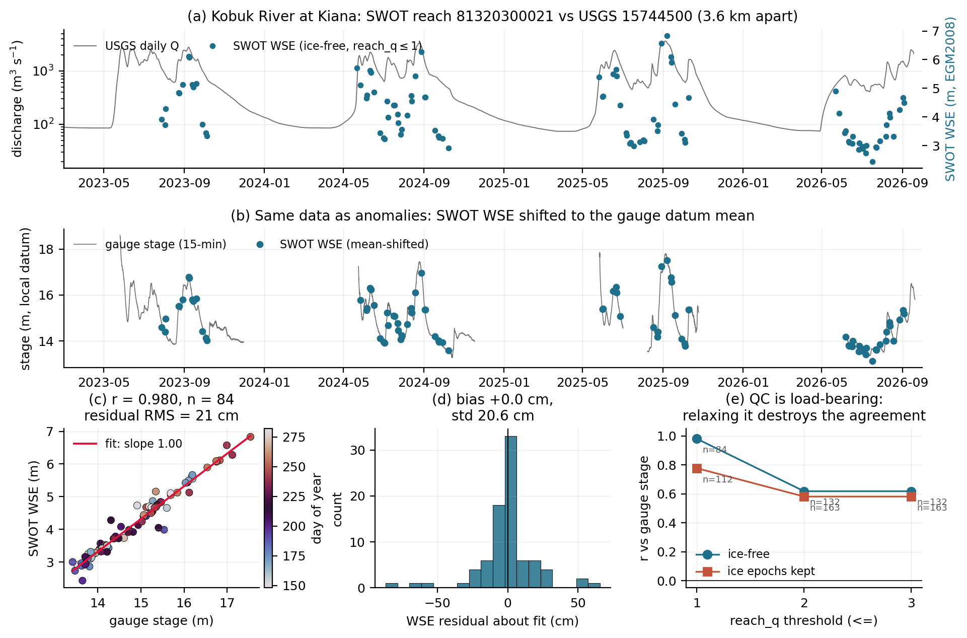
STEP 2
2
Does SWOT see it right? Elevation
Only one gauge exists on a major river: Kobuk at Kiana. SWOT reports orthometric elevation, the gauge reports stage on a local datum, so the regression slope must be exactly 1.0. Nothing is tuned to make that happen.
1.002
measured slope
(1.000 required)
r = 0.980
84 coincident
overpasses, 21 cm RMS

Slide 5
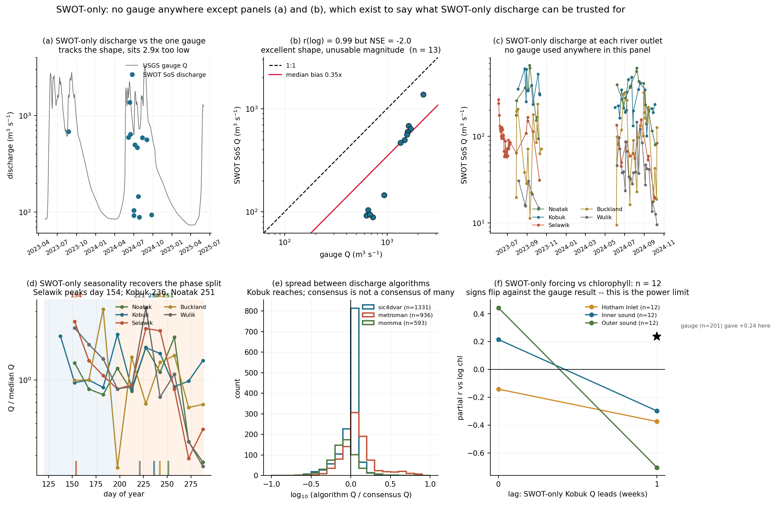
STEP 3
3
Does SWOT see it right? Discharge
SWOT-derived discharge (SoS) compared with the same gauge:
r = 0.99
shape, in log space —
the hydrograph is right
2.9x low
median bias, NSE = -2.0 —
magnitude is not usable
So relative and seasonal statements are supported; absolute freshwater flux is not. Nothing downstream computes a flux budget.
Caveat: SoS is a model-based inversion, and I have not verified whether Hydrocron serves the constrained or unconstrained run.

Slide 6
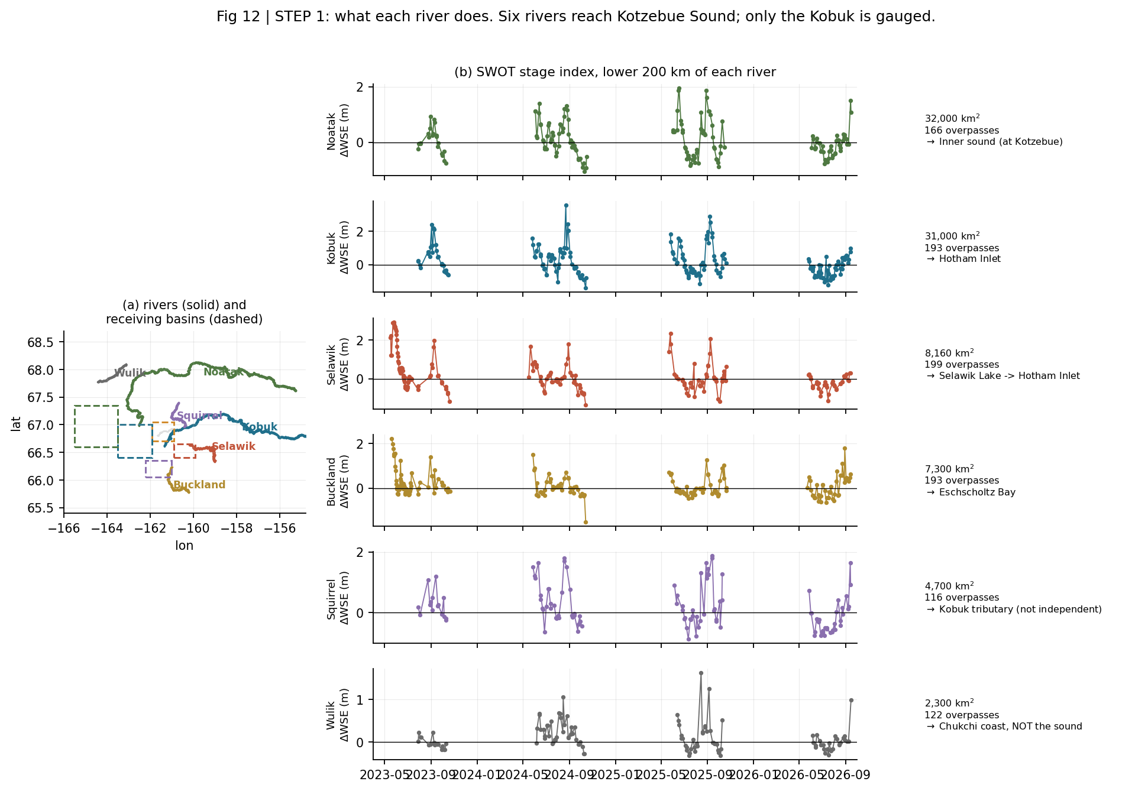
STEP 4
4
The three rivers, side by side
Every river gets a multi-year stage record. For the Selawik and Noatak this is the only stage history that has ever existed.
Note the shapes differ. The Selawik spikes sharply in mid-May and decays; the Kobuk and Noatak build a broader late-summer maximum.
The Squirrel is a Kobuk tributary, not an independent input. The Wulik drains the Chukchi coast and does not reach the sound at all.

Slide 7
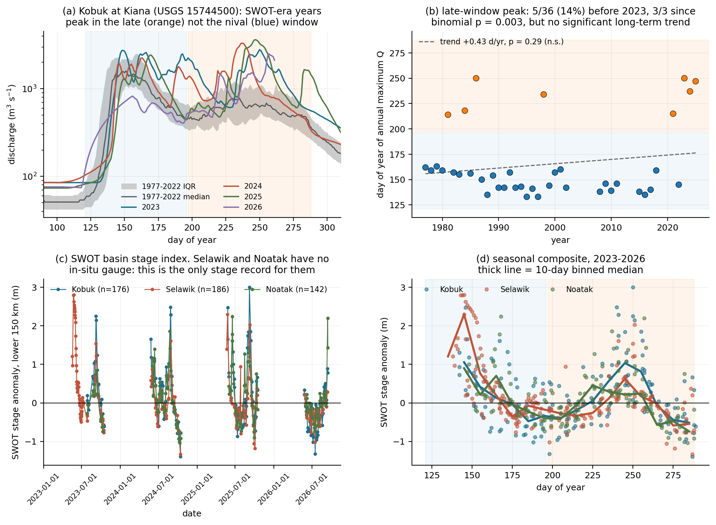
STEP 5
5
They are out of phase
Selawik | day 141, 145, 145
Kobuk | day 240, 250
Noatak | day 168, 237
Day-of-year of the seasonal stage maximum. Both the Kobuk and Selawik empty into the same lagoon complex, roughly 100 days apart.
Freshwater arriving during the summer bloom window is Kobuk and Noatak water, not Selawik water.
Recovered independently from SWOT discharge alone, with no gauge: Selawik day 154, Kobuk 236, Noatak 251.

Slide 8
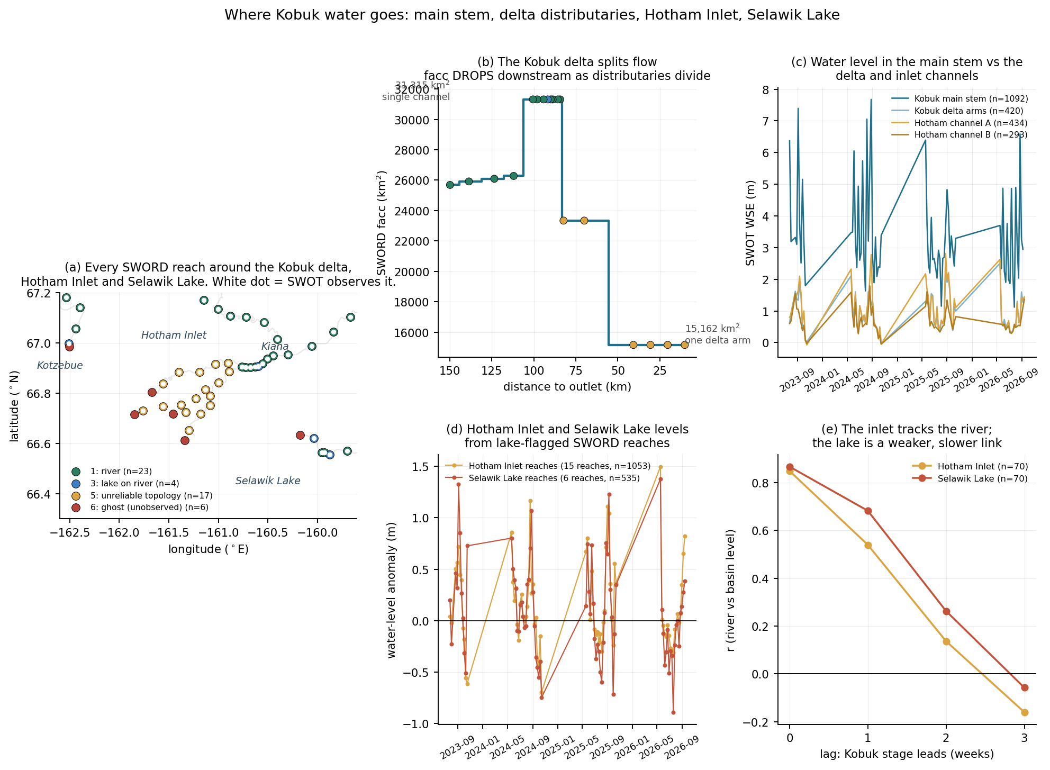
STEP 6
6
Main stem versus every delta channel
The Kobuk does not reach Hotham Inlet as one channel. It splits, and SWORD facc DROPS downstream as it does: 31,315 km2 in the single stem, 15,162 km2 in one delta arm.
 | median WSE | range
Main stem | 2.97 m | 6.18 m
Delta arms | 0.70 m | 1.94 m
Hotham ch. A | 0.77 m | 2.08 m
Hotham ch. B | 0.55 m | 1.40 m
Water level and seasonal range both collapse across the delta — the signature of flow splitting into a backwater-controlled receiving basin.

Slide 9
STEP 7
7
Hotham Inlet and Selawik Lake themselves
These were deliberately excluded earlier. SWORD types the reaches crossing the inlet and the lake as 3 (lake on river) and 5 (unreliable topology), which breaks a one-dimensional long profile. But SWOT observes them perfectly well, so here they are the subject rather than the nuisance.
What exists
What it shows
What is still missing
27 lake-flagged SWORD reaches across the inlet and lake
1,871 quality-passed observations on the channel reaches
14 PLD prior lakes in the delta with SWOT water level, 1,276 records
Hydrocron serves these as feature=PriorLake
Both basins track Kobuk stage essentially instantaneously:
Selawik Lake and Hotham Inlet are NOT in the PLD subset I obtained — the 14 lakes cap at 0.57 km2
Part of that r = 0.85 is shared seasonality, not proof of forcing
No bathymetry, so no volume or residence time
No salinity, so the freshwater/marine boundary is unconstrained
Hotham Inlet | r = 0.85 at lag 0
Selawik Lake | r = 0.87 at lag 0
Correlation collapses by 2 weeks (0.14 and 0.26), i.e. the response is sub-weekly. They are hydraulically connected, not storage-buffered.

Slide 10
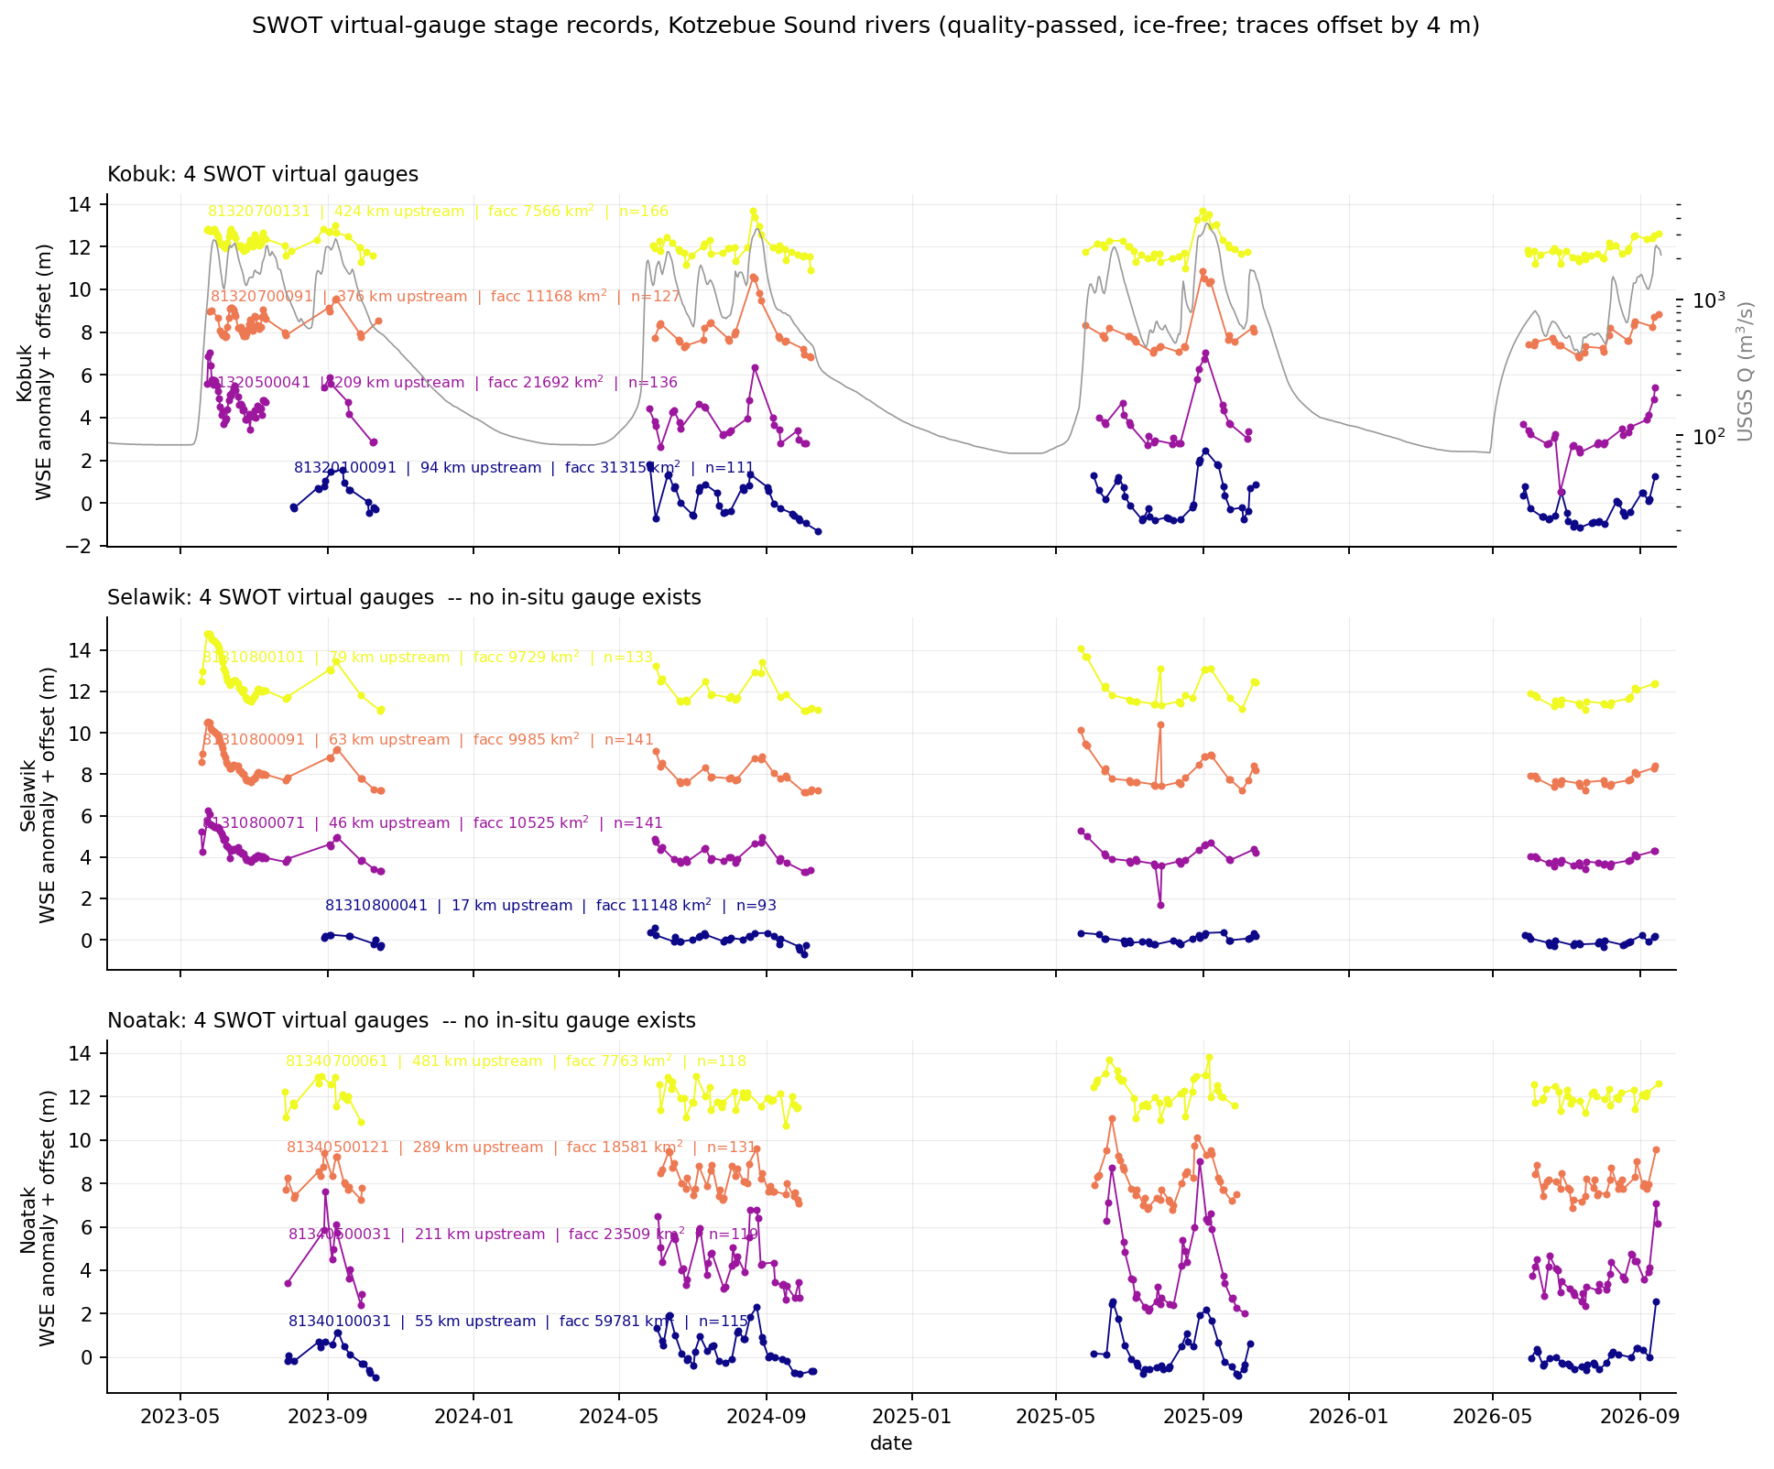
STEP 8
8
Every station, all at once
Twelve virtual gauges, four per river, spaced along each one. Eight sit where no gauge has ever been installed.
The Kobuk traces follow the USGS discharge curve (grey) closely. The Selawik traces are visibly flatter and smoother.
2.4 cm/km
Selawik gradient:
4.0 m over 166 km
That is why it is backwater-controlled.

Slide 11
SYNTHESIS
The area, end to end
1
Snowmelt, mid-May
The Selawik peaks at day 141-145 every observed year and drains into Selawik Lake.
2
Rain, late August
The Kobuk and Noatak peak at day 236-251, roughly 100 days later.
3
Through the delta
The Kobuk splits; facc falls from 31,315 to 15,162 km2 and stage drops 3.0 m to 0.7 m.
4
Into the inlet
Hotham Inlet and Selawik Lake follow river stage within a week (r = 0.85, 0.87).
5
Out to the sound
Kobuk discharge leads inner-sound chlorophyll by ~2 weeks, surviving a sediment control.
6
The blooms: open
Two competing models, neither tested here. See next slide.

Slide 12
OPEN QUESTION
The blooms: two models, neither tested here
This project measured river hydrology. It did not measure blooms, and it cannot arbitrate between these. Both are live, and they are not mutually exclusive.
Model A - advective supply
Model B - local river modulation
Blooms form offshore in the Bering Sea and are carried north through the Bering Strait; local cyst beds germinate when bottom water is warm enough.
River freshwater sets stratification, delivers terrestrial nutrients and organic matter, and controls flushing of the inlet, modulating how a bloom develops once cells are present.
Evidence
What this project adds
The 2022 event was tracked entering from the west and advecting north (Fachon et al. 2024)
That year the Ledyard Bay cyst bed was thermally suppressed, ~1.8 C
Cells were dense across a wide range of nutrient concentrations
Kobuk discharge leads inner-sound chlorophyll by ~2 weeks, surviving a sediment control (r = 0.28, n = 201)
Kobuk and Noatak peak inside the bloom window; the Selawik does not
But chlorophyll is not Alexandrium, and CDOM is still uncontrolled
Separating them needs what this project does not have: HAB cell counts or toxin data, a CDOM control, and moorings or a circulation model for the sound.

Slide 13
What this can and cannot tell you
Can. When each river delivers water, how much water level changes and where, how the delta splits it, and how fast the inlet and lake respond. For two of the three rivers, nothing else on Earth provides this.
Cannot. Absolute freshwater flux (SWOT discharge is 2.9x low), flow-wave celerity (three estimators, three failures), attribution from SWOT alone (n = 28-39), or or anything about what causes the harmful algal blooms.
All data public and unauthenticated: PO.DAAC Hydrocron, SWORD v17c and HarP on Zenodo, USGS NWIS, NOAA CoastWatch ERDDAP.

