Slide 1
SWOT over Kotzebue Sound
River flow, transport, and the summer bloom season in northwest Alaska
Two of the three major rivers have never been gauged.
The SWOT record assembled here is the only stage history that exists for them.
Selawik · Kobuk · Noatak · Buckland · Squirrel · Wulik

Slide 2
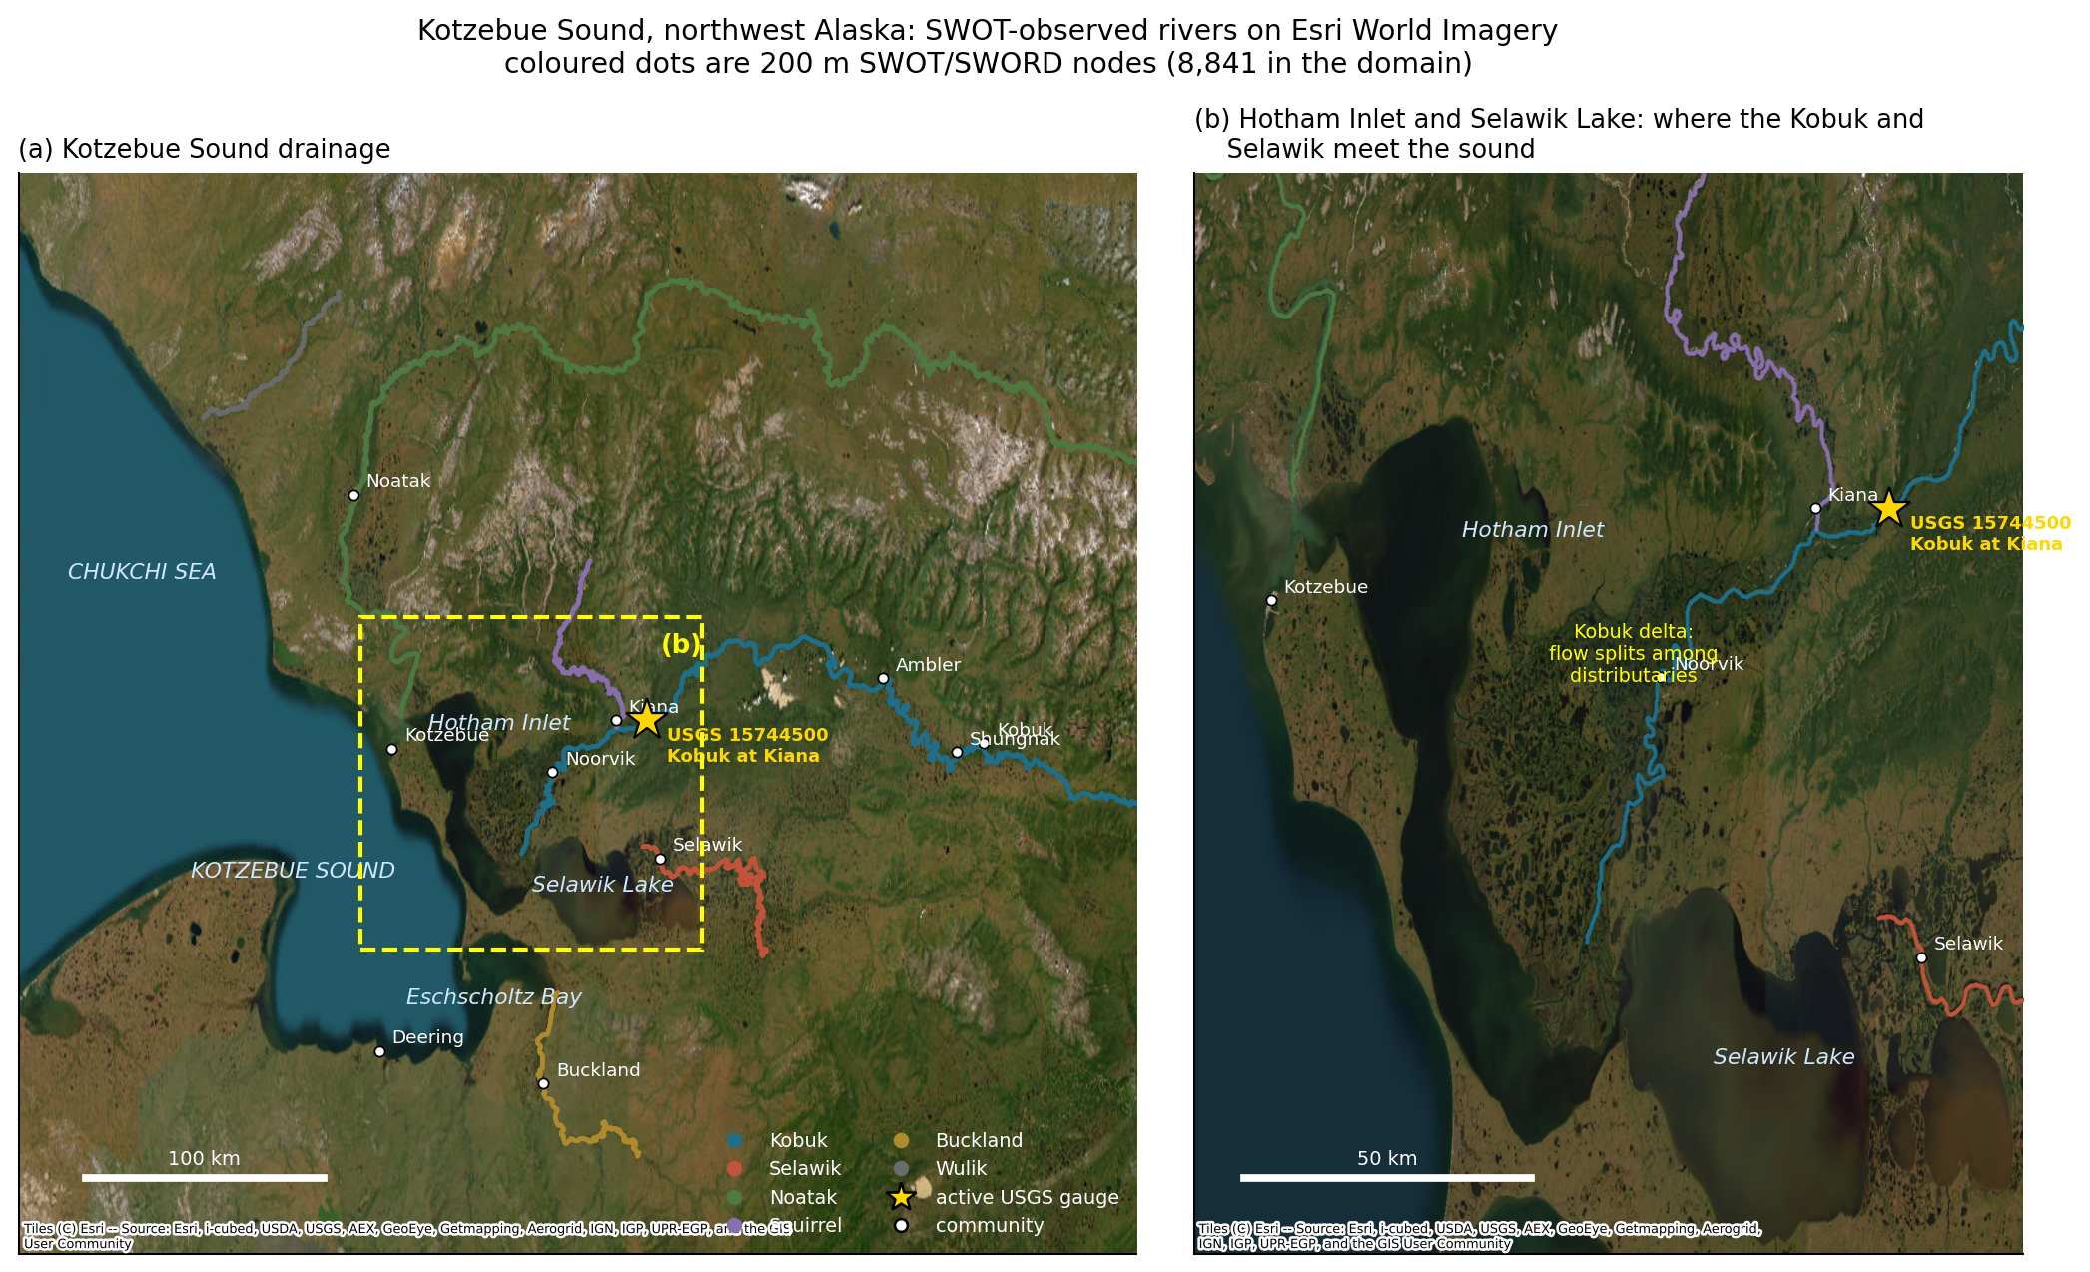
MOTIVATION
Why this basin, and why now
Kotzebue Sound has become a focus of harmful algal bloom concern in the Pacific Arctic, following documented Alexandrium catenella blooms and paralytic shellfish toxin accumulation.
Freshwater timing plausibly matters: it sets stratification, delivers terrestrial nutrients and organic matter, and controls flushing of the lagoon complex.
But the hydrology was unmeasurable. A search of all NWIS gauges in the domain returns three active records, only one on a major river.
3
1
0
Fig 6 — study area on Esri World Imagery
active gauges in the entire
Kotzebue Sound domain
of them on a major river
(Kobuk at Kiana)
on the Selawik or the
Noatak, ever
Gleason et al. (2026) find Arctic, multi-channel and ungauged rivers are exactly where global river models fail. That is the case for treating this basin observationally.

Slide 3
PROVENANCE
Method follows two papers
SWOT Captures Hydrologic Waves Traveling Down Rivers
SWOT, Empiricism, and River Modeling
Thurman et al. 2025, GRL 52(10) · 10.1029/2024GL113875
Gleason et al. 2026, GRL 53(16) · 10.1029/2026GL124323
Spatial hydrographs from node WSE, wave length from a 90th-percentile run test, celerity from a SWOT peak plus a gauge peak, and spatial baseflow separation.
68,347 reaches, ~38% of global discharge. Models struggle in developed, multi-channel, arid and Arctic basins. Motivates an observational treatment here.
Thurman full text read via Scholar Gateway (Wiley returns HTTP 403 to automated fetches). Gleason not yet in the full-text corpus — abstract and 74 references via OpenAlex, and the method notes say so.

Slide 4
DATA
Everything is unauthenticated
Source | Product | Used for | Auth
PO.DAAC Hydrocron | SWOT L2_HR_RiverSP Version D (SWORD v17b) | reach + node WSE, width, slope | no login
Zenodo 22259077 | SWORD v17c river network | topology, dist_out, main_path_id | no login
USGS NWIS | Kobuk at Kiana, Dahl Ck, Wulik; historical Ambler | discharge + stage, 1976-2026 | no login
NOAA CoastWatch ERDDAP | VIIRS chlorophyll, nLw(671), Kd(PAR) | bloom season + turbidity, 2012-2026 | no login
50,115
2.28 M
583 MB
reach observations
on 148 reaches
node observations,
2023-03 to 2026-09
pulled from a 3.9 GB SWORD
archive by HTTP range: 90 s, not 4 h
SWOT L2_HR_Raster and PIXC — the true gridded imagery — do need an Earthdata Login and are not used here. README documents how to add them.

Slide 5
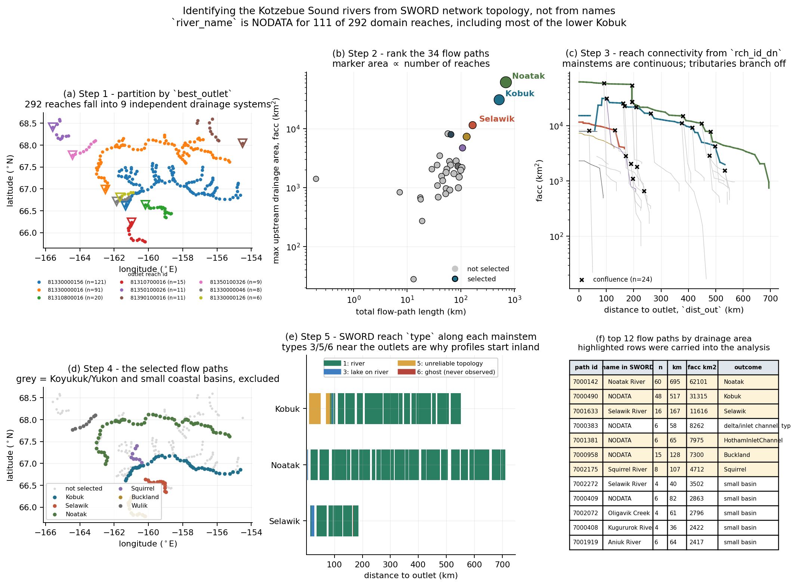
METHOD
1
Finding three rivers in a whole sound
river_name is NODATA for 111 of 292 reaches, including most of the lower Kobuk. Names cannot do the selection. Topology can:
best_outlet → 9 drainage systems
main_path_id + facc → rank 34 paths
rch_id_dn → the reach graph, 24 confluences
dist_out → order along each mainstem
type → what is usable
The Kobuk delta appears here: its lowest 84 km are types 5 and 6, which is why its profile starts inland.

Slide 6
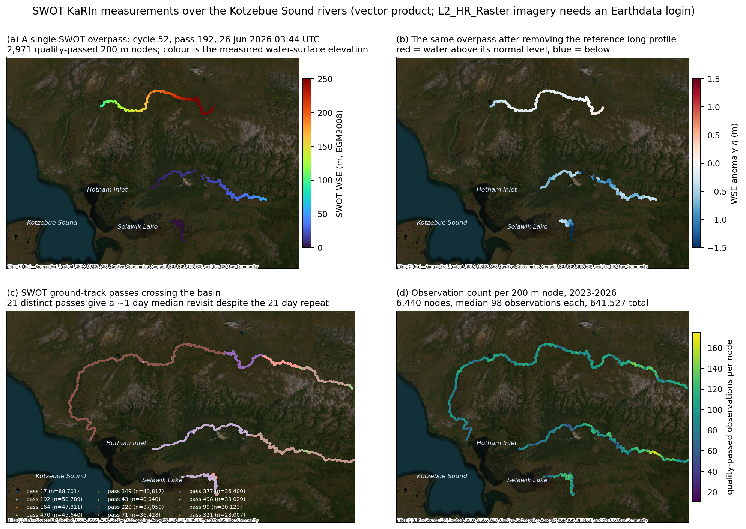
DATA
2
What SWOT actually measured
21
distinct ground-track
passes cross the basin
~1 day
median gap between
observation days
98
median observations
per 200 m node
Swath overlap at 67°N beats the 21-day repeat badly.

Slide 7
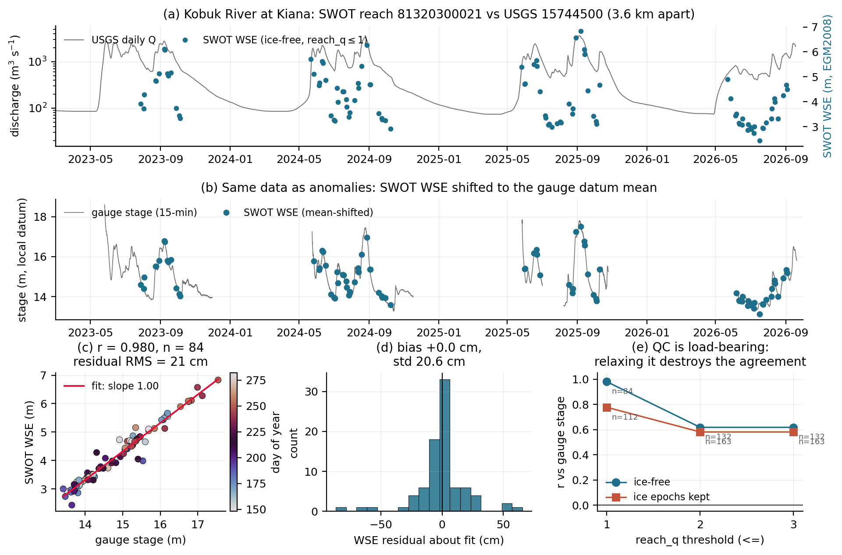
VALIDATION
3
Is the measurement trustworthy?
A parameter-free test
SWOT reports orthometric elevation; the gauge reports stage on a local datum. Same water surface, so they must differ by a constant and the slope must be exactly 1.0. Nothing is fitted to make that happen.
1.002
measured dWSE/dstage
(1.000 required)
r = 0.980
84 coincident overpasses
within 1 hour

Slide 8
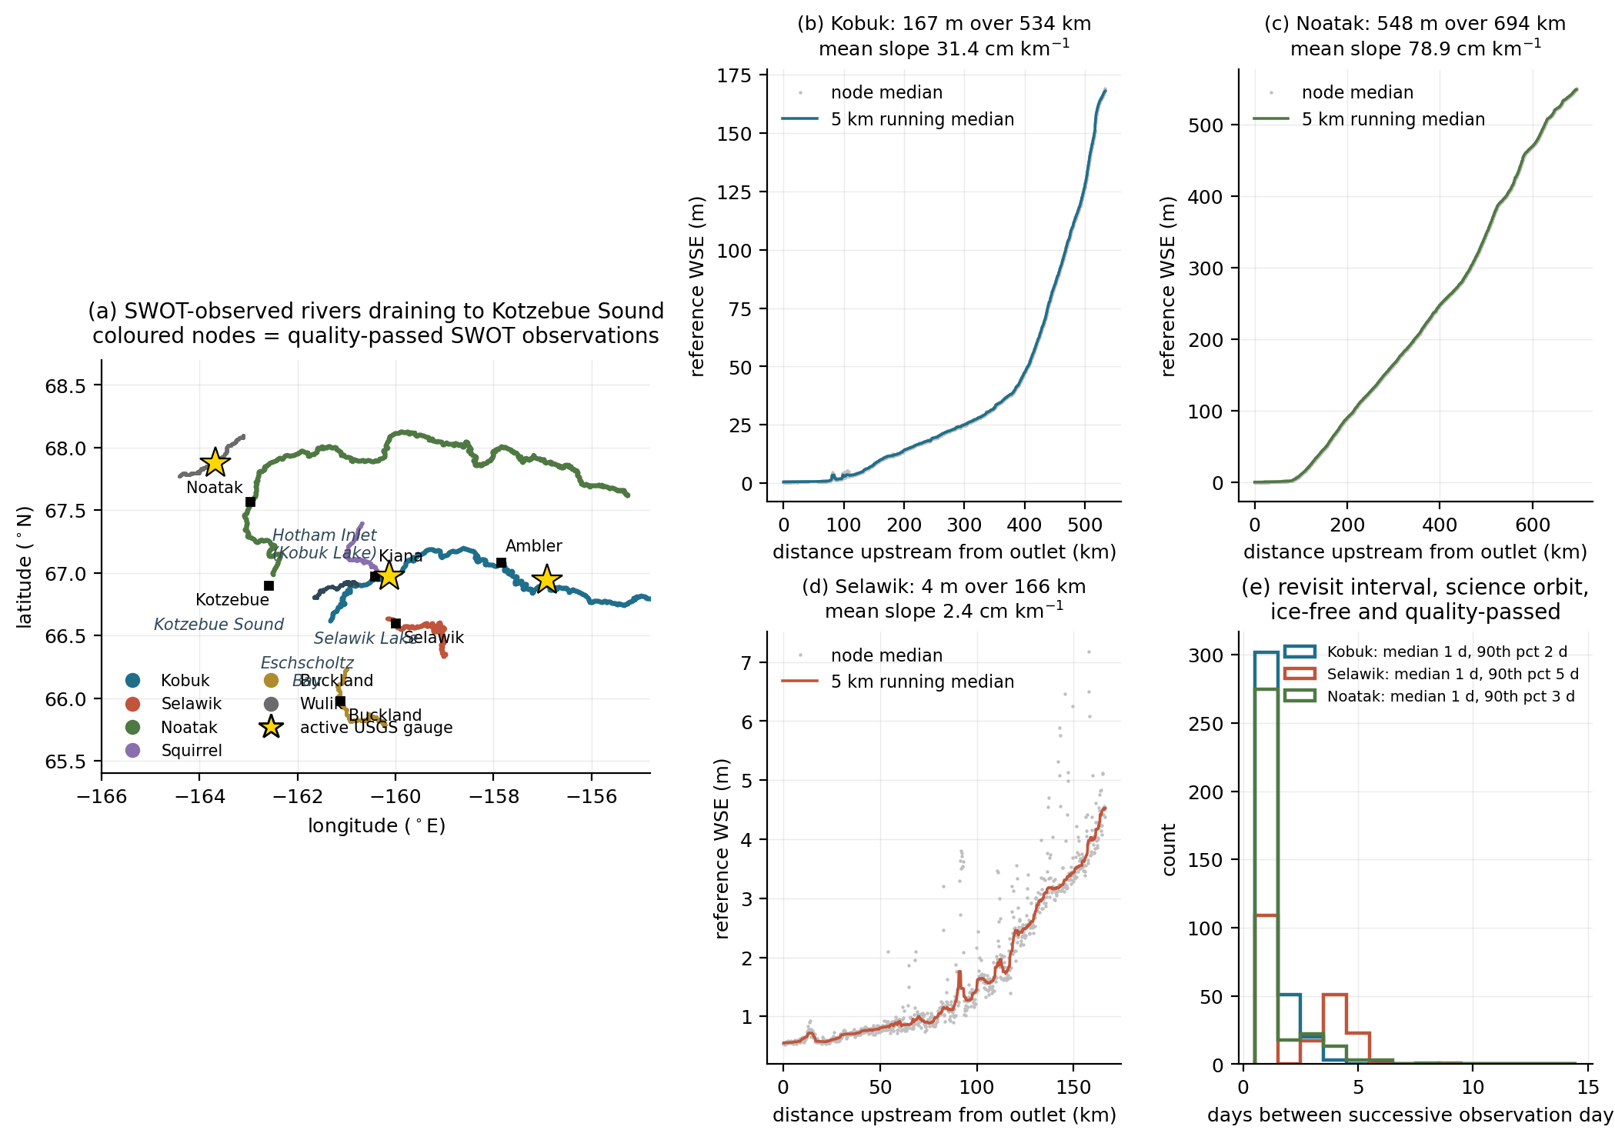
VALIDATION
The quality control is load-bearing
A passing test proves nothing if it cannot fail. The whole validation was rerun under relaxed filters.
reach_q | ice filter | n | r | residual RMS
≤ 1 | ice-free | 84 | 0.980 | 0.21 m
≤ 1 | ice kept | 112 | 0.776 | 0.70 m
≤ 2 | ice-free | 132 | 0.617 | 1.34 m
≤ 3 | ice kept | 163 | 0.581 | 1.36 m
Why reach_q ≤ 1, physically
Admitting reach_q = 2 returns WSE from −5.2 m to +11.2 m on a reach whose bed sits near 2 m and whose gauged seasonal range is ~4 m. Those are retrieval failures, not extreme flows.
Fig 2 — long profiles pass a monotonicity check
Water flows downhill, so reference WSE must rise upstream. The Noatak is monotone to 0.17 m over a 548 m rise. That check caught a real bug.

Slide 9
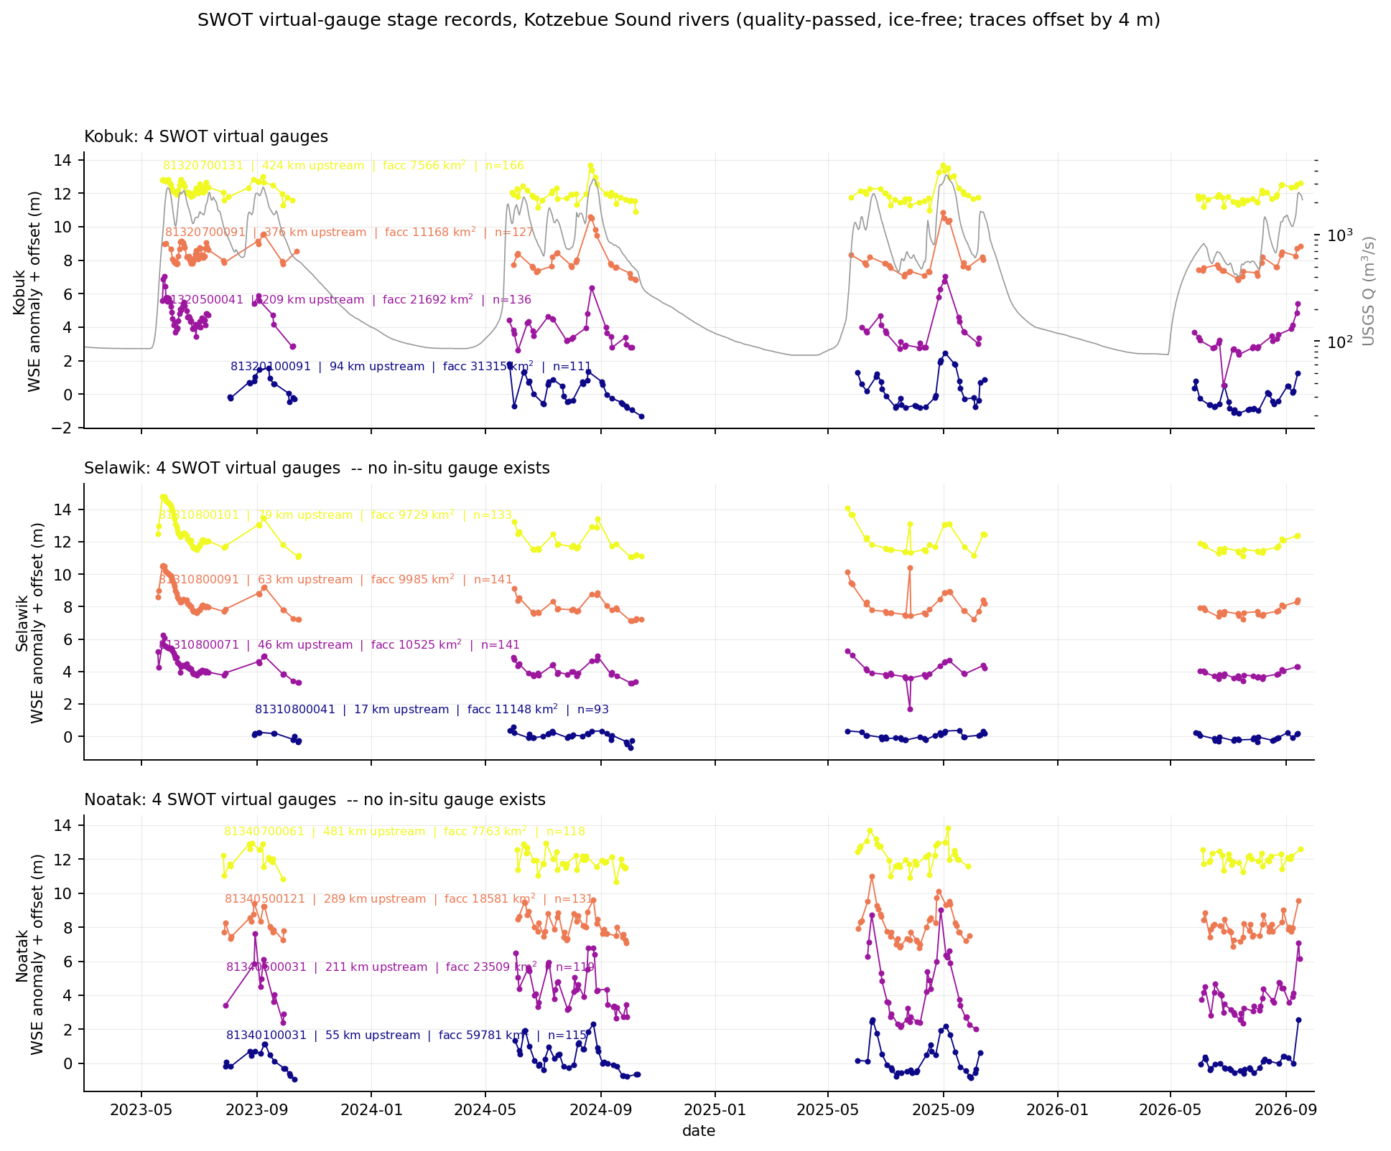
RESULT
Twelve virtual gauges, eight where none exist
Each trace is a multi-year stage record at a location on an Arctic river. For the Selawik and Noatak, no such record has ever existed.
The Selawik traces are visibly flatter and smoother than the Kobuk and Noatak — consistent with backwater control.
4.0 m
total Selawik fall over 166 km
= 2.4 cm per km

Slide 10
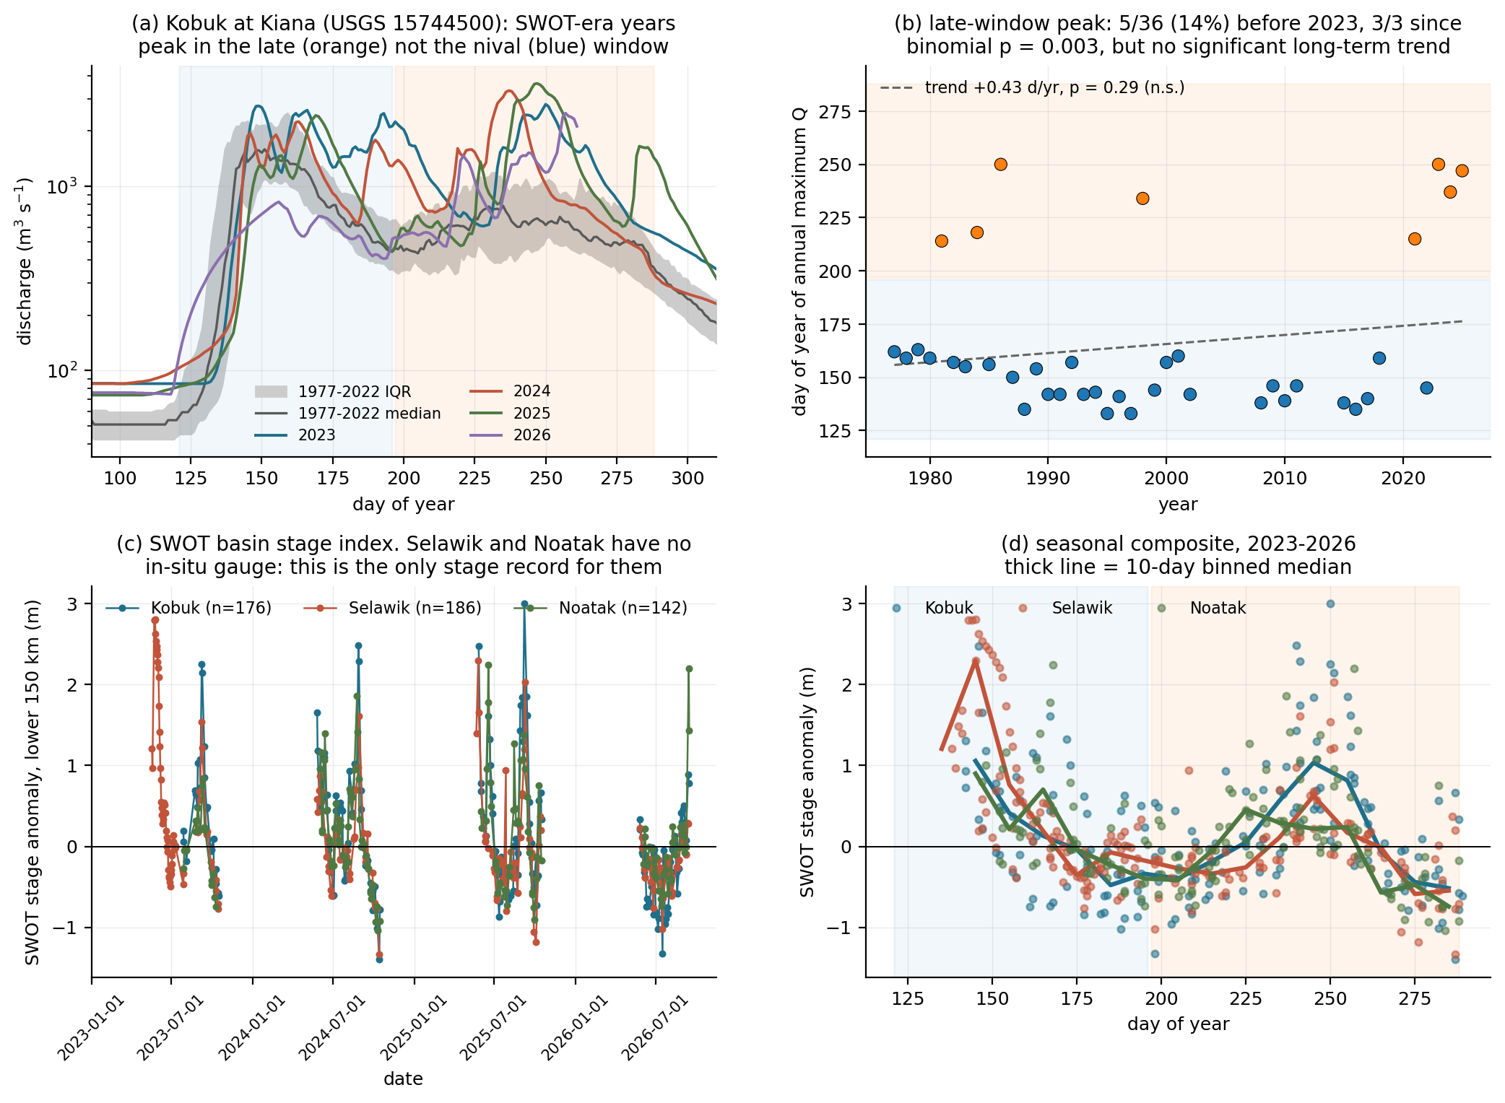
HEADLINE RESULT
The Selawik and the Kobuk are out of phase
Both drain into the same Hotham Inlet complex.
Selawik | day 141, 145, 145
Kobuk | day 240, 250
Noatak | day 168, 237
Day-of-year of the seasonal stage maximum. The Selawik is snowmelt-driven and spikes in mid-May with a 4-day spread across three years. The Kobuk peaked in late August and September.
So the freshwater arriving during the bloom window is Kobuk and Noatak water, not Selawik water.

Slide 11
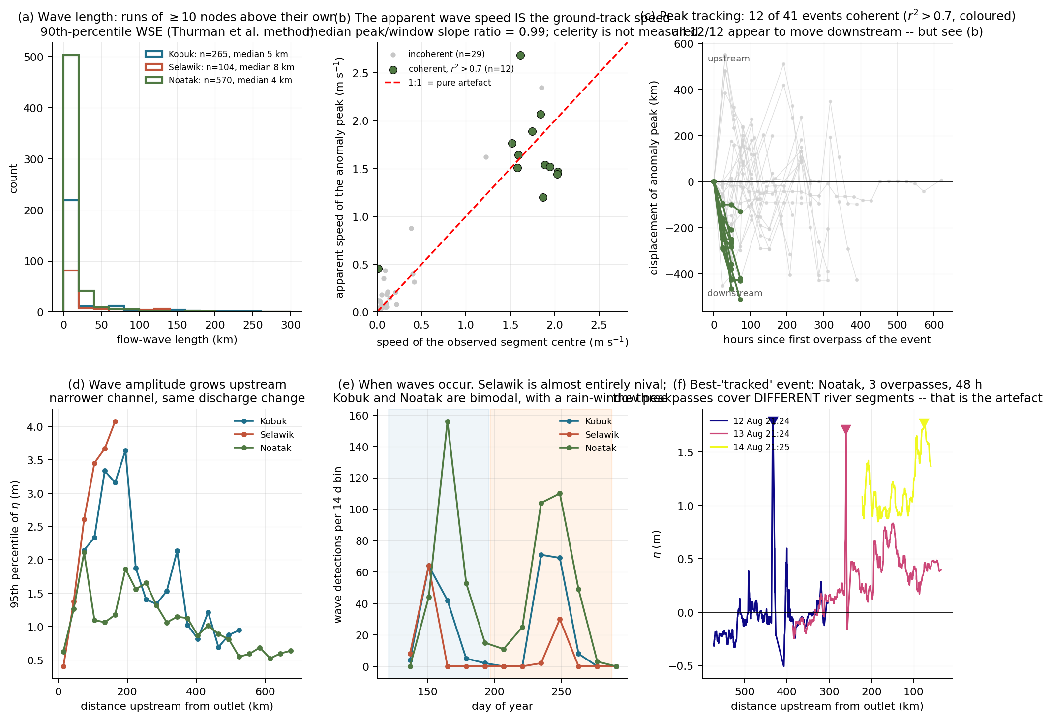
RESULT
Flow waves: length and amplitude work
939 wave detections by the Thurman 90th-percentile run test
Median 4–8 km; 65 exceed 50 km; maximum 243 km on the Kobuk
Only 1% are truncated by the observed span
Amplitude grows upstream on all three rivers as the channel narrows
Seasonal occurrence independently reproduces the phase split
None of this needs celerity.

Slide 12
WHAT WE GOT WRONG
A celerity result that looked right, and was not
The apparent finding. Tracking the anomaly peak across consecutive overpasses gave 12 coherent events (r² > 0.7), all on the Noatak, all 12 moving downstream, median 1.53 m/s — inside the kinematic-wave prior of 1.4–3.3 m/s. Direction alone looked decisive at p = 0.5¹².
The artefact. SWOT’s consecutive passes sweep along the river, so the centre of the observed segment marches downstream between overpasses. Regressing peak position and segment centre on time for the same events gives a median slope ratio of 0.99. The apparent wave speed is the ground-track speed.
Three SWOT celerity estimators, three failures — each diagnosable. No SWOT celerity is claimed for these rivers.
PRIORS P5b now requires that slope ratio be reported for any future celerity claim in this basin.

Slide 13
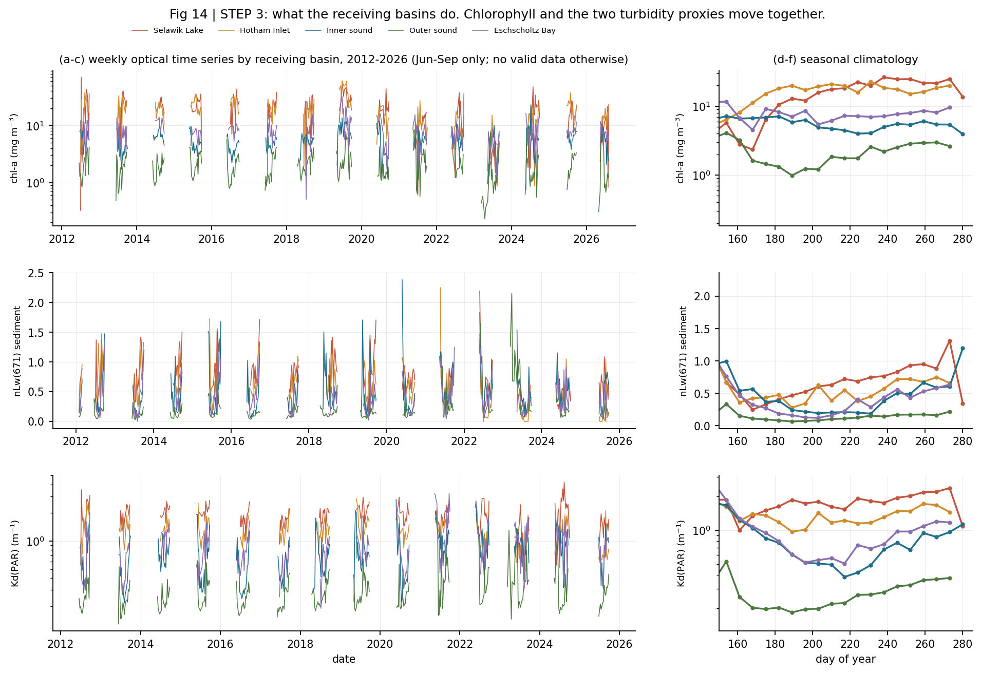
OCEAN
3
What the receiving basins do
Chlorophyll, nLw(671) and Kd(PAR) for five basins, 2012–2026.
All three order identically:
Selawik Lake > Hotham Inlet > Eschscholtz Bay > inner sound > outer sound
That is a turbidity gradient away from the river mouths. Chlorophyll following two independent turbidity proxies is the Case-2 warning restated.
Valid retrievals exist only June–September here: polar night, sea ice and low sun angle remove the rest.

Slide 14
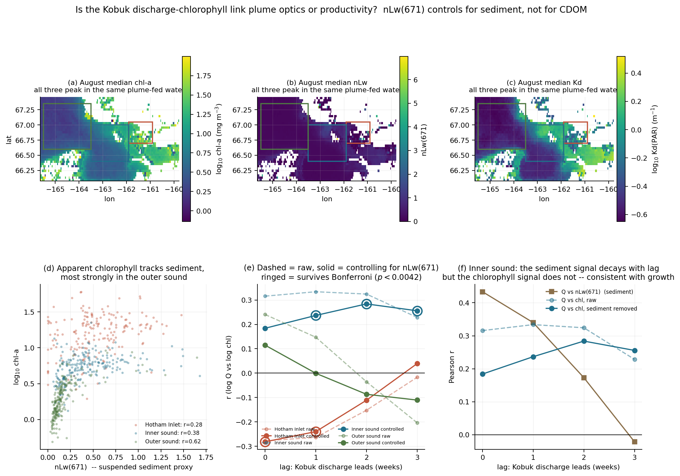
OCEAN
4
Optics or productivity?
nLw(671) responds to suspended sediment and is nearly blind to chlorophyll, so it can be used as a control. Partial correlation of log Q against log chl, controlling for it:
Outer sound | optics — collapses 0.24 → 0.11
Inner sound | survives, strengthens with lag
Hotham Inlet | not sediment; dilution
Inner sound: sediment coupling decays 0.43 → −0.02 across 0–3 weeks while the sediment-removed chlorophyll signal rises 0.18 → 0.28. The curves cross. A signal that outlives its own forcing tracer looks like growth.
Caveat: nLw(671) controls sediment, not CDOM.

Slide 15
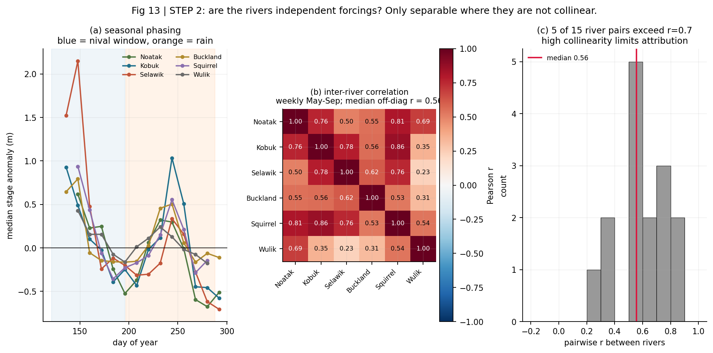
ATTRIBUTION
5
Are the rivers independent forcings?
Checked before attributing anything, not after.
0.56
median pairwise r
between the six rivers
5 / 15
river pairs exceed r = 0.7
They share weather, so they are substantially collinear and cannot be cleanly separated. Kobuk–Squirrel at 0.86 is expected: the Squirrel is a Kobuk tributary, not an independent forcing.
Fig 13 — seasonal phasing and the inter-river correlation matrix

Slide 16
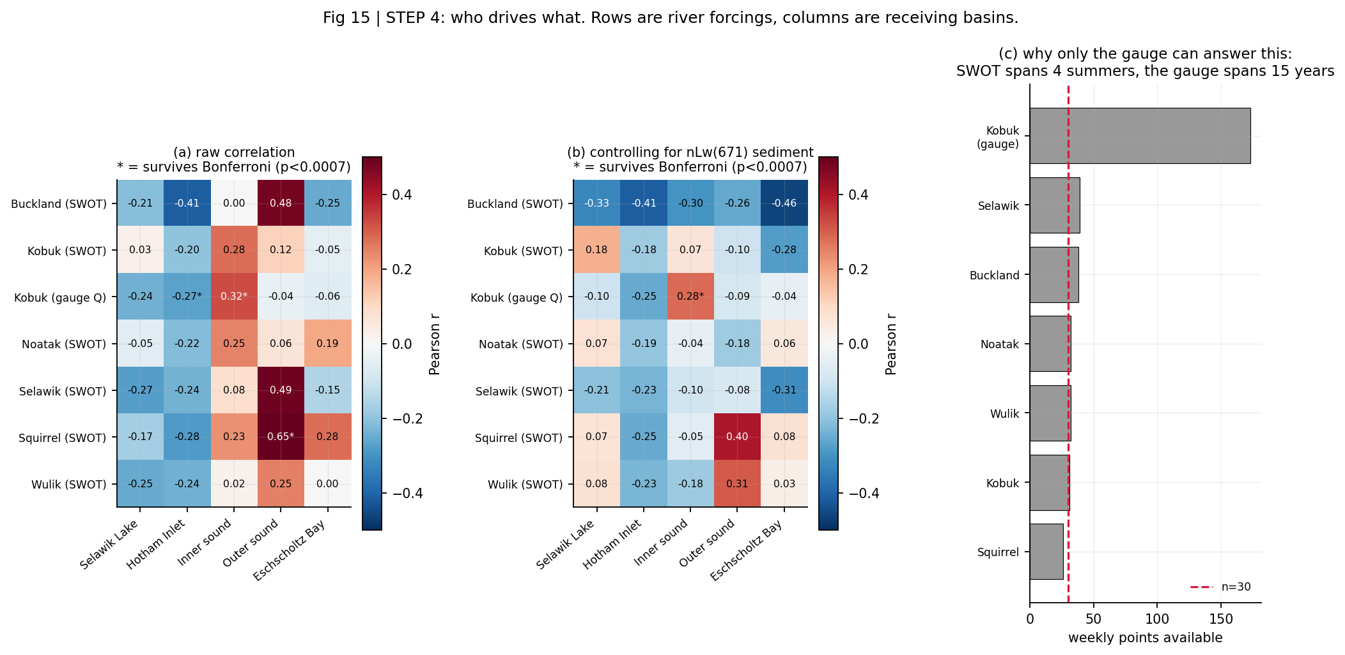
ATTRIBUTION
6
Who drives what
70 tests. Every river forcing against every receiving basin, at 1 and 2 week lags, raw and sediment-controlled.
1 of 70
survive Bonferroni
Kobuk gauged discharge → inner-sound chlorophyll, 2-week lag, partial r = 0.28, p = 4.6e−5.
No SWOT forcing survives — power, not absence. n = 28–39 weekly points against the gauge’s 201.
Fig 15 — rows are river forcings, columns are receiving basins

Slide 17
SUMMARY
What the data support, and what they do not
Supported
Not supported
SWOT WSE is quantitatively trustworthy here: slope 1.002 where physics demands 1.0, 21 cm residual.
Revisit is ~1 day, not 21, from swath overlap at 67°N.
The Selawik and Kobuk deliver freshwater ~100 days apart into the same estuarine complex.
The Selawik is backwater-controlled: 4.0 m of fall over 166 km.
Wave length and amplitude are measurable; 939 detections.
Kobuk discharge leads inner-sound chlorophyll by ~2 weeks, and survives a sediment control.
No SWOT flow-wave celerity. Three estimators, three failures; the best-looking one tracked the ground track at a ratio of 0.99.
No claim that the Kobuk late-summer peak is a trend. 3/3 in the SWOT era, but the 40-year regression gives p = 0.29.
No biological interpretation of the outer sound: that correlation is plume optics.
No attribution from SWOT alone. Four summers gives n = 28–39; nothing survives correction.
ice_clim_f is a fixed climatology — a seasonal mask, not an ice detector. No break-up dates.

Slide 18
NEXT STEPS
What would sharpen this
1
aCDOM(443) or a blue-band control
Closes the last gap in the optics-vs-biology test. CDOM is invisible to nLw(671) and is a major Arctic plume constituent. Same ERDDAP server, same chunked fetcher.
2
SWOT PLD lake product
Selawik Lake and Hotham Inlet as PriorLake features. Tests whether the Selawik stage index tracks discharge or simply lake level — a real risk at 2.4 cm/km.
3
Earthdata Login → L2_HR_Raster
True gridded imagery over the Kobuk delta and Hotham Inlet, where the vector product is weakest because SWORD types those reaches 5 and 6.
4
Two to three more SWOT years
Roughly doubles n and would bring Buckland → Eschscholtz Bay and Kobuk → Hotham Inlet into range.
5
In-situ chlorophyll or HAB cell counts
Alaska HAB network data would escape the Case-2 problem entirely.

Slide 19
Reproducibility
Every input is public and unauthenticated. No Earthdata Login is required for anything shown here.
README.md what it does, how to run it, environment
docs/THEORY.md equations, units, QC policy and its justification
docs/PRIORS.md physical constraints, each with a pass/fail state
docs/WALKTHROUGH.md derivation, validation, and what failed
packet/ flat CSV exports with a manifest
Hydrocron responses are cached per feature, so re-runs are free and offline.

