Slide 1
THAPAR AUTO
Campus Auto Booking & Pooling — Prototype Overview
Product & System Design Prototype • Thapar Institute of Engineering and Technology
TA
Flutter • Node.js • SQLite • Firebase Auth • UPI Payments

Slide 2
The Problem
Campus mobility between hostels, academic blocks, and the library is slow, uncoordinated, and cash-dependent.
W
Long Wait Times
Students wait at stops with no visibility into when the next auto will arrive.
~6
S
Empty Seats, Wasted Trips
Autos leave half-full because there's no way to pool nearby requests.
campus stops served
by the shared route
$
Cash-Only Friction
Rs. 10
Fumbling for exact change slows boarding and creates disputes.
No Queue Fairness
flat fare per seat —
no haggling, no change
Q
Drivers have no fair, first-in-first-out system for picking up the next ride.
Thapar Auto
2

Slide 3
Our Solution
A pooling-first booking system that matches students to autos already on the road, and dispatches idle autos fairly when it can't.
P
L
$
Q
Smart Pooling
Live Availability
UPI QR Payments
Fair Idle Queue
New requests are matched to enroute autos heading the same direction with spare seats.
Students see poolable autos and idle-queue depth before they tap Book.
Scan the driver's static QR and pay the flat per-seat fare — no cash needed.
Idle autos dispatch strictly FIFO and rejoin the back of the queue after each trip.
Thapar Auto
3

Slide 4
Technology Stack
A lightweight, cross-platform stack chosen for fast prototyping and easy campus deployment.
F
N
DB
ID
Flutter
Node.js + Express
SQLite
Firebase / Google Auth
Frontend
Backend API
Database
Identity
Android, iOS, Web, Windows & Linux from one codebase.
REST endpoints for booking, matching, and dispatch.
Lightweight embedded store via better-sqlite3.
Phone-OTP for drivers, @thapar.edu Google Sign-In for students.
Thapar Auto
4

Slide 5
System Architecture
Client apps talk to a single REST API backed by SQLite; the matching engine decides pooled vs. fresh dispatch.
Flutter App
Matching Engine
Student
HTTPS/JSON
pool vs. idle-queue logic
Express REST API
SQLite DB
bookings · autos · drivers
students · drivers ·
autos · bookings
Flutter App
Firebase Auth
Driver
OTP + Google Sign-In
Thapar Auto
5

Slide 6
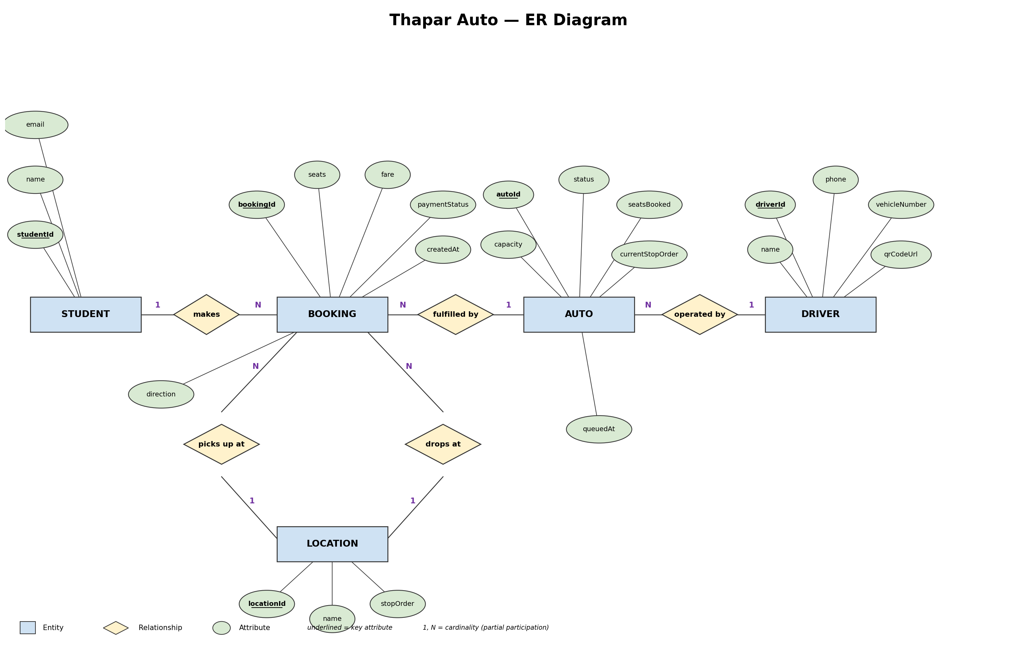
Data Model — Entity-Relationship Diagram
Thapar Auto
6

Slide 7
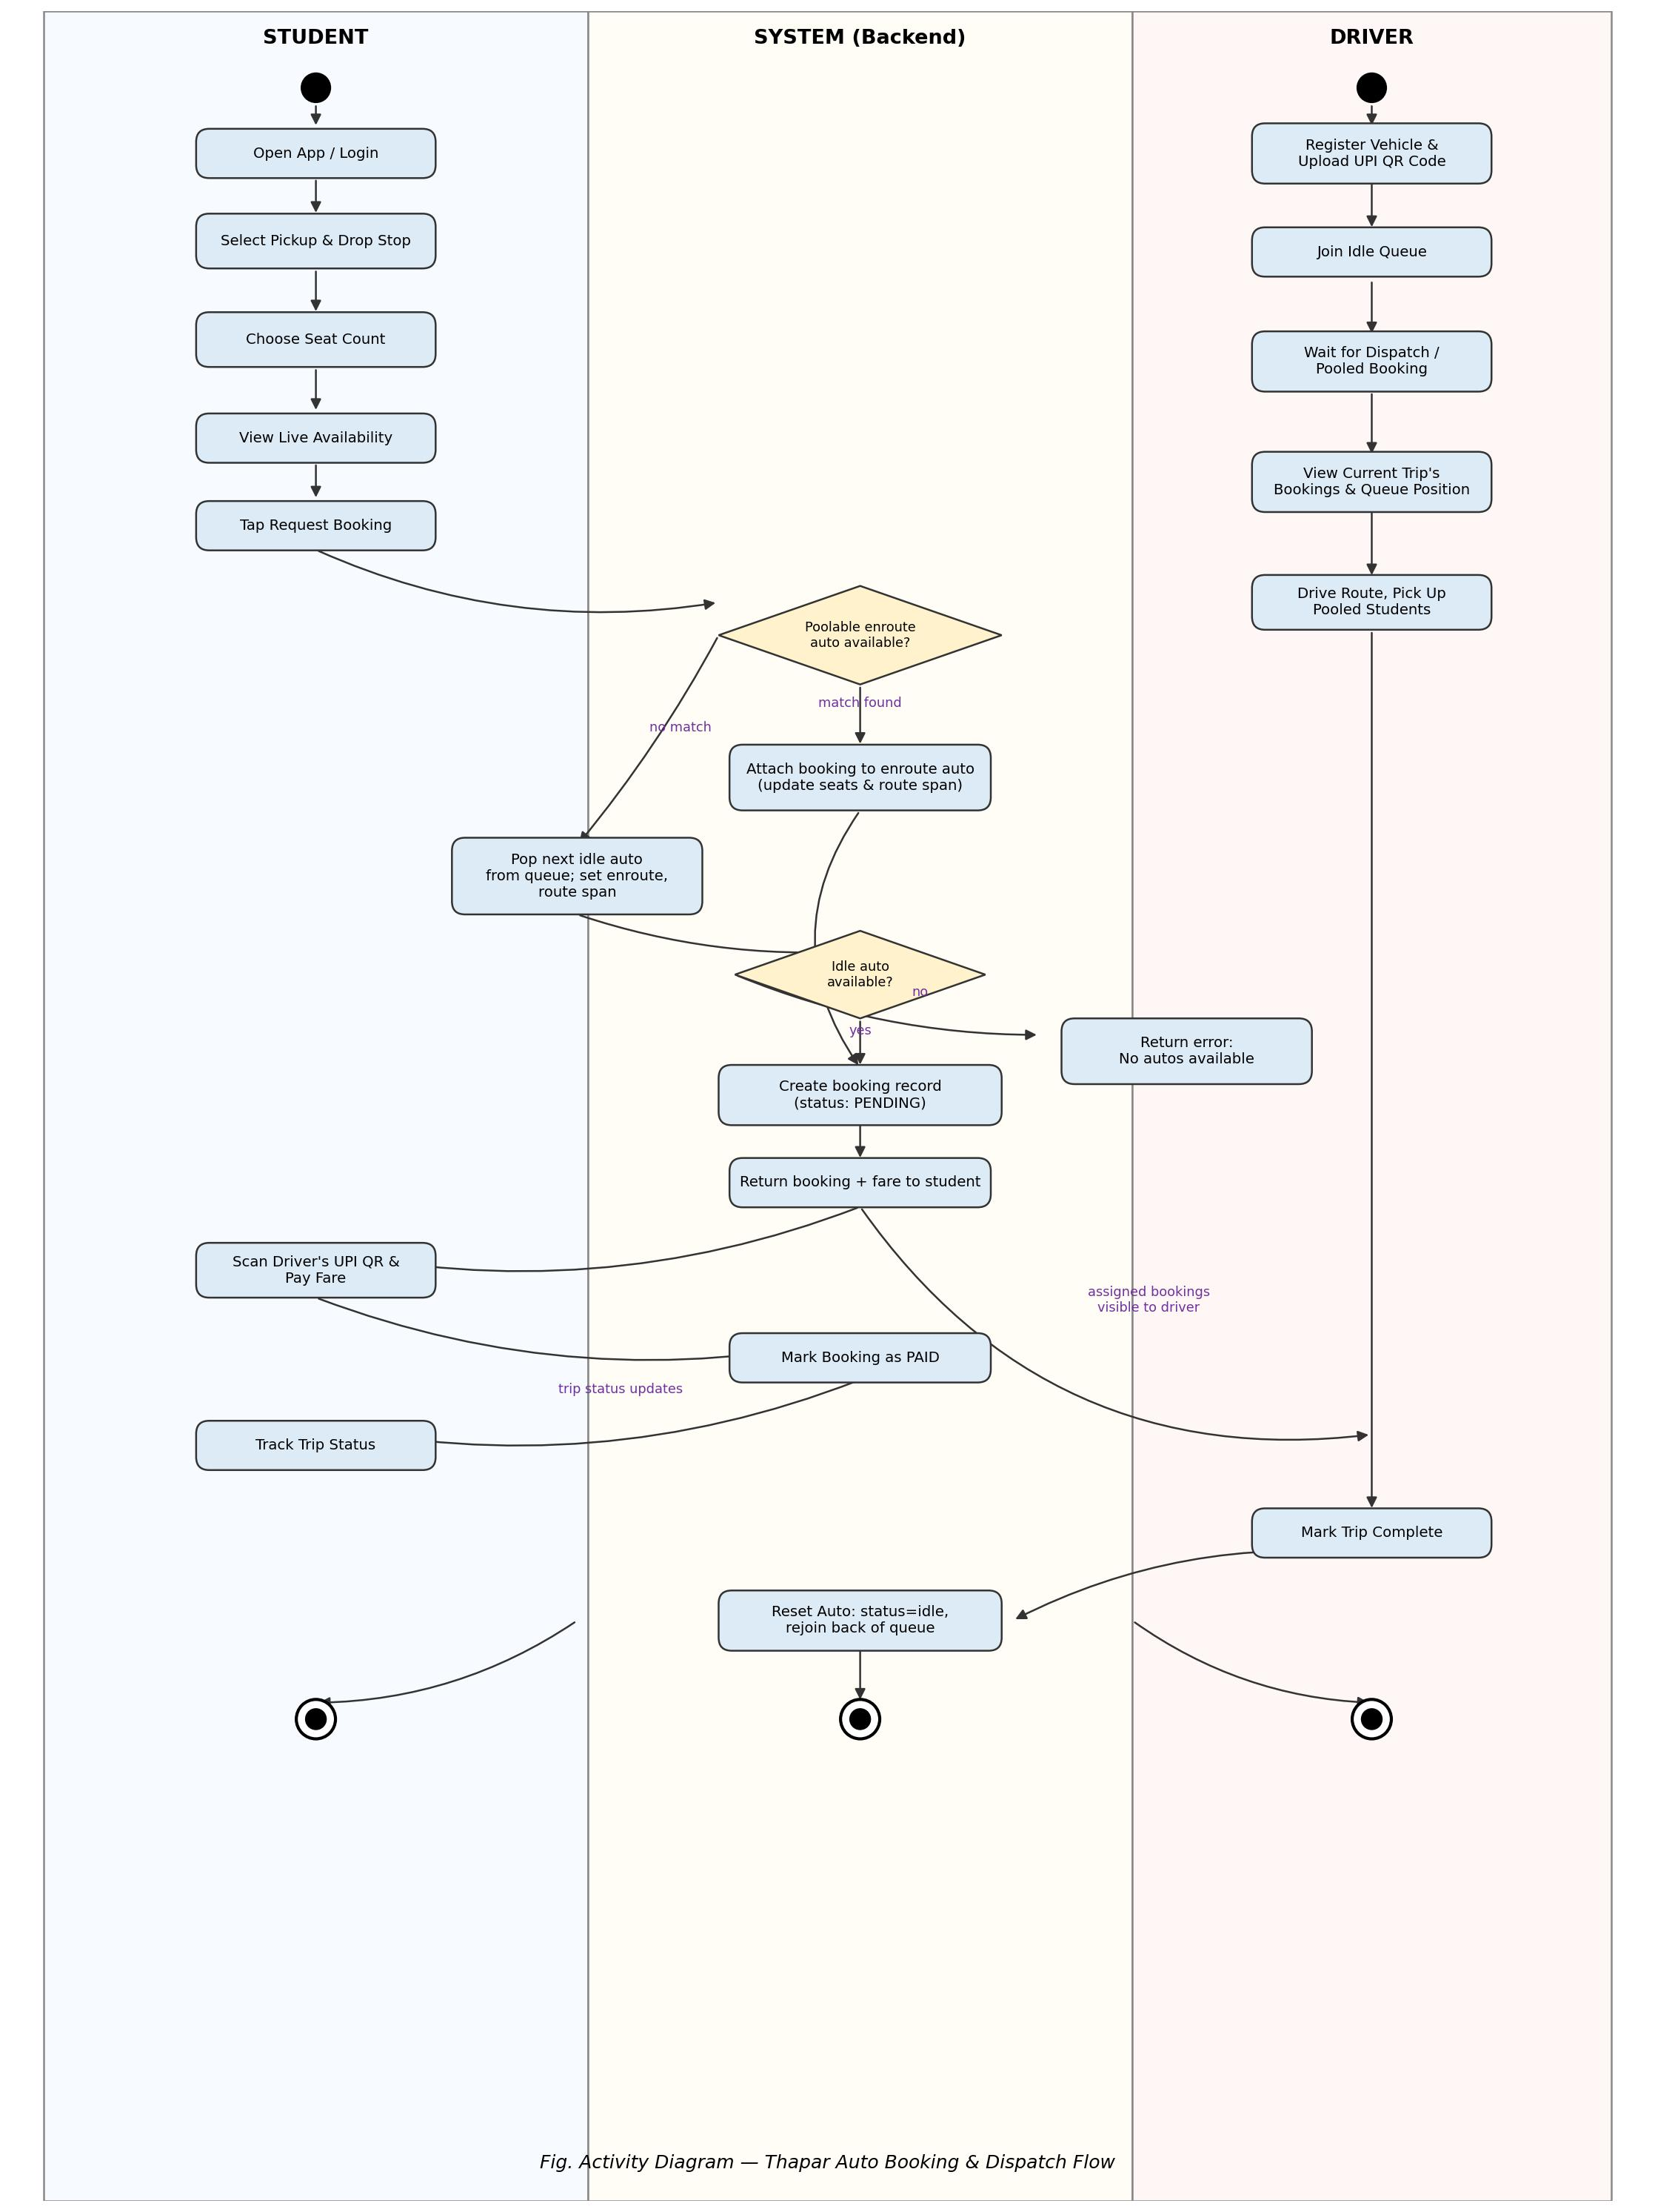
Booking & Dispatch Flow
Student, System and Driver swimlanes — from stop selection through pooling/dispatch to payment and trip completion.
Thapar Auto
7

Slide 8
Matching Algorithm in Action
Simulated outcome of 100 sample booking requests against the pooling-first matching engine.
62%
of requests were pooled onto an auto already en route — no new dispatch needed.
38%
triggered a fresh dispatch from the idle FIFO queue.
0
requests were rejected in the simulation (idle queue kept pace with demand).
Thapar Auto
8

Slide 9
Fleet Capacity Mix
Registered autos by seating capacity during the pilot registration window (illustrative).
16
total autos onboarded in the pilot
5-seaters give the best pooling flexibility — enough capacity to absorb a second or third pooled request without idling.
Thapar Auto
9

Slide 10
Fare Economics
Estimated average per-trip cost per student: a full individual auto fare vs. the flat, pooled Thapar Auto fare.
~75%
lower estimated cost per
student when pooled, vs.
an individually-hired auto
Thapar Auto
10

Slide 11
Development Timeline
Planned duration (in days) for each project phase, Jan – Apr 2026.
Thapar Auto
11

Slide 12
Screens at a Glance
Seven core screens implement the full student and driver loop.
Role Select
Student Login
Student Home
R
L
H
Student or Driver entry point
Google Sign-In, @thapar.edu only
Pick stops, seats & see availability
Payment
Trip Status
Driver Login
$
OK
D
Scan driver's UPI QR, confirm pay
Pooled/dispatched confirmation
Phone OTP + vehicle registration
Driver Dashboard
Q
Live queue position & trip bookings
Thapar Auto
12

Slide 13
Roadmap & Future Scope
What the prototype deliberately leaves out — and what comes next.
GPS
ID
$
Live GPS Tracking
Server-Side Token Verification
Payment Gateway Webhooks
Real-time auto location on the student's map, not just status text.
Verify Google ID tokens server-side instead of trusting client-sent email.
Move from scan-and-confirm to a verified UPI payment webhook.
RF
WS
AN
Ratings & Feedback
WebSocket Push
Admin Analytics Dashboard
Let students rate drivers and trips to surface quality issues.
Replace the driver dashboard's 5-second poll with real-time push.
Route utilization, peak-hour demand, and queue health at a glance.
Thapar Auto
13

Slide 14
Thank You
Questions & Discussion — Thapar Auto Prototype
Thapar Institute of Engineering and Technology, Patiala

