Slide 1
Firebreak
A new Money Management app.

Slide 2


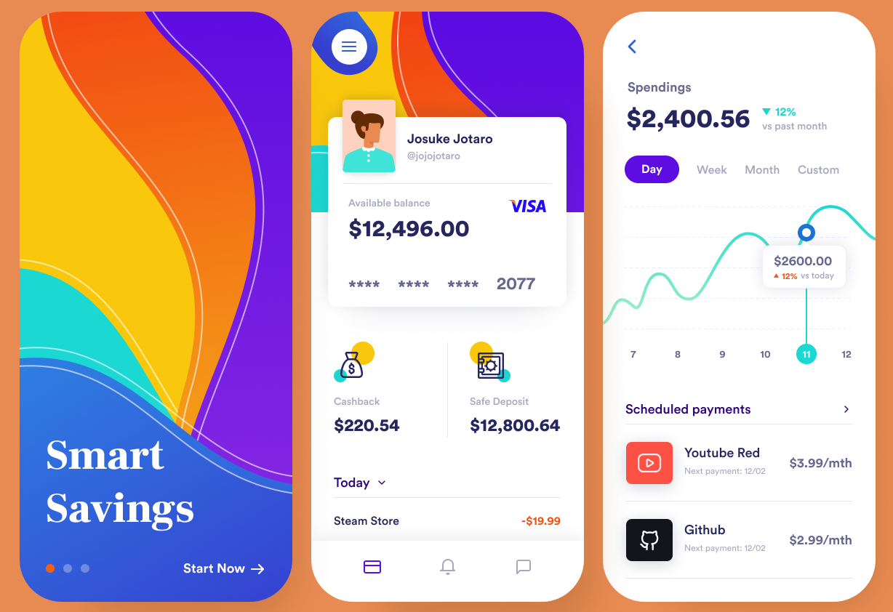

Slide 3
Why?
FIRE is an acronym for an emerging philosophy of money management - ‘Financial Independence and Retire Early’.
The aim is to control spending and maximize the value of every dollar on the way to generating wealth and independence.
Our app helps you take this level of control over your money.
Break away from the limitations of your bank and their mobile app. Choose the accounts that work for you, even if they’re with different banks. Bring all the data into Firebreak. Track your spending. Set goals, and measure progress toward them.
Our app helps you achieve your goals.
A firebreak is a buffer zone of cleared land used to control the spread of wildfire and protect valuable assets.
Firebreak app helps you build a buffer around your finances, protecting yourself.

Slide 4
Solving Problems
Enabling good money management
We simplify the process of setting budgets, comparing products, and allow you to actively manage your money.
Offer an easy, integrated experience
Choose any account, from any provider.
Privacy preserving technology
The power of artificial intelligence on your device, keeping your data secure.
Leverage Open Banking to import your data.

Slide 5
Delivering on Potential
Mobile is now the primary channel for consumers to do their banking. There is an emerging market for mobile money management apps independent from bank offerings.
Our Open Banking enabled app will give customers a clear integrated picture of their finances.
Meet consumer demand for an easy money management experience that isn’t tied to one banking provider.
The roadmap for the Consumer Data Right will allow us to integrate energy / telecommunication services – offering a revenue stream when we connect customers to providers.

