Slide 1


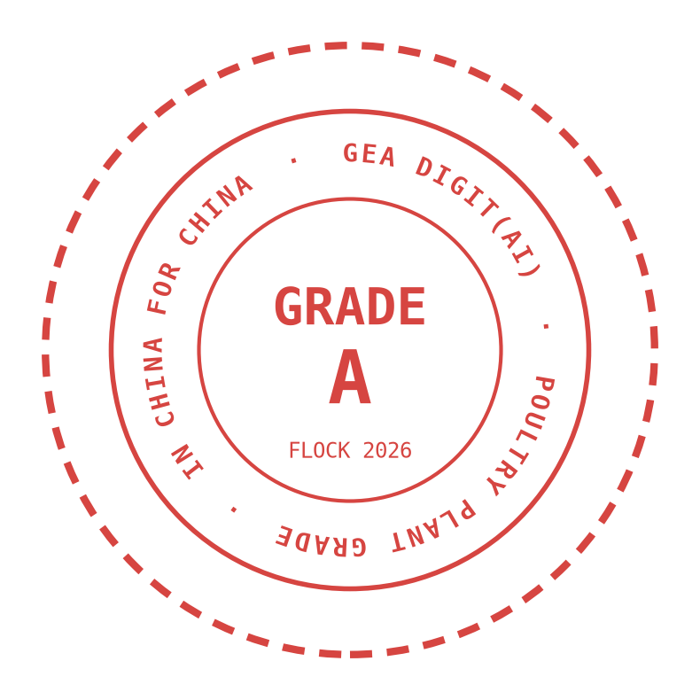
GEA PFA POULTRY · DIGITAL + AI · 2026
GEA × Digit(AI)
= THE FUTURE
The intelligent poultry plant — one operating system from bird to bite.
IN CHINA · FOR CHINA · WITH GLOBAL REACH
AI as the prime example of China → Global
GEA CHINA × Digit(AI) · PFA POULTRY
IN CHINA FOR CHINA · CHINA → GLOBAL
01 / 12
Notes:
GEA times Digit(AI) is not a slogan, it is the equation we are building. One intelligent operating system from bird to bite - built in China, for China, with global reach. Poultry is where we prove it.

Slide 2
02
02 · THE THESIS
Digit(AI) is not digital plus AI.
It is the fusion of digital platforms and artificial intelligence into a single intelligent operating layer — for the poultry plant.
PHYSICAL
GEA poultry lines, kill lines to cut-up, real plants, real birds
DIGIT
Platforms, data, edge + cloud, secure connectivity
ONE FUSED OPERATING LAYER
for the whole plant
+
×AI
One fused layer for the whole plant — not three parallel programs.
GEA CHINA × Digit(AI) · PFA POULTRY
IN CHINA FOR CHINA · CHINA → GLOBAL
02 / 12
Notes:
Digit(AI) is not digital plus AI as two separate programs. The physical - our lines, real plants, real birds. The digit - platforms, data, edge and cloud. And AI as the multiplier, not an add-on. One fused operating layer for the whole plant, not three parallel initiatives.

Slide 3

03 · WHY POULTRY, WHY NOW
China's poultry market is the perfect proving ground.
Scale, speed and scrutiny — the three forces that make AI inevitable.
26.6 Mt
20B+
No.2
China poultry meat output, 2024 (+3.8% YoY)
Birds processed in China every year
World poultry producer — and still growing
Labor scarcity. Food-safety scrutiny. Margin pressure per gram of yield.
China is the proving ground. Poultry AI is the prime example of China → Global.
GEA CHINA × Digit(AI) · PFA POULTRY
IN CHINA FOR CHINA · CHINA → GLOBAL
03 / 12
Notes:
Why poultry, why now. 26.6 million tonnes of output, growing 3.8 percent a year. More than 20 billion birds processed in China every year. The world's number-two poultry producer. Labor scarcity, food-safety scrutiny, margin pressure per gram of yield - poultry is the fastest, most data-dense protein, the place where AI learns fastest.

Slide 4
04
04 · THE SUNNER STORY · BUILT WITH GEA
Sunner 圣农: a success story GEA China helped write.
GEA processing technology has run inside Sunner's rise — full-chain integration is the ideal foundation for what comes next.
¥20.1B
800M
No.1
圣泽901
Revenue 2025 (+8.1%)
Net profit +90.6% (FY2025 report)
White-feather broilers
capacity per year
Asia's largest full-chain
player — world No.6
Self-bred genetics: broke
100 yrs of foreign monopoly
For years, GEA China's lines have powered Sunner's chain. Every GEA stage is already the data foundation Digit(AI) needs.
GRADE A
FLOCK 2026
GEA CHINA × Digit(AI) · PFA POULTRY
IN CHINA FOR CHINA · CHINA → GLOBAL
04 / 12
Notes:
Sunner is the proof. 20.1 billion renminbi revenue in 2025, 800 million broilers a year, Asia's largest full-chain player, world number six. With Shengze 901 they broke a hundred years of foreign monopoly in genetics - and already export to Africa and Central Asia. GEA China's lines have powered that rise for years: that installed base is exactly the data foundation Digit(AI) needs.

Slide 5
05 · THE CONNECTED BIRD
One bird. One data thread. Eight stages.
From live receiving to packaging — every step sensed, connected, and optimizable.
Precise, humane, monitored
Vision-guided inspection
Yield-optimized cutting
Traceability to the bite
STUNNING
EVISCERATION
CUT-UP · DEBONE
PACKAGING
02
04 AI
06 AI
08
01
03
05 AI
07
LIVE RECEIVING
SCALD & PLUCK
CHILLING
FURTHER PROCESSING
Weight & welfare data at intake
Temperature & dwell control
Autonomous setpoints
Recipe & quality control
AI OVERLAY Vision grading on the kill line · sensor fusion at every stage · autonomous setpoints · traceability to the bite
GEA CHINA × Digit(AI) · PFA POULTRY
IN CHINA FOR CHINA · CHINA → GLOBAL
05 / 12
Notes:
Follow one bird. Eight stages, one data thread. From live receiving to packaging, every step sensed, connected, optimizable. On evisceration, chilling and cut-up the AI overlay already changes the economics: vision-guided inspection, autonomous setpoints, yield-optimized cutting - and full-flock traceability from bird to bite.

Slide 6
06
06 · THE Digit(AI) STACK
From bird to algorithm — China-ready by design.
Four layers, one intelligent operating system for the poultry plant.
EDGE & IIoT
Line-side vision & sensors · secure remote access · gateways · China-compliant OT paths
DATA & CLOUD
Plant data fabric · Azure China / multi-cloud · digital twins · data residency & PIPL alignment
AI & AGENTS ★ PRIME EXAMPLE
Carcass grading · yield optimization · food-safety early warning · agents on Azure AI Foundry
HUMAN + MACHINE
Augmented operators · line-side decision support · Chinese-language interfaces · local process fluency
GEA CHINA × Digit(AI) · PFA POULTRY
IN CHINA FOR CHINA · CHINA → GLOBAL
06 / 12
Notes:
The stack, China-ready by design. Edge and IIoT at the line, with compliant OT paths. A data and cloud layer on Azure China, residency and PIPL aligned. AI and agents - the prime example - on Azure AI Foundry, built in China and designed for global scale. And human plus machine: augmented operators, Chinese-language interfaces, local process fluency.

Slide 7
07 · THE INTELLIGENCE ENGINE
Powered by what the enterprise already runs.
SAP data + industrial ontology + Azure AI Foundry — one integrated engine behind every Digit(AI) use case.
SAP
BUSINESS BACKBONE S/4HANA: orders, batches, costs, supply chain — the system of record
ONTOLOGY
SEMANTIC LAYER One shared language for assets, process steps, flocks and lots
AI FOUNDRY
MODEL & AGENT FACTORY Azure AI Foundry on Azure China: build, deploy, govern
every decision lands back in the lines and the ERP — one connected engine
GEA CHINA × Digit(AI) · PFA POULTRY
IN CHINA FOR CHINA · CHINA → GLOBAL
07 / 12
Notes:
The engine is powered by what the enterprise already runs. SAP is the business backbone. The ontology is the semantic layer: one shared language for assets, flocks and lots. Azure AI Foundry builds and governs the models. And it is a closed loop - every AI decision lands back in the lines and in the ERP. No swivel-chair integration.

Slide 8
ACT II · DIGIT(AI) × SUNNER
Same plants. Same birds.
New intelligence.
How GEA Digit(AI) can take Sunner to another level.
Notes:
Act two. Same plants, same GEA lines, same birds - new intelligence on top. Six indicative targets we would validate at pilot.

Slide 9

09
09 · ACT II · DIGIT(AI) × SUNNER
How GEA Digit(AI) can take Sunner to another level.
Same plants, same GEA lines — new intelligence on top: six AI superpowers ready to deploy on the Sunner chain.
+1–2%
TARGET
−15%
TARGET
99%+
TARGET
Meat yield
Energy
Line uptime
Vision carcass grading + yield-optimized cut-up: more grams sold per bird
Autonomous chilling & scalding setpoints, tuned live to load and ambient
Predictive maintenance on pluckers, pumps and compressors before they fail
48h
TARGET
−20%
TARGET
10x
TARGET
Earlier warning
Water & chemicals
Faster decisions
Food-safety early warning — Salmonella & Campylobacter signals before they spread
Smart washdown and process-water optimization, per shift and per flock
Line-side and management decisions in hours, not weeks — across the fleet
Source: Indicative target ranges — GEA pilot benchmarks and industry references; validated against each pilot baseline.
GEA CHINA × Digit(AI) · PFA POULTRY
IN CHINA FOR CHINA · CHINA → GLOBAL
09 / 12
Notes:
Act two - what Digit(AI) can take Sunner to. These are indicative target ranges we would validate against each pilot baseline, not promises: one to two percent more meat yield per bird; fifteen percent less energy; ninety-nine-plus percent line uptime; food-safety warnings 48 hours earlier; twenty percent less water and chemicals; decisions in hours, not weeks.

Slide 10
10 · IN CHINA FOR CHINA
Poultry Digit(AI) accelerates when it is local by design.
AI as the prime example of China → Global.
Build & prove in China.
Local architecture
Local speed
Export the system worldwide.
CSL / DSL / PIPL compliant
Decisions in days, not quarters
Flock data stays local; intelligence and architecture scale.
Local talent & partners
Local value capture
China unit owns execution
Chinese poultry customers first
GEA CHINA × Digit(AI) · PFA POULTRY
IN CHINA FOR CHINA · CHINA → GLOBAL
10 / 12
Notes:
In China for China is architecture, not a slogan. Local cloud, edge and AI that meet CSL, DSL and PIPL from day one; decision loops in days; a China digital unit that owns execution; value captured with Chinese customers first. And that is exactly what makes it the China-to-Global proof: build and prove here, at the world's largest volumes, then export the system - while flock data stays local.

Slide 11
11
11 · REPEAT THE STORY EVERYWHERE
The Sunner playbook is not a one-off. It is a template.
One proven story — now a repeatability engine for China, and for the world.
01
02
03
PROVEN
AMPLIFIED
REPEATED
GEA China × Sunner: equipment, partnership and trust that helped build Asia's No.1 full-chain champion.
Digit(AI) will overlay the same plants: yield, energy, uptime, food safety — intelligence on lines GEA already built.
The same playbook scales to every China integrator — and exports to global poultry players worldwide.
NEXT BUSINESS MODEL yield-based pricing · outcome-based contracts · service productization · fleet benchmarking
China's next integrators are waiting — 禾丰, 温氏, 正大, 新希望 — and so are poultry players worldwide.
The story GEA China wrote with Sunner can be written again — everywhere.
GEA CHINA × Digit(AI) · PFA POULTRY
IN CHINA FOR CHINA · CHINA → GLOBAL
11 / 12
Notes:
The Sunner playbook is a template, not a one-off. Proven with Sunner; amplified by Digit(AI) on the same plants; repeated across China's next integrators - Hefeng, Wens, Chia Tai, New Hope - and then with poultry players worldwide. And the commercial model evolves with it: yield-based pricing, outcome-based contracts, service productization.

Slide 12

THE FUTURE IS NOT A DESTINATION.
IT IS A SYSTEM WE BUILD.
GEA × Digit(AI) · PFA POULTRY
IN CHINA · FOR CHINA · FOR THE WORLD
The Sunner story, written once — ready to repeat everywhere. Poultry AI is the first system we take from China to Global.
Let's engineer it.
GEA CHINA × Digit(AI) · PFA POULTRY
IN CHINA FOR CHINA · CHINA → GLOBAL
12 / 12
Notes:
The future is not a destination. It is a system we build. The Sunner story, written once - ready to repeat everywhere. Poultry AI is the first system we take from China to Global. Let's engineer it.

