Slide 1
The Plan
What is Nagios Core?
Features & Benefits
Architecture
Installation & Configuration
Resources & Support
Questions
Notes:
3/3/2016

Slide 2

What is...
The Standard in Open Source IT Monitoring
  15+ years
A monitoring and alerting engine
Notes:
3/3/2016

Slide 3
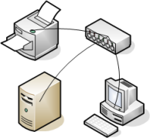


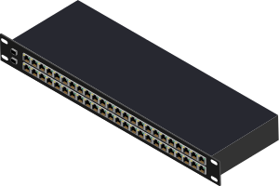


Comprehensive Monitoring
A few 'Nagiosable' things
  System metrics
  Service status
  Applications
  Network devices
???
Notes:
3/3/2016

Slide 4
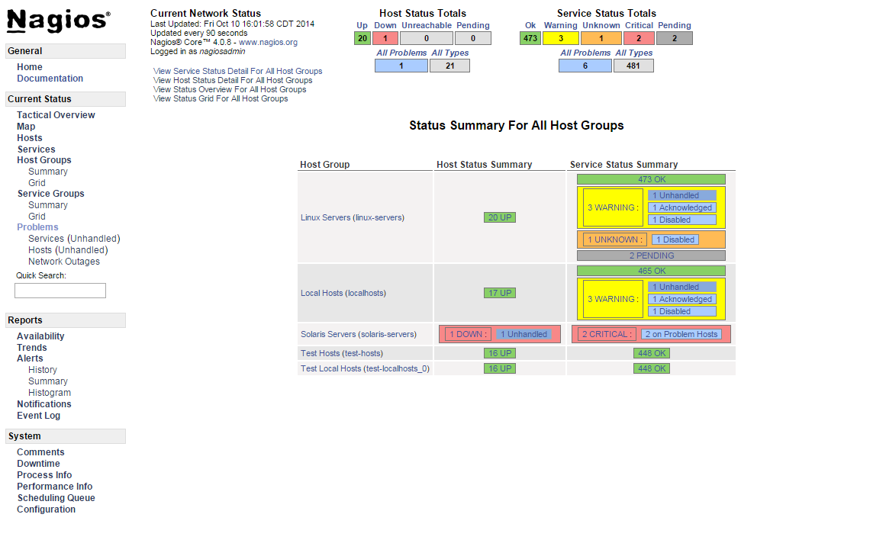
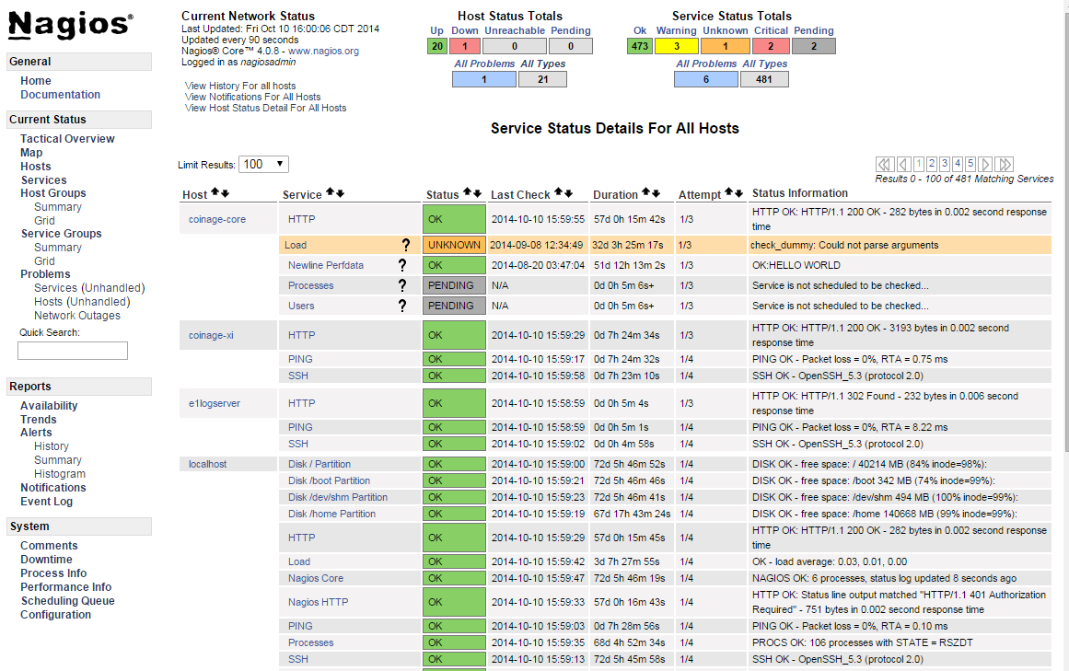
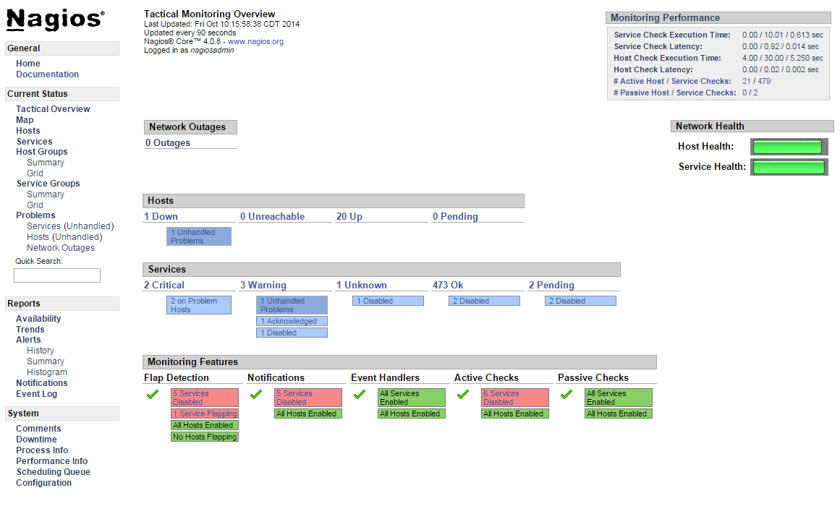
Visibility
Notes:
3/3/2016

Slide 5


Alerting & Awareness
Multiple methods
  email, SMS, ...
  Customizable
Targetable
Escalations for multi-user setups
Schedule downtime, avoid false alerts
Notes:
3/3/2016

Slide 6

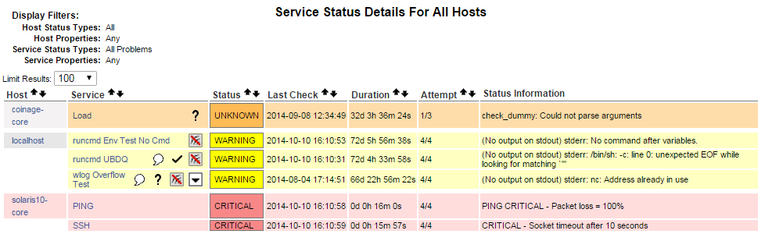
Problem Remediation
Acknowledge problems online
Notes:
3/3/2016

Slide 7
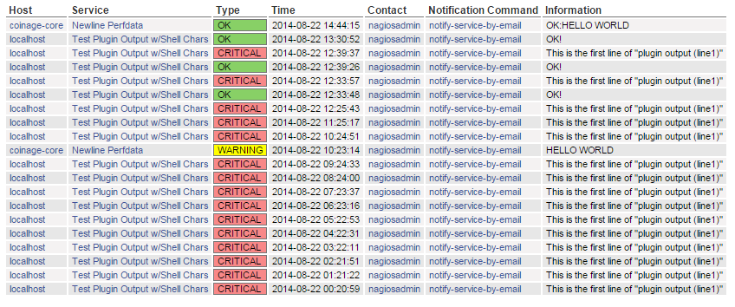
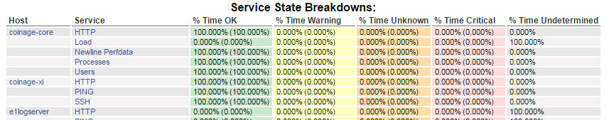
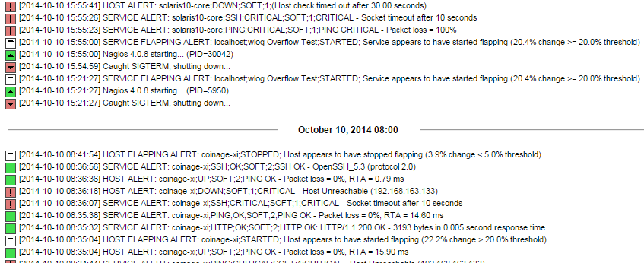
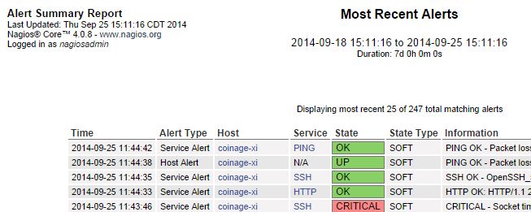
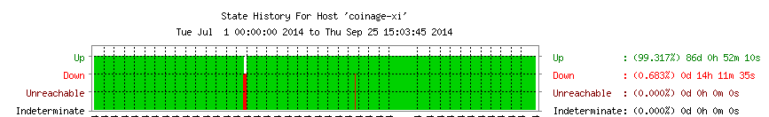
Reporting
Notes:
3/3/2016

Slide 8
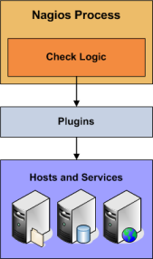
Objects
Hosts & Host Groups
Services & Service Groups
Contacts & Contact Groups
Commands
Time Periods
Notification Escalations
Notification and Execution Dependencies
Notes:
3/3/2016

Slide 9
Checks
Active
  Initiated by Nagios process
  Regularly scheduled
  On demand
  Results sent to Core
Notes:
3/3/2016

Slide 10
Formats & APIs
Configurable commands
Plugin / check result format
Performance data
External commands
Notes:
3/3/2016

Slide 11
That's Nice, but...
...how do I get started?
Notes:
3/3/2016

Slide 12
Installation - 'Soft' Requirements
UNIX OS: Linux, BSD, OS X, Solaris, AIX, …
C compiler & development tools
Web server, PHP, gd (CGIs)
Network access
Notes:
3/3/2016

Slide 13
Installation - 'Hard' Requirements
General Monitoring
 | Minimum | Recommended
Processor | 1 GHz | 2 GHz+
Memory | 512 MB | 1 GB+
Storage | 512 MB | 2 GB+
...or a Raspberry Pi...
Depends on rate and type of checks
Notes:
3/3/2016

Slide 14
Installation - Before We Begin...
WARNING: Comand Line Follows!
It doesn't last forever
Let's install Core on Linux
Notes:
3/3/2016

Slide 15
Installation - Prerequisites
# Install dependencies for Core and popular plugins
yum install -y autoconf automake gcc glibc glibc-common make wget \
fping bind-utils net-snmp net-snmp-utils perl-Net-SNMP samba-client \
openssl-devel openssh-devel mysql-devel gettext gd gd-devel httpd php
# Setup users and groups
groupadd nagcmd
useradd nagios -s /sbin/nologin -M -d /usr/local/nagios/ -U -G nagcmd
usermod -a -G nagcmd apache
usermod -a -G nagios apache
Notes:
3/3/2016

Slide 16
Installation - Nagios Plugins
Official collection of common plugins
  nagios-plugins.org
# Get the Nagios Plugins source code
cd /tmp
wget http://nagios-plugins.org/download/nagios-plugins-2.0.3.tar.gz
tar xzvf nagios-plugins-2.0.3.tar.gz
cd nagios-plugins-2.0.3
# Build and install the plugins
./tools/setup
./configure --with-nagios-user=nagios --with-nagios-group=nagios
make && make install
Notes:
3/3/2016

Slide 17
Installation - Nagios Core
# Get the Nagios Core source code
cd /tmp
wget http://prdownloads.sourceforge.net/sourceforge/nagios/nagios-4.0.8.tar.gz
tar xzvf nagios-4.0.8.tar.gz
cd nagios-4.0.8
# Build and Install Nagios Core
./configure --with-command-group=nagcmd --with-nagios-group=nagios
make all
make install install-init
make install-config
make install-commandmode
make install-webconf
# Setup credentials for accessing the web backend.
sudo -u nagios htpasswd -c /usr/local/nagios/etc/htpasswd.users nagiosadmin
Notes:
3/3/2016

Slide 18
Installation - System Setup
# SELinux is enforcing by default on CentOS. Disable it for this example.
setenforce 0
# Open up ports for HTTP. We use -I to insert the new rules at the head of
# the INPUT chain; -A adds them at the tail, possibly after a REJECT rule.
iptables -I INPUT -m state --state NEW -m tcp -p tcp --dport 80 -j ACCEPT
service iptables save
# Now (re)start our services to use the new configuration.
service httpd restart
service nagios start
# Have our services start automatically.
chkconfig nagios on
chkconfig httpd on
Notes:
3/3/2016

Slide 19
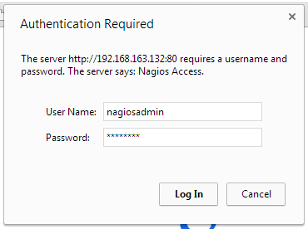
Installation - Try It Out
Notes:
3/3/2016

Slide 20
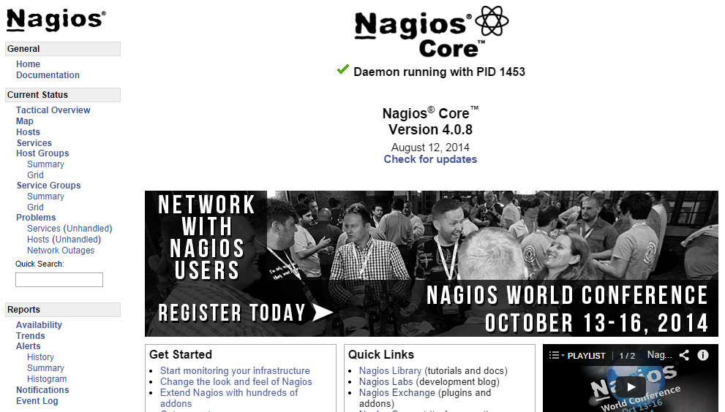
Installation - Try It Out
Notes:
3/3/2016

Slide 21
Anatomy of an Installation
/usr/local/nagios/
  bin/ - Nagios Core binaries
  etc/ - Configuration files
  libexec/ - Plugins, event handlers, cmds
  sbin/ - CGI binaries
  share/ - Web UI files
  var/ - Runtime files, data, logs
Notes:
3/3/2016
Click to add notes

Slide 22
etc/nagios.cfg
General program settings
  File paths
  NEBs to load
Loading other configuration
# You can specify individual config files:
cfg_file=/usr/local/nagios/etc/objects/commands.cfg
cfg_file=/usr/local/nagios/etc/objects/contacts.cfg
cfg_file=/usr/local/nagios/etc/objects/timeperiods.cfg
cfg_file=/usr/local/nagios/etc/objects/templates.cfg
# Configuration for multiple hosts:
cfg_dir=/usr/local/nagios/etc/hosts
Notes:
3/3/2016

Slide 23
Configuration Basics
Basic format
define someobjecttype {
some_variable Some text
another_variable 1234
}
Notes:
3/3/2016

Slide 24
A Partial Template Example
Template
define host {
check_command check-host-alive
notification_options d,u,r
max_check_attempts 5
name host_template
register 0
}
Host
define host {
use host_template
host_name example-host
alias Partial Host Example
host_address 127.0.0.1
}
Notes:
3/3/2016

Slide 25
A Real Host Template
define host {
name generic-host ; Name of this host template
notifications_enabled 1 ; Host notifications are enabled
event_handler_enabled 1 ; Host event handler is enabled
flap_detection_enabled 1 ; Flap detection is enabled
process_perf_data 1 ; Process performance data
retain_status_information 1 ; Keep status info across restarts
retain_nonstatus_information 1 ; Keep non-status info across restarts
notification_period 24x7 ; Send host notifications at any time
register 0 ; Don't register, this is a template!
}
Notes:
3/3/2016

Slide 26
More configuration
Where to from here?
Sample config: etc/
Experiment
Core Manual
nagios.sourceforge.net/docs/nagioscore/4/en/toc.html
Notes:
3/3/2016

Slide 27
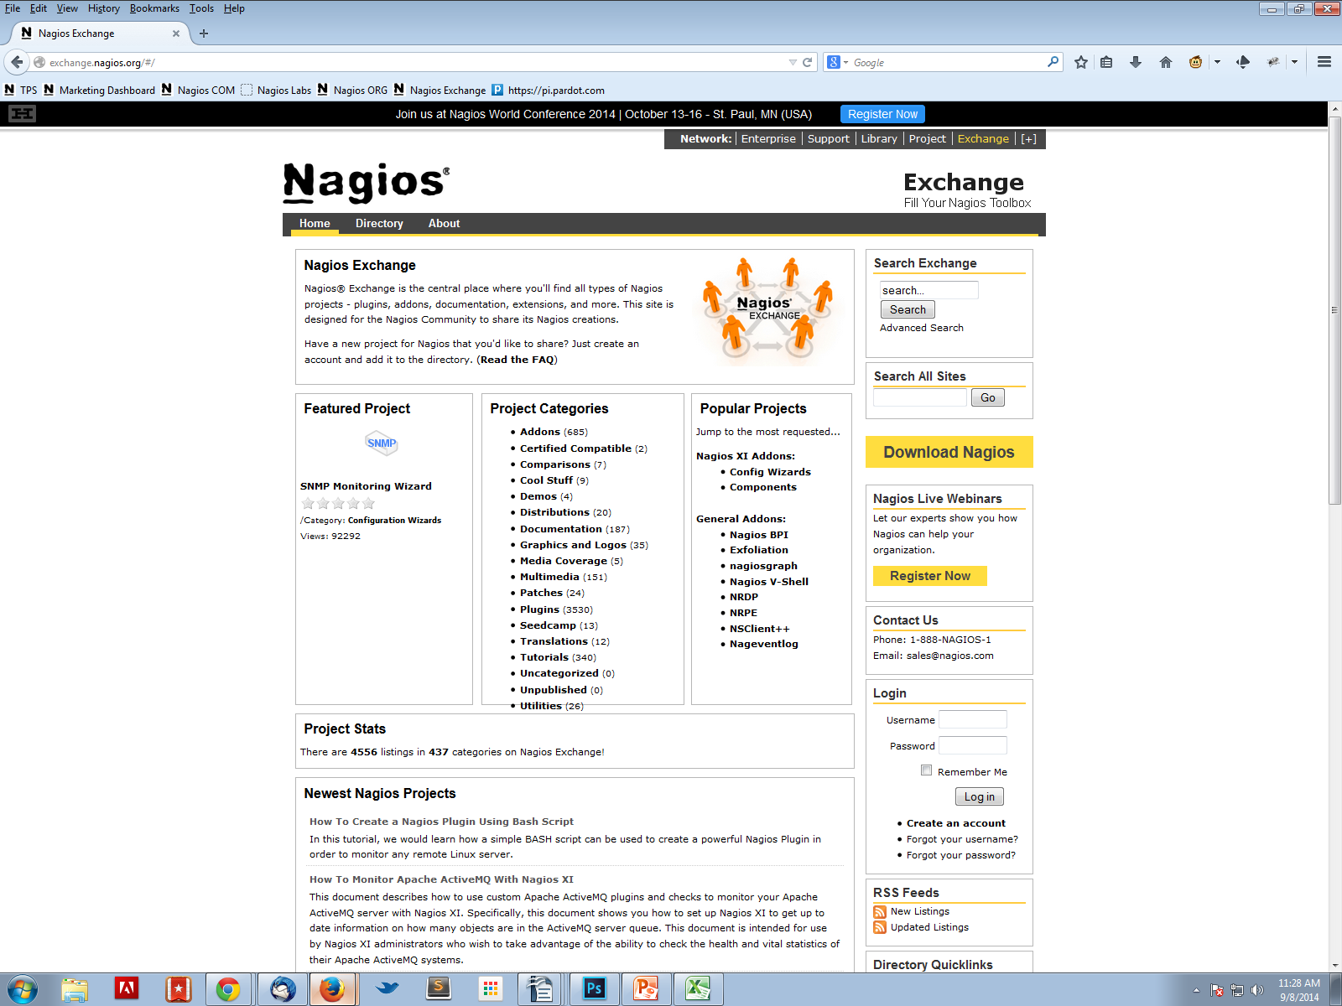
Nagios Exchange
exchange.nagios.org
Notes:
3/3/2016

Slide 28
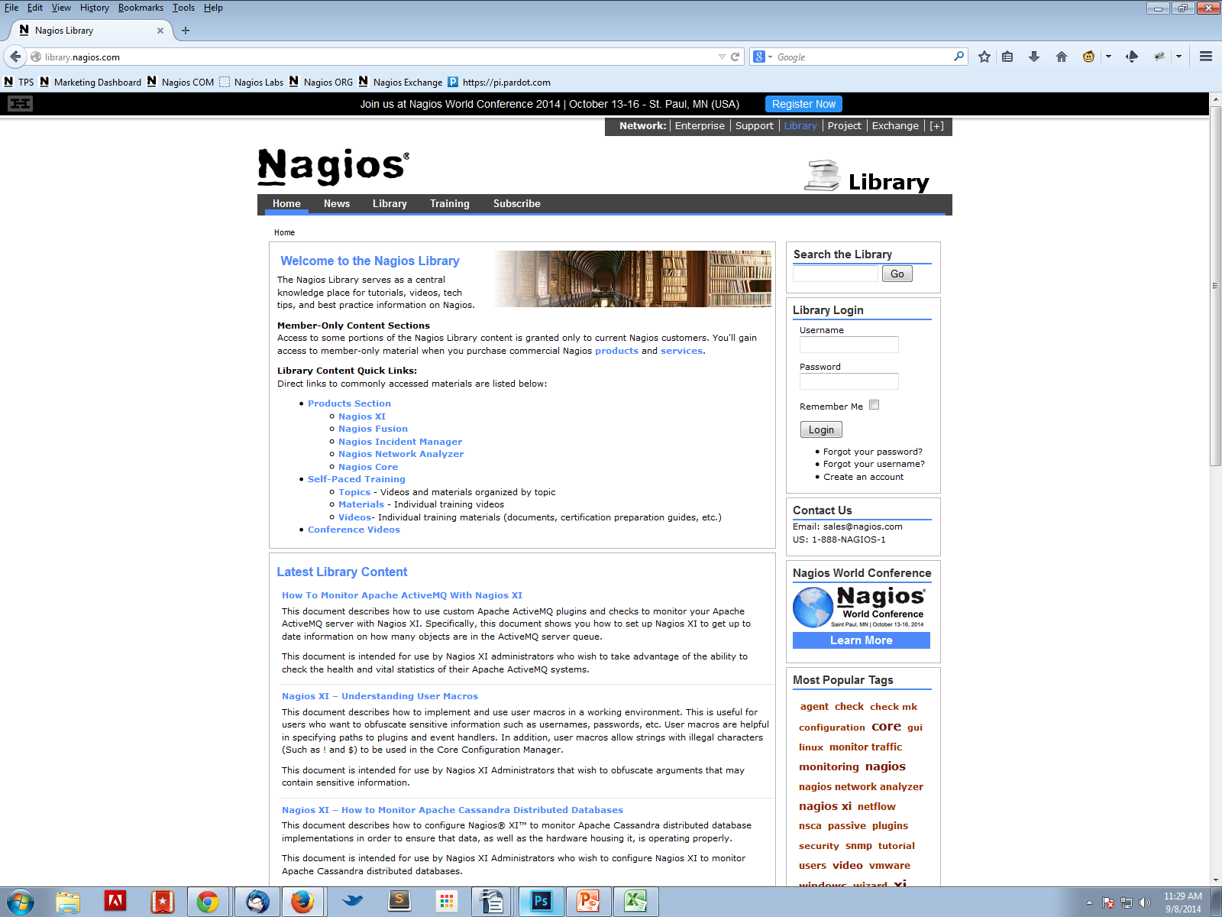
Nagios Library
library.nagios.com
Notes:
3/3/2016

Slide 29
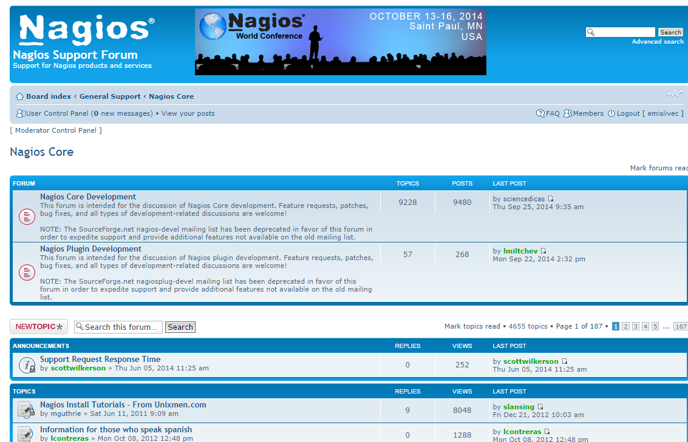
General Support Forum
support.nagios.com/forum
Notes:
3/3/2016

Slide 30

Questions?
Notes:
3/3/2016

