Slide 1
Migration des données
IBM Software - Watson IoT
Notes:
If internal presentations are confidential, please add: “IBM Confidential” to the slide masters
Select: View / Master / Slide Master and add “IBM Confidential” to both the title master and slide master
Use sentence case capitalization for presentation titles, slide titles, category labels and bullets: Format / Change Case / Sentence Case. Initial capitalization is limited to our products and offerings.
Applying this template to your existing presentation
Task Pane needs to be viewable: Select View / Task Pane
Select Slide Design - Design Templates from the Task Pane pull-down menu
Select “Browse” at the bottom, and find “Rational_Standard_Template.pot”
on your hardrive and click Apply
Please note that not all slides will reformat appropriately once template is applied. Some reformatting will be necessary
Printing your presentation on a black and white printer
Prior to printing your presentation, view the slides in grayscale mode:
Select View / Color/Grayscale / Grayscale
Select problem graphics or text and right-click and select Grayscale Setting
Select the grayscale setting that displays the problem graphic/text the best
Note: Changing the greyscale setting does not affect the color view
Return to Normal View by selecting View / Color/Grayscale / Color

Slide 2
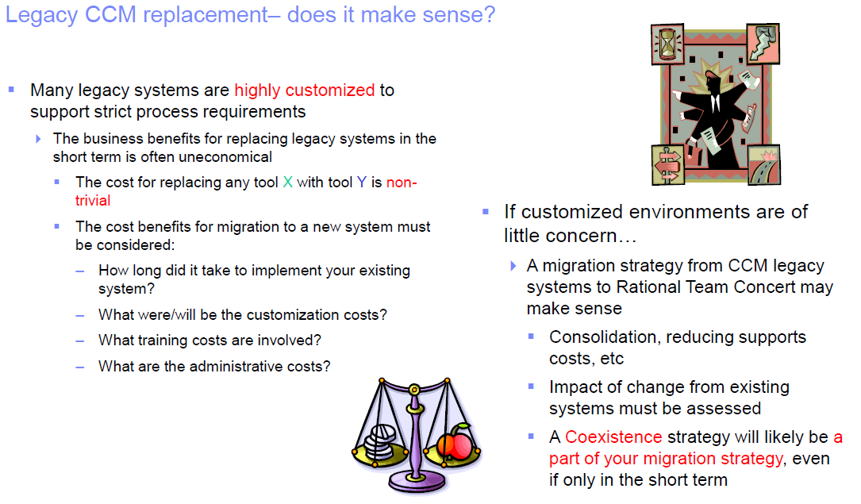


Slide 3
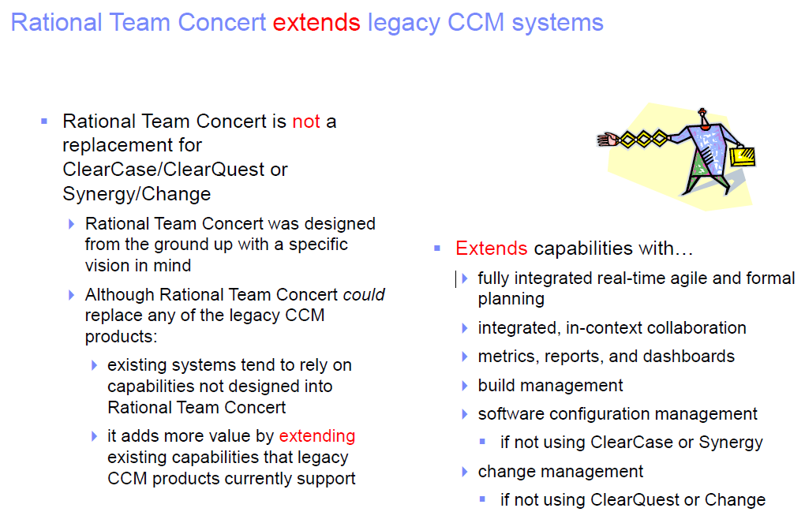

Slide 4
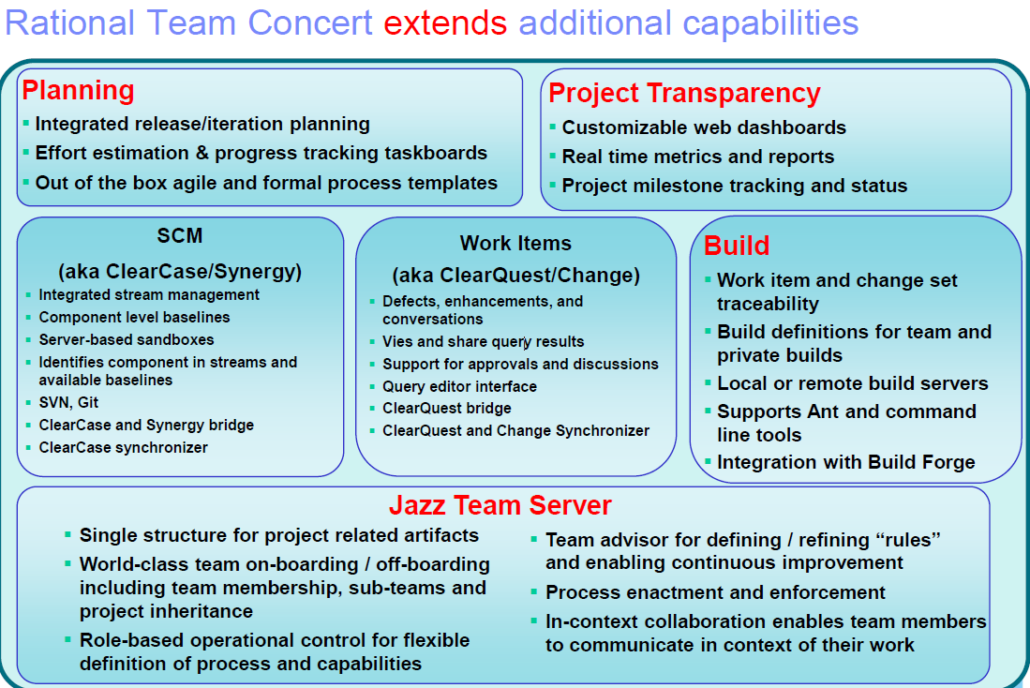

Slide 5
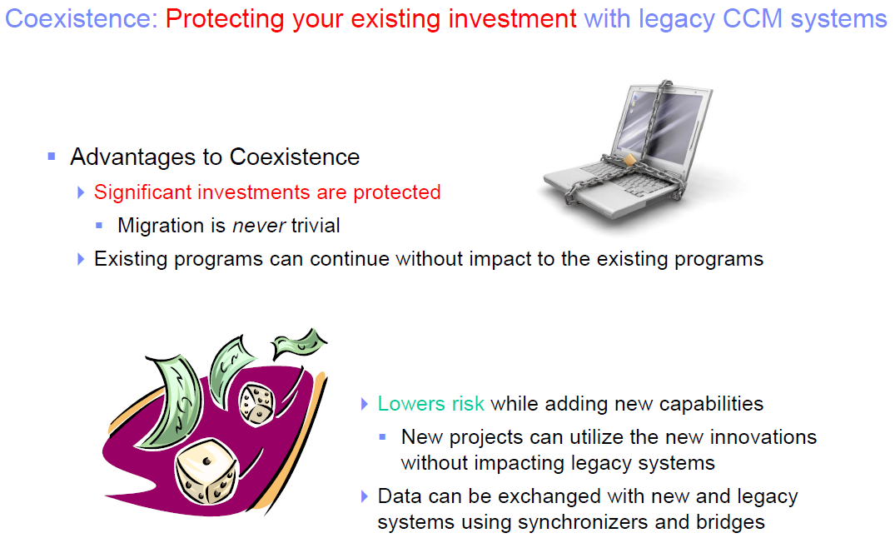

Slide 6









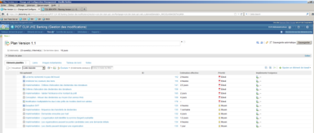

ClearCase & CLM integration on all client types
ClearCase
as SCM
Track changes
by RTC
Lifecycle mgmt.
By CLM
ClearTeam Explorer
CC SCM adaptor
CCRC (web views)
Rational
Quality Manager
VS.net
cleartool
Rational
Team Concert
Rational
DOORS NG
.
.
.
  Web client
Jazz Platform

Slide 7
SCM Connector Types
Rational Team Concert
Lifecycle Integration
Traceability / Link
User Interface Navigation
ClearCase
Bridge
Work Items
Versions and Activities
Two- way
synchronization
Rational Team Concert
ClearCase
Synchronizer
Branches and UCM Streams
Streams
One-way
DATA MIGRATION
Importer

Slide 8

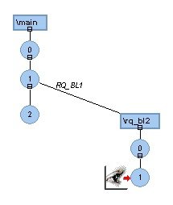

ClearCase Bridge
Scenario:
  ClearCase is the enterprise software configuration management system
  Allows ClearCase customers to benefit from many features in RTC while continuing to use ClearCase for configuration management
  Links ClearCase information with RTC work items to provide traceability in both directions
  No data to synchronize
  Loosely coupled
  Less restrictive than ClearQuest-enabled UCM
  Can be used with ClearQuest Bridge
Work Item
Build
Jazz Server

Slide 9
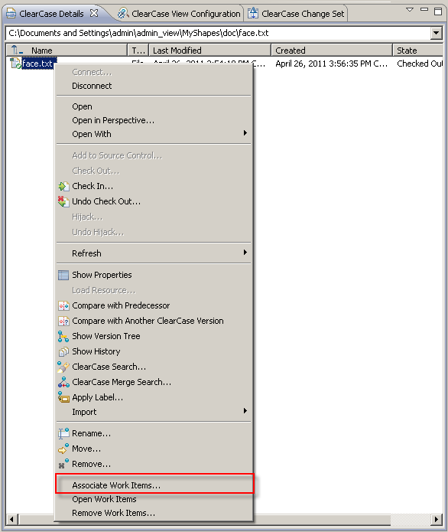
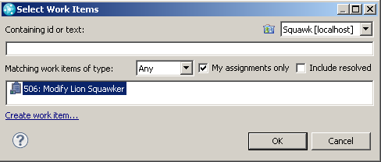
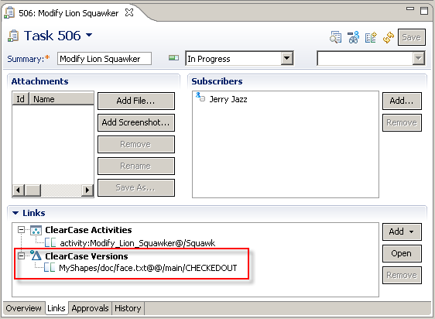
Bridge with Base ClearCase

Slide 10
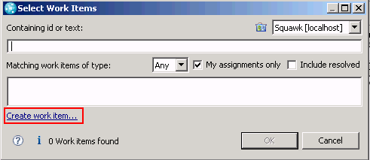
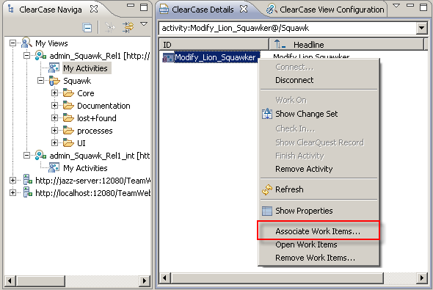
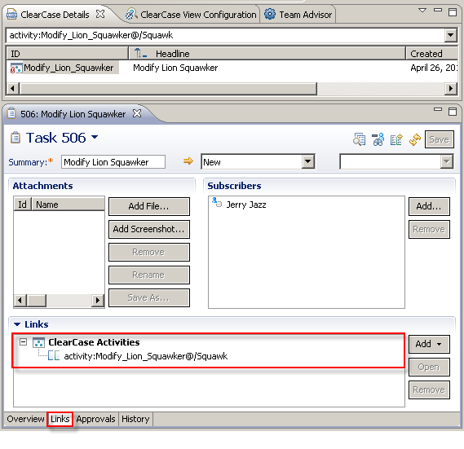
Bridge with UCM

Slide 11


ClearCase Synchronizer?
Scenario:
  ClearCase is the enterprise software configuration management system
  Product integration and release are performed in ClearCase repositories
  Small/medium teams responsible for specific components (“agile islands”) may opt to use Rational Team Concert to do work destined for a ClearCase branch or UCM stream
Synchronizer benefits for this scenario:
  Allows ClearCase customers to try RTC with its full benefits without isolating trial users from the rest of the organization
  Allows customers to use either tool/repository
  Work can occur in parallel in both repositories
  Supports both base ClearCase branches and UCM streams
SCM
Work Item
Build
Jazz Server

Slide 12
Who should use the ClearCase Importer?
Scenario:
  Customer wants to move from using ClearCase as the enterprise software configuration management system to RTV source control
Importer benefits for this scenario:
  Allows ClearCase customers to move to RTC with its full benefits
  Based on synchronizer technology; imports baseline-to-baseline differences
  Allows selection of historical data to be brought over
  Supports import of both ClearCase UCM streams and base ClearCase branches

Slide 13
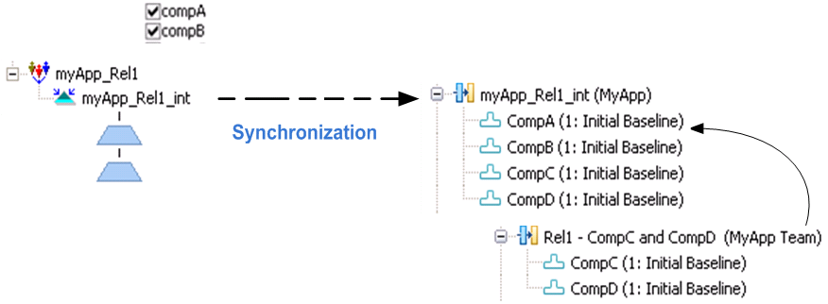
ClearCase
RTC

Slide 14
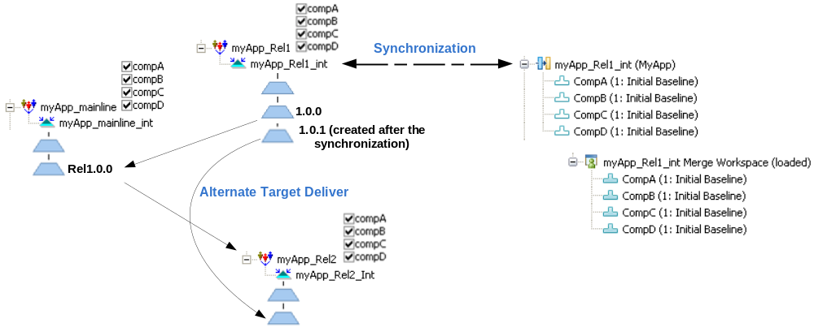

Slide 15
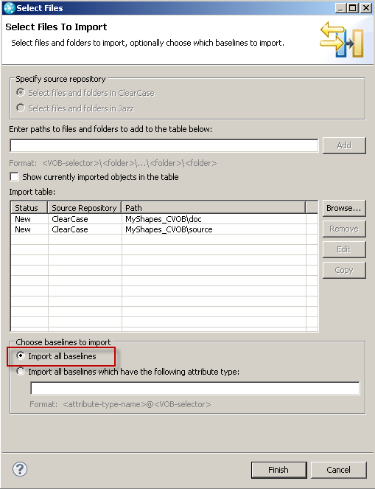
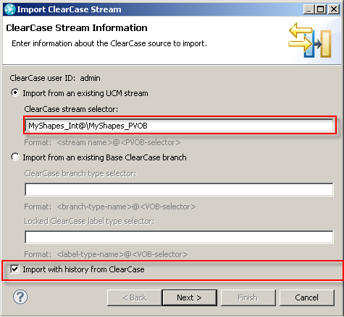
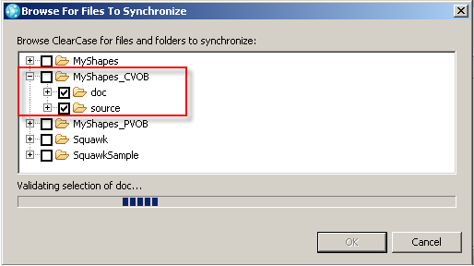
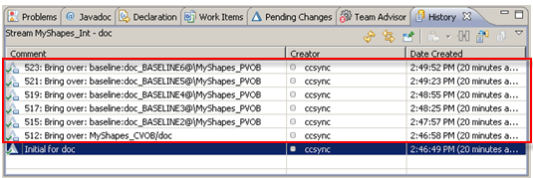

Slide 16
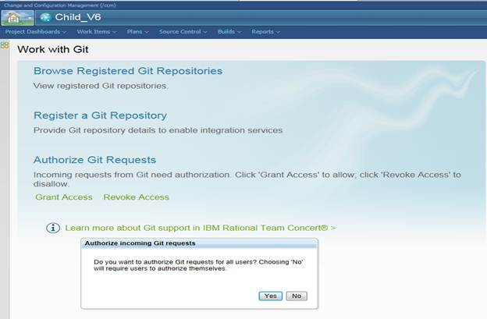
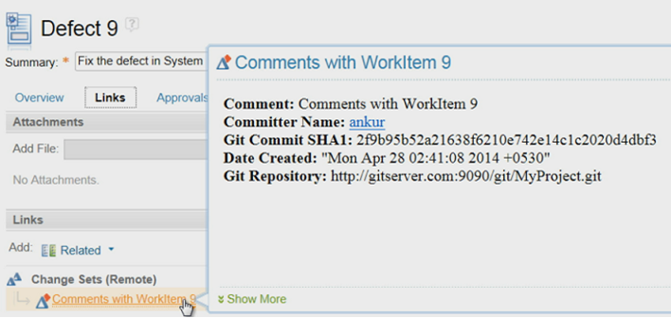
Integration with Git

Slide 17
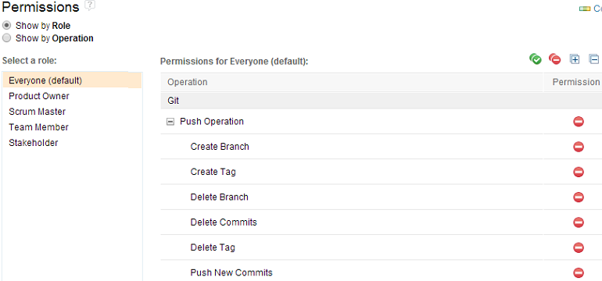
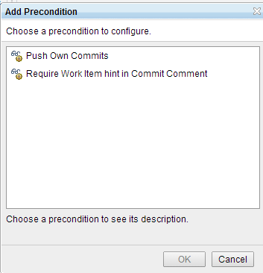
Git Process governance

Slide 18


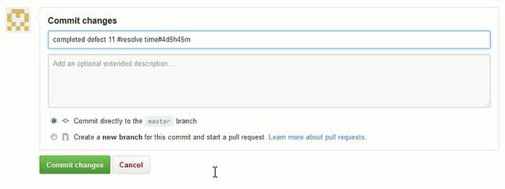
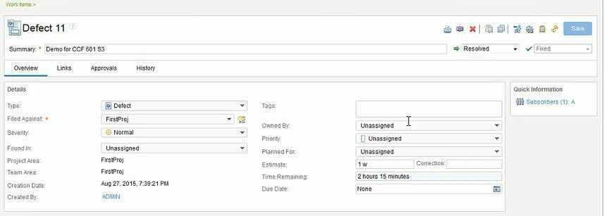
Stay in GitHub/Git to Resolve Work
Auto resolve a defect or set time spent without leaving GitHub
Notes:
New GitHub and GitLab Integration Support
- Is Git being used in your company? Are you trying to figure out how to manage it?
- Do you have pockets of Git, but you would like to manage all your teams with common governance, CCB, metrics and reporting, no matter which SCM they are using? RTC allows you to use common reporting, work item tracking and planning for any process agile, waterfall or hybrid. (iterative, scrum, Kanban, scrumban, Scaled Agile Framework)

Slide 19
Work Item Connector Types
Rational Team Concert
Lifecycle Integration
Traceability / Link
User Interface Navigation
ClearQuest
Bridge
Work Items
Records
Rational Team Concert
ClearQuest
One-way
DATA MIGRATION
Importer
Work Items
Records

Slide 20


Who should use the ClearQuest Bridge?
Scenario:
  ClearQuest is the enterprise software change management system
  ClearQuest customers don’t necessarily want to (or can’t) switch systems to get the benefits of the other Jazz features
Bridge benefits for this scenario:
  Users can incrementally adopt RTC, beginning with planning and collaboration and growing into SCM and Build as appropriate
  Associate ClearQuest records with RTC work items
  No data to synchronize
  Loosely coupled
  Can be used with ClearCase Bridge
Rational Team Concert Web User Interface
Rational
Team Concert
ClearQuest Record
Work Item
Rational ClearQuest

Slide 21
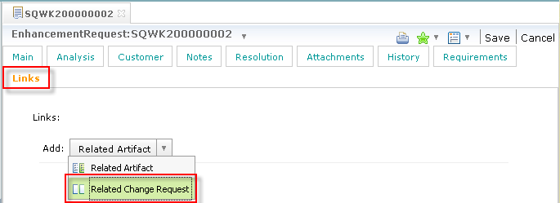
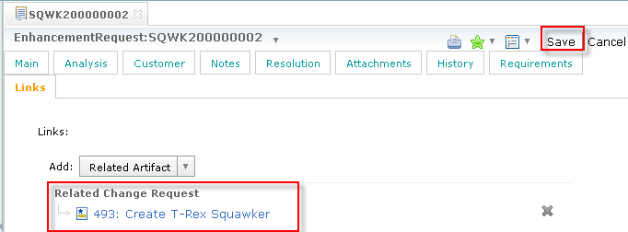
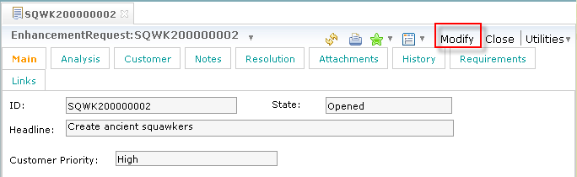
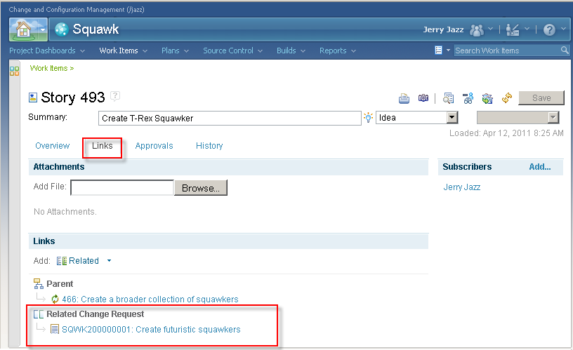
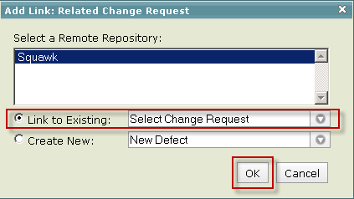
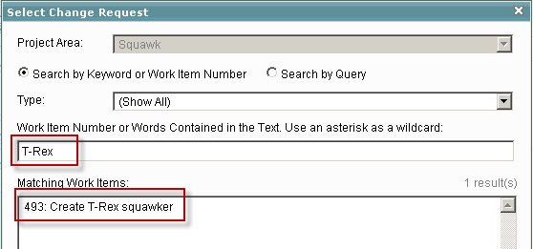

Slide 22
Replicate and synchronize data between CQ and RTC
Define synchronization rules between ClearQuest record types and Work Items Types to create and maintain synchronization between ClearQuest records and Work Items in RTC. Changes to corresponding CQ records/Work Items can continue to be performed from either system. Synchronization runs automatically and regularly.
Pros
  Data is available for write access in both systems with a bi-directional synchronization
  Provide full access to synchronized data from both systems
Cons
  Requires creation of synchronization rules
  Not a real time synchronization
  Requires the administration of synchronizer

