Slide 1
Traçabilité
IBM Software - Watson IoT
Notes:
If internal presentations are confidential, please add: “IBM Confidential” to the slide masters
Select: View / Master / Slide Master and add “IBM Confidential” to both the title master and slide master
Use sentence case capitalization for presentation titles, slide titles, category labels and bullets: Format / Change Case / Sentence Case. Initial capitalization is limited to our products and offerings.
Applying this template to your existing presentation
Task Pane needs to be viewable: Select View / Task Pane
Select Slide Design - Design Templates from the Task Pane pull-down menu
Select “Browse” at the bottom, and find “Rational_Standard_Template.pot”
on your hardrive and click Apply
Please note that not all slides will reformat appropriately once template is applied. Some reformatting will be necessary
Printing your presentation on a black and white printer
Prior to printing your presentation, view the slides in grayscale mode:
Select View / Color/Grayscale / Grayscale
Select problem graphics or text and right-click and select Grayscale Setting
Select the grayscale setting that displays the problem graphic/text the best
Note: Changing the greyscale setting does not affect the color view
Return to Normal View by selecting View / Color/Grayscale / Color

Slide 2



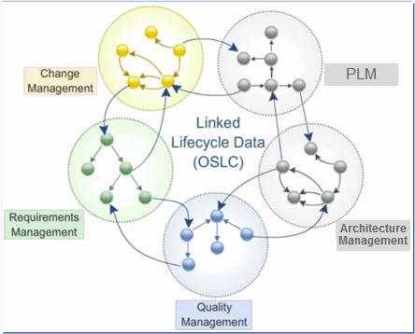


Traceability extended to other Eng. Domains via OSLC
Open Services for Lifecycle Collaboration
Lifecycle integration inspired by the web
Open Community – @ open-services.net
Driven by open-standards consortium
Open specifications for numerous disciplines
  Including ALM, PLM, and DevOps
Defined by scenarios
  Solution oriented
Inspired by the web
Open world assumption – vs. rigid APIs approach
  Web Linked-Data approach
  Internet Architecture
  HTTP based RESTful protocols
Decouple data from container
  Unlock data from silo tools
“Just enough” integration
  Consume/Provide the necessary services
IBM and EADS are part of the 22 founding members
Linked Data Platform Working Group
OSLC Member Section
Notes:
IBM Rational platform native implementation
Optimal integration of tools, data and processes without traditional constraints
No duplication of data
Cross-engineering disciplines end-to-end traceability
OSLC is an open community of vendors, integrators, and users, that creates freely-available, scenario-driven, specifications for integrating software applications.
Though OSLC’s initial focus for specification were ALM domains, the techniques used are universally applicable, and are already being applied in workgroups focused on PLM (with leadership from Siemens), and DevOps (with leadership from IBM Tivoli).
The World Wide Web Consortium (W3C) is an international community where member organizations, a full-time staff, and the public work together to develop Web standards. Led by Web inventor Tim Berners-Lee and CEO Jeffrey Jaffe, W3C's mission is to lead the Web to its full potential. IBM is a member organization, along with hundreds of other companies. www.w3.org
(Optional for more technical presentations:
All the specifications are based on the standard, and proven, architecture of the web: HTTP, REST, and Linked Data. This means integrations don’t have to copy and synchronize data, but can link to it where it “lives”.
Wherever the data is, OSLC-based integrations let users work with data from their current context.
)
Whether you want to work on the details of the specifications, get the community to focus on scenarios that are important to you, or use finalized OSLC specifications to integrate your own software, the OSLC community is open to you.

Slide 3
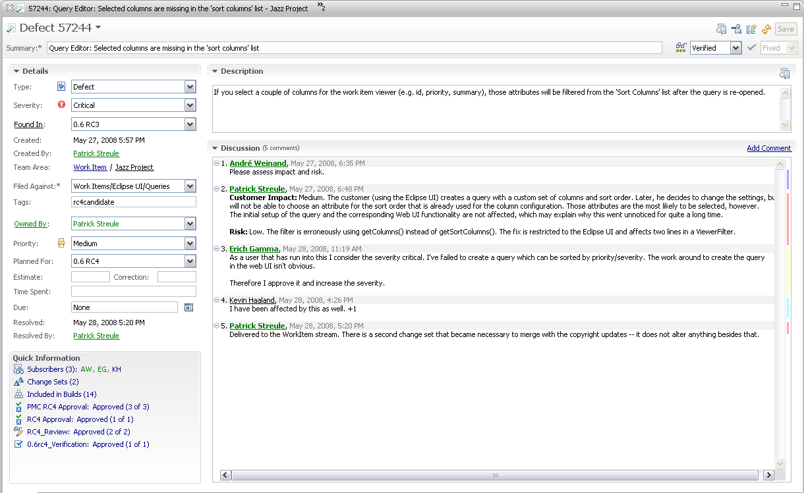
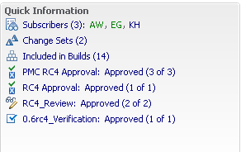
Complete data traceability
Release
found in
promoted
Iteration
Plan
planned
for
reported
against
Work Item
Build
subscribes
approves
reviews
included
implements
included
built from
related
User
Snapshot
Change Set
Artifacts
Stream
included
change flow
Workspace
“Software development is a chain with many links, and improving overall effectiveness requires
looking at the whole chain.”

Slide 4
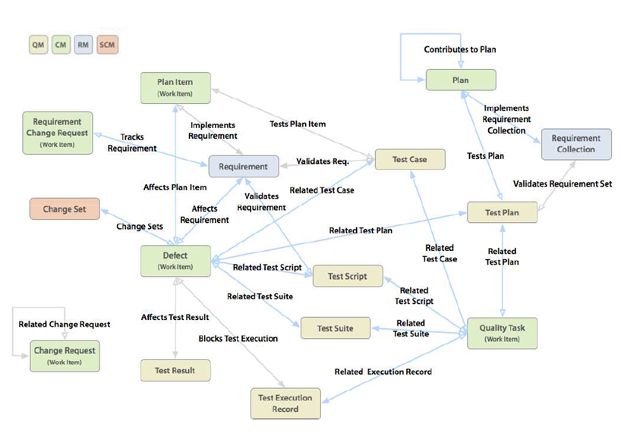

CLM links

