Slide 1
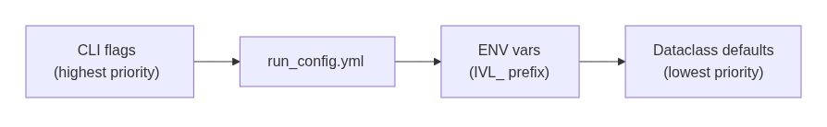
Pattern 1: Human Readable Configuration
Config Source | Controls
config/run_config.yml | Model path, dtype, max_tiles, batch sizes, generation params
config/field_definitions.yaml | Fields per doc type, min_tokens, evaluation thresholds
prompts/*.yaml | Detection, extraction, and bank prompts per type
config/bank_column_patterns.yaml | Header-to-semantic-column matching patterns
Notes:
• All tuneable state lives in YAML with strict precedence: CLI flags > run_config.yml > ENV vars (IVL_ prefix) > dataclass defaults • No hardcoded values in Python code — every magic number has a YAML home • This means every agentic decision is configurable without code changes • Prompts are version-controlled separately from logic

Slide 2
Agentic Document Extraction
Observe something → Reason about it → Act accordingly
The VLM is not a black box — it is a component inside feedback loops.
# | Pattern | Observe | Act
2 | Self-Correcting OOM Fallback | CUDA OutOfMemoryError | Recursively halve batch, retry
3 | Dynamic Routing | Document classification | Select type-specific prompt, fields, token budget
4 | Multi-Turn Bank Extraction | Column headers (Turn 0) | Template Turn 1 prompt with detected column names
5 | Balance Self-Verification | Extracted values vs balance column | Swap or derive correct debit/credit
Notes:
• Every architectural choice follows Observe → Reason → Act • The VLM is a component inside feedback loops — its outputs drive pipeline decisions, which determine what the model sees next • This separates "run a prompt" from "run an agent" • Four concrete patterns implement this today, shown in the table

Slide 3
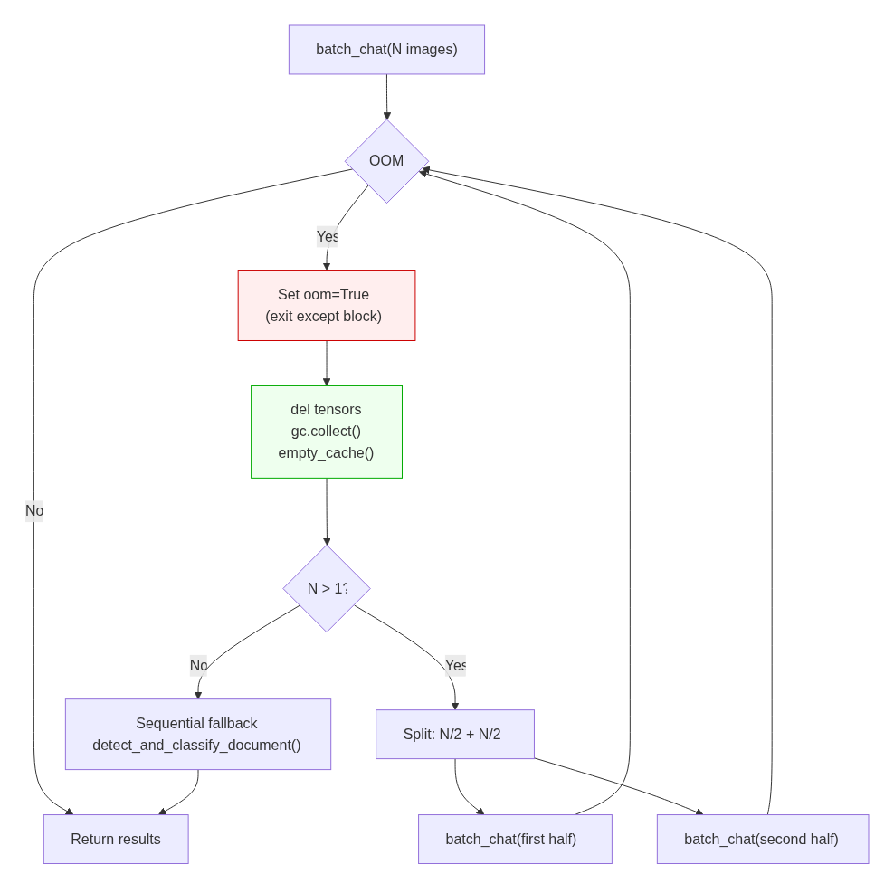
Pattern 2: OOM Fallback: Recursive Batch Halving
Why cleanup outside except
Inside an except block, Python's traceback holds references to all intermediate activation tensors.
torch.cuda.empty_cache()
inside except is a no-op — tensors are still referenced.
Set oom=True, check after the block closes.
Resilience stack:
1. Batch halving
Recursive split until fit
2. Sequential fallback
batch_size=1 → per-image
3. _resilient_generate()
3 attempts with minimal gen config
Notes:
• Critical implementation detail: cleanup MUST be outside the except block • Inside except, Python's traceback holds references to all intermediate activation tensors from the failed forward pass • torch.cuda.empty_cache() inside except is a no-op — tensors are still referenced • Solution: set oom=True flag, exit except, then do cleanup • Three-level resilience stack: batch halving → sequential fallback (batch_size=1) → _resilient_generate() (3 attempts with minimal gen config)

Slide 4
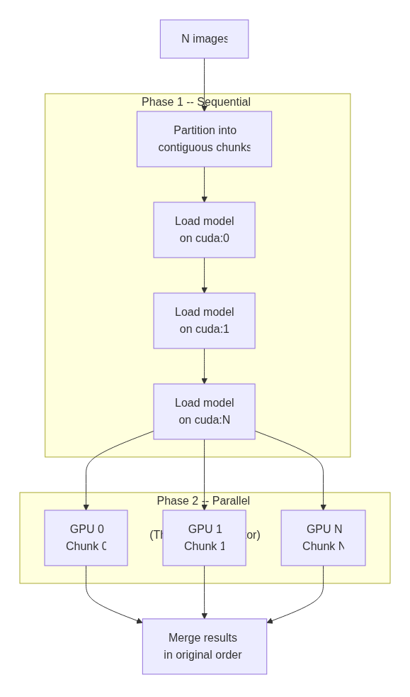
Multi-GPU Architecture
ThreadPoolExecutor
PyTorch releases GIL during CUDA kernels → true GPU parallelism, no IPC overhead
Sequential Loading
Serialised behind a lock to avoid transformers import races
Contiguous Partitioning
Equal chunks; results concatenate back in order
Auto-Detection
--num-gpus 0 auto-detects all available. Single GPU bypasses orchestrator.
Notes:
• MultiGPUOrchestrator distributes images across GPUs via --num-gpus N • Each GPU gets an independent model replica; models loaded sequentially (avoids transformers import races) • Inference runs fully parallel via ThreadPoolExecutor — PyTorch releases GIL during CUDA kernels → true GPU parallelism, no IPC overhead • Contiguous partitioning: equal chunks, results concatenate back in order • --num-gpus 0 auto-detects all available GPUs; single GPU bypasses orchestrator entirely

Slide 5
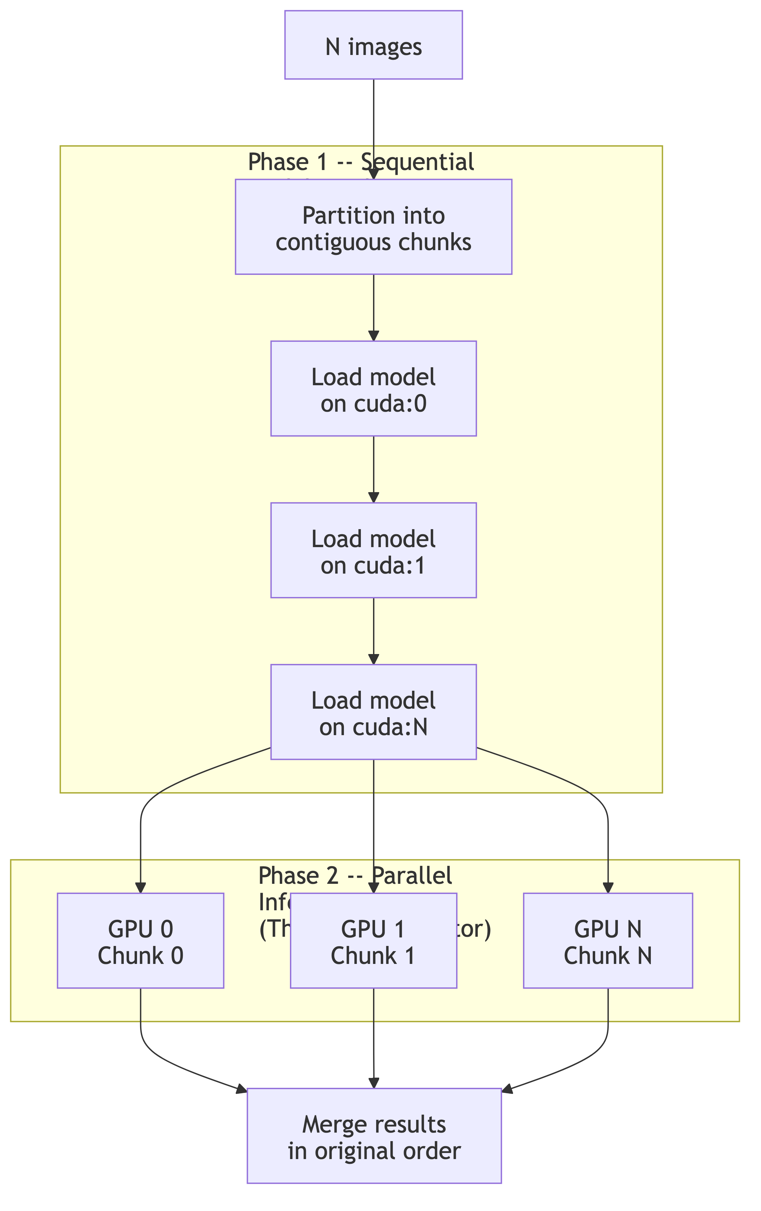
Multi-GPU Architecture
ThreadPoolExecutor
PyTorch releases GIL during CUDA kernels → true GPU parallelism, no IPC overhead
Sequential Loading
Serialised behind a lock to avoid transformers import races
Contiguous Partitioning
Equal chunks; results concatenate back in order
Auto-Detection
--num-gpus 0 auto-detects all available. Single GPU bypasses orchestrator.
Notes:
• MultiGPUOrchestrator distributes images across GPUs via --num-gpus N • Each GPU gets an independent model replica; models loaded sequentially (avoids transformers import races) • Inference runs fully parallel via ThreadPoolExecutor — PyTorch releases GIL during CUDA kernels → true GPU parallelism, no IPC overhead • Contiguous partitioning: equal chunks, results concatenate back in order • --num-gpus 0 auto-detects all available GPUs; single GPU bypasses orchestrator entirely

Slide 6
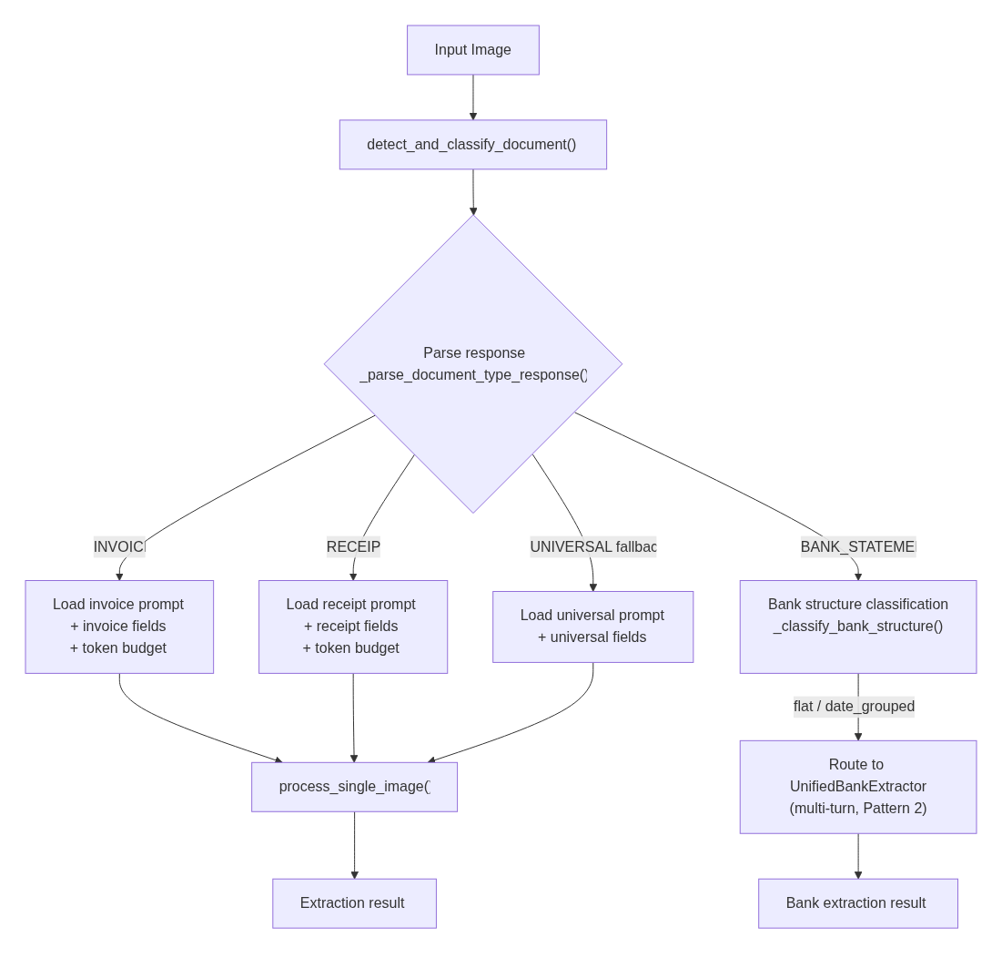
Pattern 3. Dynamic Routing (Detect then Route)
Observe → Reason → Act
The model's first output selects its own second prompt. One model call parameterizes another.
Classification drives:
Extraction prompt | Type-specific from YAML
Field list | 9–16 fields per type
Token budget | Scales with field count
Processing path | BANK → multi-turn (Pattern 2)
Notes:
• Observe: Send image with short detection prompt; VLM returns free-text classification. Cheap generation — greedy decoding, max_new_tokens=200, temperature=0.1 • Reason: Three-stage cascade resolves to canonical type — exact substring match → keyword fallback → UNIVERSAL default • Act: Canonical type drives extraction prompt, field list, token budget, and processing path (bank → multi-turn) • Key insight: the same VLM's first output literally selects its own second prompt — simplest agentic pattern

Slide 7
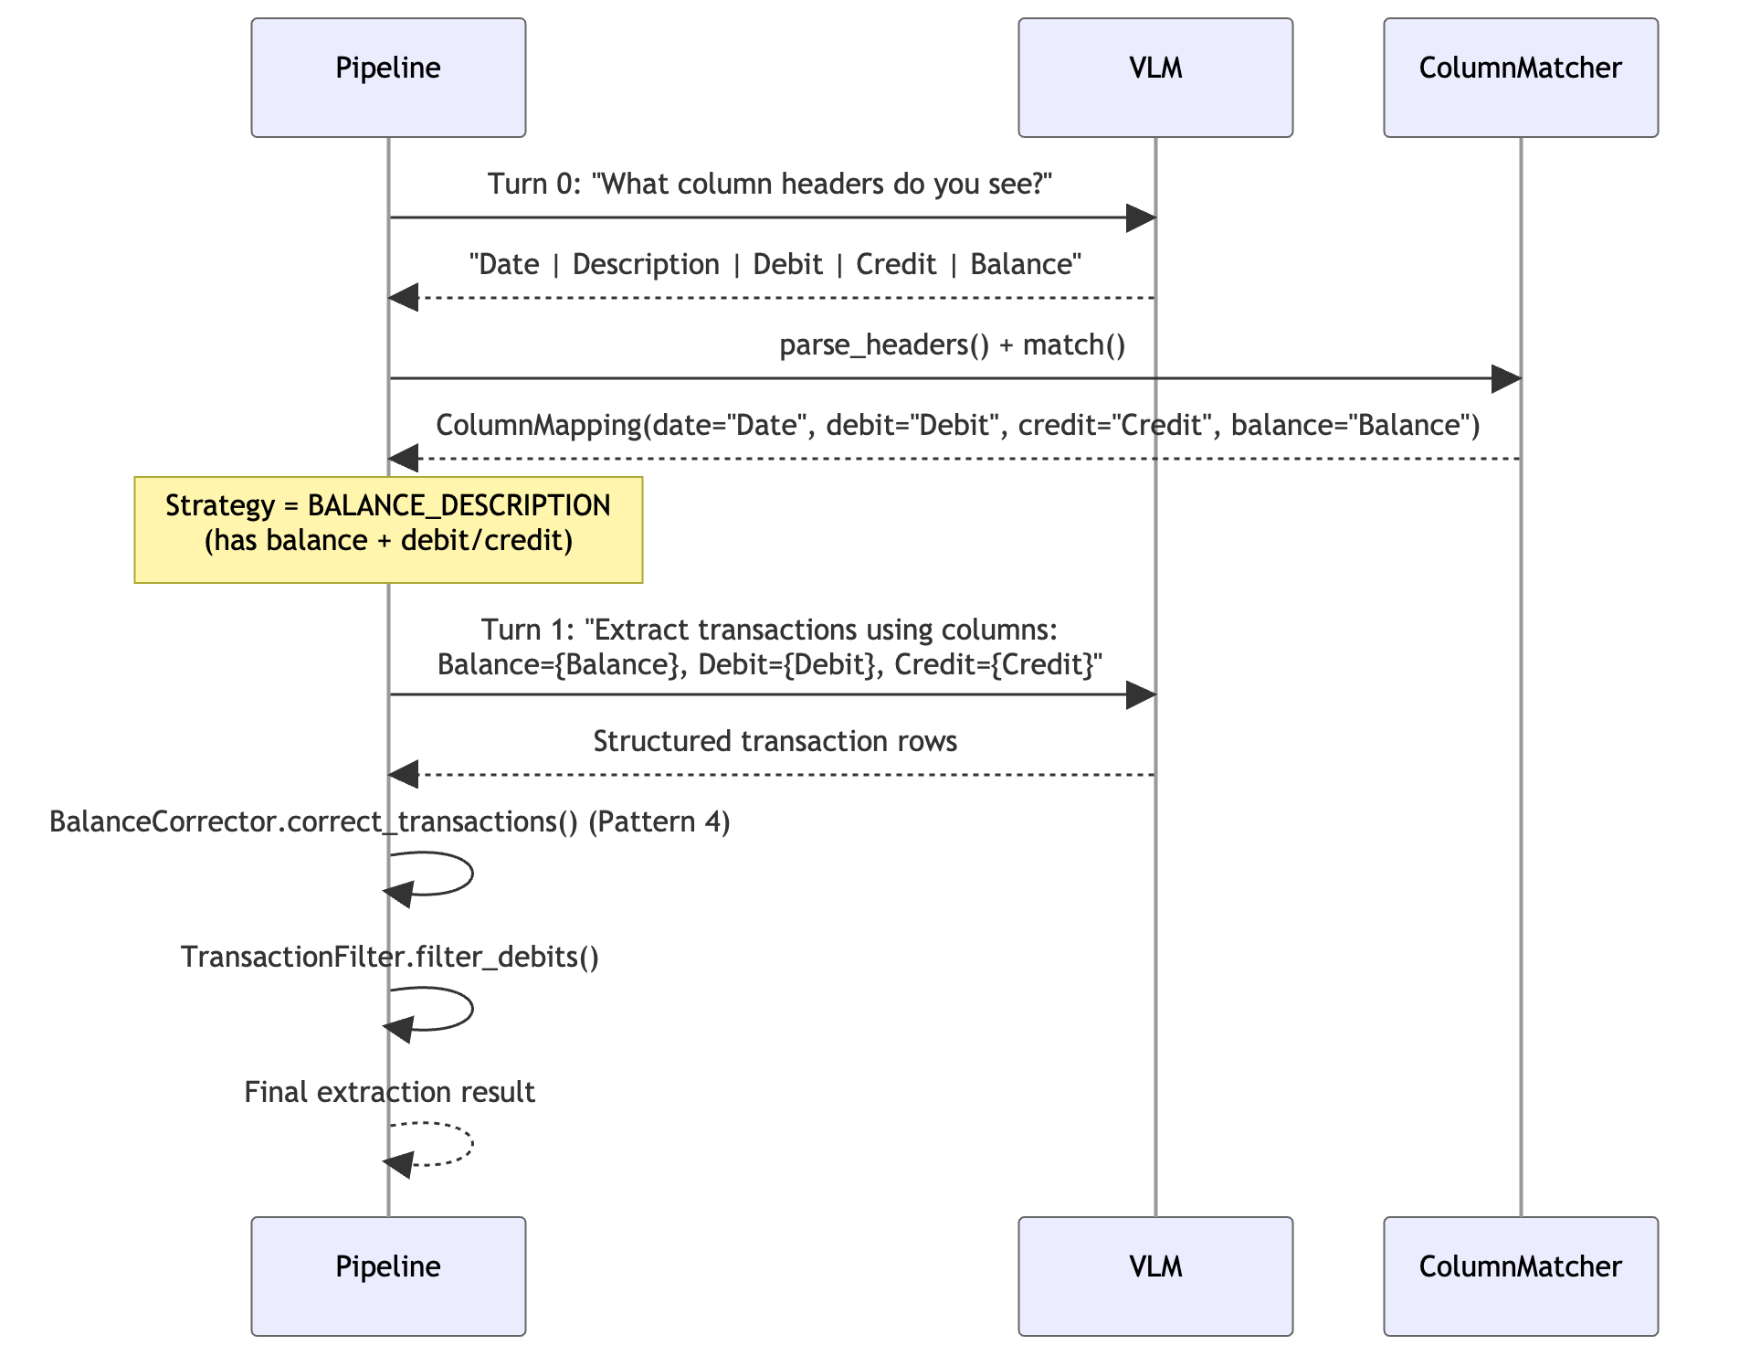
Pattern 4: Multi-Turn Bank Extraction
Notes:
• Turn 0: Ask VLM "what column headers do you see?" → model returns actual headers • ColumnMatcher.match() maps detected headers to semantic roles using pattern matching against bank_column_patterns.yaml • The resulting ColumnMapping determines which extraction strategy to use • Turn 1: Extraction prompt is templated with the actual detected column names — every prompt is document-specific

Slide 8
Column-Driven Strategy Selection
Columns Detected | Strategy | Approach
Balance + Debit/Credit | BALANCE_DESCRIPTION | Richest signal; enables Pattern 4 verification
Balance + Amount (no D/C) | AMOUNT_DESCRIPTION | Signed amounts; negative = withdrawal
Debit/Credit (no balance) | DEBIT_CREDIT_DESCRIPTION | Direct extraction; skips balance rows
None of the above | TABLE_EXTRACTION | Generic schema fallback
Key: Every extraction prompt is document-specific. The model is told to look for "Balance" because Turn 0 confirmed that column exists — not because we assumed it would.
Notes:
• Four strategies based on what columns exist: BALANCE_DESCRIPTION (richest — enables Pattern 4), AMOUNT_DESCRIPTION, DEBIT_CREDIT_DESCRIPTION, TABLE_EXTRACTION (fallback) • Key: model is told to look for "Balance" because Turn 0 confirmed it exists — not because we assumed it would • Multi-turn beats single-turn for: variable column layouts, debit/credit ambiguity, long transaction tables, balance column presence

Slide 9
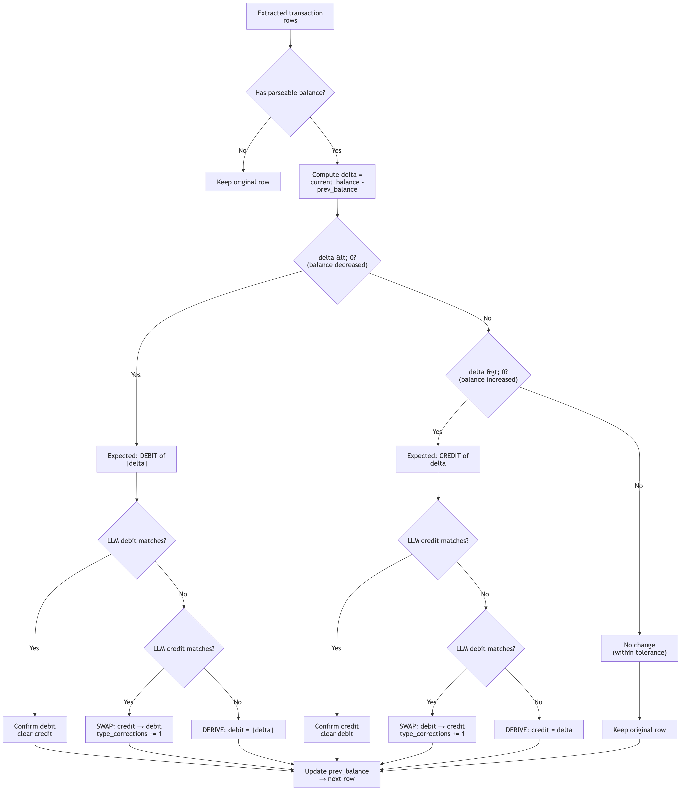
Pattern 5: Balance Verification Flowchart
Notes:
• Walk extracted rows in chronological order, maintaining sliding prev_balance • For each row: compute balance_delta, compare delta's sign against VLM's classification • Three possible corrections: Confirm (delta matches), Swap (value in wrong column), Derive (set from delta as last resort) • Prerequisite: balance arithmetic requires chronological ordering — pipeline checks and sorts if reverse-chronological • Pattern most likely to generalize: any domain with checkable invariants can use post-extraction verification

Slide 10
Balance Correction: Worked Example
VLM extracts (with error):
Corrected output:
Row | Description | Debit | Credit | Balance
1 | Opening Balance | -- | -- | $1,000
2 | Electric bill | -- | $150 | $850
3 | Salary deposit | -- | $2,000 | $2,850
Row | Description | Debit | Credit | Balance
1 | Opening Balance | -- | -- | $1,000
2 | Electric bill | $150 | -- | $850
3 | Salary deposit | -- | $2,000 | $2,850
→
Row 2: delta = 850 − 1000 = −150 (negative = debit).
VLM put $150 in Credit.
SWAP → Debit.
Row 3: delta = 2850 − 850 = +2000 (positive = credit).
VLM put $2,000 in Credit.
Confirmed ✓
Self-verification without extra inference: the pipeline treats VLM extraction as a hypothesis, not ground truth. Domain invariants (accounting math) verify and correct — zero additional model calls.
Notes:
• Row 2: delta = 850 - 1000 = -150 (negative = debit). VLM put $150 in Credit → SWAP to Debit • Row 3: delta = 2850 - 850 = +2000 (positive = credit). VLM put $2,000 in Credit → Confirmed correct • Key: pipeline treats VLM extraction as a hypothesis, not ground truth • Self-verification using domain invariants (accounting math) — zero additional model calls

Slide 11
Evaluation: Three-Layer Aggregation
Layer 1: Per-Field F1
Layer 2: Per-Image
Layer 3: Per-Model
Position-aware F1
per extracted field
mean(field_f1_scores)
mean(image_scores)
Type-specific comparison:
string, boolean, date,
monetary, list
Equal weight per field.
N varies by doc type
(9–16 fields).
Equal weight per image.
Every document counts
the same.
Headline = mean across images of (mean across fields of (position-aware F1))
Notes:
• Layer 1 — Per-Field F1: Position-aware comparison adapted to field type (string, boolean, date, monetary, list) • Layer 2 — Per-Image: Unweighted mean across all fields. Every field counts equally; N varies 9–16 by doc type • Layer 3 — Per-Model (headline): Unweighted mean across all images. Every document contributes equally regardless of field count • Formula: Headline = mean across images of (mean across fields of (position-aware F1)) • A mean of means — equal weight per image, equal weight per field within each image

Slide 12
Why Per-Image? Simpson's Paradox Check
Simpson's Paradox: A trend that appears in individual groups reverses when the groups are combined, because of unequal group sizes.
Worked Example
Document Type | Count | Fields / Doc | Total Field Scores | Accuracy
Invoices/Receipts | 170 | 14 | 2,380 | 75%
Bank Statements | 25 | 5 | 125 | 60%
Per-Field Pooling
74.3%
Per-Image Aggregation
73.1%
(2380×0.75 + 125×0.60)/2505
(170x.75+25x.6)/195
✗ Hides the poorer bank scores
✓ Every document weighted equally
Notes:
• Simpson's Paradox: a trend in individual groups reverses when combined due to unequal group sizes • Example: 100 invoices at 95% + 10 bank statements at 20%. Per-field pooling: (1400×0.95 + 50×0.20)/1450 = 92.4% — hides the critical bank failure • Per-image aggregation: mean of (100×0.95 + 10×0.20) / 110 = 88.2% — every document weighted equally, failure is visible • Five justifications for per-image: operational relevance (unit of work = document), equal representation across doc types, avoiding Simpson's Paradox, consistent model comparison, alignment with downstream use • Per-field analysis still serves diagnostics: prompt engineering, model comparison, schema design

Slide 13
Observe → Reason → Act Across the ExtractionPipeline
Pattern | Observe | Reason | Act
OOM Fallback | CUDA OOM error | Batch too large for VRAM | Recursively halve until fit
Dynamic Routing | VLM classifies doc type | Map to canonical type via YAML | Select prompt, fields, token budget
Multi-Turn Bank | VLM reads column headers | ColumnMatcher maps to semantic roles | Template prompt with column names
Balance Verification | Values + balance column | Balance delta determines true type | Swap or derive debit/credit
Key Architectural Decisions
Decision | Agentic Justification
Two-phase pipeline | Model's first observation parameterizes its second action
Greedy decoding (temp=0) | Agents need deterministic observations — variation hurts reasoning
YAML-driven everything | Agent state must be inspectable, tuneable, version-controlled
Position-aware F1 | Evaluation reflects agent's actual output ordering
Notes:
• Summary of all four patterns: Dynamic Routing, Multi-Turn Bank, OOM Fallback, Balance Verification • Key architectural decisions and their agentic justification: - Two-phase pipeline: model's first observation parameterizes its second action - Greedy decoding (temp=0): agents need deterministic observations - YAML-driven everything: agent state must be inspectable and tuneable - Position-aware F1: evaluation reflects actual output ordering - Threads over processes for multi-GPU: GIL release during CUDA kernels makes threads sufficient

Slide 14
What We Don't Do (Yet)
Re-prompting on low confidence
Detection has confidence, but low confidence just uses fallback
Tool use
VLM has no access to calculators, databases, or web search
Explicit chain-of-thought planning
Strategy selection is deterministic code, not model reasoning
Multi-model consensus
Support InternVL3 and Llama but never cross-check
Iterative refinement
Malformed output parsed as-is, never retried with corrective prompt
Human-in-the-loop escalation
Low-confidence results not flagged for review
Each represents a natural extension of the patterns already in place.
Notes:
• Six capabilities not yet implemented — each is a natural extension of existing patterns • Re-prompting on low confidence: detection returns confidence but low confidence just uses fallback type • Tool use: VLM has no access to calculators, databases, or web search — all verification is Python code • No explicit chain-of-thought planning — strategy selection is deterministic code, not model reasoning • No multi-model consensus — support InternVL3 and Llama but never cross-check on the same document • No iterative refinement — malformed output parsed as-is, never retried with corrective prompt • No human-in-the-loop escalation — low-confidence results not flagged for review

