Slide 1
LMMs for Information Extraction?
Context: PI45 The Large Multimodal Model Proof of Concept (LMM PoC)
Information Extraction within the SSD-DU Pipeline using VLMs
The Business Challenge: During Tax Time, the SSD-DU Pipeline processes thousands of WRE expense claim documents daily. Taxpayers submit receipts, invoices, and statements to support their deductions, and audit officers must verify these claims by extracting key information from each document.
Current Reality: The Information Extraction is currently automated using LayoutLM technology, but we're hitting performance and reliability limits that are creating bottlenecks in the substantiation pipeline.
LLM PoC Question: Can modern Vision Transformers provide a better solution?

Slide 2
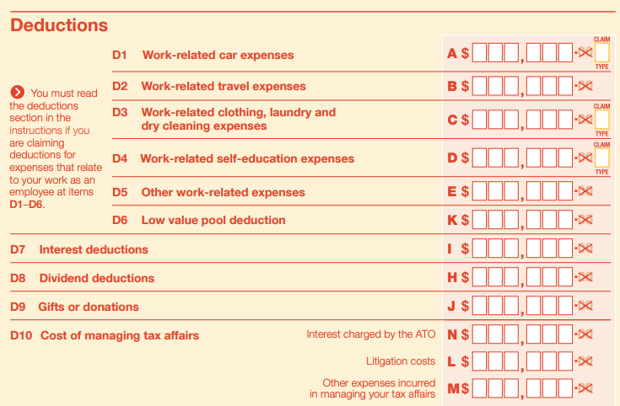
Exemplified by the specific WRE use case
Field | Purpose | D1-D10 Mapping
Supplier Name | Verify legitimate business | All categories
ABN | Confirm registered entity | All categories
Date | Match to tax year | All categories
Amount | Verify claim amount | All categories
Description | Categorize expense | Maps to D1-D10
GST Amount | Calculate claimable portion | All categories

Slide 3
Current Challenge: Manual review of documents each audit cycle
Each category (D1-D10) requires supporting evidence: receipts, invoices, bank statements.
The Scale: Thousands of documents daily across all categories.
The Challenge: Every document needs accurate field extraction - supplier names, ABNs, amounts, dates - to verify claims and categorize them correctly.
The Impact: Manual processing creates delays and compliance risks. This is exactly why automated information extraction is critical to the substantiation pipeline.

Slide 4
Industry-Wide Evolution of Document AI

Slide 5
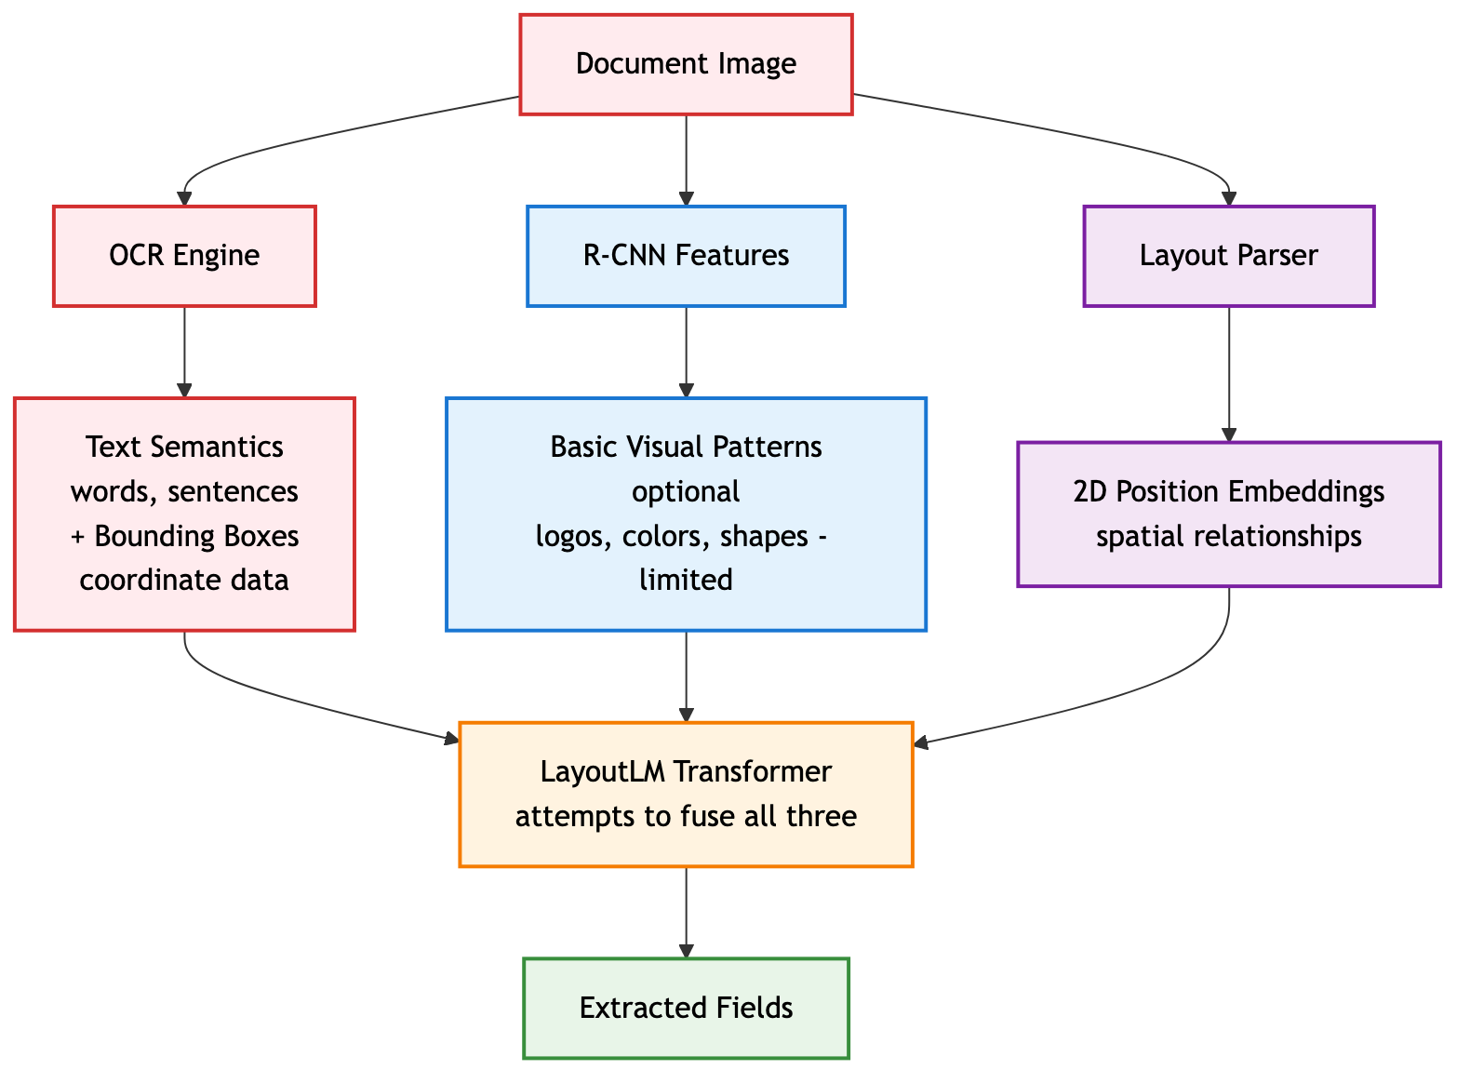
LayoutLMv1 Critical Limitations
How LayoutLMv1 Captures Semantic Information:
Text Semantics:
❌ Fragmented: OCR extracts words as isolated tokens
❌ Error-prone: OCR failures = complete semantic loss
❌ No visual context: Text meaning divorced from visual appearance
Spatial Semantics:
⚠️ Coordinate-dependent: 2D position embeddings require perfect OCR box alignment
⚠️ Brittle: Misaligned boxes break spatial understanding
Visual Semantics
❌ Minimal: Optional CNN features capture only basic visual patterns
❌ Disconnected: Visual features not integrated with text understanding
❌ Shallow: Cannot understand complex visual elements (handwriting, logos, stamps)
Semantic Integration:
❌ Post-hoc fusion: Three separate streams awkwardly combined in transformer
❌ Lossy process: Semantic information lost at each pipeline stag

Slide 6
Potential Limitations of the current LayoutLM IE at the ATO
OCR Dependency: "LayoutLM makes use of the Tesseract library for text extraction, which is not very accurate" (Nitor Infotech, 2024)
Computational Intensity: "Training and fine-tuning LayoutLM models can be computationally intensive and require significant resources" (UBIAI, 2024)
Domain Specificity: "May require additional fine-tuning and customization for domain-specific applications" (Medium, 2024)
Complex Layout Handling: "Traditional OCR systems encounter difficulties with complex layouts, multi-modal content" (DocuClipper, 2024)

Slide 7
Why we may need to move on
OCR Dependency: Failures cascade through pipeline
Complex Pipeline: 3+ models to maintain
Limited Vision: Primarily text-focused
Coordination Hell: Aligning OCR boxes with images
Business Impact:
Accuracy ceiling: ~70% on complex docs (anywhere in the world!)
High maintenance costs
OCR licensing fees if using AWS
Slow development cycles
Observed Failure Modes in the current LayoutLM Annotation PI
Invoice with logo → OCR fails → Entire extraction fails
Multiple scanned receipts
Skewed images

Slide 8
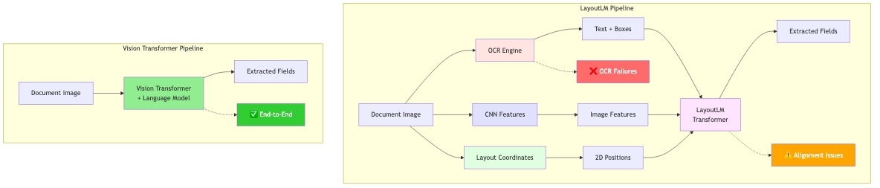
Holistic Document Understanding
Vision Transformers ensure an integrated holistic Document Understanding solution without suffering the Cascading Failure exhibited by the multistage LayoutLM IE approach above

Slide 9
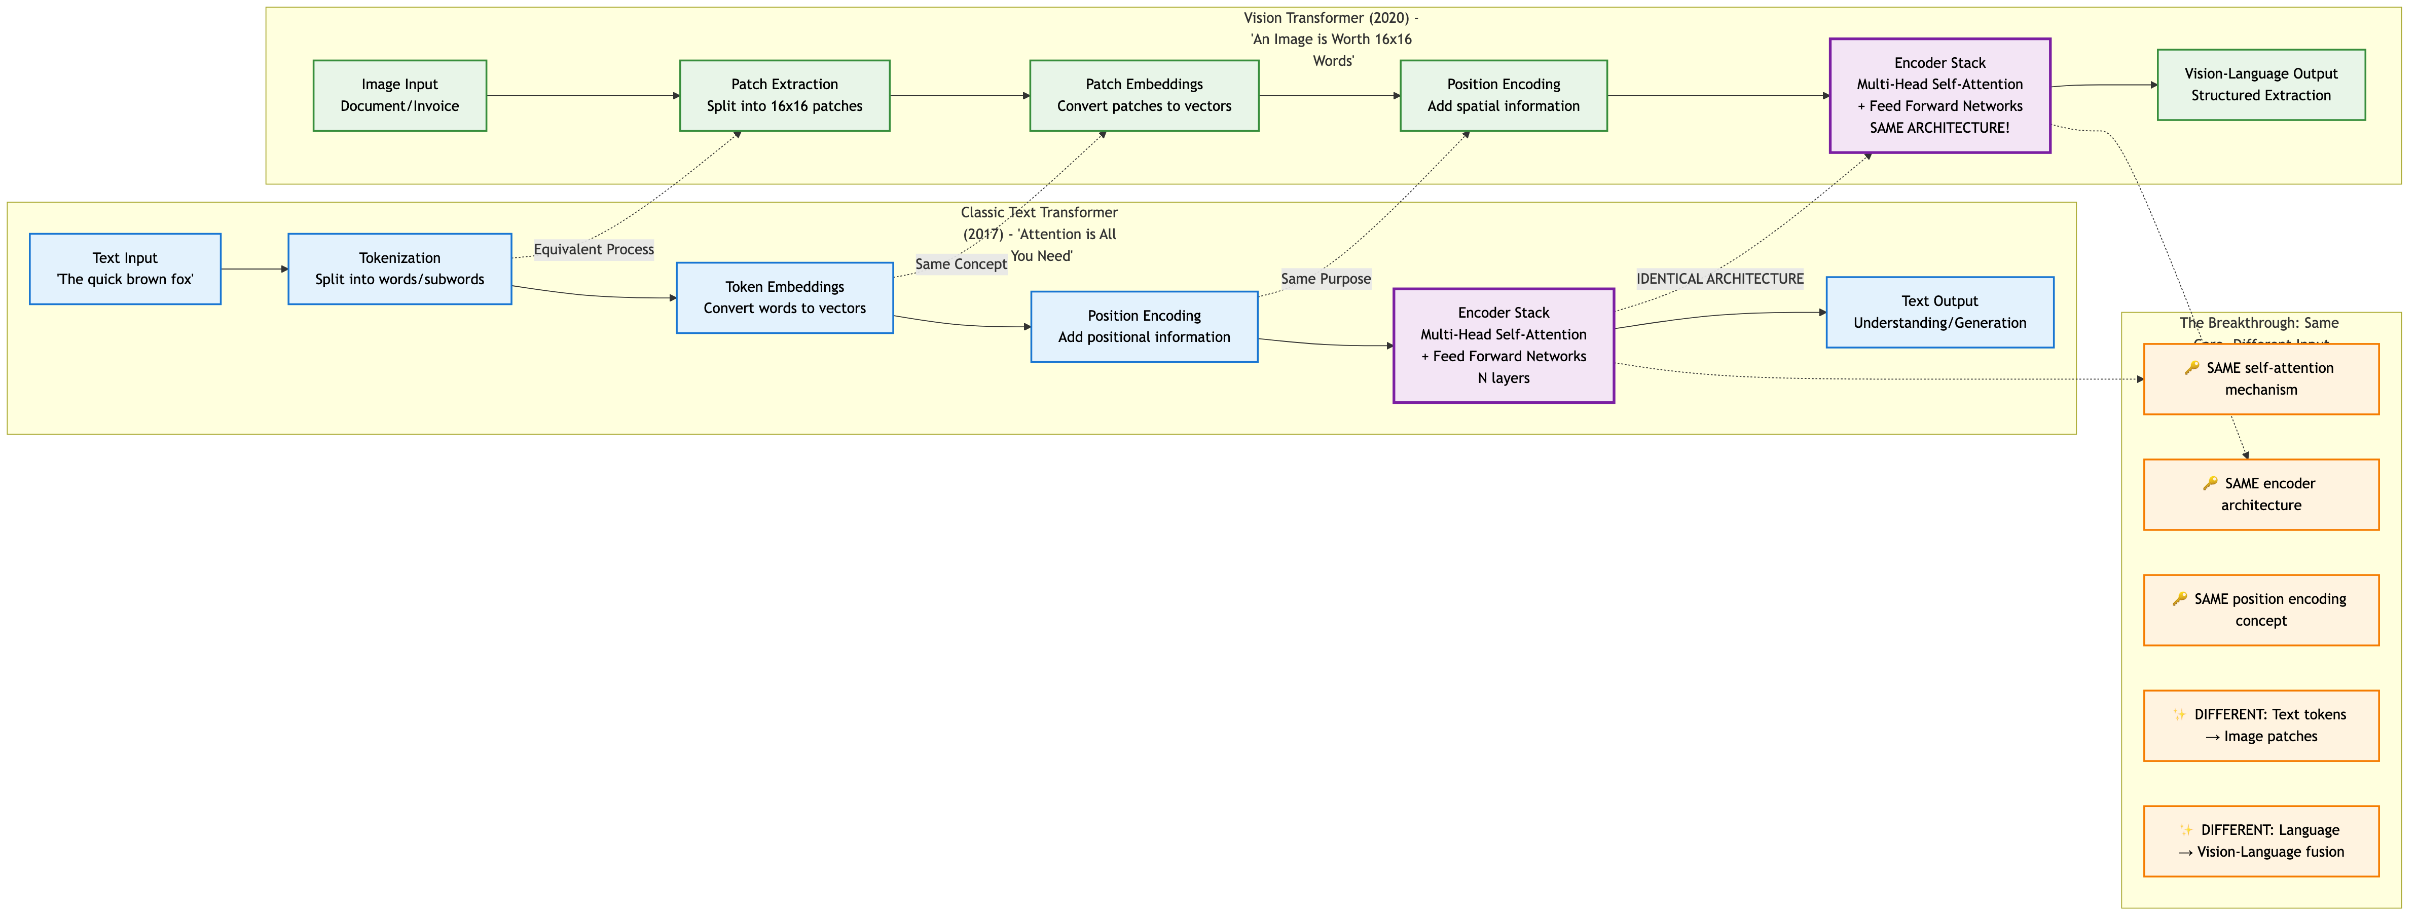
From Text to Vision - The Transformer Evolution
The Revolutionary Insight: Same core architecture, different input
What You Already Know (Text Transformers 2017):
Tokenization → Self-Attention → Understanding
"Attention is All You Need" revolutionized NLP
The Vision Breakthrough (2020):
Image patches = Text tokens
IDENTICAL self-attention architecture
Vision-Language fusion for document understanding

Slide 10
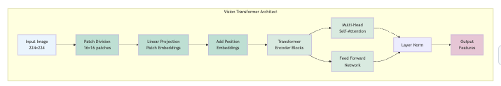
Vision Transformers – A potential solution?
Original ViT Architecture (Dosovitskiy et al., 2020)
"An Image is Worth 16x16 Words": Treats image patches like text tokens
Transformer Architecture: Applied directly to vision tasks for first time
Self-Attention: Global understanding without convolutional inductive bias

Slide 11
How Vision Transformers Capture Semantic Information:
🔄 Unified Semantic Integration:
All semantics in one model: Text, visual, and spatial understanding unified
No information loss: Every pixel contributes to understanding
End-to-end learning: Semantics emerge naturally from training
📍 Where Semantic Information Lives (Original ViT Framework):
Patch Embeddings: Each 16×16 patch captures local visual+textual semantics
Position Embeddings: Spatial relationships learned, not hard-coded
Self-Attention Layers: Global semantic relationships discovered dynamically
Classification Head: Converts visual understanding to output (adapted for language in modern models)
🔬 Evolution to Document Understanding:
Original ViT: Image classification (224×224, 16×16 patches)
Modern Adaptations: Document-optimized vision-language models
InternVL3-2B: 448×448 pixel tiles, 14×14 patches, dynamic resolution up to 4K
Llama-3.2-Vision-11B: Up to 1120×1120 pixels, 16×16 patches, language model integration
Notes: The original ViT breakthrough enabled all modern vision-language models. While specs have evolved for document tasks, the core semantic capture principles remain unchanged.

Slide 12
Global understanding without convolutional inductive bias
Convolutional Inductive Bias (CNNs)
Traditional computer vision models (CNNs) have built-in assumptions:
Local connectivity: Pixels near each other are more related
Translation invariance: Same features can appear anywhere
Hierarchical processing: Small features → larger features
Fixed receptive fields: 3×3 or 5×5 kernels look at local patches

Slide 13
Vision Transformers: No Inductive Bias
ViTs process images differently:
No locality assumption: Any patch can relate to any other patch
Global from the start: Every 16×16 patch "sees" every other patch immediately
Learned relationships: The model discovers which patches matter to each other
Dynamic attention: Different patches get different attention based on content

Slide 14
Vision Transformers: No Assumptions
ViTs process images differently:
No locality assumption: Any patch can relate to any other patch
Global from the start: Every 16×16 patch "sees" every other patch immediately
Learned relationships: The model discovers which patches matter to each other
Dynamic attention: Different patches get different attention based on content

Slide 15
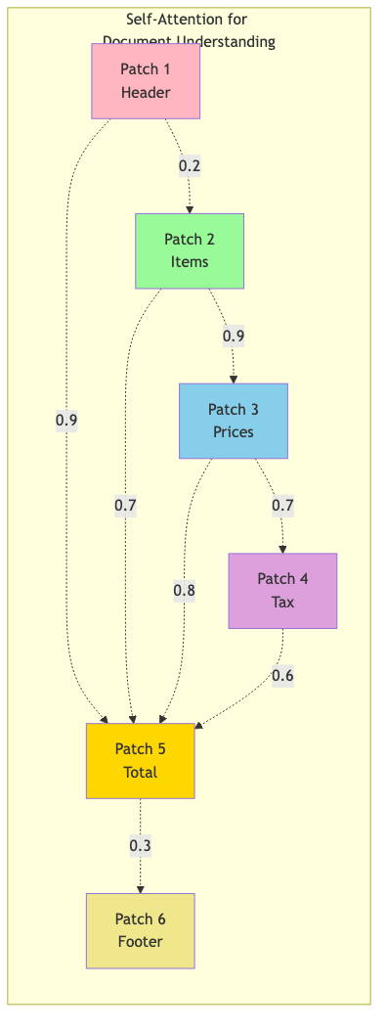
Why This Matters for Documents
CNN approach (with inductive bias):
[Invoice Total] → Can only see nearby pixels initially
Must stack many layers to connect to line items
Relationship discovered slowly, layer by layer
ViT approach (without bias):
[Invoice Total] → Immediately sees ALL patches
Can directly attend to line items anywhere
Discovers "total = sum(items)" in one step

Slide 16
Example
In a document:
- Total: $521.21 at bottom of page
- Line items at top of page
- CNN: Needs many convolutional layers to connect these distant elements
- ViT: Self-attention directly links them in the first layer
Without convolutional bias, ViTs can:
- Link page numbers to headers
- Connect footnotes to main text
- Associate logos with company names
- Understand table structures globally
This is why ViTs excel at document understanding - documents have global relationships
that CNNs struggle to capture!

