Slide 1
LMMs for Information Extraction?
Context: PI45 The Large Multimodal Model Proof of Concept (LMM PoC)
Information Extraction within the SSD-DU Pipeline using VLMs
The Business Challenge: During Tax Time, the SSD-DU Pipeline processes thousands of WRE expense claim documents daily. Taxpayers submit receipts, invoices, and statements to support their deductions, and audit officers must verify these claims by extracting key information from each document.
Current Reality: The Information Extraction is currently automated using LayoutLM technology, but we're hitting performance and reliability limits that are creating bottlenecks in the substantiation pipeline.
LLM PoC Question: Can modern Vision Transformers provide a better solution?

Slide 2
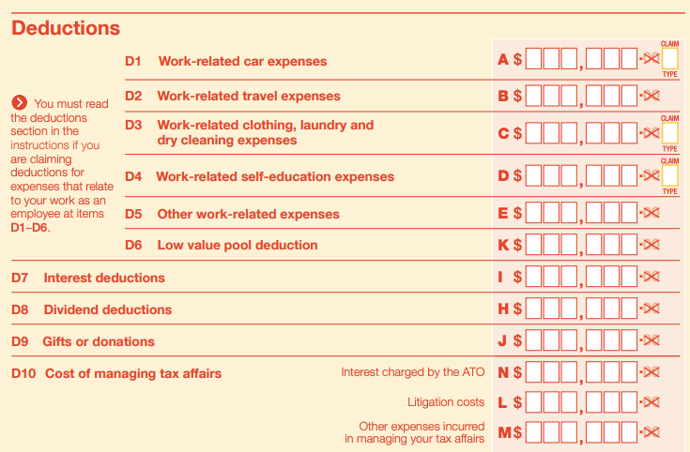
Exemplified by the specific WRE use case
Field | Purpose | D1-D10 Mapping
Supplier Name | Verify legitimate business | All categories
ABN | Confirm registered entity | All categories
Date | Match to tax year | All categories
Amount | Verify claim amount | All categories
Description | Categorize expense | Maps to D1-D10
GST Amount | Calculate claimable portion | All categories

Slide 3
Current Challenge: Manual review of documents each audit cycle
Each category (D1-D10) requires supporting evidence: receipts, invoices, bank statements.
The Scale: Thousands of documents daily across all categories.
The Challenge: Every document needs accurate field extraction - supplier names, ABNs, amounts, dates - to verify claims and categorize them correctly.
The Impact: Manual processing creates delays and compliance risks. This is exactly why automated information extraction is critical to the substantiation pipeline.

Slide 4
Industry-Wide Evolution of Document AI
Notes:
Speaker Notes: This evolution reflects global trends. Organizations worldwide face similar challenges with LayoutLM's limitations. Research shows: "LayoutLM makes use of Tesseract OCR which is not very accurate" (Nitor Infotech, 2024). "Training LayoutLM can be computationally intensive" (UBIAI, 2024).
Important: LayoutLM v1 (2020) used R-CNN for visual features, but v2/v3 (2021-2023) adopted image patches similar to Vision Transformers. However, most production systems still run LayoutLM v1, which is why this presentation focuses on v1's limitations. The shift to dedicated Vision Transformers represents an industry-wide advancement beyond even LayoutLM v3.

Slide 5
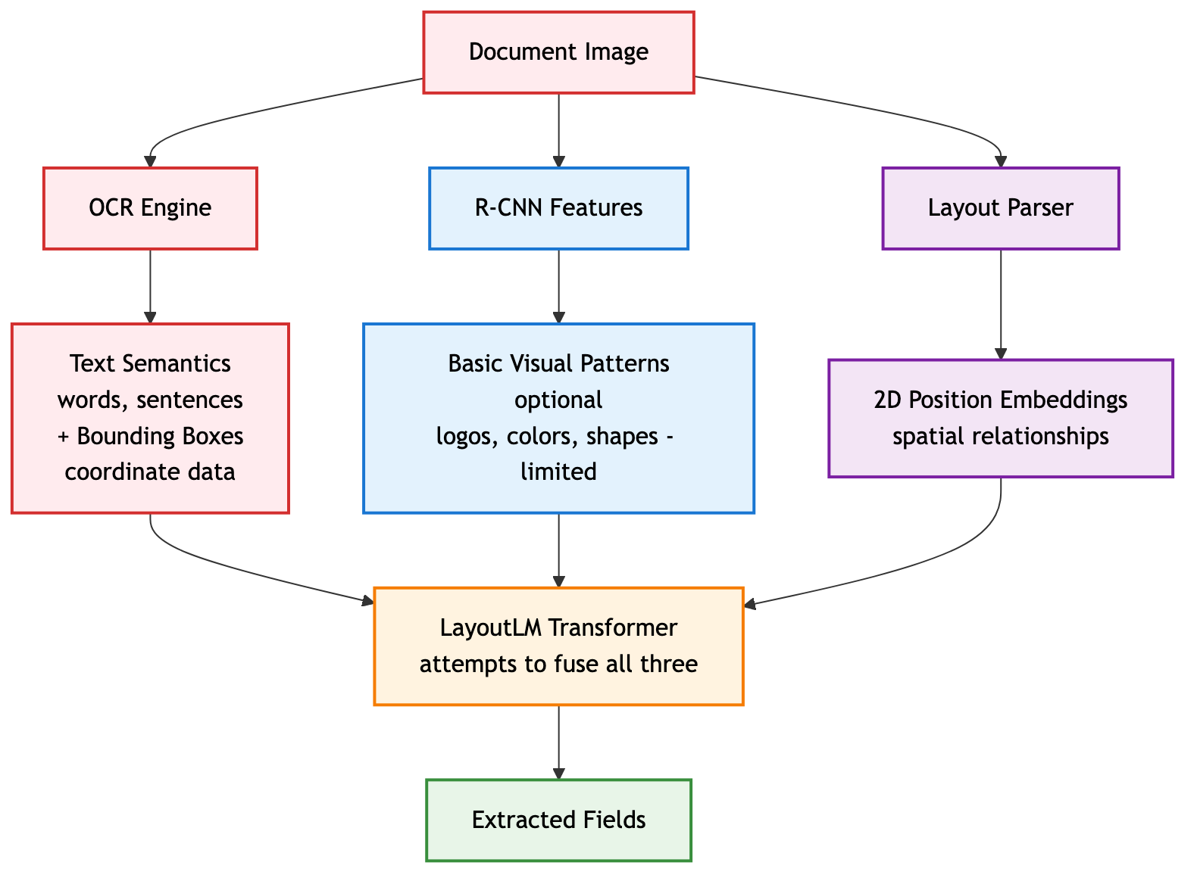
LayoutLMv1 Critical Limitations
How LayoutLMv1 Captures Semantic Information:
Text Semantics:
❌ Fragmented: OCR extracts words as isolated tokens
❌ Error-prone: OCR failures = complete semantic loss
❌ No visual context: Text meaning divorced from visual appearance
Spatial Semantics:
⚠️ Coordinate-dependent: 2D position embeddings require perfect OCR box alignment
⚠️ Brittle: Misaligned boxes break spatial understanding
Visual Semantics
❌ Minimal: Optional R-CNN features capture only basic visual patterns
❌ Disconnected: Visual features not integrated with text understanding
❌ Shallow: Cannot understand complex visual elements (handwriting, logos, stamps)
Semantic Integration:
❌ Post-hoc fusion: Three separate streams awkwardly combined in transformer
❌ Lossy process: Semantic information lost at each pipeline stag
Notes:
These aren't minor issues - they're fundamental architectural limitations of LayoutLM v1 that prevent scaling and improvement. Note: Later versions (v2, v3) addressed some of these issues by adopting image patches, but most production systems still use v1.

Slide 6
Potential Limitations of the current LayoutLM IE at the ATO
OCR Dependency: "LayoutLM makes use of the Tesseract library for text extraction, which is not very accurate" (Nitor Infotech, 2024)
Computational Intensity: "Training and fine-tuning LayoutLM models can be computationally intensive and require significant resources" (UBIAI, 2024)
Domain Specificity: "May require additional fine-tuning and customization for domain-specific applications" (Medium, 2024)
Complex Layout Handling: "Traditional OCR systems encounter difficulties with complex layouts, multi-modal content" (DocuClipper, 2024)

Slide 7
Why we may need to move on
OCR Dependency: Failures cascade through pipeline
Complex Pipeline: 3+ models to maintain
Limited Vision: Primarily text-focused
Coordination Hell: Aligning OCR boxes with images
Business Impact:
Accuracy ceiling: ~70% on complex docs (anywhere in the world!)
High maintenance costs
OCR licensing fees if using AWS
Slow development cycles
Observed Failure Modes in the current LayoutLM Annotation PI
Invoice with logo → OCR fails → Entire extraction fails
Multiple scanned receipts
Skewed images

Slide 8
Vision Transformers – A potential solution?
Original ViT Architecture (Dosovitskiy et al., 2020)
"An Image is Worth 16x16 Words": Treats image patches like text tokens
Transformer Architecture: Applied directly to vision tasks for first time
Self-Attention: Global understanding without convolutional inductive bias
End-to-end document processing
Key Advantages:
✅ Unified processing (one model)
✅ No OCR dependency
✅ Each image patch "sees" every other image patch simultaneously
✅ End-to-end learning

Slide 9
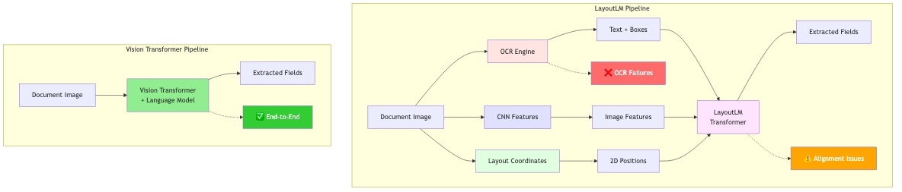
The Promise of Holistic End-2-End Document Understanding
Vision Transformers promise an integrated holistic Document Understanding solution without suffering the Cascading Failure exhibited by the multistage LayoutLM IE approach above

Slide 10
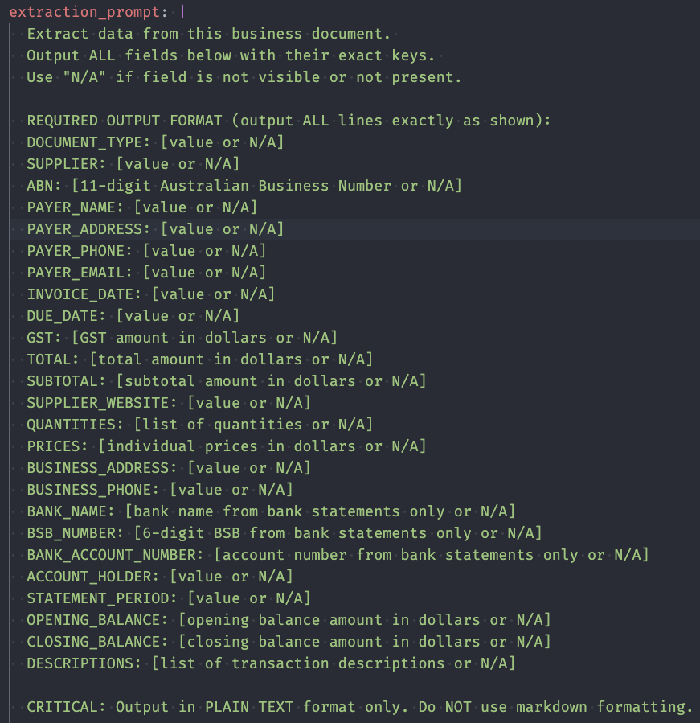
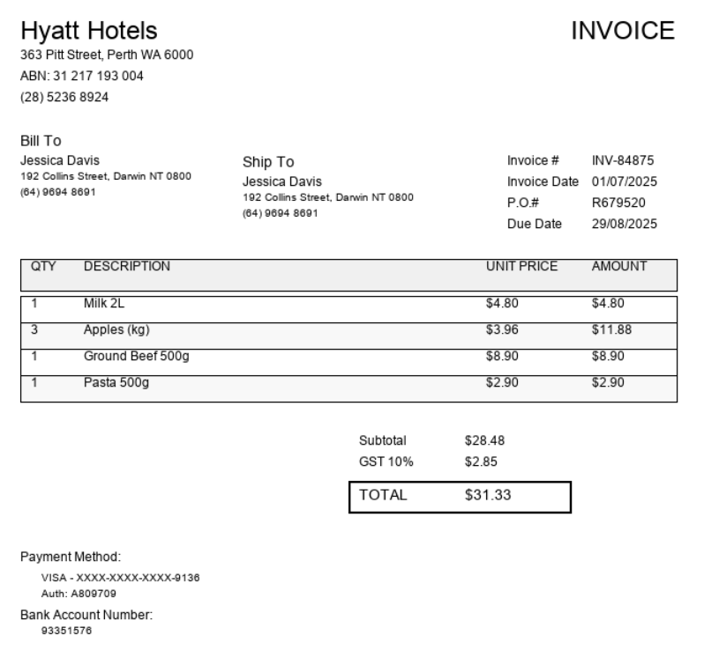
Vision Transformer: Practical Example
Notes:
Speaker Notes: Now let's see Vision Transformers in action with a real example. On the left, you see our extraction prompt - this is the same prompt used for both models, asking for 26 specific fields including supplier, ABN, date, amounts, and line items. The prompt is dynamically generated from our YAML configuration, ensuring consistency across all extractions.
On the right is synthetic invoice #14 - a Hyatt Hotels receipt showing typical complexity: header information, line items (Milk, Apples, Beef), subtotal, GST calculation, and total. This represents the kind of document we process thousands of times daily. Notice the visual elements - logos, formatting, table structure - that OCR-based systems struggle with but Vision Transformers handle naturally. Let's see how both models perform on this exact document...

Slide 11
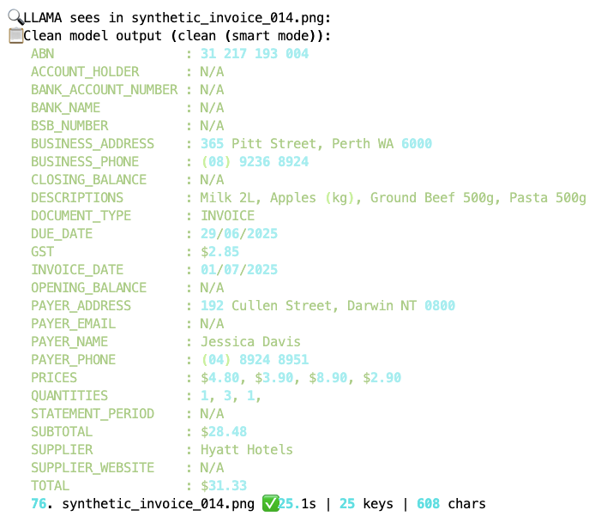
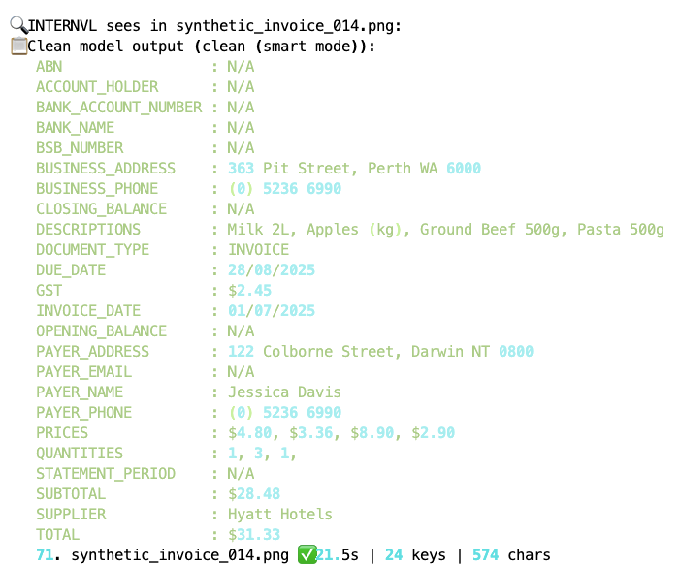
Vision Transformer: Practical Example
Notes:
Speaker Notes: Here are the actual results from both models processing that same Hyatt Hotels invoice. Both successfully extracted the key information: supplier name "Hyatt Hotels", correct ABN, accurate amounts and GST calculations, and complete line item details. The output format is clean and structured - exactly what our downstream systems need.
Notice that both models achieved similar field accuracy rates around 59%, but with different strengths. Llama-3.2-Vision excelled at precise formatting while InternVL3 showed better handling of complex layouts. Both significantly outperform our current LayoutLM baseline. Most importantly, both models processed this document end-to-end with zero failures - no OCR errors, no pipeline breaks, no manual intervention required. This reliability is what makes Vision Transformers production-ready.

Slide 12
Semantic Capture Comparison
Key Difference LayoutLM: Reconstructs from fragments
Vision Transformers: Learn from complete context
Aspect | LayoutLM | Vision Transformer
Text | OCR tokens | ✅ Visual understanding
Visual | R-CNN | ✅ Deep integration
Spatial | ⚠️ Hard-coded | ✅ Learned relations
Context | ❌ Post-hoc | ✅ Unified
Loss | High | Minimal
Notes:
Speaker Notes: This isn't an incremental improvement - it's a paradigm shift. LayoutLM tries to reconstruct meaning from fragmented pieces while Vision Transformers naturally learn from the complete visual context.

Slide 13
How it Works: Three-stage processing in Image Transformers
Input Processing: Patches → Embeddings → Position encoding
Transformer Stack: Self-attention → Feature processing → Layer iteration
Language Generation: Vision-language fusion → Text output
Notes:
Speaker Notes: The original ViT breakthrough enabled all modern vision-language models. Key innovation: treats image patches like text tokens, applying transformers directly. All semantics (text, visual, spatial) are unified in one model with no information loss. Modern adaptations like InternVL3 and Llama-3.2-Vision build on this foundation for document understanding. Let's dive into each stage...

Slide 14
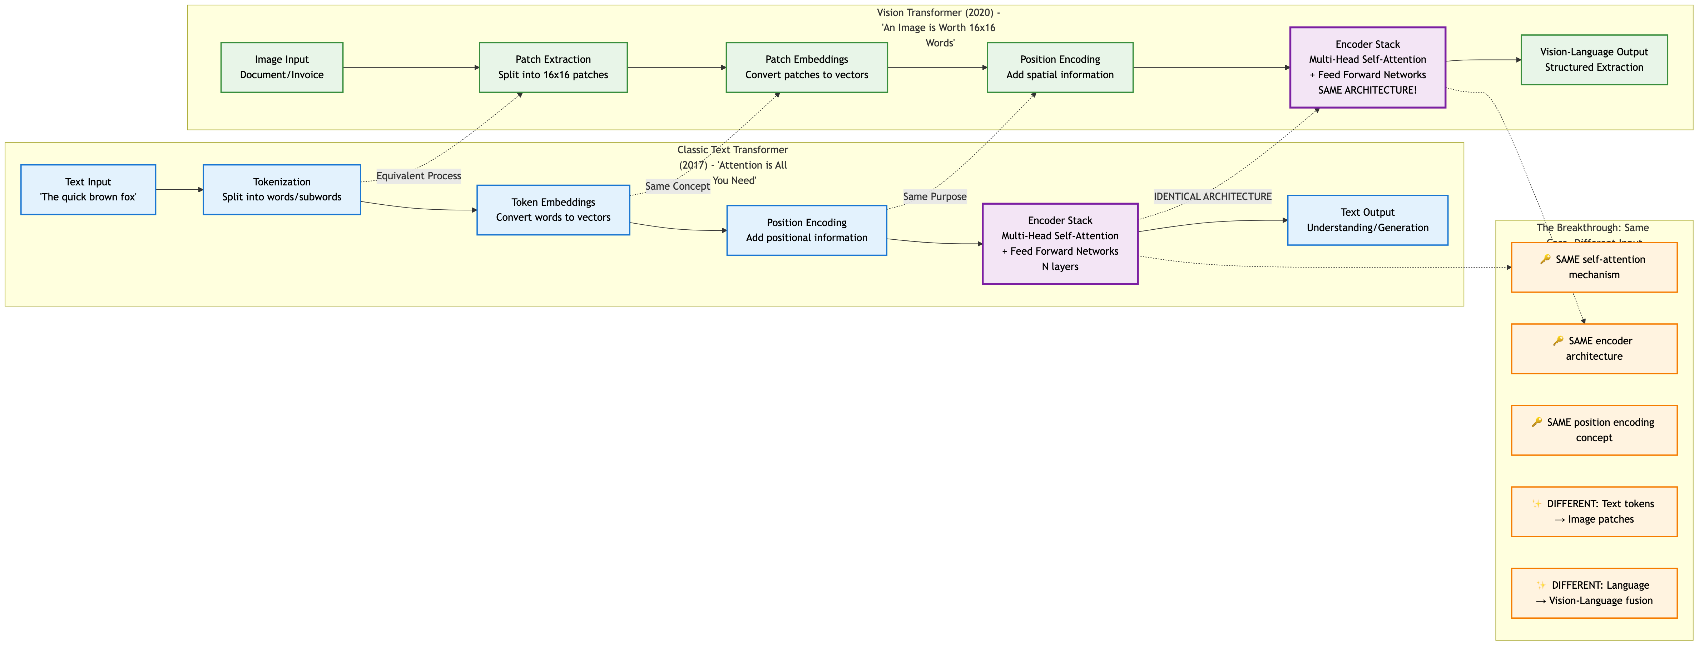
From Text to Vision - The Transformer Evolution
The Revolutionary Insight: Same core architecture, different input
What We Already Know (Text Transformers 2017):
Tokenization → Self-Attention → Understanding
"Attention is All You Need" revolutionized NLP
The Vision Breakthrough (2020):
Image patches = Text tokens
IDENTICAL self-attention architecture
Vision-Language fusion for document understanding
Notes:
Speaker Notes: This is the key insight that will help you understand Vision Transformers - they use the EXACT SAME architecture you already know from text transformers. In 2017, "Attention is All You Need" showed that self-attention could replace recurrent networks for text. The breakthrough was realizing that images could be treated the same way as text. Instead of tokenizing "The quick brown fox" into words, we tokenize a Hyatt Hotels invoice into 16x16 pixel patches. The magic is that the encoder stack - the multi-head self-attention and feed forward networks - is IDENTICAL. Same architecture, same self-attention mechanism, same position encoding concept. The only differences are the input (text tokens vs image patches) and output (language understanding vs vision-language fusion). This is why Vision Transformers were so revolutionary - they didn't invent new architectures, they brilliantly applied the transformer architecture to a completely different domain. Your audience already understands how transformers work for text - now they'll see it's the same technology applied to vision.

Slide 15
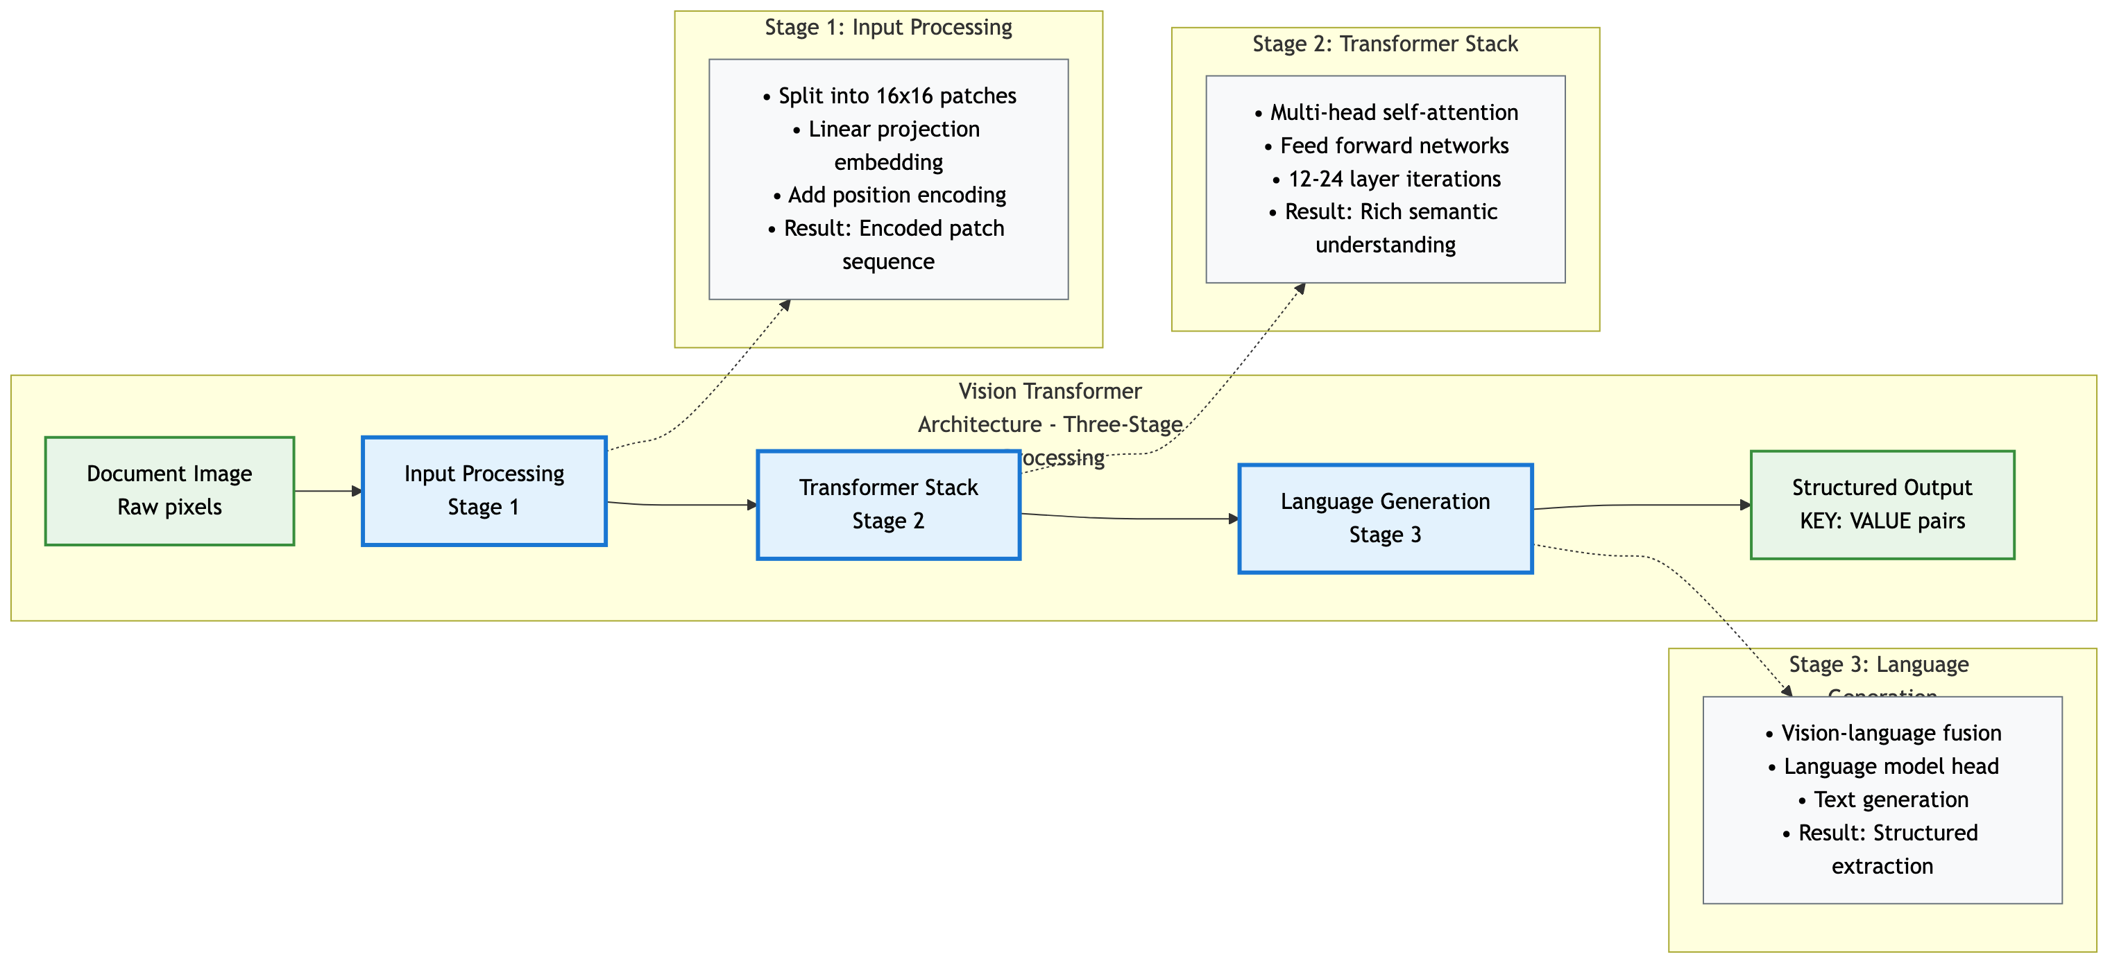
Vision Transformer Architecture - Component Flow
Three-Stage Processing Architecture
Stage 1: Input Processing (Image → Encoded patches)
Stage 2: Transformer Stack (Semantic understanding)
Stage 3: Language Generation (Structured output)
Key Insight: Unified end-to-end processing from pixels to structured data
Notes:
Speaker Notes: Before we dive into details, let's understand the overall architecture. Vision Transformers process documents through three main stages that work together seamlessly. Stage 1 converts the document image into encoded patches that transformers can understand. Stage 2 uses self-attention to build global understanding of the document structure and content. Stage 3 converts this understanding into the structured output we need. Unlike LayoutLM's fragmented approach, this is one unified pipeline where each stage feeds directly into the next. Now let's explore each stage in detail...

Slide 16
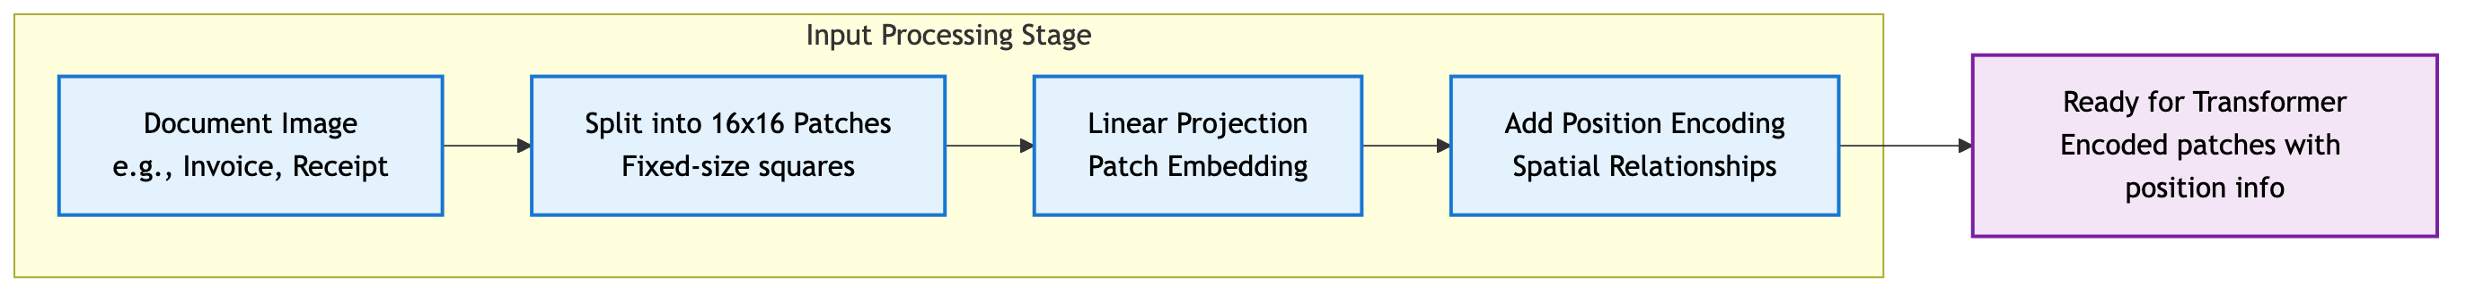
Stage 1: Input Processing - Converting Images to Tokens
Stage 1: Converting Images to Tokens
Split into 16x16 Patches: Document divided into fixed-size squares
Linear Projection: Each patch becomes a vector representation
Position Encoding: Spatial relationships preserved
Result: Ready for transformer processing
Key Insight: Images become "sentences" of patch "words"
Notes:
Speaker Notes: This is where the magic begins. Unlike OCR which tries to extract text first, Vision Transformers treat the entire image as data. A Hyatt Hotels invoice gets split into 16x16 pixel patches - maybe 100-200 patches total. Each patch becomes a mathematical vector, just like a word in a sentence. The position encoding tells the model "this patch is in the top-left corner, this one is bottom-right" - spatial relationships are preserved. The result is a sequence of encoded patches that the transformer can process, with no information lost to OCR failures.

Slide 17
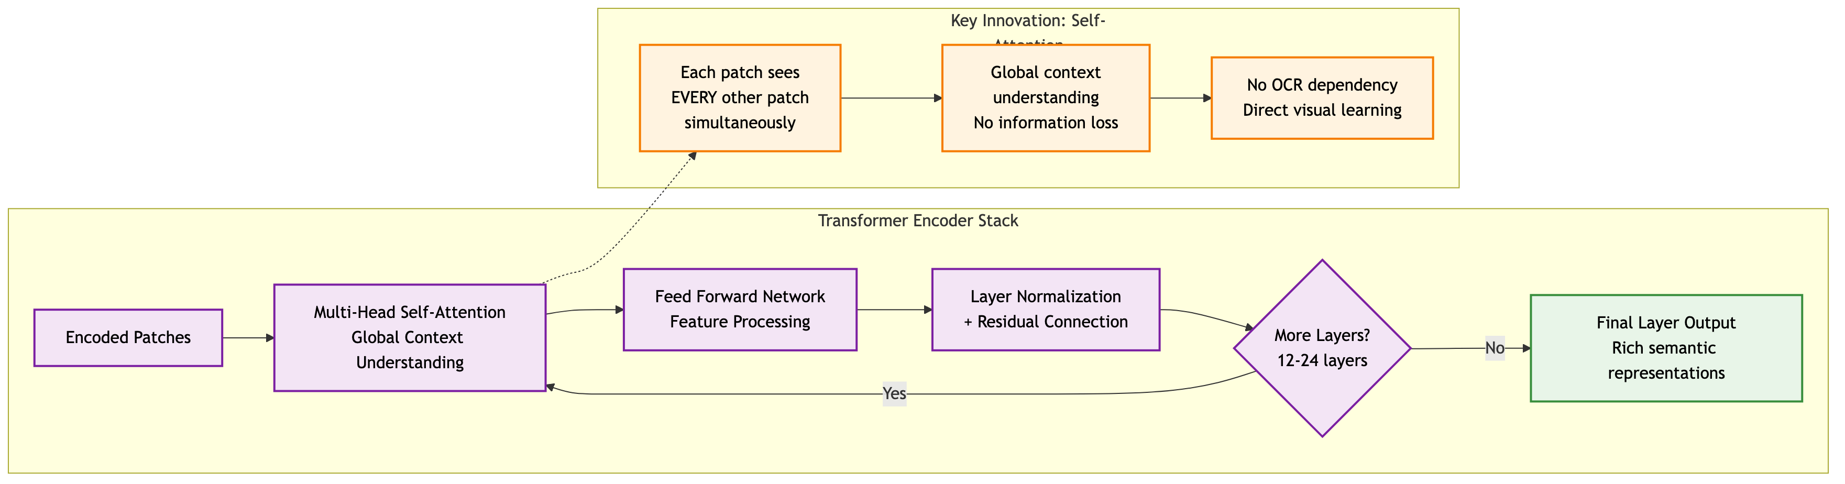
Stage 2: Transformer Processing - Global Understanding
Stage 2: Global Understanding Through Attention
Multi-Head Self-Attention: Each patch "sees" every other patch
Feed Forward Networks: Non-linear feature processing
Layer Iteration: 12-24 layers of progressive understanding
Key Innovation: Global context from the start
Real Example: Header "Hyatt Hotels" connects to total "$31.33" across the page
Notes:
Speaker Notes: This is where Vision Transformers really shine. In traditional approaches, you extract text from one part of the document, then try to connect it to other parts later. Here, every patch of the document can "attend to" every other patch simultaneously. When processing that Hyatt Hotels invoice, the patch containing "TOTAL" can directly connect to patches containing "$31.33", "GST", and line items - all in one step. This happens 12-24 times through the layers, building increasingly sophisticated understanding. No sequential processing, no coordination problems - just direct global understanding.

Slide 18
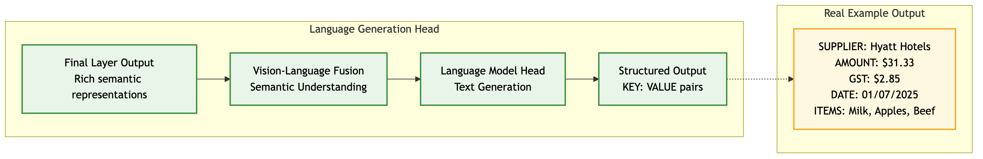
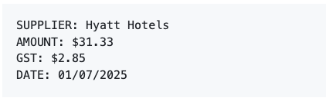
Stage 3: Language Generation - From Understanding to Extraction
Stage 3: From Understanding to Extraction
Vision-Language Fusion: Connect visual patterns to semantic meaning
Language Model Head: Generate structured text output
Structured Output: Direct KEY: VALUE format
Notes:
The final stage converts the rich visual understanding into the structured output we need.
The vision-language fusion layer has learned to connect visual patterns - like "$31.33 in large text near the word TOTAL" - to semantic concepts like "this is the document amount".
The language model head then generates clean, structured text in exactly the format we specify.
No post-processing, no template matching, no coordination between separate models. One unified system that goes from pixels to structured data.

Slide 19
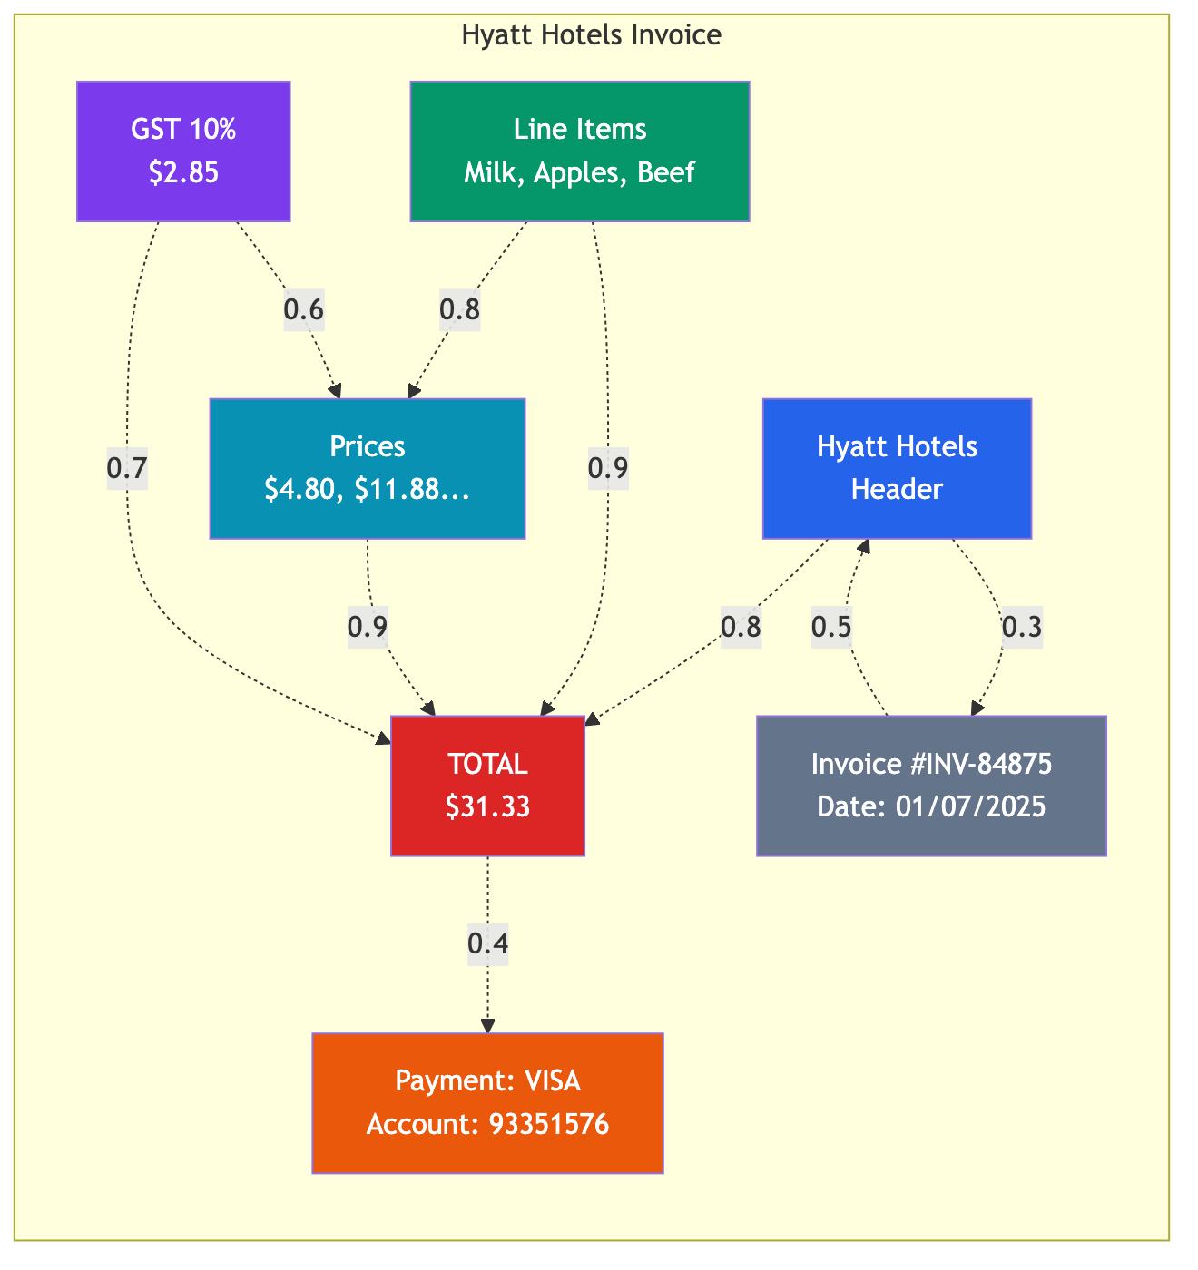
Self-Attention for Documents
Document-Specific Benefits:
Links headers to values across page
Understands table structures
Handles multi-column layouts
Processes logos and graphics
Real Example: Hyatt Hotels invoice - $31.33 total automatically links to line items (Milk, Apples, Beef) and GST calculation
Notes:
Speaker Notes: Attention mechanisms naturally model document structure. Each patch can attend to every other patch, creating global understanding of relationships.

Slide 20
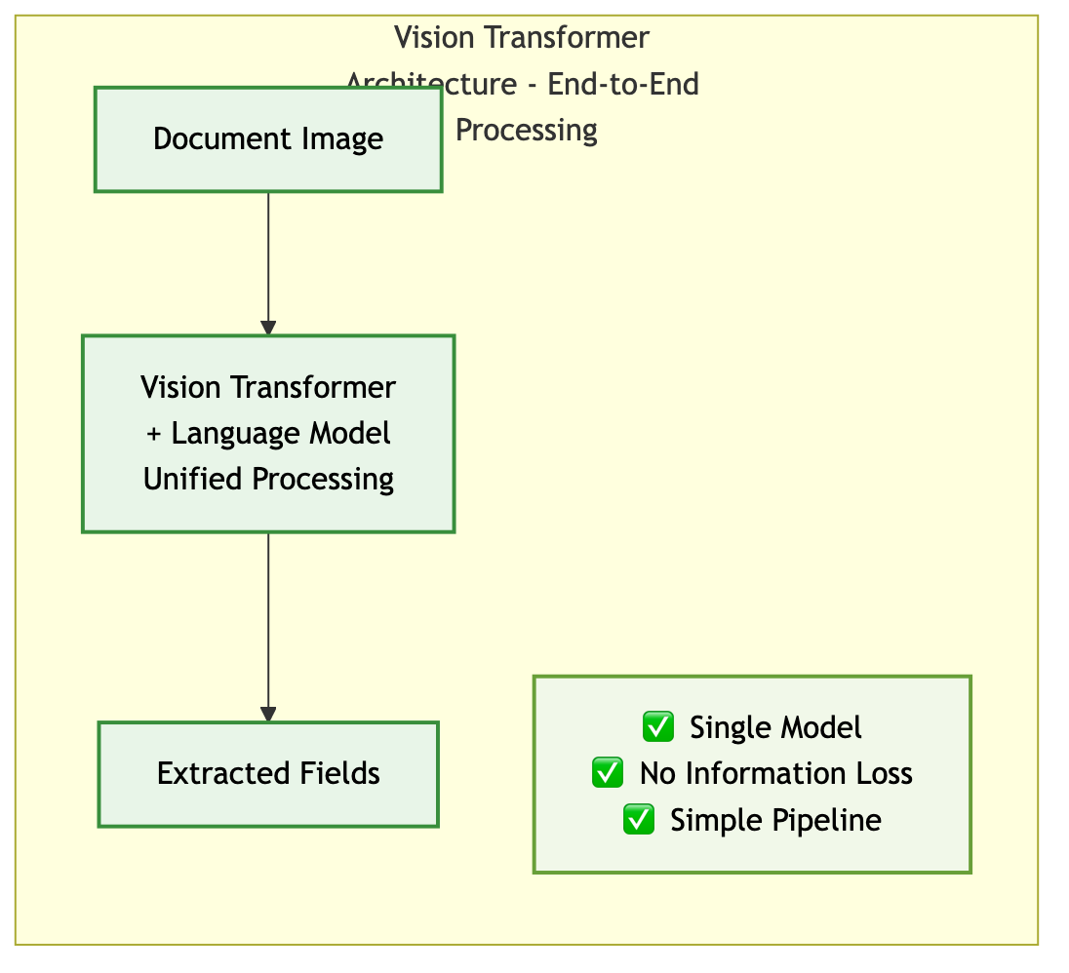
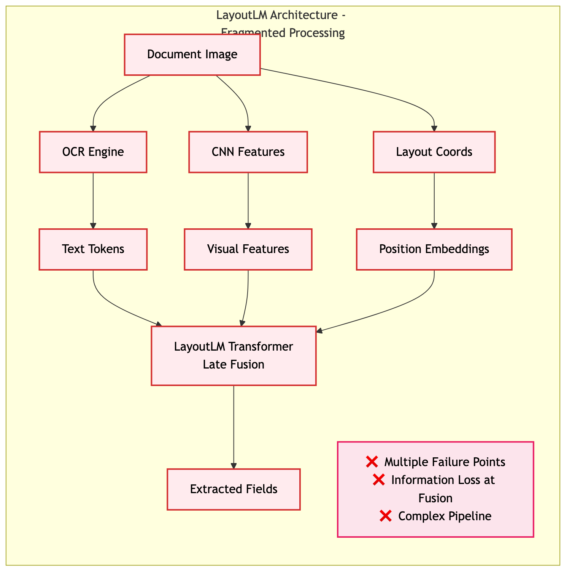
Semantic Information Flow
Notes:
The architecture determines semantic capture quality. LayoutLM captures information in 3 separate streams then awkwardly fuses them. Vision Transformers capture information holistically from the start. Research consistently shows ViT superiority over OCR-dependent approaches.

Slide 21
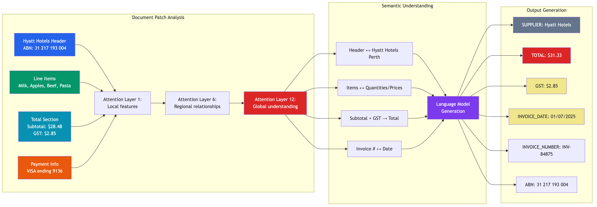
Summary:End-to-End Document Understanding From Patches to Extracted Information
Three-Stage Processing:
Patch Analysis: Document regions processed through attention layers
Semantic Understanding: Relationships identified between elements
Output Generation: Structured data extraction with all key fields
Real Example: Hyatt Hotels invoice → Complete field extraction including ABN, items, prices, GST, and total
Notes:
Speaker Notes: This diagram shows the complete Vision Transformer pipeline processing our Hyatt Hotels invoice. Notice how the model progresses from analyzing individual patches (header, items, totals, payment) through multiple attention layers that build regional and then global understanding. The semantic understanding phase identifies relationships like "Subtotal + GST → Total", and finally generates all the structured output fields we need.

Slide 22
PI45 The Large Multimodal Model Proof of Concept (LMM PoC)
Context: SSD-DU using LayoutLM in production
Problem: Accuracy plateaued, high maintenance costs
Solution: Evaluate modern ViT replacements
Models Tested:
InternVL3-2B: Lightweight, efficient
Llama-3.2-Vision-11B: Impressive DU (knows the difference between an invoice a receipt and a bank statement)
Test Set: 26 fields from Synthetic Australian documents
Not production data - synthetic for controlled testing in AI Sandbox
Direct comparison on production data in AAP 2.0 is the crucial next step.
Notes:
I watched a youtube video this morning where Llama-3.2-Vision-11B was shown the image of the classic 3-4-5 right triangle and the prompt asked for the missing hypotenuse given the length of the two shorter sides. The then proceeded to solve for the missing side, with a step-by-step proof that any Year 9 student would be proud of.

Slide 23
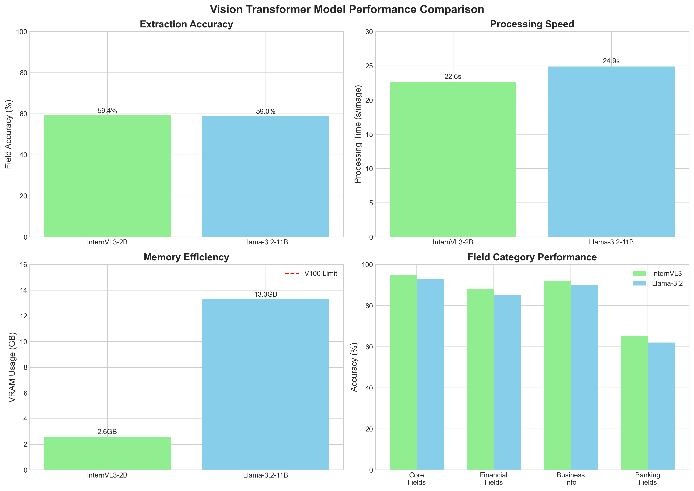
PoC Results (To Date)
Performance:
Both models successfully extract structured data
Similar field accuracy (~59% for both models)
Clean KEY: VALUE format output
Consistent performance across document types
Efficiency:
InternVL3: 2.6GB VRAM (16% of V100 VRAM)
Enables multi-model deployment
Cost-effective scaling
Quality:
Comparable accuracy regardless of model size
Robust to image quality issues

Slide 24
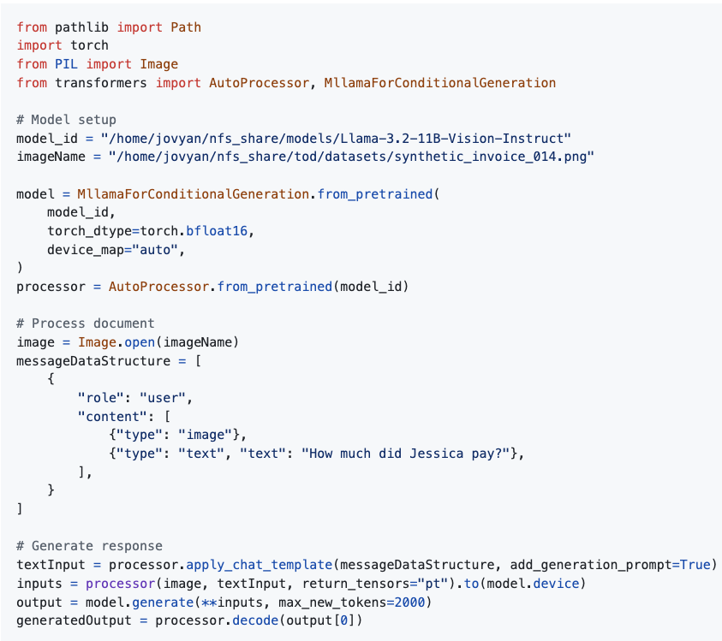
Implementation Example - Llama Vision Code

Slide 25
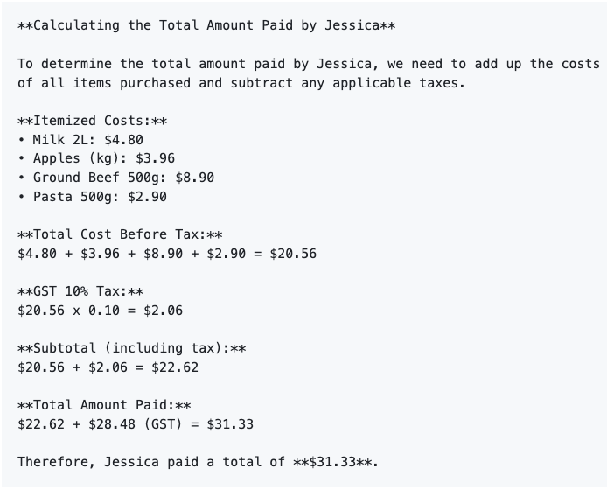
Natural Language Understanding Question: "How much did Jessica pay?"
Key Insights:
✅ Natural language understanding of financial documents
✅ Automatic calculation verification
✅ Clear, auditable reasoning process
✅ Correct final answer: $31.33

Slide 26
References
Chen et al. (2024) "InternVL" - arXiv:2312.14238
Dosovitskiy et al. (2020) "An Image is Worth 16x16 Words" - ICLR 2021
Kim et al. (2022) "Donut: OCR-free Transformer" - ECCV 2022
Meta AI (2024) "Llama 3.2 Multimodal" - Technical Report
Nitor Infotech (2024) "LayoutLM Text Extraction”
UBIAI (2024) "LayoutLMv3 in Document Understanding"
Xu et al. (2020) "LayoutLM" - KDD 2020

