Slide 1
Recorded data
Duration = 600 seconds
Interval = 0.033 second
17952 x 3
Time | X | Y
Shrinking data
Duration = 600 seconds
Interval = 1.0 second
600 x 3
Time | X | Y
Converting (X, Y) to
(Distance, Turn Angle)
600 x 3
Time | Distance | Turn Angle
Remove column Time and
Transpose data
1200 x 1
Distance_0 | TurnAngle_0 | … | … | Distance_599 | TurnAngle_599
Figure 1: Preprocessing recorded locomotor data

Slide 2
Table 1: Accuracy of binary classification trained with the first 2.5 minutes dataset
Model | Accuracy
 | First 2.5 minute | Last 2.5 minute | First 5.0 minute | Last 5.0 minute | 10 minute
Logistic Regression | 0.56 | 0.67 | 0.67 | 0.59 | 0.76
Support Vector Machine | 0.68 | 0.72 | 0.73 | 0.71 | 0.78
Random Forest | 0.76 | 0.74 | 0.80 | 0.73 | 0.79
Gradient Boosting | 0.78 | 0.76 | 0.79 | 0.72 | 0.76

Slide 3
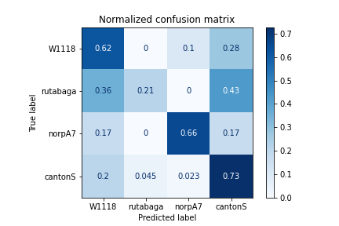
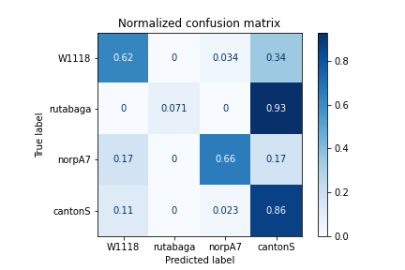
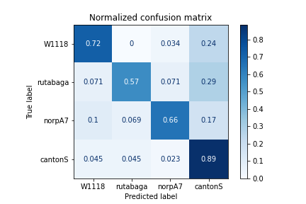
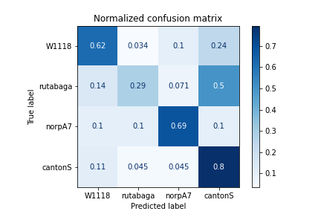
Logistic Regression
Support Vector Machine
Random Forest
Gradient Boosting
Figure 1: Multi-label classification with 10-minute dataset

Slide 4
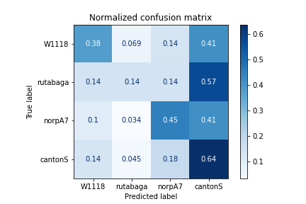
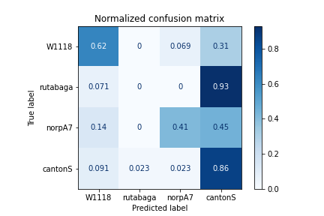
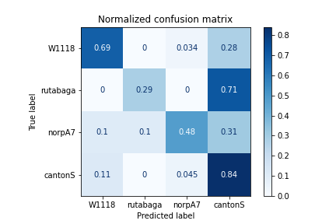
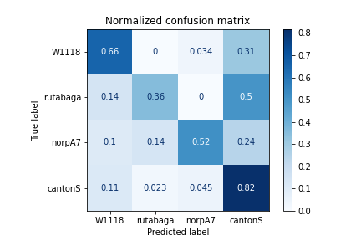
Logistic Regression
Support Vector Machine
Random Forest
Gradient Boosting
Figure 2: Multi-label classification with first 2.5-minute dataset

Slide 5
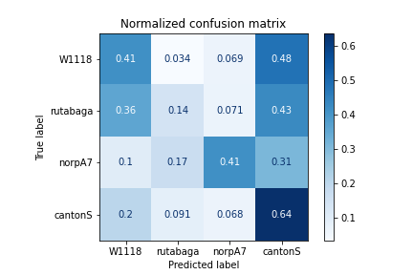
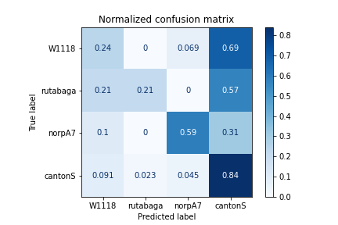
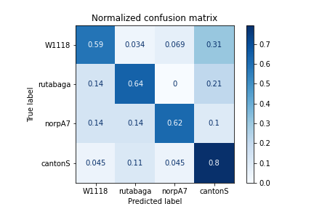
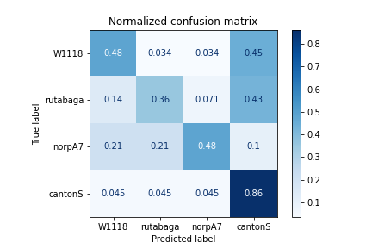
Logistic Regression
Support Vector Machine
Random Forest
Gradient Boosting
Figure 3: Multi-label classification with last 2.5-minute dataset

Slide 6
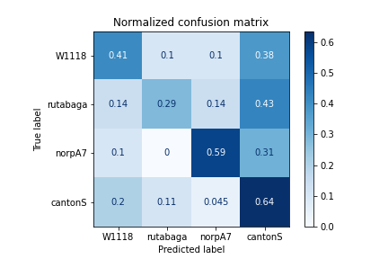
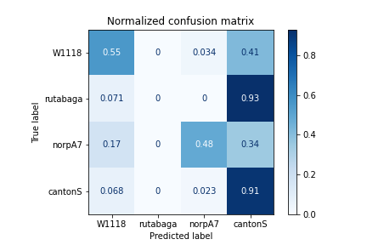
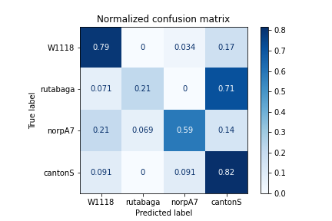
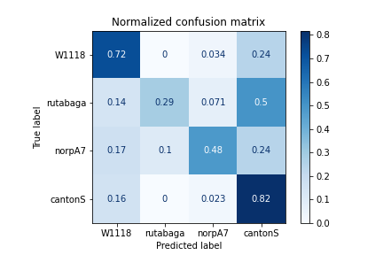
Logistic Regression
Support Vector Machine
Random Forest
Gradient Boosting
Figure 4: Multi-label classification with first 5-minute dataset

Slide 7
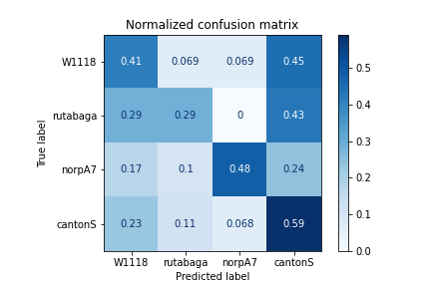
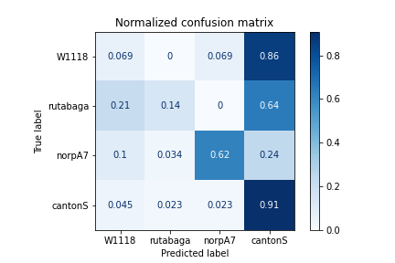
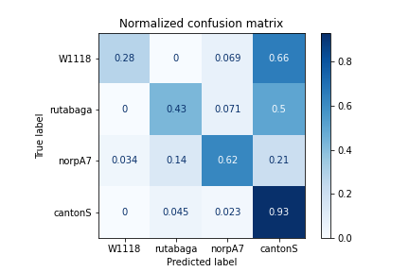
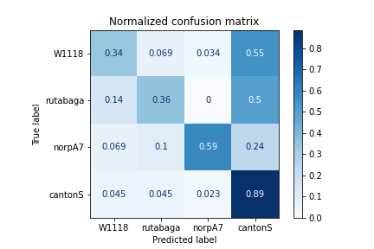
Logistic Regression
Support Vector Machine
Random Forest
Gradient Boosting
Figure 5: Multi-label classification with last 5-minute dataset

