Slide 1
Part 1: Introduction to Systematic Review
Teresa Ober, Ph.D.
Assistant Research Professor
University of Notre Dame
July 8, 2021
Notes:
Hello. My name is Teresa Ober and I am an Assistant Research Professor at the University of Notre Dame in the U.S.A. Today, I'm going to be walking you through some of the key steps in conducting a systematic review and meta-analysis.
Given the scope and potential complexity of the topic, there is a LOT that I will not be covering, but I'm hoping by the end of the next two hours, you will have a foundational understanding of the process.

Slide 2
Workshop materials
If you have not already, pleas navigate to the following URL to access workshop materials, including these slides:
https://tmober.github.io/meta-workshop/
Notes:
If you have not already, now might be a good time to install R and RStudio and the required packages listed on the website here.
I’ll also acknowledge that I made several changes, so if you downloaded the material more than 12 hours ago, it may not be the most current. In which case, please consider downloading the latest files.

Slide 3
Overview of topics
Part 1: Systematic Review
What is a systematic review?
Best practices for systematic reviews
Question formulation
Creating a protocol
Searching for literature
Screening literature
Data extraction
Risk of bias and quality assessment
Synthesis
Part 2: Meta-analysis
What is a meta-analysis?
Effect size estimates
Fixed- and random-effects models
Conducting the meta-analysis
Reporting results
https://tmober.github.io/meta-workshop/
Notes:
I'm hoping to spend about the first hour introducing the systematic review process. During the second hour, I will then talk about conducting a meta-analysis. It is during the second hour that you will be running some code.

Slide 4
Aims of this session….
Receive overview of systematic review processes
Discuss the scope and the formulation of a review question
Consider the purpose and format of a protocol
Gain familiarity with systematic searching/screening strategies
Learn data extraction, quality assessment, and synthesis
https://tmober.github.io/meta-workshop/
Notes:
By the end of this first session

Slide 5
What is a systematic review?
SYSTEMATIC: Done or acting according to a fixed plan or system: methodical
REVIEW: A critical appraisal of a book, play or other work

Slide 6
What is a systematic review?
A systematic review attempts to collate all empirical evidence that fits pre-specified eligibility criteria in order to answer a specific research question.
It uses explicit, systematic methods that are selected with a view to minimizing bias, thus providing more reliable findings from which conclusions can be drawn and decisions made.
(Antman, 1992; Oxman 1993)

Slide 7
Why do we need systematic reviews?
Minimize the impact of bias/errors that arise in any one study
Help to address or even resolve confusion on a topic
Highlight where there is insufficient evidence
Combining results from different studies can reveal new findings
Mitigate the need for further empirical research on a topic

Slide 8
Why do we need systematic reviews?
Educators, clinicians, researchers, and policy-makers, etc. are inundated with unmanageable amounts of information
Often impossible to consider all relevant primary research studies in a decision making context
Enables stakeholders to stay current with evidence accumulating in a field and to practice or conduct further research in evidence-based manner
Facilitates rational decision making

Slide 9
Why are traditional reviews insufficient?
Rarely pre-specify or make methods explicit
Lack transparency and reproducibility
May present subjective opinions of an individual if not conducted rigorously
Incomplete, lacking information from unpublished research
Difficult to synthesize across groups of studies, especially when conflicts or apparent contradictions arise based on reading and qualitative analysis alone

Slide 10
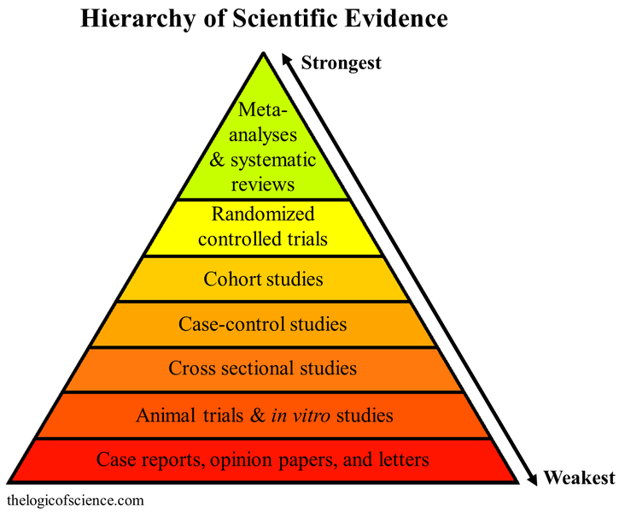
Hierarchy of scientific evidence

Slide 11
Who undertakes systematic reviews?
Systematic reviews are widely used across a variety of disciplines, though are often conducted by individuals who strive for transparency, reproducibility, and accountability of the synthesis of findings:
Government entities and regulatory bodies
Academic researchers, Non-academic researchers, Clinicians
May be conducted by small groups of researchers or as a collaboration
E.g., Cochrane (Health and medicine) and Campbell (Social sciences) Collaborations
Notes:
Multidisciplinary teams
Clinicians
Health services researchers
Information scientists
Statisticians
Health Economists
Patient and public involvement – particularly for guidelines

Slide 12
Best practices for conducting systematic reviews

Slide 13
General Best Practices
Only conduct reviews that are needed
Use correct research synthesis methodology for your question
Strive to conduct reviews that are free from bias
Notes:
Research synthesis is a catch-all term for methods that we use to synthesize results from multiple studies
Systematic reviews and meta-analyses are often placed at the top of frameworks for understanding the hierarchy of evidence. But, with great power comes great responsibility
Remember: Best practice changes over time

Slide 14
Is the review needed?
Reasons to conduct a review
You have a research question that is best answered by synthesizing existing evidence rather than running a new study
There is no recent review that answers that same question
You want to explore apparent inconsistencies in previous studies
Reasons NOT to conduct a review
They take a very long time
They are really hard
Not every topic needs a review

Slide 15
Reviews take a very long time
Category | Mean ± SD | Median | Range
Authors/team members | 5±3 | 5 | 1–27
Time (in weeks; registered project start to publication date) | 67.3±31.0 | 65.8 | 6–186
Quantitative analysis yield rate (%) | 2.6±4.7 | 1.0 | 0.03–32.43
Qualitative analysis yield rate (%) | 2.7±4.6 | 1.0 | 0.05–26.19
Borah, R., Brown, A. W., Capers, P. L., & Kaiser, K. A. (2017). Analysis of the time and workers needed to conduct systematic reviews of medical interventions using data from the PROSPERO registry. BMJ open, 7(2), e012545. https://bmjopen.bmj.com/content/7/2/e012545

Slide 16
Types of Reviews
Factor | Evidence Briefing | Mapping Review | Scoping Review | Rapid Evidence Assessment | Rapid Realist Review | Systematic Review | Meta-analysis
Question | Narrow | Broad | Narrow | Narrow | Narrow | Narrow | Narrow
Timescale | 2 weeks | 4-16 weeks | 24 weeks | 8-24 weeks | 8-24 weeks | 36-52 weeks | 52-78 weeks
Resources | Single reviewer, limited databases | Single reviewer, comprehensive databases | Single review, limited databases | Double reviewer, limited databases | Double reviewer, limited databases | Double reviewer, comprehensive databases | Double reviewer, comprehensive databases
Adapted from: Booth, A. (2016) EVIDENT Guidance for Reviewing the Evidence: a compendium of methodological literature and websites https://doi.org/10.13140/RG.2.1.1562.9842
Notes:
The type of review you conduct will depend on the purpose of the review, your question, your resources, expertise, and type of data.
Don’t assume that it is better to do the “harder” type of review

Slide 17
Question Formulation

Slide 18
Key stages of a Systematic Review
Define research/review question
In consultation/collaboration with the clinical community, commissioners and patient/public representatives
Data extraction /checking
Develop data extraction from into which study information and outcome data can be extracted, checked & verified
Develop review protocol
Pre-specify the type of studies to be included, the methods of collating, appraising and analysing data
Study assessment/appraisal
Assess the quality and validity of the included studies using the pre-defined method.
Identify relevant studies
Develop a comprehensive search strategy and undertake systematic searches of the literature
Synthesis
Narratively and/or statistically summarize/describe the data, exploring similarities and differences between studies.
Assess eligibility
Select those studies which meet the pre-defined inclusion criteria
Knowledge translation
Review details and results are disseminated to relevant target audiences using appropriate formats

Slide 19
Developing a research question
As with primary research, developing a good research question is the key to conducting a good review
What has been done?
What hasn’t been done?
What do we know?
What works?
How does it work?

Slide 20
Developing a research question
Questions may be broad or narrow
Well-formulated questions will guide many aspects of the review process:
Searching strategy
Inclusion/exclusion criteria
Data extraction
Choice of synthesis method
Presentation and dissemination of findings

Slide 21
PICO(S)
One strategy for developing a review question
This may be a more useful framework for systematic reviews that involve comparing two or more treatment groups.
P | I | C | O | (S)
Population or Problem | Intervention or Exposure | Comparison | Outcome | Study Design
What are the characteristics of the Population or participant/patient? What is the Problem or condition you are interested in? | How do you wish to Intervene? What do you want to do with this participant? – treat, diagnose, observe, etc. | What is the Comparison or alternative to the intervention? – placebo, different treatment or intervention, etc.? | What are the possible Outcomes? – improved learning, change in attitudes, etc. | What are the designs of the Studies to be included? – quantitative, qualitative, etc.

Slide 22
Developing a research question
The aim of a systematic review should consist of a clear and concise statement of a review's objectives (or questions)
Ideally, this would be presented in a single sentence
For specific guidance on this, please read the updated 2020 PRISMA statement
Page, M. J., Moher, D., Bossuyt, P. M., Boutron, I., Hoffmann, T. C., Mulrow, C. D., ... & McKenzie, J. E. (2021). PRISMA 2020 explanation and elaboration: updated guidance and exemplars for reporting systematic reviews. BMJ, 372, n160. https://doi.org/10.1136/bmj.n160

Slide 23
For example,…
“This systematic review (and meta-analysis) aimed to assess the effects of [Intervention] relative to [Comparison] for [Population] with respect to [Outcome].”
“This systematic review (and meta-analysis) aimed to assess the strength of the association (Outcome) between [Intervention] and [Comparison] for [Population].”

Slide 24
Determining the scope of a review
Determining the scope of the review depends on multiple factors:
Perspectives regarding a question’s relevance and potential impact
Supporting theoretical, biologic and epidemiological information
Potential generalizability and validity of answers to the questions
Available resources to access relevant literature
Wider literature base – has a recent high-quality systematic review been conducted?

Slide 25
Determining the scope of a review
Advantages and disadvantages to both broad and narrow questions
The validity of very broad question may be criticized for ‘mixing apples and pears’; but advantages might include
Comprehensive summary of the evidence
Generalizability of findings
Most obvious advantage of narrow focus is clarity of objectives and ease of reading; but disadvantages might include
Sparse evidence may limit findings/usefulness
Lack of generalizability of findings

Slide 26
Creating operational definitions
Often dealing with considerable complexity and variability between studies
Need to develop concrete operational definitions related to phenomenon of interest:
Ensure that definitions are grounded in theory or even competing theories
Consult with content experts to ensure that the resulting definitions are likely to be robust and meaningful

Slide 27

Activity: Question Formulation
Discuss a very broad question and how you might narrow it
Discuss the potential limitations of your review questions
If time and resource were not a limitation – consider how useful would the answer to your review question be?

Slide 28
Creating a Protocol

Slide 29
Protocol development
A protocol is an essential component of the systematic review process
Helps to ensure careful a priori planning
Consistency
Transparency
Integrity
Integral part of the process for leading organisations/publication process

Slide 30
Protocol development
One of the features that distinguish a systematic review from a narrative review is the pre-specification of important aspects such as:
Inclusion criteria
Exclusion criteria
Outcomes to be synthesized
Methods to be used to synthesize findings

Slide 31
Standards
Multiple standards available and your choice of which one to use may depend on the conventions of your field:
Conduct standards
MECIR (Cochrane)
MEC2IR (Campbell)
Reporting standards
PRISMA *appears to be one of the more universally accepted formats
MOOSE (American Medical Association)
MARS (American Psychological Association)

Slide 32
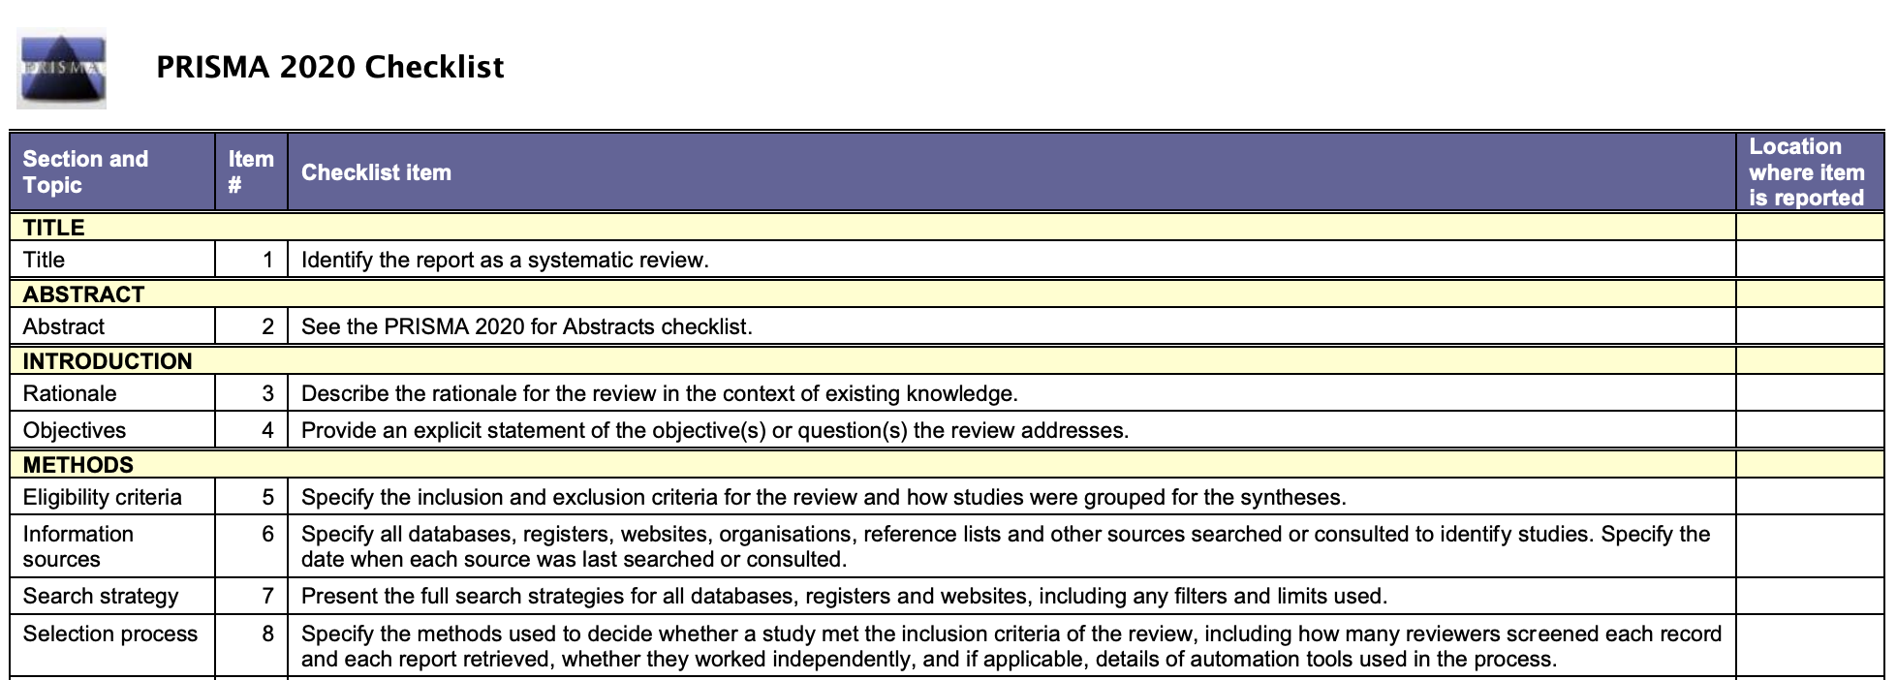
PRISMA Checklist (Excerpt)
http://www.prisma-statement.org/PRISMAStatement/Checklist

Slide 33
Before you begin your search….
You will want to complete the following steps
Formalize your research question ✅
Operationally define relevant constructs/phenomenon ✅
Search for any existing or in-progress systematic reviews or meta-analyses on your topic
Draft (and register) a protocol

Slide 34
Benefits of online registries
In systematic review registries such as PROSPERO, you can:
Search for existing current reviews
Register a planned review online
Publish protocol online
Update record on Prospero website as the review progresses
All of these steps can help to avoids duplication of reviews
https://www.crd.york.ac.uk/prospero

Slide 35
Writing and registering a protocol
The protocol sets out in advance the methods to be used in the review with the aim of minimizing bias.
The protocol should specify:
Review question
Define any relevant constructs/phenomena
Describe search strategy
List any inclusion and exclusion criteria (e.g., using PICOS)
Methods for data extraction
Plans for quality assessment of included studies
Analytic procedure for synthesizing results
Intentions for dissemination of findings

Slide 36
Also before you begin your search….
You may also want to
Talk to a librarian to help develop/review your search terms
Identify methods to locate unpublished and poorly indexed literature
Create a plan to stay organized
Document your process

Slide 37

Timelines and Gantt charts

Slide 38
Searching for Literature

Slide 39
Creating search phrases
Familiarize yourself with search conventions:
Boolean operands
Medical Subject Heading (MeSH) – especially for health/medicine related searches
*end of the ‘stem’ of the word it will automatically search for all the endings for that word stem
E.g., Child* will also return children, childbearing, childbirth and so on…

Slide 40
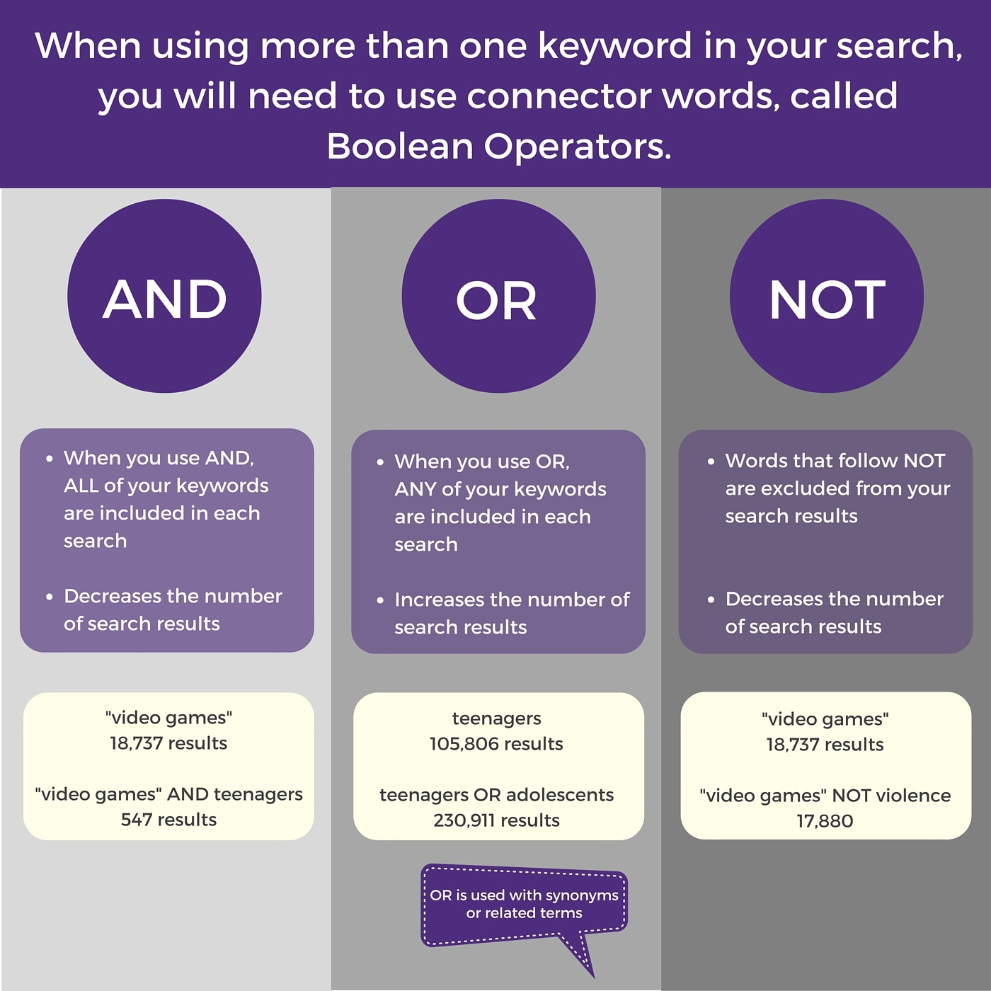
Boolean operators (English)
https://libguides.uww.edu/boolean
Notes:
39
APHO staff conference 2009

Slide 41
Where to begin searching?
Electronic databases for published work:
EBSCO, ProQuest, PsycINFO, PubMed, etc.
Grey literature for unpublished work:
ProQuest Dissertation and Theses
Conference proceedings
listservs
Look at the databases guidance for searching as they may vary!

Slide 42
Reference management
Use a reference manger!
Keep all citations retrieved and dates/keywords of search
Add in even citations you cannot immediately download
De-duplicate results
Sift citations for inclusion/exclusion
Can use codes/notes

Slide 43
Reference managers for systematic reviews
Any reference management software (e.g., Endnote, RefMan, ProCite, Mendeley, Zotero) will work, but some are specifically designed to assist in systematic reviews:
Covidence ($)
Rayyan (free)
HubMeta (for correlational meta-analyses only)

Slide 44
Screening Literature

Slide 45
Screening literature
Screening is one of the most time consuming parts of running a systematic review
Attempt to keep the screening transparent and reduce error
Pilot everything and refine through iteration
This process is meant to be collaborative

Slide 46
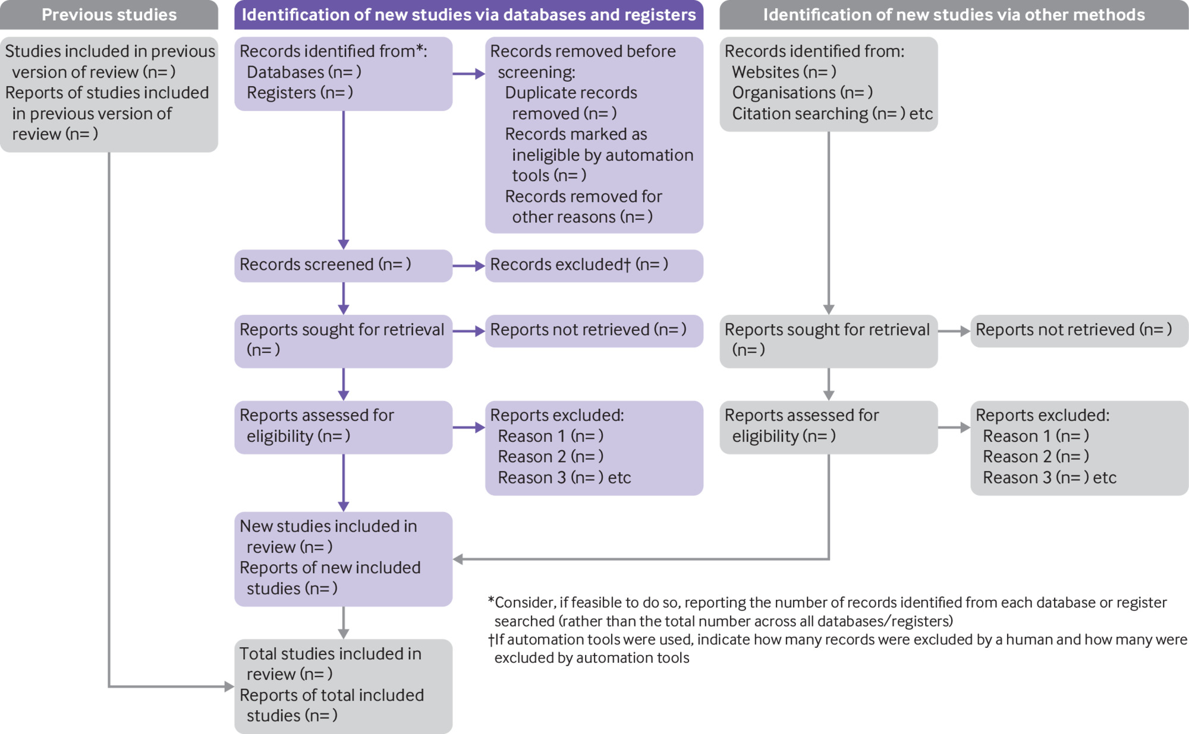
PRISMA Flow Diagram
Page, M. J., Moher, D., Bossuyt, P. M., Boutron, I., Hoffmann, T. C., Mulrow, C. D., ... & McKenzie, J. E. (2021). PRISMA 2020 explanation and elaboration: updated guidance and exemplars for reporting systematic reviews. bmj, 372, https://www.bmj.com/content/372/bmj.n160

Slide 47
Screening: Two Stages (at least)
Stage 1: Title/abstract screening
Assess citations based on titles and abstracts for inclusion against your predetermined criteria
If in doubt include in early stages of screening
Retrieve full text articles of initial selections
Stage 2: Full text screening
Assess full text of citation for inclusion
Requires judgement from more than one perspective (ideally >1 reviewer)
Check reviewer agreement (3rd review to resolve or achieve consensus)
Try to use a selection form to ensure consistency and record decisions

Slide 48
Data Extraction

Slide 49
Data extraction
Be clear what information you want from the studies:
Study details
Data for your analysis
Information will need to be collected relating to each study’s:
Methodology
Population
Interventions being compared
Outcomes evaluated

Slide 50
If planning to conduct a meta-analysis, give consideration to….
What effect measures you are you going to use?
What effect measures you are you going to need to calculate?
What data do you need to do this?
How are you planning to group effect sizes for the analysis?
By author?
By intervention?
By study design?
What information do you need to extract to enable you to organize and analyze the way you want?
Remember your protocol!

Slide 51
How data needs to be extracted?
A certain level of judgement is required
Extracted data from each study needs to be sufficient to
describe each study
allow you to undertake the planned analysis
prevent you from needing to return repeatedly to the full text
However, you need to limit unnecessary detail

Slide 52
What data are commonly extracted?
Study design
Descriptions of study groups
Diagnostic information
Treatments
Length of follow-up evaluation
Outcome measures

Slide 53
Data extraction software
There is a wide selection of software to choose from
Selection depends on a number of factors, above all, your research question/aim
Main considerations are probably
What are you are familiar with?
What package best suits your data?
How many included studies do you have?

Slide 54
Data extraction software
Some options include:
Spreadsheet programs (e.g., Excel, GoogleSheets)
Covidence ($) – can be used for citation screening and data extraction
RevMan (Cochrane)

Slide 55
Data extraction with multiple coders
For a rigorous systematic review, more than one coder must be involved in extracting data
Standardization and consistency is essential!
Independent piloting of data extraction forms – always use one standardized form
Data must be interpreted in the same way by all reviewers
Process of data extraction is iterative
Regular discussion of progress/disagreements
Regular comparison of data extraction – don’t wait till the end!

Slide 56
Efficient data extraction techniques
Once data extraction is complete you will likely need to:
Sort/search your data
Filter data
Calculate frequencies
Transform data (e.g., SE to SD)
Categorizing/coding data will make these tasks easier
Needs to be implemented with consistency by the whole team
A database can be designed to have this functionality

Slide 57
Other things to consider
Are you including more than one study design?
You may need separate forms for each study design
If so, make sure the core information extracted is the same
Have one or a few studies reported data differently from the others?
Will the data still be useful?
Should you include it?
Make sure the core information extracted is the same
You may need to update the form, or have more than one form
Any changes need to be agreed on by all data coders and made consistently for all studies

Slide 58
Other things to consider
Be careful about collecting “extra” data
Extract only data needed to answer the review question should have already been decided
Refer back to your protocol!

Slide 59
Risk of Bias and Quality Assessment

Slide 60
Bias Reduction Methods
Sources of Bias in the Meta-analysis
Researcher/
Author
Mitigation:
Bias in the analysis
Selective reporting
Bias risk assessment
Author follow-up
Publication
Mitigation:
“Gray literature”
Multiple indices of publication bias
Journal index
Meta-analyst
Mitigation:
2 reviewers co-extracted data from subset of studies
Data extraction
Bias Reduction Methods
(Stroup et al., 2000; Williamson et al., 2005)
Notes:
There are multiple possible sources of bias in a meta-analysis

Slide 61
Quality assessment and critical appraisal
Not all published and unpublished literature is rigorous
Quality may be used as an explanation for differences in study results or to guide interpretation of findings and the strengths/limitations of inferences that can be made from a study

Slide 62
Assessing risk of bias
You should incorporate risk of bias assessments into interpretation of findings
There are widely used tools for randomized and quasi-experimental designs (Cochrane Risk of Bias Tool and ROBINS-I)
There is less consensus about appropriate tools for observational studies
Make domain assessments of bias rather than global scores

Slide 63
Common types of bias
Database Bias - “No single database is likely to contain all published studies on a given subject.”
Publication Bias - selective publication of articles that show positive treatment of effects and statistical significance.
Hence, it is important to search for unpublished studies through a manual search of conference proceedings, correspondence with experts, and a search of clinical trials registries.
English-language bias - occurs when reviewers exclude papers published in languages other than English
Citation bias - occurs when studies with significant or positive results are referenced in other publications, compared with studies with inconclusive or negative findings
Notes:
Margaliot, Zvi, Kevin C. Chung. “Systematic Reviews: A Primer for Plastic Surgery Research.” PRS Journal. 120/7 (2007) p.1837

Slide 64
Quality assessment
Quality and risk of bias assessments
Cochrane RoB 2 – assess bias in RCTs
GRADE Risk of Bias – assess quality of systematic review
QUADAS 2– assess quality of systematic review
ROBIS for systematic reviews – assess quality of systematic review

Slide 65
Synthesis

Slide 66
Data synthesis
Results from different studies need to be synthesized
Are studies and results similar enough to be combined into a single numerical result?
NO – qualitative descriptive/narrative summary
YES – quantitative meta-analysis
Heterogeneity
Difference in results can arise due to differences in study design, population, selection, intervention delivery
How similar is similar? Results from heterogeneous studies should not be pooled

Slide 67
When can data in a systematic review be synthesized numerically?
When data are NOT too sparse, of too low quality or too heterogeneous
For example: the patients, interventions and outcomes in each of the included studies are sufficiently similar

Slide 68
Narrative synthesis
If it does not make sense or is not feasible to conduct a meta-analysis following a systematic review, a narrative synthesis may be a good option.
Advantages
May be sufficient in providing a synthesis of current literature and theory for a particular phenomenon
Disadvantages
Potential bias in presentation
May of a clear conclusion or key take-aways

Slide 69
Questions?
We’ll pause here for questions before beginning Part 2: Meta-analysis

