Slide 1
Part 2: Introduction to Meta-analysis
Teresa Ober, Ph.D.
Assistant Research Professor
University of Notre Dame
July 8, 2021

Slide 2
Overview of topics
Part 1: Systematic Review
What is a systematic review?
Best practices for systematic reviews
Question formulation
Creating a protocol
Searching for literature
Screening literature
Data extraction
Risk of bias and quality assessment
Synthesis
Part 2: Meta-analysis
What is a meta-analysis?
Effect size estimates
Fixed- and random-effects models
Conducting the meta-analysis
Reporting results
https://tmober.github.io/meta-workshop/
Notes:
In this the second hour, I will then talk about conducting a meta-analysis. It is during the second hour that you will be running some code. If you have not already, now might be a good time to install R and RStudio and the required packages listed on the website.

Slide 3
Aims of this session….
Receive overview of steps involved in a meta-analysis
Discuss effect size estimates and challenges to extraction
Gain an orientation to fixed- and random-effects models
Experience data extraction and meta-analysis
Outline the reporting of meta-analysis findings
https://tmober.github.io/meta-workshop/

Slide 4
What is a meta-analysis?
A statistical technique for combining the results of independent, but similar, studies to obtain an overall estimate of an effect.
Provides a
quantitative summary of the results included studies
mechanism for statistically examining variation in effect sizes across studies
Notes:
Margaliot, Zvi, Kevin C. Chung. “Systematic Reviews: A Primer for Plastic Surgery Research.” PRS Journal. 120/7 (2007) p.1840

Slide 5
When can data from a systematic review be synthesized in a meta-analysis?
When data are NOT too sparse, of too low quality or too heterogeneous
For example: the patients, interventions and outcomes in each of the included studies are sufficiently similar
Meta-analyses may or may not follow a systematic review
Selective meta-analysis v. systematic review + meta-analysis
Notes:
Research synthesis is a catch-all term for methods that we use to synthesize results from multiple studies
Systematic reviews and meta-analyses are often placed at the top of frameworks for understanding the hierarchy of evidence. But, with great power comes great responsibility
Remember: Best practice changes over time

Slide 6
Effect size estimates

Slide 7
Decide on the appropriate effect size
When developing the protocol you should identify the effect size(s) that are most appropriate to the research question
Within behavioural science commonly used effect sizes include
Correlations
Standardized mean differences
Odds ratios

Slide 8
Data for correlations
r and N
r and SE
r and variance
Fisher’s Z and N
Fisher’s Z and SE
r and t value
t value and sample size (for correlation)
p value and sample size (for correlation)

Slide 9
Data for standardized mean differences
Mean, SD or SE, and N for each group
d and confidence interval
d and variance
p value and n
And much more…

Slide 10
Data for odds ratios
2 x 2 frequency table
Odds ratio and confidence intervals
Risk difference
Risk ratio
And much more…
Meta-analyses involving odds ratios are very common in meta-analyses involving health and medicine outcomes, though less common in meta-analyses with social, behavioral, or educational outcomes.

Slide 11
Extracting effect sizes for meta-analysis
Two reviewers extract effect size data from each paper, extraction is compared and disagreements resolved through consensus
Each reviewer records
Data required to calculate the effect size
Test statistics (e.g. p values, t values) relevant to the effect size
Assumptions made when extracting data
This is what should occur in an ideal world, where all effect sizes are well described in all included studies

Slide 12
Minimum data extraction for correlations
Study ID | r | N | Exact P value* | Location in Text | Notes
*Extracting the p-value is a not a bad idea, though not necessary for correlations as long as the correlation coefficients (r) and sample size (N) values are available.

Slide 13
Minimum data extraction for standardized mean difference
Study ID | Means group 1 | N group 1 | SD group 1 | Means group 2 | N group 2 | SD group 2 | Exact p value | Location in Text | Notes

Slide 14
Minimum data extraction for odds ratio
Study ID | N events group 1 | N non-events group 1 | N events group 2 | N non-events group 2 | Exact p value | Location in Text | Notes

Slide 15

Activity 1: Data Extraction
You are going to try extracting data yourself!
Study Description:
You are attempting to extract data for a meta-analysis that will determine an average effect size between executive functions (working memory/updating task-switching, and inhibitory control)and decoding (word reading/non-word reading), a foundational aspect of reading.
You will need to extract at least one effect size from a study that meets the inclusion criteria.

Slide 16
Activity 1: Data Extraction
Go to the URL here:
Open the GoogleForm: https://forms.gle/479WBcH42EXiX2Hm6
Download Kieffer et al. (2013), find at least one effect size estimate, and enter that effect size and the accompanying information into the form
When you are done, you should be able to view the responses here: https://docs.google.com/spreadsheets/d/1uQ-RgROwNAboQvsaKgVkv02whsFDE4fdHE5eW-vv7WU/
Kieffer, M. J., Vukovic, R. K., & Berry, D. (2013). Roles of attention shifting and inhibitory control in fourth‐grade reading comprehension. Reading Research Quarterly, 48(4), 333-348. https://doi.org/10.1002/rrq.54

Slide 17
Activity 1: Data Extraction
The data is not so different than that which you might use for analysis
However, several additional data preparation steps are necessary, including
Effect size conversion (typically Pearson r undergoes Fisher’s Z-transformation before analysis)
Compilation of different effect sizes

Slide 18
Compiling effect sizes: Challenges
In the perfect world all studies are well described. Sadly, this is often not the case.
Studies commonly do not report information in the format that you would find most helpful
Even after trying to extract maximal data from all studies you’ll often need to contact authors
You may also need to use a number of formulas* different to calculate effect sizes based on the information provided
* Useful article with formulas for doing this: Polanin, J. R., & Snilstveit, B. (2016). Converting between effect sizes. Campbell Systematic Reviews, 12(1), 1-13. https://doi.org/10.4073/cmpn.2016.3

Slide 19
Compiling effect sizes: Challenges
It is especially important to use best practice to report how you extracted effect sizes when studies are not perfectly reported.
You will (often) need to make assumptions when extracting data and it must be clear to readers (and future you) what those were so your meta-analysis can be replicated

Slide 20
Compiling effect sizes – Comparison of options
 | Advantages | Disadvantages
CMA | Easy to compile effect sizes in different formats | Expensive Meta-analysis is relatively “black box”
Online calculators | Free Allows for very specialized effect size calculations that aren’t built into any software | Very time consuming if you have a lot to calculate Can be difficult to reproduce your calculation
R packages (particularly the escalc function in metaphor) | Free Reproducible | Intimidating if you’re not familiar with R
Kothe, E. (2016). Systematic reviews and meta-Analysis in behavioural medicine: A practical introduction to best practices. doi:10.17605/OSF.IO/6BK7B
Notes:
Depending on the scope of your analysis and the software you’re using you have a number of options
CMA (Comprehensive Meta-Analysis) allows direct entry of 100 different data formats
Online calculators can be used to hand calculate effect sizes using different data formats
R packages to compile effect sizes to prepare for analysis

Slide 21
Fixed- and Random-Effects

Slide 22
Choosing your model
Most meta-analytic software packages incorporate two statistical models for meta-analysis, the fixed-effect model and the random-effects model.
You should choose which one you will use in the protocol stage

Slide 23
Fixed effect vs. Random effects meta-analysis
Fixed effect meta-analysis assumes that the underlying true effect does not vary between studies and that variations in observed effects are due to sampling error
Random effects meta-analysis assumes that the true effect does vary between studies within the meta-analysis and that variation in observed effects are due to sampling error and by moderators of the effect

Slide 24
Fixed effect vs. Random effects meta-analysis
Increasingly, meta-analysts recommend that random effects meta-analysis be the default analysis
Because
The assumptions underlying the fixed effect model are almost never supported
Using a random effects model when the fixed effect model is true gives the same results as running the fixed effect model but running a FE model when random effects is true gives misleading results

Slide 25
Conducting the Meta-analysis

Slide 26
Conducting the Meta-analysis
Now that we have extracted the data, running the actual meta-analysis should be relatively straightforward
However, it does involve several important steps

Slide 27
Steps for Conducting the Meta-analysis
Import appropriately formatted data
Compile or calculate effect sizes and create summary table
Visually inspect for outliers
Run main meta-analytic model
Calculate and interpret heterogeneity
Check again for influential points
Generate forest plot
Conduct meta-regression analysis
Test for publication bias

Slide 28
Outlier analysis
A data point is considered an outlier if the predicted value (y) of an input variable (x) does not follow the general trend of the rest of the data
A data point is influential if it unduly influences any part of a regression analysis
A common rule is to flag any observation whose leverage value is more than 3 times larger than the mean leverage value

Slide 29
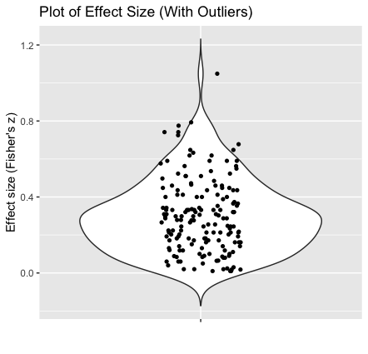
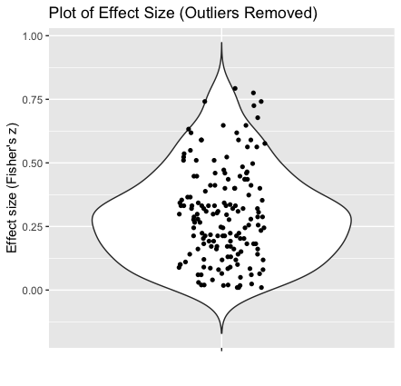
Outlier analysis: Violin plots
After compiling/transforming effect sizes, violin plots can be used to inspect potential outliers

Slide 30
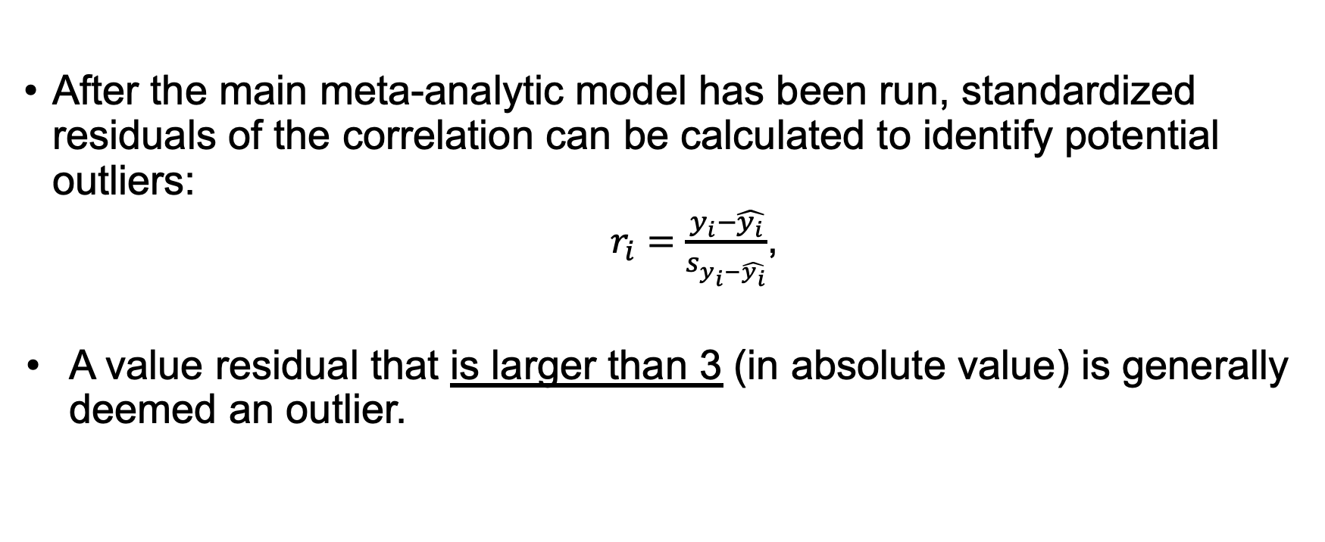
Outlier analysis: Standardized residuals of correlations
After the main meta-analytic model has been run, standardized residuals of the correlation can be calculated to identify potential outliers:
$r_{i}=\frac{y_{i}−\hat{y_{i}}}{s_{y_{i}−\hat{y_{i}}}}$,
A value residual that is larger than 3 (in absolute value) is generally deemed an outlier.
https://online.stat.psu.edu/stat501/book/export/html/973

Slide 31
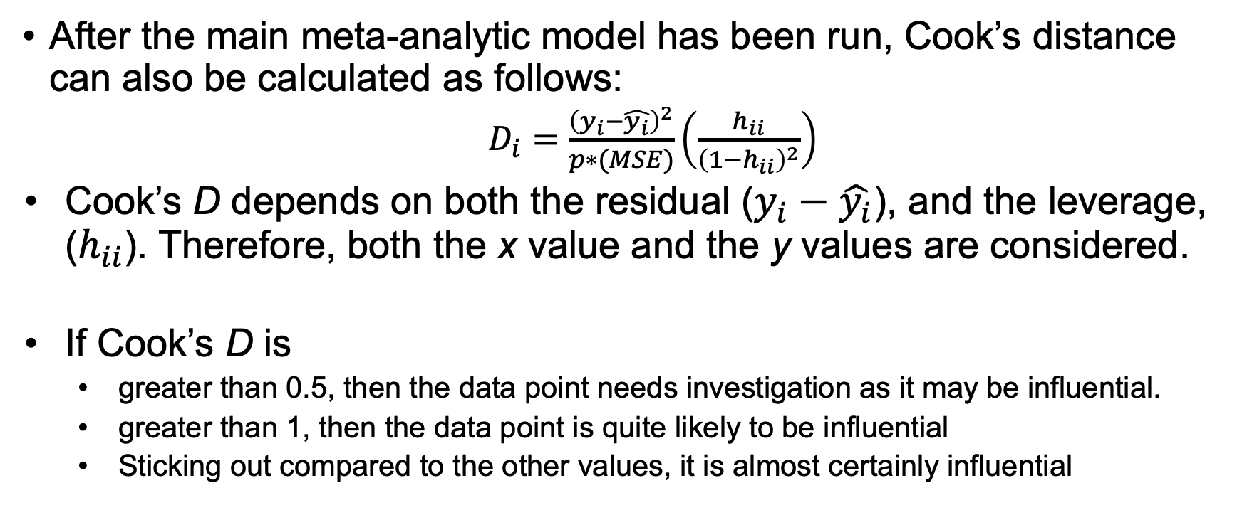
Outlier analysis: Cook’s distance
After the main meta-analytic model has been run, Cook’s distance can also be calculated as follows:
$D_{i}=\frac{{\left(y_{i}−\hat{y_{i}}\right)}^{2}}{p∗(MSE)}\left(\frac{h_{ii}}{{\left(1−h_{ii}\right)}^{2}}\right)$
Cook’s D depends on both the residual ($y_{i}−\hat{y_{i}}$), and the leverage, ($h_{ii}$). Therefore, both the x value and the y values are considered.
If Cook’s D is
greater than 0.5, then the data point needs investigation as it may be influential.
greater than 1, then the data point is quite likely to be influential
Sticking out compared to the other values, it is almost certainly influential
https://online.stat.psu.edu/stat501/book/export/html/973

Slide 32
Main meta-analytic model
To conduct the meta-analysis, you will need data properly formatted with an effect size and variance estimate for all included studies
You will also need to consider the structure of your data and relations between effect estimates. For example,
Are multiple effects from the same citation?
Is it possible multiple effects (even from different citations) involve the same participants?
If there are interdependencies, you will need to specify a model that handles this type of data structure

Slide 33
Heterogeneity of effect sizes
Heterogeneity refers to variation in study outcomes between studies
It is important to consider to what extent the results of studies are consistent
Large heterogeneity may justify meta-regression analyses (discussed later)
https://handbook-5-1.cochrane.org/chapter_9/9_5_2_identifying_and_measuring_heterogeneity.htm

Slide 34
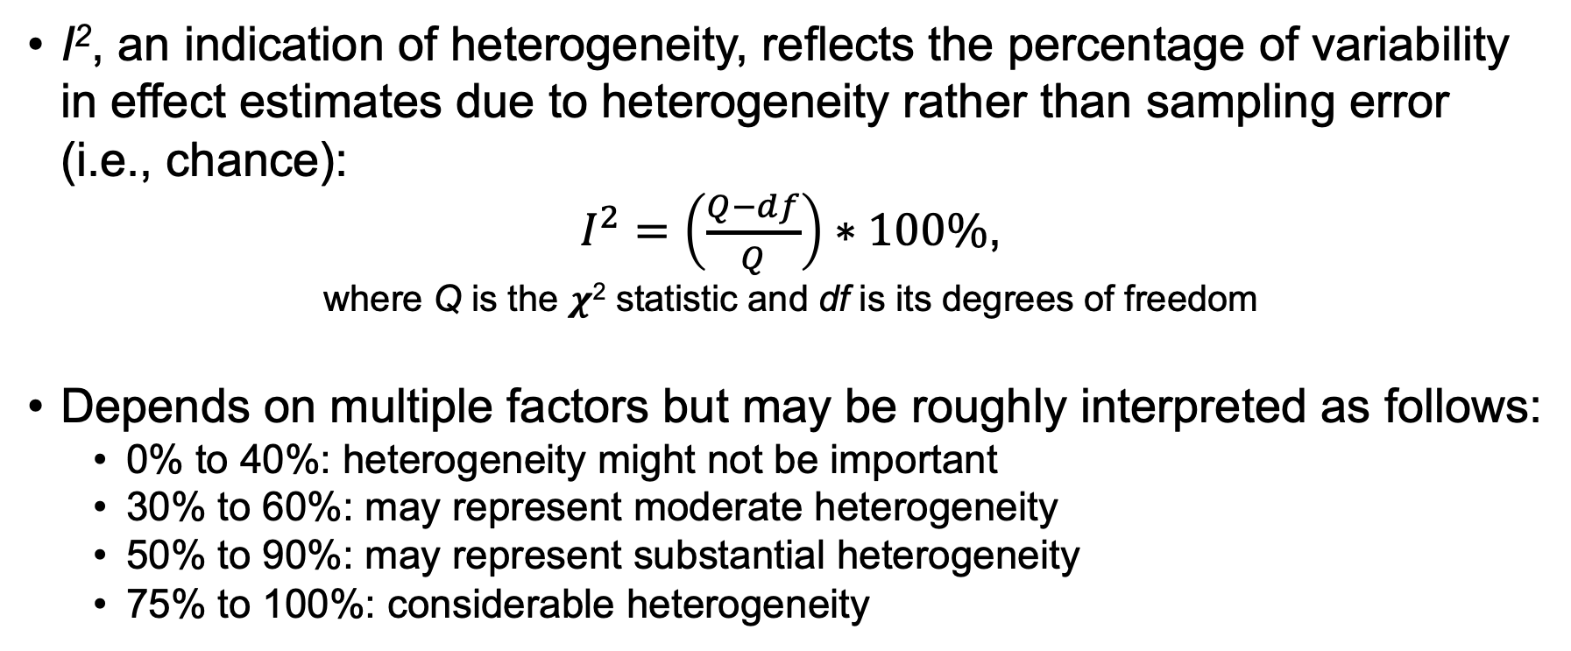
Heterogeneity of effect sizes: I²
I², an indication of heterogeneity, reflects the percentage of variability in effect estimates due to heterogeneity rather than sampling error (i.e., chance):
$I^{2}=\left(\frac{Q−df}{Q}\right)∗100\%$,
where Q is the 𝝌² statistic and df is its degrees of freedom
Depends on multiple factors but may be roughly interpreted as follows:
0% to 40%: heterogeneity might not be important
30% to 60%: may represent moderate heterogeneity
50% to 90%: may represent substantial heterogeneity
75% to 100%: considerable heterogeneity
https://handbook-5-1.cochrane.org/chapter_9/9_5_2_identifying_and_measuring_heterogeneity.htm

Slide 35
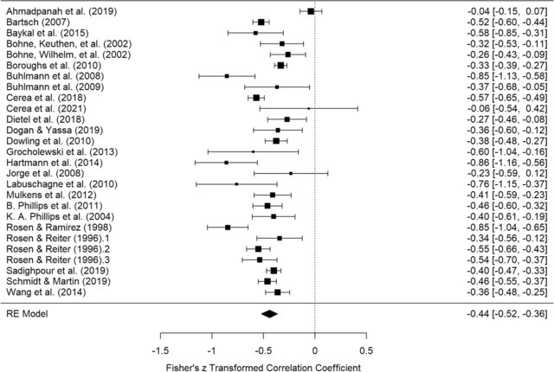
Forrest plots
Correlations
Kuck, N., Cafitz, L., Bürkner, P. C., Hoppen, L., Wilhelm, S., & Buhlmann, U. (2021). Body dysmorphic disorder and self-esteem: A meta-analysis. BMC psychiatry, 21(1), 1-16.

Slide 36
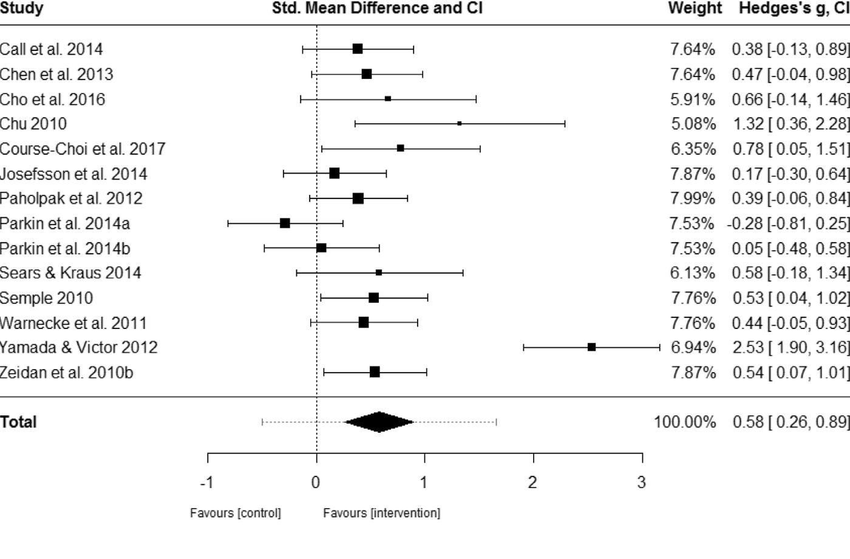
Forrest plots
Standard mean difference
Blanck, P., Perleth, S., Heidenreich, T., Kröger, P., Ditzen, B., Bents, H., & Mander, J. (2018). Behaviour Research and Therapy, 102, 25–35.

Slide 37
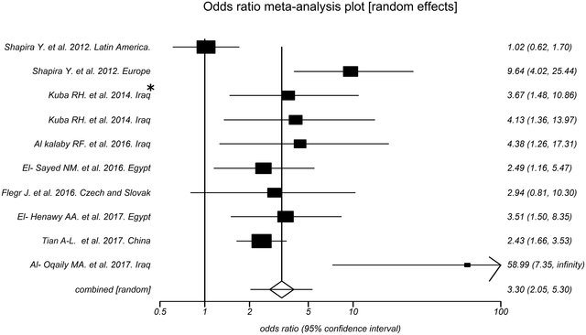
Forrest plots
Odds ratio
Hosseininejad, Z., Sharif, M., Sarvi, S., Amouei, A., Hosseini, S. A., Nayeri Chegeni, T., ... & Daryani, A. (2018). Toxoplasmosis seroprevalence in rheumatoid arthritis patients: a systematic review and meta-analysis. PLoS Neglected Tropical Diseases, 12(6), e0006545.

Slide 38
Meta-regression
After we have conducted the meta-analysis and determined an overall effect size estimate, additional analyses can be very informative.
For example, if we have evidence of heterogeneity (i.e., variation in effect size estimates), we may want to conduct a meta-regression to determine whether certain study variables explain variation in effect sizes
Meta-regression is sometimes also referred to as a “moderator analysis”

Slide 39
Evaluating for publication bias
Publication bias occurs when the outcome of a study influences the likelihood it will be published
It is important to try to understand whether the results of a meta-analysis may be influenced by publication bias
Several methods
Egger’s test
Rosenthal’s fail-safe N
Trim-and-fill funnel plot

Slide 40
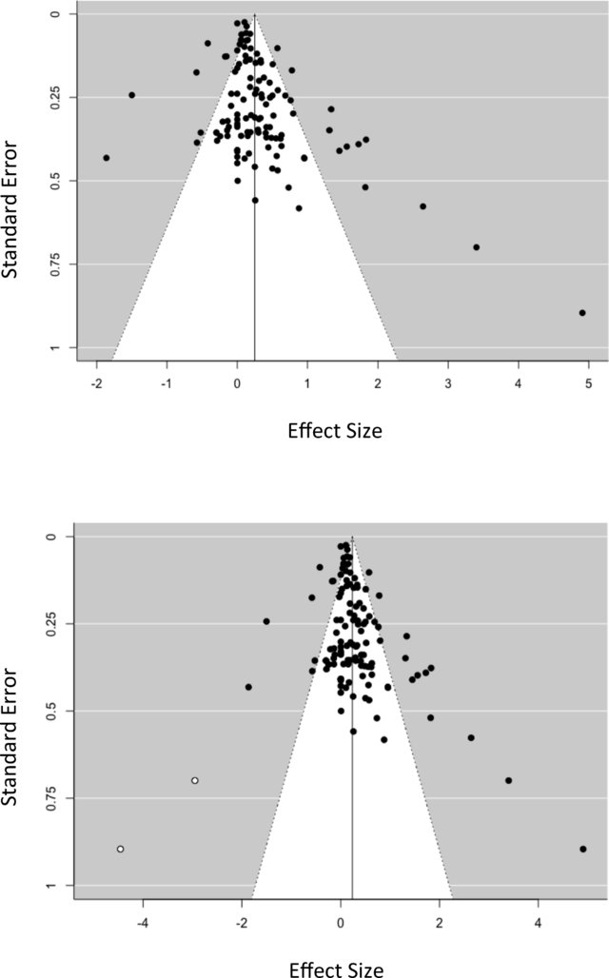
Evaluating for publication bias
Funnel plot (left) and trim-and-fill funnel plot (right)
Asymmetry may indicate publication bias
Beelmann, A., & Lösel, F. (2020). A comprehensive meta-analysis of randomized evaluations of the effect of child social skills training on antisocial development. Journal of Developmental and Life-Course Criminology, 1-25.

Slide 41
Useful R packages
metafor
Good all-round package for running meta-analysis and meta-regression
robumeta
Good for meta-analyses where effects have a high degree of interdependence (note that this type of can also be be conducted using metafor)

Slide 42
Other useful software
STATA
Comprehensive Meta-analysis (CMA)
JASP - Bayesian approach to meta-analysis

Slide 43
Activity 2: Meta-analysis
Open R or Rstudio
Go to the following URL:
https://tmober.github.io/meta-workshop/example-meta-script.html
Download the script and take a moment to install/load the required packages into your R library

Slide 44
Other types of meta-analyses
Meta-analyses can be conducted using a variety of techniques, including:
Longitudinal meta-analysis (metafor in R)
Structural Equation Modeling Meta-analysis (metaSEM in R)
Bayesian meta-analysis (JASP software)
More new methods are constantly evolving!

Slide 45
Reporting Results

Slide 46
Manuscript Preparation
Somewhat different based on discipline, but ultimately, a typical manuscript describing a meta-analysis should include:
Introduction
Justifies why the review/meta-analysis was conducted
Methods
Describe the literature search, specifically the databases used, and if the search was restricted in any way.
The selection process for articles, quality assessment, methods of data abstraction, and synthesis.

Slide 47
Manuscript Preparation
Results
Include a flow chart of studies included
Include a Table that lists all effect size estimates and key study variables
A figure displaying the results from each individual study (forest plot), results of heterogeneity testing, overall summary statistic, and results of a sensitivity analysis and meta-regression, if performed.
Discussion
Explains how the findings advance an understanding of the topic

Slide 48
Strive for Openness
Consider making data and analysis script available via an online repository (e.g., Open Science Framework)
Update any pre-registrations and note status and any major deviations from protocol

Slide 49
Additional Online Resources
Coursera: https://www.coursera.org/learn/systematic-review
Cochrane Learning: https://training.cochrane.org/interactivelearning

Slide 50
Questions?
We’ll pause here for questions about either Part 1 (Systematic review) or Part 2 (Meta-analysis)

