Slide 1

$$\hat{y}>{\hat{y}}_{max}^{∗}$$
C
S
I
S_{D}
S_{P}

Slide 2





Potentiation supervisor
Potentiation and depression supervisors
C
I
S_{P}
$Z$_{D}
$$\hat{y}>{\hat{y}}_{min}^{∗}$$
$Z$_{P}
S_{D}
C
I
S_{P}
$$\hat{y}>{\hat{y}}_{max}^{∗}$$
$$\hat{y}>{\hat{y}}_{min}^{∗}$$
$Z$_{P}

Slide 3








Target supervisor
Critic supervisor
$$y$$
$Z$_{D}
$$y$$
$y=0$, $\hat{y}=1$
C
S
C
S
$$y=1$$
$$\hat{y}$$
$Z$_{P}
$y=1$,$\hat{y}=0$
$Z$_{P}

Slide 4





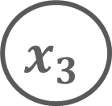






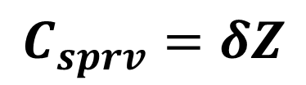
$$C_{local}^{i}=αx_{i}$$
$$x_{1}$$
$$w_{1}$$
$$C_{het} =β∗\left(\sum_{i = 1}^{N}{w_{i}x_{i}}\right)$$
$$w_{2}$$
$$∑$$
$$x_{2}$$
$$\hat{y}$$
$$C_{BAP}=γ\hat{y}$$
$$w_{3}$$
$$x_{3}$$
$$Z$$
$$C_{sprv}=δZ$$

Slide 5
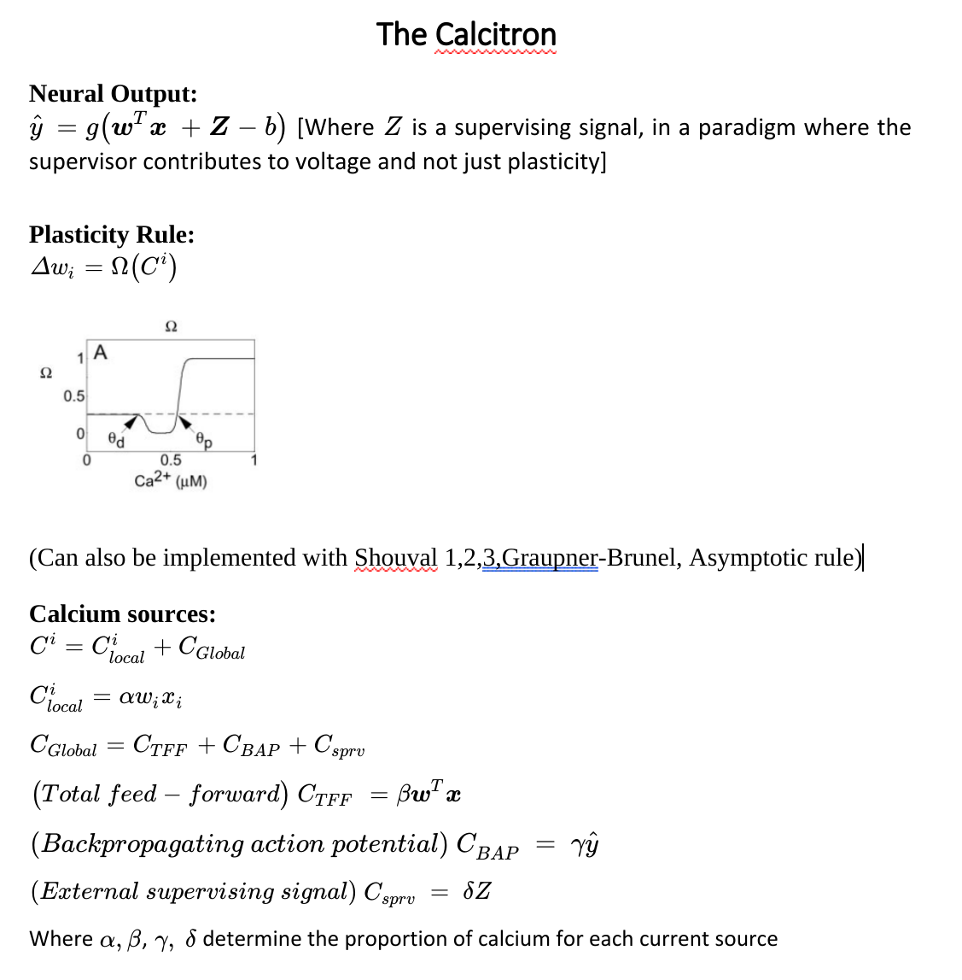

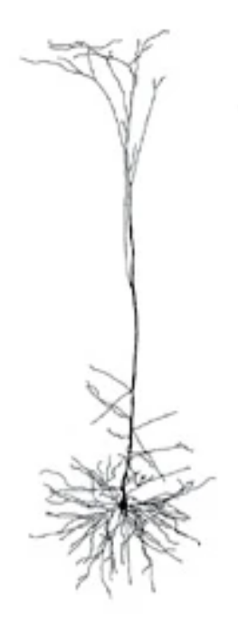



The Calcitron

Slide 6
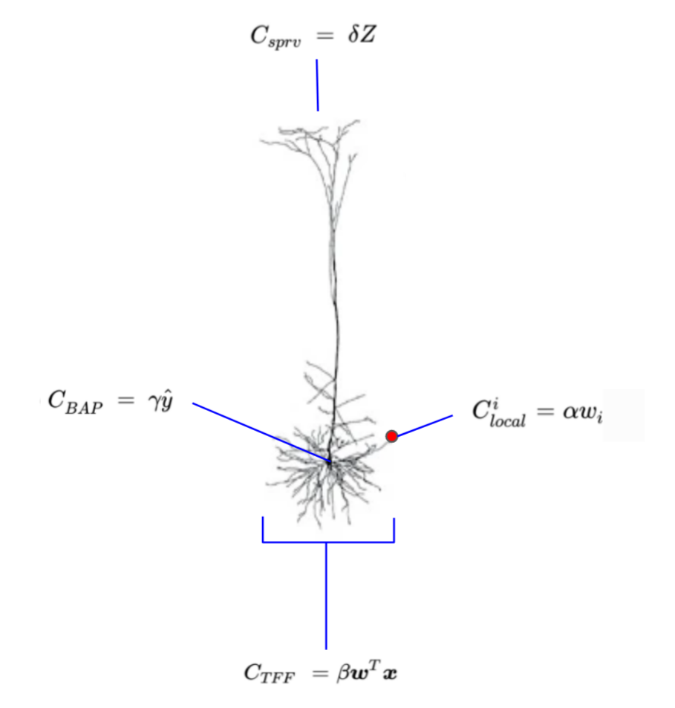
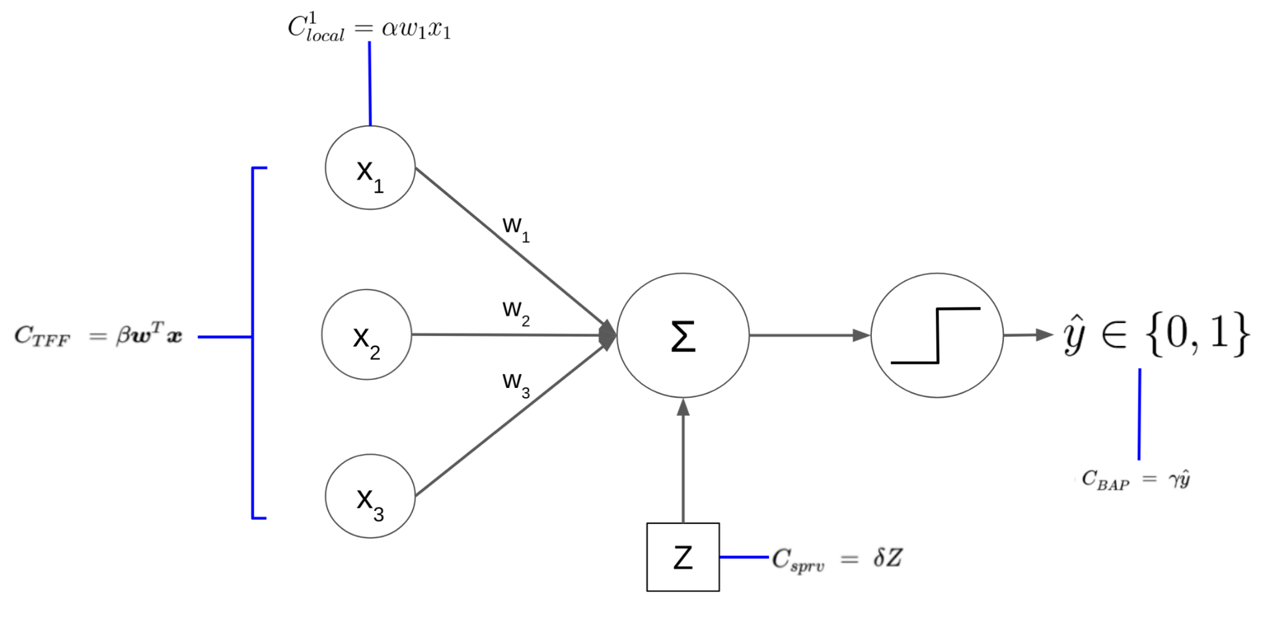


The Calcitron

Slide 7
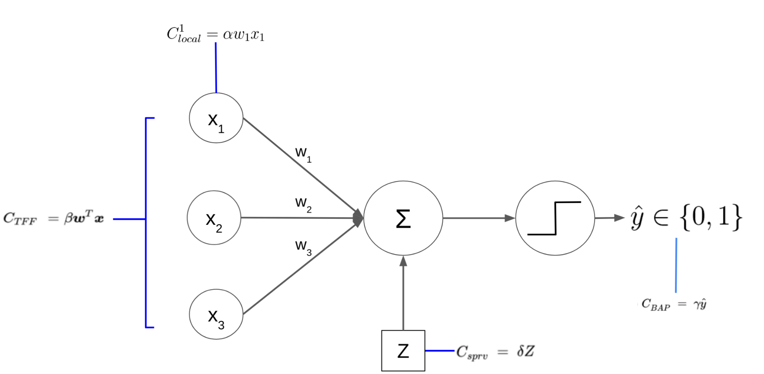
The Calcitron

