Slide 1
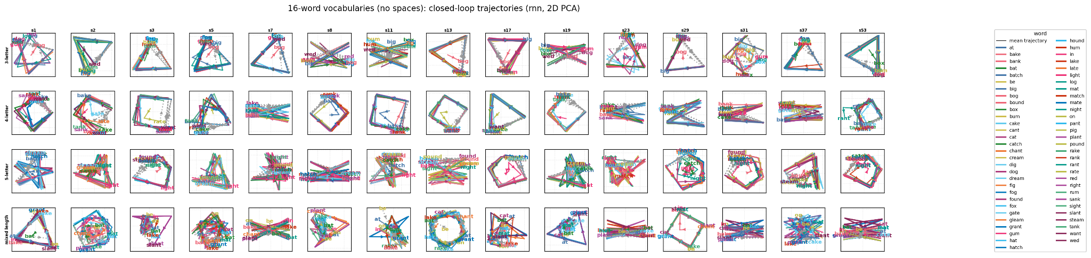
Recurrent networks trained on statistical learning tasks reveal principles of neural sequence representation

Slide 2
The big picture
The brain needs to store and represent sequences of primitives (phonemes->words, muscle movements->motor sequences, etc.). How are these representations stored in the brain, and how are they recalled/produced in a sequential manner?

Slide 3
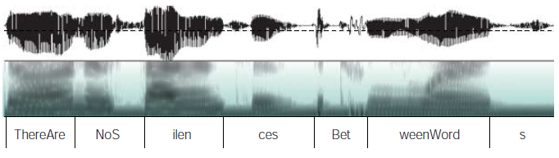
Statistical Learning and Language Acquisition
Saffran, Newport, Aslin. Science (1996). “Statistical Learning By 8-Month-Old Infants.”
How do infants learn to segment auditory information into individual words?
Kuhl, P. K. (2004) Early language acquisition: cracking the speech code. Nature Reviews Neuroscience, 5(11):831--843.

Slide 4
Statistical Language Segmentation: Saffran Experiment
Pseudo-words, like bupado and kutaba, were randomly concatenated and presented to infants in sequences such as:
bupadokutabakutababupadobupadokutaba
In a probing session, infants demonstrated a greater familiarity with the “words”, bupado and kutaba, than they did with non-words that crossed word boundaries, like padoku
Conclusion: transitional probabilities between syllables allow infants to segment speech into individual words
bu pa do ku ta ba
1.0
1.0
0.5
1.0
1.0

Slide 5
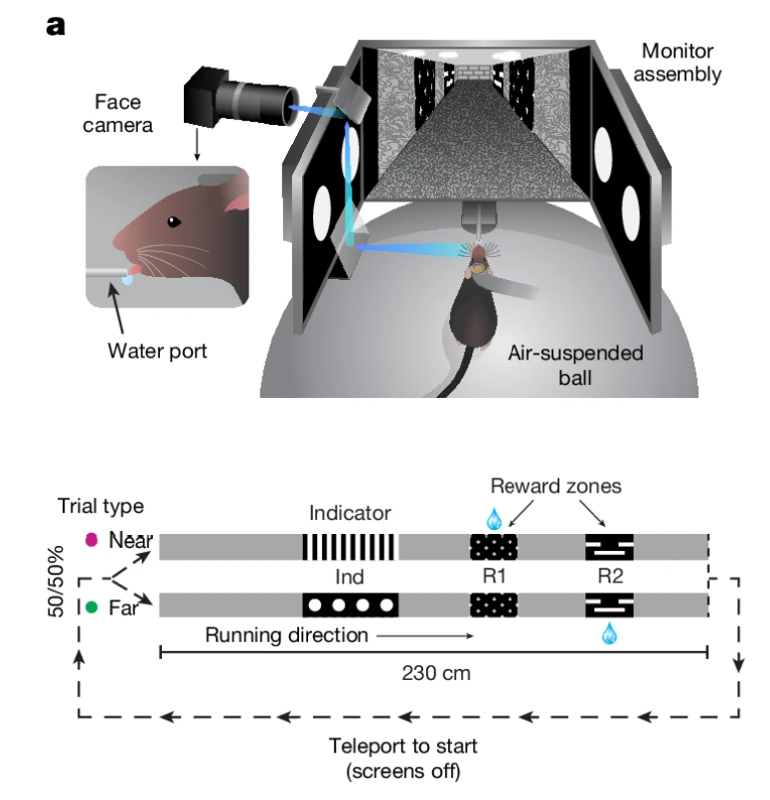
Generic statistical learning
The two maze conditions are like two ‘words’ that need to be memorized.
Sun, W., Winnubst, J., Natrajan, M. et al. Learning produces an orthogonalized state machine in the hippocampus. Nature 640, 165–175 (2025). https://doi.org/10.1038/s41586-024-08548-w

Slide 6
Assumptions
To a first approximation, the brain is a recurrent neural network.
The output of the brain at any given time is a function of the state of the network at that time; the output of the network over a period of time is a trajectory through the state space.
The brain originally learns sequences without any prior assumptions about sequence structure; all learned structure is emergent from naive next token prediction.
Once learned, the brain produces sequences via a closed loop process - it generates (predicts) a token, which is fed as an input to the network at the next time step.

Slide 7
Specific questions to be addressed
What do trajectory geometries generally look like for learned sequences (words)?
How stable is the representational geometry over multiple random seeds? (Multiple realizability).
How does word length influence trajectory geometry?
How does the number of words stored influence trajectory geometry?
Why does the trajectory geometry look the way it does?
What sort of features (specific token, position in sequence, DFA state) are easily read out of the neural representation?
What sort of features do we see in single-neuron responses?

Slide 8
Questions be addressed
How is lexical information (word position, character, etc.) represented in a recurrent network that learns to produce words?
How does network’s representation of information change with vocabulary complexity?
How do the network’s weights differ as a function of the complexity of the learned vocabulary (function->structure).

Slide 9
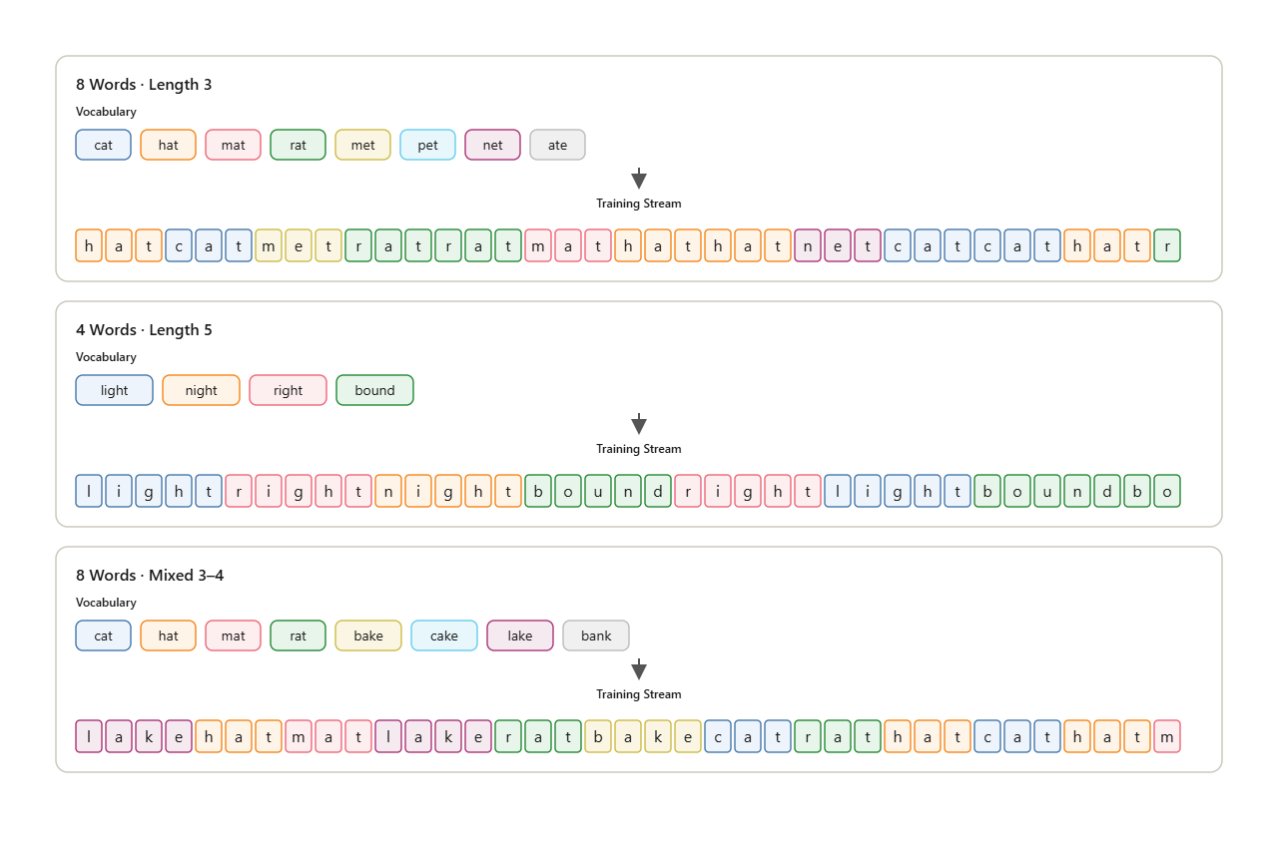
Vocabularies for statistical learning

Slide 10
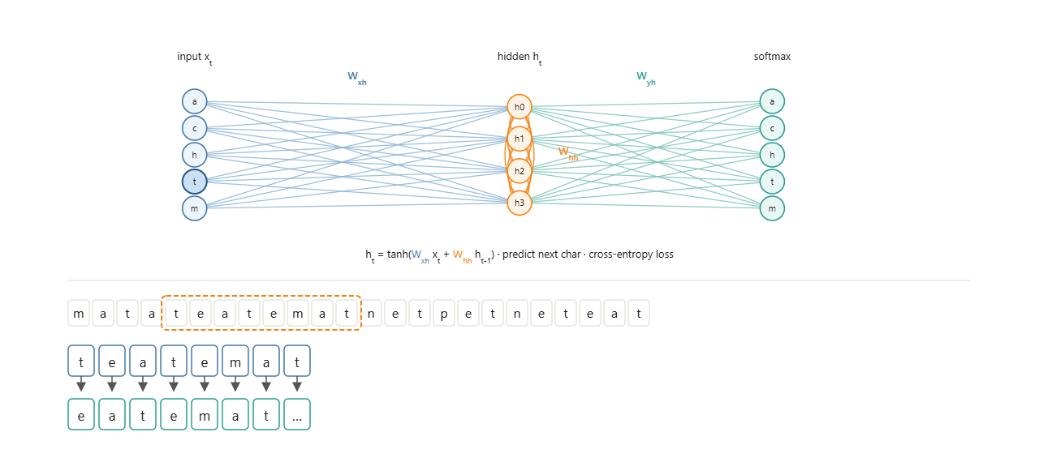
Training an RNN

Slide 11
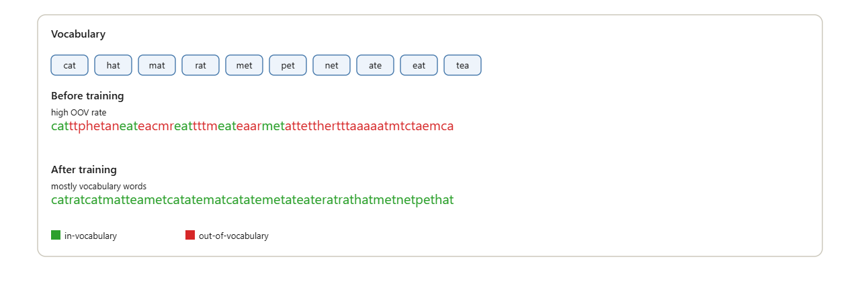
Evaluation

Slide 12
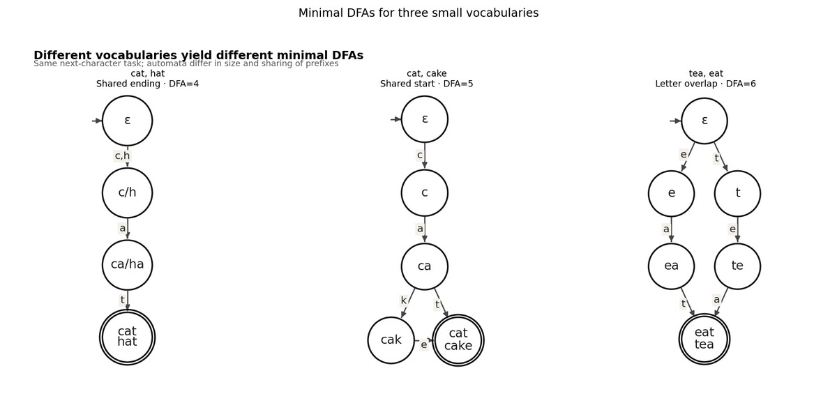
Minimal DFAs for three small vocabularies

Slide 13
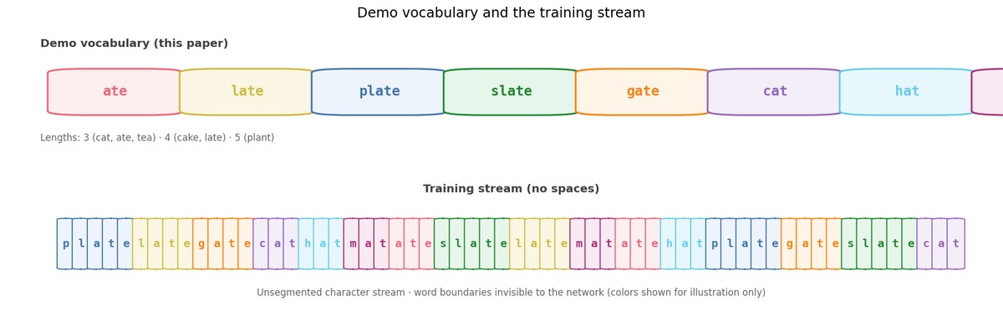
Demo vocabulary and training stream

Slide 14
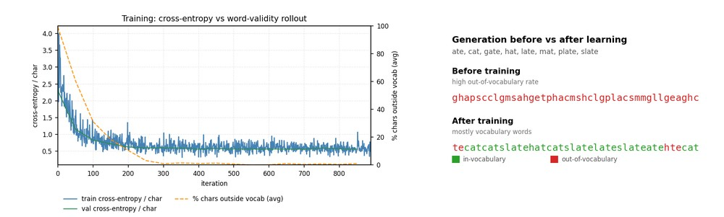
Learning curve and generation

Slide 15
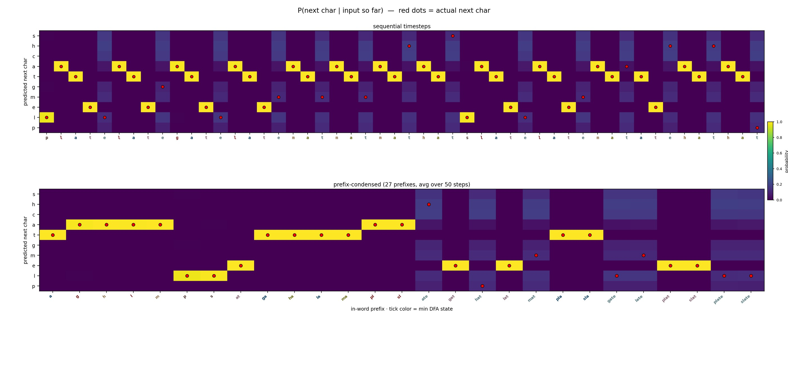
Next-character probabilities

Slide 16
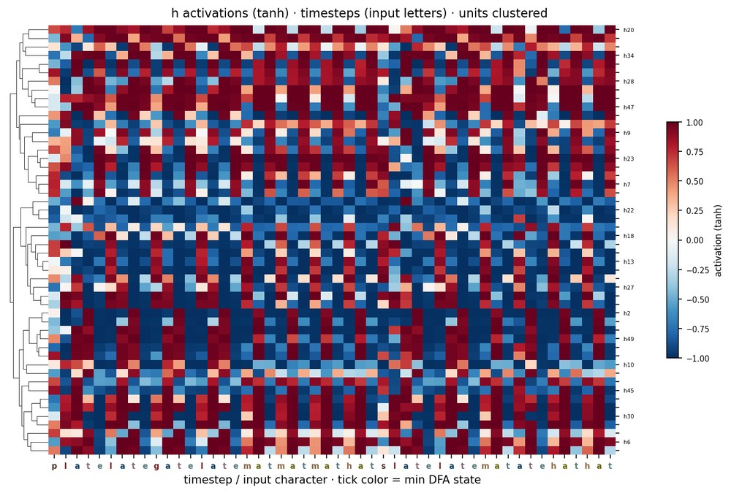
Activation heatmap

Slide 17
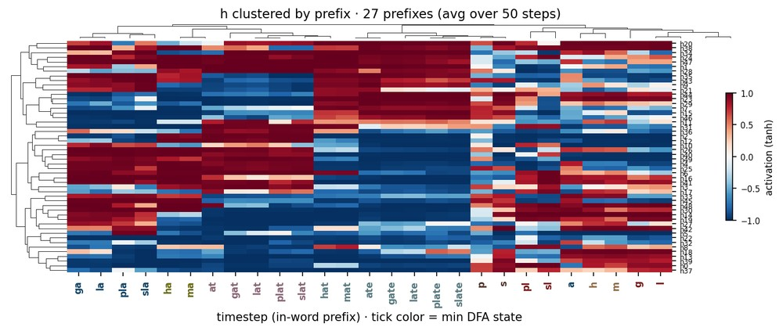
Activations clustered by prefix

Slide 18
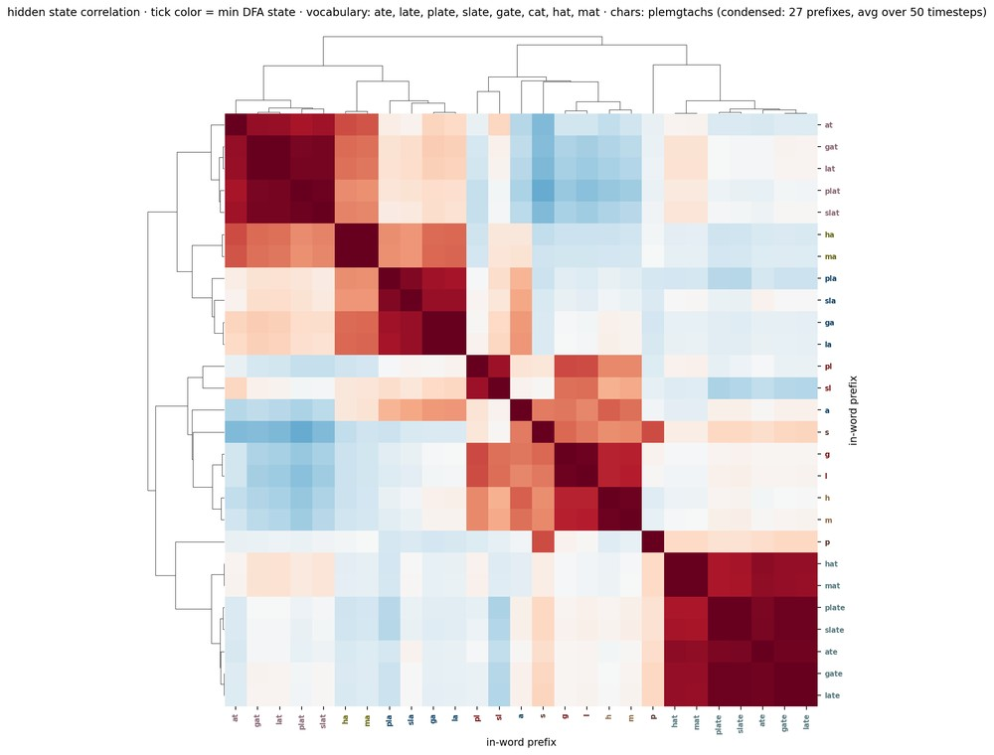
Hidden-state correlation

Slide 19
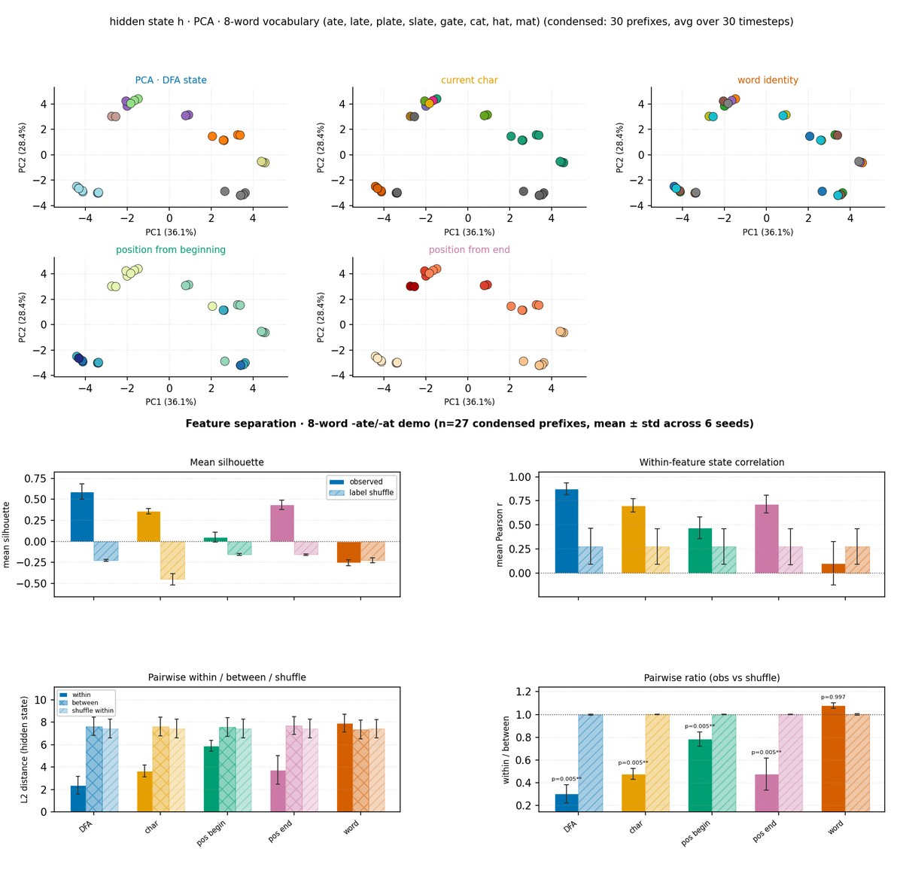
DFA PCA geometry and feature separation

Slide 20
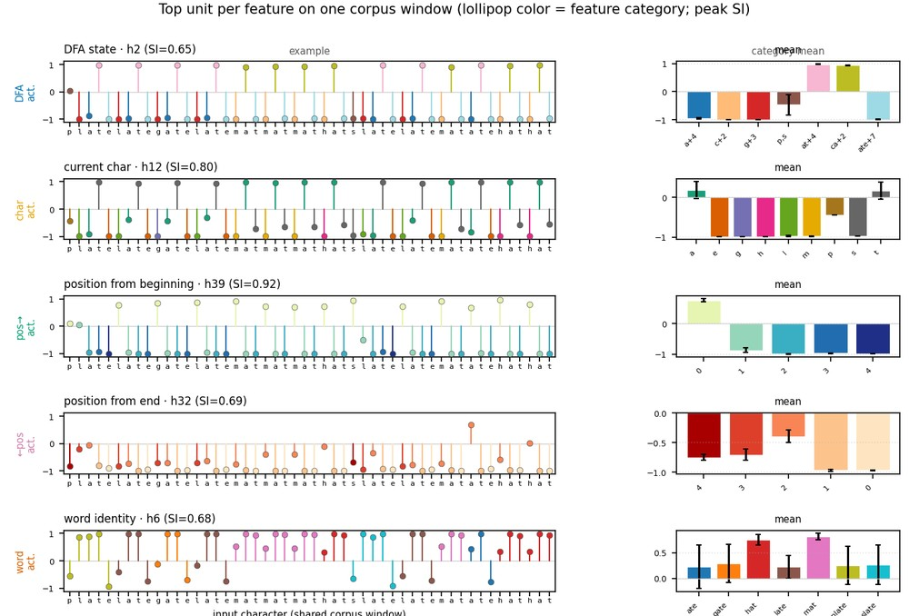
Example selective units

Slide 21
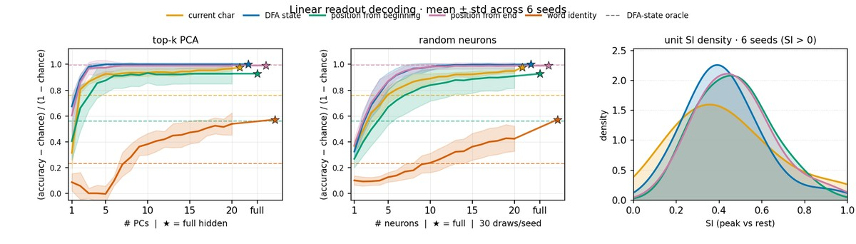
Linear decoding with word identity

Slide 22
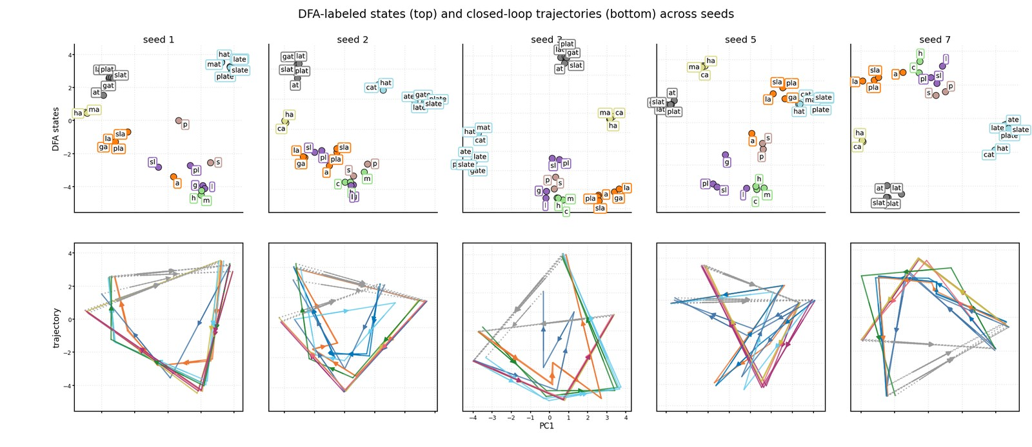
DFA states and trajectories across seeds

Slide 23
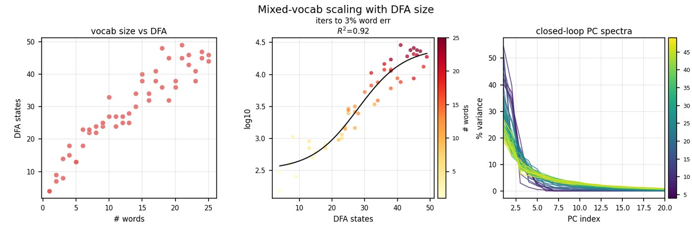
Mixed-vocab scaling overview

Slide 24
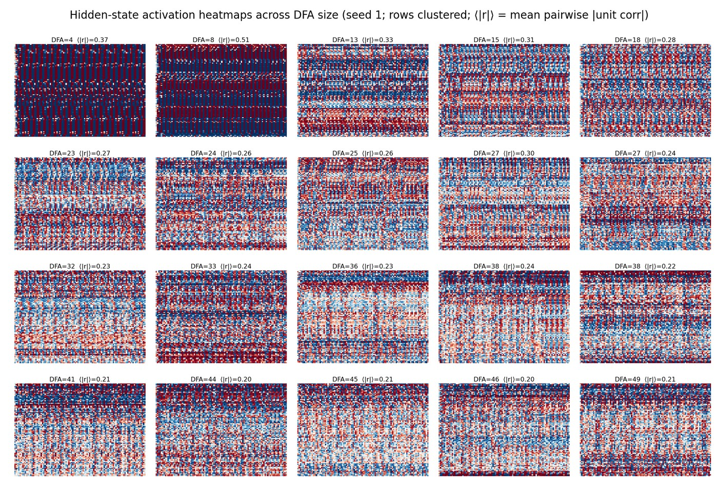
Activation heatmaps across DFA size

Slide 25
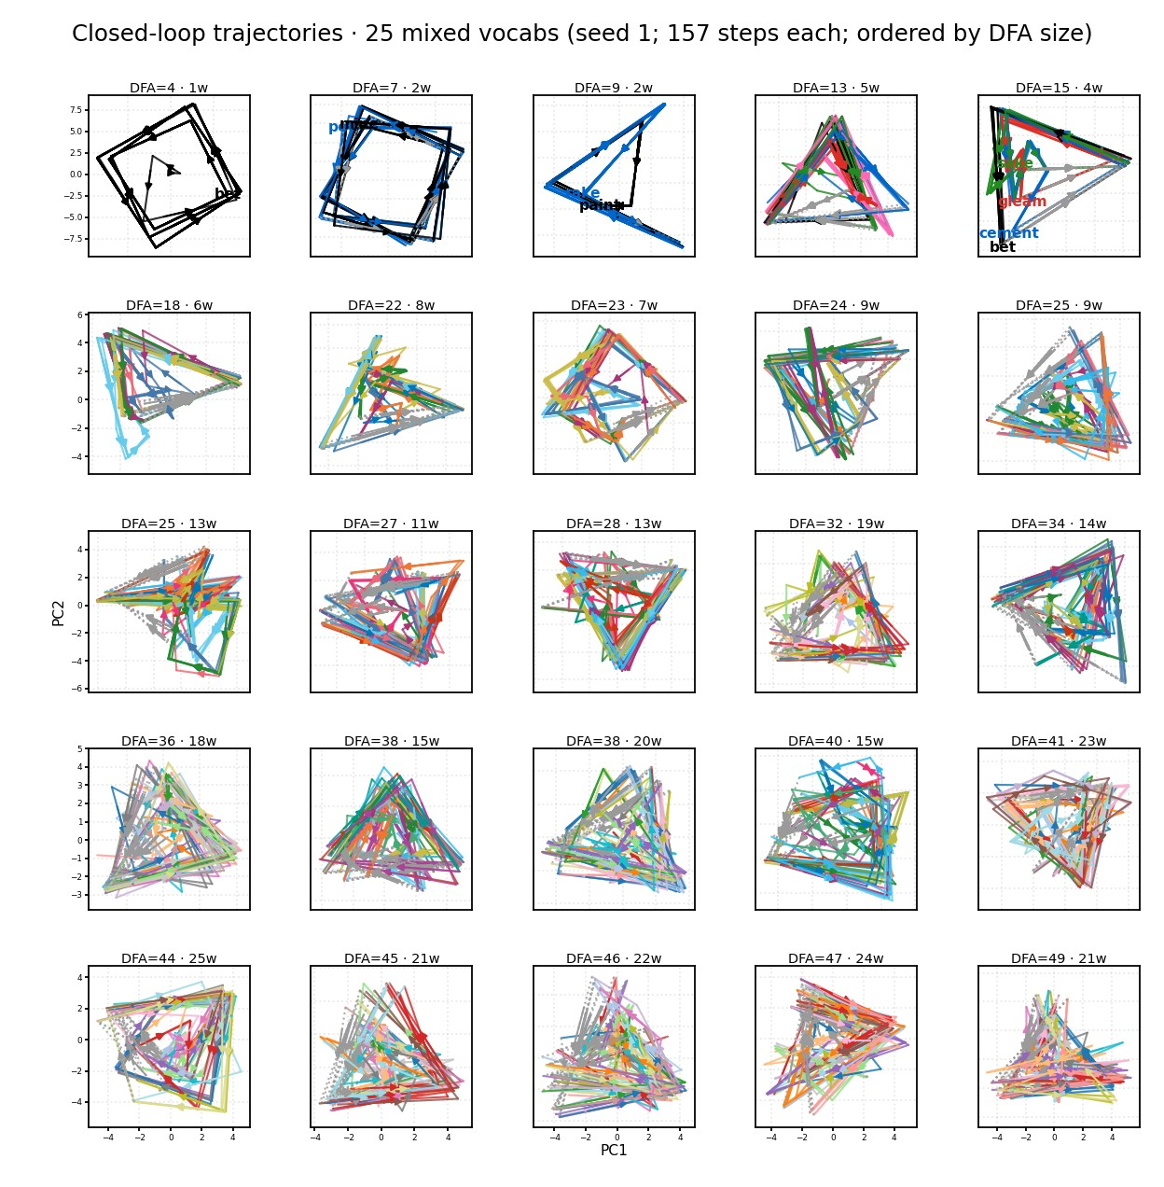
Closed-loop trajectories by DFA span

Slide 26
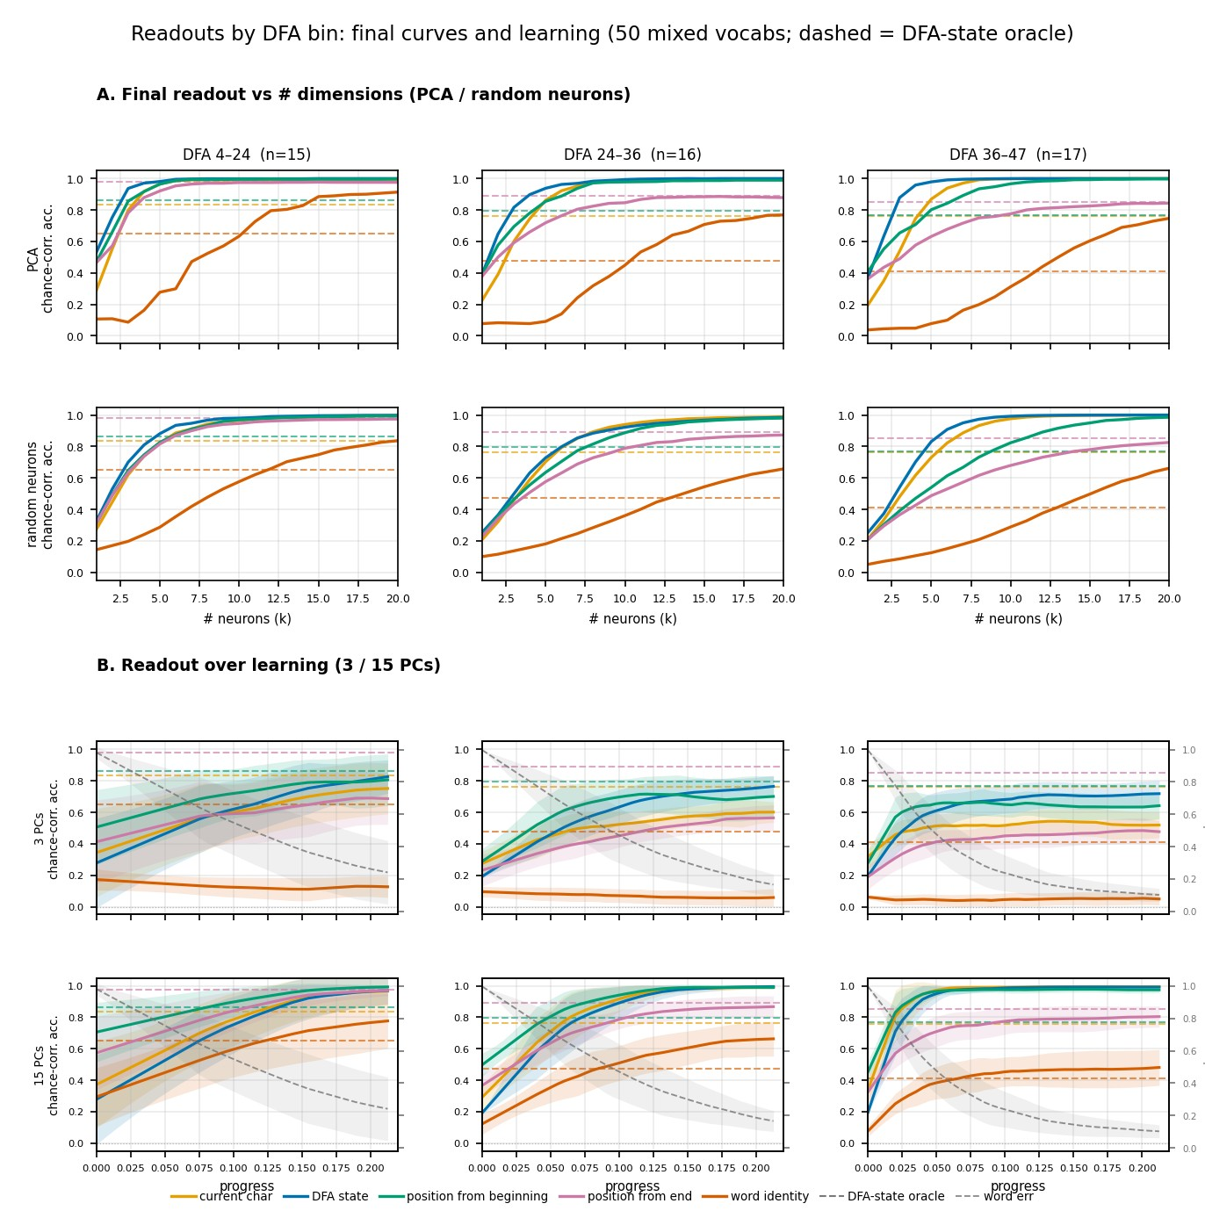
Readout curves and learning

Slide 27
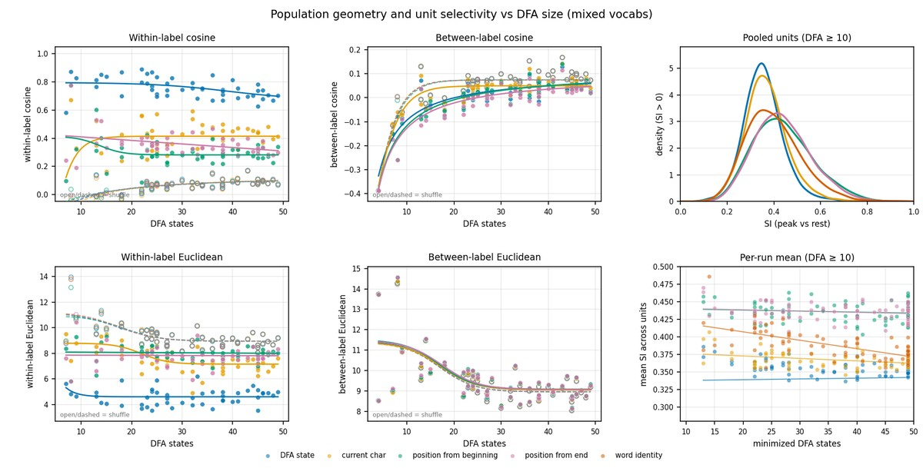
Within-feature geometry and unit selectivity

Slide 28
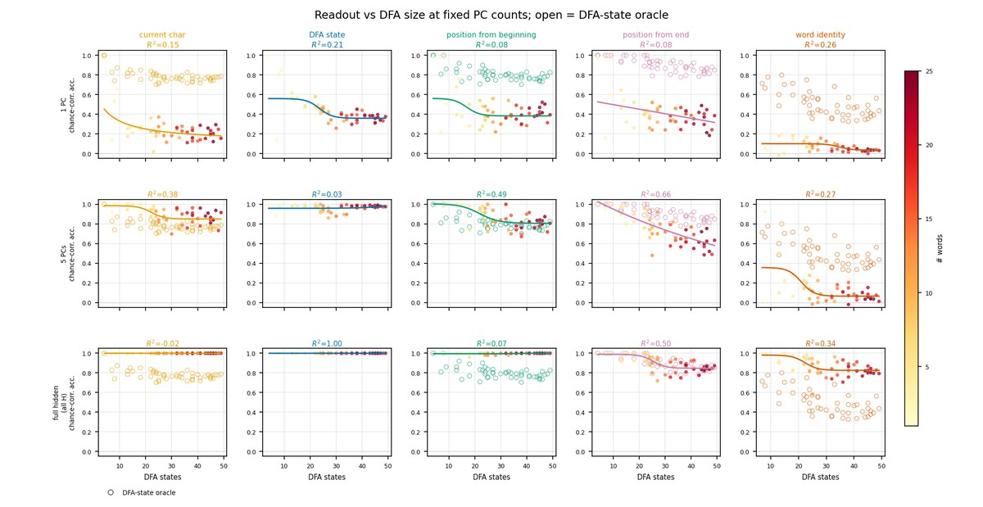
Readout vs DFA at fixed PCs

Slide 29
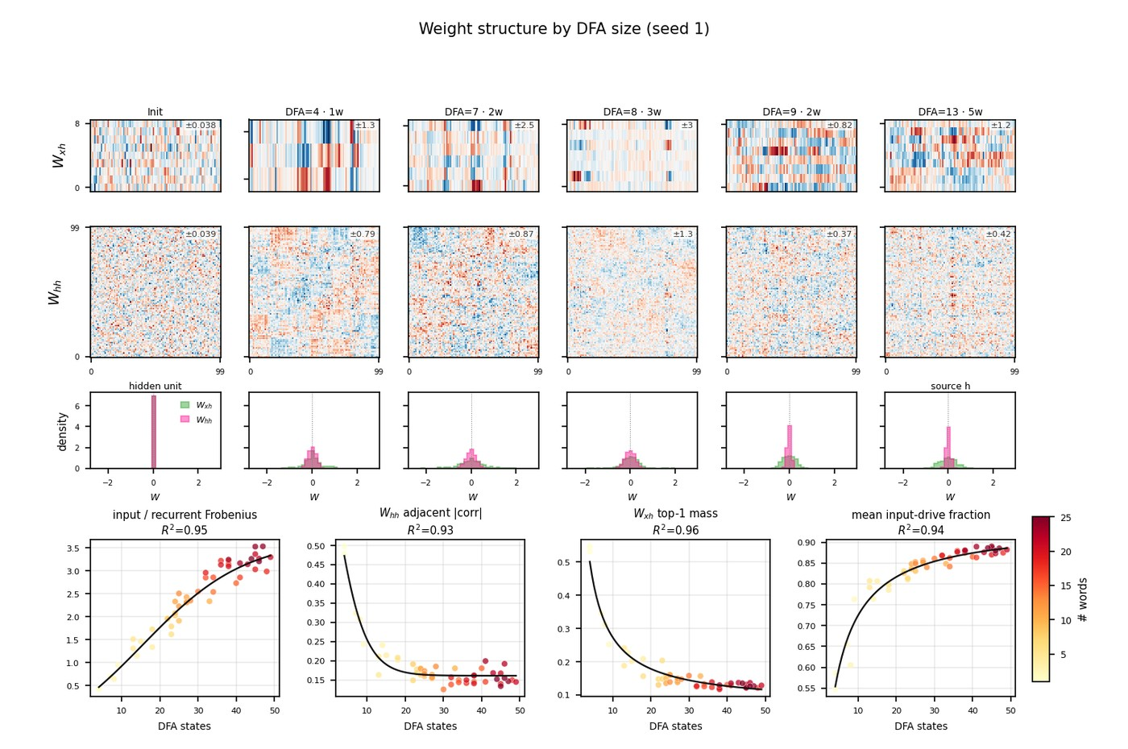
Weight matrices by DFA size

Slide 30
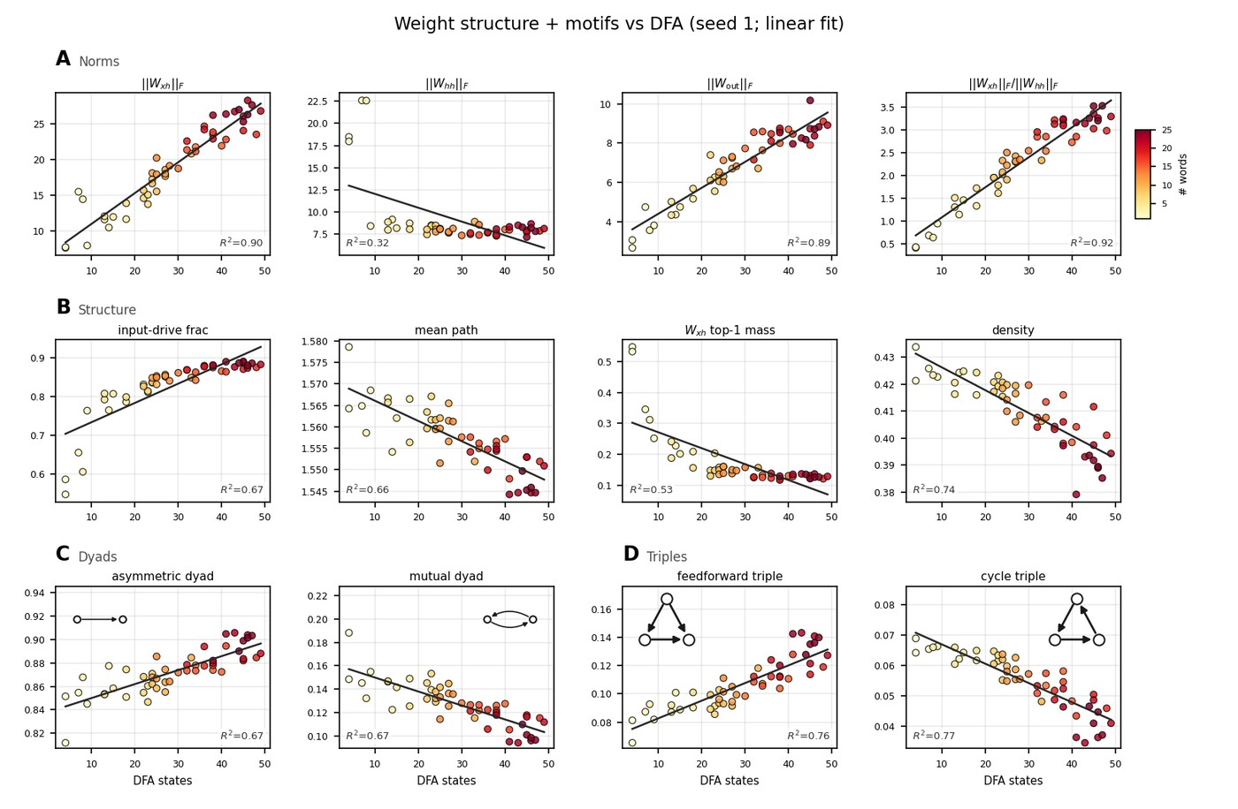
Weight graph structure and motifs vs DFA

Slide 31
Conclusions
Next token prediction in RNNs can produce statistical learning effects (not surprising).
Various lexical features can be read out from neurons – more neurons, easier readout.
DFA state is most easily read out, but letter position, input character, and so on are also readable.
Information about lexical properties is distributed throughout the network, not in single-unit activity.
Increasing DFA states in the task increases difficult of learning and readout.
Increasing DFA states makes the internal representation higher dimensional (PC space).
Consequently, more complex vocabularies result in network structure with less recurrency and fewer cyclic/bidirectional motifs.
More complex vocabularies also result in broader input weight distribution (not sure why).

Slide 32
TODO
Apply Dale’s law, see influence on encoding and motifs.
Train on different task – word classification – observe influence on encoding.
Figure out why the input weight distribution increases relative to recurrent on more complex vocabularies.
Explore question of low single unit selectivity (Daneila concept neurons).

