Slide 1
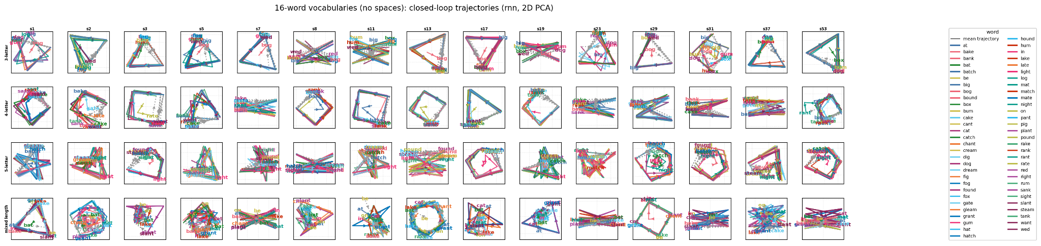
Recurrent networks trained on statistical learning tasks reveal principles of neural sequence representation

Slide 2
The big picture
The brain needs to store and represent sequences of primitives (phonemes->words, muscle movements->motor sequences, etc.). How are these representations stored in the brain, and how are they recalled/produced in a sequential manner?

Slide 3
Assumptions
To a first approximation, the brain is a recurrent neural network.
The output of the brain at any given time is a function of the state of the network at that time; the output of the network over a period of time is a trajectory through the state space.
The brain originally learns sequences without any prior assumptions about sequence structure; all learned structure is emergent from naive next token prediction.
Once learned, the brain produces sequences via a closed loop process - it generates (predicts) a token, which is fed as an input to the network at the next time step.

Slide 4
Specific questions to be addressed
What do trajectory geometries generally look like for learned sequences (words)?
How stable is the representational geometry over multiple random seeds? (Multiple realizability).
How does word length influence trajectory geometry?
How does the number of words stored influence trajectory geometry?
Why does the trajectory geometry look the way it does?
What sort of features (specific token, position in sequence, DFA state) are easily read out of the neural representation?
What sort of features do we see in single-neuron responses?

Slide 5
Questions be addressed
How is lexical information (word position, character, etc.) represented in a recurrent network that learns to produce words?
How does network’s representation of information change with vocabulary complexity?
How do the network’s weights differ as a function of the complexity of the learned vocabulary (function->structure).

Slide 6
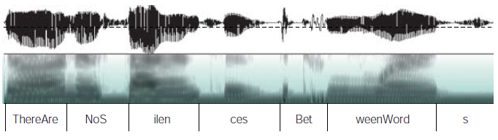
Statistical Learning and Language Acquisition
Saffran, Newport, Aslin. Science (1996). “Statistical Learning By 8-Month-Old Infants.”
How do infants learn to segment auditory information into individual words?
Kuhl, P. K. (2004) Early language acquisition: cracking the speech code. Nature Reviews Neuroscience, 5(11):831--843.

Slide 7
Statistical Language Segmentation: Saffran Experiment
Pseudo-words, like bupado and kutaba, were randomly concatenated and presented to infants in sequences such as:
bupadokutabakutababupadobupadokutaba
In a probing session, infants demonstrated a greater familiarity with the “words”, bupado and kutaba, than they did with non-words that crossed word boundaries, like padoku
Conclusion: transitional probabilities between syllables allow infants to segment speech into individual words
bu pa do ku ta ba
1.0
1.0
0.5
1.0
1.0

Slide 8
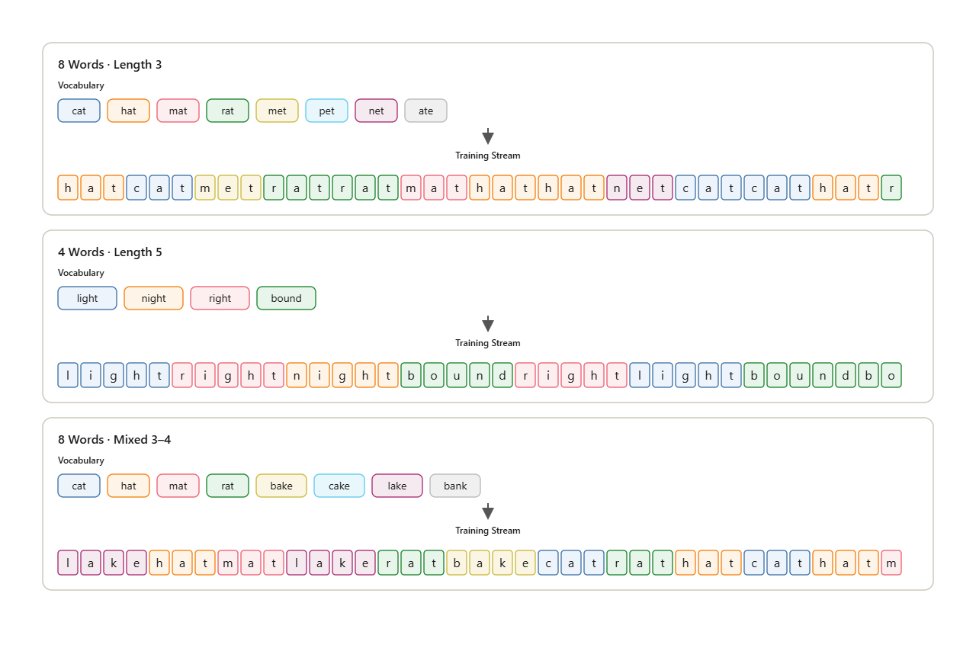
Vocabularies for statistical learning

Slide 9
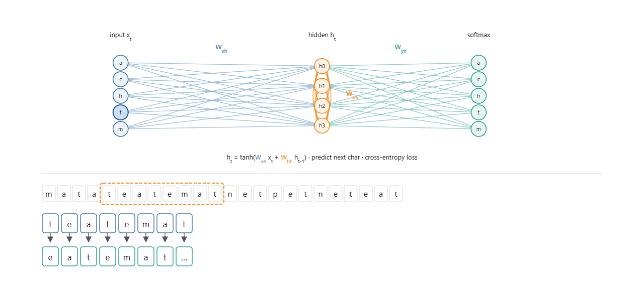
Training an RNN

Slide 10
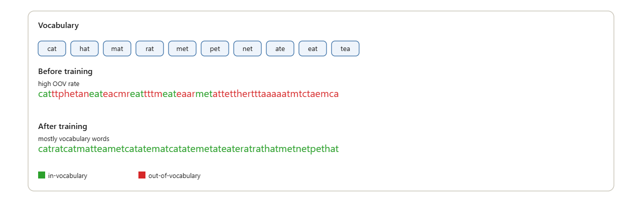
Evaluation

Slide 11
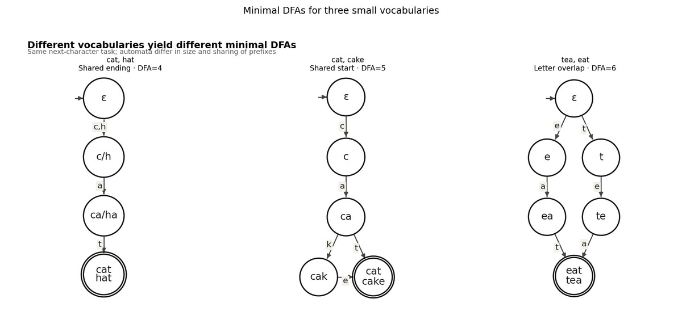
Minimal DFAs for three small vocabularies

Slide 12
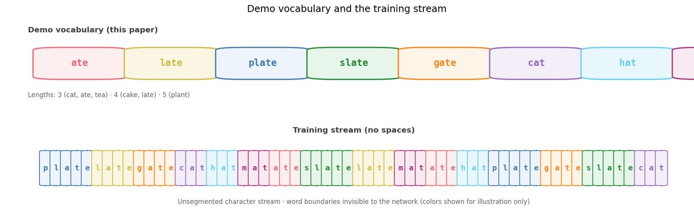
Demo vocabulary and training stream

Slide 13
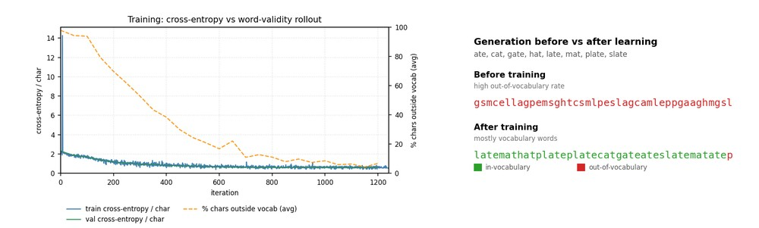
Learning curve and generation

Slide 14
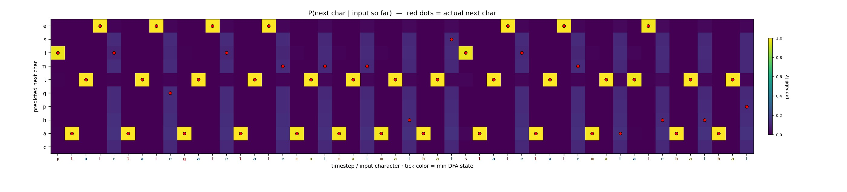
Next-character probabilities

Slide 15
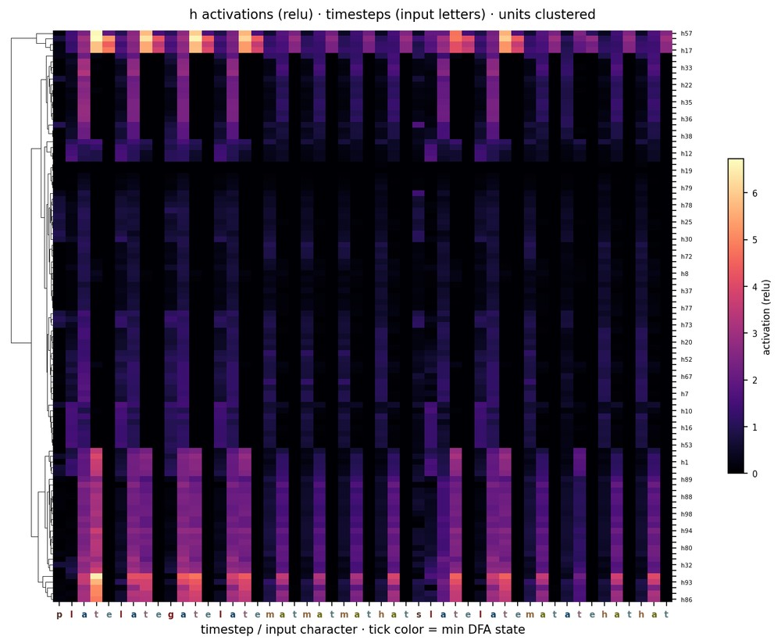
Activation heatmap

Slide 16
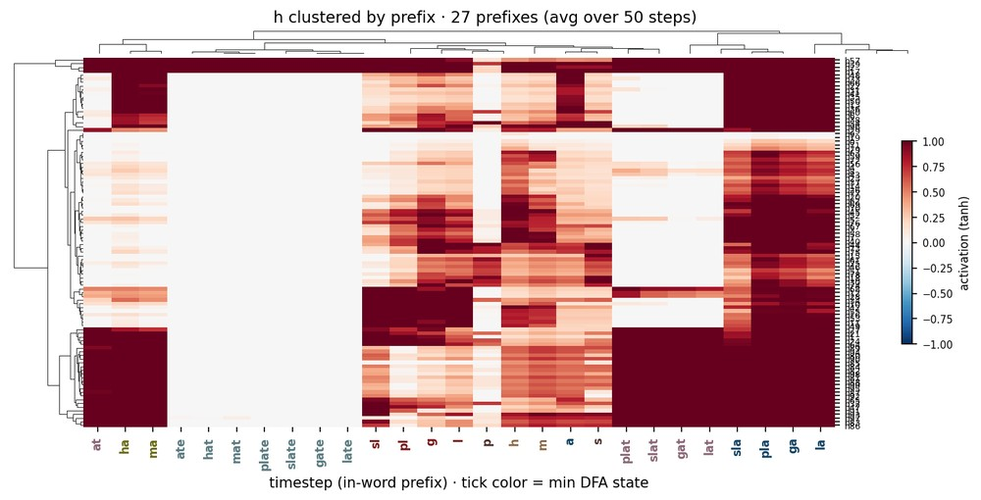
Activations clustered by prefix

Slide 17
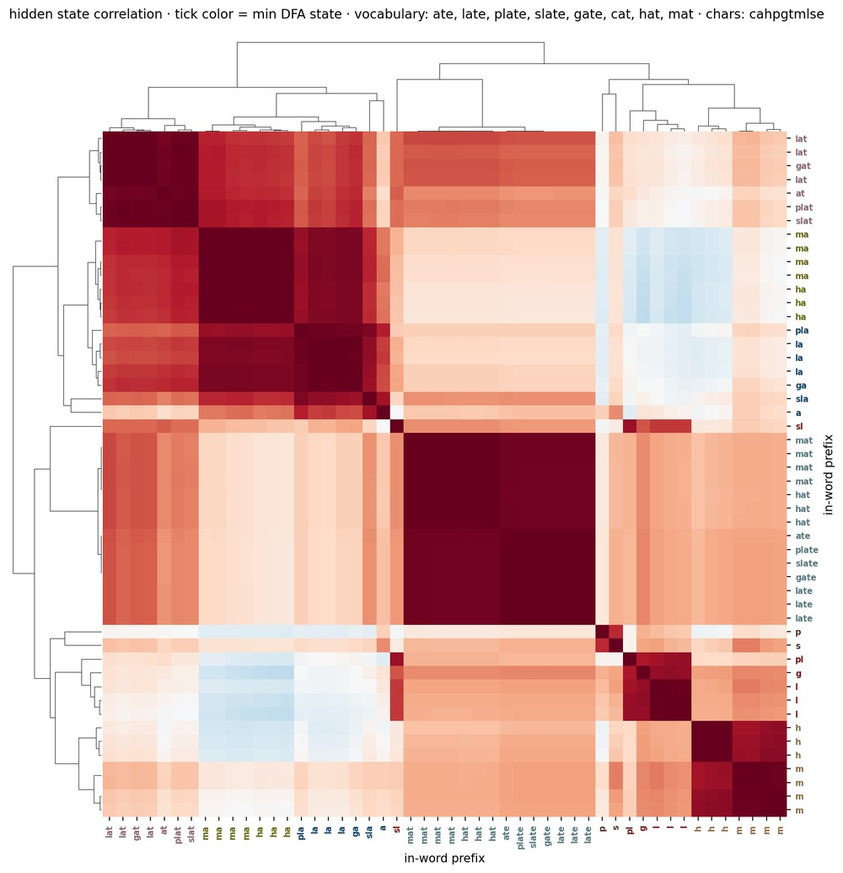
Hidden-state correlation

Slide 18
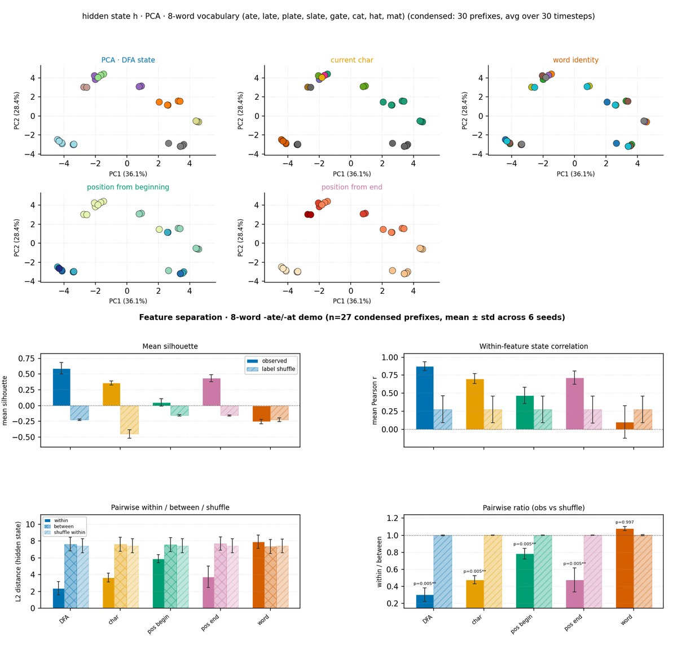
DFA PCA geometry and feature separation

Slide 19
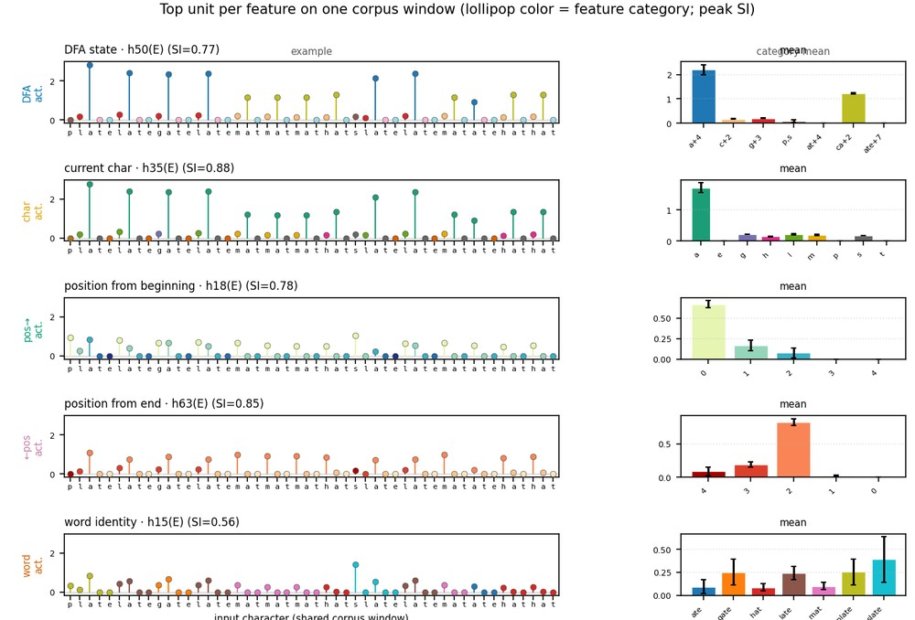
Example selective units

Slide 20
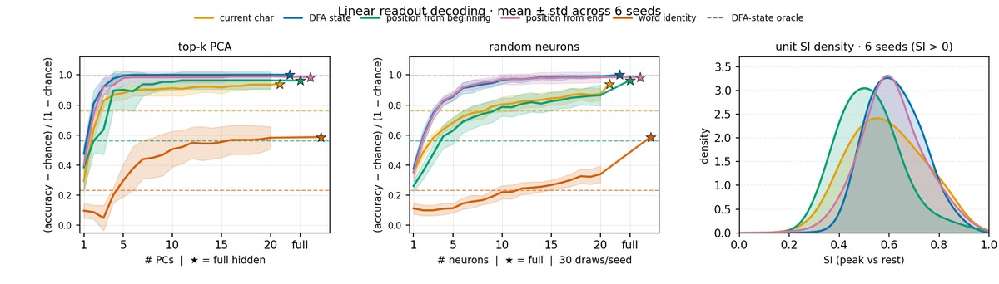
Linear decoding with word identity

Slide 21
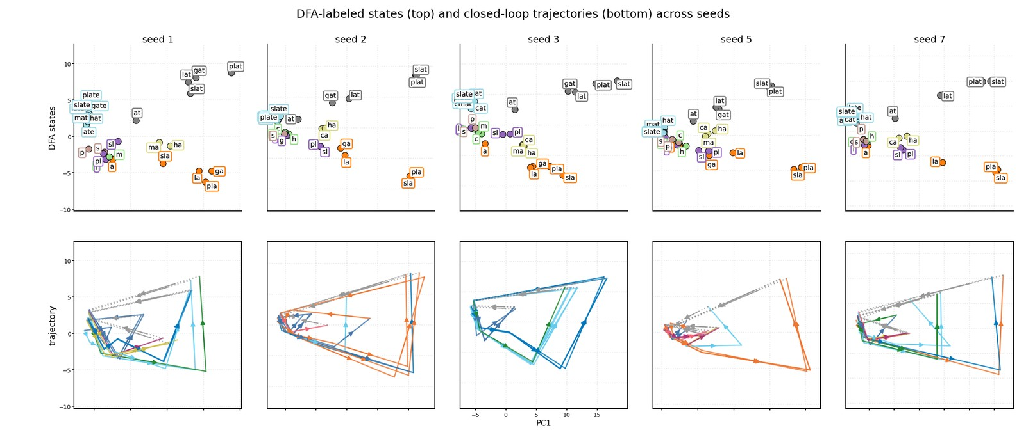
DFA states and trajectories across seeds

Slide 22
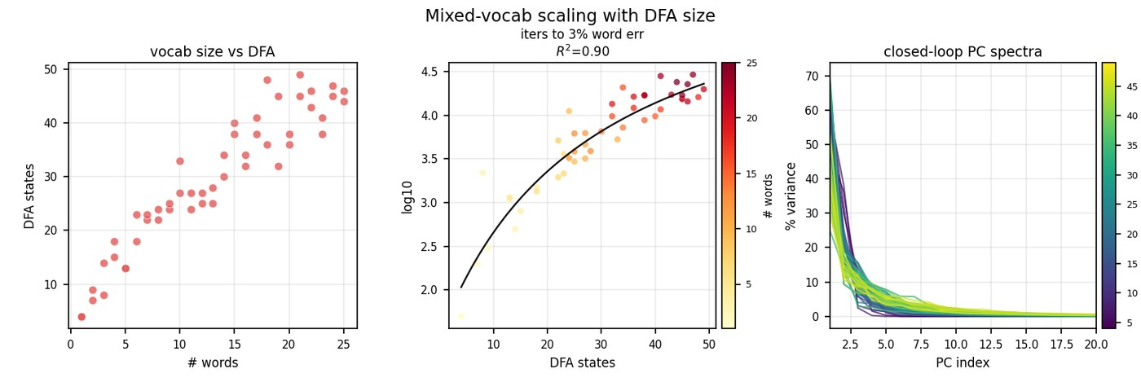
Mixed-vocab scaling overview

Slide 23
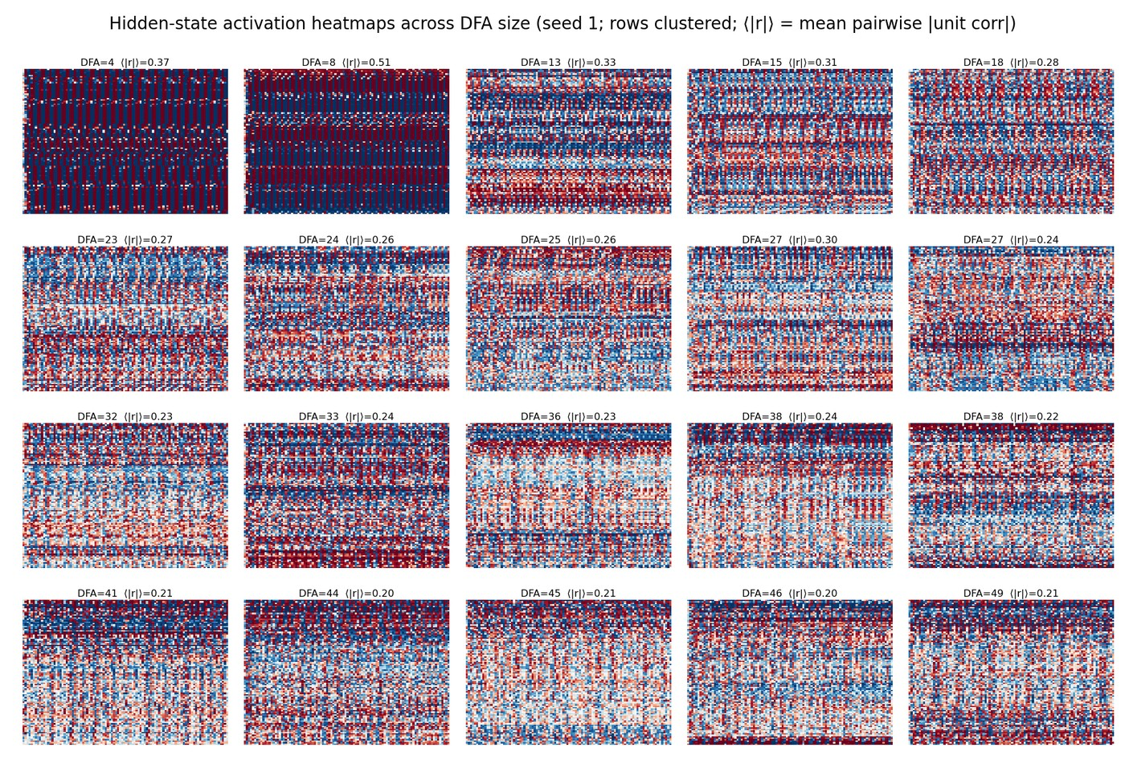
Activation heatmaps across DFA size

Slide 24
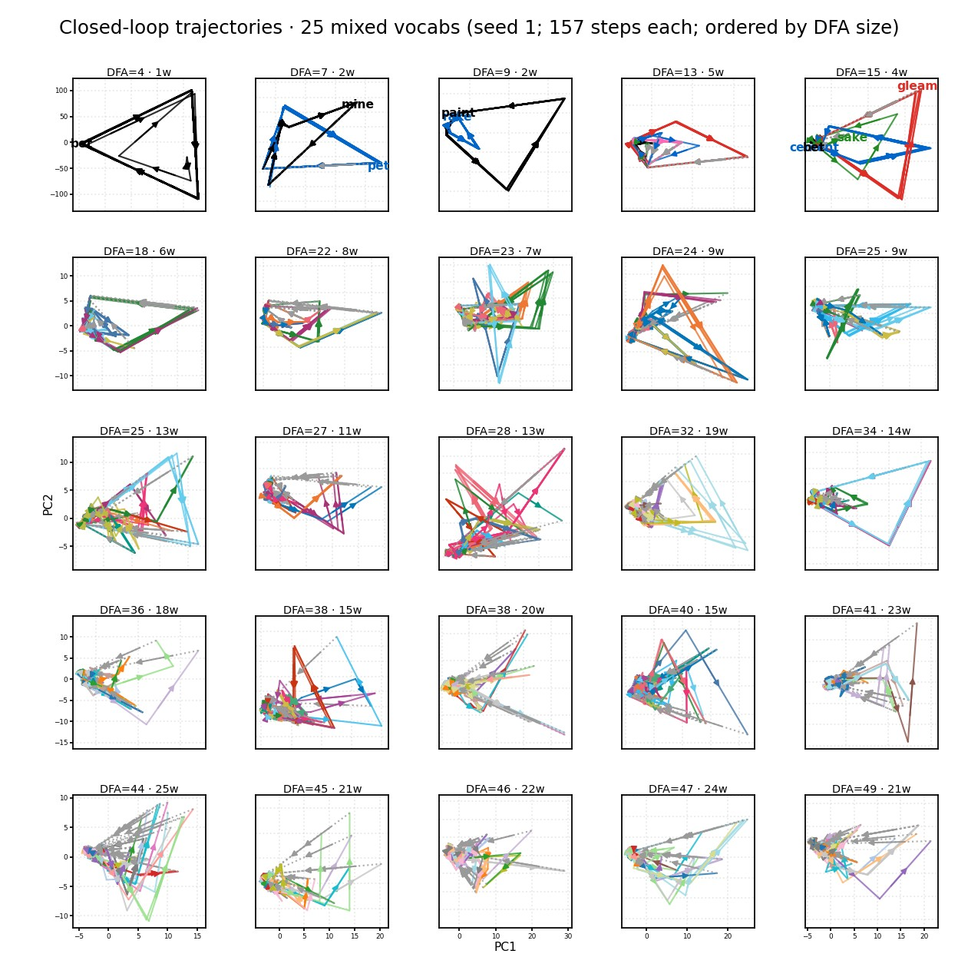
Closed-loop trajectories by DFA span

Slide 25
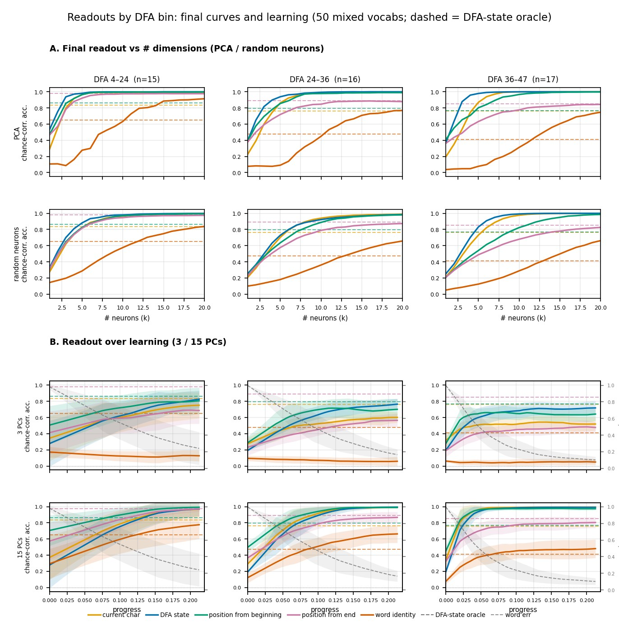
Readout curves and learning

Slide 26
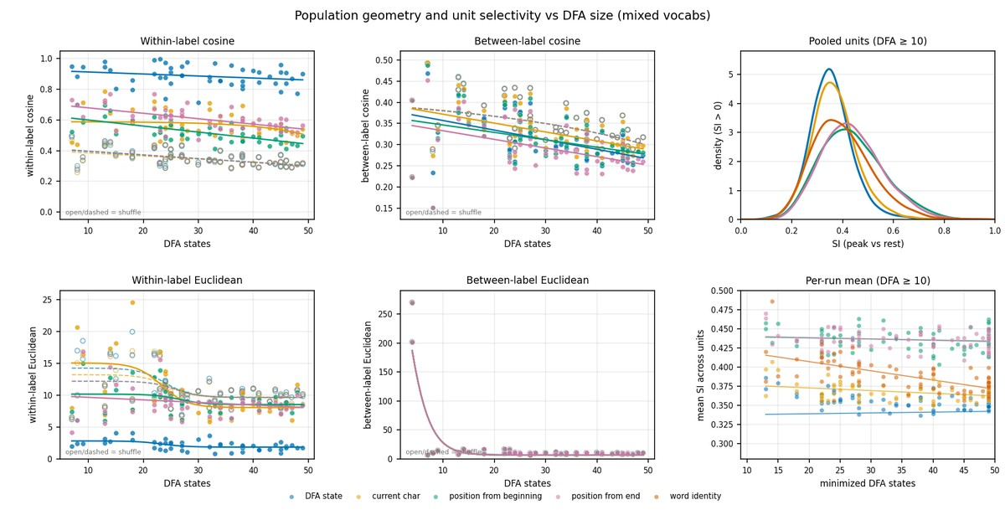
Within-feature geometry and unit selectivity

Slide 27
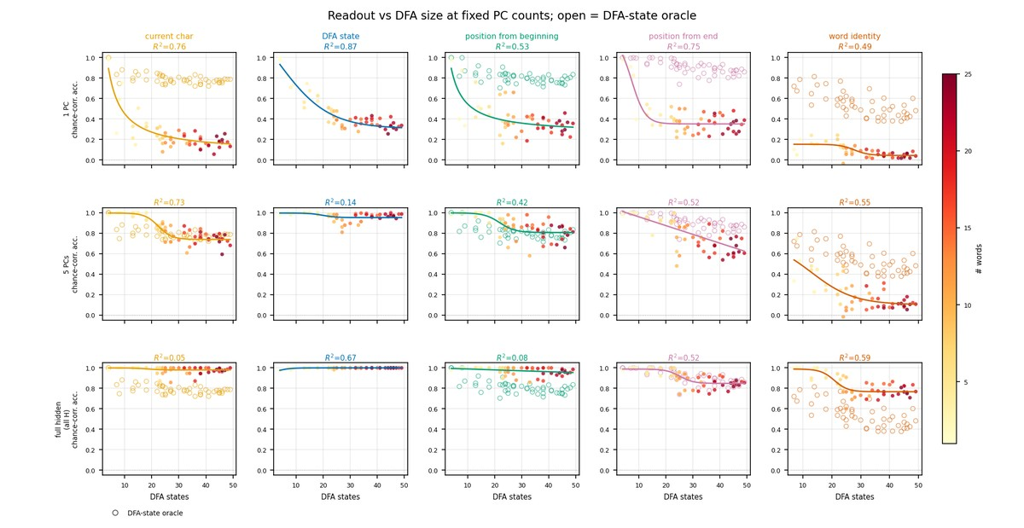
Readout vs DFA at fixed PCs

Slide 28
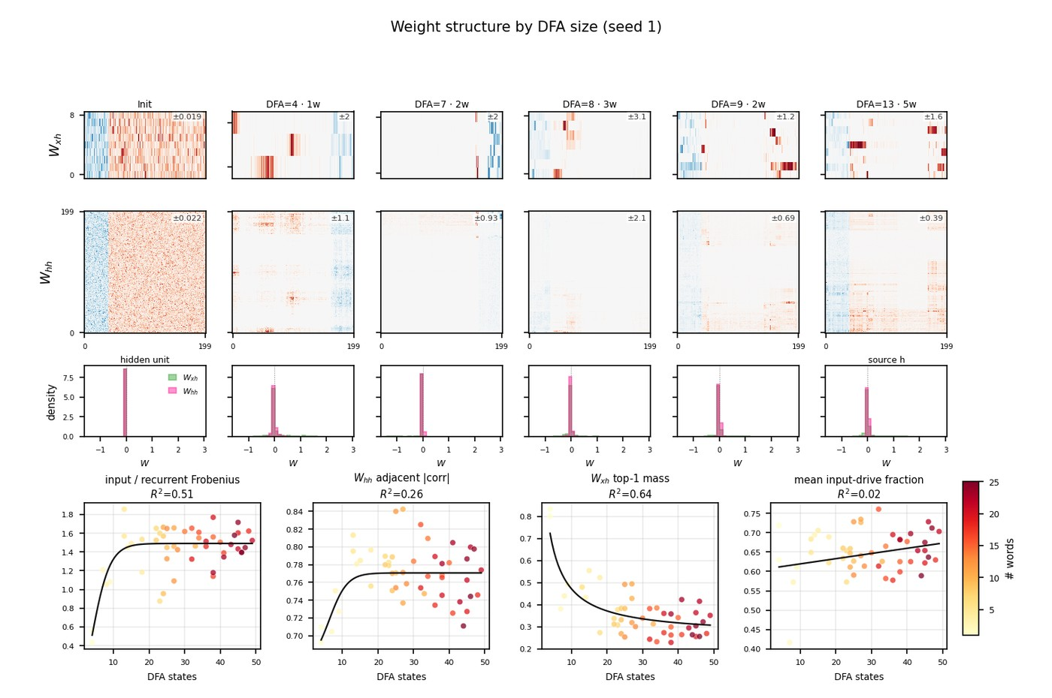
Weight matrices by DFA size

Slide 29
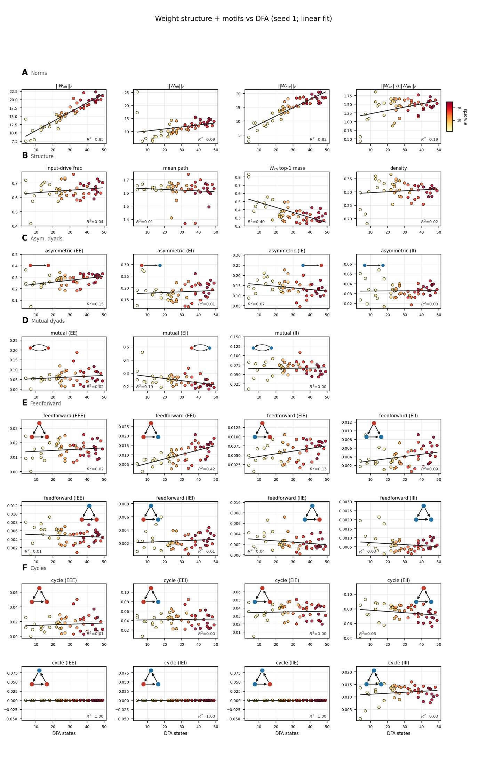
Weight graph structure and motifs vs DFA

