Slide 1
Statistical Word Segmentation as Emergent Structure in a Next-Character RNN
Generated from paper/draft.md · import into Google Slides via Upload

Slide 2
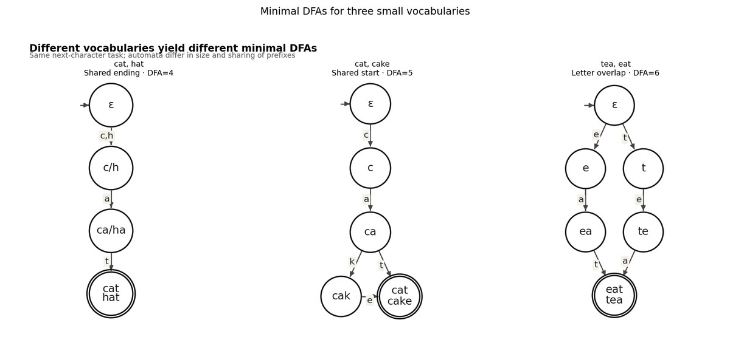
Minimal DFAs for three small vocabularies

Slide 3
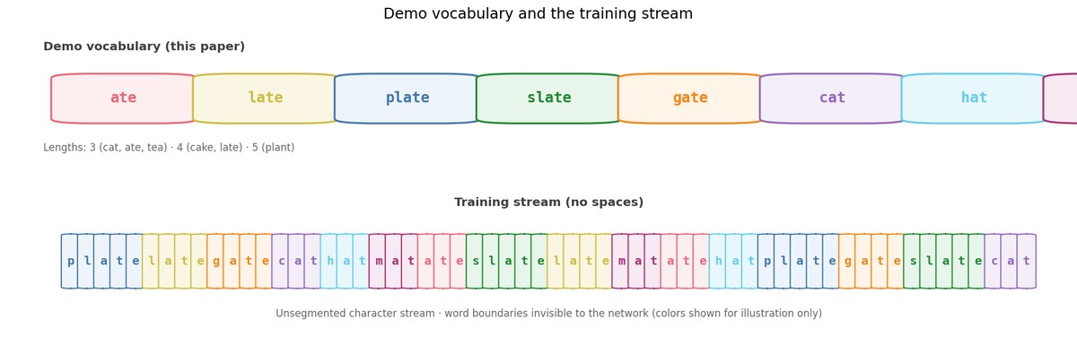
Demo vocabulary and training stream

Slide 4
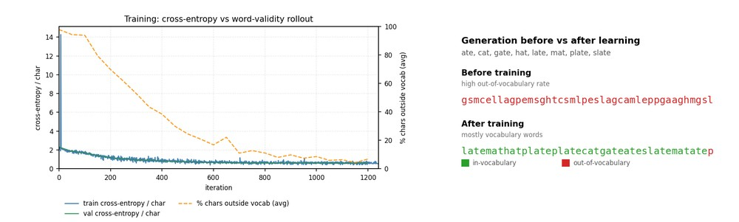
Learning curve and generation

Slide 5
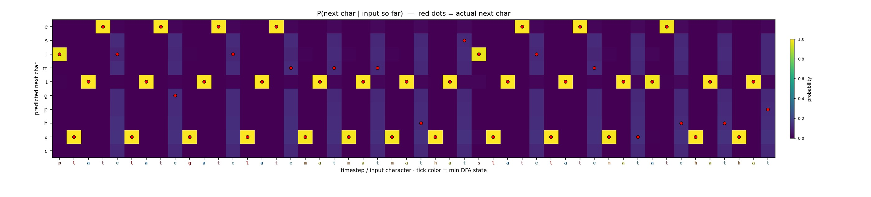
Next-character probabilities

Slide 6
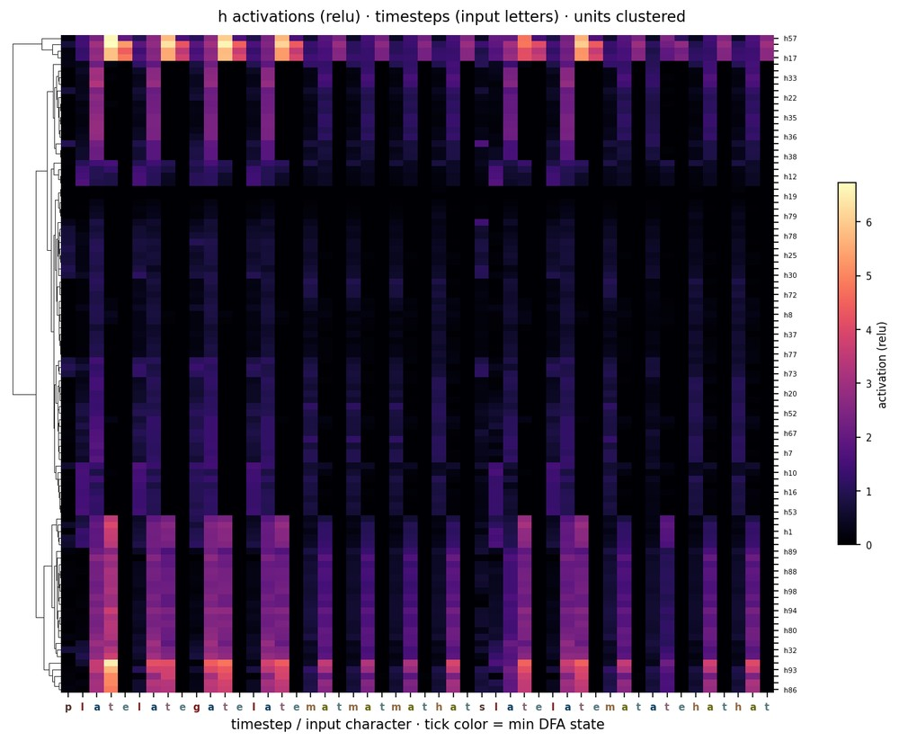
Activation heatmap

Slide 7
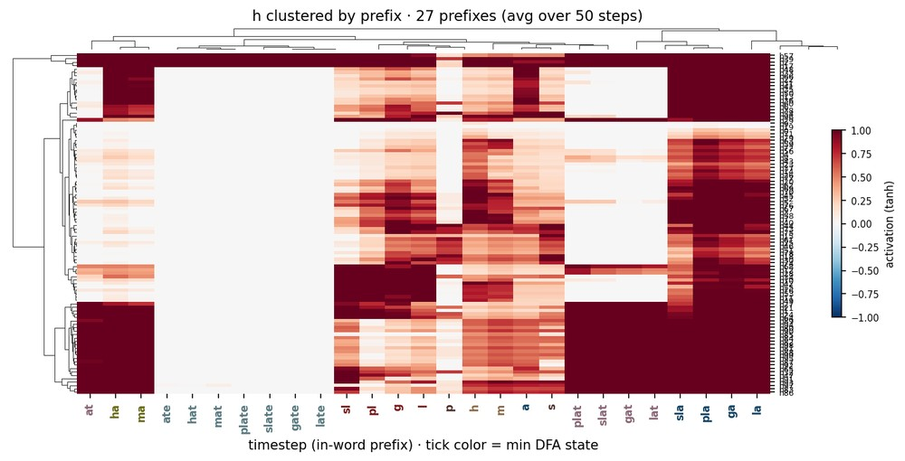
Activations clustered by prefix

Slide 8
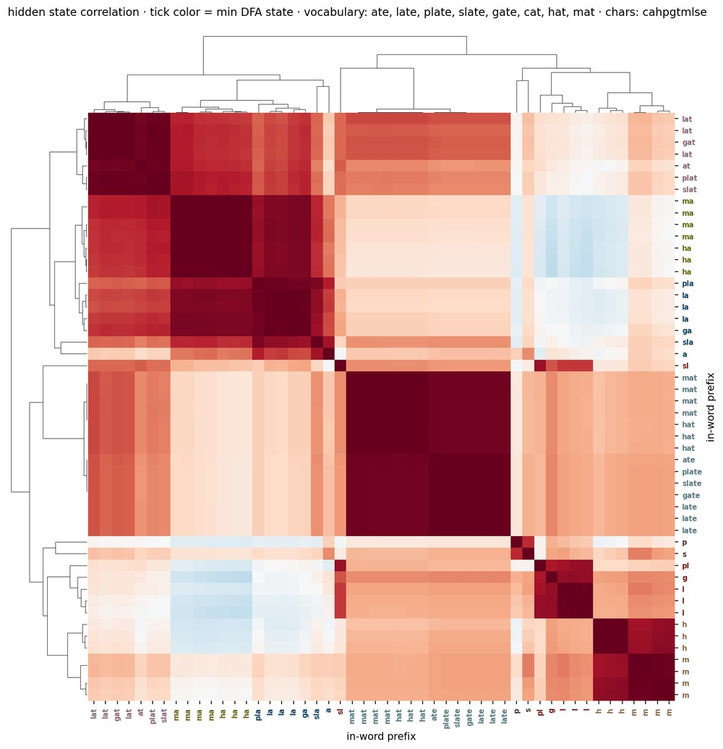
Hidden-state correlation

Slide 9
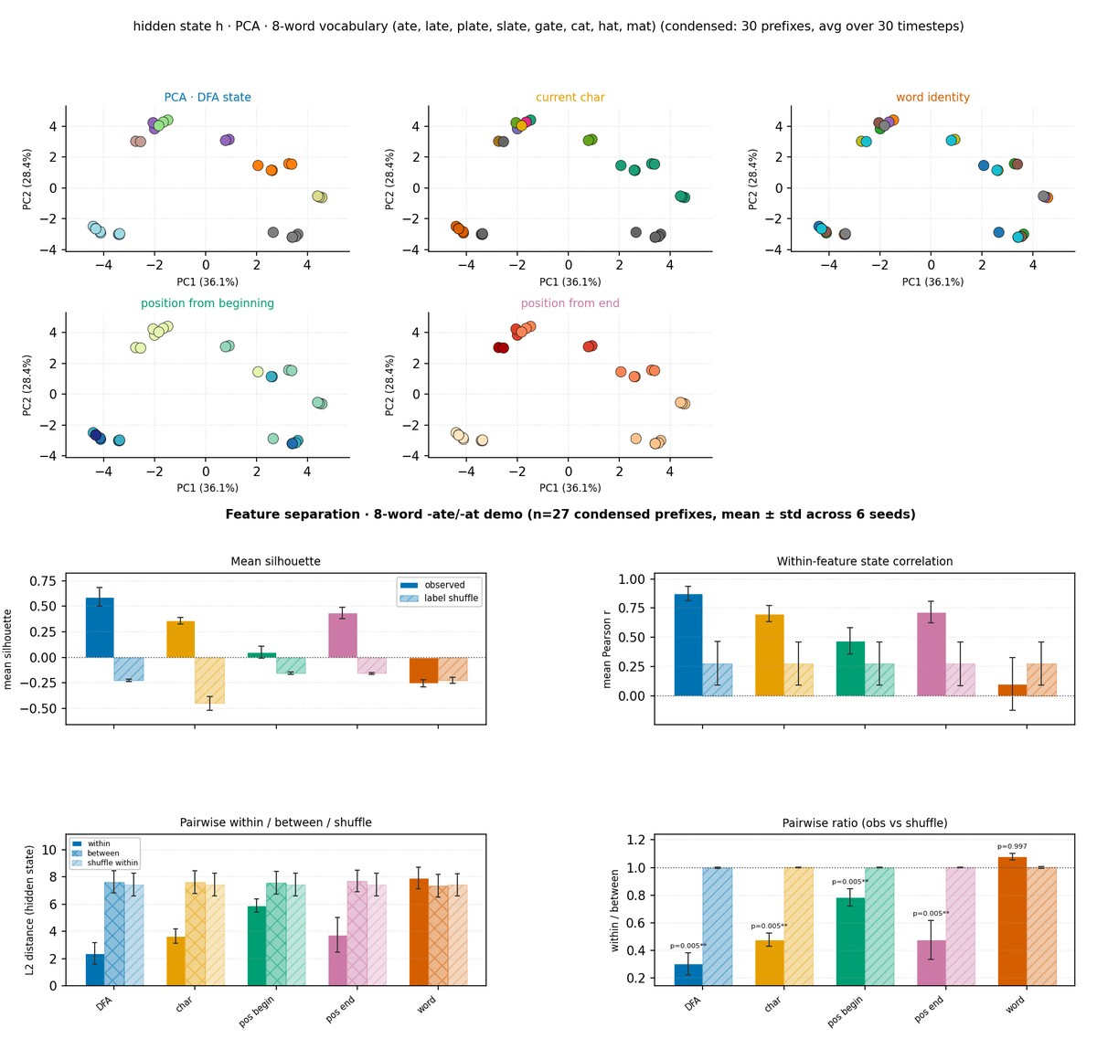
DFA PCA geometry and feature separation

Slide 10
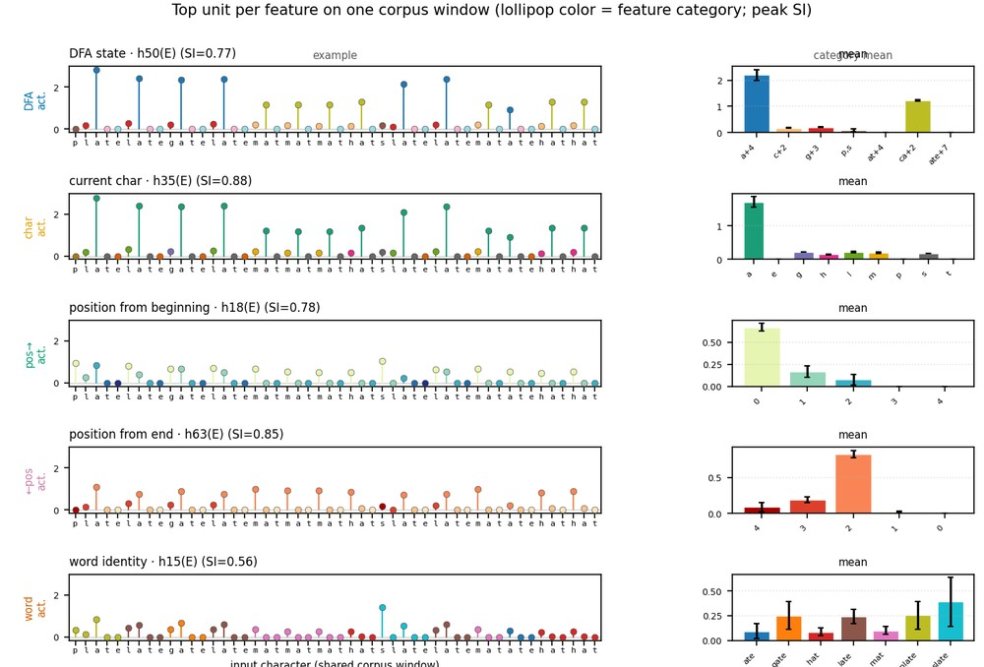
Example selective units

Slide 11
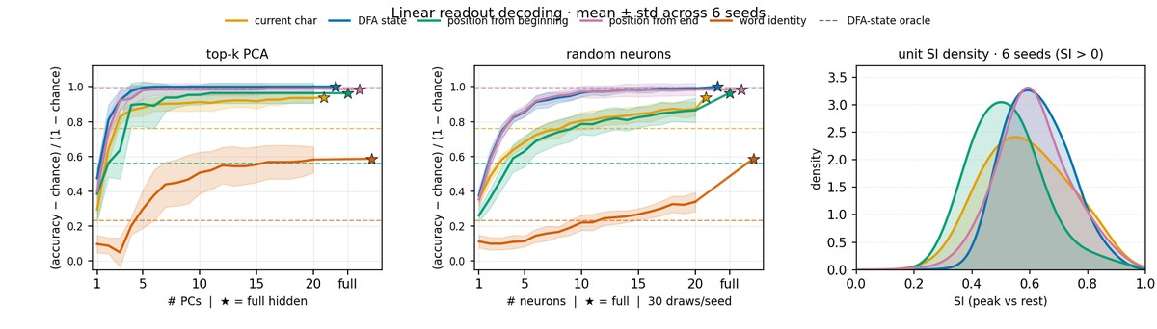
Linear decoding with word identity

Slide 12
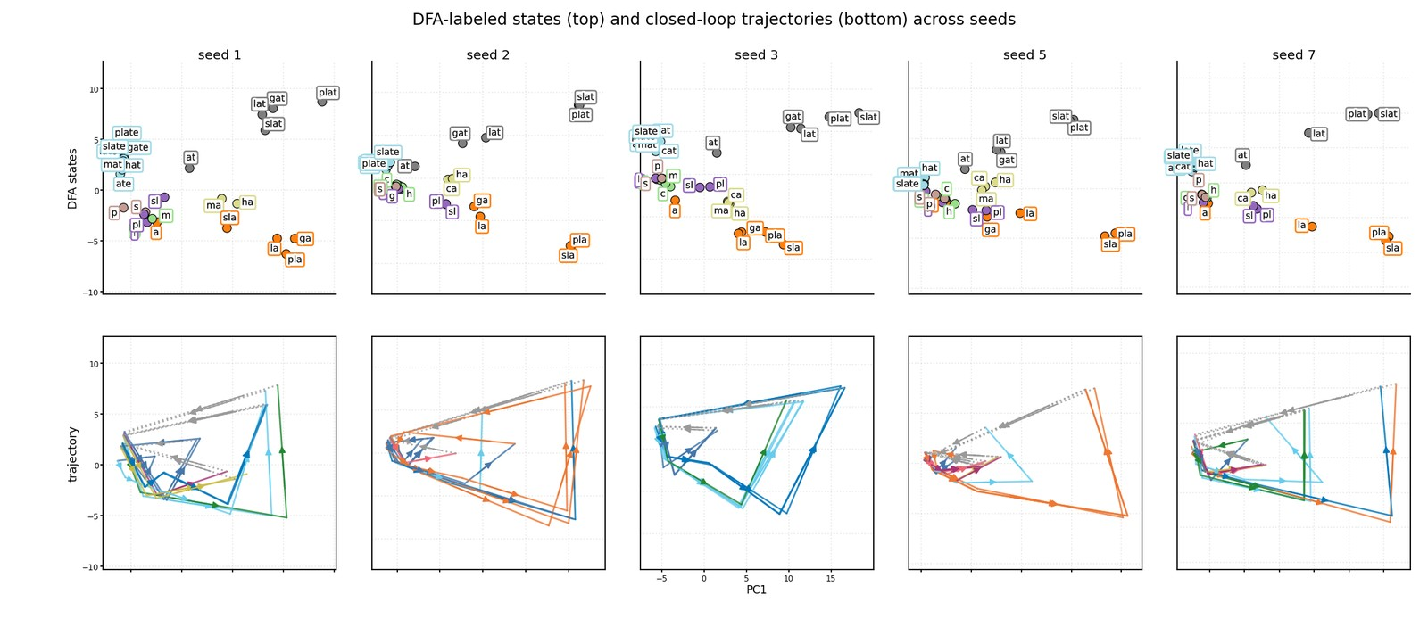
DFA states and trajectories across seeds

Slide 13
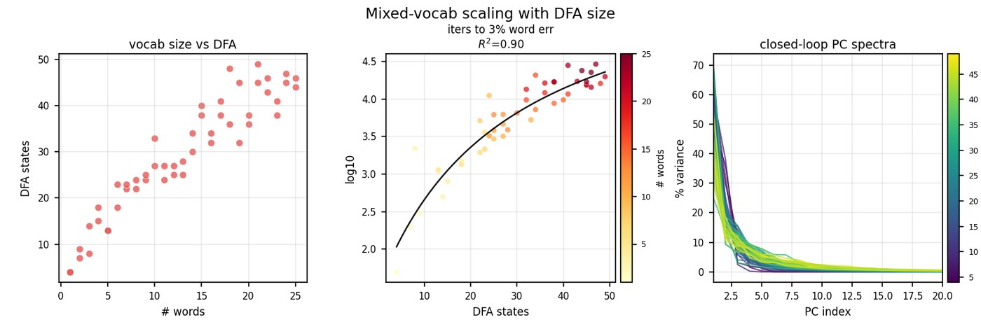
Mixed-vocab scaling overview

Slide 14
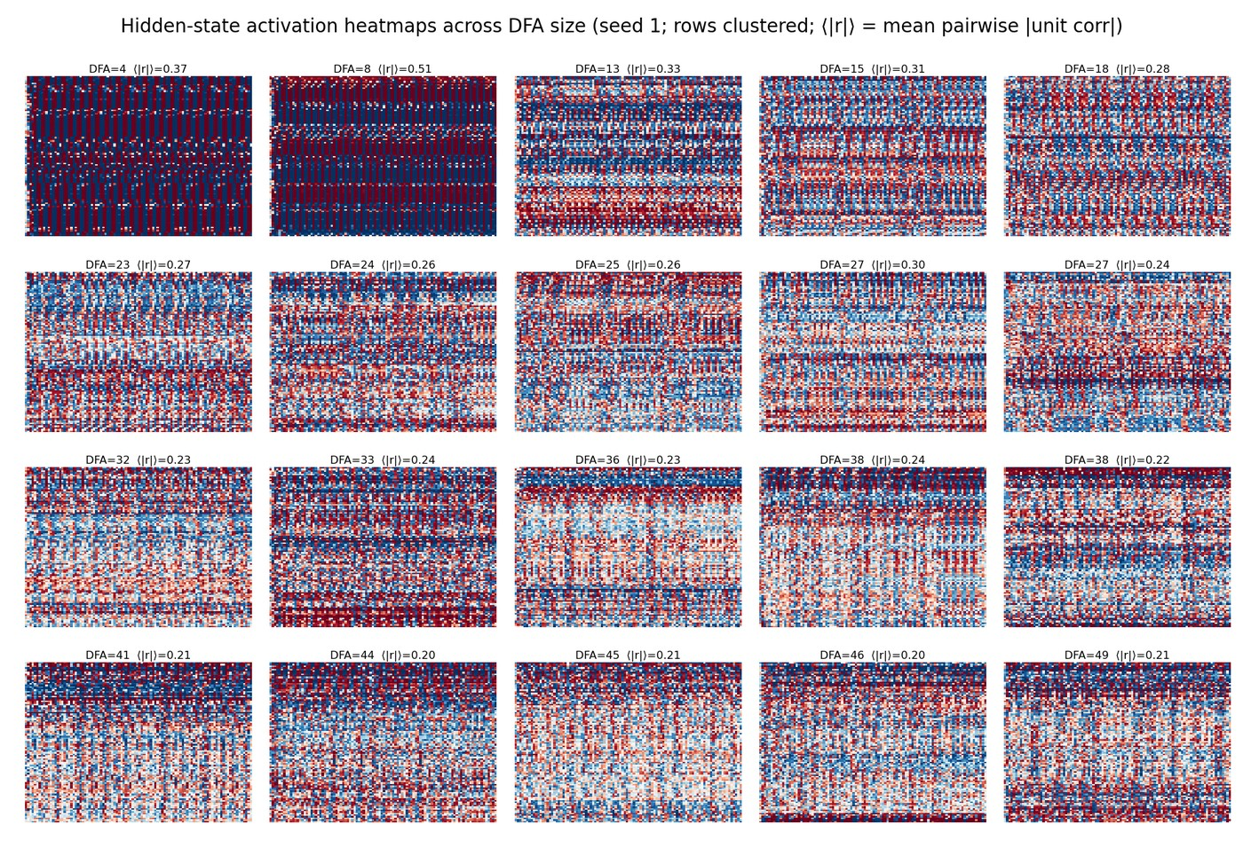
Activation heatmaps across DFA size

Slide 15
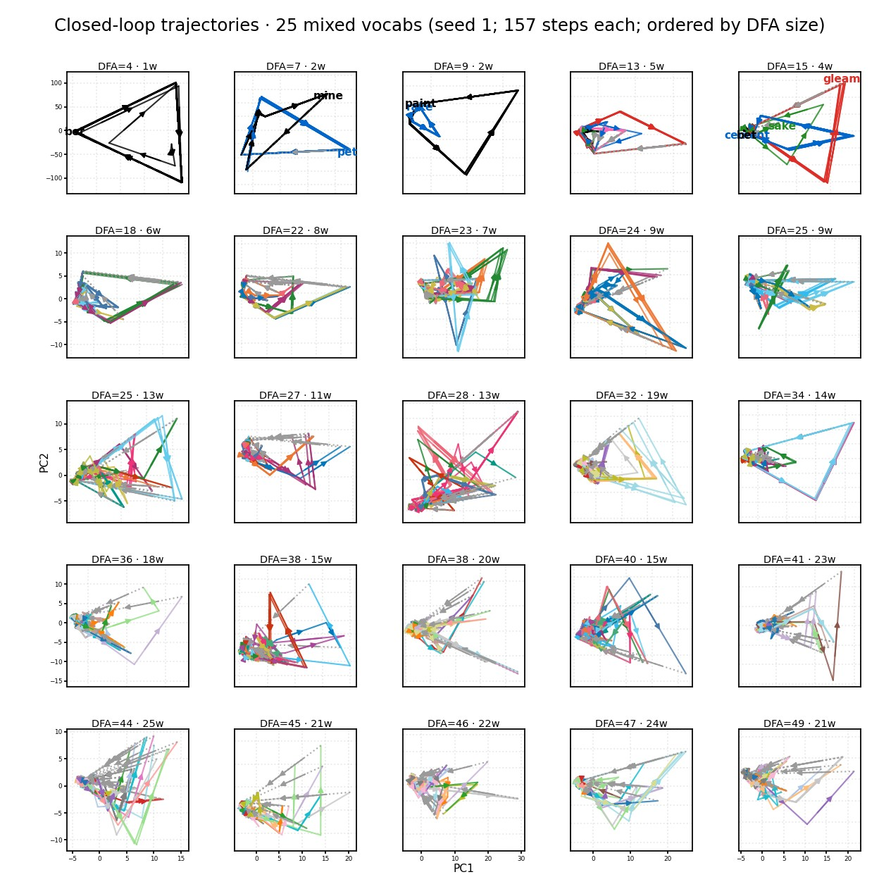
Closed-loop trajectories by DFA span

Slide 16
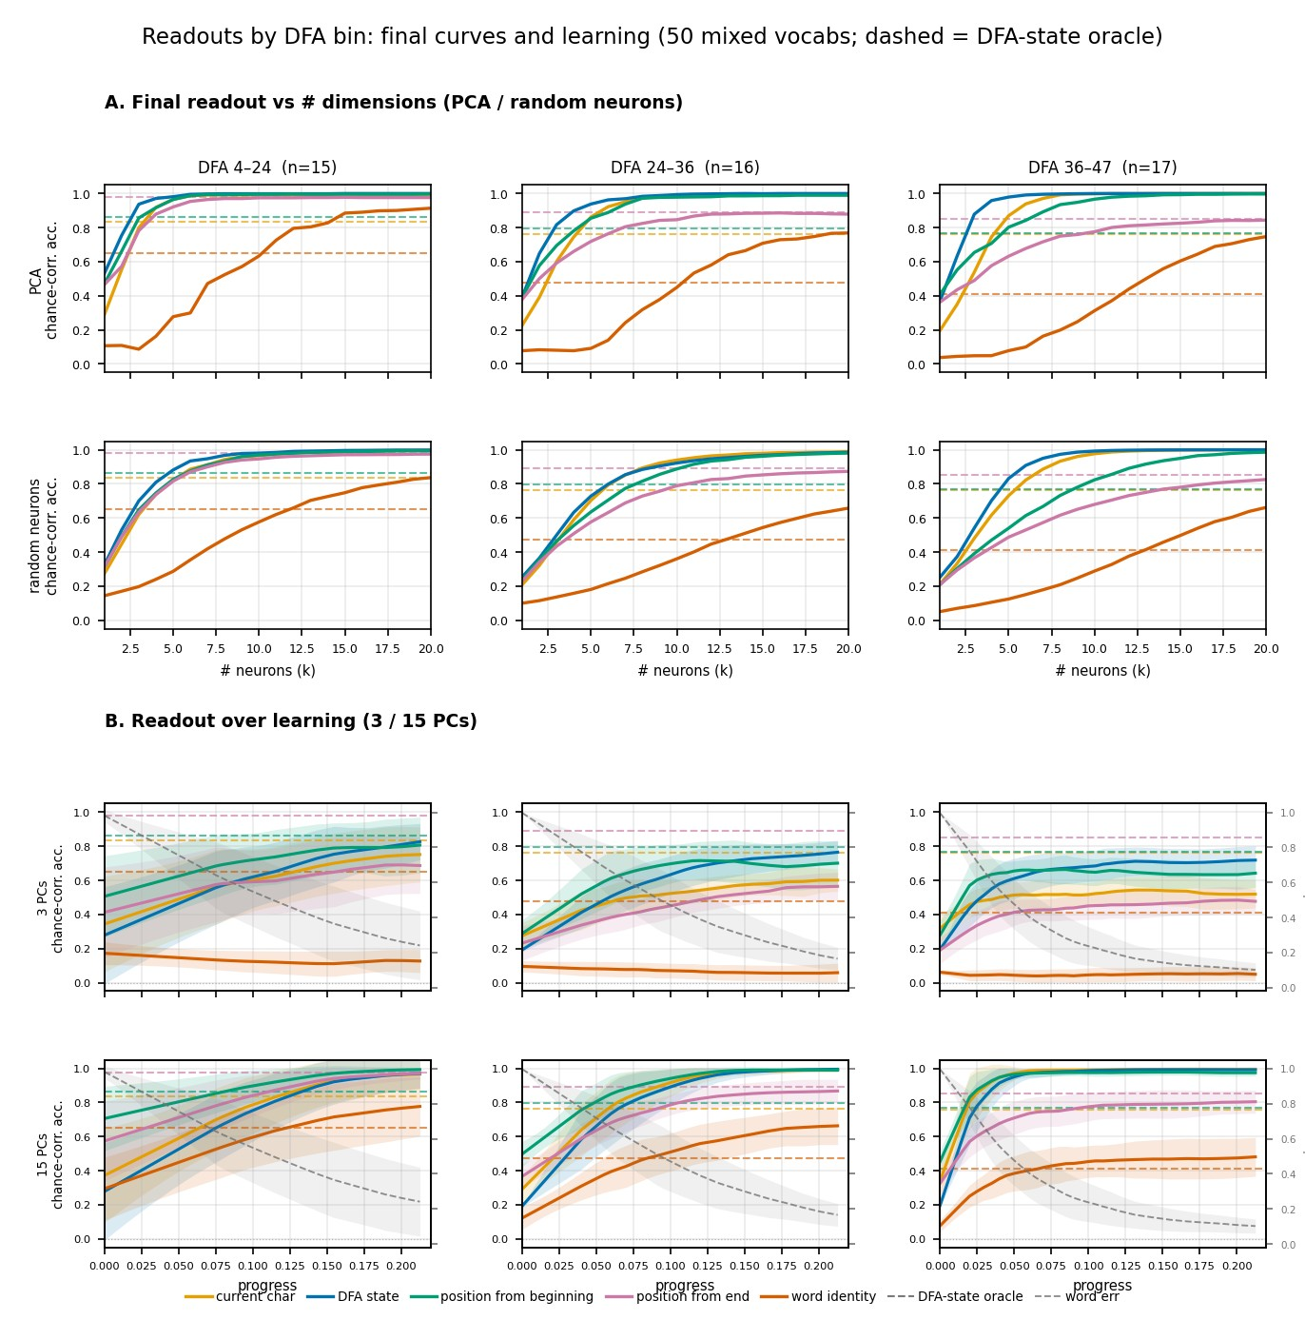
Readout curves and learning

Slide 17
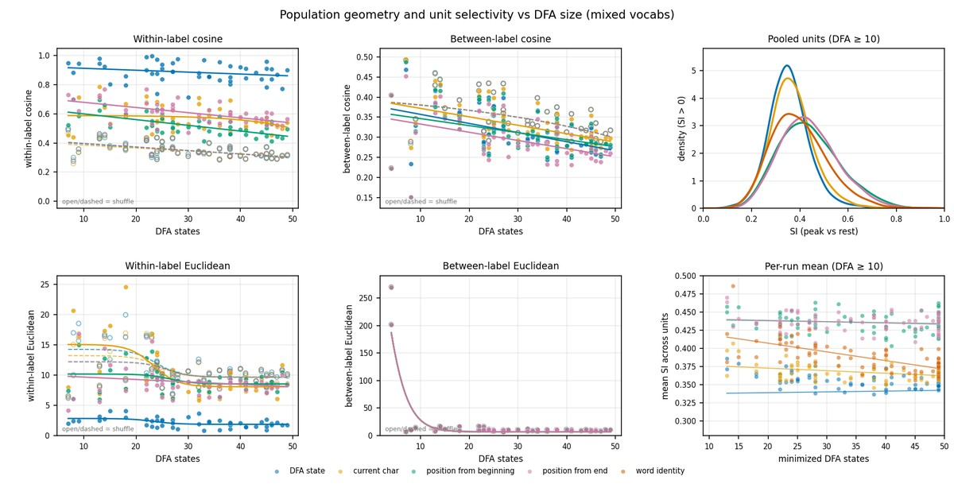
Within-feature geometry and unit selectivity

Slide 18
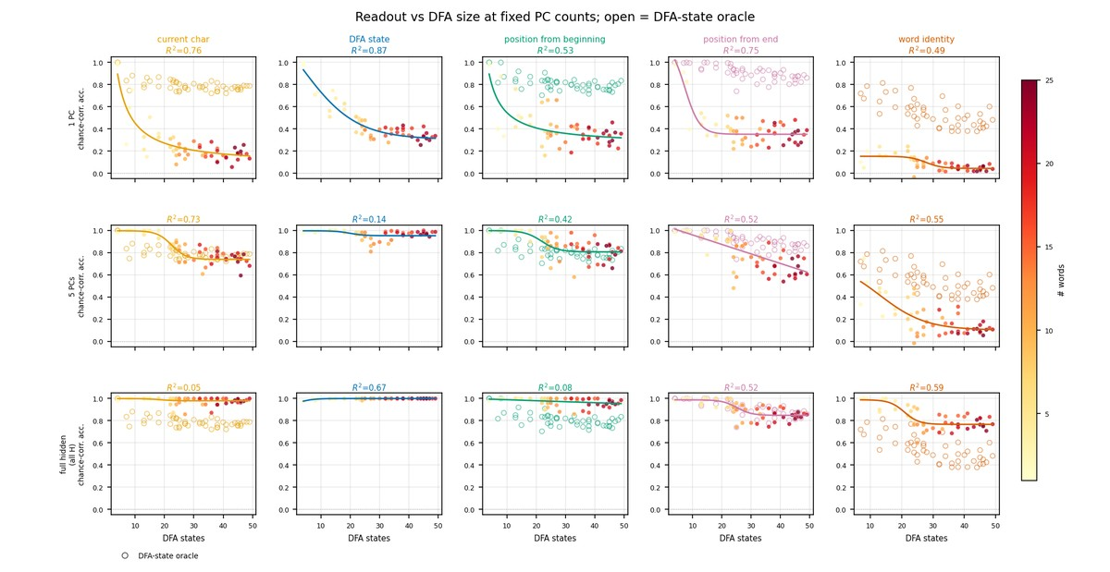
Readout vs DFA at fixed PCs

Slide 19
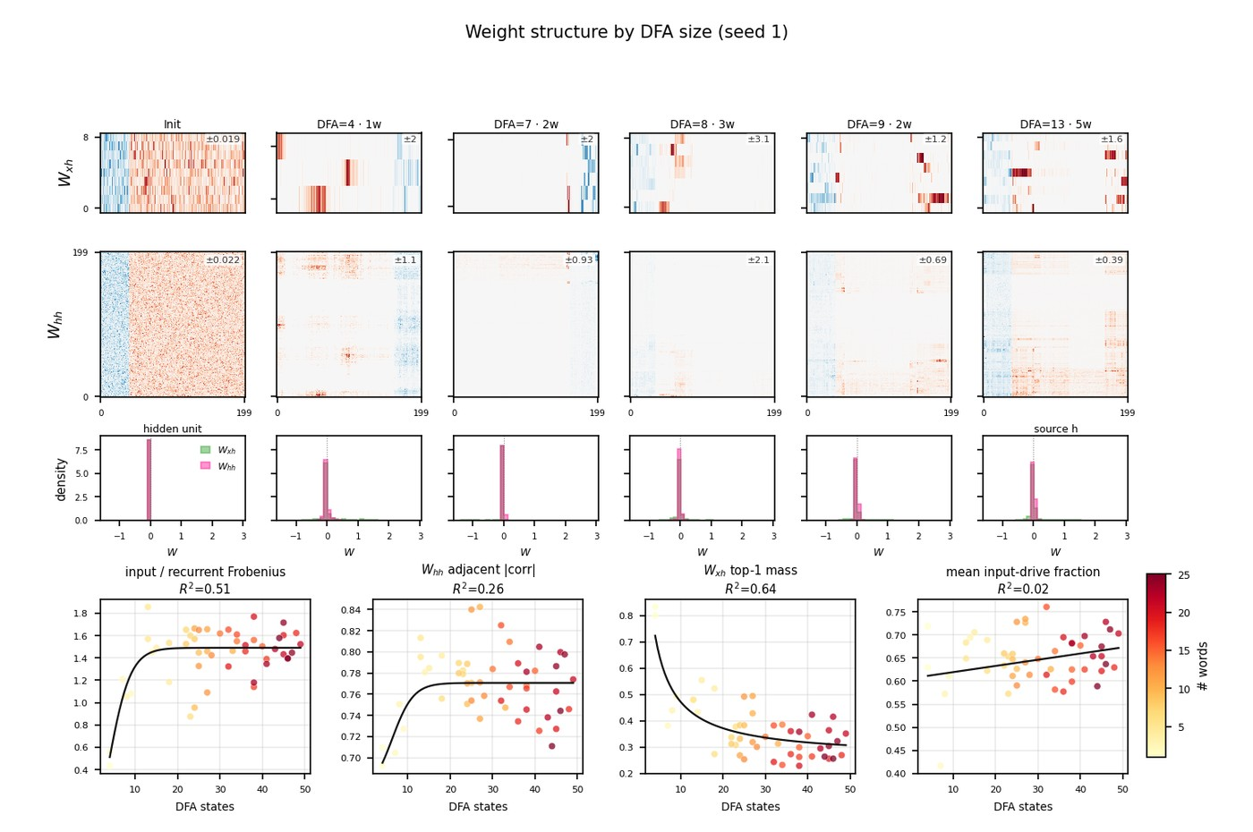
Weight matrices by DFA size

Slide 20
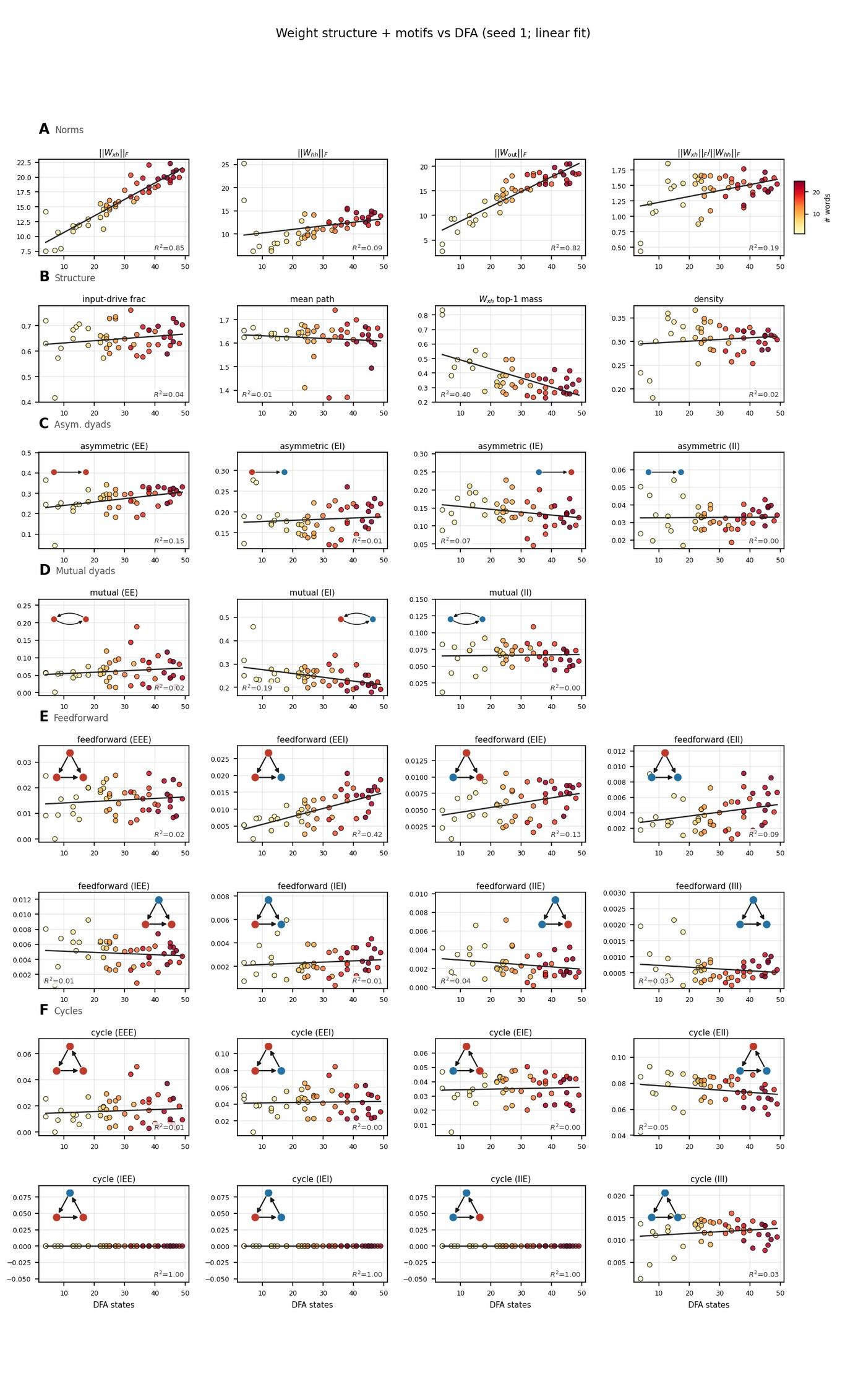
Weight graph structure and motifs vs DFA

