Slide 1
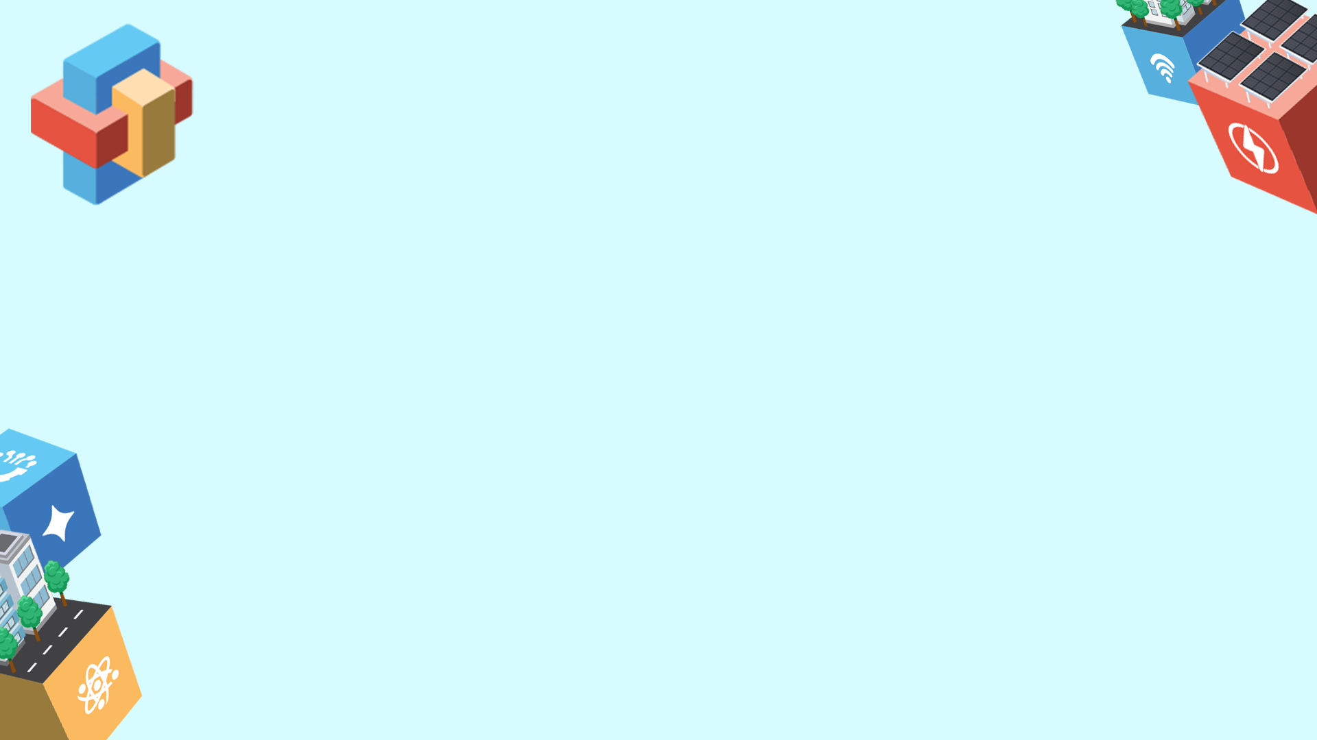
(Insert Entry Title Here)
(Insert School Name here)
Chosen Theme: (choose 1 and remove others)
- Environmental Sustainability through Technology
- Social Change through Tech and Sport
- Solving Community Problems with AI
Team Members:
(insert full name of Team Member 1, Grade Level) [ex: Juan A. Dela Cruz, Grade 8]
(insert full name of Team Member 2, Grade Level)
(insert full name of Team Member 3, Grade Level)
(insert full name of Team Member 4, Grade Level)
Adviser: (insert full name of Adviser)
(insert project description here)
NOTE: ONLY THREE (3) SENTENCES which may be used as the entry’s official description for write-ups

Slide 2

What problem are we trying to solve?
[Provide an overview of the project. What specific problem in your community or opportunity does your project address? Briefly cite the research or data that proves this need exists and guided your approach.]
What do we want to achieve?
Goal: What broad, long-term impact do you want to achieve (e.g., shifts in community awareness, attitude, or behavior)?
Objectives: [List 2–3 objectives you want your project to achieve. Your objectives must be written using the SMART framework (Specific, Measurable, Attainable, Relevant, Time-bound). Focus on real outcomes rather than just output tactics (e.g., “deploy 1 unit of OL trap to each classroom in the district, eliminating 90% of dengue mosquitoes cases by 90%” rather than "inform 20 schools how to use OL trap").]
Who will benefit from this project?
[Who specifically are you trying to reach and help? Define your primary and secondary beneficiaries clearly (avoid vague terms like "general public") and state your target reach, key beneficiary traits, and the research behind your choice.]

Slide 3

How did we come up with this proposal?
[State the process your team took to create the solution. How did your team develop and select this solution? Outline the key brainstorming steps and criteria you used to confirm this was the best fit for the problem.]

Slide 4

How will this tech solution work?
[Summarize your final project and the core logic behind it. How is STEM the main element in your solution? What is your key message and why is this specific solution the most effective way to deliver it?]

Slide 5
How do we implement this?
[Describe what your team will need to implement the solution and ensure the project’s success.]
Resources: What are the technical requirements, resources, budget needed to implement your solution?
Stakeholders: Who are the key people, groups, or organizations you will need to work with or help from (such as LGUs, schools, community organizations, or other partners).
Risks & Mitigation: Identify the potential risks or challenges that may affect implementation and the measures you will take to address them

Slide 6
What kind of impact do we hope to achieve and what is the long term vision for this proposal?
[Describe the change your solution aims to create in the community. Explain how you will measure its success, how the solution can grow or improve over time, and what lasting impact you hope to achieve]
Measurable Outcomes: Identify 2–3 specific results you want your solution to achieve and the metrics you will use to measure them.
Long-Term Vision: Scalability and evolution. Explain how your solution can be expanded to help more people or communities and how it can improve or adapt over time.
Key Takeaway: Provide one powerful closing statement that captures the lasting change your solution hopes to create in the community.

Slide 7
REMINDERS:
Provide the required information for all seven (7) sections.
Your entry must not exceed 3,000 words and is limited to a maximum of six (6) slides only.
The font style must be Arial, 11.
You may change the design, fonts, and insert supporting visual elements (e.g., graphics, photos).
Delete this slide once your entry is complete.
Convert this file to PDF and submit via Google Form link provided. The file must not exceed 40MB.

