Slide 1
Samsung Solve for Tomorrow 2026 · Environmental Sustainability through Technology
TALA
A PHP 6,000 solar-powered estero guardian that lifts floating plastic out of the water and counts every item as evidence for producer accountability
Quezon City Science High School
[TEAM NAMES, Grade 10] · Adviser: [NAME]
Notes:
Open with the pitch in one sentence: TALA removes floating plastic from a creek and counts every item with a camera, giving the barangay the evidence the law needs to hold packaging makers accountable. Name the team and adviser, then move to the problem.

Slide 2



Our creeks carry plastic unrecorded
Removal is invisible
No item-level proof
Blocked creeks flood
Cleanups are weighed in bulk. Nothing is kept about what the plastic was, so the same items return.
RA 11898 makes producers responsible for packaging, but brand audits are periodic, manual and mostly land-based.
Debris chokes channels, and barangays learn of a blockage only after the water has risen.
The gap: a continuous, low-cost record taken at the waterway itself, run by a single barangay.
Notes:
Plastic reaches the sea through creeks and esteros. Cleanups record bulk weight only. RA 11898 makes producers responsible for packaging, which needs item-level proof that barangays cannot currently produce. Flooding from blocked channels is a secondary hazard on the same creek. [VERIFY the Meijer et al. 2021 ranking and the RA 11898 scope before presenting.]

Slide 3
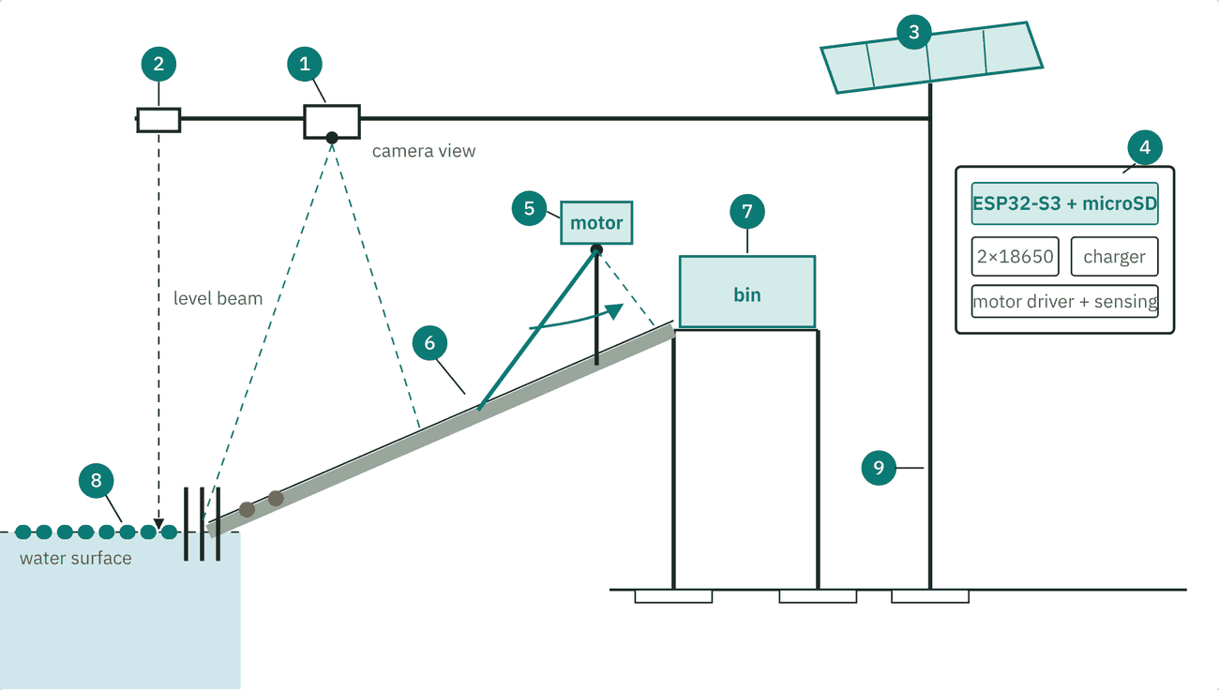
TALA lifts plastic out and counts every item
1
Trap
A bottle boom guides plastic to a bar screen.
2
Lift
A camera-triggered arm sweeps debris up a ramp into a bin.
3
Count
An on-chip model classifies each item by type and, where legible, brand.
4
Report
A weekly offline report and an open dataset for the barangay.
Schematic, not to scale
Notes:
Walk the drawing left to right. The boom herds floating plastic to the bank. The camera counts each item and also triggers the arm, so one inexpensive chip yields evidence and saves energy. Everything electrical sits high on the post. Flood warning is a secondary feature: an ultrasonic sensor reads the water level against a painted gauge.

Slide 4
The parts exist. The combination is new
How it works
What exists, and what it leaves open
On-chip counting. An INT8 model on an ESP32-S3 classifies each item and triggers the arm.
Jam protection. Current and Hall sensing, a shear pin and at most three retries.
Audit-grade data. An append-only log of class, time, level and image hash, checked by a weekly hand audit.
Solar budget. About 18 Wh a day against about 6 Wh for the electronics (planning figure).
Existing work | Leaves open
Cameras and deep learning (van Lieshout et al., 2020) | Monitors only, removes nothing
Robotic boats (HydroSentinel, 2026) | Need radio, charging and an operator
Estero trash traps (Manila Bulletin, 2026) | Record bulk weight only
Brand audits (Break Free From Plastic, 2019) | Periodic, manual, land-based
TALA | Fixed, solar, lifts and counts on one chip
Notes:
None of these components is new. Van Lieshout et al. (2020) count floating plastic from bridge cameras but remove nothing. HydroSentinel (2026) is a moving boat. Trash traps remove plastic but record weight only. Brand audits name companies but are periodic and manual. TALA is the continuous, community-owned, low-cost counterpart. Our search was limited, and we say so. [Confirm each citation before presenting.]

Slide 5
Each stage waits for a passing test
Stage 1 · Bench
Stage 2 · Passive trap
Stage 3 · Arm and sensor
PHP 1,800
PHP 2,500
PHP 1,350
Gate: precision and recall on held-out photos meet the target.
Gate: boom survives rain events, counts within 15% of hand counts.
Gate: wet bench test, then solar-only lifts at the target jam rate.
PHP 6,000
total, including PHP 350 contingency. If the arm fails, the boom, bin and camera still deliver the data.
Nov 2 submit · Dec 7 present · Mar 2027 replicate
Notes:
Each stage is bought only after the previous gate passes, so a failed model or a rejected site does not strand money. Stage 3 begins with a wet bench rig using real hyacinth, estero silt and a little cooking oil. Prices are estimates to confirm locally. The barangay signs a maintenance agreement naming who empties the bin weekly. [Fill in the barangay and estero before presenting.]

Slide 6
One creek proves the method
Research question Can a PHP 6,000 on-chip counter match a trained hand audit within 15 percent, and does continuous counting reveal rain-driven pulses that weekly audits miss?
±15%
PHP 6,000
1 to 2
device count against a hand audit
per unit, copyable by any barangay
more sites by March 2027
The Philippines already knows who makes much of its plastic. TALA makes the proof continuous, cheap and community-owned, and lifts some of the plastic out along the way.
Notes:
Be plain about the limits. One unit lifts a small mass of plastic. The significance lies in a design cheap enough to copy and data open enough to combine. Until a second barangay builds a unit, the wider reach is a plan, not a result. The pilot proves the method at one creek.

