Slide 1
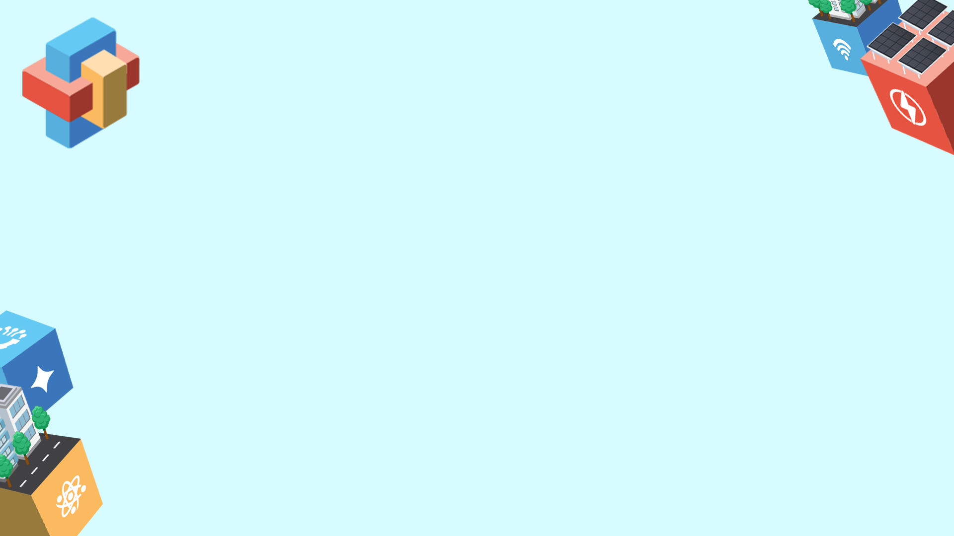
SAGIP: A Low-Cost, Solar-Powered Estero Guardian with On-Chip AI That Lifts Floating Plastic and Counts Every Item as Evidence for Producer Accountability
Quezon City Science High School
Chosen Theme:
Environmental Sustainability through Technology
Team Members:
Aaron Jed E. Campo, Grade 10
Raya Kalayaan R. Amparo, Grade 10
Ayeza Leigh F. Delos Santos, Grade 10
Sophia Laureen A. Tado, Grade 10
Adviser: Skjoukje U. Jemoya
Our device is a low-cost, solar-powered unit in which a floating boom guides surface plastic toward the bank, a camera-triggered sweeper arm lifts it into a bin, and an ESP32-S3 camera running a tiny on-chip AI model counts each item by plastic type. Barangay officials receive a weekly offline report of what was removed and, where labels are legible, who produced it, with no images of people, plus a secondary water-level alert for impending channel blockage. Built from local and upcycled parts for about PHP 6,000 and tested against a hand-counted baseline, it adds anonymized records to an open dataset that other barangays can copy and extend.

Slide 2

2. What do we want to achieve?
Goal: make creek plastic measurable evidence instead of invisible waste, with cleaner creeks now and community-owned data that shifts the burden of proof to packaging producers.
Objectives (SMART):
1. Remove plastic. In an 8-week pilot from December 2026, lift at least [TARGET] kg of floating debris and capture at least [X]% of what reaches the boom, against a baseline week.
2. Prove what it is. By Nov 20, reach 85% precision and recall on unseen photos, then keep weekly counts within 15% of a hand audit.
3. Make it copyable. By March 2027, a free build guide in English and Filipino, an open dataset, and 2+ more barangays or schools building a unit for about PHP 6,000.
1. What problem are we trying to solve?
Plastic reaches the sea through creeks and esteros, and Philippine rivers rank among the largest sources of ocean plastic (Meijer et al., 2021). Cleanups weigh trash in bulk and record nothing about it. RA 11898 makes producers responsible for packaging, but brand audits are periodic, manual and mostly land-based (Break Free From Plastic, 2019).
The gap: a continuous, low-cost record taken at the creek itself that one barangay can run. A blocked channel is a related hazard.
3. Who will benefit from this project?
Primary: the [N] households of [barangay and purok] along [estero] and the barangay sanitation officers. Secondary: the city solid-waste office and DENR, who need item-level evidence, 2+ more barangays or schools by March 2027, and downstream fisherfolk.

Slide 3

4. How did we come up with this proposal?
Select. We scored five community problems on significance, feasibility, STEM depth, replicability and originality. Creek plastic won. We can reach a creek, measure it weekly, and RA 11898 has just made item-level data useful. [Edit to match your process.]
What exists. Cameras with deep learning count floating plastic from bridges but remove nothing (van Lieshout et al., 2020). Low-cost robotic boats detect and collect plastic but need radio, charging and an operator (HydroSentinel, 2026). Estero trash traps remove plastic at scale but record bulk weight only (Manila Bulletin, 2026). Brand audits name the companies but are periodic and manual (Break Free From Plastic, 2019).
Gap we test. None of these lifts, counts and shares open data in a unit a barangay can afford. Our search was limited. We ask: can a PHP 6,000 on-chip counter match a trained hand audit within 15%, and does continuous counting reveal rain-driven pulses of plastic that weekly audits miss?
Sources: Break Free From Plastic 2019; HydroSentinel 2026 (ScienceDirect); Manila Bulletin 2026; Meijer 2021 (Science Advances); RA 11898; van Lieshout 2020 (Earth and Space Science).

Slide 4

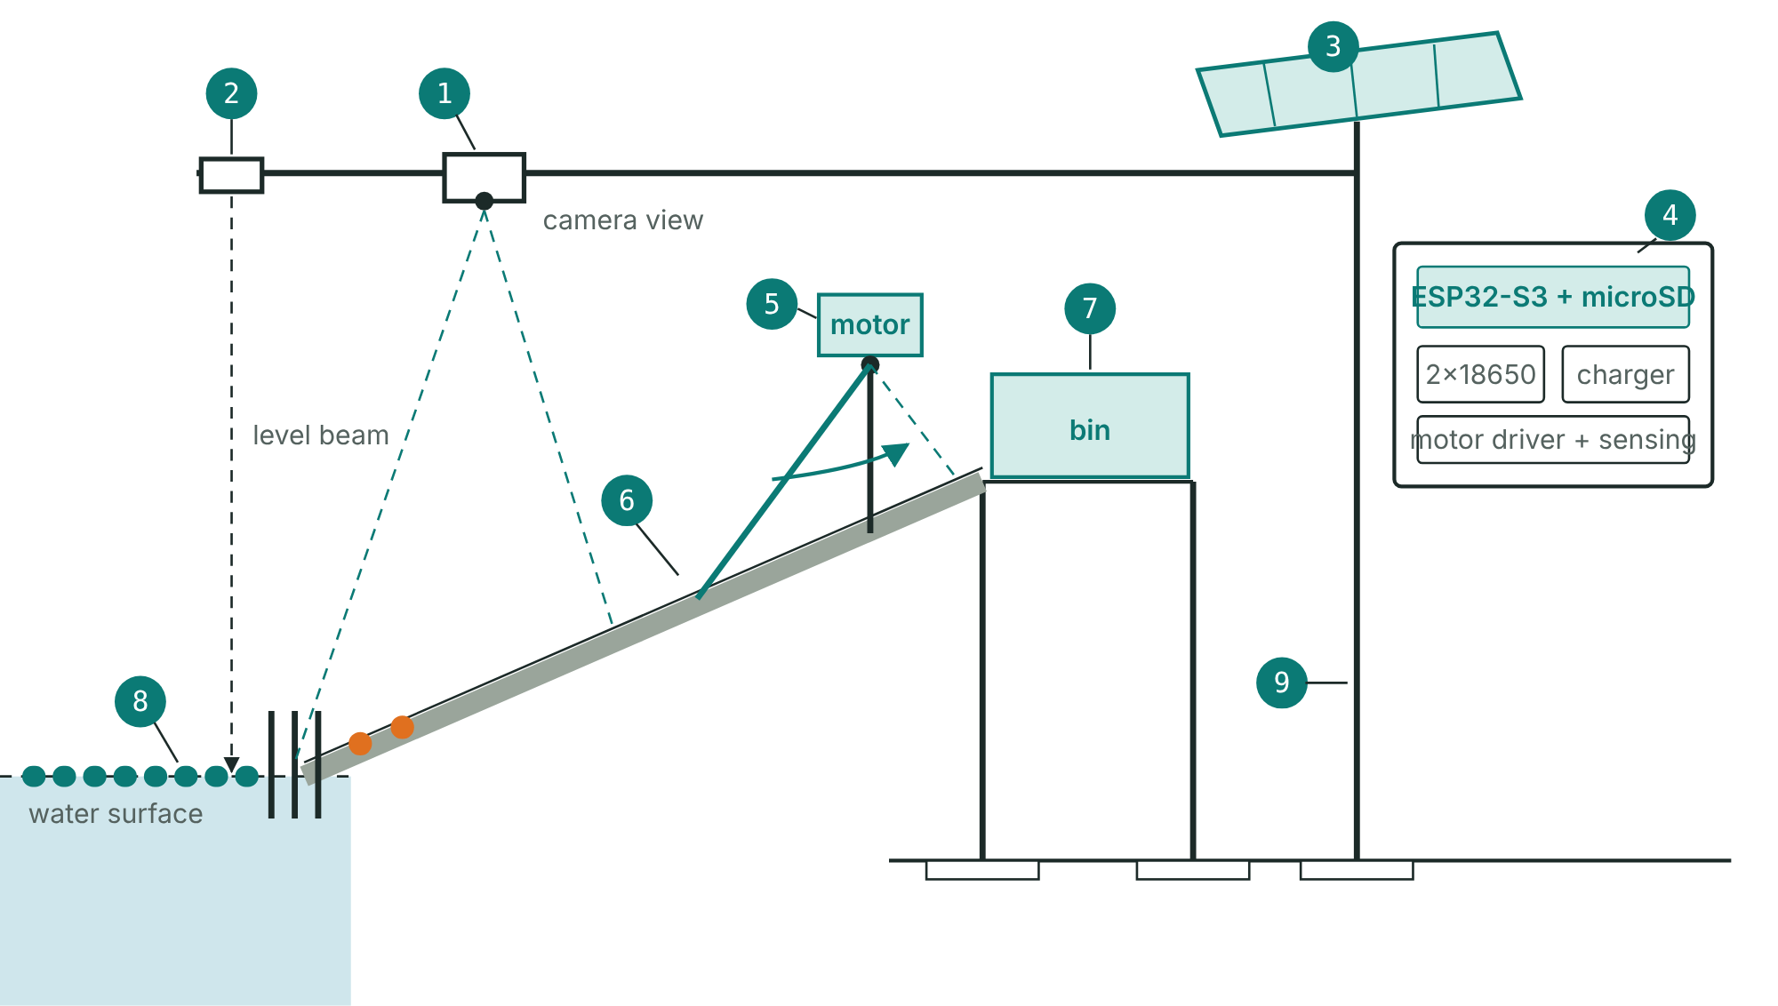
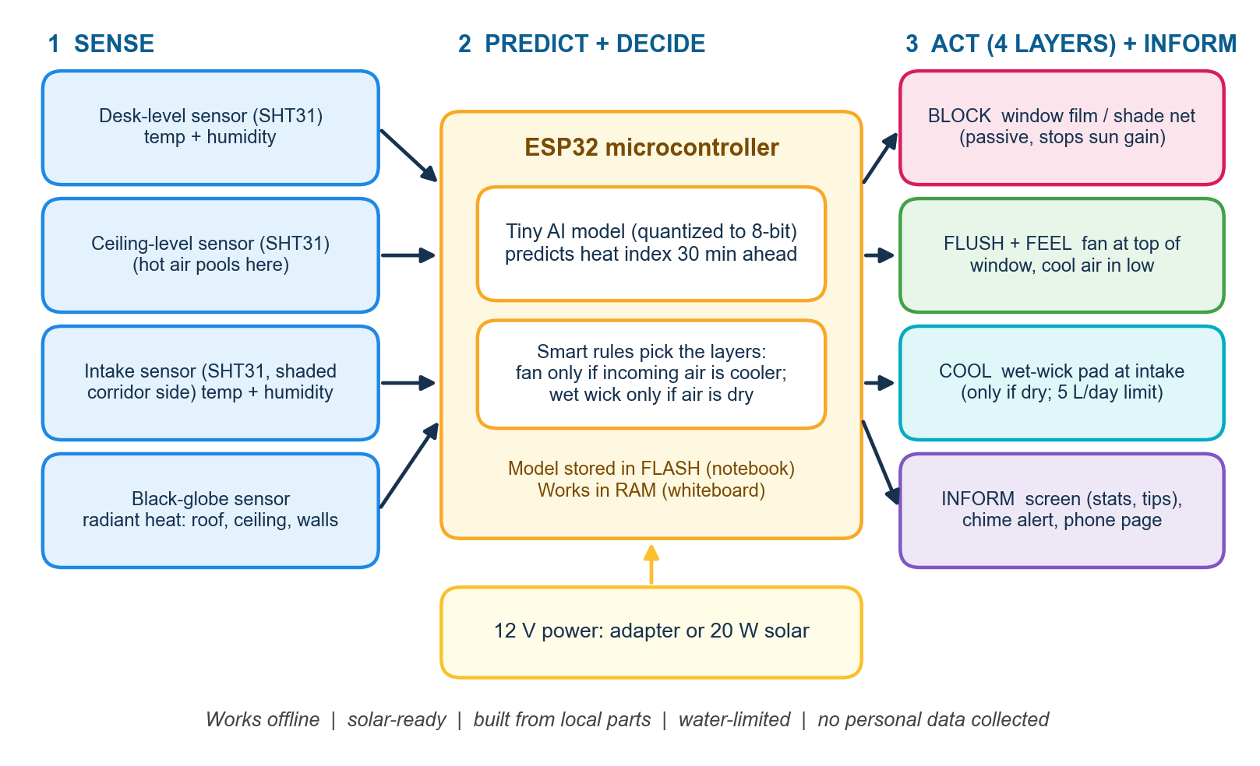
5. How will this tech solution work?
Trap: a boom of reused bottles guides plastic to a bar screen. The current does the herding, and a wide-gapped deflector lets hyacinth mats pass.
Lift: a camera-triggered arm sweeps debris up a ramp into a bin. A shear pin protects the gearbox, and current and Hall sensors stop jams, with at most three retries.
Count: an ESP32-S3 camera looks down at the water only, and an INT8 model classifies each item on the chip. Weekly hand counts check it.
Report: an offline Wi-Fi page gives the barangay a weekly report and an open dataset.
Warn (secondary): an ultrasonic sensor logs the water level and alerts before a blockage.
STEM: buoyancy and torque, a solar energy budget, precision and recall, and a quantized AI model.
In plain words: the model is the skill of a sanitation worker who can tell a PET bottle from a sachet at a glance, saved as a file of numbers. Quantization rounds the numbers like a gradebook (87, not 87.3416), so the file fits the chip. No internet is needed.

Slide 5
6. How do we implement this?
Stakeholders
Barangay captain and sanitation officers: site approval, weekly emptying, and use of reports under a one-page maintenance agreement. City solid-waste office and DENR: use the data. Adviser and school head: supervision and safety sign-off. Students: build, label, count and report. Residents: consent and a clear site.
Risks and mitigation
Hyacinth mats: deflector, a vegetation class that stops the arm, daily screen clearing.
Jams and burnout: shear pin, current and Hall sensing, three retries, driver off by default.
Oil and silt: motor mounted high, sealed bearings, hooded lens.
Model errors: test on unseen places, keep the hand count.
Arm fails: boom, bin and camera still work, so the data pilot survives.
Safety, privacy: no student enters the water, guarded arm, camera sees water only.
Storms, theft: quick-release line, electronics retrieved before a typhoon.
Resources
Pilot unit: about PHP 6,000 (ESP32-S3 camera 1,300, microSD 200, box 300, solar panel 600, charger and cells 700, boom and post 800, bin 150, wiring 250, level sensor 350, motor and driver 700, sensing 150, ramp and arm 150, contingency 350). Estimates to confirm.
Stages: bench 1,800, passive trap 2,500, arm and sensor 1,350, each bought after a test passes.
Timeline: site visit and baseline by Nov 2, model by Nov 20, results Dec 7, pilot Dec to Feb, build guide by March.

Slide 6
7. What impact do we hope to achieve, and what is the long-term vision?
Long-Term Vision: a student-built, barangay-owned network of units along connected creeks, feeding one open dataset that shows where plastic enters, which products dominate and whether EPR commitments change what the water carries. Planned upgrades are a belt conveyor for higher volumes and a second camera angle. Each barangay added makes every unit's data more valuable. The pilot proves the method at one creek and claims no more.
Success means plastic lifted from a real creek and a trustworthy weekly record of what it was. One unit lifts little, so the value lies in a design cheap enough to copy and data open enough to combine.
Measurable Outcomes:
1. Less plastic: at least [TARGET] kg lifted in 8 weeks, capture rate of at least [X]% against the baseline.
2. Trustworthy counts: weekly error of 15% or less against the hand audit, and 85% precision and recall on unseen places.
3. Replication: 2+ more sites by March 2027 at about PHP 6,000 each, sharing one open data format.
Key Takeaway: The Philippines already knows who makes much of its plastic. SAGIP makes the proof continuous, cheap and community-owned, and lifts some of the plastic out along the way.

