Slide 1
Final Project
Raikes 284H

Slide 2
Components You’ll Need …
Program Counter (8-bit counter)
Instruction Register
Decoder (VHDL please)
Register File (need a demux)
RAM & ROM (use Altera’s library)
ALU + Shifter
Synchronizing clock
Clock (1 Hz for debugging, provided)

Slide 3
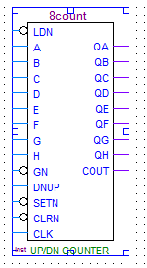
Program Counter
N-bit counter that counts up each time a clock arrives (8count is available in Altera library)
N is set to the maximum address for your ROM
Must have a clock input
Must have target_address input to support branching
Must have a write enable to control when to write the new address (write when 1, count up when 0)

Slide 4
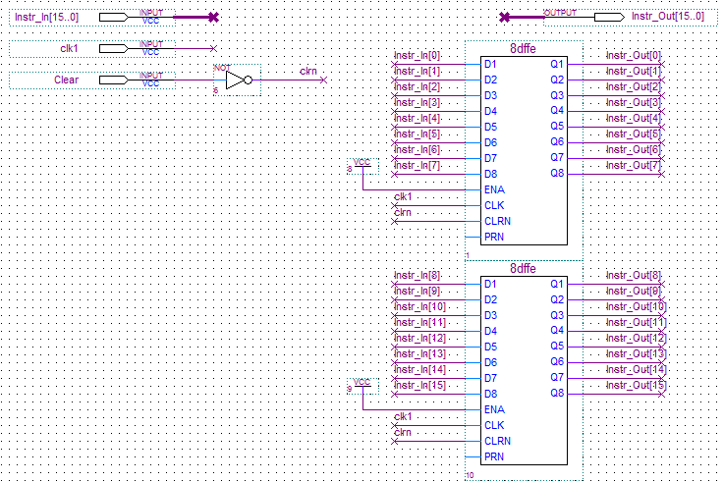
Instruction Register (Optional)
Hold the current instruction while the Program Counter (PC) increments to the next instruction

Slide 5
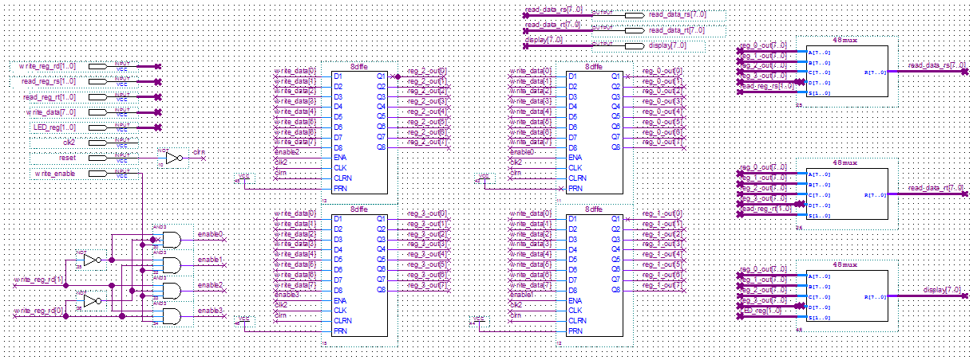
Register File
Contains a collection of registers
Must support write to a particular register (1 write port)
Clock and write enable are needed
Must support read from a particular register (2 read ports)

Slide 6
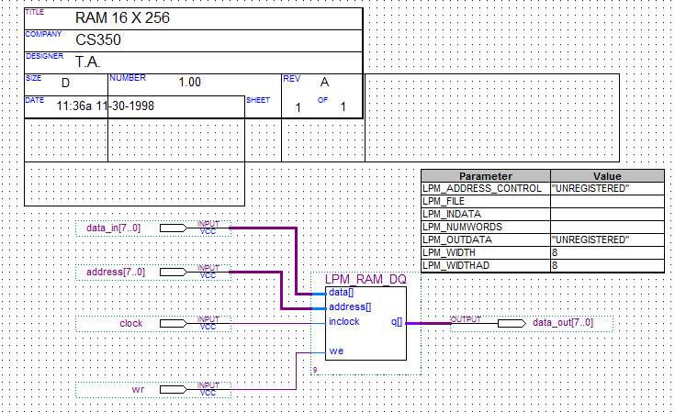
RAM
Used to hold data
you can adjust the configuration based on your need (e.g., change LPM_WIDTH to 16 to store 16-bit data)

Slide 7
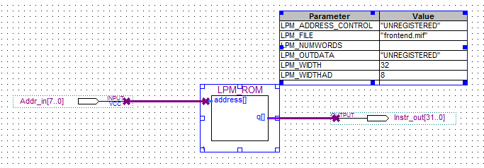
ROM
Used to hold binary program
Configuration should be changed according to your need

Slide 8
ALU + Shifter
ALU: Performs the basic operations including add, subtract, and, or
Ripple carry adder can be used (from your lab)
Support zero output
Support overflow detection
Shifter: Performs multiple bits shifting

Slide 9
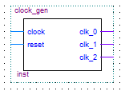
Synchronizing Clock
One potential way to synchronize the operation is to create a synchronizing clock
Takes a clock input
Outputs two (or three) clock signals
clock
clock0
clock1
clock2

Slide 10
Synchronizing Clock
How many devices need clock signals to operate?
IR (if you choose) (clock 0?)
RAM (clock 1?)
Register file (clock 1?)
PC (clock2?)

Slide 11
Helpful Advices
Agree on a convention
When declare a bus, choose a consistent definition of bus width (a[7..0] or a[0..7])
Inconsistency is a major headache
Typically, a[7..0] is used (7 is msb and 0 is lsb)
Don’t throw in everything all at once
Test each component thoroughly
Step wise refinement
Connect PC to ROM then test
Add IR then test again
Think about front-end/back-end
Front end might include PC/ROM/IR/sync_Clock
Backend might include decoder, RF, ALU/shifter, RAM
Think about how to debug
Add hardware components to connect to switches and displays (check RF contents)

