Slide 1
Amazon Alexa Skill
Tyler Moon

Slide 2
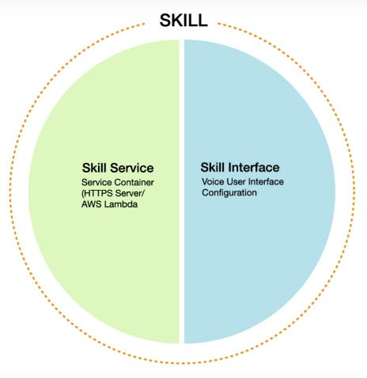
Mad Lib Builder Skill Components
AWS Lambda Function https://aws.amazon.com/
Python 2.7
Amazon Alexa Developer Console https://developer.amazon.com/
Echo Dot

Slide 3
Mad Lib Builder Skill
Intent Schema: Utterances:
Lambda Function: lambda_function.py
{
"intents": [
{
"slots": [
{
"name": "Word",
"type": "LIST_OF_WORDS"
}
],
"intent": "MadlibsIntent"
},
{
"intent": "AMAZON.HelpIntent"
},
{
"intent": "AMAZON.StopIntent"
},
{
"intent": "AMAZON.CancelIntent"
}
]
}
MadlibsIntent my word is {Word}
MadlibsIntent I choose {Word}
MadlibsIntent I pick {Word}
MadlibsIntent {Word}
MadlibsIntent my verb is {Word}
MadlibsIntent my adjective is {Word}
MadlibsIntent my noun is {Word}
MadlibsIntent my food is {Word}
MadlibsIntent my animal is {Word}

Slide 4
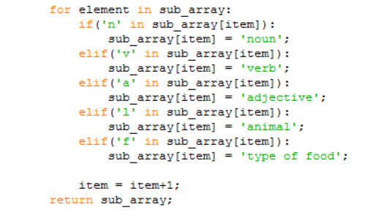
How the Code Works
Randomly Selects a preloaded mad lib
Uses the percent sign (%) as the delimiter
Counts the occurrences for the number of prompts in the mad lib
Checks for an ‘n,’ ‘v,’ ‘a,’ ‘l,’ or ‘f’ afterwards

Slide 5
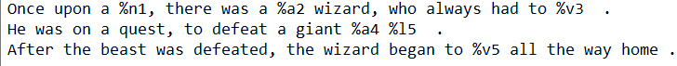
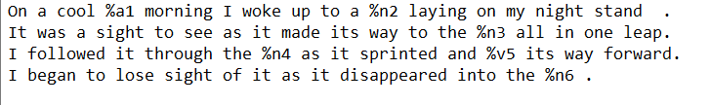
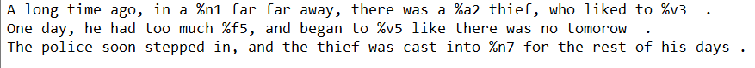
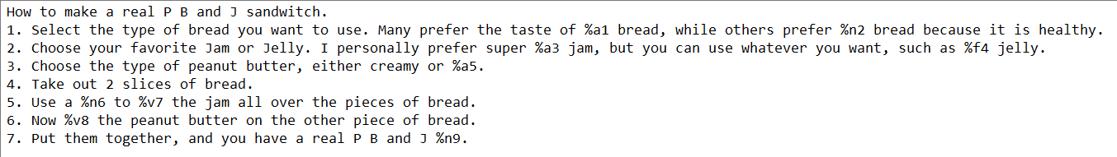
Mad Lib Scripts

Slide 6
Video Demo
Mad Lib Demo Youtube Video

Slide 7
Works Cited
Alexa Developers: https://www.youtube.com/watch?v=GnjY8cqSPf0
Mad Lib Shell: https://github.com/boyP

