Slide 1
Elevator Pitch
Team 5

Slide 2
Problem 3 - Security
Physical Security
Building Access
Scalable to Site, and Sites
Central Access Control
Central Access Log
Re-use of held data

Slide 3



Scenario
Outside
Inside
Cam 1
Cam 2

Slide 4
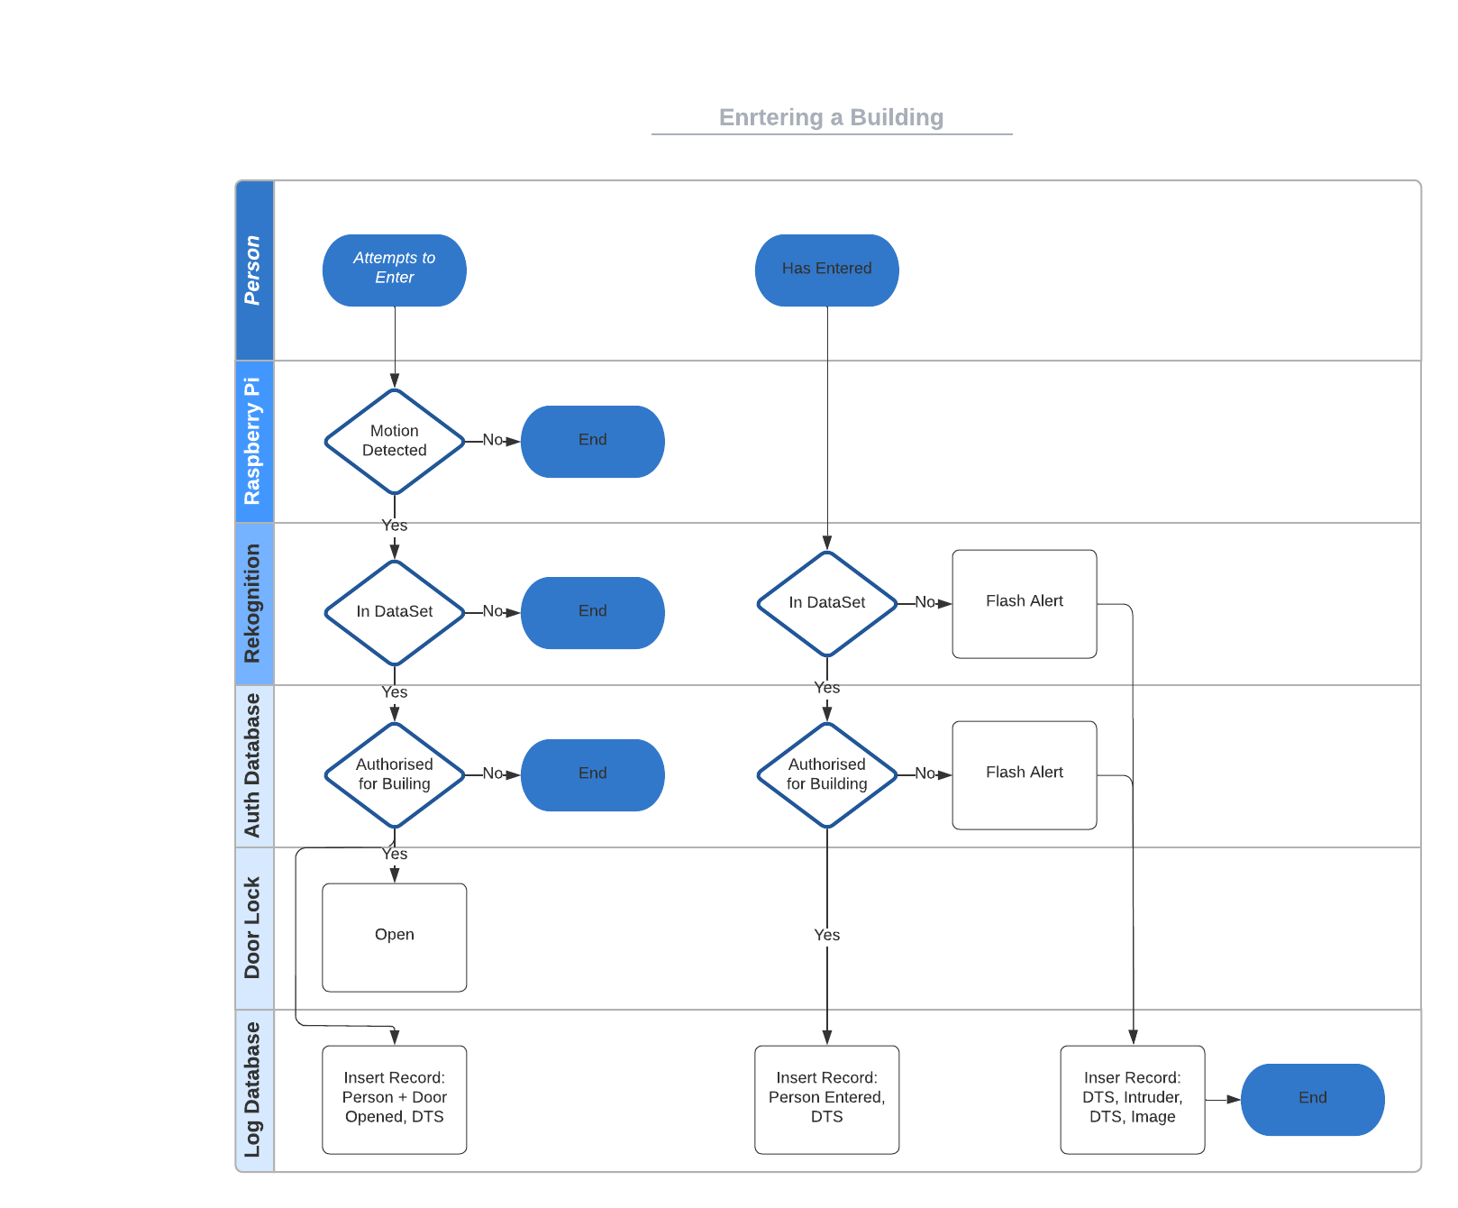
Enter a Building

Slide 5
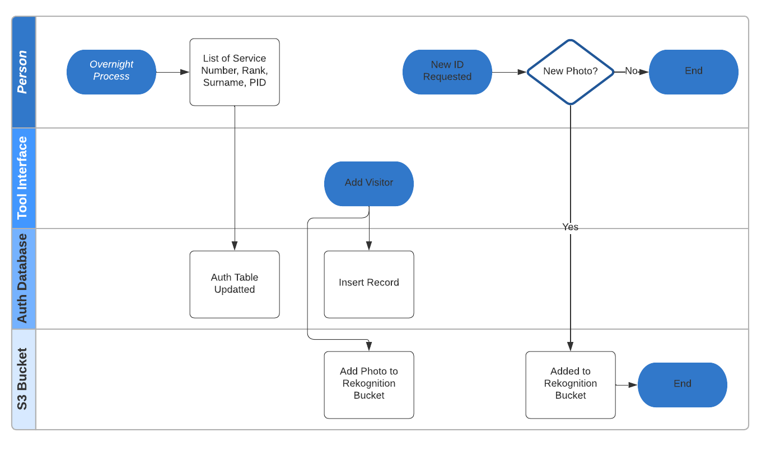
Admin / Integration

Slide 6
Tech Stack
Raspberry Pi + Camera
AWS Rekognition
AWS S3
AWS DynamoDb
xCode – Swift UI - iPad

Slide 7
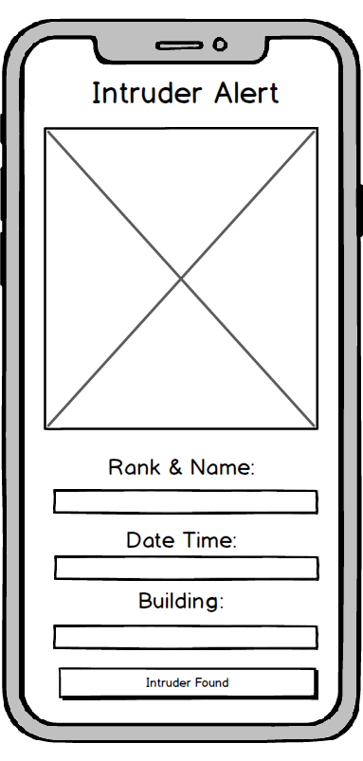
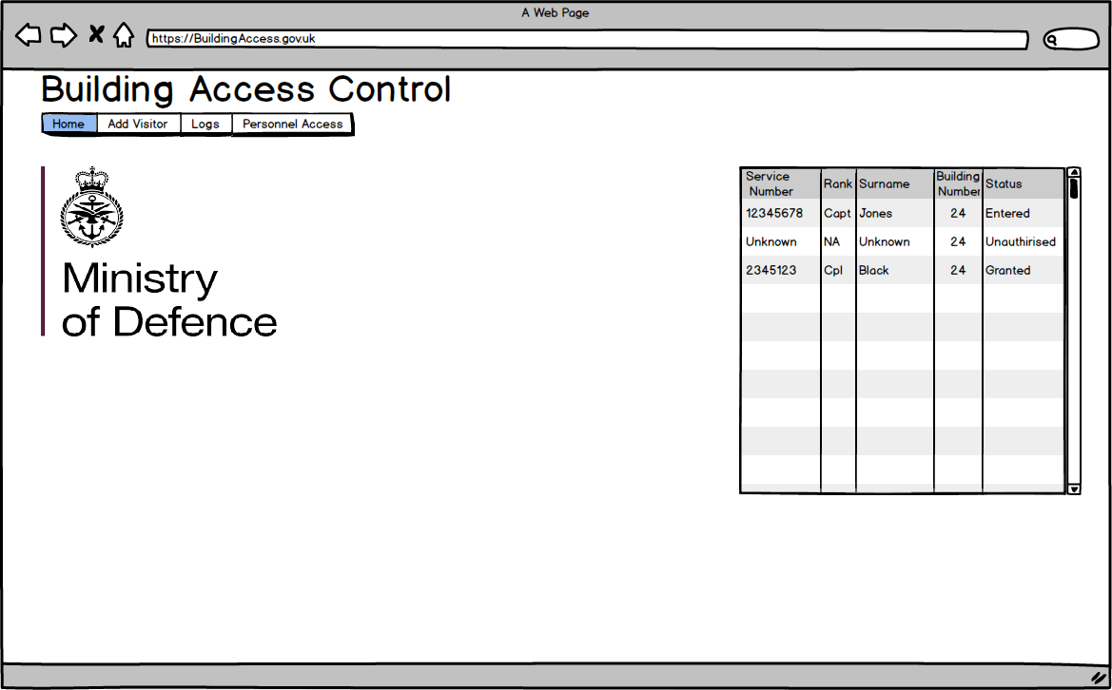
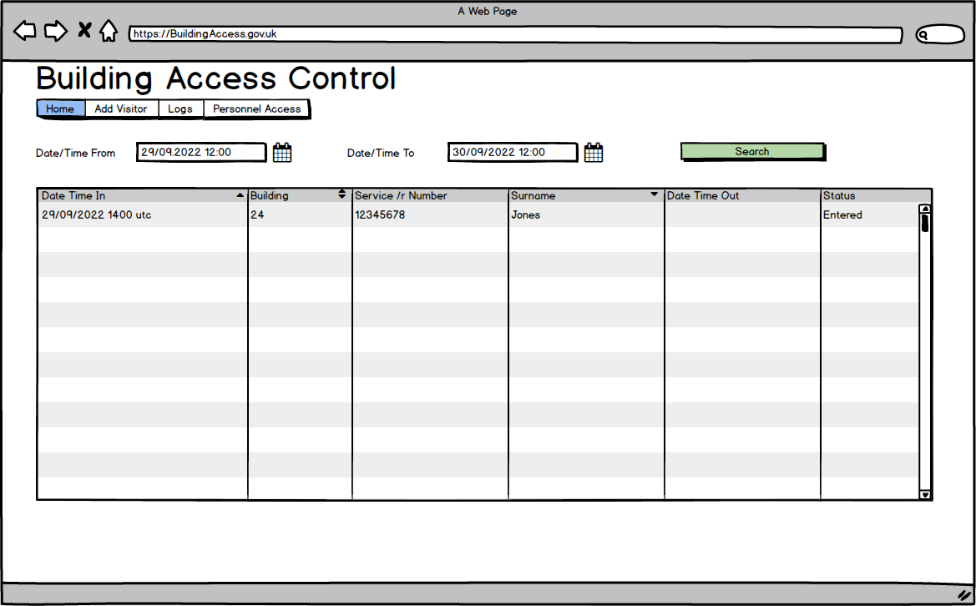
Mockups

Slide 8
Team Progress Measurement
Self Organised and Tasked
2 hourly stand-ups – all team members to update
Flex workforce for current problem
GitHub Projects - Kanban
Nightly Retrospective & replan

