Slide 1
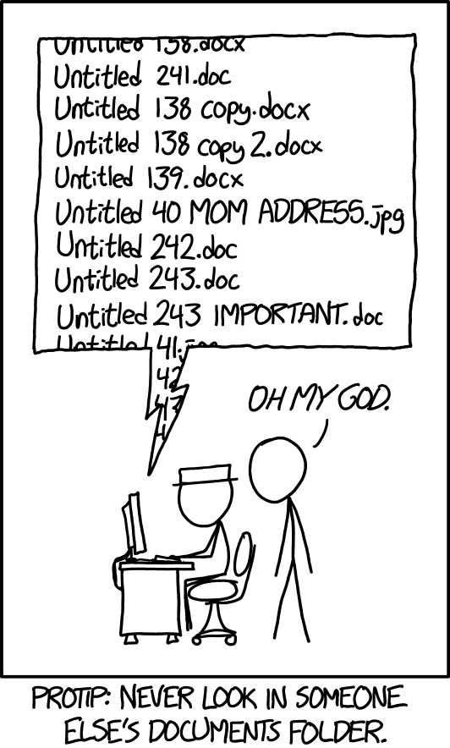
What is BIDS and why should I use it?
Tom Morin
April 25, 2025

Slide 3


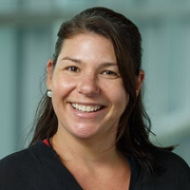
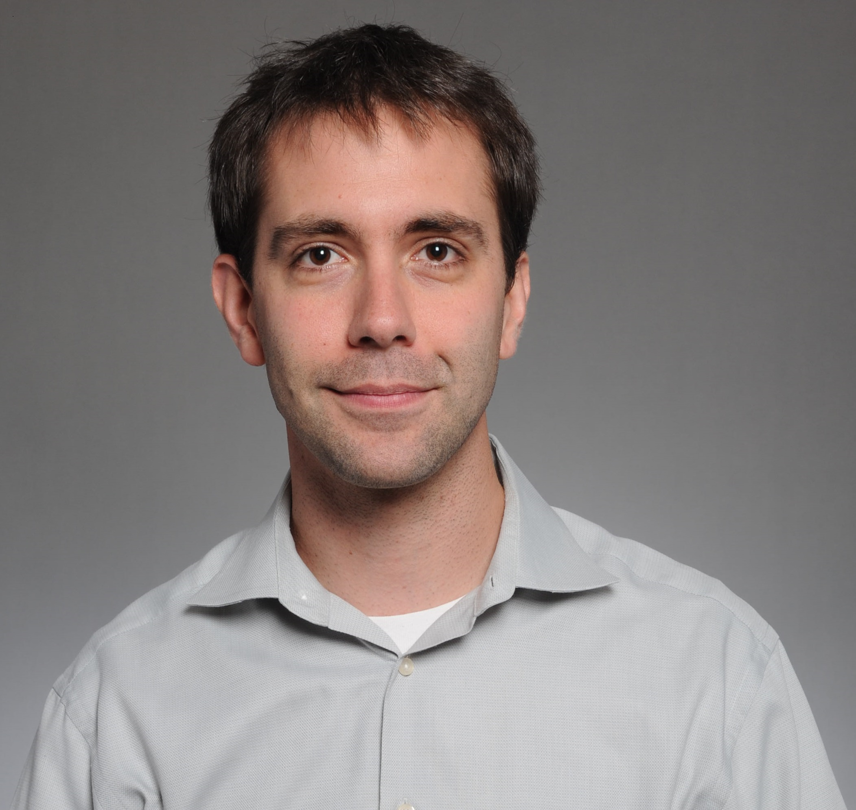
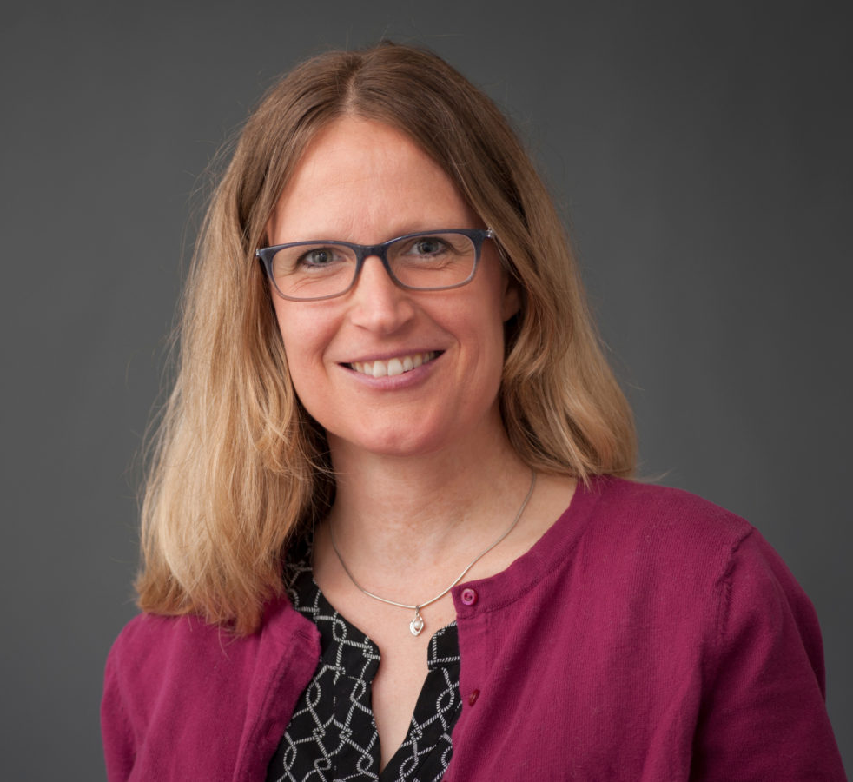
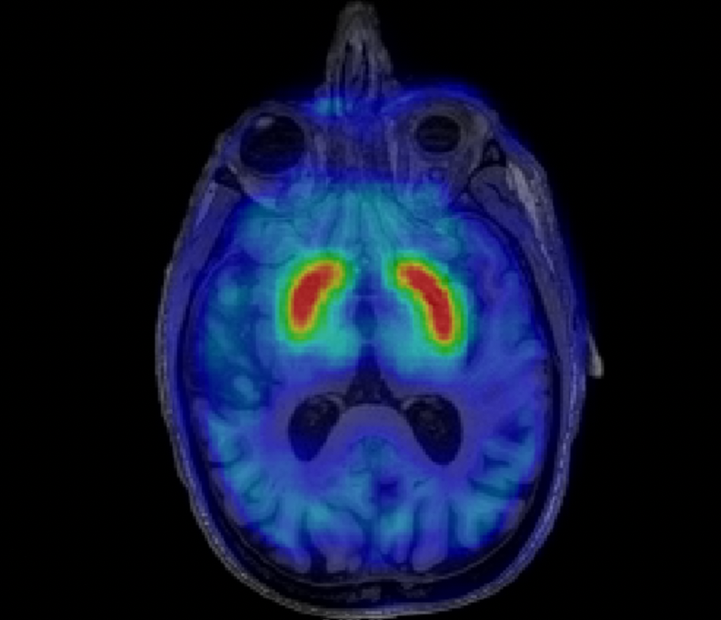
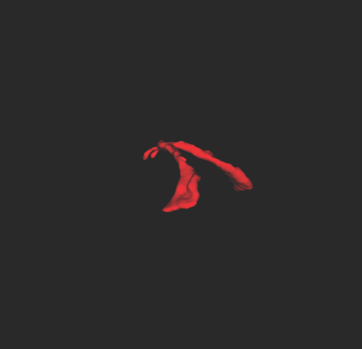
Anne Berry
Jacob Hooker
Nicole Zürcher
Brandeis Aging Brain Study
(Dopamine System in Cognitive Aging)
Neuroimmune Differences in Autism
(Choroid Plexus Segmentation)

Slide 4

https://www.repronim.org/
“ReproNim's goal is to improve the reproducibility of neuroimaging science and extend the value of our national investment in neuroimaging research, while making the process easier and more efficient for investigators.”

Slide 5



Collect Data
Organize & Clean Data
Analyze Data

Slide 6
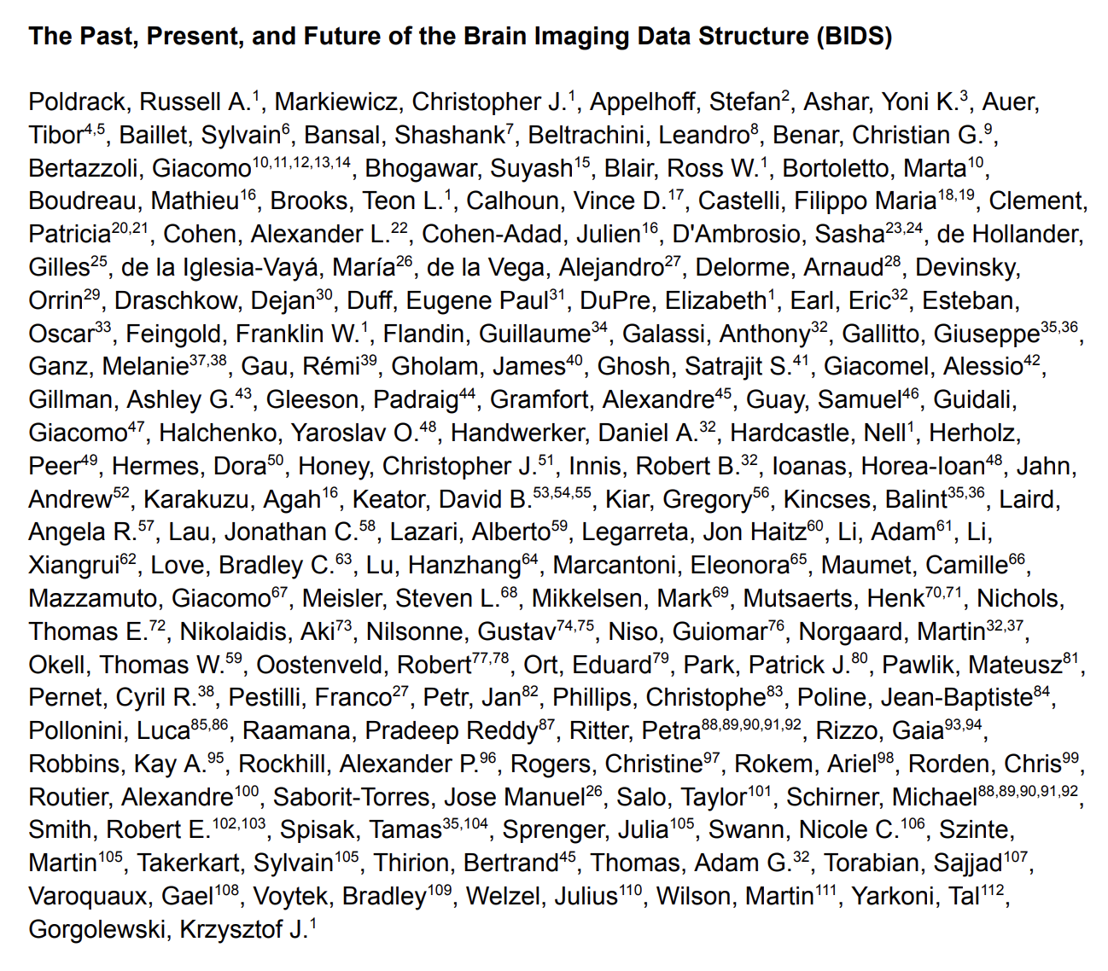
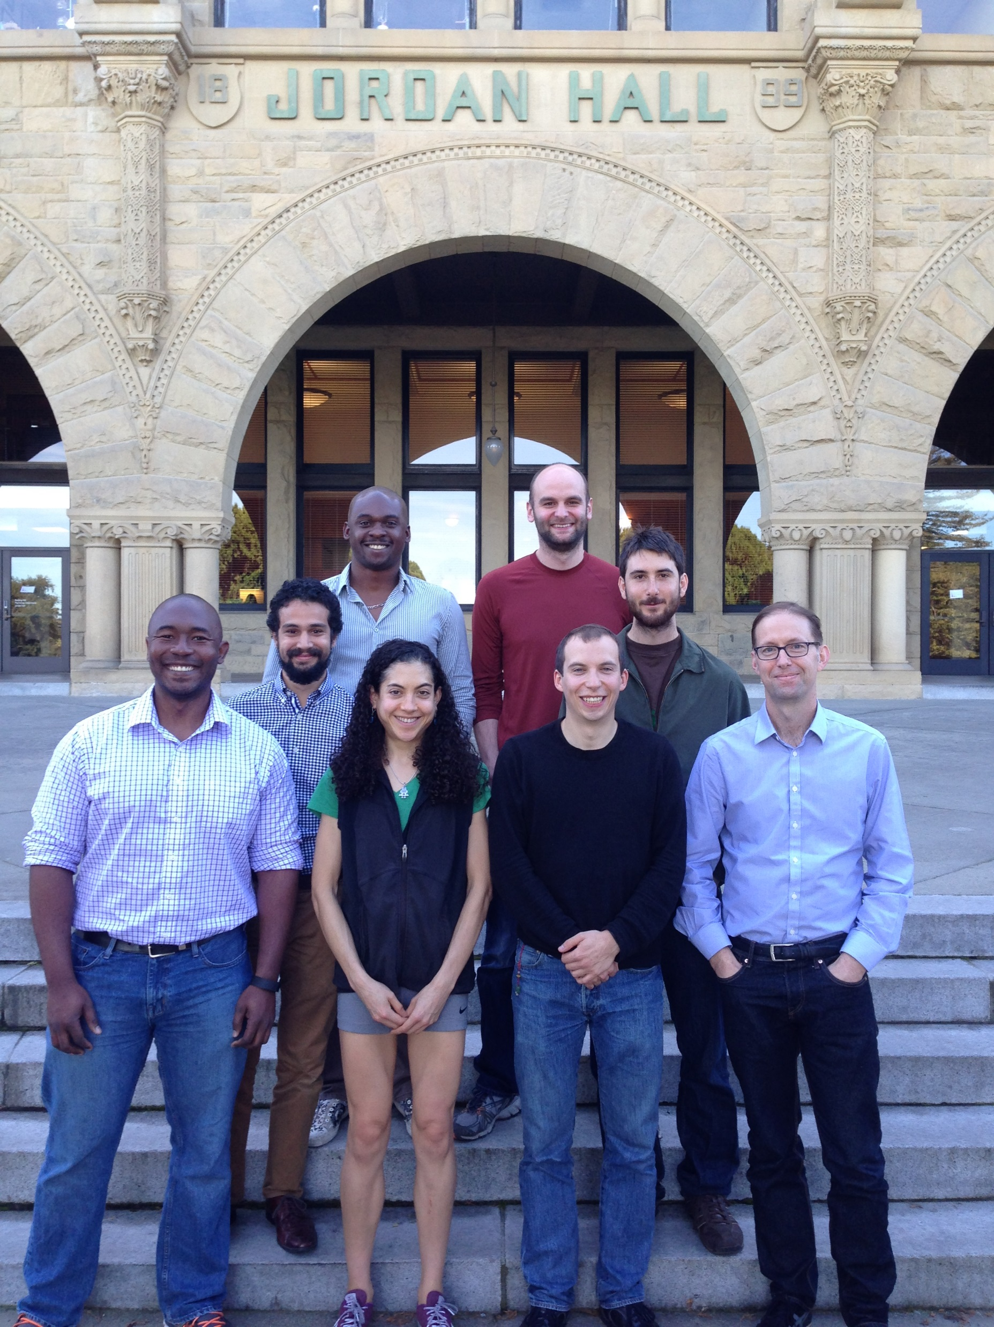

BIDS Turns 10!
The Poldrack Lab @ Stanford

Slide 7
‘FAIR’ Guiding Principles for
Data Management
Findability
Accessibility
Interoperability
Reuse of Digital Assets
https://www.go-fair.org/fair-principles/

Slide 8

Why is this Important?
NIH Data Sharing Mandate!
Make data more accessible
  For yourself six months from now
  For others in the lab (new students, collaborators)
  For other researchers (data sharing)

Slide 9



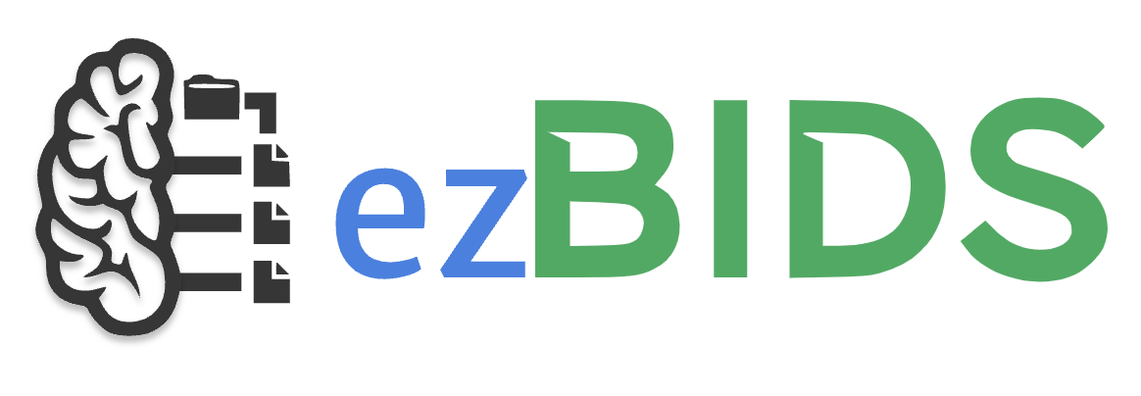
BIDS Unlocks an Entire Ecosystem of Reusable Pipelines
Unpacking:
HeuDiCov
Dcm2Bids
Preprocessing:
fMRIPrep
QSIPrep
ASLPrep
ABCD-BIDS
Quality Control:
MRIQC
Data Sharing:
Many More!
https://bids.neuroimaging.io/tools/bids-apps.html

Slide 10
Essence of BIDS
Directory hierarchy and file naming system
  Conveys essential meta-data in filenames alone
Remaining meta-data in “sidecar” files
@CyrilRPernet
wamcyril@gmail.com

Slide 11
Brandeis Aging Brain Study (BABS)
As of December 2024:
  314 Cognitively Normal Older Adult Participants with Neuropsychological Testing Data
  151 Participants with at least one MRI Scan
Datatypes:
  Neuropsychological Assessments
  fMRI During Movie Watching/Listening to Music
  High-res Structural Imaging of Brain Stem Nuclei
  [¹⁸F]MK6240 PET to measure Tau Burden
  [¹⁸F]FMT PET to measure Catecholamine Synthesis Capacity
  [¹¹C]Raclopride PET to measure Dopamine Receptor Density

Slide 12
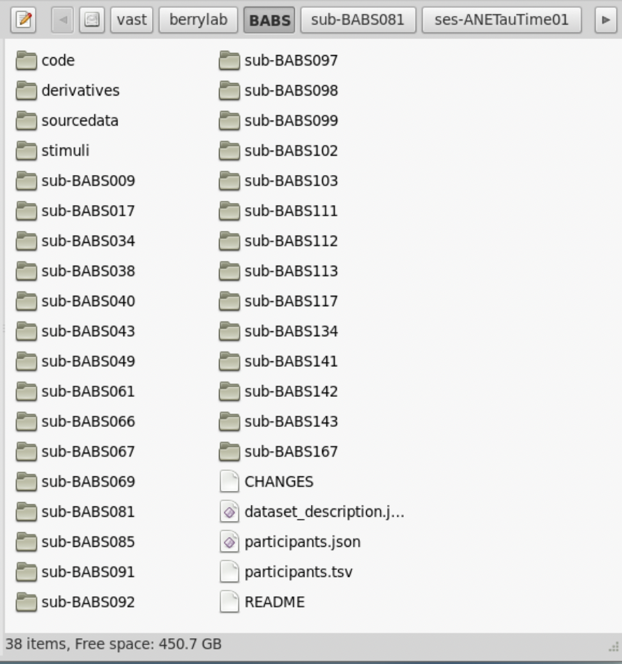
BABS in BIDS
/vast/berrylab/BABS
Bids.neuroimaging.io

Slide 13
Metadata as text files (tsv, json)
dataset_description.json
{
"Name": ”Brandeis Aging Brain Study”,
"BIDSVersion": ”1.2.1",
"License": "",
"Authors": [
    “Anne Berry”,
    “Katherine O’Malley”
    ],
"Acknowledgements": ”Special thanks…”,
"HowToAcknowledge": " ",
"Funding": [
    “National Institute of Aging R00…”,
    “National Institute of Aging R01…”,
    ],
"ReferencesAndLinks": "",
"SourceDatasetsURLs": ”/vast/berrylab/BABS”
}
Bids.neuroimaging.io

Slide 14
Metadata as text files (tsv, json)
dataset_description.json
{
"Name": ”Brandeis Aging Brain Study”,
"BIDSVersion": ”1.2.1",
"License": "",
"Authors": [
    “Anne Berry”,
    “Katherine O’Malley”
    ],
"Acknowledgements": ”Special thanks…”,
"HowToAcknowledge": " ",
"Funding": [
    “National Institute of Aging R00…”,
    “National Institute of Aging R01…”,
    ],
"ReferencesAndLinks": "",
"SourceDatasetsURLs": ”/vast/berrylab/BABS”
}
Bids.neuroimaging.io

Slide 15
Metadata as text files (tsv, json)
dataset_description.json
{
"Name": ”Brandeis Aging Brain Study”,
"BIDSVersion": ”1.2.1",
"License": ”n/a",
"Authors": [
    “Anne Berry”,
    “Katherine O’Malley”
    ],
"Acknowledgements": ”Special thanks…”,
"HowToAcknowledge": ”n/a",
"Funding": [
    “National Institute of Aging R00…”,
    “National Institute of Aging R01…”,
    ],
"ReferencesAndLinks": ”n/a",
"SourceDatasetsURLs": ”/vast/berrylab/BABS”
}
Bids.neuroimaging.io

Slide 16
Metadata as text files (tsv, json)
participants.tsv
participant_id YOB sex race ethnicity
BABS009 1943 M white non-hispanic
BABS017 1951 M white non-hispanic
BABS038 1952 M white non-hispanic
BABS040 1949 F white non-hispanic
BABS043 1951 M white non-hispanic
BABS049 1954 F white non-hispanic
BABS061 1954 M black n/a
BABS067 1959 M white non-hispanic
Bids.neuroimaging.io

Slide 17
Metadata as text files (tsv, json)
participants.tsv
participant_id YOB sex race ethnicity
BABS009 1943 M white non-hispanic
BABS017 1951 M white non-hispanic
BABS038 1952 M white non-hispanic
BABS040 1949 F white non-hispanic
BABS043 1951 M white non-hispanic
BABS049 1954 F white non-hispanic
BABS061 1954 M black n/a
BABS067 1959 M white non-hispanic
participants.json
{
  “YOB”: {
    “Description”: “participant year of birth”,
    “Units”: “year”
    }
    “sex”: {
      “Description”: “self-reported sex of subject”
      “Levels”: {
        “M”: “male”
        “F”: “female”
        }
        }
Bids.neuroimaging.io

Slide 18
Overarching Organization
code directory contains scripts for the following:
Downloading to:
sourcedata
Unpacking to:
Raw Data (Main BIDS Directory)
Preprocessing to:
derivatives
Bids.neuroimaging.io

Slide 19
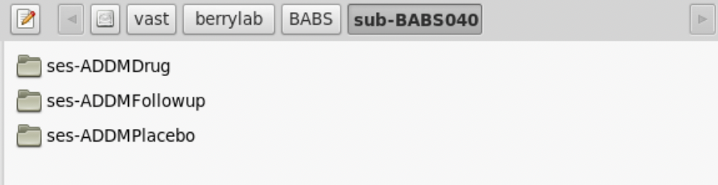
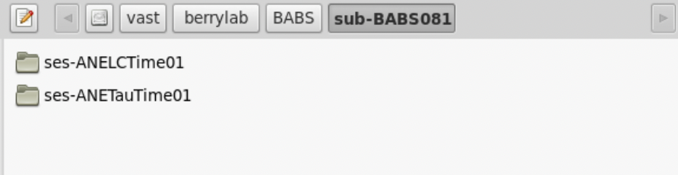
Session
A logical grouping of neuroimaging and behavioral data consistent across subjects. Session can (but doesn't have to) be synonymous to a visit in a longitudinal study. In general, subjects will stay in the scanner during one session.
BIDS Glossary: https://bids-specification.readthedocs.io/en/stable/glossary.html

Slide 20
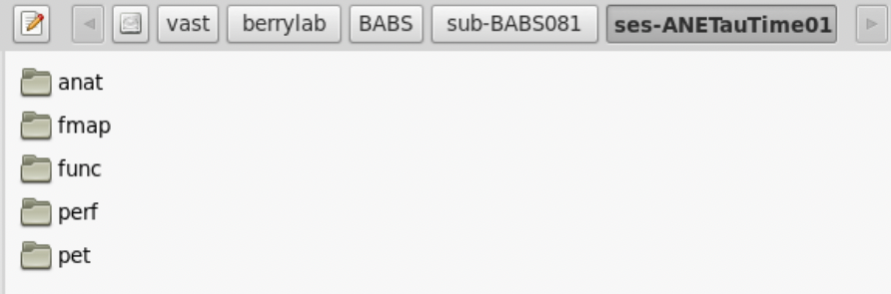
Data Type
A functional group of different types of data. Data files are contained in a directory named for the data type. In raw datasets, the data type directory is nested inside subject and session directories.

Slide 21
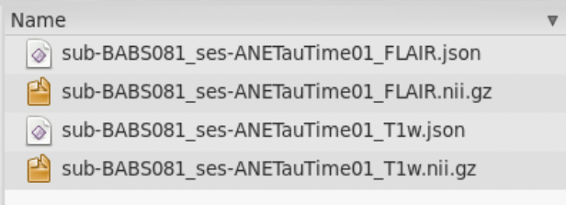
Modality/Run/Task

Slide 22
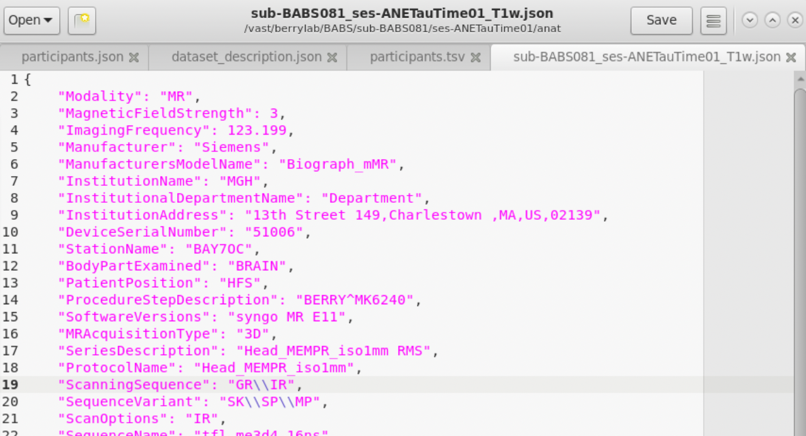
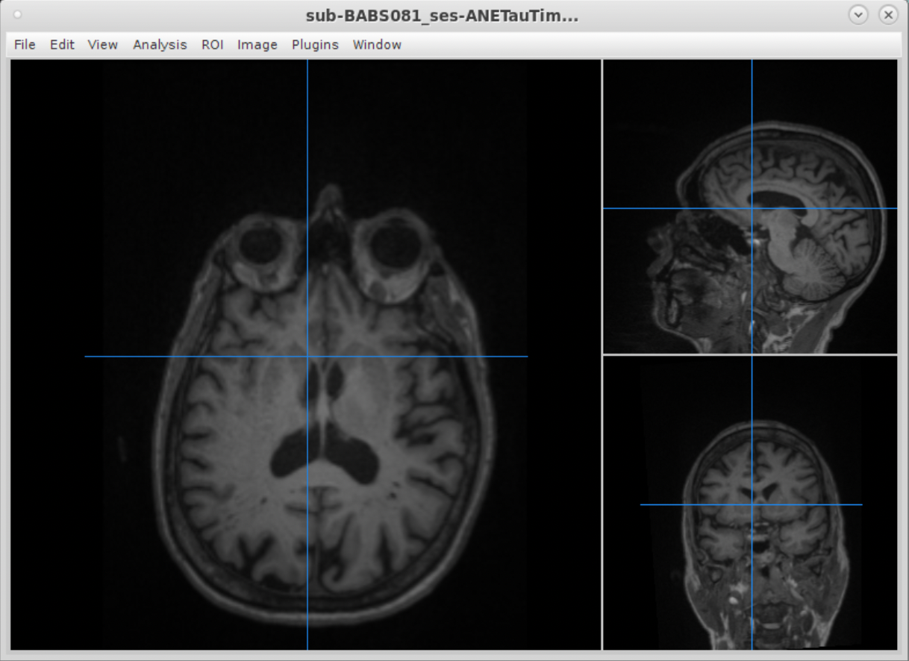
NifTi & JSON Sidecar Pairs

Slide 23
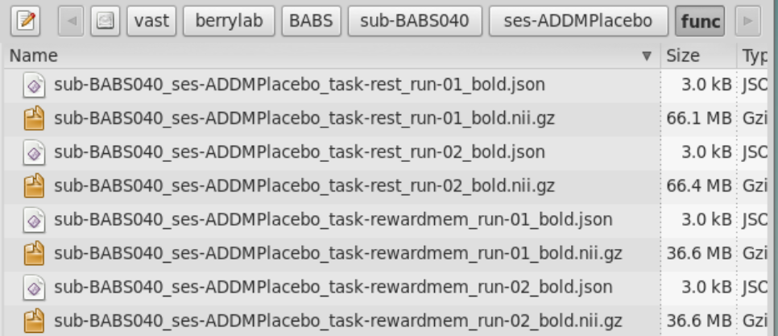
BIDS Filenames
sub-BABS040_ses-ADDMPlacebo_task-rewardmem_run-01_bold.nii.gz
Entities
Modality Suffix
File Extension
key-<label>

Slide 24
BIDS Filenames: Entities
sub-BABS040_ses-ADDMPlacebo_task-rewardmem_run-01_bold.nii.gz
Subject

Slide 25
BIDS Filenames: Entities
sub-BABS040_ses-ADDMPlacebo_task-rewardmem_run-01_bold.nii.gz
Subject
Session

Slide 26
BIDS Filenames: Entities
sub-BABS040_ses-ADDMPlacebo_task-rewardmem_run-01_bold.nii.gz
Subject
(Always 1st Entity)
Session
(Always 2nd Entity)
Task
Run

Slide 27
BIDS Filenames: Entities (Keys)
sub-BABS040_ses-ADDMPlacebo_task-rewardmem_run-01_bold.nii.gz
Subject
(Always 1st Entity)
Session
(Always 2nd Entity)
Task
Run

Slide 28
BIDS Filenames: Entities (Values)
sub-BABS040_ses-ADDMPlacebo_task-rewardmem_run-01_bold.nii.gz
Subject
(Always 1st Entity)
Session
(Always 2nd Entity)
Task
Run

Slide 29
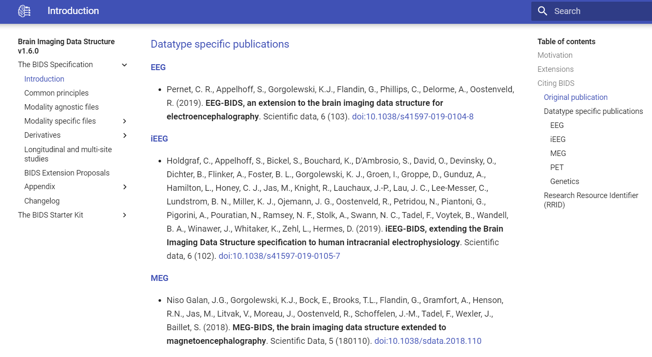
Full BIDS Specification online: https://bids-specification.readthedocs.io/en/stable/
Bids.neuroimaging.io
@CyrilRPernet
wamcyril@gmail.com

Slide 30
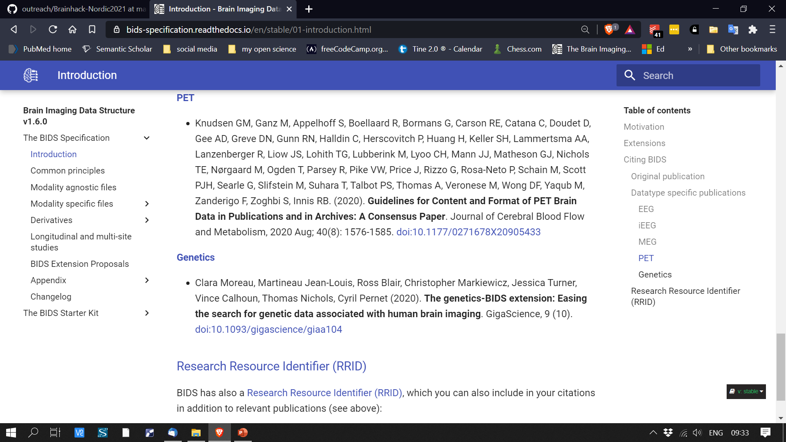
Bids.neuroimaging.io
@CyrilRPernet
wamcyril@gmail.com

Slide 31
Looking Ahead…
Stay tuned for info on a BIDS summer workshop!
Build out a standard for BIDS-ifying data acquired at Martinos?
https://www.repronim.org/

Slide 32
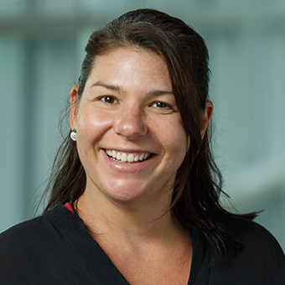



Acknowledgements
Neurochemistry & Cognition Lab
(Brandeis University):
Anne Berry, PhD
Megan Applegate-Kenton, PhD
Alex Adornato
Mariah Lewis
Johanna Matulonis
Hsiang-Yu Chen, PhD
Jenny Crawford, PhD
Jourdan Parent
Claire Ciampa
Teodora Markova
Rachel Marcus
Daisy Kiyemba
Chemical Neuroscience Program
(MGH Martinos Center):
Jacob Hooker, PhD
Nicole Zürcher, PhD
So Jeong Lee, PhD
Chieh-En (Jane) Tseng, PhD
Ya-chin Chen, PhD
Elisa Guma, PhD
Ramya Tokala, PhD
Krista Fariel
Emma Johnston
Tye Chu
Brendan Kelleher
R01 AG074330

