Slide 1
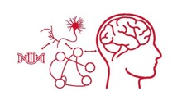


Dynamic Brain Network Reconfiguration Supports Abstract Reasoning and Rule Learning
Tom Morin
PhD Candidate, Computational Neuroscience
Dissertation Defense
March 17, 2022

Slide 2
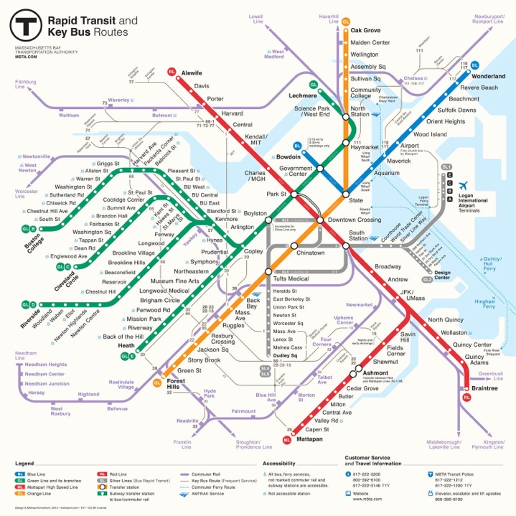
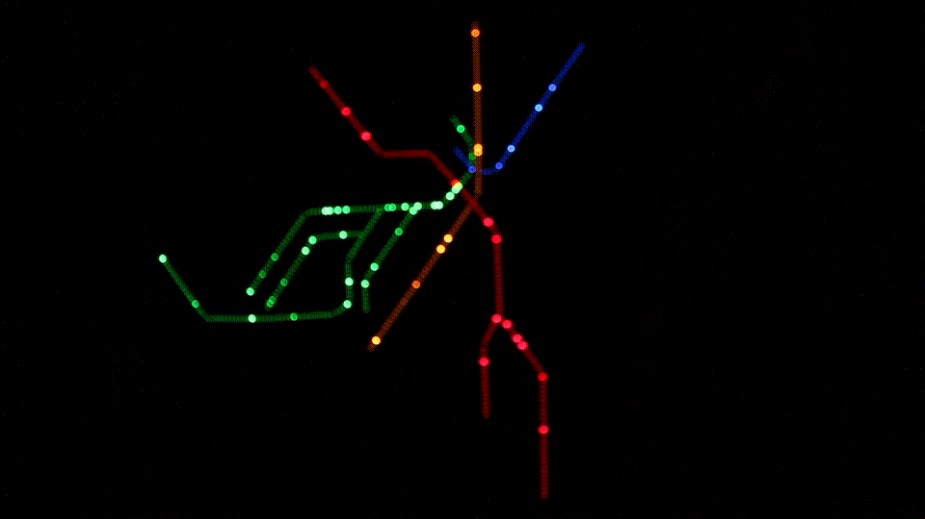

Slide 3
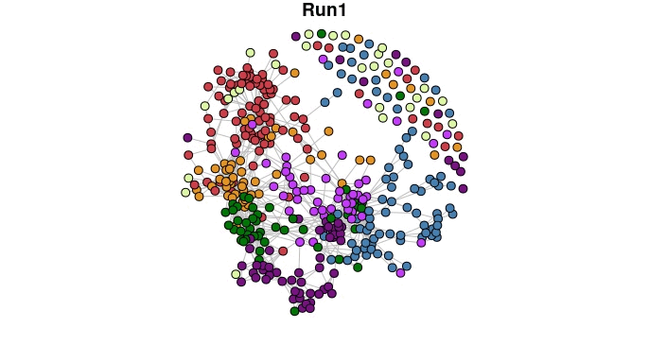
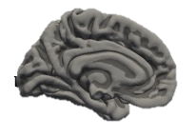
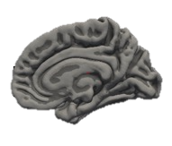

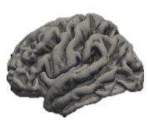
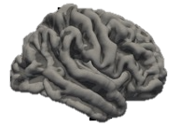

How do Brain Network Dynamics
Support Cognitive Function?

Slide 4
Agenda
Introduction
Context-Dependent Rule Learning
  Stable Network Connectivity
  Hippocampal & Prefrontal Gradients
Abstract Reasoning
  Network Reconfiguration & Stability
Conclusion

Slide 5
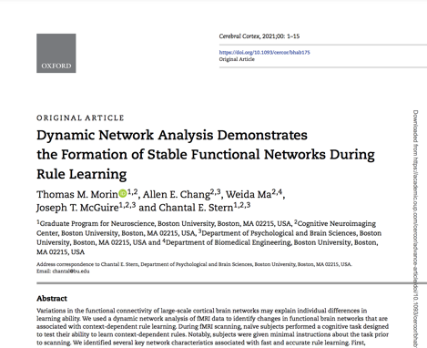
Agenda
Introduction
Context-Dependent Rule Learning
  Stable Network Connectivity
  Hippocampal & Prefrontal Gradients
Abstract Reasoning
  Network Reconfiguration & Stability
Conclusion

Slide 6
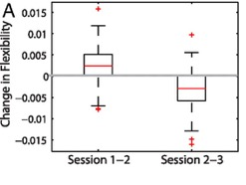
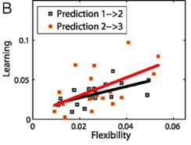
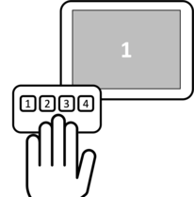
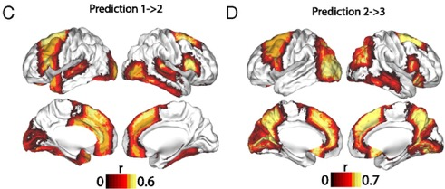
Brain Network Flexibility Predicts Performance on Motor Sequence Learning
Flexibility increased during learning, and decreased once motor sequences became learned
Flexibility of frontoparietal regions was predictive of learning
Bassett et al. 2011
Notes:
Flexibility and learning. (A) Boxplots showing that the increase in flexibility from experimental session 1 to session 2 was significantly greater than zero (a one-sample t-test gives the result t ≈ 6.00 with p ≈ 2 × 10⁻⁸), and that the magnitude of the decrease in flexibility from session 2 to session 3 was significantly greater than zero (t ≈ 7.46, p ≈ 2 × 10⁻¹¹). (B) Significant predictive correlations between flexibility in session 1 and learning in session 2 (black curve, p ≈ 0.001) and between flexibility in session 2 and learning in session 3 (red curve, p ≈ 0.009). Note that relationships between learning and network flexibility in the same experimental sessions (1 and 2) were not significant; we obtained p > 0.13 using permutation tests. (C) Brain regions whose flexibility in session 1 predicted learning in session 2 (p < 0.05, uncorrected for multiple comparisons). Regions that also passed false-positive correction were the left anterior fusiform cortex and the right inferior frontal gyrus, thalamus, and nucleus accumbens. (D) Brain regions whose flexibility in session 2 predicted learning in session 3 (p < 0.05, uncorrected for multiple comparisons). Regions that also passed false-positive correction for multiple comparisons were the left intracalcarine cortex, paracingulate gyrus, precuneus, and lingual gyrus and the right superior frontal gyrus and precuneus cortex. In (C) and (D), colors indicate the Spearman correlation coefficient r between flexibility and learning.

Slide 7
Context Dependent Rules
Notes:
Here, I have an example of a context-dependent rule you might encounter if you’re parking your car in the US.
This sign on the left indicates that you cannot park your car in this zone. The signs on the right, which are real signs that you can find in Boston, show you just how complicated it can be when deciding whether or not it is ok to park your car. Depending on the context (the time of day, your residency status, etc.) your actions have to change in order to follow the rule.

Slide 8
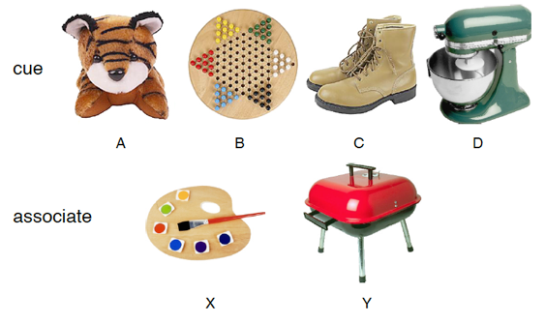


Context Dependent Rule Learning Task
Task Designed to Mimic Animal Studies:
Komorowski et al. 2009
Wallis et al. 2001
Allen Chang, PhD
Weida Ma
Morin et al. 2021

Slide 9


Incorrect
Correct
Pair?

Slide 10
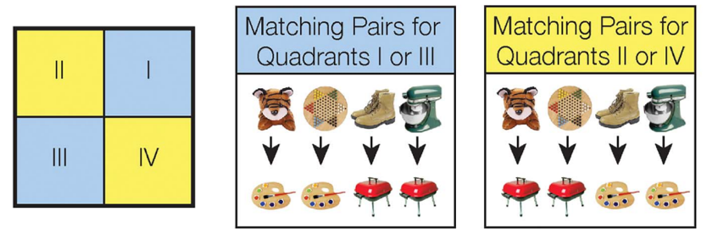
Context Dependent Rule Learning Task – Underlying Rule Structure
Morin et al. 2021

Slide 11
Learning Varies Across Subjects
n = 19
n = 10
Morin et al. 2021
Notes:
If you think that is confusing, you are not alone, as 30% of our subjects never performed above chance during the task. Here you can see subject performance across the 9 scanning runs. Blue dots show subjects that successfully learned the task, and red dots show subjects that were unsuccessful. You can see that for the successful participants, accuracy is generally increasing over time. Our main question is: what is different about the brain network dynamics between these successful and unsuccessful participants.

Slide 12

Study Goals
Assess how network dynamics differed between successful and unsuccessful learners.
Characterize how network measures shifted as subject performance improved on the task.

Slide 13
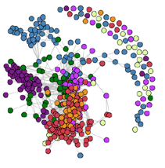



The Brain as a Network
1
2
r
…
400
(Schaefer et al. 2018)
Node: A brain region of interest
Edge: Functional connectivity (correlation) between two nodes
Community: A group of nodes (defined a priori or in a data-driven manner)

Slide 14
Dynamic Network Construction
Morin et al. 2021
Notes:
To answer this question, we formed a multilayer functional connectivity network for each subject, using the regions found in the Schaefer 400 atlas. To create the network, each region in the atlas becomes a node. If the BOLD signal is highly correlated between two nodes, then we connect them with an edge. We repeat this for all nine-scanning runs, and create this multi-layered network for each of our subjects. With a network constructed, we can start to ask questions about the network’s structure.

Slide 15
Dynamic Network Construction
Scan Run #1
Scan Run #2
Scan Run #3
Scan Run #4
…

Slide 16
Characterizing the Dynamic Network: Guiding Questions
Do some brain regions show more frequent changes in functional connectivity?
  (Flexibility)
How does connectivity between communities change during learning?
  (Inter-community Edge Strength)

Slide 17
Characterizing the Dynamic Network: Guiding Questions
Do some brain regions show more frequent changes in functional connectivity?
  (Flexibility)
How does connectivity between communities change during learning?
  (Inter-community Edge Strength)

Slide 18
Calculating Node Flexibility
# Community Switches
Flexibility =
= 0.25
# Possible Switches
Notes:
First, we wanted to know if the overall flexibility of the network was different between learner’s and non-learners. We predicted that successful learner’s would quickly adopt a successful strategy and form a rigid community structure. To test this, we ran a Louvain community detection algorithm on each subject’s multilayered network, essentially giving each node a data-driven community assignment. If we follow the community membership of this node circled in yellow, this is what we find: First the node belongs to the purple network. Then, it spends a few scanning runs in the green network, until it becomes a part of this blue network, and then the subject reaches the end of the scanning session. To calculate the flexibility of this node, we look at how many times its community membership switches, and divide by the total possible number of switches. For this node, that is 2 switches over 8 possible switches, or 0.25.

Slide 19
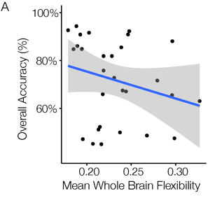
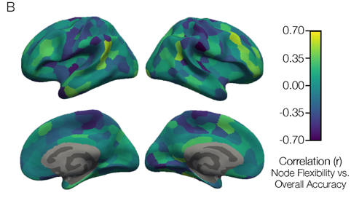


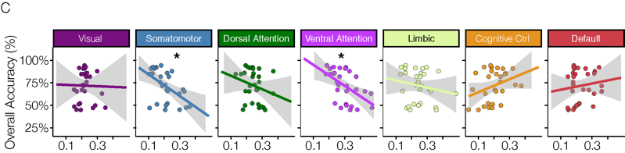
Higher Accuracy is Associated with Reduced Flexibility (Higher Stability)
Mean Community Flexibility
Morin et al. 2021
Notes:
We can take the average flexibility of all 400 brain regions, and correlate it with each subject’s overall accuracy on the task. When we plot that we find that indeed, the successful learners – who had high overall accuracy, show lower flexibility scores, implying that they quickly form stable community structures. We can also map the correlation between flexibility and accuracy onto each individual cortical region to get a brain map like this. And while most of the brain is blue, driving that whole brain negative correlation plotted to the left, we actually see several brain regions with warm colors, demonstrating that there are regions of cortex that are flexibly switching their community allegiance in successful learners.

Slide 20
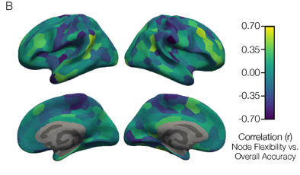
Successful Learners Have More Stable Rule Representations
Working Model: During learning, brain regions flexibly adapt their community allegiance as subjects adopt different task strategies.
Successful subjects learned quickly, suggesting that they settle on a strategy and have more stable neural representations of the learned rules.

Slide 21
Characterizing the Dynamic Network: Guiding Questions
Do some brain regions show more frequent changes in functional connectivity?
  (Flexibility)
How does connectivity between communities change during learning?
  (Inter-community Edge Strength)

Slide 22
Calculating Inter-community Edge Strength

Slide 23
Calculating Inter-community Edge Strength
2

Slide 24
Calculating Inter-community Edge Strength
2
= 0.22
9
Higher inter-community edge strength indicates increased coupling between communities

Slide 25
Plotting Inter-community Edge Strength

Slide 26


Inter-community Edge Strength Between Cognitive Control and Ventral Attention Increases with Successful Rule Learning
0.5
Inter-community
Edge Strength
0.0
1
Time
9

Slide 27


Inter-community Edge Strength Shows Segregated Attention Communities in Successful Learners
Somato-
motor
Dorsal
Attn.
Ventral
Attn.
Limbic
Cog. Ctrl.
Default
Default
Somato-
motor
Dorsal
Attn.
Ventral
Attn.
Limbic
Cog. Ctrl.
Morin et al. 2021

Slide 28
Successful Learners Have More Segregated Attention Communities
Previous work shows that anticorrelation between dorsal attention and default communities is associated with higher working memory capacity (e.g. Keller et al. 2015).
Connectivity between attention communities and other communities could be an indication of how attentional resources are being allocated to benefit rule learning.
0.5
Inter-community
Edge Strength
0.0
1
Time
9

Slide 29

Key Takeaways
Overall, successful learners have a more “stable” brain network structure.
  Working Hypothesis: Successful learners latch onto an effective strategy quickly, and form stable representations of the rules.
A stable and segregated attention system is maintained in successful learners

Slide 30
Agenda
Introduction
Context-Dependent Rule Learning
  Stable Network Connectivity
  Hippocampal & Prefrontal Gradients
Abstract Reasoning
  Network Reconfiguration & Stability
Conclusion

Slide 31
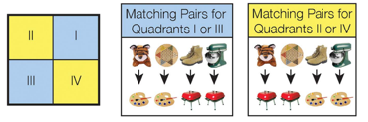
Hippocampal Neurons Encode Context-Specific Memories
Our context-dependent rule-learning task is based on a similar task designed for rodents
Komorowski et al. 2009
Morin et al. 2021

Slide 32
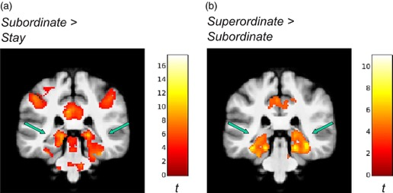
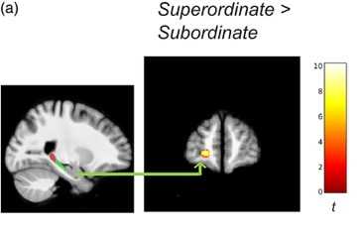
Anterior-Posterior Gradient for Abstract Rule Levels in Hippocampus
Brown et al. 2021
Higher-level (superordinate) abstract rules:
  Activated more anterior regions of hippocampus.
  Increased Functional Connectivity between anterior hippocampus and anterior prefrontal cortex
Notes:
Results demonstrated that hippocampal activity and hippocampal–prefrontal functional interconnectivity distinguished retrieval under different levels of hierarchically organized task rules. In explicit contrast to the hippocampal tail, anterior (body and head) regions were recruited specifically for superordinate changes in the contextual hierarchy. The hippocampal body also differed in its functional connectivity with the prefrontal cortex for superordinate versus subordinate changes

Slide 33
Anterior-Posterior Gradient Organization of the Hippocampus
Brunec et al. 2018
Anterior Regions: Coarse Representation
Posterior Regions: Fine Representation
Notes:
Results demonstrated that hippocampal activity and hippocampal–prefrontal functional interconnectivity distinguished retrieval under different levels of hierarchically organized task rules. In explicit contrast to the hippocampal tail, anterior (body and head) regions were recruited specifically for superordinate changes in the contextual hierarchy. The hippocampal body also differed in its functional connectivity with the prefrontal cortex for superordinate versus subordinate changes

Slide 34
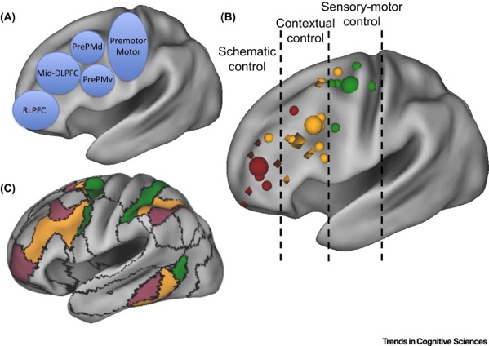
Rostro-caudal Hierarchical Organization of Prefrontal Cortex
More Concrete
More Abstract
Badre & Nee 2018

Slide 35

Hypotheses
Functional connectivity between anterior hippocampus and anterior prefrontal cortex supports the integration of higher order contexts.
In successful learners, this connectivity pattern will develop as context-dependent rules are learned.

Slide 36

Hippocampal ROIs
Matt Dunne

Slide 37
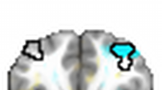
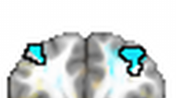
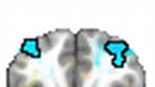
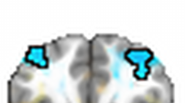



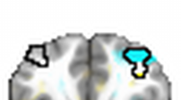

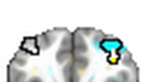
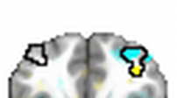
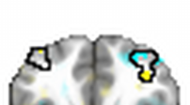
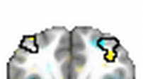
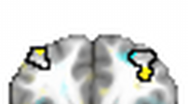
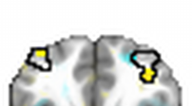
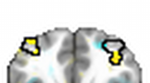
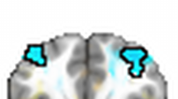
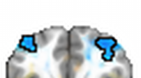
Hippocampal Head Functional Connectivity with Lateral Frontal Pole
Successful
Learners
Unsuccessful Learners
t=1
t=1
Beta Series Correlation (Z)
t=2
t=3
t=4
t=5
t=6
t=7
t=8
t=9
t=2
t=3
t=4
t=5
t=6
t=7
t=8
t=9
Time

Slide 38
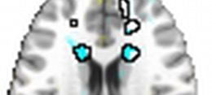
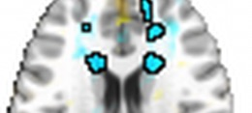
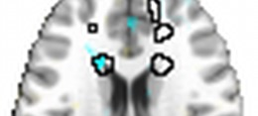
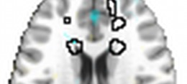
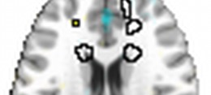
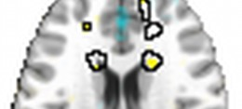

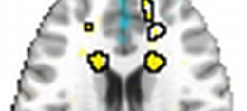
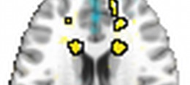
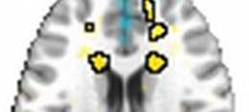


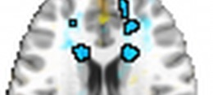

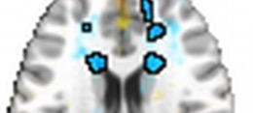

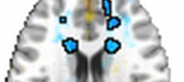

Hippocampal Head Functional Connectivity with the Caudate
Successful
Learners
Unsuccessful Learners
t=1
t=1
Beta Series Correlation (Z)
t=2
t=3
t=4
t=5
t=6
t=7
t=8
t=2
t=9
t=3
t=4
t=5
t=6
t=7
t=8
t=9
Time

Slide 39

Hippocampal Gradient
Functional Connectivity
Tail
Body
Head
t=1
Successful
>
Unsuccessful
t=9

Slide 40


Interactions Between Medial Temporal and Frontoparietal Systems
Medial Temporal/
Orbitomedial Prefrontal
Frontoparietal
Abstract Knowledge in State Space
Abstract Knowledge as Control Policies
Medial Parietal Cortex
Vaidya & Badre (Under Review)

Slide 41


















Hippocampal Head Functional Connectivity w/ Medial Parietal Cortex
Successful
Learners
Unsuccessful Learners
t=1
t=1
Beta Series Correlation (Z)
t=2
t=3
t=4
t=5
t=6
t=7
t=8
t=9
t=2
t=3
t=4
t=5
t=6
t=7
t=8
t=9

Slide 42



Interactions Between Medial Temporal and Frontoparietal Systems
Medial Parietal
(RSC/PCC/PHC)
Lateral Frontal
Pole (RLPFC)
With learning, hippocampus may “bypass” intermediary connections (in RSC/PCC/PHC) to prefrontal circuitry
Vaidya & Badre (Under Review)

Slide 43
Agenda
Introduction
Context-Dependent Rule Learning
  Stable Network Connectivity
  Hippocampal & Prefrontal Gradients
Abstract Reasoning
  Network Reconfiguration & Stability
Conclusion

Slide 44


Raven’s Progressive Matrices Test
Through reasoning, the brain can apply previously learned information, strategies, and ideas to new situations.
Raven, 1936

Slide 45
Simplified Raven’s Progressive Matrices Task

Slide 46
Simplified Raven’s Progressive Matrices Task
Resting State
(3 x 6 Minutes)
Task
(6 x 6.5 Minutes)
+

Slide 47
Guiding Questions
How does task activation differ for symbolic and perceptual reasoning?
How does functional connectivity reconfigure between resting state and the various task conditions?

Slide 48
Guiding Questions
How does task activation differ for symbolic and perceptual reasoning?
How does functional connectivity reconfigure between resting state and the various task conditions?

Slide 49
Unique Activity Patterns Associated With Perceptual and Symbolic Reasoning
n = 27

Slide 50
Unique Activity Patterns Associated With Perceptual and Symbolic Reasoning
Activation of frontoparietal cortex supports both symbolic and perceptual reasoning.
Anterior prefrontal activity supports symbolic reasoning.
Inferior temporal activity supports perceptual reasoning.
Symbolic Reasoning > Matching
Perceptual Reasoning > Matching

Slide 51
Guiding Questions
How does task activation differ for symbolic and perceptual reasoning?
How does functional connectivity reconfigure between resting state and the various task conditions?

Slide 52


Task Performance is Associated with Less Task-Related Brain Network Reconfiguration
Subjects with more stable brain networks between rest and task performed better on a variety of tasks
Schultz & Cole 2016

Slide 53

Network Reconfiguration During Abstract Reasoning
Sensory & Default communities remained stable between rest and task
Visual & Frontoparietal communities reconfigured
Pre-task
Resting State
Hearne et al. 2017

Slide 54




Stable Community Structure Across Reasoning Conditions
Rest
Symbolic
Reasoning

Slide 55
Task Community Structure

Slide 56
Community C is Most Active and Most Reconfigured During Reasoning
*
*
*
*
*
*
*
*
*
*

Slide 57
Regional Network Reconfiguration Supports Transition from Rest to Task
Between rest and task we observed:
  A stable network core (default and somatomotor regions)
  A flexible community (composed of frontoparietal, dorsal attention, & visual regions) that was fragmented at rest, but became more strongly interconnected during the task
Working hypothesis: Network reconfiguration assists the brain in reaching specific activation states.
Symbolic
Perceptual

Slide 58
Agenda
Introduction
Context-Dependent Rule Learning
  Stable Network Connectivity
  Hippocampal & Prefrontal Gradients
Abstract Reasoning
  Network Reconfiguration & Stability
Conclusion

Slide 59



Conclusions
Rule Learning
Stability in somatomotor and ventral attention networks supports rule learning and abstract reasoning
Flexibility
Abstract Reasoning

Slide 60


Conclusions
Rule Learning
Flexible reconfiguration of the cognitive control network supports rule learning and the transition from rest to abstract reasoning
Flexibility
Abstract Reasoning

Slide 61

Conclusions
Dynamic interactions between hippocampal and prefrontal gradients support context-dependent rule learning
More Concrete
More Abstract
Badre & Nee 2018
Brunec et al. 2018
Tail
Body
Head
t=1
t=9

Slide 63

To all of my teachers,
Thanks for twenty-two extraordinary years of learning!

Slide 64


Acknowledgements
Dissertation Advisory Committee
Chantal Stern
David Badre
David Somers
Joe McGuire
Mike Hasselmo

Slide 65


Acknowledgements
GPN Admin
Shelley Russek
Sandi Grasso
Lavell Blackwell
CSN Admin
Jun Shen
Denise Parisi
Kilachand Center
Kevin Gonzales
Funding Sources
NSF Major Research Instrumentation Award 1625552
ONR MURI Award N00014-16-1-2832
ONR DURIP Award N00014-17-1-2304

Slide 66












Cognitive Neuroimaging Lab & Center

Slide 67






Family

Slide 68













Friends

Slide 69

Questions?

Slide 70







Acknowledgements
Stern Lab Alumni
Allen Chang
Rachel Wehr
Justine Cohen
Weida Ma
Dissertation Advisory Committee
Chantal Stern
Joe McGuire
David Badre
David Somers
Mike Hasselmo
GPN Admin
Shelley Russek
Sandi Grasso
Lavell Blackwell
Stern Lab
Chantal Stern
Matt Dunne
Stamati Liapis
Kylie Moore
Caroline Ahn
Kylie Isenburg
Jing
Cognitive Neuroimaging Center
Stephanie McMains
Shruthi Chakrapani
Funding
NSF Major Research Instrumentation Award 1625552
ONR MURI Award N00014-16-1-2832
ONR DURIP Award N00014-17-1-2304

Slide 71
FUTURE DIRECTIONS

Slide 72

Potential Future Directions
Does catecholamine synthesis moderate network connectivity changes that are associated with aging and disease?
LC catecholamine synthesis moderates tau’s negative effect on memory
Ciampa, Parent et al. 2022

Slide 73


Potential Future Directions
Does catecholamine synthesis moderate network connectivity changes that are associated with aging and disease?
Segregation of functional brain networks typically decreases with age
Chan et al. 2014

Slide 74


Potential Future Directions
How do catecholamines (e.g. dopamine, norepinephrine) influence network dynamics (e.g. flexibility/stability)?
  Flexibility of prefrontal regions is higher during a 2-back vs. 0-back working memory task
  Stability on both conditions is associated with genetically-predicted D1 receptor expression
Braun et al. 2015
Braun et al. 2021

Slide 75



Potential Future Directions
How do catecholamines (e.g. dopamine, norepinephrine) influence network dynamics (e.g. flexibility/stability)?
Increased Striatal D1 signal is associated with:
  Reduced within-network connectivity in the default network
  Enhanced within-network connectivity in the frontoparietal control network
Roffman et al. 2016

Slide 76
CHAPTER 2
(REASONING)

Slide 77
Abstract Reasoning Activates Frontoparietal Cortex

Slide 78
PM
PR
SM
SR
PM
PR
SM
SR
PM
PR
SM
SR
PM
PR
SM
SR

Slide 83
CHAPTER 3
RULE LEARNING (NX)

Slide 84


Context-Dependent Rule Learning Task
Accuracy
Response Times

Slide 85
Characterizing the Dynamic Network: Guiding Questions
Do some brain regions show more frequent changes in functional connectivity?
  (Flexibility)
How does connectivity within communities change during learning?
  (Assortativity)
How does connectivity between communities change during learning?
  (Inter-community Edge Strength)

Slide 86
Positive Assortativity: Communities Are More Connected to Themselves
Positive Assortativity
1.0
0.0
-1.0
Negative Assortativity

Slide 87
Zero Assortativity: Communities Are Equally Connected to Each Other & Themselves
Positive Assortativity
1.0
0.0
-1.0
Negative Assortativity

Slide 88
Negative Assortativity: Communities Are More Connected to Each Other
Positive Assortativity
1.0
0.0
-1.0
Negative Assortativity

Slide 89
Assortativity in a Single Community
Positive Assortativity
1.0
0.0
???
-1.0
Negative Assortativity

Slide 90
Assortativity in a Single Community
Positive Assortativity
1.0
0.0
-1.0
Negative Assortativity

Slide 91





Assortativity in Cognitive Control Network Increased with Learning
Cognitive Control

Slide 92
Assortativity Across Cortex
Morin et al. 2021

Slide 93
Successful Learners Have More Assortative Brain Networks
Assortativity measures how interconnected communities are to themselves as opposed to other communities
Stronger connectivity within the cognitive control community could support the formation of stable rule representations in dlPFC.
Cognitive Control

Slide 94
Characterizing the Dynamic Network: Guiding Questions
Do some brain regions show more frequent changes in functional connectivity?
  (Flexibility)
How does connectivity within communities change during learning?
  (Assortativity)
How does connectivity between communities change during learning?
  (Inter-community Edge Strength)

Slide 95
Betweenness Centrality
Centrality Points
|
|
|

Slide 96
Centrality Results

Slide 97
CHAPTER 4
RULE LEARNING (HIPPOCAMPUS)

Slide 98
Learning-Related Functional Connectivity Changes

Slide 99
Learning-Related Functional Connectivity Changes

Slide 100
Post-Hoc Analysis: Hippocampal Head Functional Connectivity Over Time
Lateral Frontal Pole

Slide 103
Changes in Functional Connectivity are Associated with Learning Ability

Slide 105




Lateral Frontal Pole
PCC & Prec.
Caudate

Slide 106
Conclusions
Hippocampal head exhibits increased functional connectivity with frontostriatal circuitry in successful learners.
Hippocampal head also shows decreased functional connectivity with default network regions in successful learners.
Hierarchical organization of the hippocampus and prefrontal cortex support context-dependent rule learning.

Slide 107

Hippocampal Head Functional Connectivity w/ Medial Parietal Cortex
Mid-cingulate and precuneus are part of the default network
In successful learners, hippocampus may decouple from default regions to couple with ”task-active” frontostriatal regions.
Unsuccessful learners may continue to focus on internally generated strategies
neurosynth.org

Slide 108

Hippocampal – Frontostriatal Functional Connectivity
Successful subjects show increased functional connectivity with caudate and lateral frontal pole – key nodes in frontostriatal circuitry
Rule-guided behaviors can be implemented in these circuits through gating/control policies
Working hypothesis: Inc. functional connectivity with hippocampal head indicates that frontostriatal loops are utilizing rule representations formed in hippocampus
Working hypothesis: Increased functional connectivity between hippocampal head and caudate/PFC may indicate that frontostriatal circuitry is utilizing rule representations formed in hippocampus to guide behavior
Successful > Unsuccessful
Motor
Oculomotor
Associative
Limbic

