Slide 1







2022 Year in Review
Neuromodulatory Subcortical Systems PIA
[Clinical/Human Research]
Thomas Morin, PhD
January 19, 2023
Contact Info
tmorin2@mgh.harvard.edu
tommorin@brandeis.edu
@ThomasMorin1
www.tmmorin.com
Join the PIA Group.
http://bit.ly/NSS_PIA
Follow @NSS_PIA

Slide 2


Search Criteria
Google Scholar: _______ & “Human” & “Alzheimer’s”
Neurotransmitters:
Acetylcholine
Dopamine
Serotonin
(Nor)Adrenaline/Epinephrine
Histamine, Leptin, Grehlin, Orexin
Subcortical Nuclei:
Cholinergic Basal Forebrain
Nucleus Basalis of Meynert
Substantia Nigra
Ventral Tegmental Area
(Dorsal) Raphe
Locus Coeruleus
Hypothalamus
Results: Reviewed 86 Papers
Highlighting 11 empirical articles & 2 reviews

Slide 3
Focus Areas
Jan
Aghakhanyan et al. Neurobio. Aging.
Feb
Prokopiou et al. Nature Comm.
Mar
Jacobs et al. Alz. & Dementia
1. Neuropsychiatric Symptoms
2. Measuring NSS Structure & Function
3. Tau Accumulation and the Locus Coeruleus
Cassidy et al. Neuropsychopharm.
Apr
Dahl et al. Neurobio. Aging
May
Jun
Jul
Lin et al. Brain
Aug
Liebe et al. Molecular Psychiatry
Sep
Gilvesy et al. Neuropathologica
Oct
Parent et al. Neuroimage
Nov
Morris et al. NeuroImage
Dec
Murray et al. Neurodegeneration

Slide 4
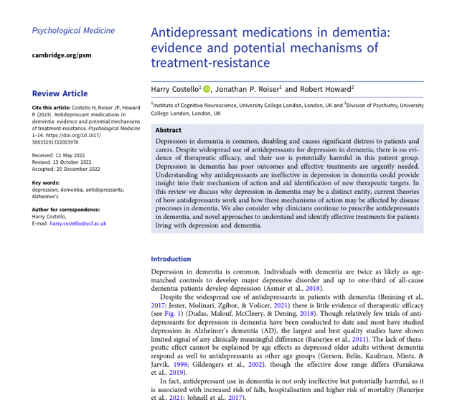
Area 1: Neuropsychiatric Symptoms
Jan
Aghakhanyan et al. Neurobio. Aging.
Feb
Prokopiou et al. Nature Comm.
Mar
Jacobs et al. Alz. & Dementia
“Understanding why antidepressants are ineffective in depression in dementia could provide insight into their mechanism of action and aid identification of new therapeutic targets.”
Cassidy et al. Neuropsychopharm.
Apr
Dahl et al. Neurobio. Aging
May
Jun
Jul
Lin et al. Brain
Aug
Liebe et al. Molecular Psychiatry
Sep
Gilvesy et al. Neuropathologica
Oct
Parent et al. Neuroimage
Nov
Morris et al. NeuroImage
Dec
Costello et al. Psychological Medicine
Murray et al. Neurodegeneration
Notes:
December

Slide 5
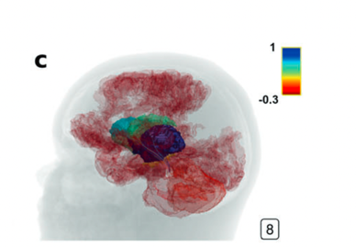
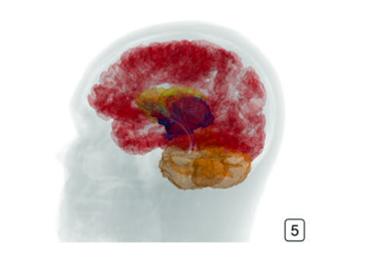
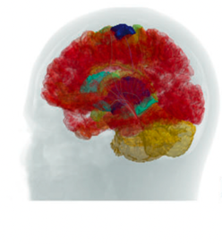
Area 1: Neuropsychiatric Symptoms
Neuropsychiatric Symptoms Related to LC Structural Connectivity
Jan
Aghakhanyan et al. Neurobio. Aging.
Feb
Prokopiou et al. Nature Comm.
Mar
Jacobs et al. Alz. & Dementia
Cassidy et al. Neuropsychopharm.
Apr
Dahl et al. Neurobio. Aging
May
Jun
Jul
Lin et al. Brain
Aug
Liebe et al. Molecular Psychiatry
Sep
Increased Alertness
Gilvesy et al. Neuropathologica
Oct
Decreased Anxiety
Parent et al. Neuroimage
Nov
Morris et al. NeuroImage
Dec
Liebe et al. Molecular Psychiatry
Murray et al. Neurodegeneration
Notes:
25 cognitively normal young adult males

Slide 6
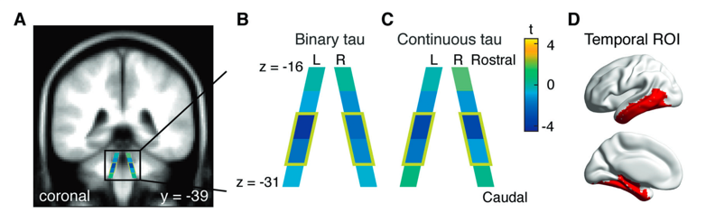
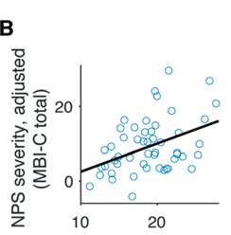

Area 1: Neuropsychiatric Symptoms
Neuropsychiatric Symptoms Related to LC Integrity
Jan
Aghakhanyan et al. Neurobio. Aging.
Feb
Prokopiou et al. Nature Comm.
Mar
Jacobs et al. Alz. & Dementia
Cassidy et al. Neuropsychopharm.
Apr
Dahl et al. Neurobio. Aging
May
Jun
Jul
Tau+ Subjects
Lin et al. Brain
Aug
Liebe et al. Molecular Psychiatry
Sep
Gilvesy et al. Neuropathologica
Oct
Parent et al. Neuroimage
Nov
Morris et al. NeuroImage
Dec
Cassidy et al. Neuropsychopharmacology
Murray et al. Neurodegeneration
Notes:
Cog. Normal older adults n=118
MCI n=44
AD n=28

Slide 7
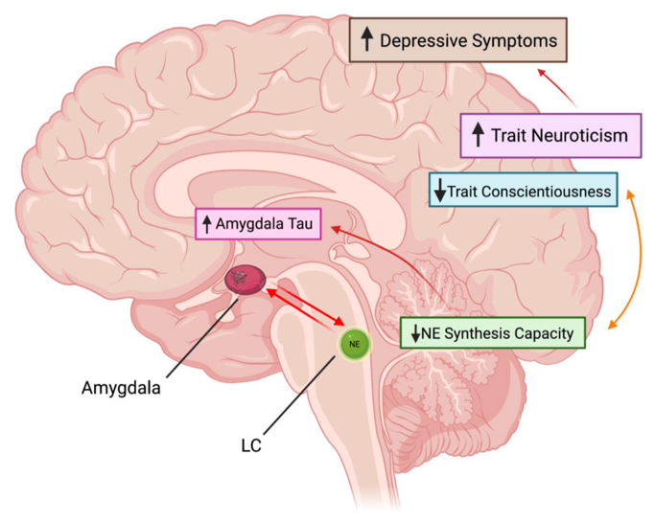
Area 1: Neuropsychiatric Symptoms
Neuropsychiatric Symptoms Related to LC NE Synthesis Capacity
Jan
Aghakhanyan et al. Neurobio. Aging.
Feb
Prokopiou et al. Nature Comm.
Mar
Jacobs et al. Alz. & Dementia
Cassidy et al. Neuropsychopharm.
Apr
Dahl et al. Neurobio. Aging
May
Jun
Jul
Lin et al. Brain
Aug
Liebe et al. Molecular Psychiatry
Sep
Gilvesy et al. Neuropathologica
Oct
Parent et al. Neuroimage
Nov
Morris et al. NeuroImage
Dec
Parent et al. NeuroImage
Murray et al. Neurodegeneration
Notes:
N = 47 cognitive normal older adults

Slide 8
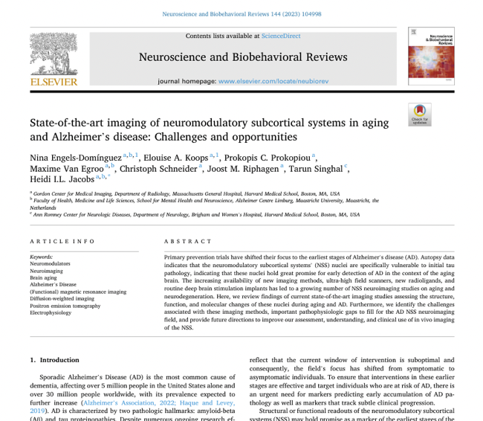
Area 2: Measuring NSS Structure & Function
Jan
Aghakhanyan et al. Neurobio. Aging.
Feb
Prokopiou et al. Nature Comm.
Mar
Jacobs et al. Alz. & Dementia
“Recent developments in neuroimaging methods have revived the focus on the neuromodulatory subcortical systems in AD as the next frontier for early detection and intervention of AD.”
Cassidy et al. Neuropsychopharm.
Apr
Dahl et al. Neurobio. Aging
May
Jun
Jul
Lin et al. Brain
Aug
Liebe et al. Molecular Psychiatry
Sep
Gilvesy et al. Neuropathologica
Oct
Parent et al. Neuroimage
Nov
Morris et al. NeuroImage
Dec
Engels-Domínguez et al. Neuroscience & Biobehavioral Reviews
Murray et al. Neurodegeneration

Slide 9
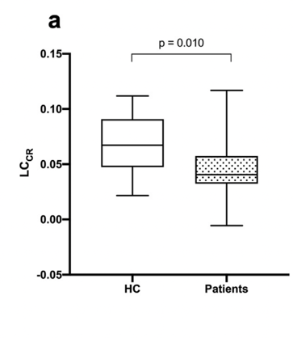
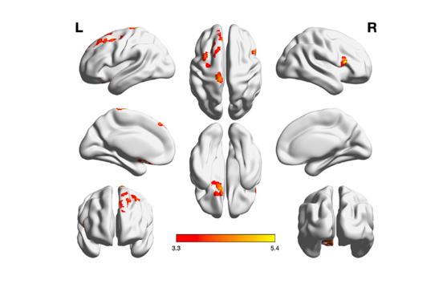
Area 2: Measuring NSS Structure & Function
Linking LC Integrity to Cortical Hypometabolism
Jan
Aghakhanyan et al. Neurobio. Aging.
Feb
Prokopiou et al. Nature Comm.
Mar
Jacobs et al. Alz. & Dementia
Hypometabolism Related to LC Signal
Cassidy et al. Neuropsychopharm.
Dahl et al. Neurobio. Aging
Apr
May
Jun
Jul
LC Signal
Lin et al. Brain
Aug
Liebe et al. Molecular Psychiatry
Sep
Gilvesy et al. Neuropathologica
Oct
Parent et al. Neuroimage
Nov
Morris et al. NeuroImage
Dec
Aghakhanyan et al. Neuorbiology of Aging
Murray et al. Neurodegeneration

Slide 10
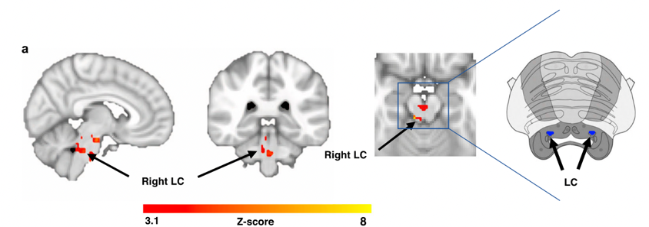
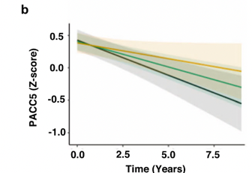
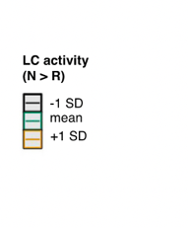
Area 2: Measuring NSS Structure & Function
Linking LC Functional Activity to Subsequent Cognitive Decline
Jan
Aghakhanyan et al. Neurobio. Aging.
Feb
Novelty-Related LC Activity
Prokopiou et al. Nature Comm.
Jacobs et al. Alz. & Dementia
Mar
Cassidy et al. Neuropsychopharm.
Apr
Dahl et al. Neurobio. Aging
May
Jun
Jul
Lin et al. Brain
Aug
Liebe et al. Molecular Psychiatry
Sep
Cognitive
Performance
Gilvesy et al. Neuropathologica
Oct
Parent et al. Neuroimage
Nov
Morris et al. NeuroImage
Dec
Prokopiou et al. Nature Comm.
Murray et al. Neurodegeneration
Notes:
128 individuals from the Harvard Aging Brain Study. They found that reduced novelty-related activity and reduced functional connectivity between the LC and the hippocampus were associated with steeper cognitive decline over ten years. This was particularly true on the presence of elevated levels of A-beta. This study suggests that LC functional activation can be measured as a potential risk-factor and that it may be predictive of AD-trajectories.

Slide 11
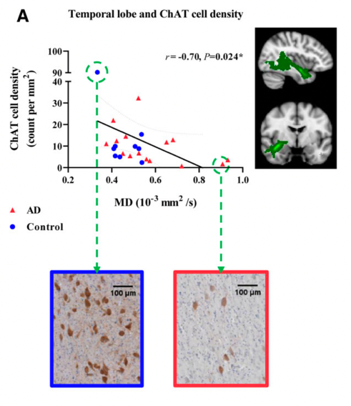
Area 2: Measuring NSS Structure & Function
NbM Cholinergic Cell Density and Integrity of White Matter Tracts
Jan
Aghakhanyan et al. Neurobio. Aging.
Feb
Prokopiou et al. Nature Comm.
Mar
Jacobs et al. Alz. & Dementia
Cassidy et al. Neuropsychopharm.
Apr
Dahl et al. Neurobio. Aging
May
Jun
Jul
Lin et al. Brain
Aug
Liebe et al. Molecular Psychiatry
Sep
Gilvesy et al. Neuropathologica
Oct
Parent et al. Neuroimage
Nov
Morris et al. NeuroImage
Dec
Lin et al. Brain
Murray et al. Neurodegeneration
Notes:
Lin et al. also examined NbM volume in a sample of 28 (14 AD, 14 age matched controls). Using ex-vivo MRI and immunohistochemistry follow-ups, they related imaging measures with cholinergic cell density. They found that NbM volume, and mean diffusivity of white matter tracts projecting from NbM to the temporal lobe were associated cholinergic cell density. Together, this suggests that cholinergic degeneration in NbM may contribute to damaged cortical projections and cognitive decline.

Slide 12
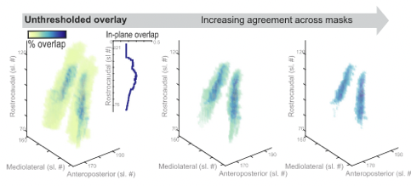
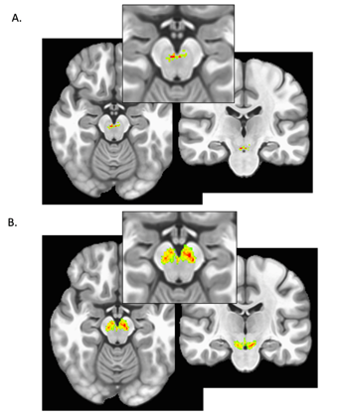
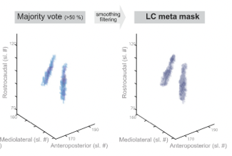
Area 2: Measuring NSS Structure & Function
New NSS Masking Methods
Jan
Aghakhanyan et al. Neurobio. Aging.
Feb
VTA & SN
LC Meta-mask
Prokopiou et al. Nature Comm.
Jacobs et al. Alz. & Dementia
Mar
Cassidy et al. Neuropsychopharm.
Apr
Dahl et al. Neurobio. Aging
May
Jun
Jul
Lin et al. Brain
Aug
Liebe et al. Molecular Psychiatry
Sep
Gilvesy et al. Neuropathologica
Oct
Parent et al. Neuroimage
Nov
Morris et al. NeuroImage
Dec
Morris et al. NeuroImage
Dahl et al. Neurobiology Of Aging
Murray et al. Neurodegeneration
Notes:
Moving on to measuring volume and signal intensity in the neuromodulatory subcortical systems, Morris et al. developed a machine learning algorithm to segment the VTA (top) and the Substantia Nigra (bottom) using 3T and 7T MR images. Their sample consisted of 51 subjects, 21 of whom has a mood or anxiety disorder. They found that VTA integrity (measured by signal intensity) was associated with motivation scores. The machine learning methods used here might be useful in the future if we are trying to segment these small nuclei on lower resolution scanners.
Dahl et al. aggregated across published LC maps to yield a high confidence meta-mask, which corresponds well with previously published post-mortem reports.

Slide 13

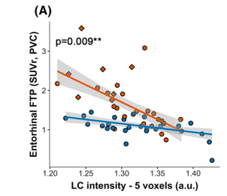
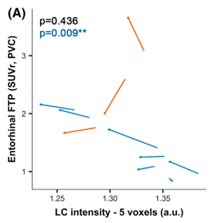

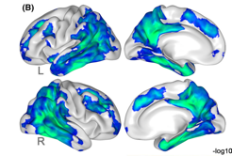
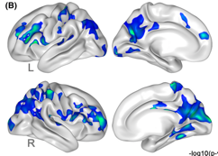

Area 3: Tau Accumulation and the Locus Coeruleus
Waning LC Integrity Precedes Cortical Tau in Preclinical ADAD
Jan
Aghakhanyan et al. Neurobio. Aging.
Feb
Prokopiou et al. Nature Comm.
Mar
Jacobs et al. Alz. & Dementia
Cassidy et al. Neuropsychopharm.
Apr
Tau
Dahl et al. Neurobio. Aging
Tau
May
Jun
Jul
Lin et al. Brain
Aug
Liebe et al. Molecular Psychiatry
Sep
Gilvesy et al. Neuropathologica
Oct
Parent et al. Neuroimage
Nov
Morris et al. NeuroImage
Dec
Jacobs et al. Alzheimer’s & Dementia
Murray et al. Neurodegeneration
Notes:
Moving on to the final focus area, let’s talk about tau accumulation and the locus Coeruleus!
A big area of discussion is whether LC degeneration and tau accumulation are a normal part of aging, or whether it should be considered a prodromal stage of Alzheimer’s disease. In a study by Jacobs et al., they looked at LC integrity carriers of PSEN-1. Carriers are predestined to develop autosomoal dominant AD at an early age. They found that LC integrity started to decline at age 32 in carriers, 12 years before clinical onset, and 20 years earlier than in sporadic AD. LC integrity was associated with memory scores, and this relationship was mediated by tau accumulation in posterior parietal regions. Additionally, LC integrity was correlated with cortical accumulation of Amyloid beta, measured by PiB PET, cortical Tau, measured by flortaucipir. And perhaps most excitingly, they found a relationship between the change in LC intensity and the change in precuneus tau burden during longitudinal follow-ups (subset of 10 carriers and 7 non-carriers). As LC intensity decreased, tau burden increased. These sorts of longitudinal studies, and the opportunity to study ADAD is crucial to understanding the etiology of AD and how LC may be involved in the disease’s earliest stages.

Slide 14
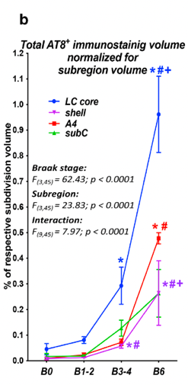
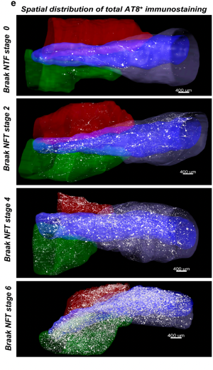
Area 3: Tau Accumulation and the Locus Coeruleus
Characterizing Tau Pathology in the LC
Jan
Aghakhanyan et al. Neurobio. Aging.
Feb
Prokopiou et al. Nature Comm.
Mar
Jacobs et al. Alz. & Dementia
Cassidy et al. Neuropsychopharm.
Apr
Dahl et al. Neurobio. Aging
May
Jun
Jul
Lin et al. Brain
Aug
Liebe et al. Molecular Psychiatry
Sep
Gilvesy et al. Neuropathologica
Oct
Parent et al. Neuroimage
Nov
Morris et al. NeuroImage
Dec
Gilvesy et al. Acta Neuropathologica
Murray et al. Neurodegeneration
Notes:
In a study of post-mortem tissue, Gilvesy et al. show that tau-burden in the LC increases with Braak stage. They suggest that LC neurons are uniquely susceptible because the cytoskeleton is repeatedly reorganized for homeostatic adaptation. This paper suggests that more rostral areas of LC accumulate more tau, and that this may result in its spread to hippocampus, EC, and other AD-vulnerable regions along LC projections.

Slide 15
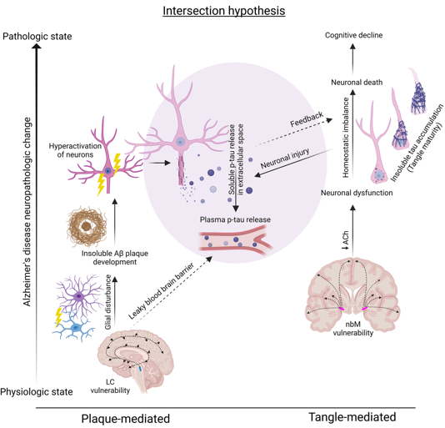
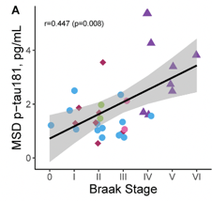
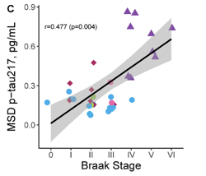
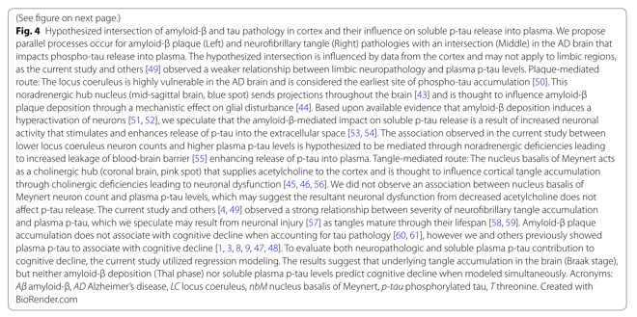
Area 3: Tau Accumulation and the Locus Coeruleus
Plasma Tau Linked to Braak Stage & LC Vulnerability
Jan
Aghakhanyan et al. Neurobio. Aging.
Feb
Prokopiou et al. Nature Comm.
Mar
Jacobs et al. Alz. & Dementia
Cassidy et al. Neuropsychopharm.
Apr
Dahl et al. Neurobio. Aging
May
Jun
Plasma Tau
Jul
Lin et al. Brain
Aug
Liebe et al. Molecular Psychiatry
Sep
Gilvesy et al. Neuropathologica
Oct
Parent et al. Neuroimage
Nov
Morris et al. NeuroImage
Dec
Murray et al. Molecular Neurodegeneration
Murray et al. Neurodegeneration
Notes:
In a study of 35 patients, Murray et al. measured ptau217 and ptau181 in plasma. In autopsy follow ups they found that plasma tau levels were associated with parietal tau and amyloid. They also found that LC cell count was predictive of plasma tau, but NbM cell count was not. Cognitive measures were predicted by brain tau, but not plasma tau.
They conclude that “Higher soluble plasma p‑tau levels may be the result of an intersection between insoluble deposits of amyloid‑β and tau accumulation in brain, and may be associated with locus coeruleus degeneration.” And here they outline a possible mechanism by which amyloid-driven LC degeneration allows tau to begin spreading throughout the brain.

Slide 16
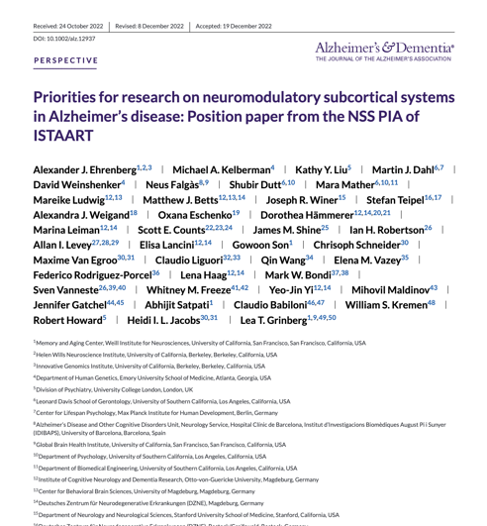
Future Focus Areas
Cohort Design: Population-based aging studies for early detection
Biomarkers: Improve imaging methods; revise autopsy guidelines
Neuropsychiatric Symptoms: Update syndromic definitions & treatment guidelines for AD
Neuropathology: Develop a staging scheme for NSS degeneration

Slide 17

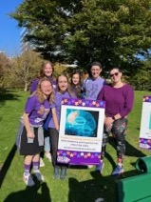




Acknowledgements
Berry Lab
Anne Berry
Katherine O’Malley
Jordyn Cowan
Alex Adornato
Hsiang-Yu Chen
Jenny Crawford
Jourdan Parent
Claire Ciampa
Teodora Markova
Rachel Marcus
Bailey Gold
Maya Stiefel
Arielle Schutt
Isaac Zygmuntowicz
ISTAART NSS PIA
Heidi Jacobs
Alexander Ehrenberg
Martin Dahl
Neus Falgas Martinez
Scott E. Counts
Christoph Schneider
Michael Kelberman
Gowoon Son
Lea T. Grinberg
ISTAART
Jodi Titiner
Stefania Forner
View Papers from this Presentation
MGH Martinos Center
Jacob Hooker
Krista Fariel
Contact Info
tmorin2@mgh.harvard.edu
tommorin@brandeis.edu
@ThomasMorin1
www.tmmorin.com

