Slide 1
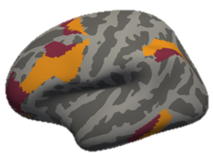
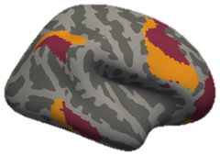
Frontoparietal Control Network Contributions to Abstract Reasoning Behavior in Humans
Tom Morin
Qualifying Exam
June 27, 2019

Slide 2
Outline
General Background
Specific Aim #1 (Preliminary Data)
  Discussion/Q&A
Specific Aim #2
  Discussion/Q&A
Specific Aim #3
  Discussion/Q&A

Slide 3
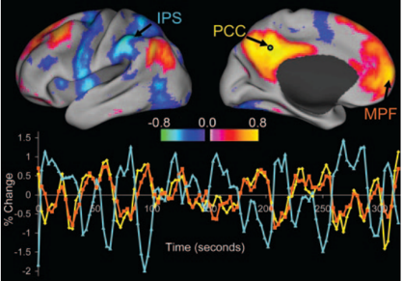
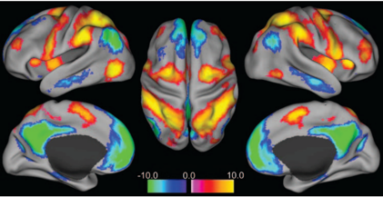
Resting State Connectivity
Fox et al. 2005 (PNAS)

Slide 4
Resting State Networks
7-Network Parcellation
17-Network Parcellation
Yeo, et al. 2011 (J. Neurophys.)

Slide 5
Other Cortical Parcellations
Power et al. 2011 (Neuron)
Glasser et al. 2016 (Nature)

Slide 6
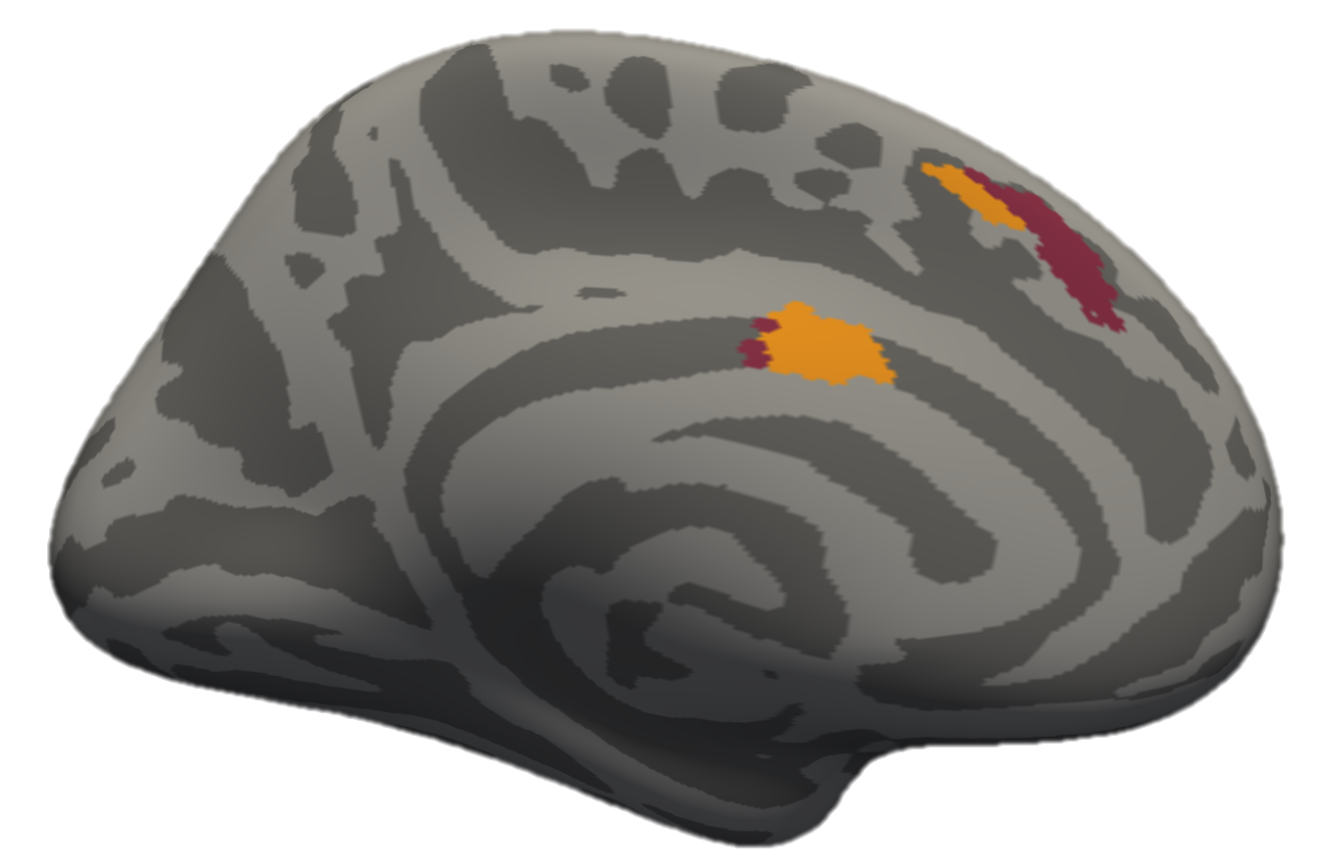
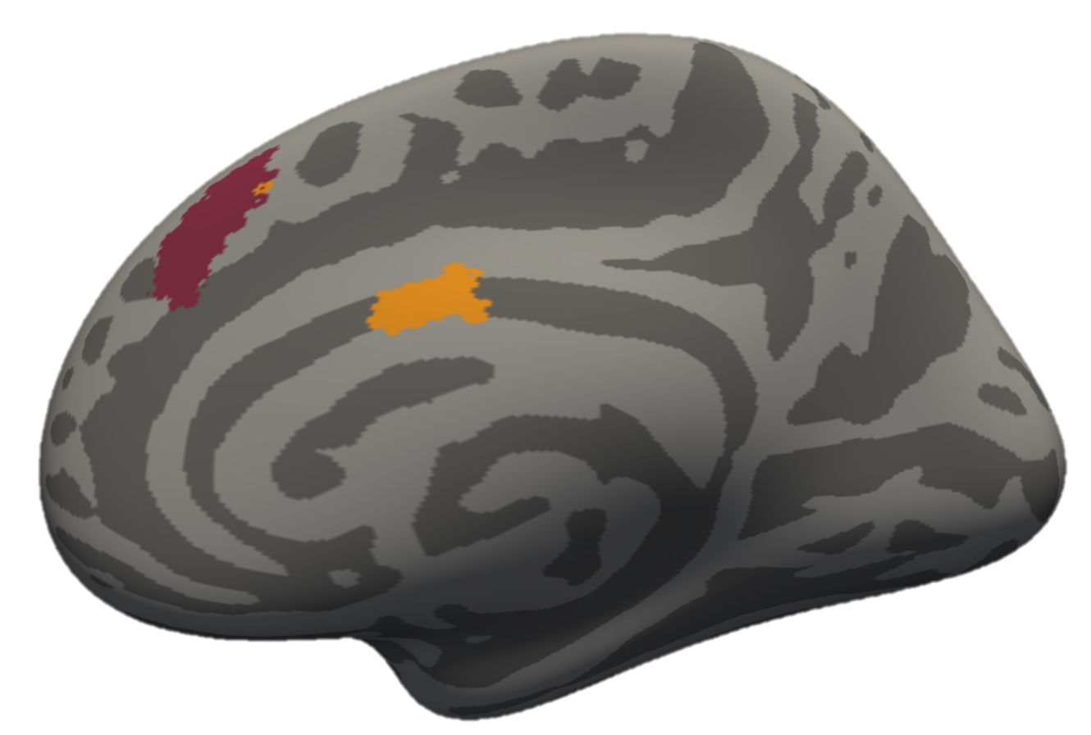
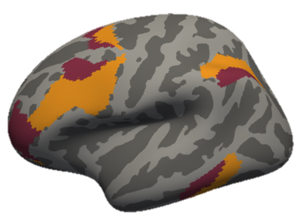
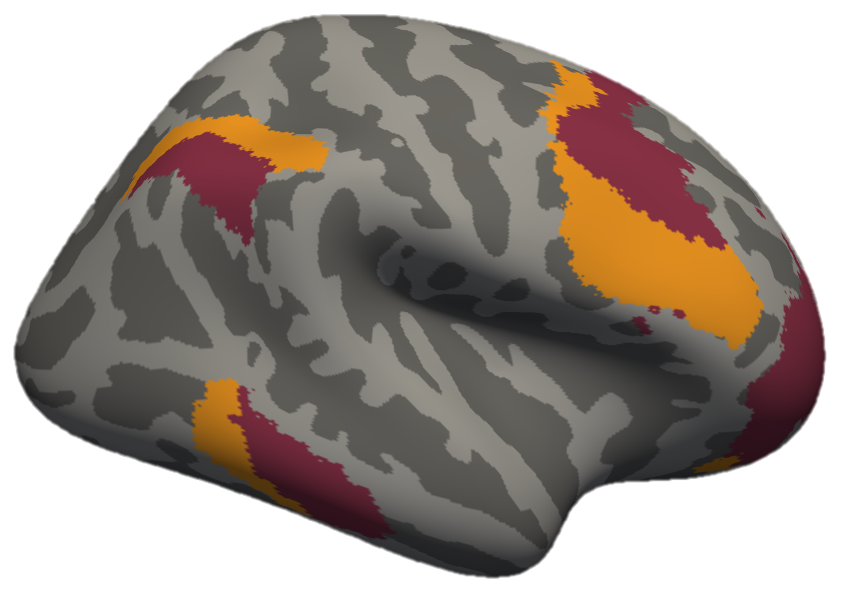
Frontoparietal Control Network
Right
Left
pre-SMA
CaS
sPCS
sPCS
MFG/IFS
lat-IPS
MFG/IFS
rlPFC
rlPFC
lat-IT
Yeo, et al. 2011 (J. Neurophys.)

Slide 7
FPCN Subdivisions & Function
Dixon, et al 2018 (PNAS)

Slide 8
Specific Aims
Determine frontoparietal control network contributions to discrete symbolic and continuous perceptual abstract reasoning tasks.
Characterize local and global functional connectivity of the frontoparietal control network during abstract reasoning including interactions between the frontoparietal control, dorsal attention, and default mode networks.
Functionally determine the complementary contributions of lateral prefrontal and lateral parietal nodes of the frontoparietal control network during an abstract reasoning task.

Slide 9
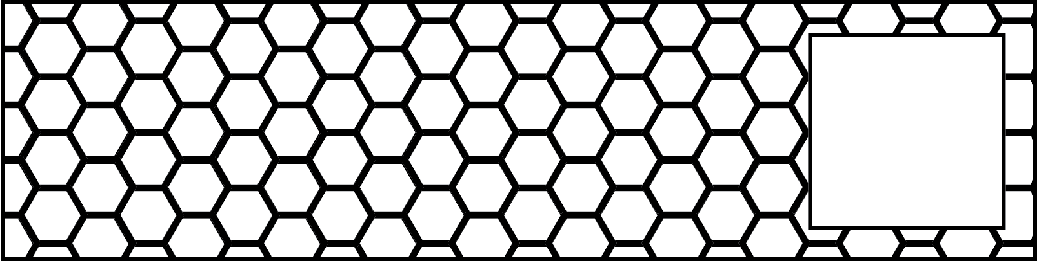
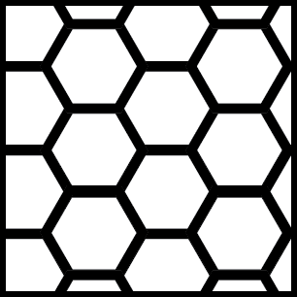
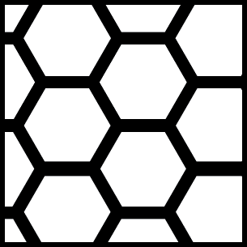

Slide 10




Slide 11
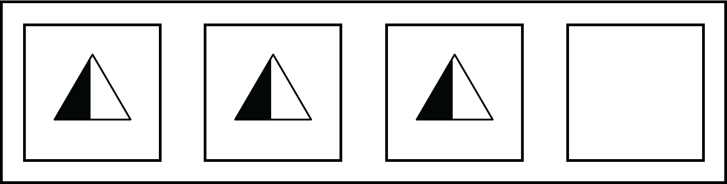



Slide 12
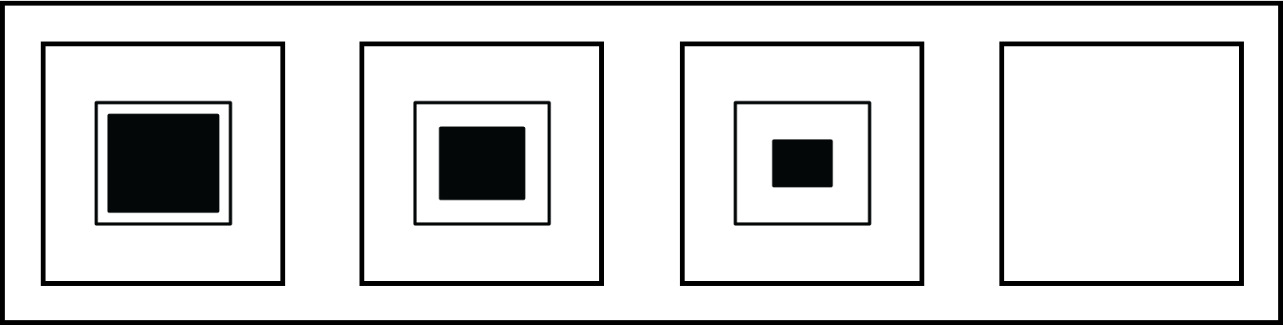

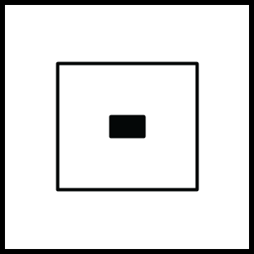

Slide 13
Raven’s Progressive Matrices Task
Neuropsychological test of:
  Fluid Intelligence
  Relational Reasoning
  Symbolic Processing
Several Problem Types:
Notes:
Elaborate more? Mention that the test is used for aging studies, children developmental, etc.
Neuropsych test of “intelligence and reasoning”
Bracket under textures: “Perceptual Reasoning”… “symbolic reasoning”

Slide 14
Previous Work on the Raven’s Progressive Matrices Task
Computational Models
Carpenter, Just, & Shell (1990)
Kunda, McGreggor, & Goel (2013)
Rasmussen & Eliasmith (2011, 2014)
Lovett & Forbus (2017)
Raudies & Hasselmo (2017)
Hasselmo (Preprint, 2018)
fMRI Studies
Prabhakaran et al (1997)
Christoff et al. (2001)
Melrose, Poulin, & Stern (2007)
Golde, Cramon, & Schubotz (2010)
Notes:
Texture as contiguous and symbol as discrete…. Harder to model contiguous stuff?

Slide 15
Computational Models of the Raven’s Progressive Matrices
Common Modelling Approach:
  Deduce the visuospatial relationship between stimuli
  Apply that rule to simulate what comes next

Slide 16
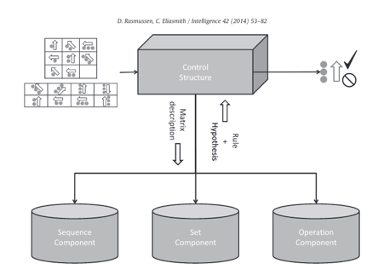
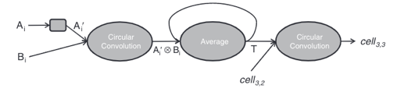
Computational Models of the Raven’s Progressive Matrices Task
Sequence Component:
Deduce Relationship
Apply
Relationship
Rasmussen & Eliasmith, 2014 (Intelligence)

Slide 17
Computational Models of the Raven’s Progressive Matrices Task
Deduce
Relationship
Apply
Relationship
Define Stimulus Features
Raudies & Hasselmo, 2017 (Bio. Insp. Cog. Arch.)

Slide 18
Frontoparietal Activity Contributes to Relational Reasoning
Golde et al. 2010 (Neuroimage)
Genovesio, Wise, & Passingham; 2014 (TiCS)
Notes:
Instead of relationship: “rule”

Slide 19
Past Raven’s Studies
Golde et al. 2010 (NeuroImage)

Slide 20
Past Raven’s Studies
Melrose et al. 2007 (Brain)

Slide 21
Past Raven’s Studies
(R > Rc Condition)
Melrose et al. 2018 (Clinical Neuroimage)

Slide 22
Motivation
Questions:
Do neuroimaging results coincide with the computational models?
How does perceptual reasoning (texture stimuli) differ from symbolic reasoning (symbol stimuli)?
Hypothesis:
Both types of reasoning recruit frontoparietal regions.
Perceptual reasoning may recruit ventral visual regions and symbolic reasoning may recruit anterior prefrontal regions.
Notes:
Maybe ways to extend the hypothesis … include network stuff

Slide 23
Task Conditions

Slide 24
Sample Trial
N=27
396 Trials per Participant

Slide 25
Activity During Symbolic and Perceptual Reasoning
Symbol Rule
>
Symbol Uniform
Texture Rule
>
Texture Uniform

Slide 26
Key Differences Between Symbolic and Perceptual Reasoning Activity

Slide 27
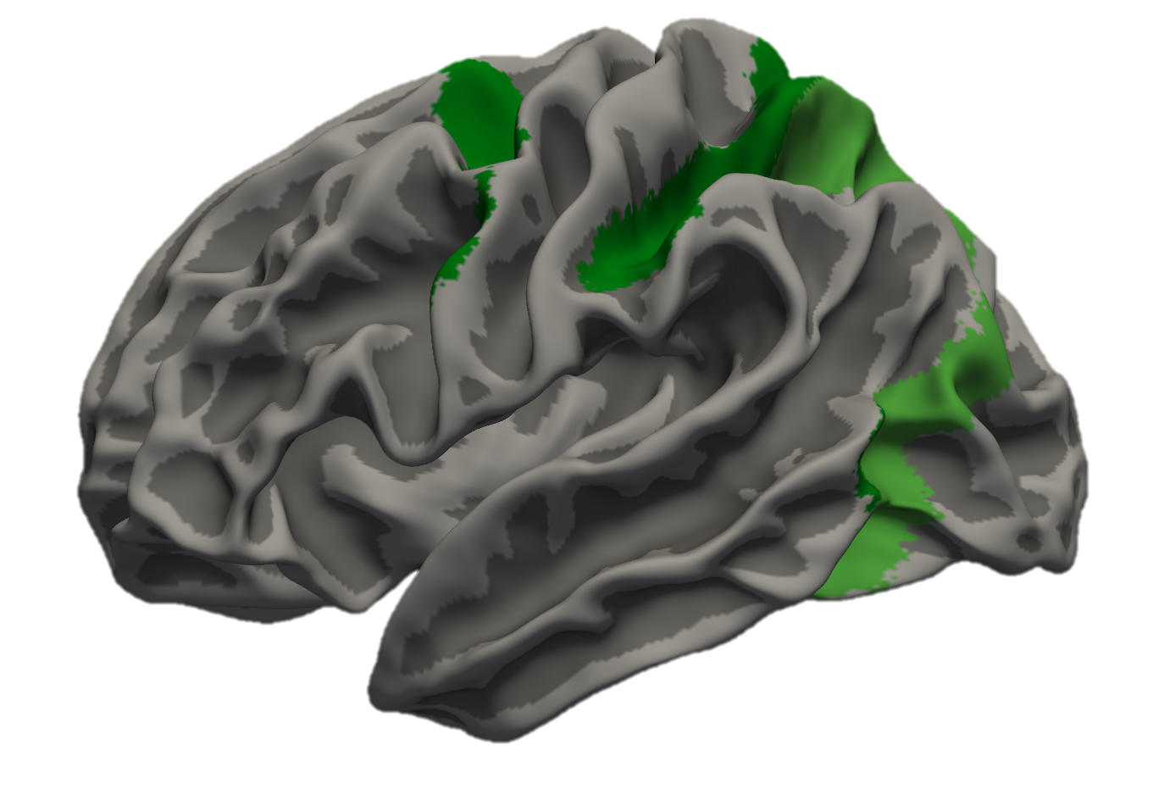
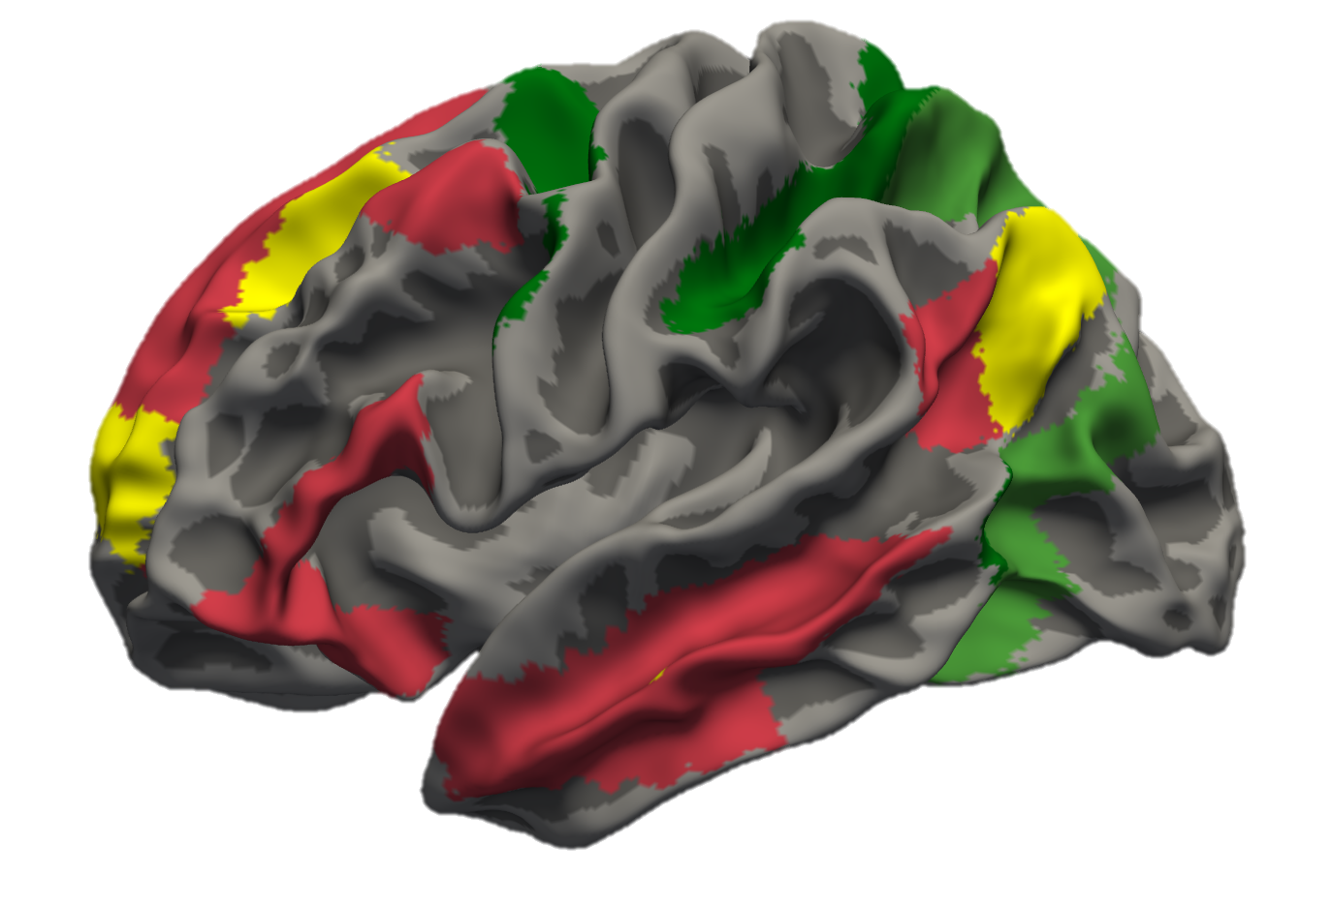
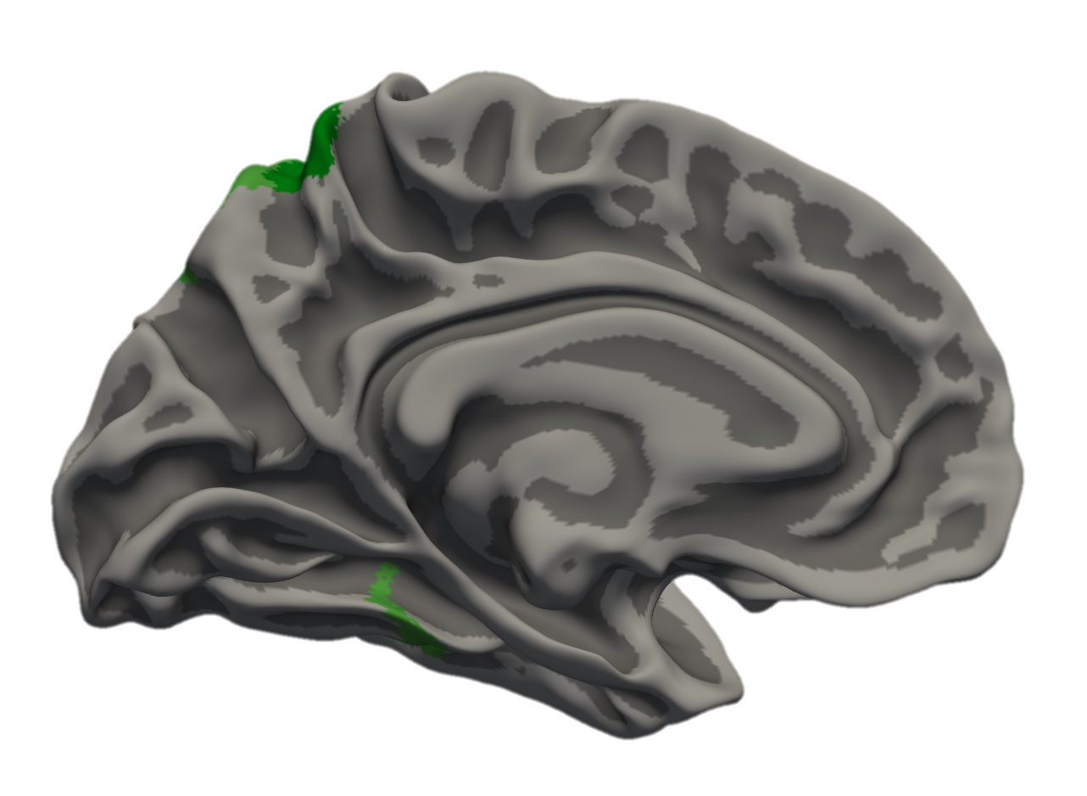
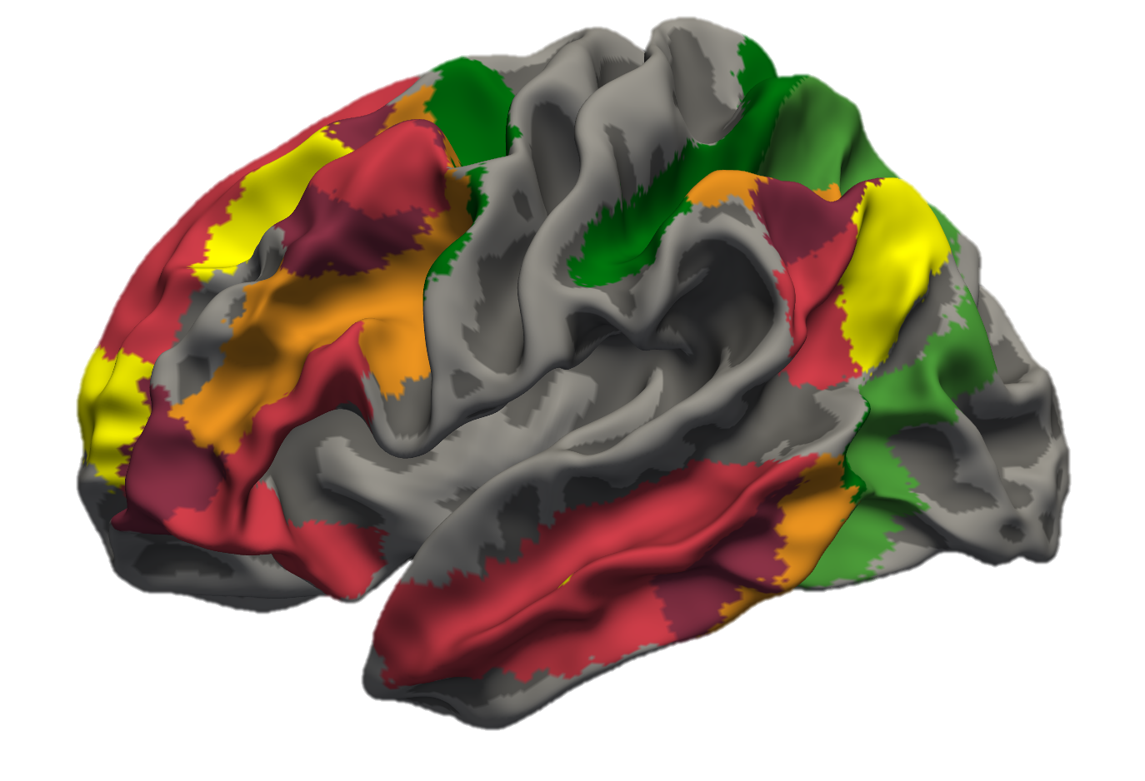
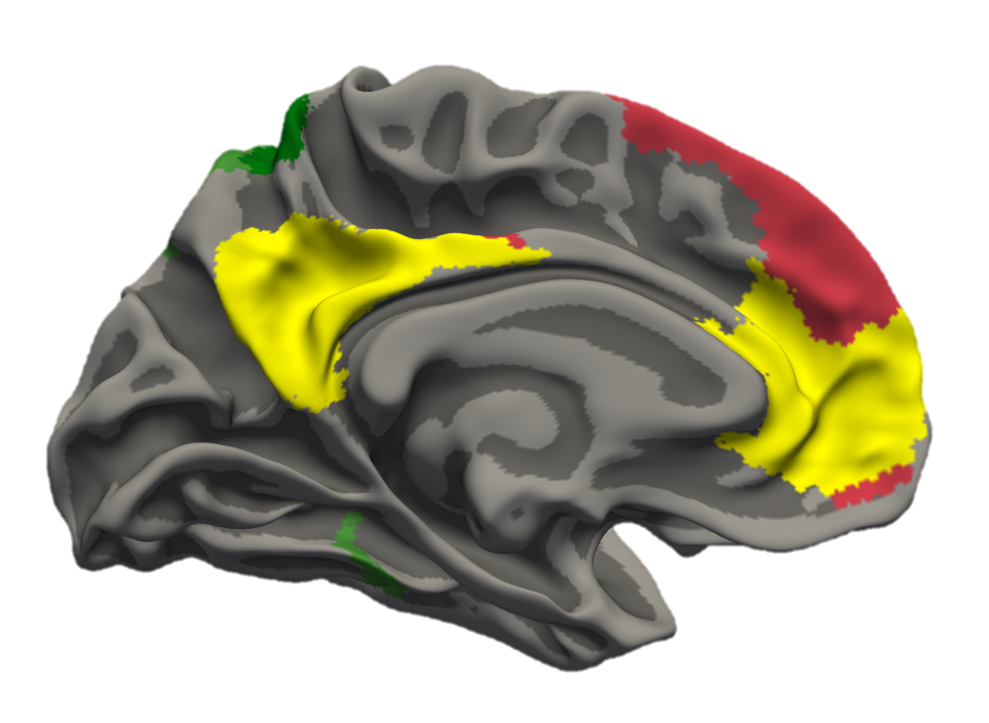
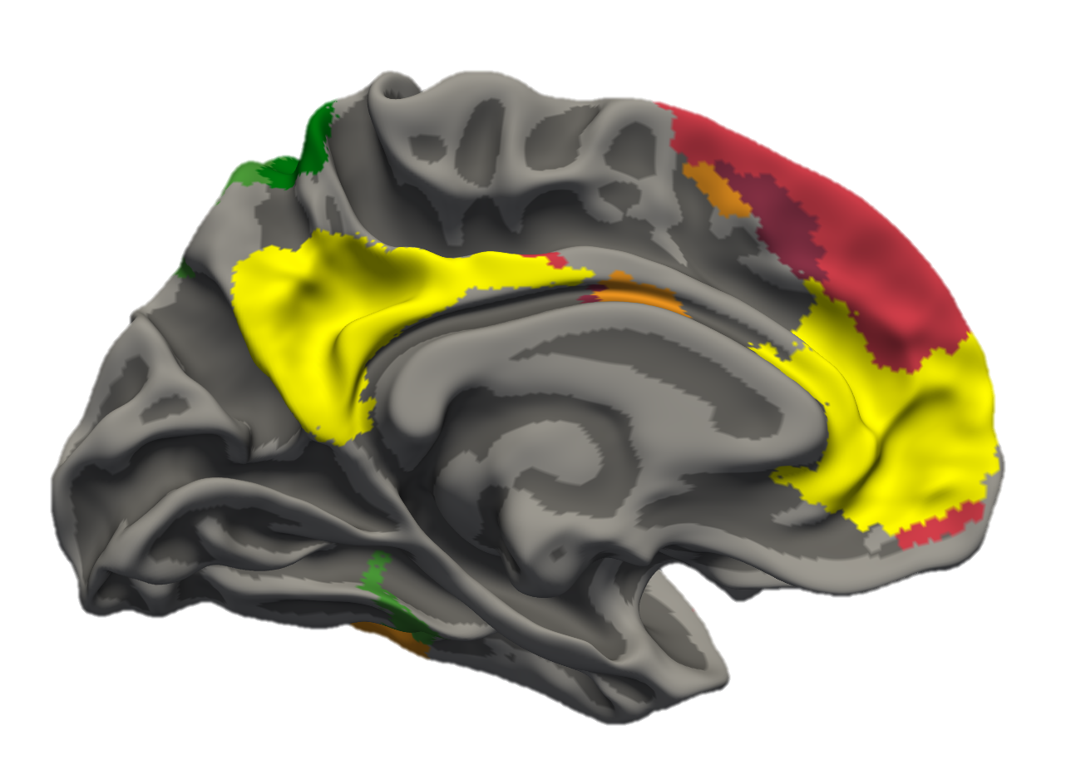
Examining Network Activity Across Symbolic and Perceptual Reasoning
17 Network Parcellation
Yeo et al. 2011
Dorsal Attention
Frontoparietal Control
Default Mode

Slide 28
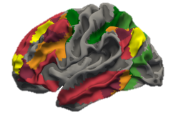
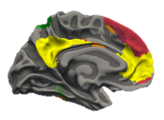
Differential Frontoparietal Control Network Activation
Dorsal Attention
Frontoparietal Control
Default Mode
Notes:
Color code the x-axis in illustrator to correspond to conditions
Angle slightly off (not vertical)

Slide 29
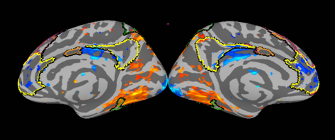

Differences in Frontoparietal Control Network Activity
Texture
(Rule > Uniform)
Symbol
(Rule > Uniform)
R
L
R
L
L
R
L
R
Dorsal Attention
Frontoparietal Control
Default Mode
n=27
-0.40
0.40
% Signal Change
(FDR Corrected)

Slide 30
Summary of Results
Increased IT activity for perceptual reasoning and rlPFC for symbolic reasoning
DAN & FPCN support reasoning
FPCN supports symbolic reasoning over and above texture reasoning

Slide 31
Implications
Future computational models might consider the additional ventral-visual processing involved in perceptual reasoning
Processing of symbolic stimuli may draw on long-term representations (schemas)
Notes:
Other robotics people focusing on basic perceptual processing a lot… basic perceptual processing vs. reasoning

Slide 32
Specific Aim #2
Characterize local and global functional connectivity of the frontoparietal control network during abstract reasoning including interactions between the frontoparietal control, dorsal attention, and default mode networks.

Slide 33
Inter-Subject Variability of Resting State Networks
Mueller et al., 2013 (Neuron)

Slide 34
Individual Subject Network Parcellation
Wang et al., 2015 (Nat. Neuro)

Slide 35
Hypothesis 2a: IPS serves as a Hub for the Frontoparietal Control Network
Default Mode
Frontoparietal Control
PHC
dlPFC
lat-IT
Dorsal Attention
sPCS
iPCS
lat-IPS
mPFC
PrC
IPS
pre-SMA
CaS
STG
TPJ

Slide 36
Hypothesis 2b: During Texture Reasoning, FPCN-DAN connectivity increases.
Default Mode
Frontoparietal Control
PHC
dlPFC
lat-IT
Dorsal Attention
sPCS
iPCS
lat-IPS
mPFC
PrC
IPS
pre-SMA
CaS
STG
TPJ

Slide 37
Hypothesis 2b: During Symbolic reasoning, FPCN-DMN connectivity increases
Default Mode
Frontoparietal Control
PHC
dlPFC
lat-IT
Dorsal Attention
sPCS
iPCS
lat-IPS
mPFC
PrC
IPS
pre-SMA
CaS
STG
TPJ

Slide 38
Specific Aim #3
Functionally determine the complementary contributions of lateral prefrontal and lateral parietal nodes of the frontoparietal control network during an abstract reasoning task.

Slide 39
Frontoparietal Control Network
Right
Left
pre-SMA
CaS
sPCS
sPCS
MFG/IFS
lat-IPS
MFG/IFS
IPS
IPS
LFPC
LFPC
rlPFC
rlPFC
lat-IT
Yeo, et al. 2011 (J. Neurophys.)

Slide 40
Moving Through “Problem Space”
Constantinescu, O’Reilly, & Behrens, 2016 (Science)

Slide 41
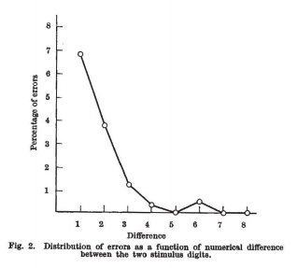
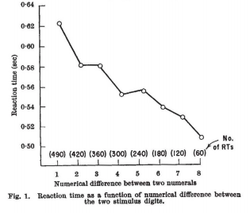
Numerical Distance Effect
Moyer & Landauer 1967 (Nature)

Slide 42
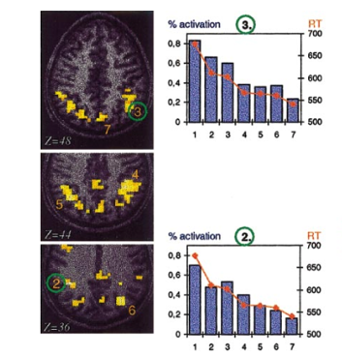
Symbolic Distance Effect
Hinton et al. 2010 (Neuroscience)
Pinel et al. 2001 (Neuroimage)

Slide 43
Hierarchical Organization of LPFC
Badre & Nee 2018 (TiCS)

Slide 44
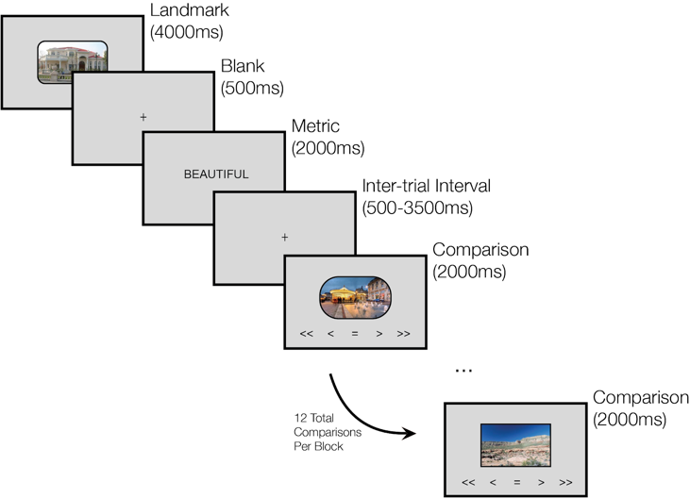
Example Block

Slide 45
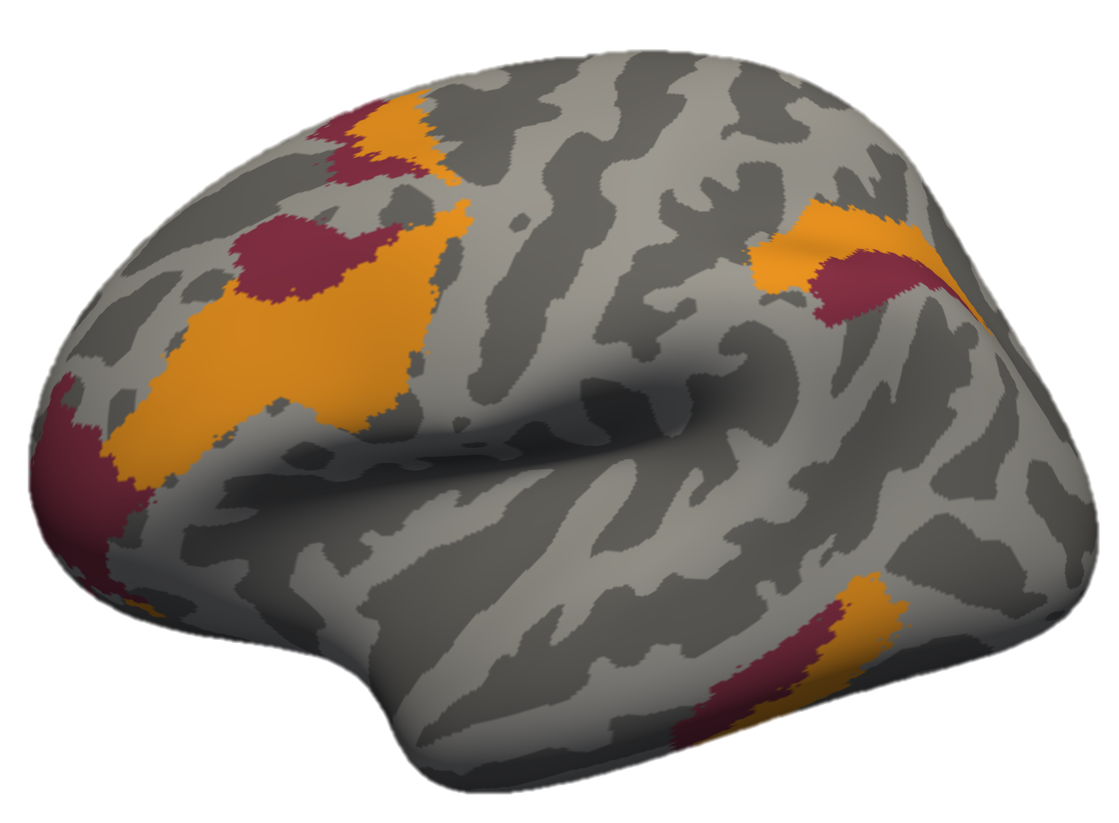
Aim #3 Hypotheses
Signal Scales with Distance
Least Abstract
(External Info)
% Signal Change
=
>
>>
Most Abstract
(Internal Schema)
BEAUTIFUL
ROUNDED
URBAN

Slide 46
Significance
Develop a detailed understanding of frontoparietal control network dynamics
Improve our understanding of the neural substrates for abstract reasoning
Consider the co-dependent functions of individual network nodes

Slide 47
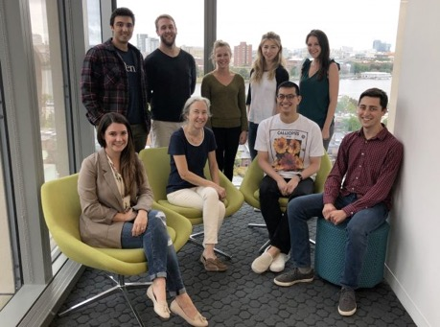
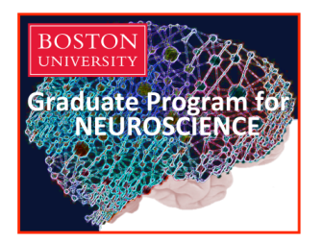
Thank You!
GPN
Shelley Russek
Sandi Grasso
Nazifa Haque
Qualifying Exam Committee
Chantal Stern
Joe McGuire
Mike Hasselmo
Cognitive Neuroimaging Center
Jay Bohland
Shruthi Chakrapani
Stern Lab
Chantal Stern
Allen Chang
Rachel Nauer
Matt Dunne
Stamati Liapis
Kylie Moore
Kelli Tahaney
Tashauna Blankenship
Weida Ma
Sheila Yee
Boston University
David Somers
Funding
NSF Major Research Instrumentation Award 1625552
ONR MURI Award N00014-16-1-2832
ONR DURIP Award N00014-17-1-2304

