Slide 1
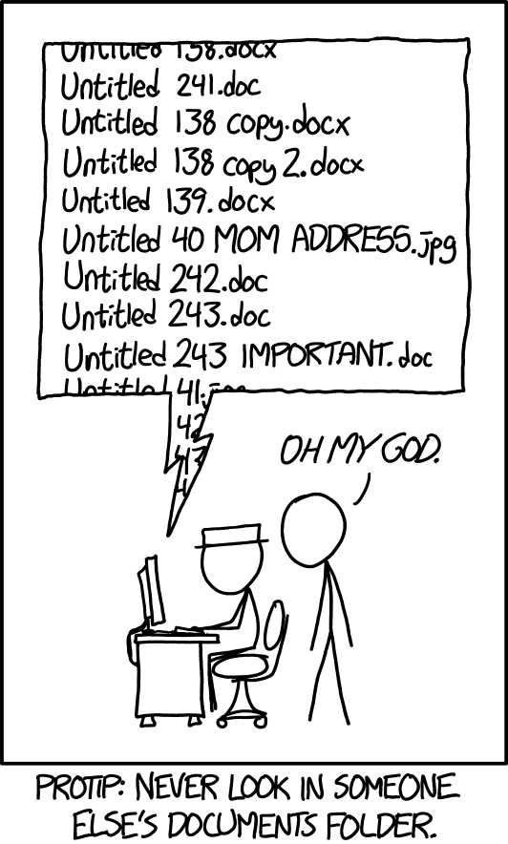
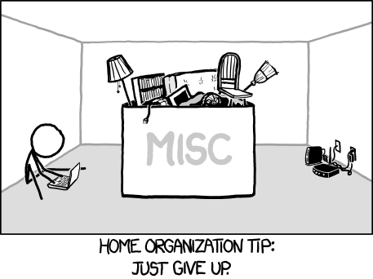
A BIDS Refresher
July 9, 2024
Tom Morin

Slide 2


INCF
  Vetting, endorsing, and promoting community standards/best practices.
  Develop and maintain standards, software tools, and infrastructure.
  Provide educational courses and forums on FAIR data management methods & supporting.
ReproNim
  Data and software discovery.
  Implementation of standardized description of data, results and workflows.
  Provide training and education to the community.

Slide 3

2 – week “summer school” at the University of Washington in Seattle.
Week 1: hands-on lectures and open Q&A sessions
Week 2: participant-driven “hackathon”

Slide 4



Slide 5

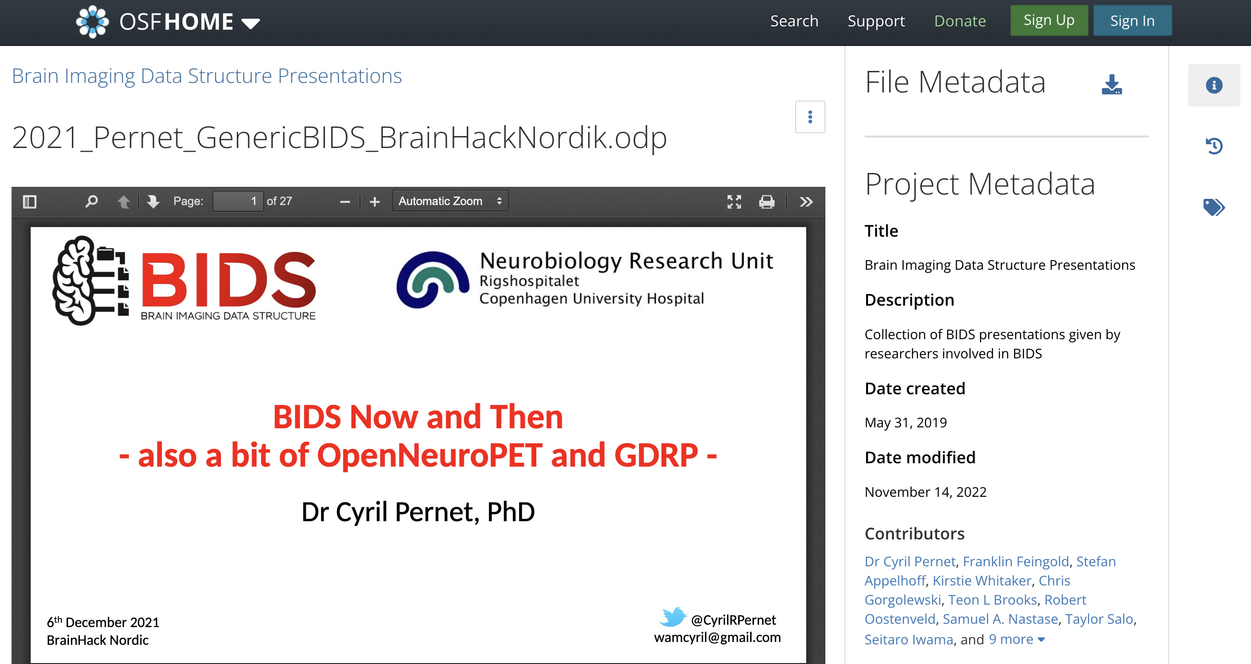
Why is this Important?
New NIH Data Sharing Mandate!
Make data more accessible
  For yourself six months from now
  For others in the lab (new students, collaborators)
  For other researchers (data sharing)
@CyrilRPernet
wamcyril@gmail.com
https://osf.io/84g7a

Slide 6
Today’s Focus:
Collect Data
Organize & Clean Data
Analyze Data

Slide 7

‘FAIR’ Guiding Principles for
Data Management
Findability
Accessibility
Interoperability
Reuse of Digital Assets
https://www.go-fair.org/fair-principles/

Slide 8

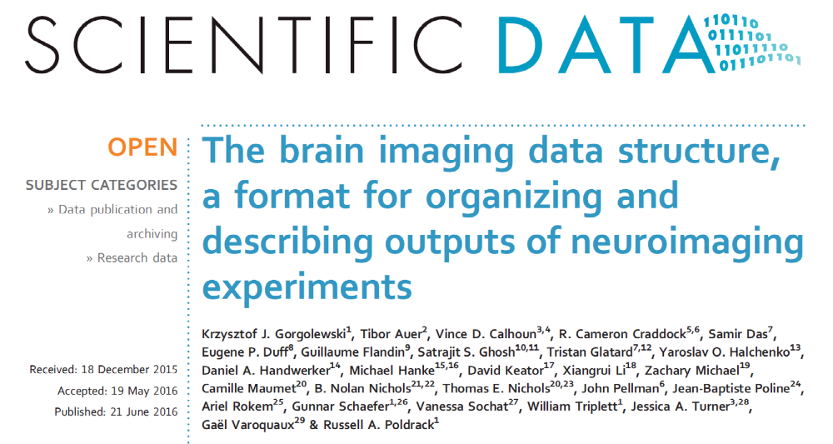
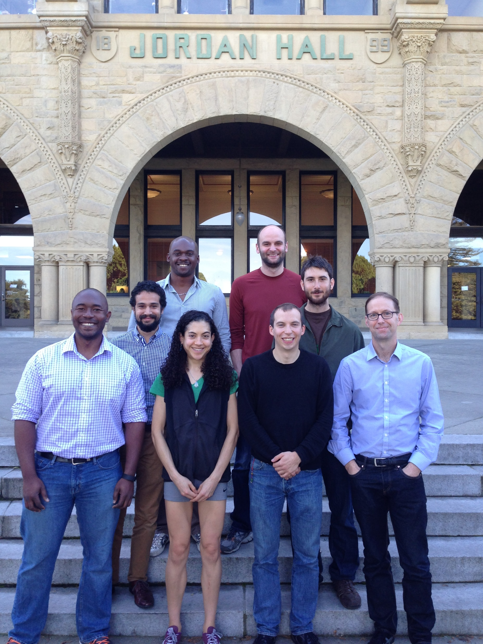
CREDITS
Data Sharing Task Force
The Poldrack Lab @ Stanford
@CyrilRPernet
wamcyril@gmail.com

Slide 9
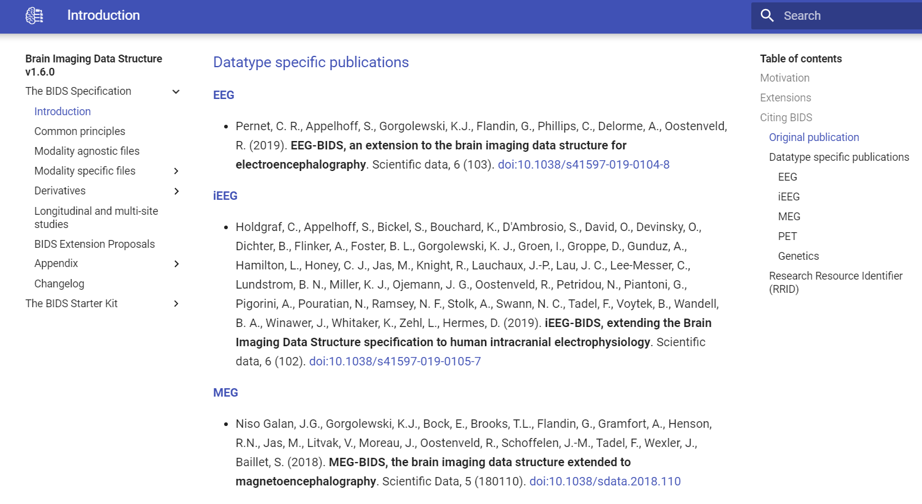
Bids.neuroimaging.io
@CyrilRPernet
wamcyril@gmail.com

Slide 10
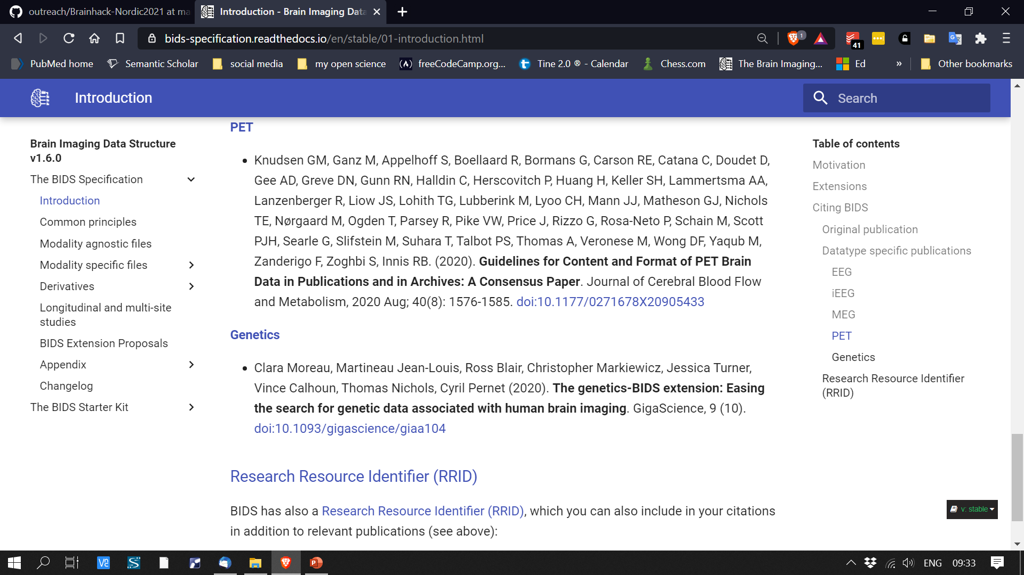
Bids.neuroimaging.io
@CyrilRPernet
wamcyril@gmail.com

Slide 11
The BIDS goal is to make more data accessible to more researchers
@CyrilRPernet
wamcyril@gmail.com

Slide 12
BIDS data structure basics
@CyrilRPernet
wamcyril@gmail.com

Slide 13
Essence of BIDS
Directory hierarchy and file naming system
  Conveys essential meta-data in filenames alone
Remaining meta-data in “sidecar” files
@CyrilRPernet
wamcyril@gmail.com

Slide 14
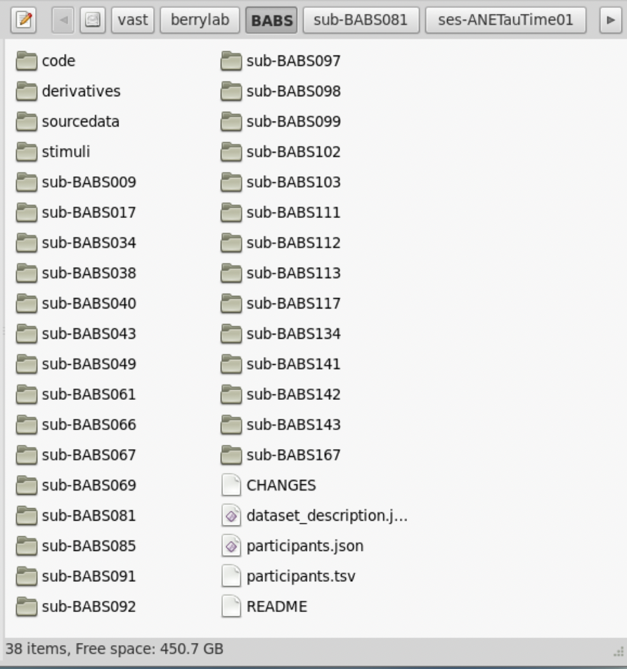
BABS in BIDS
/vast/berrylab/BABS
Bids.neuroimaging.io

Slide 15
Metadata as text files (tsv, json)
dataset_description.json
{
"Name": ”Brandeis Aging Brain Study”,
"BIDSVersion": ”1.2.1",
"License": "",
"Authors": [
    “Anne Berry”,
    “Katherine O’Malley”
    ],
"Acknowledgements": ”Special thanks…”,
"HowToAcknowledge": " ",
"Funding": [
    “National Institute of Aging R00…”,
    “National Institute of Aging R01…”,
    ],
"ReferencesAndLinks": "",
"SourceDatasetsURLs": ”/vast/berrylab/BABS”
}
Bids.neuroimaging.io

Slide 16
Metadata as text files (tsv, json)
dataset_description.json
{
"Name": ”Brandeis Aging Brain Study”,
"BIDSVersion": ”1.2.1",
"License": "",
"Authors": [
    “Anne Berry”,
    “Katherine O’Malley”
    ],
"Acknowledgements": ”Special thanks…”,
"HowToAcknowledge": " ",
"Funding": [
    “National Institute of Aging R00…”,
    “National Institute of Aging R01…”,
    ],
"ReferencesAndLinks": "",
"SourceDatasetsURLs": ”/vast/berrylab/BABS”
}
Bids.neuroimaging.io

Slide 17
Metadata as text files (tsv, json)
dataset_description.json
{
"Name": ”Brandeis Aging Brain Study”,
"BIDSVersion": ”1.2.1",
"License": ”n/a",
"Authors": [
    “Anne Berry”,
    “Katherine O’Malley”
    ],
"Acknowledgements": ”Special thanks…”,
"HowToAcknowledge": ”n/a",
"Funding": [
    “National Institute of Aging R00…”,
    “National Institute of Aging R01…”,
    ],
"ReferencesAndLinks": ”n/a",
"SourceDatasetsURLs": ”/vast/berrylab/BABS”
}
Bids.neuroimaging.io

Slide 18
Metadata as text files (tsv, json)
dataset_description.json
{
"Name": ”Brandeis Aging Brain Study”,
"BIDSVersion": ”1.2.1",
"License": ”n/a",
"Authors": [
    “Anne Berry”,
    “Katherine O’Malley”
    ],
"Acknowledgements": ”Special thanks…”,
"HowToAcknowledge": ”n/a",
"Funding": [
    “National Institute of Aging R00…”,
    “National Institute of Aging R01…”,
    ],
"ReferencesAndLinks": ”n/a",
"SourceDatasetsURLs": ”/vast/berrylab/BABS”
}
Bids.neuroimaging.io

Slide 19
Metadata as text files (tsv, json)
dataset_description.json
{
"Name": ”Brandeis Aging Brain Study”,
"BIDSVersion": ”1.2.1",
"License": ”n/a",
"Authors": [
    “Anne Berry”,
    “Katherine O’Malley”
    ],
"Acknowledgements": ”Special thanks…”,
"HowToAcknowledge": ”n/a",
"Funding": [
    “National Institute of Aging R00…”,
    “National Institute of Aging R01…”,
    ],
"ReferencesAndLinks": ”n/a",
"SourceDatasetsURLs": ”/vast/berrylab/BABS”
}
Bids.neuroimaging.io

Slide 20
Metadata as text files (tsv, json)
participants.tsv
participant_id YOB sex race ethnicity
BABS009 1943 M white non-hispanic
BABS017 1951 M white non-hispanic
BABS038 1952 M white non-hispanic
BABS040 1949 F white non-hispanic
BABS043 1951 M white non-hispanic
BABS049 1954 F white non-hispanic
BABS061 1954 M black n/a
BABS067 1959 M white non-hispanic
Bids.neuroimaging.io

Slide 21
Metadata as text files (tsv, json)
participants.tsv
participant_id YOB sex race ethnicity
BABS009 1943 M white non-hispanic
BABS017 1951 M white non-hispanic
BABS038 1952 M white non-hispanic
BABS040 1949 F white non-hispanic
BABS043 1951 M white non-hispanic
BABS049 1954 F white non-hispanic
BABS061 1954 M black n/a
BABS067 1959 M white non-hispanic
participants.json
{
  “YOB”: {
    “Description”: “participant year of birth”,
    “Units”: “year”
    }
    “sex”: {
      “Description”: “self-reported sex of subject”
      “Levels”: {
        “M”: “male”
        “F”: “female”
        }
        }
Bids.neuroimaging.io

Slide 22
Overarching Organization
code directory contains scripts for the following:
Downloading to:
sourcedata
Unpacking to:
Raw Data (Main BIDS Directory)
Preprocessing to:
derivatives
Bids.neuroimaging.io

Slide 23
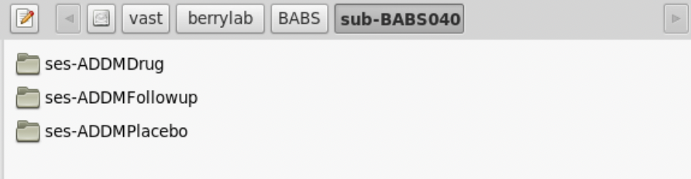
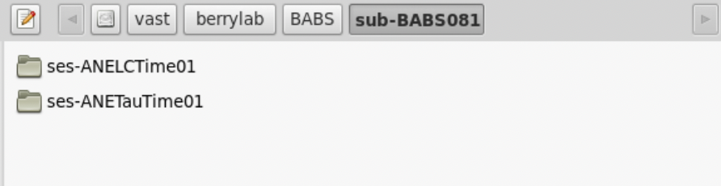
Session
A logical grouping of neuroimaging and behavioral data consistent across subjects. Session can (but doesn't have to) be synonymous to a visit in a longitudinal study. In general, subjects will stay in the scanner during one session.
BIDS Glossary: https://bids-specification.readthedocs.io/en/stable/glossary.html

Slide 24
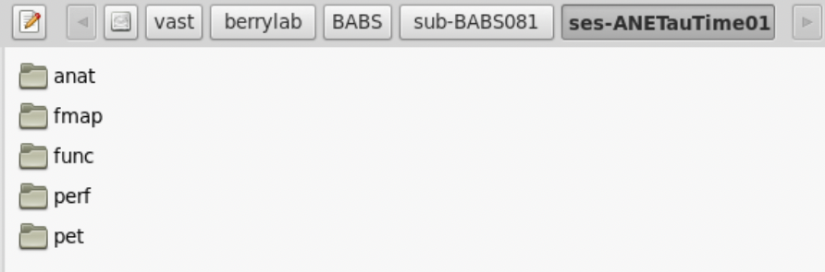
Data Type
A functional group of different types of data. Data files are contained in a directory named for the data type. In raw datasets, the data type directory is nested inside subject and session directories.

Slide 25
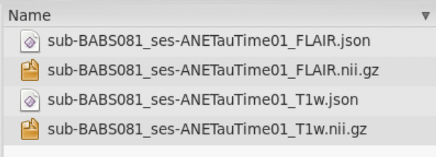
Modality/Run/Task

Slide 26
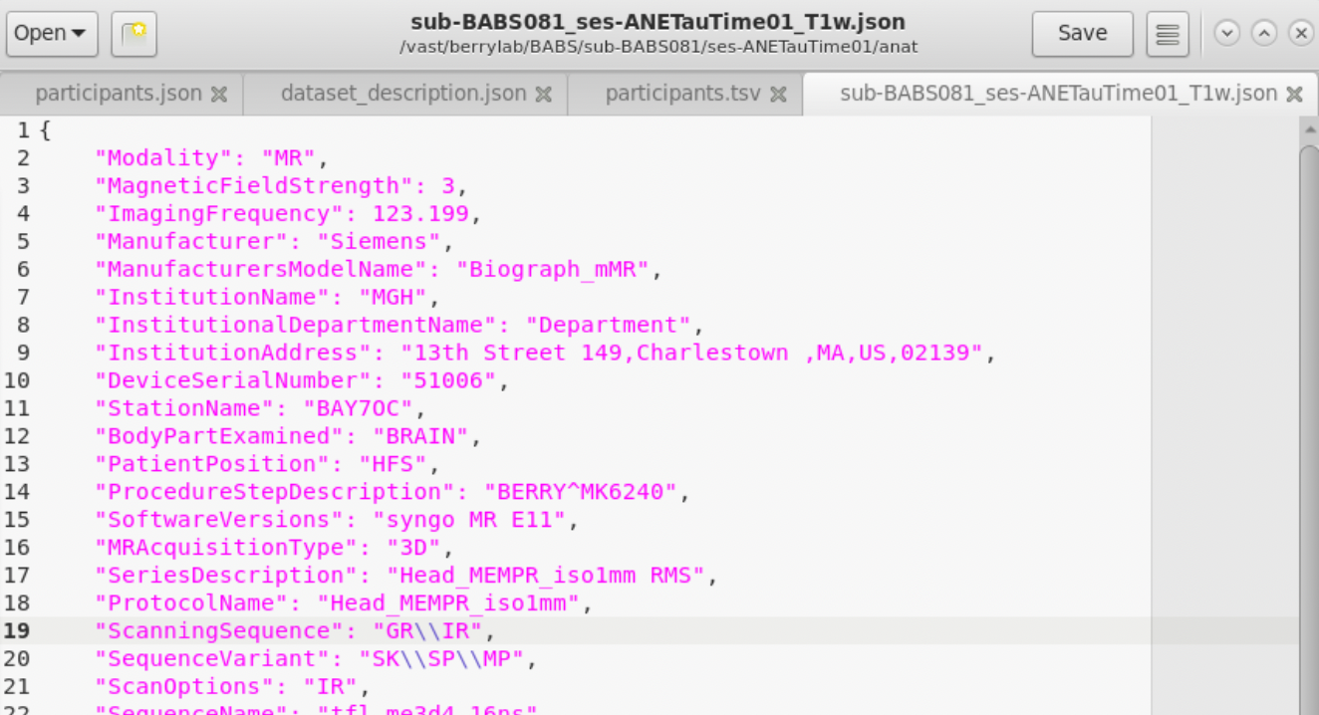
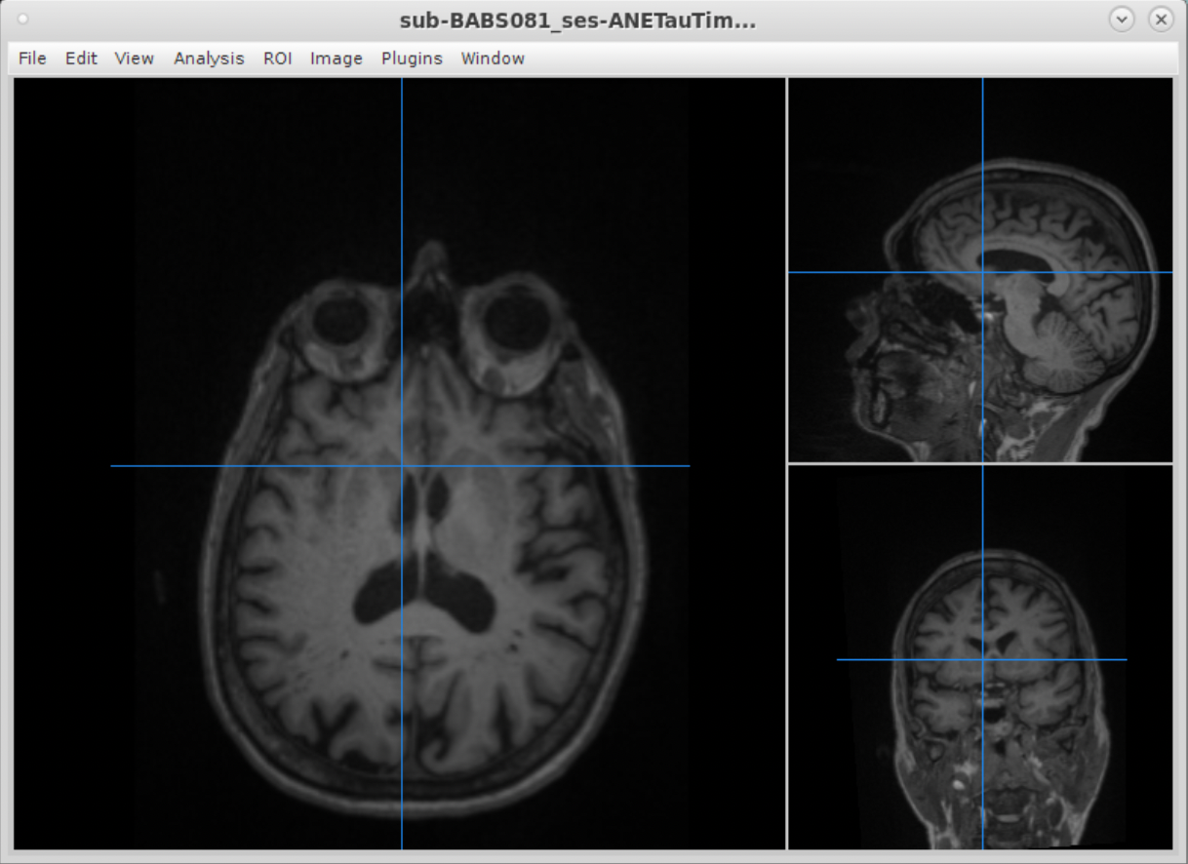
Nifti & JSON Sidecar Pairs

Slide 27
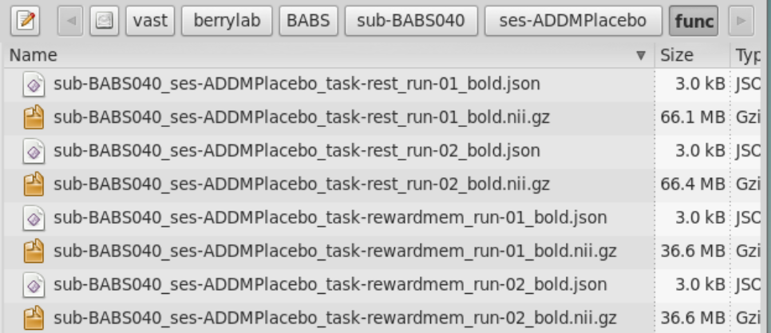
BIDS Filenames
sub-BABS040_ses-ADDMPlacebo_task-rewardmem_run-01_bold.nii.gz
Entities
Modality Suffix
File Extension
key-<label>

Slide 28
BIDS Filenames: Entities
sub-BABS040_ses-ADDMPlacebo_task-rewardmem_run-01_bold.nii.gz
Subject

Slide 29
BIDS Filenames: Entities
sub-BABS040_ses-ADDMPlacebo_task-rewardmem_run-01_bold.nii.gz
Subject
Session

Slide 30
BIDS Filenames: Entities
sub-BABS040_ses-ADDMPlacebo_task-rewardmem_run-01_bold.nii.gz
Subject
(Always 1st Entity)
Session
(Always 2nd Entity)
Task
Run

Slide 31
BIDS Filenames: Entities (Keys)
sub-BABS040_ses-ADDMPlacebo_task-rewardmem_run-01_bold.nii.gz
Subject
(Always 1st Entity)
Session
(Always 2nd Entity)
Task
Run

Slide 32
BIDS Filenames: Entities (Values)
sub-BABS040_ses-ADDMPlacebo_task-rewardmem_run-01_bold.nii.gz
Subject
(Always 1st Entity)
Session
(Always 2nd Entity)
Task
Run

Slide 33
BIDS Specification
https://bids-specification.readthedocs.io/en/stable/
Documentation for:
  Common Principles
  Modality Specific Files
  Modality Agnostic Files
  Glossary of terms
  BIDS Extension Proposals

Slide 34
What BIDS is NOT
  The Brain Imaging Data Structure, is not a new file format
  BIDS is not a database tool, but it helps archiving and major imaging databasing tools (XNat, Loris, etc) are BIDS compliant
  BIDS is not a search engine, but it facilitates data discovery for search engines
  BIDS is not a sharing tool, but it facilitates sharing
  with yourself next time you look at old data,
  with members of the lab (new students, new collaborators)
  with the community
@CyrilRPernet
wamcyril@gmail.com

Slide 35
Questions/Discussion?
Potential Discussions:
  Code demos
  Behavioral data examples
  Sourcedata & derivatives
Notes:
  PET standards are new/evolving
  LC neuromelanin scan does not yet have a naming standard (Turbo Spin Echo)

