Slide 1
GB

Slide 2
P
K
SIMULATION

Slide 3

?

Slide 4
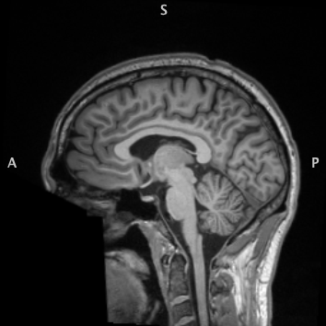
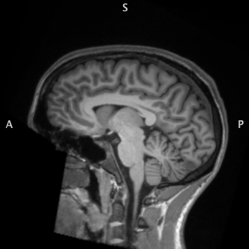
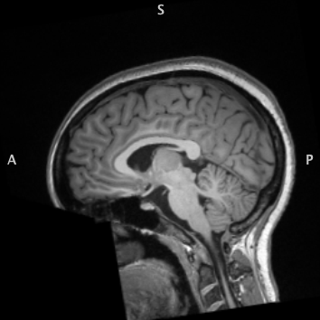
Can You Guess Which Brain Has Schizophrenia?
(Scroll Over This Image for Answers)

Slide 5
E

