Slide 1
Moving Gradients:
A Path-Based Method for Plausible Image Interpolation
Alex Yin, Sayuri Soejima, Simon Yang

Slide 2
Moving Gradients:
A Path-Based Method for Plausible Image Interpolation
Authors:
  Dhruv Mahajan (Columbia University)
  Fu-Chung Huang (UC Berkeley)
  Wojciech Matusik (Adobe Systems)
  Ravi Ramamoorthi (UC Berkeley)
  Peter Belhumeur (Columbia University)
Accepted to SIGGRAPH 2009
(and presented in early August 2009)

Slide 3
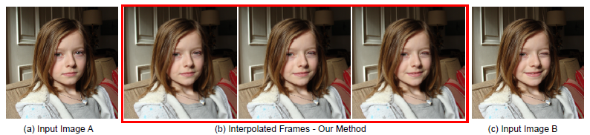
Results from the paper
(Automated interpolation method that will reduce blurring and ghosting)

Slide 4
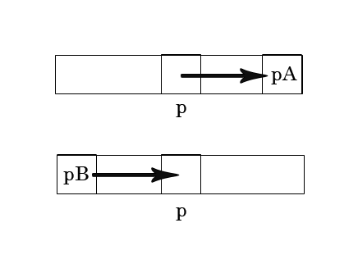
Defining a path
The path describes the relationship between 2 images: image A and image B
Image A
Image B

Slide 5
Path constraints
The vectors (p, pA) and (pB, p) must be parallel and in the same direction
  Ensures that the movements of pixels within a path are consistent
Goal is to find a path where pA and pB are similar in intensity
However, large images + arbitrary transition points = huge search space

Slide 6
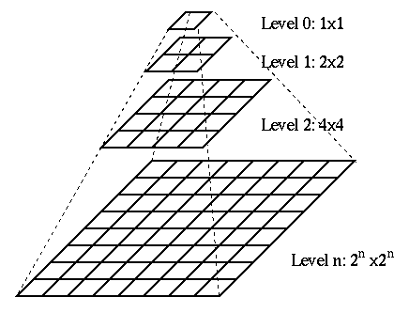
Solution: Gaussian pyramid
Takes the image and makes it smaller - repeat until we have a very small image
Use path from smaller layer to reduce number of possible choices for next layer

Slide 7
Next layer of the Gaussian pyramid
Once the paths have been selected, move to next layer
p1
p2
pA1
pA2
Image A
p3
p4
pA3
pA4
Pixel p
pA
pB1
pB2
p1
p2
Image B
pB3
pB4
p3
p4
pB

Slide 8
Interpolated pixel intensity
Compute length of final path
Multiply by interpolation value
Sample along the path from pixel p
Image A
Image B

Slide 9


Calculating correspondence
Compare gradients and intensities of transition points pA and pB
Normalize using the standard deviation between the transition points and their 4 neighbors
The more similar the transition points, the less energy the path requires

Slide 10
Coherency calculation
Deal with the following equation:
Compares the direction and length of two neighboring paths
  The more similar the path, the less energy is required

Slide 11

Energy minimization
The paper used graph cuts (similar to network flow problem solution)
We used a hill-climbing algorithm

Slide 12
Our implementation
Our implementation works with grayscale images of size n x n (where n is a power of 2)
Deviations from the paper:
  Hill-climbing approach vs. graph cuts
  Interpolate according to intensity vs. gradients
  Occlusion handling is not implemented

Slide 13
Problems Encountered
When the transition points fall outside of the image
Graph cuts connection/implementation (even after examining the 2 Graph Cuts papers)
The algorithm to process the paths runs very, very slowly
  Path validation function is constraining the initial random assignment of paths
Our energy function works, but we have path computation bugs

Slide 14
Resolved problems
Standard deviation use (inclusion of center pixel) in correspondence function
Hill-climbing approach instead of graph cuts

Slide 15

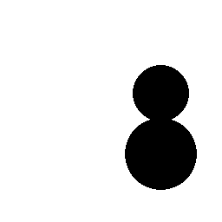
Our results
Sample test images

Slide 16
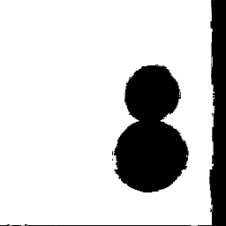
Our results, cont.
Sample interpolated image (at value 0.96)

Slide 17
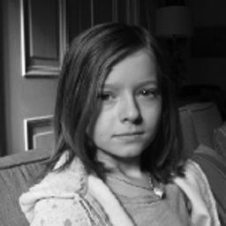
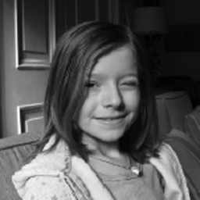
Our results, cont.
More complex input images

Slide 18
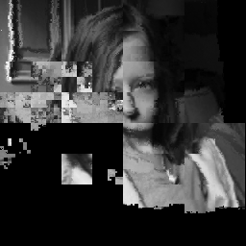
Our results, cont.
Sample interpolated image (at value 0.1)

Slide 19
Questions?

