Slide 1

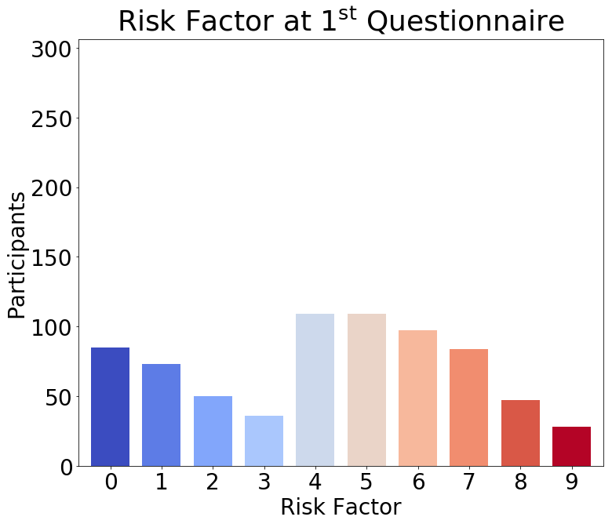
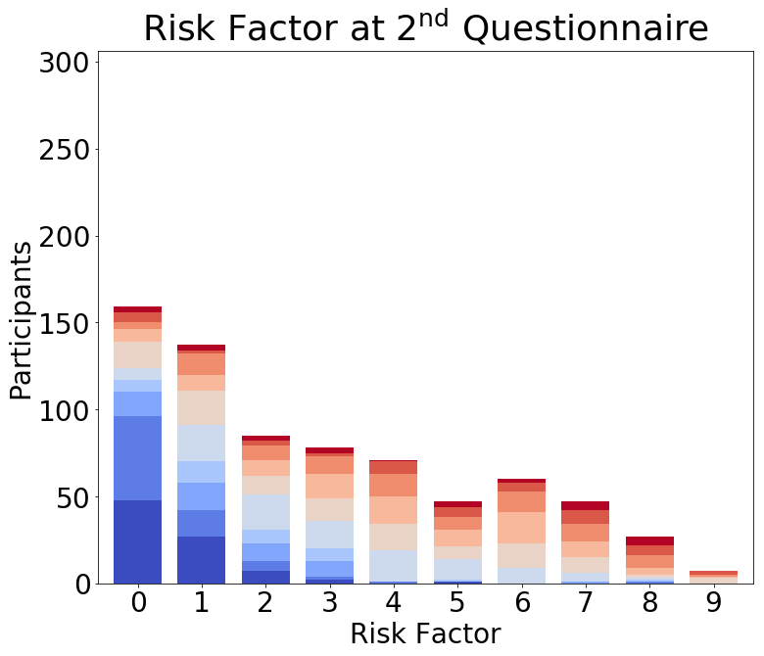
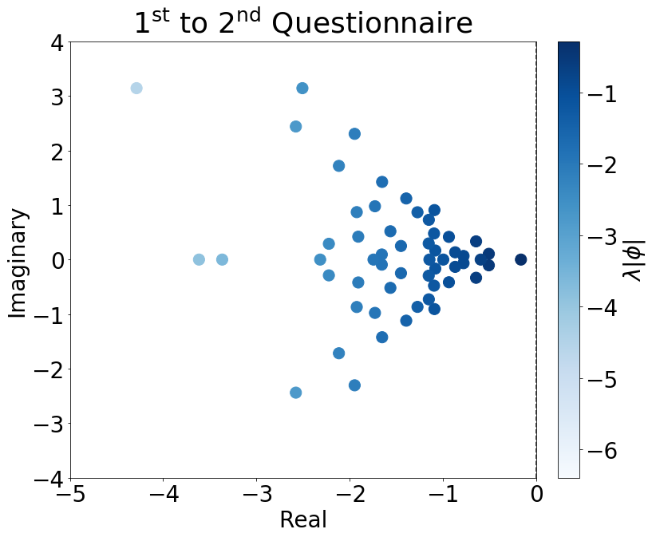
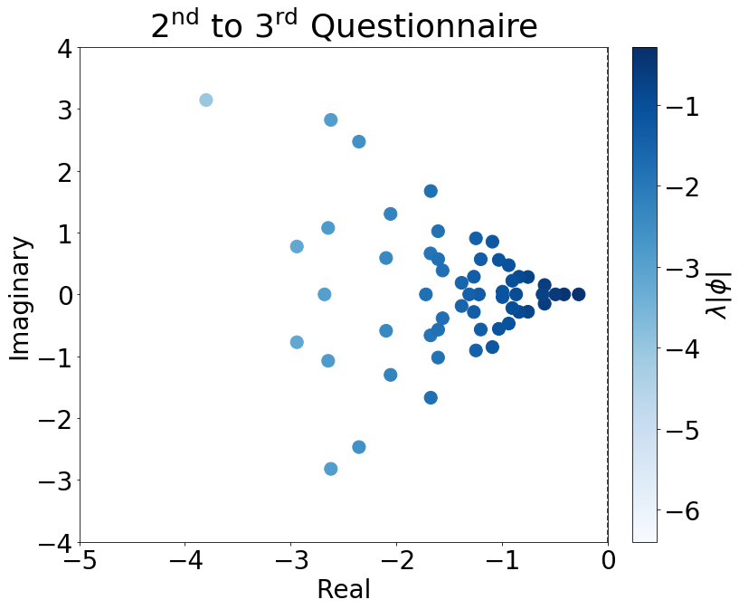
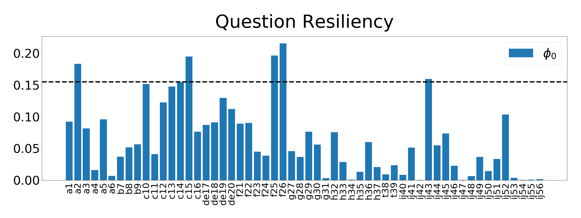
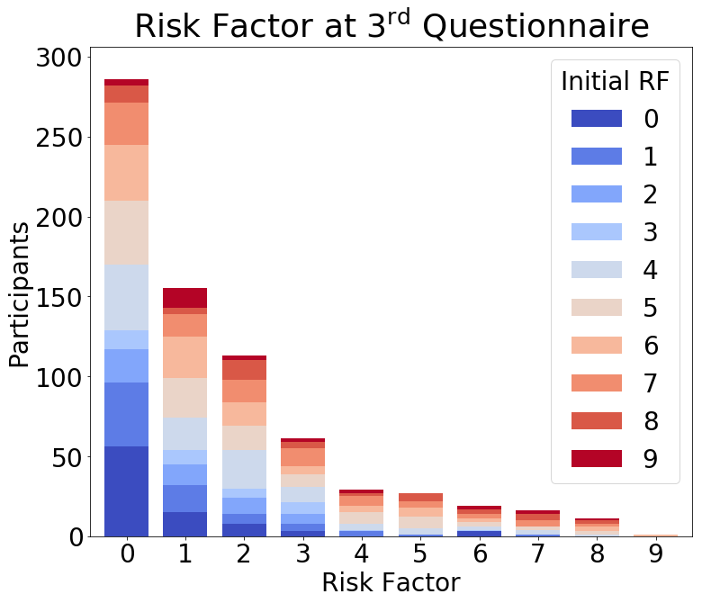
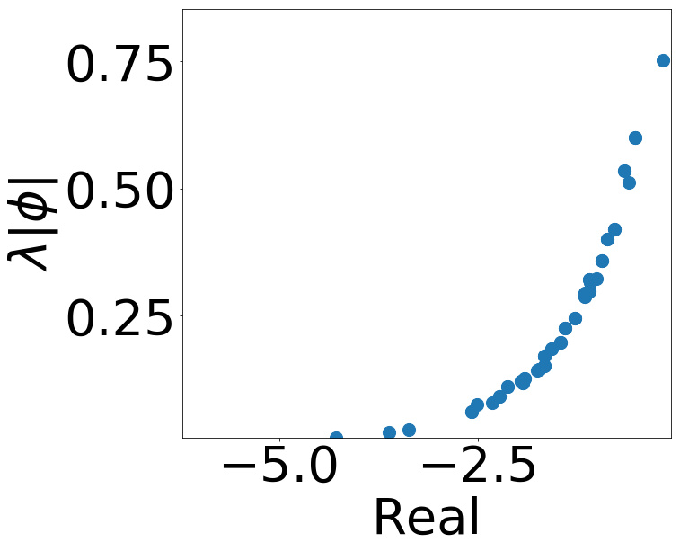
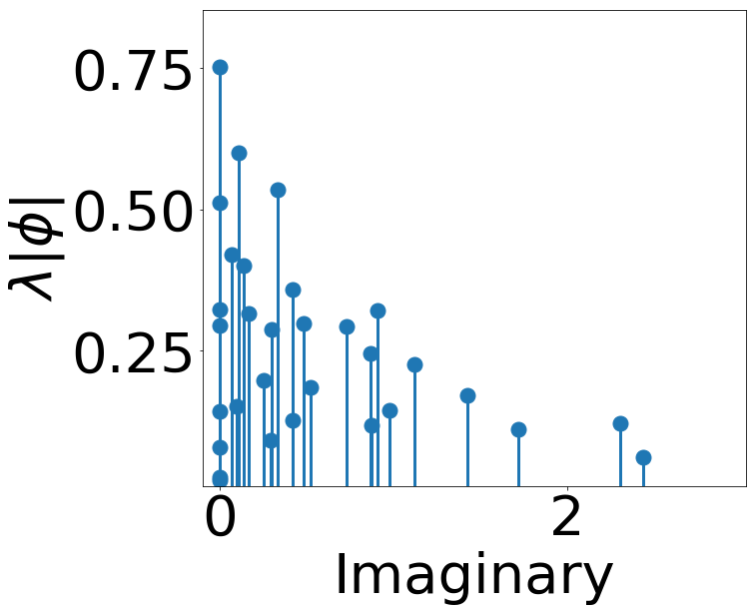
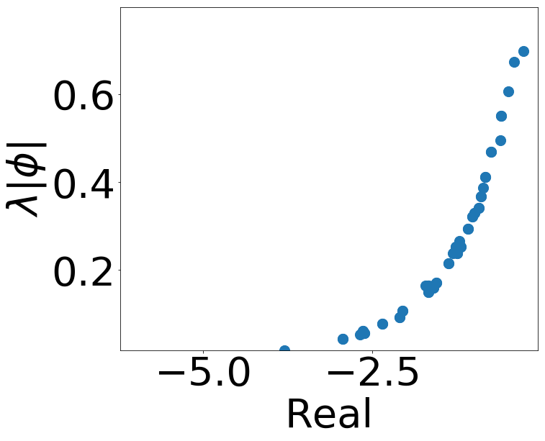
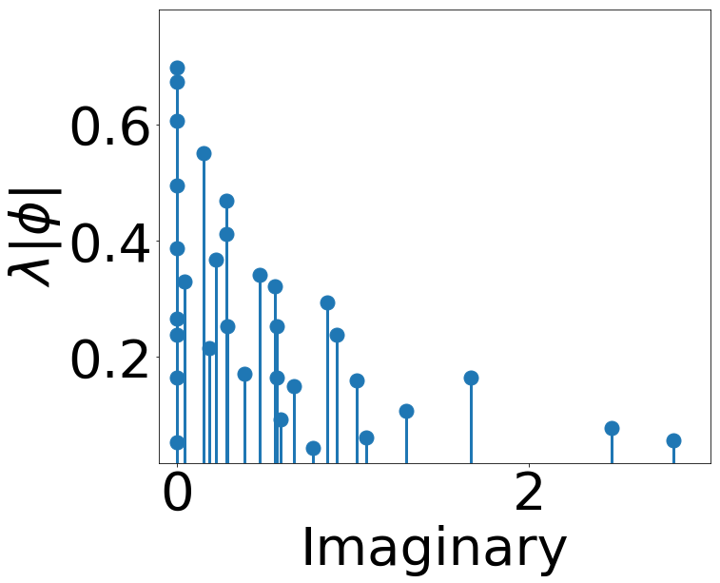
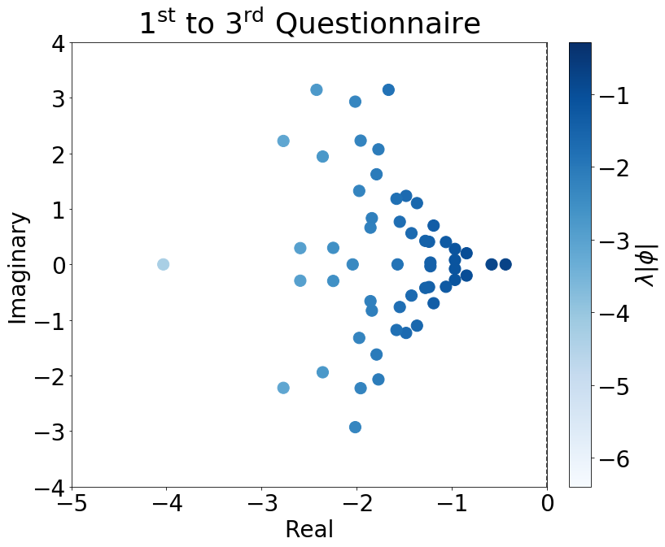
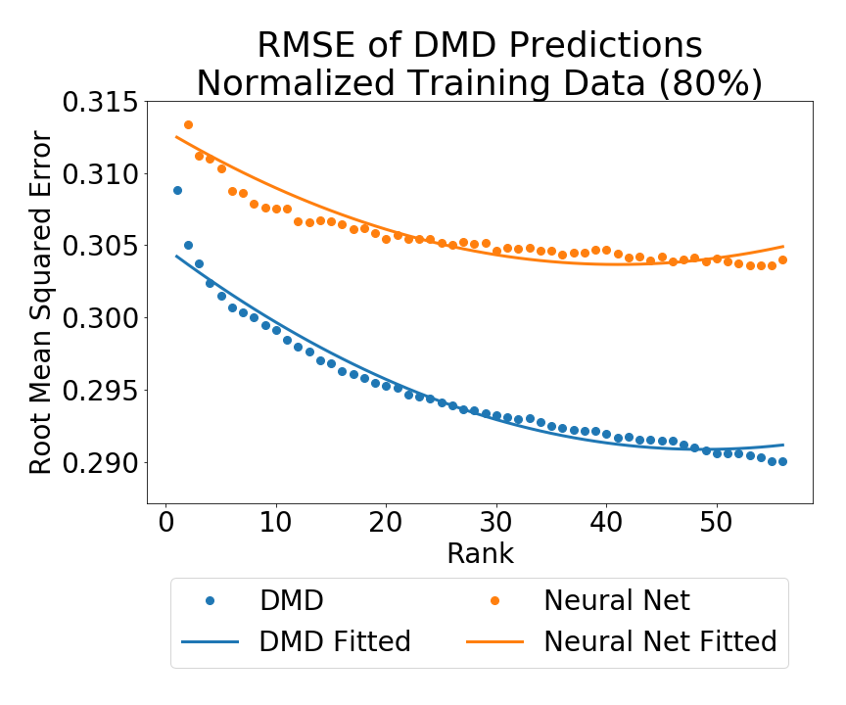
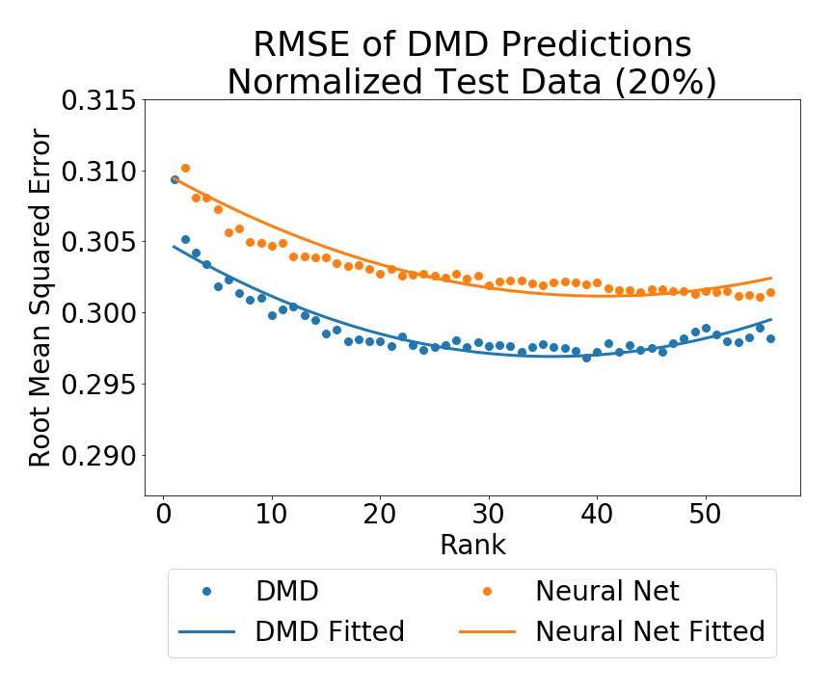
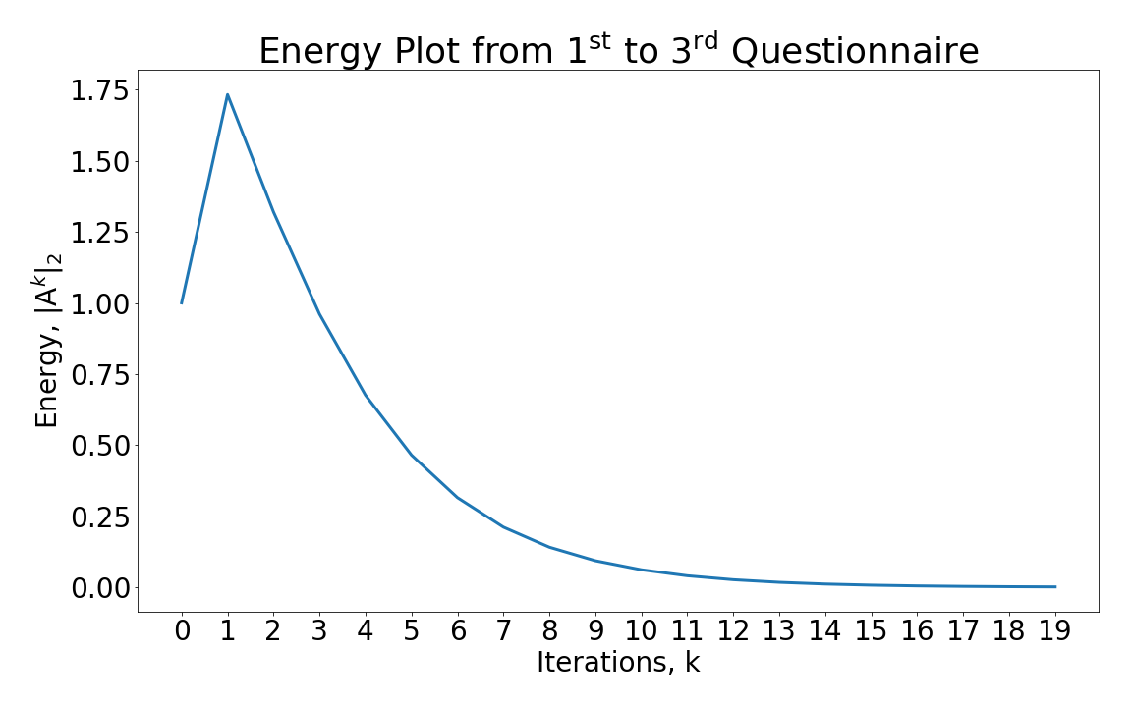
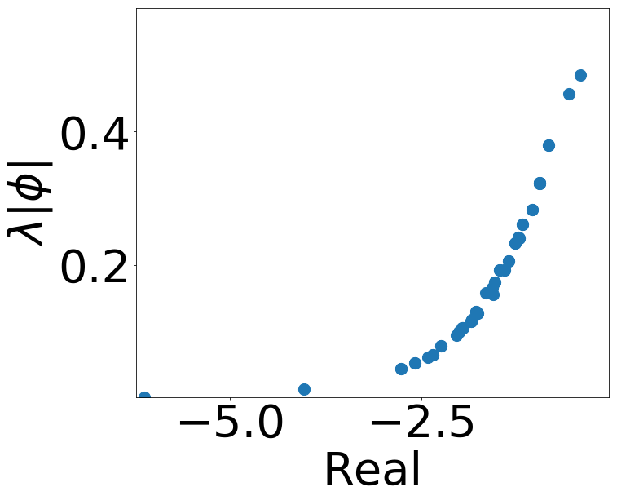
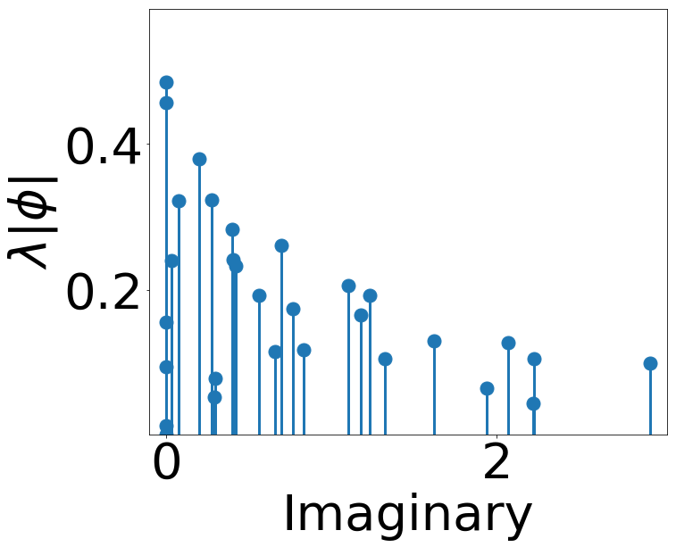










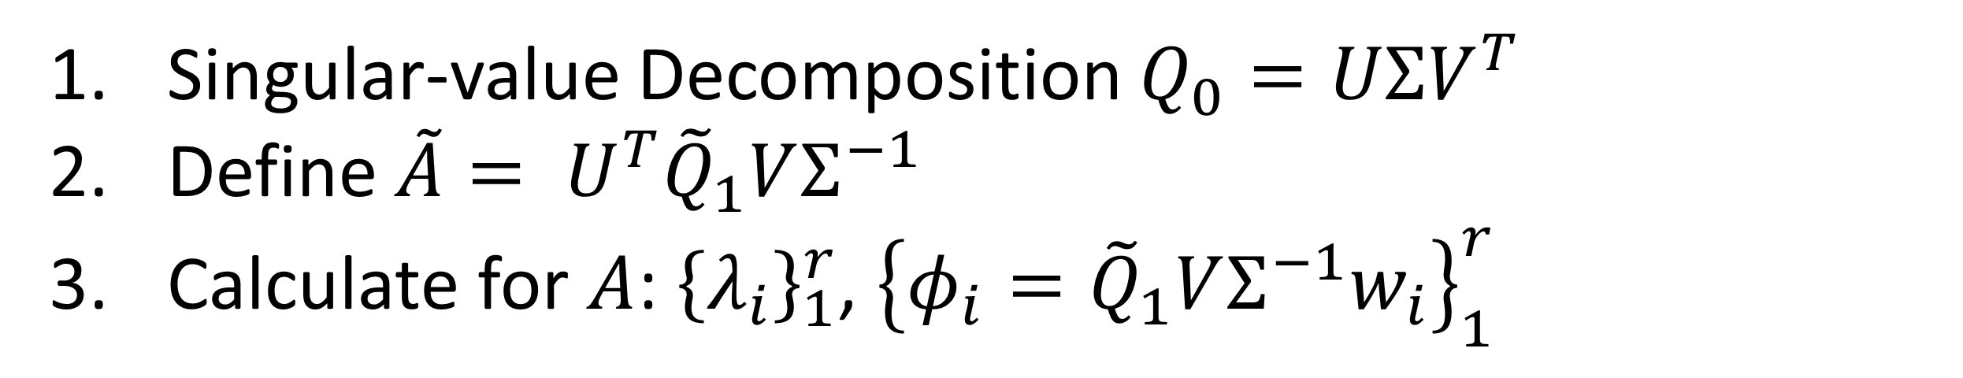
Analyzing Youth Program Effectiveness in
Gang Reduction Using Dynamic Mode Decomposition
AVIVA PRINS¹, Yifan Li¹, Jiazhong Mei², Qinyi Zeng¹, Omri Azencot¹, Michael Lindstrom¹, Andrea Bertozzi¹, Jeff Brantingham¹
¹University of California, Los Angeles; ²University of California, Berkeley
Introduction
Results
Results
a2: “I try to be nice to other people because I care about their feelings”
c15: “In the last year, did you start hanging our with a new or different group of friends?”
f25: “It is okay to beat people up if they hit me first”
ij43: “Have you skipped class without an excuse?”
Figure 2. Label in 28pt Calibri.
Method
participants
questions
$$Q_{0}$$
intake
$$A$$
$$Q_{1}$$
retake
$$m×n$$
$$m×n$$
$${\tilde{Q}}_{0}$$
$$\tilde{A}$$
$${\tilde{Q}}_{1}$$
$$r×n$$
$$r×n$$
Acknowledgements
Singular-value Decomposition $Q_{0}=UΣV^{T}$
Define $\tilde{A}= U^{T}{\tilde{Q}}_{1}VΣ^{−1}$
Calculate for $A$: ${\left\{λ_{i}\right\}}_{1}^{r}$, ${\left\{φ_{i}={\tilde{Q}}_{1}VΣ^{−1}w_{i}\right\}}_{1}^{r}$
Special thanks to Melanie Sonsteng. This work was funded by NSF grant DMS-1737770 and the City of Los Angeles, Gang Reduction Youth Development Analysis Program.

