Slide 1
C-NERGY
Multi-Agent System for Decentralized
Energy Market Simulation

Slide 2
System Overview
Fault
This project presents a decentralized multi-agent system for simulating and optimizing energy distribution and pricing in a dynamic market environment.
Key Agents:
Producers: Solar, Wind, Conventional
Consumers: Household, EVs (follow load profiles, bid adaptively)
Broker: Matches bids/asks via double-auction
Support Agents: Weather (simulate weather conditions), Fault (inject disruptions), GUI (providing the Dashboard with information)
Weather
Solar
Wind
Conventional
Dashboard
Broker
Consumer
Consumer
Consumer

Slide 3
Adaptive Agent Strategies
Producers:
Solar/Wind: Generation depends on weather conditions.
Pricing: Adjust margin using market feedback: Acceptance: Increase price. Rejection: Decrease price.
Battery Logic: Store extra energy, avoid producing excess energy
Broker:
Matching Engine: Price-time priority (highest bid vs lowest ask).
Price Broadcast: Update market clearing price after a trade.
Consumers:
Load Profile: Follow 24-hour demand patterns.
Pricing: Adjust margin using market feedback: Acceptance: Decrease price. Rejection: Increase price.
Backlog: Carry unmet demand forward

Slide 4
Real-World Dynamics
Weather Agent:
Simulates weather conditions by generating weather and time-of-day tokens that affect the production of renewable energy sources.
Fault Agent:
Simulates disruptions in producer agents (e.g., outages) by injecting fault messages into randomly selected victims and disables them for a specific duration.
Sun
“SUNNY” or “CLOUDY”
Weather
Wind
Fault
Random selection
Victim Agent
“WINDY” or “CALM”
“Duration” = x ticks
Time
“DAY” or “NIGHT”

Slide 5
Producer Agents
Solar Agent
Wind Agent
Conventional Agent
Adjusts energy production based on sun and time tokens.
Adjusts energy production based on wind tokens.
Acts as a backup power with infinite supply.
Submits expensive sell orders at a fixed price (based on fossil fuels cost).
Supports the market during in insufficient supply conditions and prevents market collapse during shortages.
Fault recovery.
“SUNNY”
“CLOUDY”
“NIGHT”
“WINDY”
“CALM”
100%
40%
0%
100%
20%
Manages battery storage to avoid waste.
Submits adaptive sell orders with dynamic pricing.
Fault recovery.
Manages battery storage to avoid waste.
Submits adaptive sell orders with dynamic pricing.
Fault recovery.

Slide 6
Consumer Agents
Consumer agents adapt their behavior through customizable load profiles, representing different consumer types like households and electric vehicles (EVs) as implemented in this project.
Household Load Profile:
Peak demand during daytime hours for appliances, lighting, and HVAC.
Sustained low demand during nighttime hours for heating, security systems, and idle devices.
EVs Load Profile:
Zero demand during daytime hours since EVs are unplugged and on the road.
High demand during nighttime hours since EVs are plugged-in and require high-power chargers.
Household Agent
EV Agent

Slide 7
Broker Agent
Priority queues:
Bids (buyers): Highest price first.
Asks (sellers): Lowest price first.
Post-trade:
Notify trade participants.
Broadcast clearing price to all agents.
Matching:
Pair highest bid with lowest ask.
Clearing price: Seller’s ask price.
Buy 0.08€
Buy 0.07€
Buy 0.07€
Broker Agent
Buy 0.06€
Clearing Price
0.04€
Sell 0.04€
Sell 0.06€
Sell 0.06€
Sell 0.05€

Slide 8
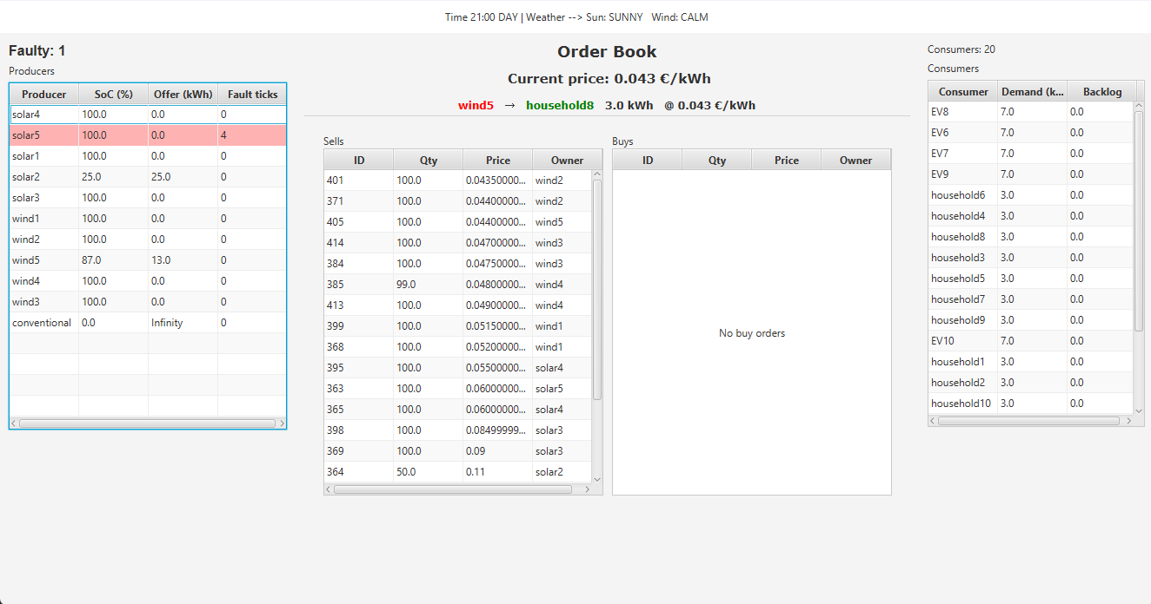
Dashboard
Fault
Successful Trade
Clearing Price
Weather
Consumers
Producers
Order Book

Slide 9
Future Improvements
Trader Agent: ML/rule-based intermediary which flips energy for profit.
Battery Degradation: Battery capacity loss over charge/discharge cycles.
Transmission Losses: Simulate energy loss over grid distance.
Equipment Wear: Maintenance costs and efficiency decay.
Dynamic Fuel Pricing: Update conventional energy costs via real-time fuel market APIs.
Larger Load Profiles: Enable weekly/monthly/yearly consumer demand profiles.
Reinforcement Learning Pricing: Train agents to optimize bids via reward systems.
ML Forecasting: Predict demand/price trends using time-series models.

Slide 10
Thank you
Athanasios Boulionis - 2025

