Slide 1



Every Beginning Matters:
Fetal Mortality in St. Louis County, 2019-2023
Presented to Community Action Team (CAT) Meeting
Michael Royce Tan
December 9, 2025

Slide 2



Why This Matters
The health of our mothers and babies is a mirror reflecting the health of our entire community. Fetal mortality is more than a statistic; it's a measure of our collective well-being and a call care for every family.
A sensitive topic we will
approach with care.
A shared challenge that
requires a shared response
A story told through data,
leading to action
Notes:
It is a profound loss for families and a critical indicator of maternal and child health in our community.

Slide 3



Our Approach
Case Definition
A fetal death is the loss of a pregnancy at 20 weeks of gestation or more.
Data Source
St. Louis County birth and fetal death records from 2019 to 2023
What is a 95% Confidence Interval?
A measure of reliability. The shaded areas on our graphs show the range where we are 95% sure the true rate lies. Wider ranges mean less certainty, usually because of smaller numbers of events.
Notes:
Fetal death is the loss of a baby before or during delivery after 20 weeks of pregnancy

Slide 4
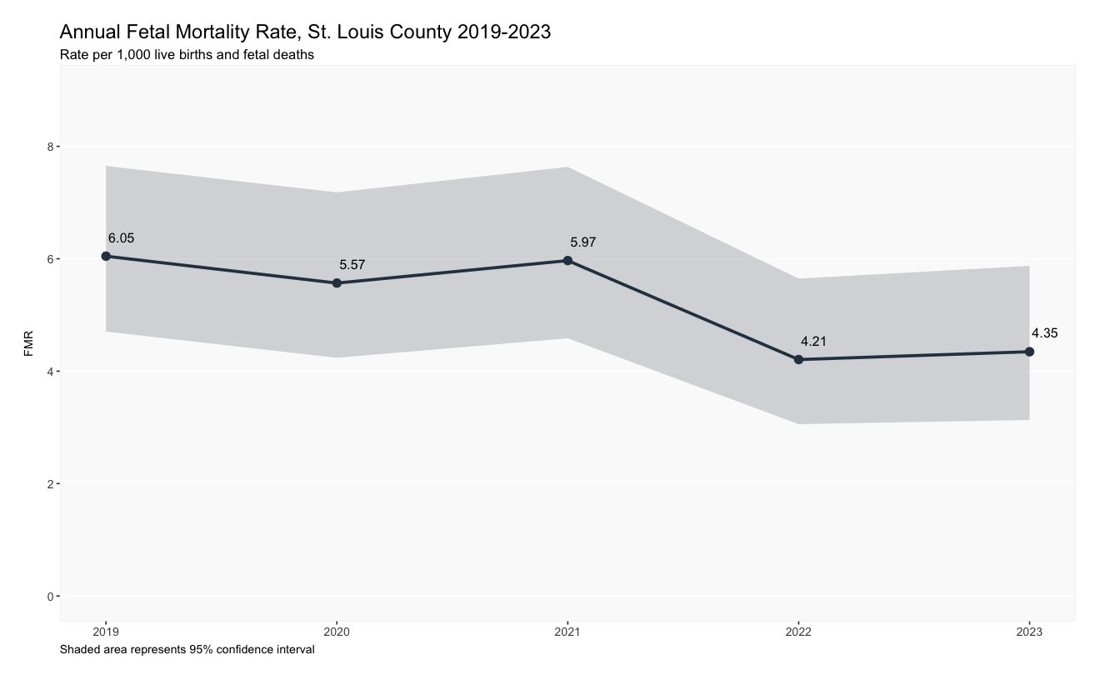
The Big Picture: Overall Fetal Death is Trending Downward
6.05
The rate has decreased
from 6.05 per 1,000 in 2019
to 4.35 in 2023.
4.35

Slide 5
But... does this overall trend tell the whole story?

Slide 6
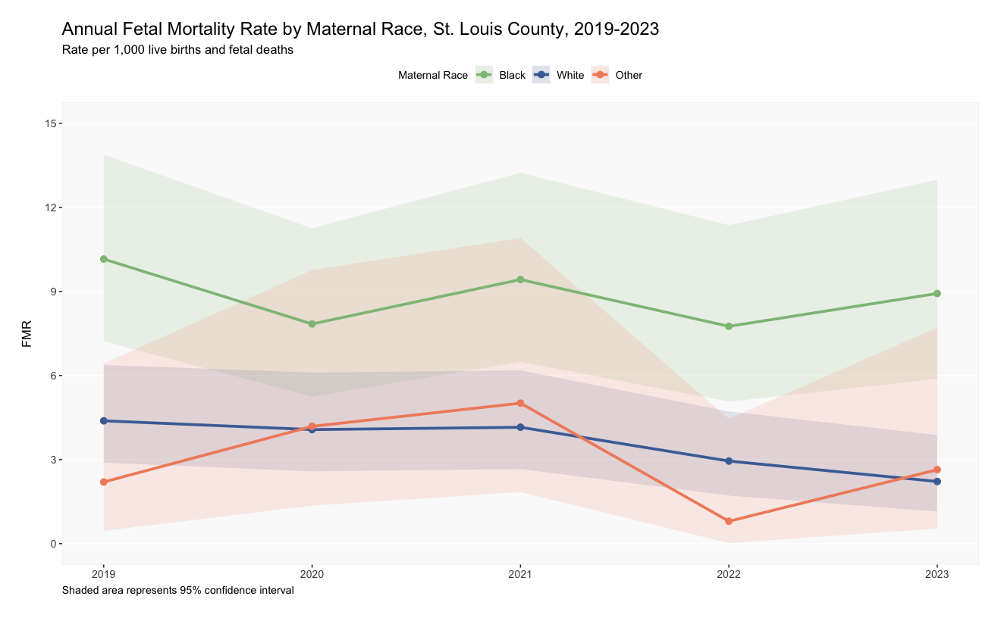
A tale of Two Realities: A Deep and Persistent Racial Gap
The fetal mortality rate for Black mothers has consistently remained more than double the rate for White mothers
Black
White
Other

Slide 7
Black Mothers Face 2.5 Times
the Risk of Fetal Loss
8.84 per 1,000
2.5x
3.58 per 1,000

Slide 8
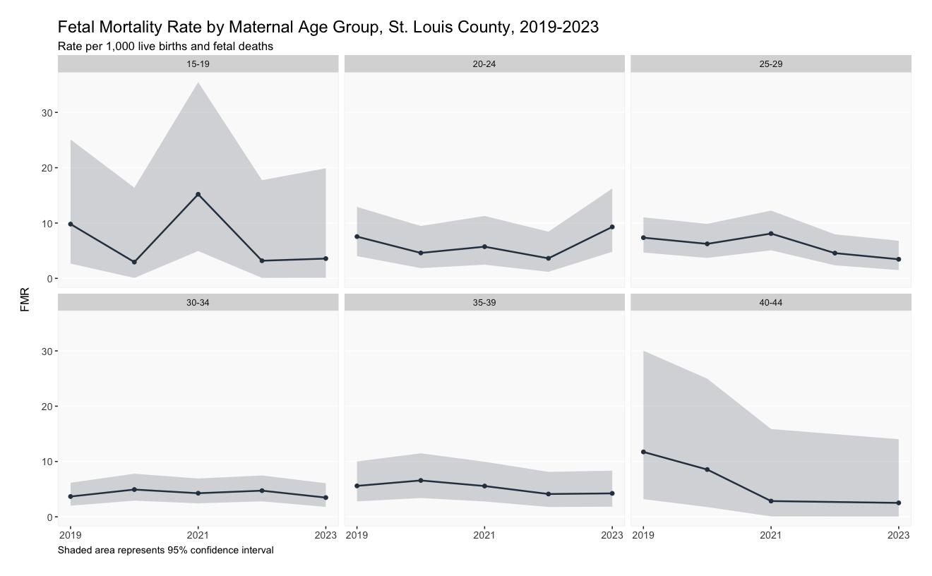
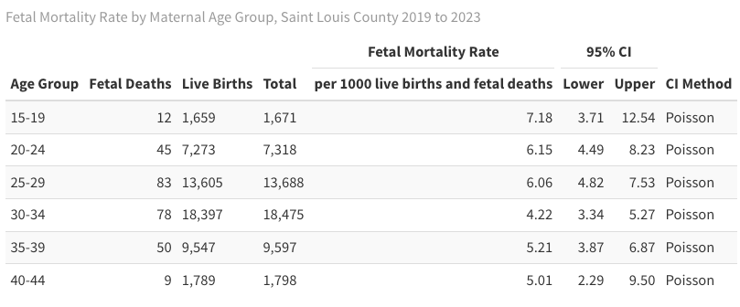
Risk is Highest among the Youngest
We see elevated rates among the youngest (7.18 per 1,000 for ages 15-19)

Slide 9
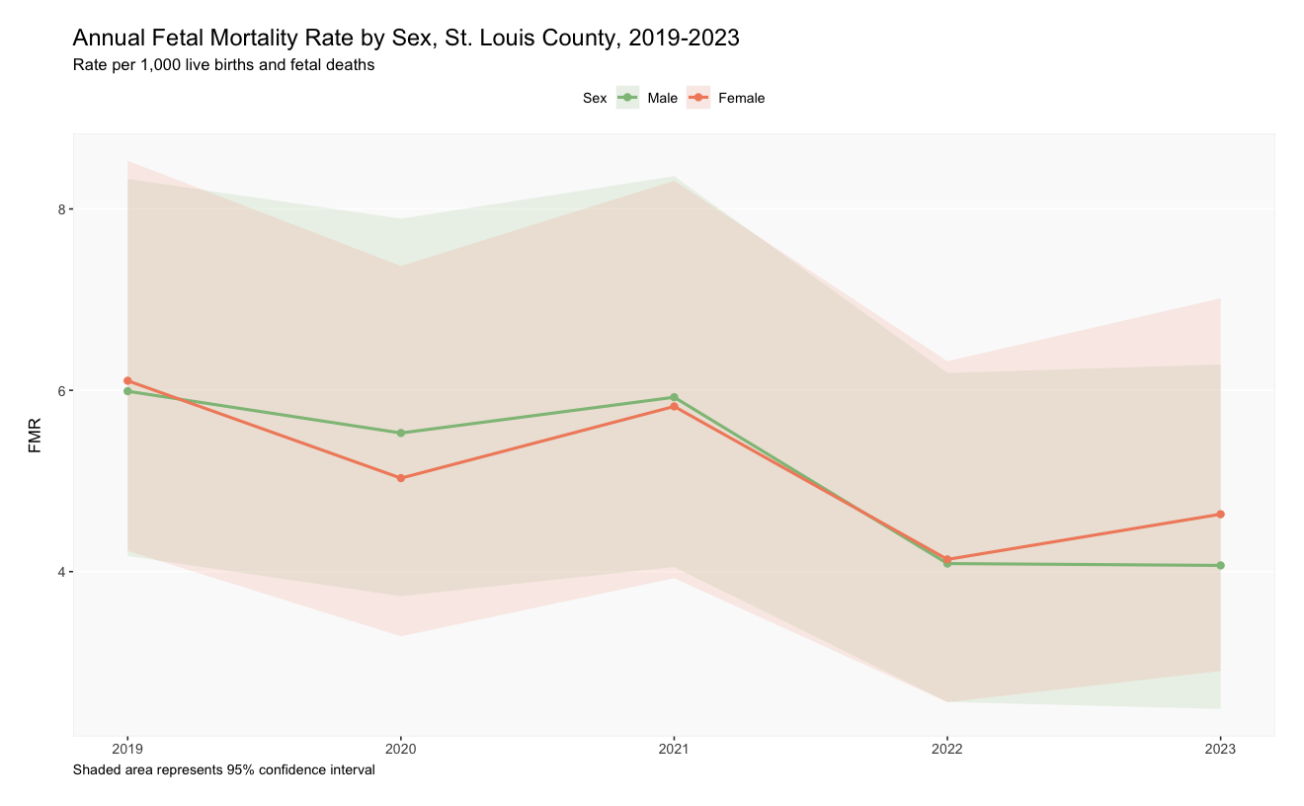
Shows No Significant Difference by Fetal Sex
The rates for male (5.15 per 1,000) and female (5.17 per 1,000) are nearly identical and track closely over time.

Slide 10



From Data to Meaning: The Story of Inequity
1. Averages Hide Disparities
Our overall progress is positive, but it masks a critical and
ongoing crisis for Black families in our community.
2. This is a Systemic Issue
A gap this large and persistent is not about individual choices. It points to systemic factors like healthcare access, quality of care, and structural inequities.
3. This is a Call to Action
This data is not just information; it is a mandate to act.

Slide 11



How Can We Write a Different Story?
Listen & Learn: How do we center the voices and lived experiences to understand the "why" behind the numbers? to understand their lived experiences and co-design meaningful solutions
Strengthen Support: What community-based programs can we expand to provide culturally competent care? To improve the quality and availability of culturally competent care.
Demand Equity: How can we work with healthcare systems ensure equitable, respectful care for every mother? Champion policies that address social determinants of health, such as stable housing, food security, and economic opportunity
Notes:
We must act collaboratively to address the root causes of these disparities

Slide 12

What We Need for a Clearer Picture
More Granular Data: Analysis by zip code or neighborhood to identify hotspots of disparities
Linkage to Social Determinants: Connecting outcomes to data on housing, income, and education.
Qualitative Insights: A formal process for gathering patient experience stories to complement the numbers.

Slide 13
Every pregnancy
should have a
healthy outcome.
Discussion & Questions
Thank You

Slide 14
Reference
1. Centers for Disease Control and Prevention. (2023). User guide to the 2023 fetal death public use file. https://ftp.cdc.gov/pub/Health_Statistics/NCHS/Dataset_Documentation/DVS/fetaldeath/2023fetaluserguide.pdf
2. MacDorman, M. F., & Gregory, E. C. W. (2015, July 23). Fetal and perinatal mortality: United States, 2013 (National Center for Health Statistics. Vital and Health Statistics, 64[8], 1–24). https://stacks.cdc.gov/view/cdc/231851

Slide 15
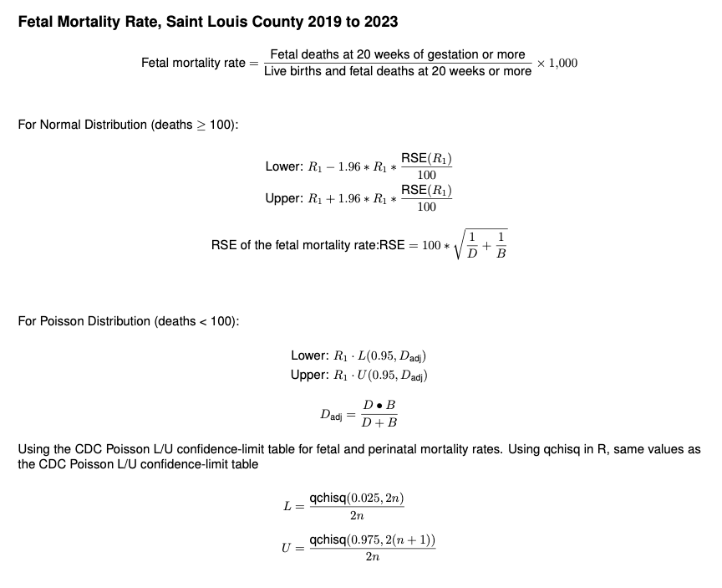

Slide 16
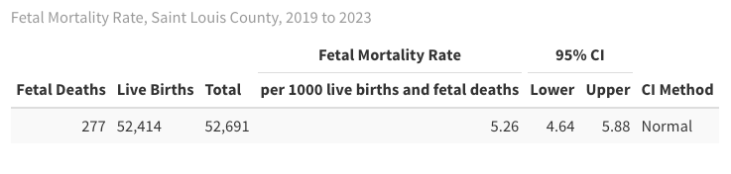
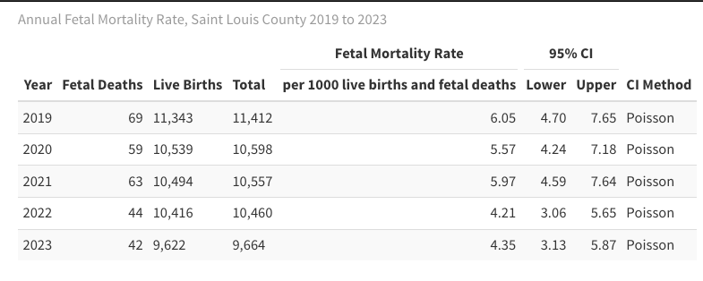

Slide 17
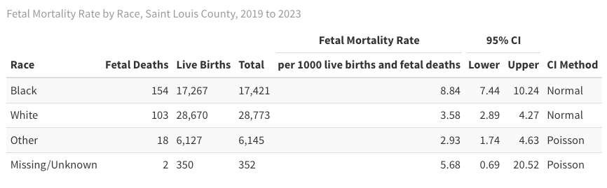

Slide 18
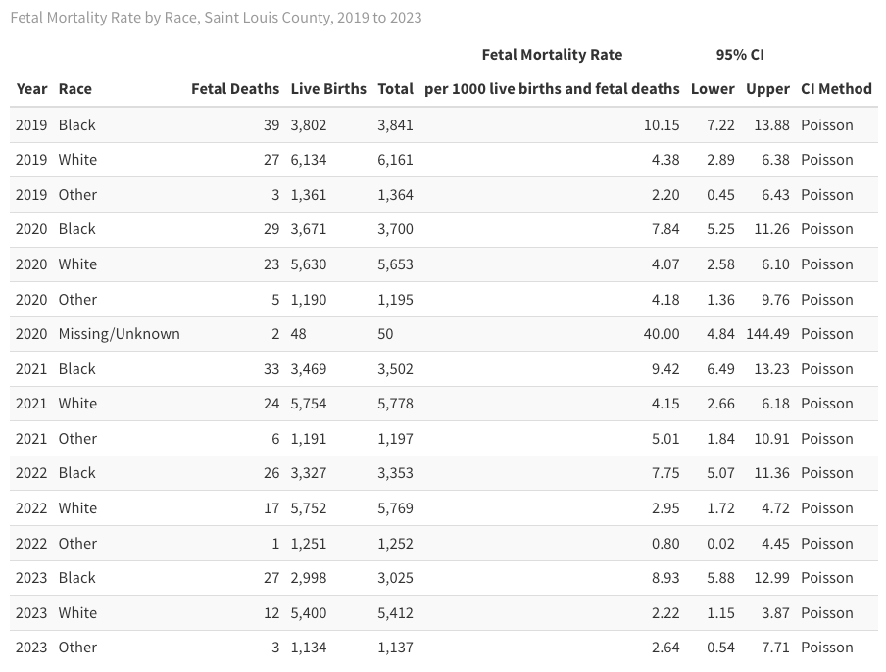

Slide 19
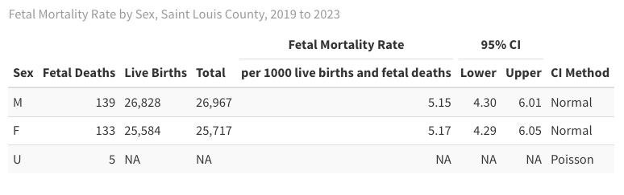

Slide 20
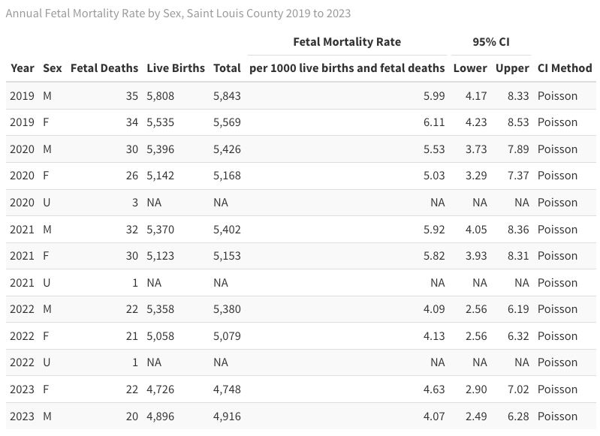

Slide 21
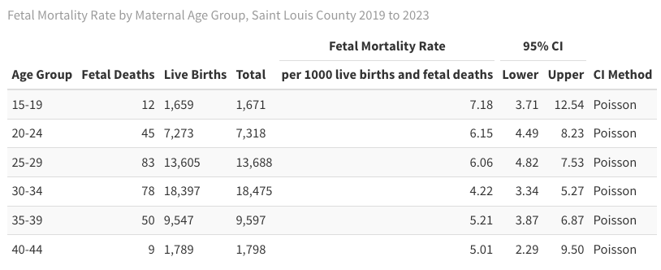

Slide 22
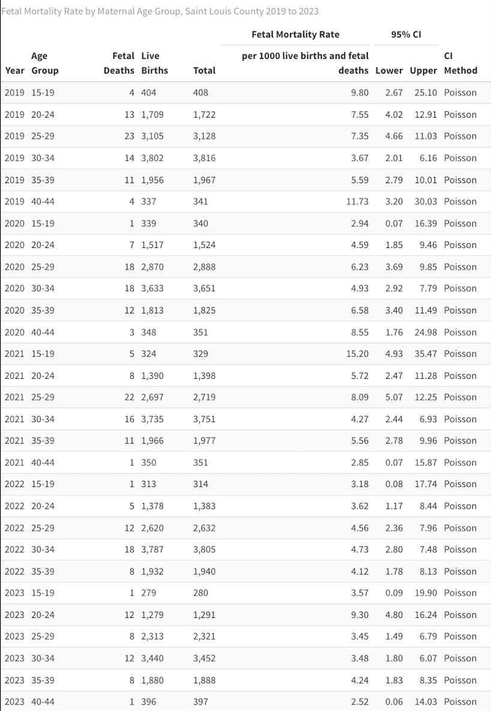

Slide 23

Every Beginning Matters:
Fetal Mortality in St. Louis County, 2019-2023
Presented to Community Action Team (CAT) Meeting
Michael Royce Tan
December 9, 2025

