Slide 1
Predictive Analytics
T.Sasi Kumar

Slide 2
Table of Contents
Predictive Analysis
Linear Regression
Logistic Regression
Problem Statement
Practice
Uses

Slide 3
What is Predictive Analysis
Advanced branch of analytics which connects data to make reliable conclusion.
It is used to make predictions about unknown future events using current conditions.
It exploits pattern found in historical data to identify possible risk and opportunities.
It captures relationship among different entities in the data to make an effective assesment.

Slide 4
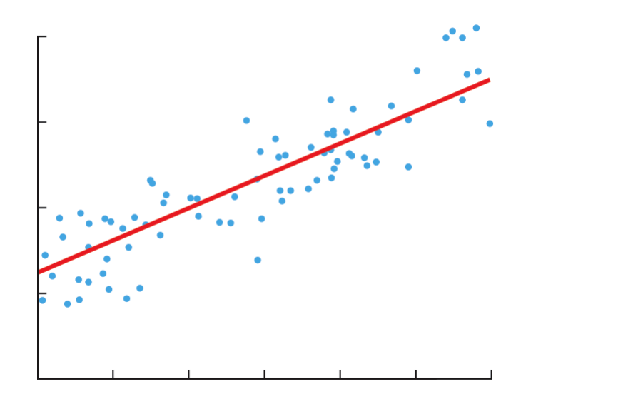
Linear Regression
`
Y = mx + c

Slide 5

Logistic Regression
It is the preferred regression analysis used when the target is binary.
It explains the relationship between one dependent binary variable and one or more independent variables.
The logit function transforms the number number of occurrences to a probability.

Slide 6
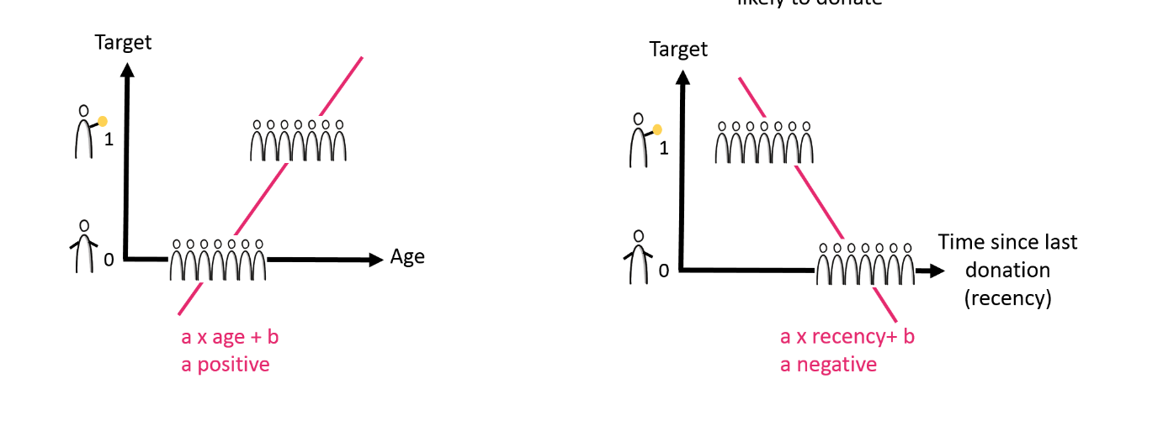

Slide 7
Problem Statement
Population
Target
Candidate Predictors
Current year
Previous year

Slide 8
Terminologies
Sklearn
Machine learning library for python
Features various classification, regression and clustering algorithms
Pandas
High level data manipulation tool
Built on top of Numpy package, its key data structure is DataFrame
Matplotlib
Plotting library for Python
It provides an object oriented API for embedding plots into application.

