Slide 1
Task-based Search
Thomas Schoegje
Hier komt ook tekst
Notes:
Want to share the what we did at Utrecht during my PhD
So I am going to talk about task-based search, but I am also going to talk about

Slide 2
How Utrecht develops
tech around user needs
Hier komt ook tekst

Slide 3
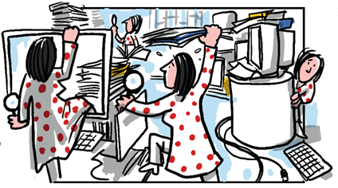
Information overload
Notes:
The problem we were facing is that we have so much information that our staff has to embark on an information journey to find what they need
So when we want a better search solution, we could just look at the existing systems and their technical specifications, but there’s a problem here.

Slide 4
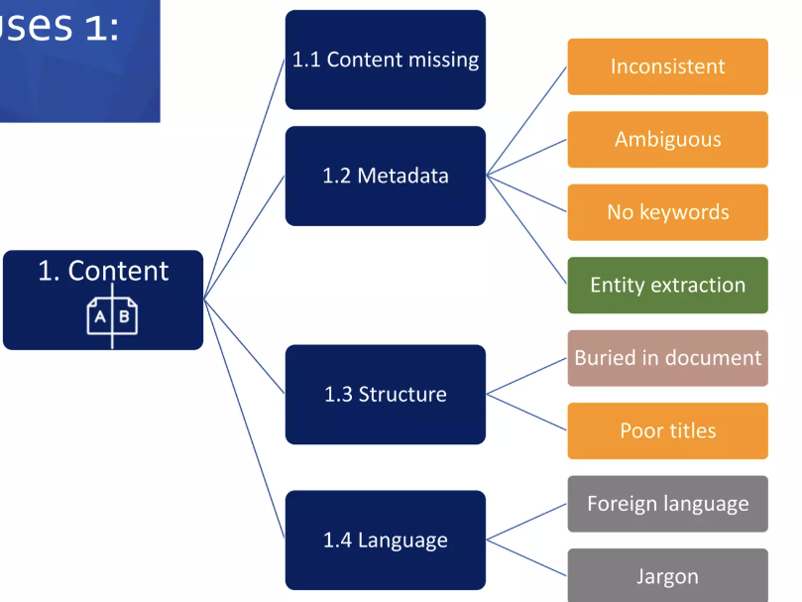
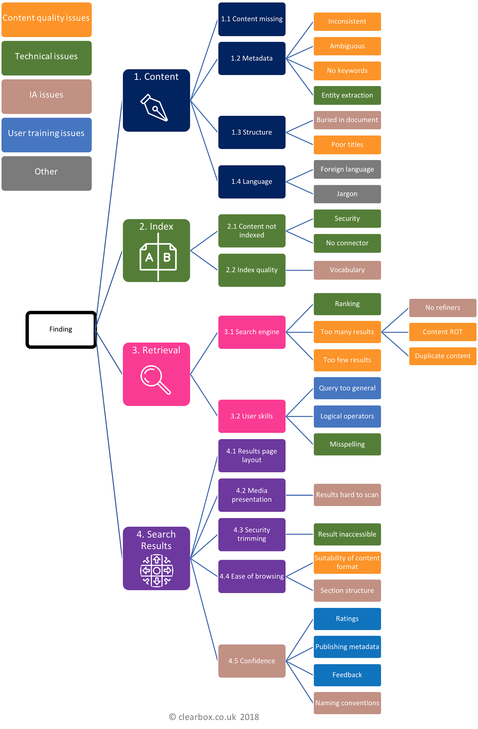
Reasons search fails
Notes:
There are many potential causes why a search system is not doing well.

Slide 5
Reasons search fails
Notes:
A lot
If we just get a new system without understanding the underlying problems, we risk getting a system that we’ll have to replace in a few years

Slide 6
Search tasks
Notes:
So to make sure we develop systems that will stay useful, we design our system around the needs of our users
Which information is useful depends on your goal, so first we figure out what are users are searching for
This way we can ensure we retrieve useful information, and show it in a meaningful context

Slide 7
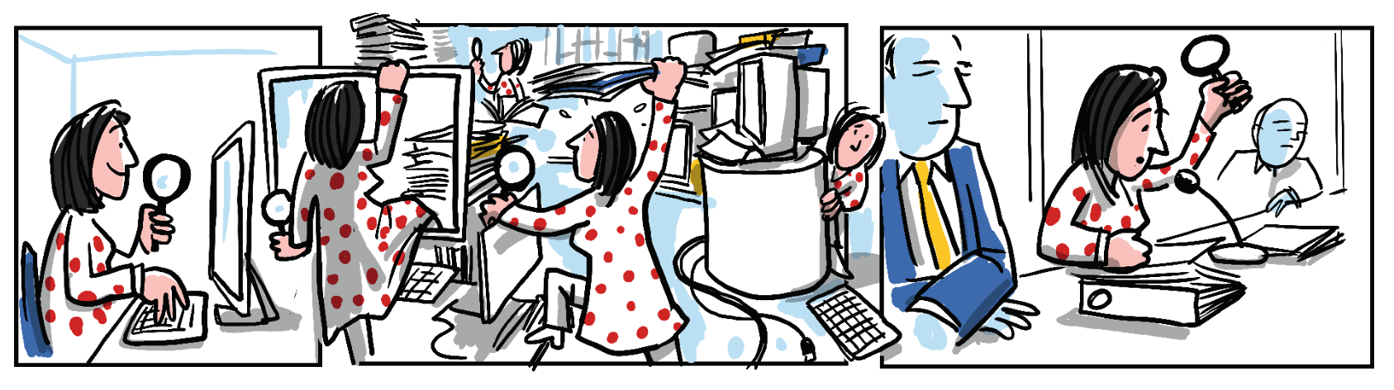
Work tasks
Notes:
And why they are searching for it
So in the case of city council members, their work revolves around the city council meetings, where they try to achieve a number of goals

Slide 8
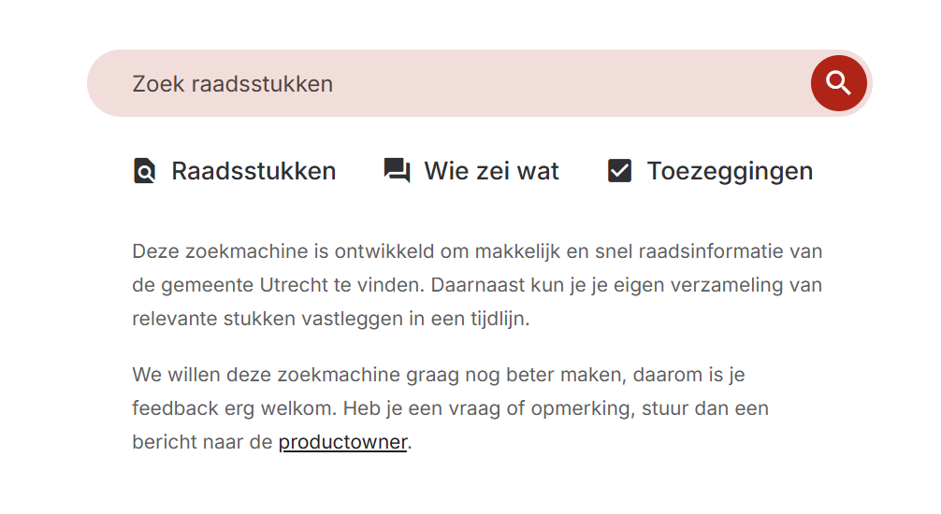

City council information
www.ureka.utrecht.nl
www.ureka.utrecht.nl
Notes:
When we developed a search engine for council information, we made sure it reflects these different goals.
From this first screen you already see an option to search for
Factual information, political opinions, and official commitments

Slide 9
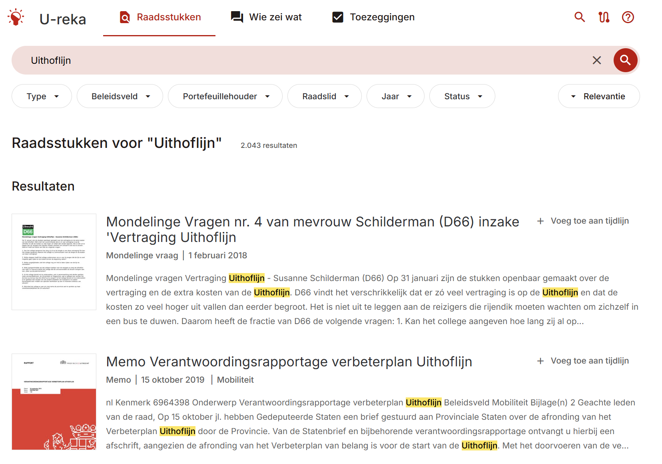
City council information
Notes:
Each of these pages is tailored to the task it supports. E.g. this one finds council documents, which can be used as evidence

Slide 10
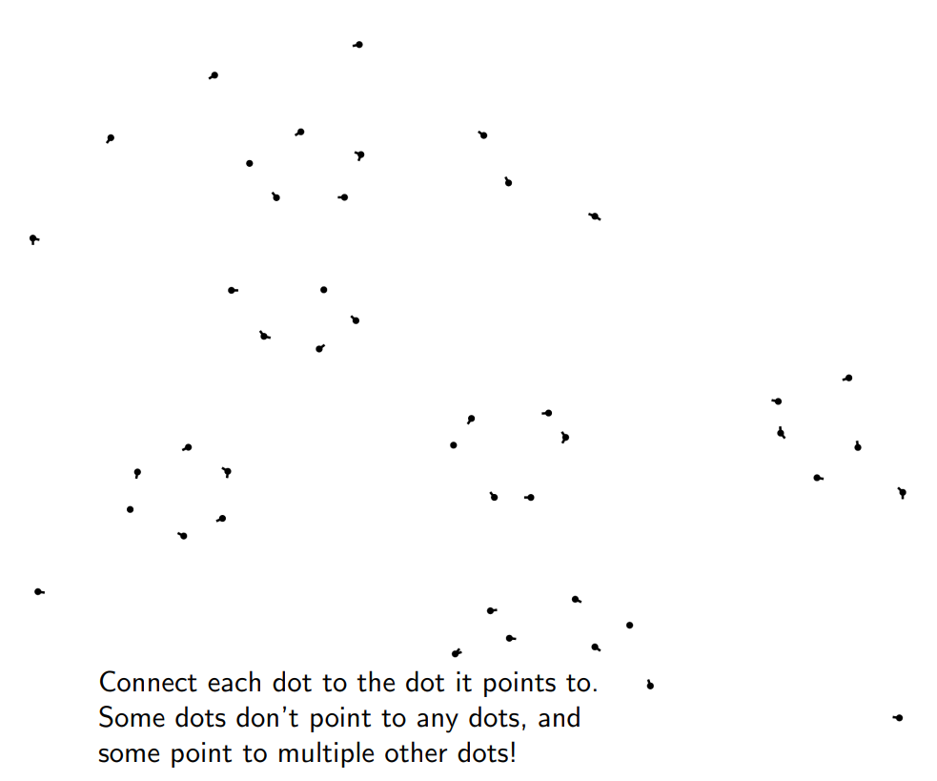
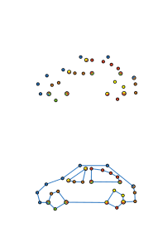

City council information
Notes:
This approach helped us identify a key problem in their search:
sometimes council members don’t need fragments of information

Slide 11
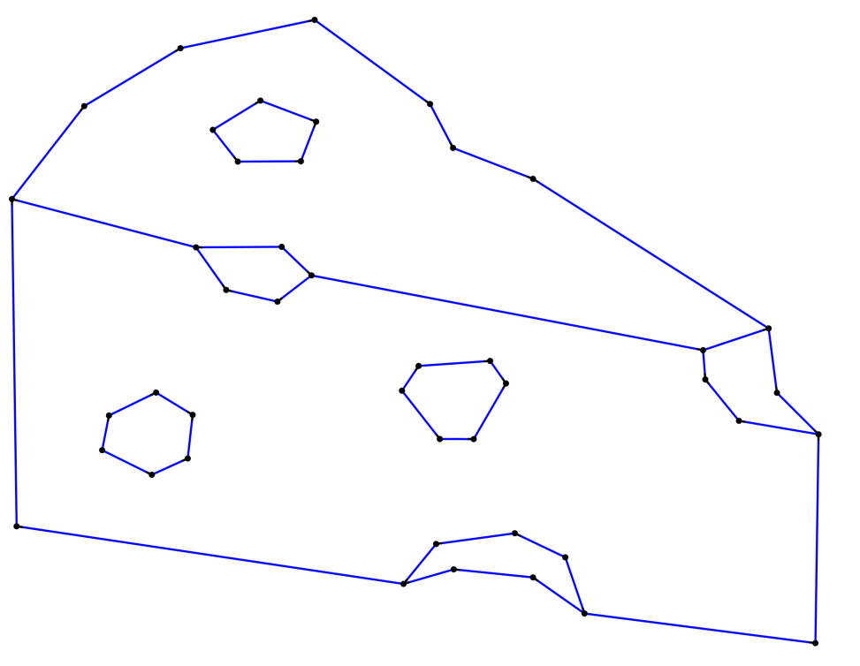
City council information
Notes:
But the big picture

Slide 12
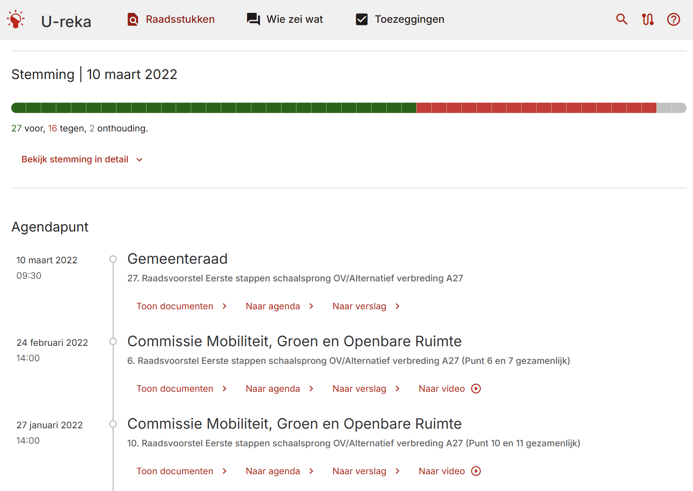
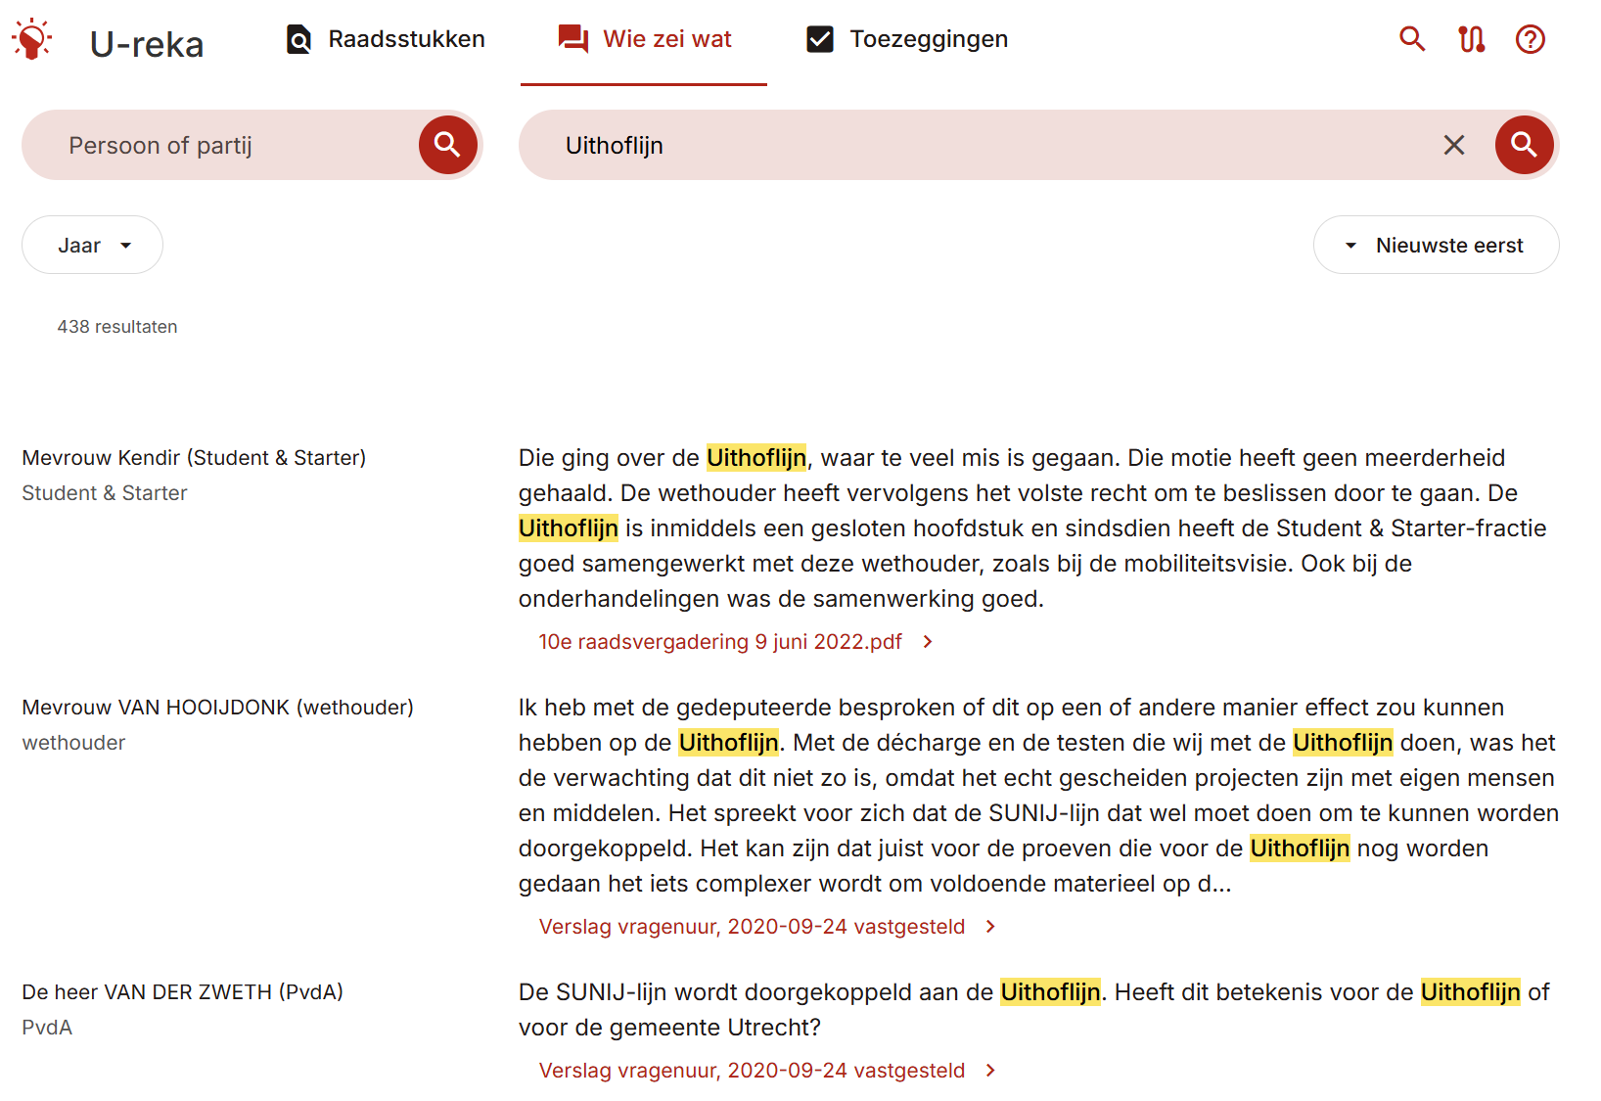
City council information
Notes:
That’s why we created timelines of council information. When users click certain search results, they get to see that council document in its political context

Slide 13
Approach
Identify tasks Semi structured interviews [3]
Compare tasks to existing functionality Don’t need to replace Google or tailor to every task
Develop solution Iterative with user feedback
Notes:
We applied this general approach multiple times
We’ll give some examples of search engines, but the same principles go for AI projects

Slide 14
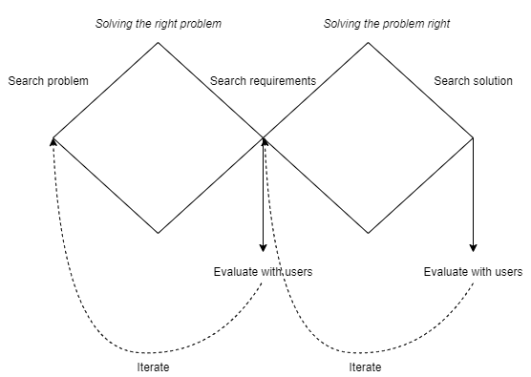
Approach
Notes:
From another perspective, we are first focusing on finding the right problem, and then on solving the problem right

Slide 15
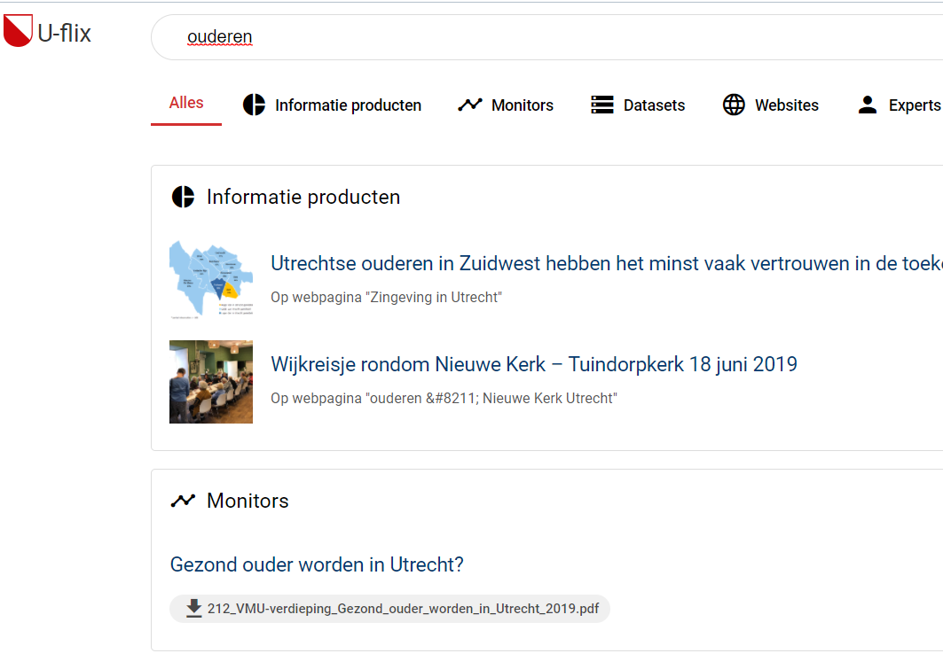
Policy worker search
Notes:
We also used this approach to develop a search engine for policy workers. The original ambition was to create a general purpose search engine.
Based on our interviews, we found that we were solving a problem that our users didnt experience. This allowed us to pivot the project into something that our users did need

Slide 16
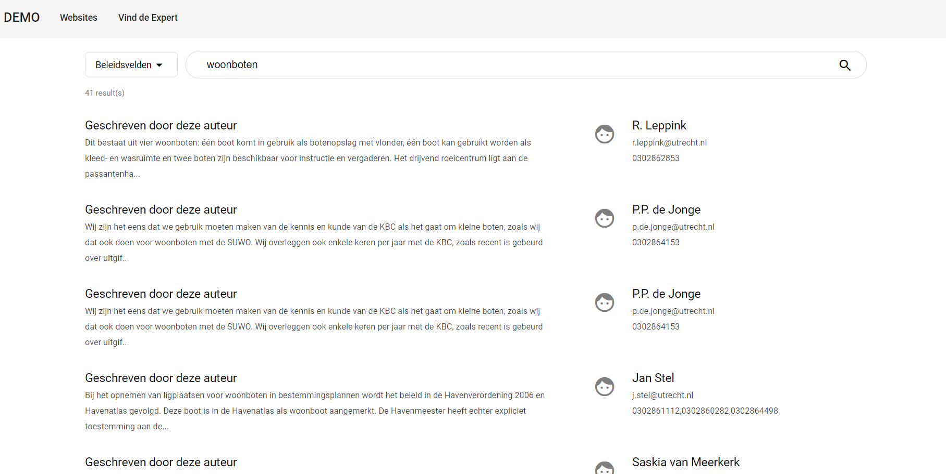
Expert Search
Notes:
In short, when search tasks became difficult, they usually solved it by looking for a colleague with expertise
This expertise has a bunch of advantages over just finding a document
So we created a prototype system where you can look for the right colleague, based on the documents they have written in the past

Slide 17
Conclusion
Technology is useful when it helps its users achieve their goals
Understand our users and their goals helps develop useful technology
t.schoegje@utrecht.nl
Notes:
That’s why we created timelines of council information. When users click certain search results, they get to see that council document in its political context

Slide 18
References
[1] Findwise. Enterprise Search and Findability Survey 2015. 2015. url: https:// findwise.com/en/enterprise-search-and-findability-survey-2015
[2] Clearbox. Diagnosing Enterprise Search. 2018. url: https://www.clearbox.co.uk/diagnosing-enterprise-search/
[3] Thomas Schoegje. Task-based search for municipal knowledge workers. 2024. url: https://ir.cwi.nl/pub/34568/34568D.pdf
Notes:
That’s why we created timelines of council information. When users click certain search results, they get to see that council document in its political context

Slide 19
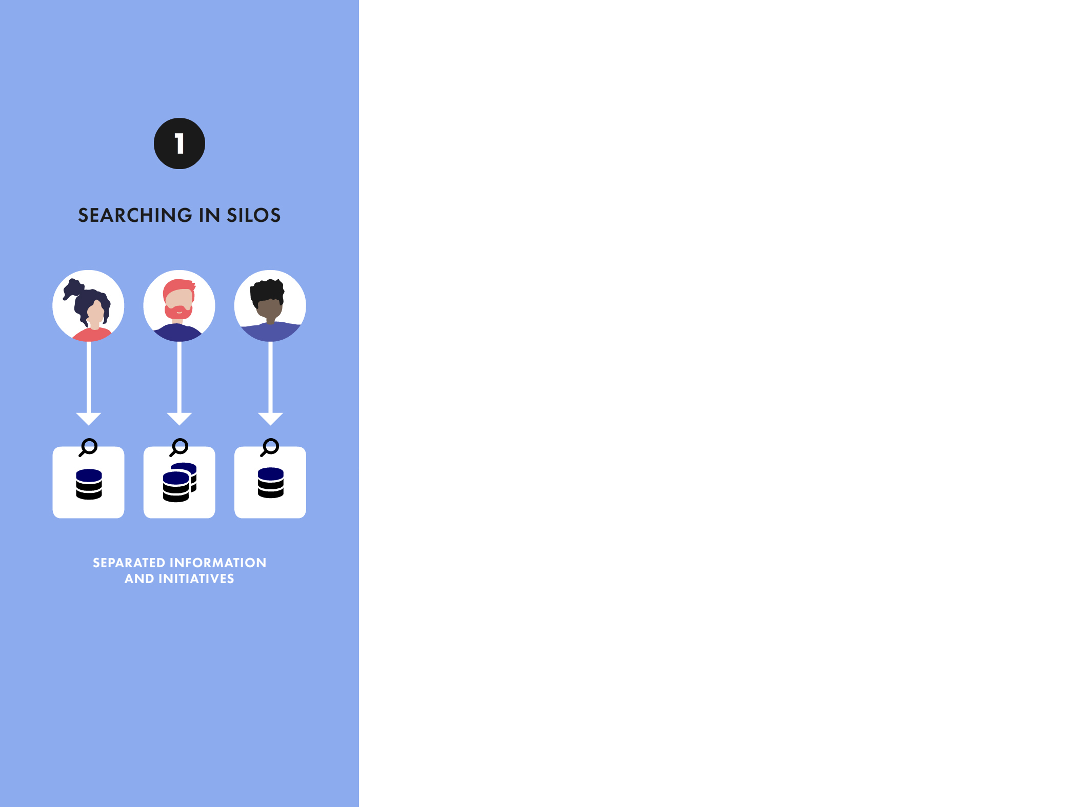
Notes:
Based on research by Findwise, we can see how search systems tend to develop over time
It usually starts when departments arehaving difficulty managing their information, and so they get information systems. When different departments do this over time, you get information silo’s

Slide 20
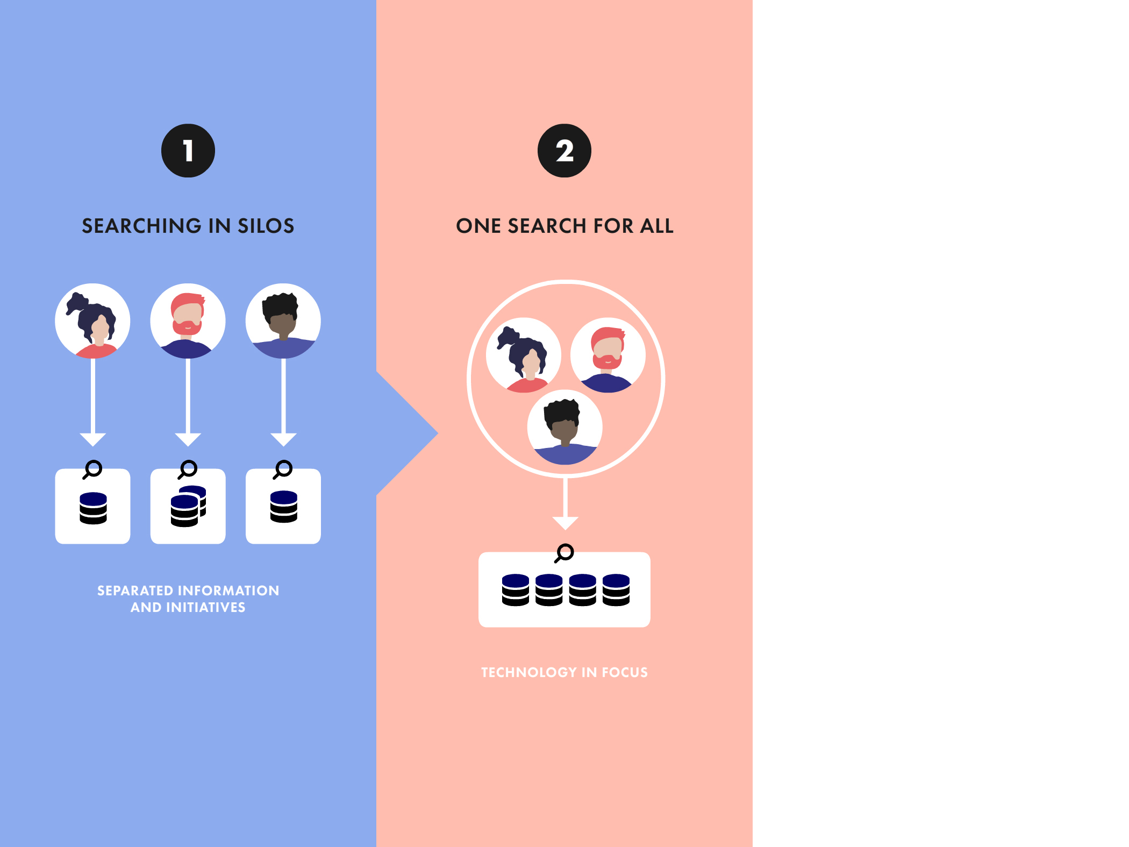
Notes:
At some point Deparments want to learn from eachother’s knowledge, and the organisation wants to move towards One Search For All

Slide 21
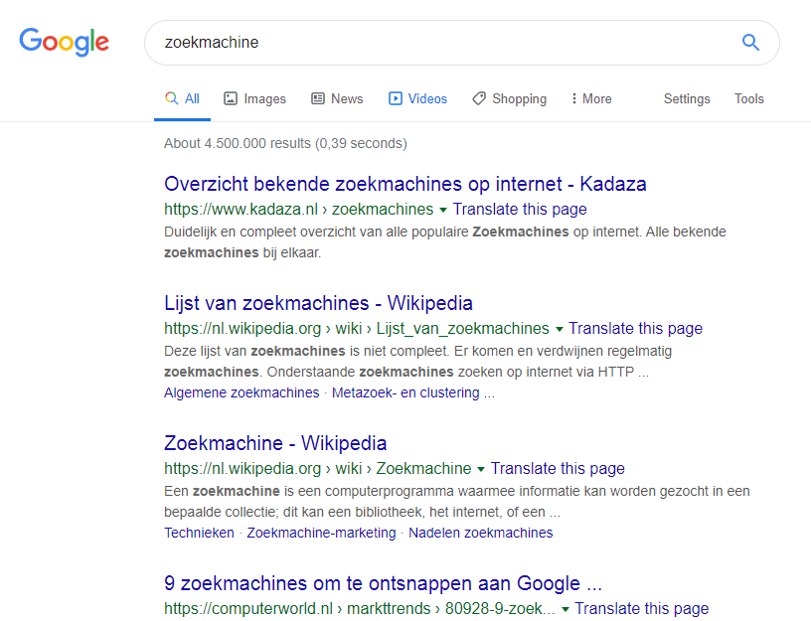
One-Search-For-All
Notes:
Dit is de verwachting die dan altijd op komt. Dat je net zoals Google gewoon een lijstje krijgt met de meest belangrijke resultaten

Slide 22
Challenges One-Search-For-All
Garbage in = garbage out
Users have contradicting information needs
Notes:
There are some challenges wish one search for all. Most notable, that different users can have contradictory needs. Council member vs citizen uithoflijn
For instance
If you just throw all documents together, then you will find anything
including a lot of duplicate documents, work-in-progress documents, notes
We should not give the same results to every user
A citizen who searches for the Uithoflijn may be interested in when the tramline leaves, whereas a council member may be more interested in the construction plans

Slide 23
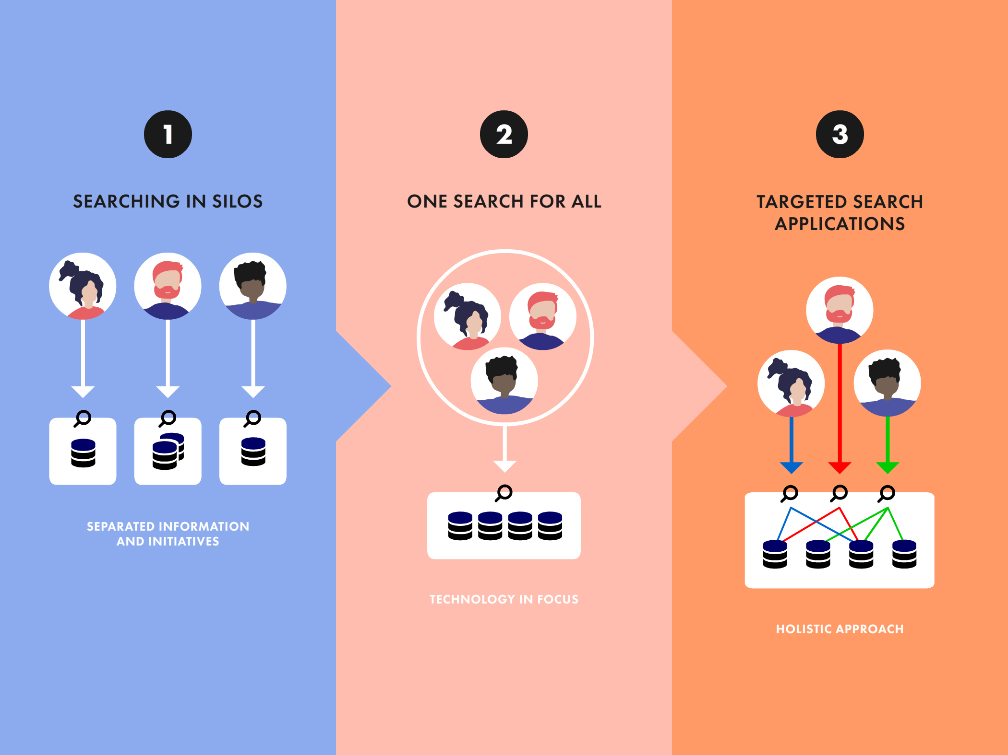
Doelgericht zoeken
Notes:
So we nééd some way to tailor search results to different target user group
This raises some questions
Who are these user groups,
Which needs do they have
And most importantly – can’t we just fix it with AI

Slide 24
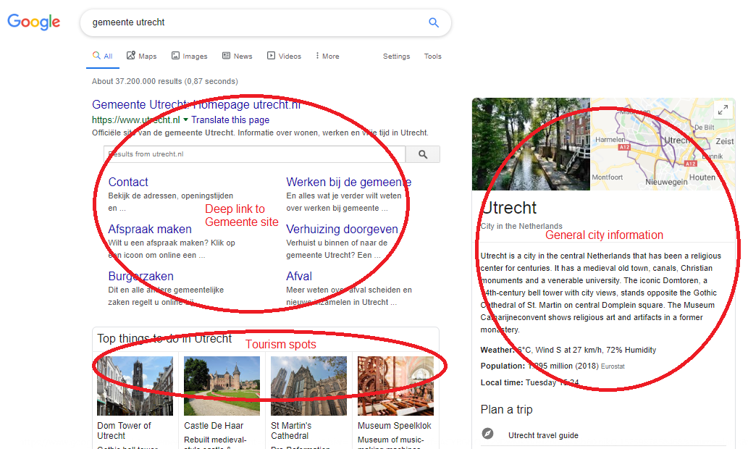
Doelgericht zoeken
Notes:
Stiekem doen top zoekmachines zoals Google ook dit soort dingen achter de schermen. Dit is een voorbeeld van een zoekopdracht ‘Gemeente Utrecht’.
Ze hebben gemerkt dat deze zoekwoorden vaak andere dingen zoeken.
publiekdienstverlening van de Gemeente – die mensen willen meteen navigeren naar een pagina op utrecht.nl
sommigen zoeken naar algmeene informatie over de gemeente ‘utrecht’ – daarom hebben ze hier algemene info van wikipedia
tenslotte zijn er veel mensen die op ‘utrecht’ zoeken omdat ze willen opzoeken wat er te doen valt in de stad

Slide 25
Limitations on AI
Limited training data Limited evidence how well learning to rank works in this setting
Specialist user groups with domain-specific needs
Generic AI approach may not solve specific problems
Need useful ways to interact with information Interface needs to present information in a usable way
Need meaningful perspective on information Interface needs to present information in a meaningful context
Notes:
AI is very useful to search for information, and nowadays to ask about information
But it has some limitation
We don’t have that much training data, interface changes

Slide 26
Verschil websearch en enterprise search
1. Websites ontworpen om vindbaar te zijn – documenten niet Meta data, SEO
2. Google heeft veel meer gebruikers, en dus meer data
Statistische zoektechnologie
Werknemers hebben zijn specialisten met specifieke behoeften
Domein-specifieke zoektaken
Notes:
De vraag blijft: waarom doen we niet wat google doet? 3 van de redenen hoe online zoeken anders is dan in een organisatie
Websites ontworpen om vindbaar te zijn. Veel websites investeren tijd en geld om hun website hoger op zoekmachines terug te laten komen. Ze voegen bv sleutelwoorden toe waarop veel gezocht wordt. Dat heet search engine optimisation. Als beleidsmedewerker maak je niet je document zodat het later terug gevonden wordt. Je maakt het voor een ander doel, en daarom is het niet logisch voor jou om daar goede meta-data toe te voegen
Veel werknemers in een organisatie zijn specialisten op een domein. De dingen die een specialist nodig heeft zijn heel anders dan wat de meeste mensen online zoeken

