Slide 1
Exploring Recommendation System Techniques to Enhance Customer Experience
Tom Sharp

Slide 2







Introduction
Started my MS in Analytics program at Georgia Tech!
Aug. 2018
Aug. 2018
July 2016
Joined an analytics team at CBP
May
2016
Graduated from
University of Delaware
Major: ChemE
Min: BioChemE
Jan. 2018
Started to learn how to code using DataCamp
Apr.
2019
Today
Joined the Deloitte ML Guild Apprentice Program in Austin, TX

Slide 3





Business Case
Problem Statement
Background on Recommendation Systems
Recommendation systems are used to enhance the customer experience by suggesting new content for users to interact with. Examples of recommendation systems are suggestions for Friends and Events on Facebook, Connections on LinkedIn, Songs on Spotify, TV and Movies on Netflix, and consumer products on Amazon.
Imbedding recommendation systems into user-focused applications enables organizations to increase their customer experience and provide unique functionality in highly competitive markets.
Problem Statement
Untappd is a social networking / technology company that allows its users to check into venues, rate beers, and interact with friends on its app.
Currently, users are able to rate beers that they have already tried, but the app lacks the functionality to suggest and/or predict the ratings of one or more beers that a user may be interested in but has never tried.

Slide 4
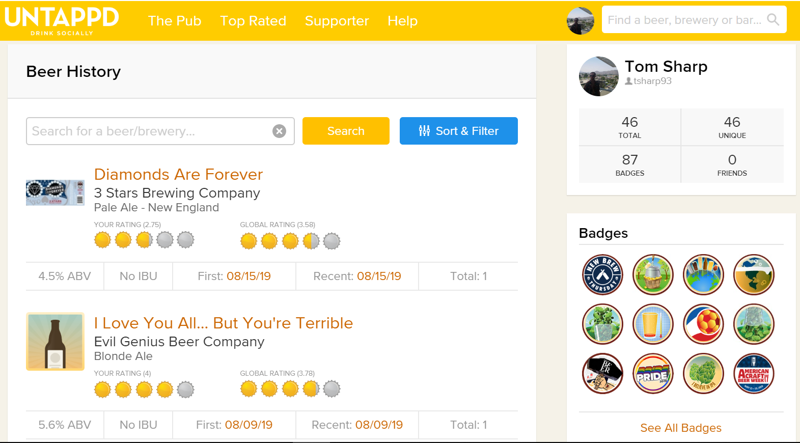
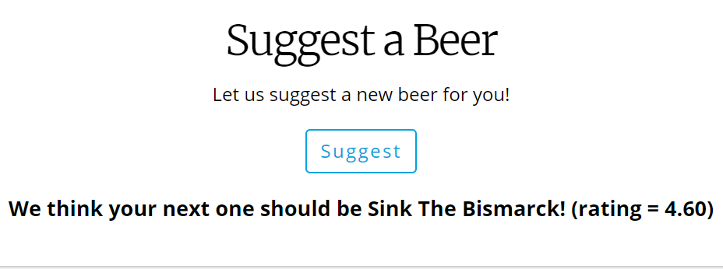
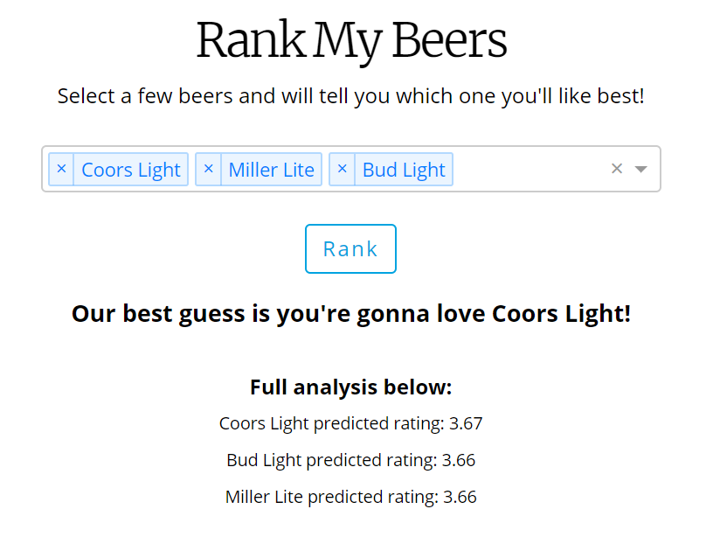
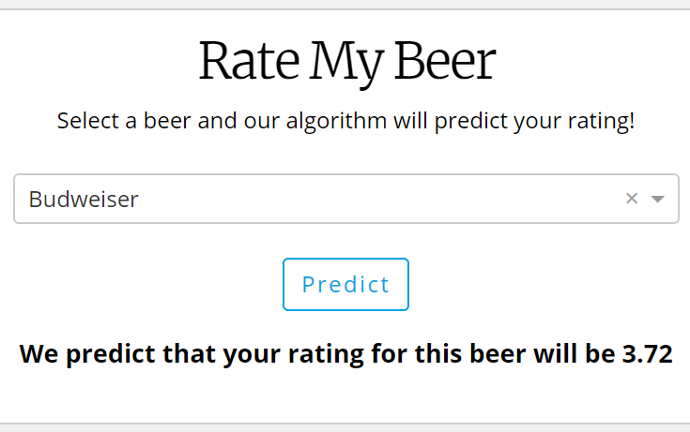
Business Case
Solution and Impact
Solution
Using data from the Untappd app/website, several recommendation system techniques were explored. Using these techniques, the application allows users to Rate, Rank, and Suggest. These modules predict the rating of a specific beer, rank a list of beers that a user may be interested in trying, and suggest a new beer that they user may never have seen before, respectively.
Impact
With these new features, current users of Untappd are able to use their data to their benefit, enhancing the current user experience and increasing app use and user retention. These features could also draw new users to the app, who may not be interested in the social network aspect but are looking for a way to find new and exciting items.

Slide 5

https://beerme-dash.herokuapp.com/
Technical Approach
App Demo

Slide 6
Technical Approach
Design
Feature Selection + Engineering
Remove Target Outliers
Untappd.com
SQLite
data_extractors
BeerMe-App
Scale (Normalize)
Selenium
Plotly Dash, Sklearn
Sqlite3, Pandas
Sqlite3, Pandas
data_pipeline
+
prep_data
Model
Key
BeerMe Module
Python Libraries Used
Import user_extract table
Impute missing data
Convert datatypes,
drop cols
Perform outlier analysis
Write to prepped_data table
Key Functionality
Sqlite3, Pandas, Numpy, Sklearn.preprocessing

Slide 7
Technical Approach
Recommendation Systems
Recommendation Systems for Ratings – regression – are different than those that predict a binary class (“Like”, “Friend”, “Connection”, etc.)
Content-Based Filtering (CBF) *
Collaborative Filtering (CF)
Hybrid
Uses attributes of items
Uses ratings of similar users
Combines methodology from both CBF and CF
Finds
Trains
Finds
2.75
4.5
3.0
Most Similar Users
2.75
4.5
3.0
2.75
4.5
3.0
Rates
Rates
Most Similar User
Rates
Rates
?
Rates
3.0
2.0
4.0
3.5
?
Model
4.75
Trains
3.75
4.75
Predicts Rating
Predicts Rating
4.25
?
Model
Predicts Rating
Key
Previously Rated Item
x.xx
Prediction for New Item
x.xx
?
New Item
*Alternatively, the rating of the most similar item can be used to give a predicted rating

Slide 8
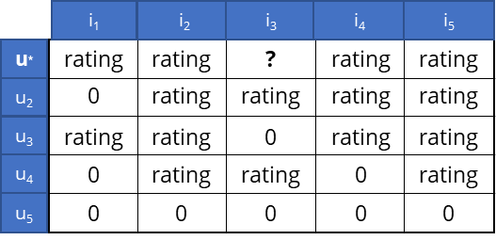
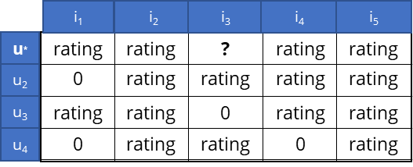
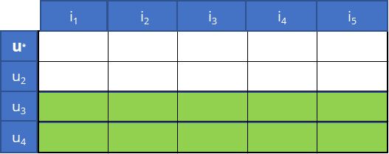


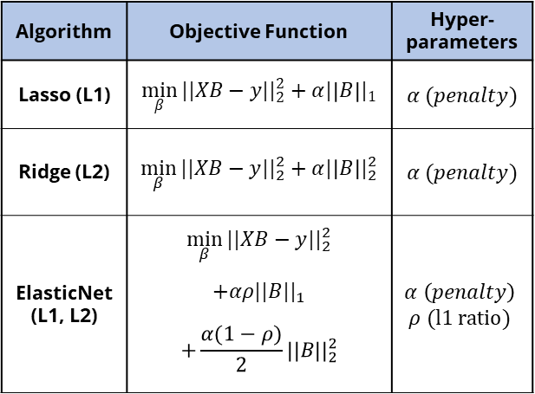
Technical Approach
Modeling Techniques
Content-Based Filtering*
Collaborative Filtering
Hybrid
$$\hat{y}=XB$$
Objective: Predict the rating of item 3 for user*
i₁
i₂
i₃
i₄
i₅
$$\hat{y}−y=ε$$
u*
rating
rating
?
rating
rating
u₂
0
rating
rating
rating
rating
u₃
rating
rating
0
rating
rating
Users with a total number of ratings less than min_ppu
are filtered out
Algorithm | Objective Function | Hyper- parameters
Lasso (L1) | $${\min_{β}{||XB}−y||}_{2}^{2}+α{|\left|B\right||}_{1}$$ | $$α (penalty)$$
Ridge (L2) | $${\min_{β}{||XB}−y||}_{2}^{2}+α{|\left|B\right||}_{2}^{2}$$ | $$α (penalty)$$
ElasticNet (L1, L2) | $${\min_{β}{||XB}−y||}_{2}^{2}$$ $$+αρ{||B||}_{1}$$ $$+\frac{α(1−ρ)}{2}{||B||}_{2}^{2}$$ | $$α \left(penalty\right)$$ $$ρ (l1 ratio)$$
u₄
0
rating
rating
0
rating
min_ppu = 3
u₅
0
0
0
0
0
A user-item matrix is created
CosineSim
i₁
i₂
i₃
i₄
i₅
u*
CosineSim finds the most similar user
prediction
CosineSim
(n = 2)
u₂
The n most similar users are identified
u₃
u₄
rating = prediction
u₅
The user’s rating is returned as the predicted rating of item 3 for user*
The data from the n most similar users is used to build a model which will predict the rating of user*
Lasso

Slide 9
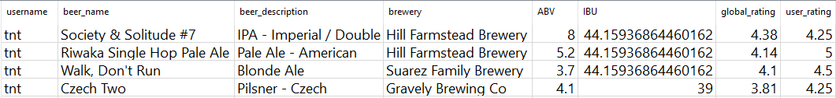
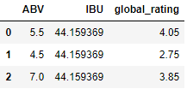
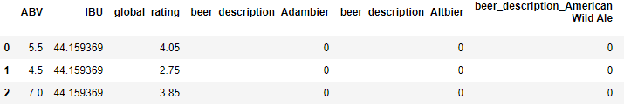
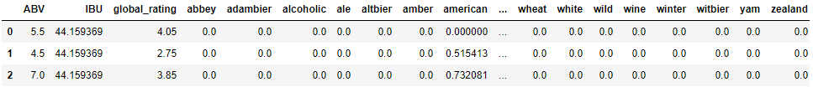
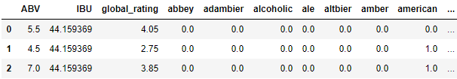
Technical Approach
Data & Feature Selection
The processed data contains the features (blue) and target (black) needed to build the models
Method | Examples
Simple
Categorical Encoding
Count Vectorizer (NLP)
TFIDF Vectorizer (NLP)
Before building the model, the user can select which feature engineering technique they’d like to use

Slide 10
Next Steps
Hybrid Approach
Find better approach to search for min_ppu and n_users while also increasing speed of model training
Statistical Significance Testing
Compare content-based filtering, collaborative filtering, and hybrid approaches
Front-End Changes
Clean up front-end for application
Add ability for users without username to interact with app

Slide 11
Thank You!

Slide 12
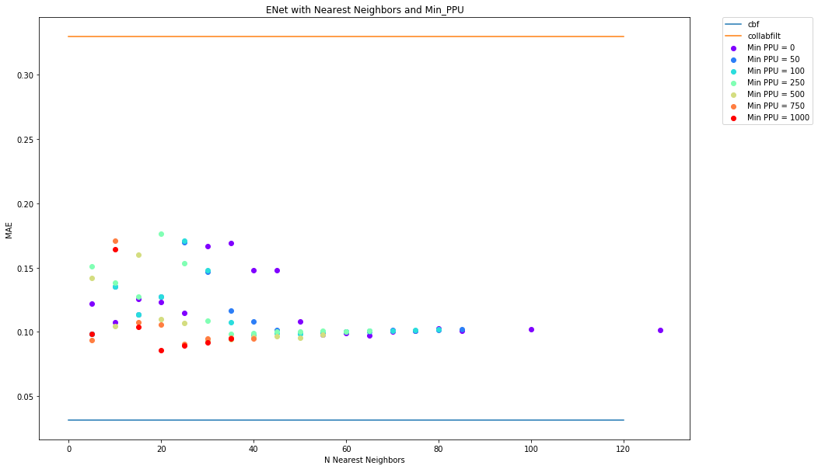
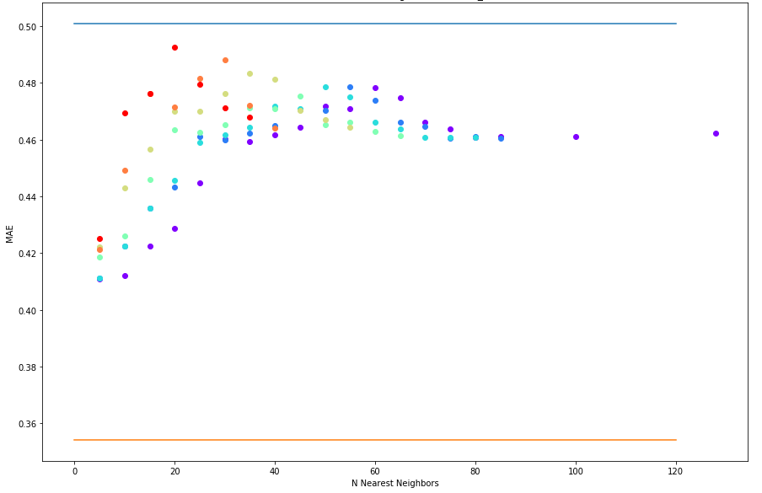
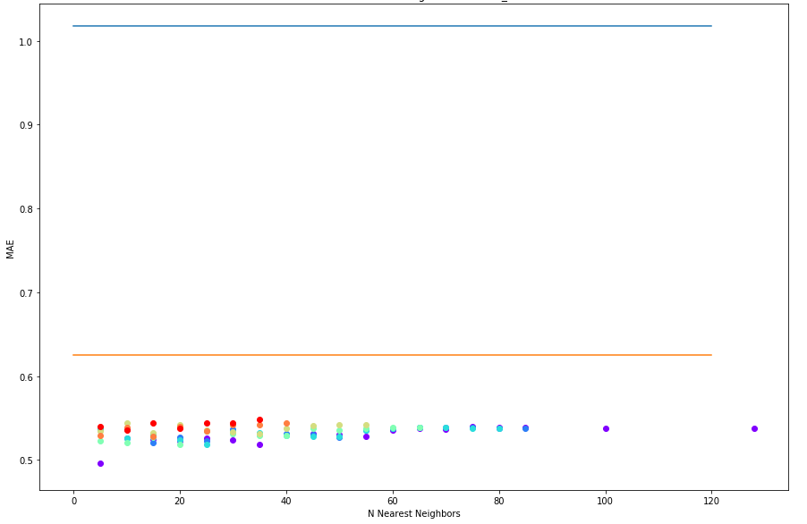
Technical Approach
Comparison of Models
Results from the all three methods differ for each user selected. More time is needed to investigate the difference between each

Slide 13
Technical Approach
Comparison of Models

Slide 14
Technical Approach
Comparison of Models

Slide 15
Technical Approach
Comparison of Models

Slide 16



Technical Approach
Modeling
Content-Based Filtering*
Collaborative Filtering
Hybrid
i₁
i₂
i₃
i₄
i₅
Lasso (L1)
Objective: Predict the rating of item 3 for user*
u*
rating
rating
?
rating
rating
u₂
0
rating
rating
rating
rating
i₁
i₂
i₃
i₄
i₅
u₃
rating
rating
0
rating
rating
Hyperparameters:
u*
rating
rating
?
rating
rating
u₄
0
rating
rating
0
rating
u₂
0
rating
rating
rating
rating
u₅
0
0
0
0
0
Ridge (L2)
u₃
rating
rating
0
rating
rating
min_ppu
= 3
u₄
0
rating
rating
0
rating
u₅
0
0
0
0
0
A user-item matrix is created
i₁
i₂
i₃
i₄
i₅
Cosine Similarity
u*
rating
rating
?
rating
rating
Hyperparameters:
u₂
0
rating
rating
rating
rating
u₃
rating
rating
0
rating
rating
ElasticNet (L1, L2)
i₁
i₂
i₃
i₄
i₅
u₄
0
rating
rating
0
rating
u*
CosineSim finds the most similar user
prediction
CosineSim
n_users = 2
u₂
i₁
i₂
i₃
i₄
i₅
u₃
u*
u₄
rating = prediction
u₂
u₅
The user’s rating is returned as the predicted rating of item 3 for user*
u₃
Hyperparameters:
u₄
LassoCV
* Photos from DataCamp.com

