Slide 2
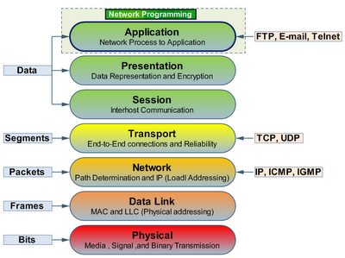
Layer 4-7
软件 | 工作层
F5 | 4-7
NetScaler | 4-7
LVS | 4
HAProxy | 4-7
Layer4-7
Switch

Slide 3

Schedule
Basically
  Hardware/GUI/CLI (Configure method)/HA (Config Sync)
Load balance related
  virtual server/node/pool/pool member
  Monitors
  Sorry server
  Maintenance Mode
  Load balance method
Persistence
SNAT/RNAT
Server Protection
ACL/Content Switch
GSLB
Performance

Slide 4
We are here
LB related
Persistence
Basically
SNAT/RNAT
Server Protection
GSLB
ACL/CS

Slide 5
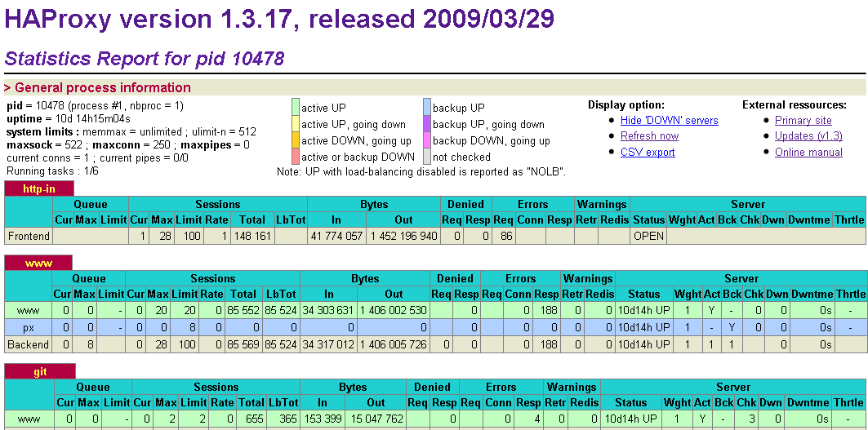
Hardware/GUI/CLI/HA
 | Commercial |  | Open Source
 | F5 | NetScaler | LVS | HAProxy
Hardware
GUI
CLI
HA

Slide 6
HAProxy Hot Reconfiguration
mv /etc/haproxy/config /etc/haproxy/config.old
mv /var/run/haproxy.pid /var/run/haproxy.pid.old
mv /etc/haproxy/config.new /etc/haproxy/config
kill -TTOU $(cat /var/run/haproxy.pid.old)
if haproxy -p /var/run/haproxy.pid -f /etc/haproxy/config; then
echo "New instance successfully loaded, stopping previous one."
kill -USR1 $(cat /var/run/haproxy.pid.old)
rm -f /var/run/haproxy.pid.old
exit 1
else
echo "New instance failed to start, resuming previous one."
kill -TTIN $(cat /var/run/haproxy.pid.old)
rm -f /var/run/haproxy.pid
mv /var/run/haproxy.pid.old /var/run/haproxy.pid
mv /etc/haproxy/config /etc/haproxy/config.new
mv /etc/haproxy/config.old /etc/haproxy/config
exit 0
fi
保存之前状态
停止老的监听
成功，清理老的连接和pid
失败，恢复老的配置

Slide 7
We are here
LB related
Persistence
Basically
SNAT/RNAT
Server Protection
GSLB
ACL/CS

Slide 8
Concepts
Monitor
Availability requirement
SNAT/NAT
Priority-based member activation
ACTION of service
down
Slow Ramp Time
Pool/pool
member statistics
Incoming request
IP Addr.-based
Traffic Direction
VIP
192.168.101.1
VIP
192.168.101.2
Port-based
Traffic Direction
virtual server
192.168.101.1:80
virtual server
192.168.101.1:443
Intelligent
Traffic Control
(look at URL, client IP addr., etc.)
pool
(name=
cgi_boxes)
pool
(name=
asp_boxes)
pool
(name=
ssl_boxes)
Load
Balancing
member
(server=
10.1.1.1:80)
member
(server=
10.1.1.2:80)
member
(server=
10.1.1.3:80)
member
(server=
10.1.1.4:80)
member
(server=
10.1.1.5:80)
member
(server=
10.1.1.6:80)
member
(server=
10.1.1.1:443)
member
(server=
10.1.1.2:443)
member
(server=
10.1.1.6:443)

Slide 9
Monitors
Monitor类型
Simple | ECV | EAV
ICMP/GW ICMP/TCP ECHO | TCP/HTTP/HTTPS | 外部程序/FTP下载一个文件到LTM系统上，看是否下载成功/IMAP/LDAP/MSSQL/NNTP/Oracle/POP3/RADIUS/Real Server/SIP/SMTP/SOAP/WMI
自定义monitor

Slide 10

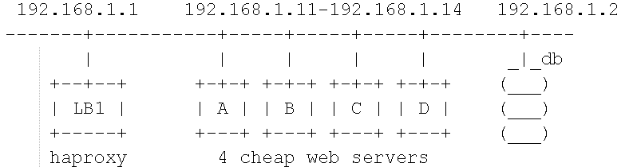

HAProxy Monitor
http://www.chinaunix.net
listen webfarm 192.168.1.1:80
mode http
balance roundrobin
cookie SERVERID insert indirect
option httpchk HEAD /index.html HTTP/1.0
server webA 192.168.1.11:80 cookie A check
server webB 192.168.1.12:80 cookie B check port 81 inter 2000
server webC 192.168.1.13:80 cookie C check
server webD 192.168.1.14:80 cookie D check

Slide 11
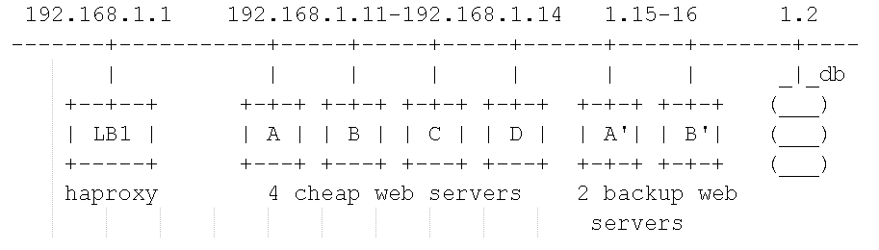
HAProxy Sorry Server
http://www.chinaunix.net
listen webfarm 192.168.1.1:80
mode http
balance roundrobin
cookie SERVERID insert indirect
option httpchk HEAD /index.html HTTP/1.0
server webA 192.168.1.11:80 cookie A check
server webB 192.168.1.12:80 cookie B check port 81 inter 2000
server webC 192.168.1.13:80 cookie C check
server webD 192.168.1.14:80 cookie D check
server bkpA 192.168.1.15:80 cookie A check backup
server bkpB 192.168.1.16:80 cookie B check backup

Slide 12
HAProxy Maintenance Mode
http://www.chinaunix.net
503 Service Unavailable
No server is available to handle this request.
Updating...

Slide 13
Load balancing algorithm
Round Robin
Wrr(Ratio(member), Ratio(Node))
Dynamic Ratio：根据对服务器性能的观察来动态设置weight，观察点包括连接数、响应时间等。
Fastest(node) & Fastest(application): 服务器/应用的最快响应时间
LC(Member) & LC(node)
Observed(member) & Observed(node)
Predictive(member) & Predictive(node)
Source
URL HASH
URL Param

Slide 14
We are here
LB related
Persistence
Basically
SNAT/RNAT
Server Protection
GSLB
ACL/CS

Slide 15
Persistence
TCP handshake
GET /URI1 HTTP/1.1
HTTP request (no cookie)
pick
server
TCP handshake
First Hit
listen webfarm 192.168.1.1:80
mode http
balance roundrobin
cookie SERVERID insert indirect
option httpchk HEAD /index.html HTTP/1.0
server webA 192.168.1.11:80 cookie A check
server webB 192.168.1.12:80 cookie B check
server webC 192.168.1.13:80 cookie C check
server webD 192.168.1.14:80 cookie D check
Cookie persistence
1.1 HTTP Cookie Insert
1.2 HTTP Cookie Rewrite
1.3 HTTP Cookie Passive
1.4 Cookie Hash
Destination Address affinity persistence
Hash persistence
MSRDP persistence
SIP persistence(session Initiation protocol)
Souce address affnity persistence
SSL persistence
Universal persistence
GET /URI1 HTTP/1.1
HTTP request (no cookie)
insert
rewrite
prefix
HTTP/1.1 200 OK
HTTP reply (with inserted cookie)
HTTP/1.1 200 OK
HTTP reply (no cookie)
Set-Cookie: SERVERID=A
Client
Server A
TCP handshake
GET /URI2 HTTP/1.1
HTTP request (with same cookie)
cookie
specifies
server
TCP handshake
Second Hit
Cookie: SERVERID=A
GET /URI2 HTTP/1.1
HTTP request (with same cookie)
HTTP/1.1 200 OK
HTTP reply (no cookie)
HTTP/1.1 200 OK
HTTP reply (updated cookie)

Slide 16
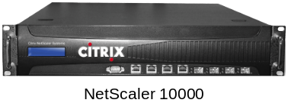

SNAT & RNAT
backend private
# Connect to the servers using our 192.168.1.200 source address
source 192.168.1.200
backend transparent_ssl1
# Connect to the SSL farm from the client's source address
source 192.168.1.200 usesrc clientip
server railsA 192.168.1.11:80 source 192.168.1.201 check
server railsB 192.168.1.12:80 minconn 4 maxconn 12 check
server railsC 192.168.1.13:80 minconn 4 maxconn 12 check
RNAT
VIP:221.238.249.177
External vlan
MAPPED IP: 10.10.1.1
SNAT
eth0: 10.10.1.2
Internal vlan
eth1: 192.168.1.2

Slide 17
We are here
LB related
Persistence
Basically
SNAT/RNAT
Server Protection
GSLB
ACL/CS

Slide 18
Server Protection
Attack (SYN Flood)
Connection Limit
Timeout
Surge Queue
Slow Start
listen appfarm 192.168.1.1:80
mode http
maxconn 10000
option httpclose
option abortonclose
option forwardfor
balance roundrobin
server railsA 192.168.1.11:80 minconn 4 maxconn 12 check
server railsB 192.168.1.12:80 minconn 4 maxconn 12 check
server railsC 192.168.1.13:80 minconn 4 maxconn 12 check
contimeout 60000
F5 | Syn Proxy ACL/iControl/iRules
NetScaler | Syn Cookie/TCP offload/Content Filter/ACL
LVS | Iptables?
HAProxy | ACL
weight
maxconn

Slide 19
Timeout
Timeout client | 客户端连接的闲置时间
timeout clitimeout | 同上、已废弃
timeout connect | 服务器端连接的超时时间(尝试连接)
timeout contimeout | 同上、已废弃
timeout http-request | 一个完整的HTTP请求的超时时间(仅针对header，降低DDoS风险，连接堆积危险)
timeout queue | 队列中等待的超时时间，当服务器连接满时，多余的请求会放到服务器或者proxy实例的queue里面。返回503
timeout server | 服务器端连接的闲置时间
timeout srvtimeout | 同上、已废弃
timeout tarpit | 使用reqtarpit后，连接保持打开的时间，超时则关闭
Client
proxy
server

Slide 20
We are here
LB related
Persistence
Basically
SNAT/RNAT
Server Protection
GSLB
ACL/CS

Slide 21
HAProxy ACL
Layer 4 and below
Layer 7 Content
acl missing_cl hdr_cnt(Content-length) eq 0
block if HTTP_URL_STAR !METH_OPTIONS || METH_POST missing_cl
block if METH_GET HTTP_CONTENT
block unless METH_GET or METH_POST or METH_OPTIONS
src/dst
src_port/dst_port
dst_conn
nbsrv(backend)
method
req_ver
path_*
url_*
hdr_*
To select a different backend for requests to static contents on the "www" site
and to every request on the "img", "video", "download" and "ftp" hosts :
acl url_static path_beg /static /images /img /css
acl url_static path_end .gif .png .jpg .css .js
acl host_www hdr_beg(host) -i www
acl host_static hdr_beg(host) -i img. video. download. ftp.
# now use backend "static" for all static-only hosts, and for static urls
# of host "www". Use backend "www" for the rest.
use_backend static if host_static or host_www url_static
use_backend www if host_www
Layer 4 Content
req_len
wait_end
req_ssl_ver
Pre-defined ACL
HTTP_1.1
METH_GET
…

Slide 22
Content Switch (UIE/iRule/ACL)
if (http_uri ends_with “.gif”) {
use pool image_servers
}
else if (http_uri starts_with “/foo”) {
use pool foo_servers
}
else if (http_cookie(“XYZ-Type”) == “direct”) {
use pool cookie_servers
}
else if (findstr(http_uri, “?type=”, 6, “&”) == “cgi”) {
use pool cgi_servers
}
else {
use pool web_servers
}
frontend public
reqisetbe ^Host:\ img static
# The URI will use a specific keyword soon
reqisetbe ^[^\ ]*\ /(img|css)/ static
reqisetbe ^[^\ ]*\ /admin/stats stats
default_backend dynamic
# The static backend backend for 'Host: img', /img and /css.
backend static
…
backend dynamic
…
backend stats
…
acl url_static path_beg /static /images /img /css
acl url_static path_end .gif .png .jpg .css .js
acl host_www hdr_beg(host) -i www
acl host_static hdr_beg(host) -i img. video. download. ftp.
use_backend static if host_static or host_www url_static
use_backend www if host_www

Slide 23
We are here
LB related
Persistence
Basically
SNAT/RNAT
Server Protection
GSLB
ACL/CS

Slide 24
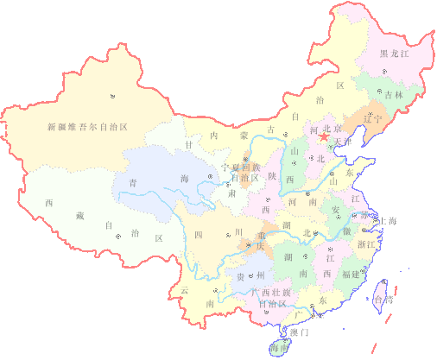




GSLB
Illustrated
如何实现CDN和站点容灾？！

Slide 25
Performance
Keep-Alive
Compression
In-memory Cache
Server Offload
TCP Buffering

Slide 26
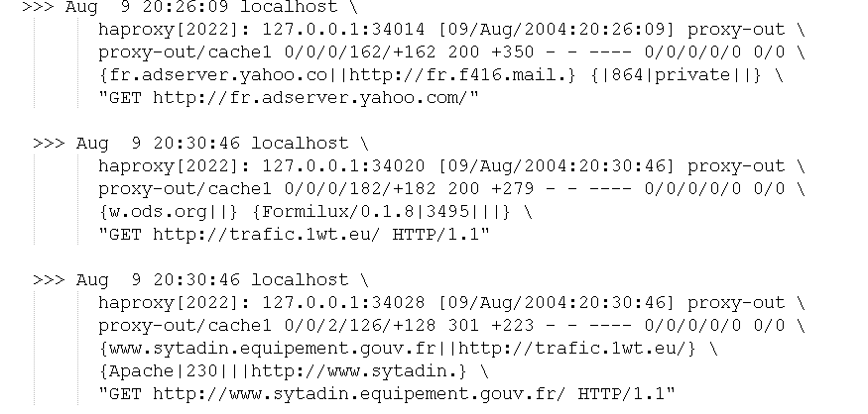
Logging
listen proxy-out
mode http
option httplog
option logasap
log global
server cache1 192.168.1.1:3128
# log the name of the virtual server
capture request header Host len 20
# log the amount of data uploaded during a POST
capture request header Content-Length len 10
# log the beginning of the referrer
capture request header Referer len 20
# server name (useful for outgoing proxies only)
capture response header Server len 20
# logging the content-length is useful with "option logasap"
capture response header Content-Length len 10
# log the expected cache behaviour on the response
capture response header Cache-Control len 8

Slide 27
HTTP Header Manipulation
reqdel
reqdeny
reqpass
reqtarpit
reqsetbe
reqisetbe
reqirep
reqidel
reqideny
reqipass
reqiallow
reqitarpit
reqadd
rsp*
# remove X-Forwarded-For header and SERVER cookie
reqidel ^X-Forwarded-For:.*
reqidel ^Cookie:.*SERVER=
# refuse *.local, then allow www.*
reqideny ^Host:\ .*\.local
reqiallow ^Host:\ www\.
# refuse *.local, then allow www.*, but ignore #www.private.local"
reqipass ^Host:\ www.private\.local
reqideny ^Host:\ .*\.local
reqiallow ^Host:\ www\.
# replace "/static/" with "/" at the beginning of any request path.
reqrep ^([^\ ]*)\ /static/(.*) \1\ /\2
# replace "www.mydomain.com" with "www" in the host name.
reqirep ^Host:\ www.mydomain.com Host:\ www

Slide 28
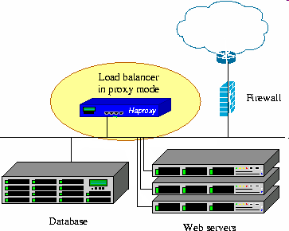
HAProxy – The Reliable, High Performance
TCP/HTTP Load Balancer
简介
功能
性能
安全

Slide 29

Bibliography
[1] HAProxy Official Site: http://haproxy.1wt.eu
[2] Willy TARREAU: HAProxy Configuration Manual (English)
[3] Willy TARREAU: HAProxy Architecture Guide (English)
[4] Willy TARREAU: HAProxy Reference Manual
[5] F5 Networks: Configuration Guide for Local Traffic Management(v9.2.2)
[6] Citrix: NetScaler Installation and Configuration Guide - Vol. 1(2)
THE END

