Slide 1
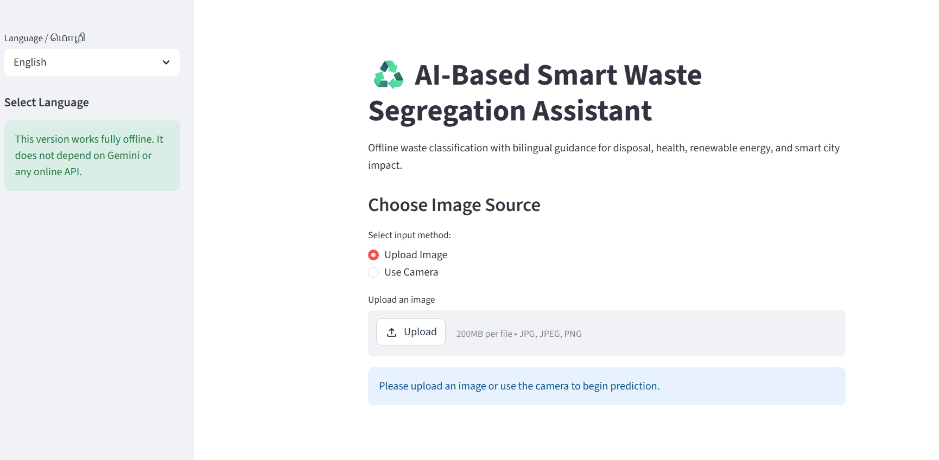
AI/ML PORTFOLIO PROJECT | COMPUTER VISION
AI-Based Smart Waste Segregation & Recycling Assistant
Image classification with transfer learning and bilingual (English / Tamil) disposal guidance
Actual app screenshot from the repository
Deep Learning | Transfer Learning | Environmental AI
Built at the Techies "N" Smartathon internal hackathon
Thangaraj T | tmthangaraj1980@gmail.com | +91 9952045978
github.com/tmthangaraj1980-AIML
Notes:
Hackathon project. The app takes a photo of waste, predicts a category with a transfer-learned CNN, and shows bilingual disposal guidance. Be ready for one honest point: the README says MobileNetV2, but the code in the repository trains EfficientNetB0.

Slide 2
Executive overview
Upload or capture a photo of one waste item
A CNN predicts the waste class with a confidence score
A knowledge base shows segregation stream, disposal, recycling, health and smart-city notes
Works offline: no online API is called
English and Tamil interface
6
classes in the app knowledge base
224
pixel square model input
2
interface languages
1 Upload
2 Preprocess
3 Features
4 Classify
5 Guidance
6 Display
Notes:
Position it as a complete small product: model, rules-based guidance, bilingual UI. The model is the ML part; the guidance text is a curated lookup.

Slide 3
Problem statement
Mixed waste
Low awareness
Wet and dry waste collected together lowers recycling quality.
Households are unsure which stream an item belongs to.
Pollution and health
Language barrier
Open dumping and burning harm air, water and public health.
Guidance in English alone excludes many households.
1 Upload
2 Preprocess
3 Features
4 Classify
5 Guidance
6 Display
Notes:
The README frames it as pollution, health risk and weak smart-city waste management. The root cause is mixed waste at the source.

Slide 4
Objectives and use cases
Objectives
Users
Benefits
Classify a waste photo
Name the segregation stream
Give disposal and recycling advice
Support English and Tamil
Households
Schools and campuses
Municipal awareness programmes
Better source segregation
Less landfill load
Circular-economy awareness
1 Upload
2 Preprocess
3 Features
4 Classify
5 Guidance
6 Display
Notes:
Users: households, school or campus eco-clubs, municipal awareness drives.

Slide 5
Technology stack
Deep learning
Application
TensorFlow / Keras
EfficientNetB0 (ImageNet weights)
ImageDataGenerator augmentation
Streamlit web app
Pillow, NumPy image handling
run_app.py launcher
Knowledge base
Offline by design
Python dictionary per class
English and Tamil text
Rule-based, not learned
Model loaded from model/waste_model.keras
No Gemini or online API call
Camera input supported
1 Upload
2 Preprocess
3 Features
4 Classify
5 Guidance
6 Display
Notes:
From requirements.txt (tensorflow, streamlit, pillow, numpy) and the imports. run_app.py is a convenience launcher that starts Streamlit and opens Chrome.

Slide 6
Model note: README vs source code
Item | README | Source code
Backbone | MobileNetV2 | EfficientNetB0 (train_model.py)
Preprocessing | not stated | efficientnet preprocess_input
Classes | Plastic, Paper, Metal, Organic | 6 keys: biological, cardboard, metal, paper, plastic, trash
Pretrained weights | not stated | ImageNet
How this deck handles it
Technical slides follow the source code (EfficientNetB0, 6 classes). MobileNetV2 is explained as the related efficient-CNN concept. Recommended fix: update the README to match the code.
1 Upload
2 Preprocess
3 Features
4 Classify
5 Guidance
6 Display
Notes:
This is the first thing an interviewer may catch. The README and the project name say MobileNetV2, but train_model.py imports EfficientNetB0 and the app uses efficientnet preprocess_input. I present the code as the source of truth and recommend updating the README.

Slide 7
Concept: efficient CNNs and inverted residuals
Thin input
Expand
Depthwise 3x3
Project
Skip add
few channels
1x1 conv widens channels
cheap spatial filtering
1x1 linear bottleneck
connect thin ends
MobileNetV2
EfficientNetB0 (used here)
Introduced inverted residual blocks
Built for mobile speed
Uses the MBConv block family
Adds squeeze-and-excitation
1 Upload
2 Preprocess
3 Features
4 Classify
5 Guidance
6 Display
Notes:
MobileNetV2 introduced inverted residual blocks with linear bottlenecks: expand channels, depthwise convolution, project back down, with a skip connection between the thin ends. EfficientNet reuses this block (MBConv) and adds squeeze-and-excitation and compound scaling.

Slide 8
End-to-end project flow
1 Upload
2 Preprocess
3 Features
4 Classify
5 Guidance
6 Display
Photo upload or camera
RGB, 224x224, EfficientNet scaling
EfficientNetB0 backbone
Dense + softmax, class and confidence
Dictionary lookup of advice
Streamlit result in EN or Tamil
Stages 2 to 4 are the machine-learning part. Stage 5 is a rule-based lookup keyed by the predicted class.
1 Upload
2 Preprocess
3 Features
4 Classify
5 Guidance
6 Display
Notes:
Master slide: the footer strip on every following slide shows which stage you are in.

Slide 9
System architecture
Streamlit UI
Pillow + NumPy
Keras model
class_names.json
waste_data
language, upload / camera
resize, array, preprocess
waste_model.keras
index to class name
bilingual guidance dictionary
Not in the repository
Trained model file, class_names.json and the dataset folder are not committed. The repo holds code and screenshots only, so the model cannot be re-run from a clone without retraining.
1 Upload
2 Preprocess
3 Features
4 Classify
5 Guidance
6 Display
Notes:
Single-process Streamlit app. cache_resource loads the model once. Class names come from class_names.json written during training.

Slide 10
Dataset and knowledge source
dataset/
flow_from_directory
80 / 20 split
class_names.json
one folder per class (not in repo)
labels from folder names
validation_split = 0.2
saved after training
Classes handled by the app
Unverified
biological, cardboard, metal
paper, plastic, trash
Unknown label falls back to trash
Dataset name and source
Image counts per class
Class balance
1 Upload
2 Preprocess
3 Features
4 Classify
5 Guidance
6 Display
Notes:
The dataset folder is expected by train_model.py but not included. The six class keys come from the app knowledge base; the true folder names are written to class_names.json at training time.

Slide 11
Preprocessing and augmentation
Step | Setting
Input size | 224 x 224, RGB
Scaling | EfficientNet preprocess_input
Rotation / zoom | 20 deg / 0.2
Shift (width, height) | 0.2 / 0.2
Shear | 0.15
Horizontal flip | True
Why augment?
Few training photos rarely cover every angle
Random changes reduce overfitting
Applied to training data only
1 Upload
2 Preprocess
3 Features
4 Classify
5 Guidance
6 Display
Notes:
Augmentation is applied only to the training generator; validation images are only preprocessed. Both use the same 80/20 split seed behaviour of Keras.

Slide 12
Model architecture
Image
EfficientNetB0
Global avg pool
BatchNorm
Dense 256
Softmax
224x224x3
ImageNet weights, no top
feature map to vector
stabilise
ReLU + Dropout 0.4
one output per class
Trained here: the new head, then the last 30 backbone layers. Pretrained, not trained here: the ImageNet backbone weights.
1 Upload
2 Preprocess
3 Features
4 Classify
5 Guidance
6 Display
Notes:
Transfer learning: the ImageNet-trained backbone already knows edges, textures and shapes. A small new head learns the waste classes. Dropout 0.4 and BatchNorm regularise the head.

Slide 13
Training strategy
Phase 1
Phase 2
Best model
backbone frozen, Adam 1e-3, up to 10 epochs
unfreeze last 30 layers, Adam 1e-4, 5 epochs
saved to model/waste_model.keras
Callbacks
EarlyStopping on val_loss (patience 3, restore best weights)
ReduceLROnPlateau (factor 0.2, patience 2)
ModelCheckpoint on val_accuracy
1 Upload
2 Preprocess
3 Features
4 Classify
5 Guidance
6 Display
Notes:
Two phases is standard transfer learning: warm up the new head, then gently fine-tune the top of the backbone at a lower learning rate. ModelCheckpoint saves on best val_accuracy.

Slide 14
Inference and softmax confidence
PIL image
Resize + scale
model.predict
argmax
Low-confidence check
convert to RGB
224x224, preprocess_input
probability vector
class = top index; confidence = max x 100
below 60% shows a warning
Reading confidence
97% means the model was very sure of its top class on that image, not that it is 97% accurate overall.
1 Upload
2 Preprocess
3 Features
4 Classify
5 Guidance
6 Display
Notes:
Softmax turns logits into probabilities that sum to 1. The displayed confidence is the top probability. It is not accuracy and can be high even when wrong.

Slide 15
Stage 5: guidance is a rule-based lookup
Predicted class | Segregation stream shown
biological | Biodegradable / Wet Waste
cardboard, paper | Dry Recyclable Waste
metal, plastic | Dry Recyclable Waste
trash (and unknown labels) | Reject / Mixed Waste
Each class also has
Disposal method
Environmental impact
Recycling / reuse
Composting or energy
Health and smart-city notes
Verification note
1 Upload
2 Preprocess
3 Features
4 Classify
5 Guidance
6 Display
Notes:
Make this distinction explicit: the CNN only outputs the class. Everything else is hand-written content in a dictionary.

Slide 16
Results and evaluation: what is verified
Verified
Not available
Caution
Code trains with an 80/20 split
App runs and returns class and confidence
Screenshot: one prediction at 97.30% confidence (single image)
Training / validation accuracy
Test accuracy
Confusion matrix
Per-class precision and recall
ModelCheckpoint and reporting use the same validation set
No separate test set
Reported numbers would be optimistic
1 Upload
2 Preprocess
3 Features
4 Classify
5 Guidance
6 Display
Notes:
Be direct: no training or test accuracy exists in the repository. The 97.30 percent figure in the screenshot is the softmax confidence for one image. It must not be quoted as model accuracy.

Slide 17
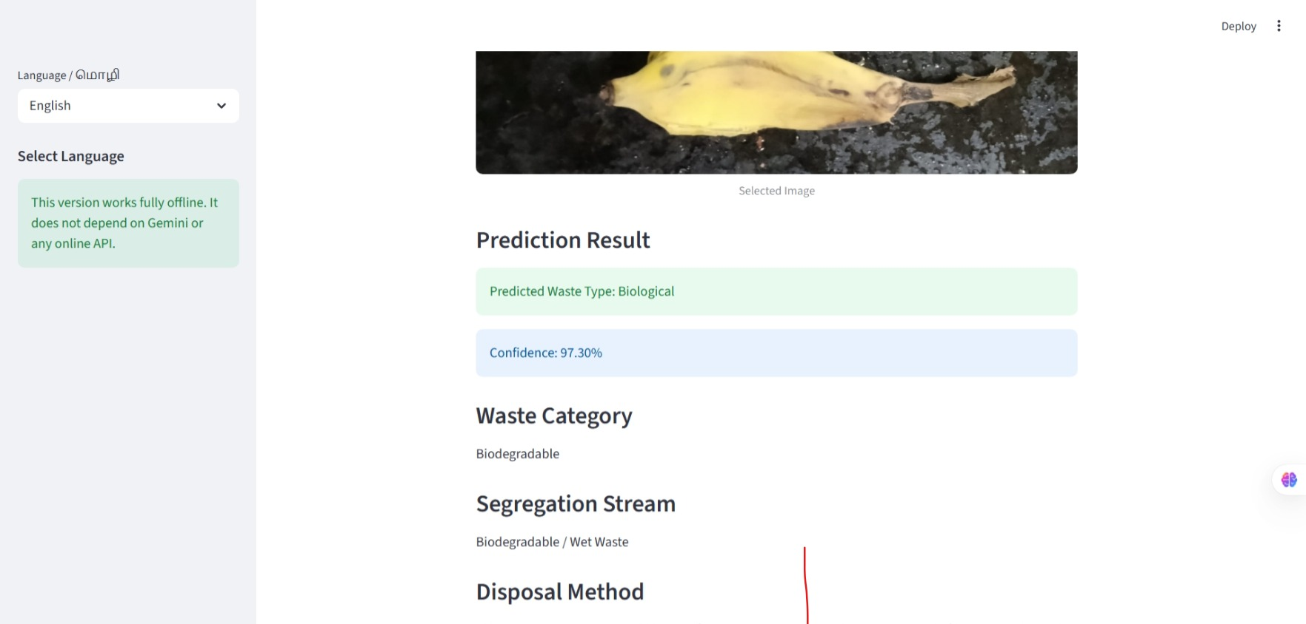
Application demonstration
1
3
4
2
1 Language selector and offline note. 2 Upload or camera input.
3 Predicted class: Biological. 4 Confidence 97.30%, then category and stream.
Actual screenshots from the project repository
1 Upload
2 Preprocess
3 Features
4 Classify
5 Guidance
6 Display
Notes:
Screenshots are from the repository. Walk through: language selector, upload or camera, prediction with confidence, then the guidance sections.

Slide 18
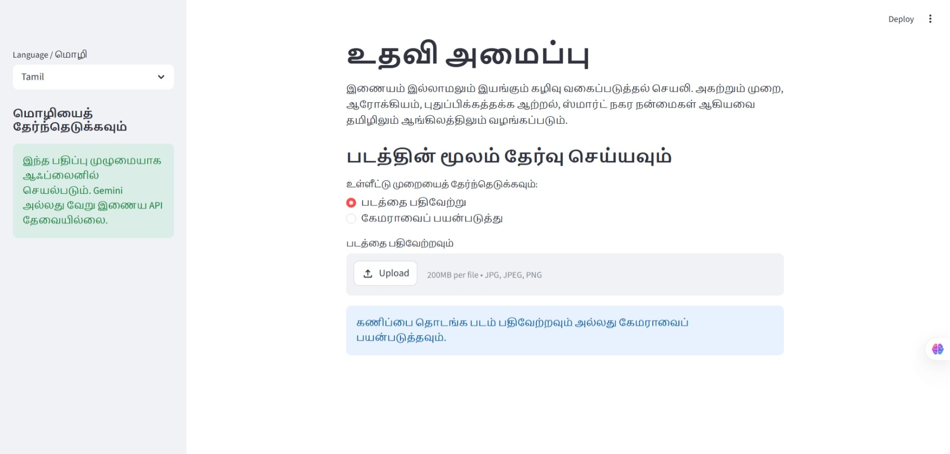
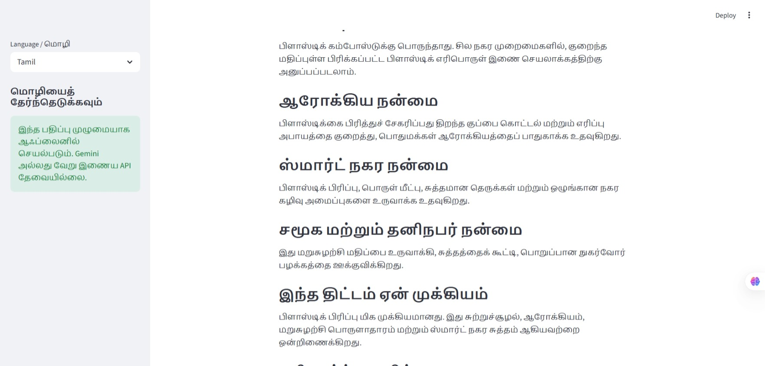
Bilingual interface (Tamil)
What it shows
Same app in Tamil: the full interface and every guidance section switch language from the sidebar dropdown. Actual screenshots from the repository.
1 Upload
2 Preprocess
3 Features
4 Classify
5 Guidance
6 Display
Notes:
The README lists Tamil and English as future work, but the code already implements both. I note that as an update to the roadmap.

Slide 19
Classification vs object detection
Image classification (this project)
Object detection (YOLO project)
One label for the whole image
Softmax over classes
Best for a single item in frame
No locations returned
Many objects per image
Bounding boxes + labels
Handles mixed scenes
Evaluated with mAP
1 Upload
2 Preprocess
3 Features
4 Classify
5 Guidance
6 Display
Notes:
This app assigns one label per image. A photo with several items cannot be handled; that is why project 03 uses YOLO.

Slide 20
How to evaluate this model properly
Metric | Why | How
Test accuracy | overall correctness | held-out test folder, never used in checkpointing
Confusion matrix | which classes mix up | sklearn confusion_matrix
Per-class precision / recall | class imbalance | classification_report
Real-photo test | domain shift | household photos, mixed backgrounds
Calibration | is 97% really 97%? | confidence vs accuracy bins
1 Upload
2 Preprocess
3 Features
4 Classify
5 Guidance
6 Display
Notes:
Method, not invented numbers. Hold out a test set the checkpoint never saw.

Slide 21
Technical challenges and limitations
Model
Evidence
One label per image only
Mixed or dirty items are hard
Confidence is not accuracy
No metrics committed
Model and dataset not in repo
README mismatch (MobileNetV2)
Guidance
Packaging
Rule-based text, not learned
Local rules vary by city
Low-confidence warning only below 60%
requirements.txt unpinned
No automated tests
Large files must be shared separately
1 Upload
2 Preprocess
3 Features
4 Classify
5 Guidance
6 Display
Notes:
Honest limits help in interviews: single-item classification, unverified metrics, README mismatch.

Slide 22
Improvements and roadmap
Fix
Measure
Detect
Deploy
Integrate
update README, pin requirements, add model card
test split, confusion matrix, calibration
multi-item scenes with YOLO
cloud or mobile app
IoT smart bin (README idea)
1 Upload
2 Preprocess
3 Features
4 Classify
5 Guidance
6 Display
Notes:
README ideas plus engineering fixes. Tamil support is already done.

Slide 23
Interview preparation
1. Which model does the code use?
EfficientNetB0 with ImageNet weights; the README says MobileNetV2, a mismatch I would correct.
2. Why transfer learning?
A pretrained backbone supplies visual features, so a small waste dataset trains faster with less overfitting.
3. What does the confidence mean?
The top softmax probability. It is not accuracy and can be high on a wrong class.
4. Which outputs are ML and which are rules?
Only the class and confidence are ML. Disposal and impact text is a hand-written dictionary.
5. Classification vs detection?
Classification gives one label per image; detection locates several objects with boxes, which suits mixed waste.
1 Upload
2 Preprocess
3 Features
4 Classify
5 Guidance
6 Display
Notes:
Lead with answer 1: it shows you read your own code critically.

Slide 24
Resources and missing details
Available
Missing or unverified
Repository (code, README, 4 screenshots)
Local run: streamlit run app.py
No live demo URL
Dataset name and size
Trained model and class_names.json
Accuracy and confusion matrix
Exact class folder names
github.com/tmthangaraj1980-AIML/AI-Based-Smart-Waste-Segregation-Recycling-Assistant
1 Upload
2 Preprocess
3 Features
4 Classify
5 Guidance
6 Display
Notes:
Repository link was cloned and read. No live demo link exists in the README.

Slide 25
Conclusion
Skills demonstrated
Project impact
Transfer learning with Keras
Augmentation and fine-tuning
Streamlit app with bilingual UI
Reading code critically against docs
Separating ML output from rules
Practical aid for waste segregation
Offline and bilingual
Clear path to detection and IoT
Thangaraj T | tmthangaraj1980@gmail.com | +91 9952045978
Notes:
Close: a complete small product built on transfer learning, with an honest account of what is verified and what still needs measuring.

