Slide 1
Elavon Onsite 2
Agenda

Slide 2
What we think the problem is
Sales/Customer Relationship Management
Discovery
Ecosystem
User Experience
App Filtering

Slide 3
Current State
What we can feasibly deliver:
Website
Improvements to the UI

Slide 4
Given more information on customers/sales:
Sales & Customer Relationship Management Strategy
Sales Process
Promotional Material
App Store Engagement Strategy

Slide 5
Questions:

Slide 6
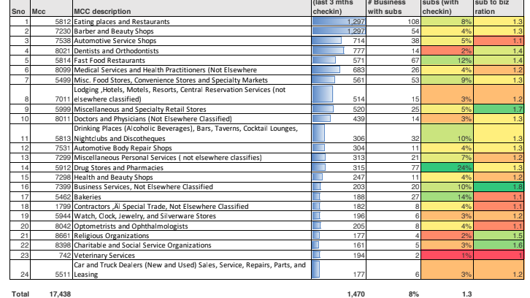

Slide 7
Customer Journey

Slide 8
Sales Journey
After Sales Support?

