Slide 1
CycleSense Analytics
Forecasting solutions for urban bike-sharing systems
Phase II: Individual Industry Case Study
CS 595: Time Series Analysis and Forecasting
Spring 2026
Presented By: Thejaswini Mundargi -- A20586100
Notes:
Good morning, everyone
I’m Thejaswini Mundargi, and today I’ll be presenting Phase II: industry case study
My project is titled CycleSense Analytics, where the goal is to develop forecasting solutions for urban bike-sharing systems
Specifically, I focus on predicting bike rental demand for Washington D.C.’s Capital Bikeshare system using time series forecasting methods
This project moves beyond model comparison from Phase I and
applies forecasting to a real operational business problem where prediction accuracy directly impacts planning and cost efficiency

Slide 2
Business Context & Objective
Who we are?
~ We are CycleSense Analytics, and we specialize in helping, city bike-share programs run better
The Mission
We are predicting bike rentals for Washington D.C.’s “Capital Bikeshare” 14 days in advance
Why 14 days?
Rebalancing truck routes and staff schedules are planned 1-2 weeks ahead → this is the operational planning horizon
Deliverable: Point forecasts + prediction intervals to quantify demand uncertainty for fleet sizing decisions
Notes:
The business problem here is simple: operators need to know how many bikes people will need before the actual demand happens
We forecast bike rentals 14 days in advance
This 14-day horizon is important because operational decisions like truck routing and bike redistribution, and workforce scheduling are planned one to two weeks ahead—not the same day
Our final deliverable includes two things:
First, point forecasts, which estimate expected rentals
Second, Prediction intervals help measure uncertainty and show the expected demand range
This is important because overestimating wastes resources, while underestimating creates empty stations and customer dissatisfaction

Slide 3
Business Context & Objective
Why accurate forecasts matter?
A Quick Glance at Dataset
Category | Information
Source | Capital Bikeshare, Washington D.C.
Period | Jan 2011 - Dec 2012 (731 days)
Granularity | Hourly is aggregated to daily
Records | 17,379 hourly observations
Target | Daily total rentals (cnt)
Avg demand | 4,504 rentals/day (σ = 1,937)
Range | 22 - 8714 rentals/day
Missing | None (zero nulls, zero gaps)
Station Rebalancing
Trucks move bikes between stations at night. To plan routes properly, we need to estimate demand 1–2 weeks in advance.
Maintenance Periods
Bikes need regular servicing. It is best to do this on days when fewer people are expected to use them.
Workforce Planning
Weekly schedules depend on demand forecasts to decide how many staff are needed.
Budgeting
Overestimating wastes resources; underestimating leads to empty stations and lost revenue.
Notes:
Forecasting directly affects four major business areas:
First is station rebalancing. Bikes must be moved between stations overnight so high-demand stations don’t become empty
Second is maintenance scheduling. Low-demand days are the best time for bike servicing
Third is workforce planning. Staff scheduling depends more on expected demand
And fourth is budgeting, where inaccurate forecasts lead either to unnecessary spending or lost revenue
The dataset comes from Capital Bikeshare in Washington D.C.
It covers January 2011 to December 2012, giving us 731 daily observations after aggregating hourly records
Originally there were over 17,000 hourly records
The average daily demand is around 4,500 rentals, with no missing values, which makes the dataset very reliable for forecasting

Slide 4
Dataset Characteristics
Feature | Description | Type
cnt (target) | Total bike rentals = casual + registered users | Integer
temp / atemp | Temperature / feels-like temperature (normalized to 0-1) | Continuous
hum | Relative humidity (normalized to 0-1) | Continuous
windspeed | Wind speed (normalized to 0-1) | Continuous
weathersit | 1=Clear, 2=Mist/Cloud, 3=Light rain/snow, 4=Heavy rain | Ordinal
season | 1=Spring, 2=Summer, 3=Fall, 4=Winter | Categorical
holiday / workingday | 1= weekday (not weekend or holiday), 0 otherwise | Binary
weekday / hr | Day of week (0=Sun to 6=Sat) / Hour of day (0-23) | Categorical
Preprocessing & Evaluation Design
Data Aggregation: Converted hourly data into daily totals for forecasting
De-normalized features for interpretability: temp ×41°C, humidity ×100%, wind ×67 km/h
3 extreme low-demand days (weather cat 4) are retained as legitimate data points
76/731 days have <24 hourly records low activity late-night hours, but daily totals are still accurate
Primary test: Dec 1–14, 2012 (14 days) | Holiday case study: Dec 18–31 | Validation: 10 rolling tests × 14-day windows
Notes:
The target variable is total daily rentals, called “cnt.”
Other important features include temperature, humidity, wind speed, weather condition, season, holidays, working days, weekday, and hour
Since my forecasting objective is daily planning, I aggregated hourly observations into daily totals
I also de-normalized weather features like temperature and humidity so results are easier to interpret Three extremely low-demand days caused by severe weather were retained because they represent real operational events, not errors
For evaluation, I used three setups:
Primary testing on December 1st to 14th,
Holiday case study on December 18th to 31st,
and 10 rolling-origin validation windows for stronger out-of-sample testing

Slide 5
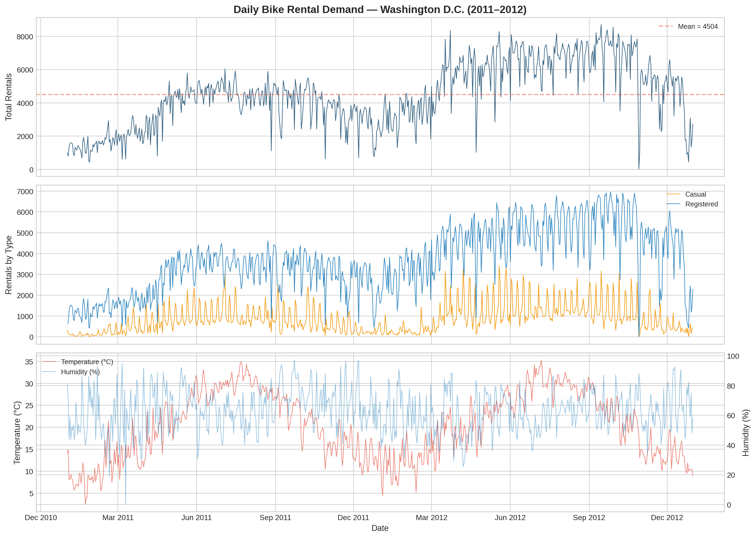
Exploratory Analysis
Comprehensive EDA revealed several crucial patterns in the historical data:
Trend & Seasonality: Demand grew ~65% from 2011 to 2012, with a clear weekly cycle
User Variances: Registered users (~81%) dominate; casual users (~19%) spike on weekends and are more weather-sensitive
Weather Impact: Temperature is the strongest predictor (r = 0.63). Rain/snow reduces demand by ~40%
Notes:
EDA revealed three important patterns.
First, demand increased by around 65 percent from 2011 to 2012, showing clear business growth
Second, there is strong weekly seasonality
Registered users make up 81% of demand and are mainly commuters,
while casual users are more active on weekends, and more weather-sensitive
Third, temperature is the strongest predictor, with a correlation of 0.63
Rain and snow reduce demand by approximately 40 percent
This confirms that both seasonality and weather play major roles in rental demand

Slide 6
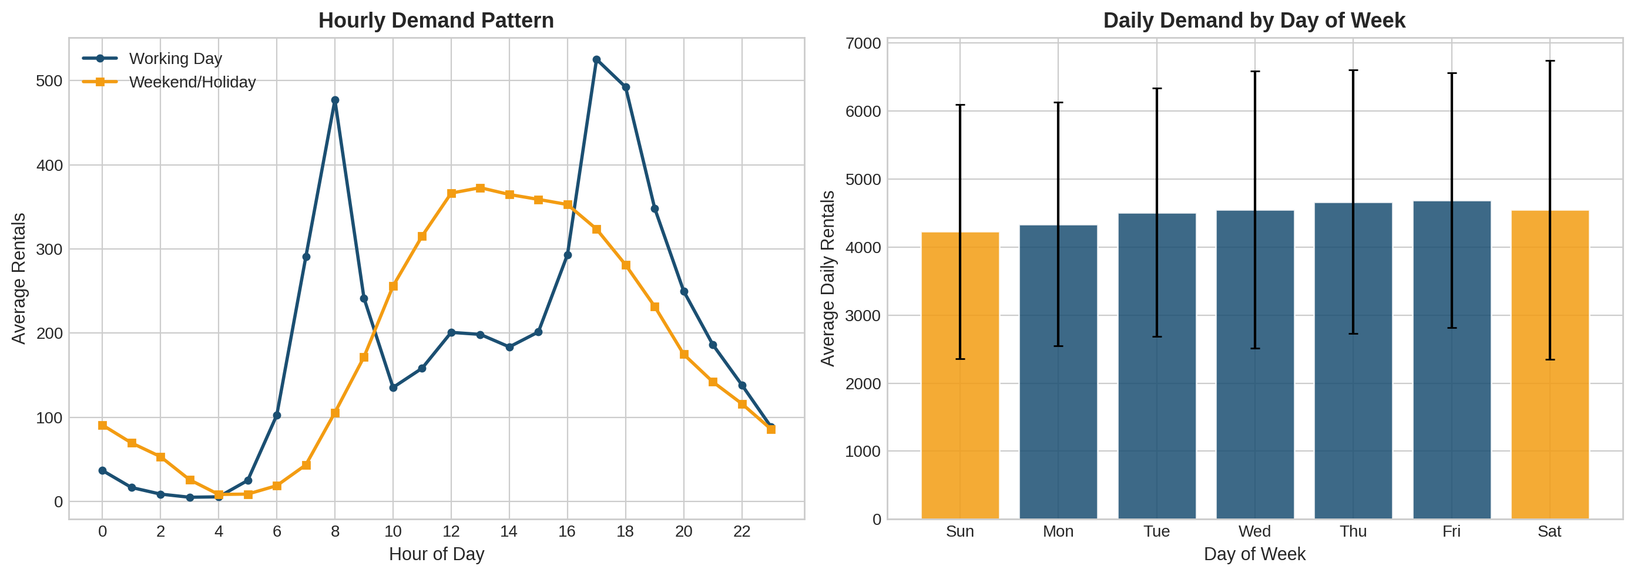
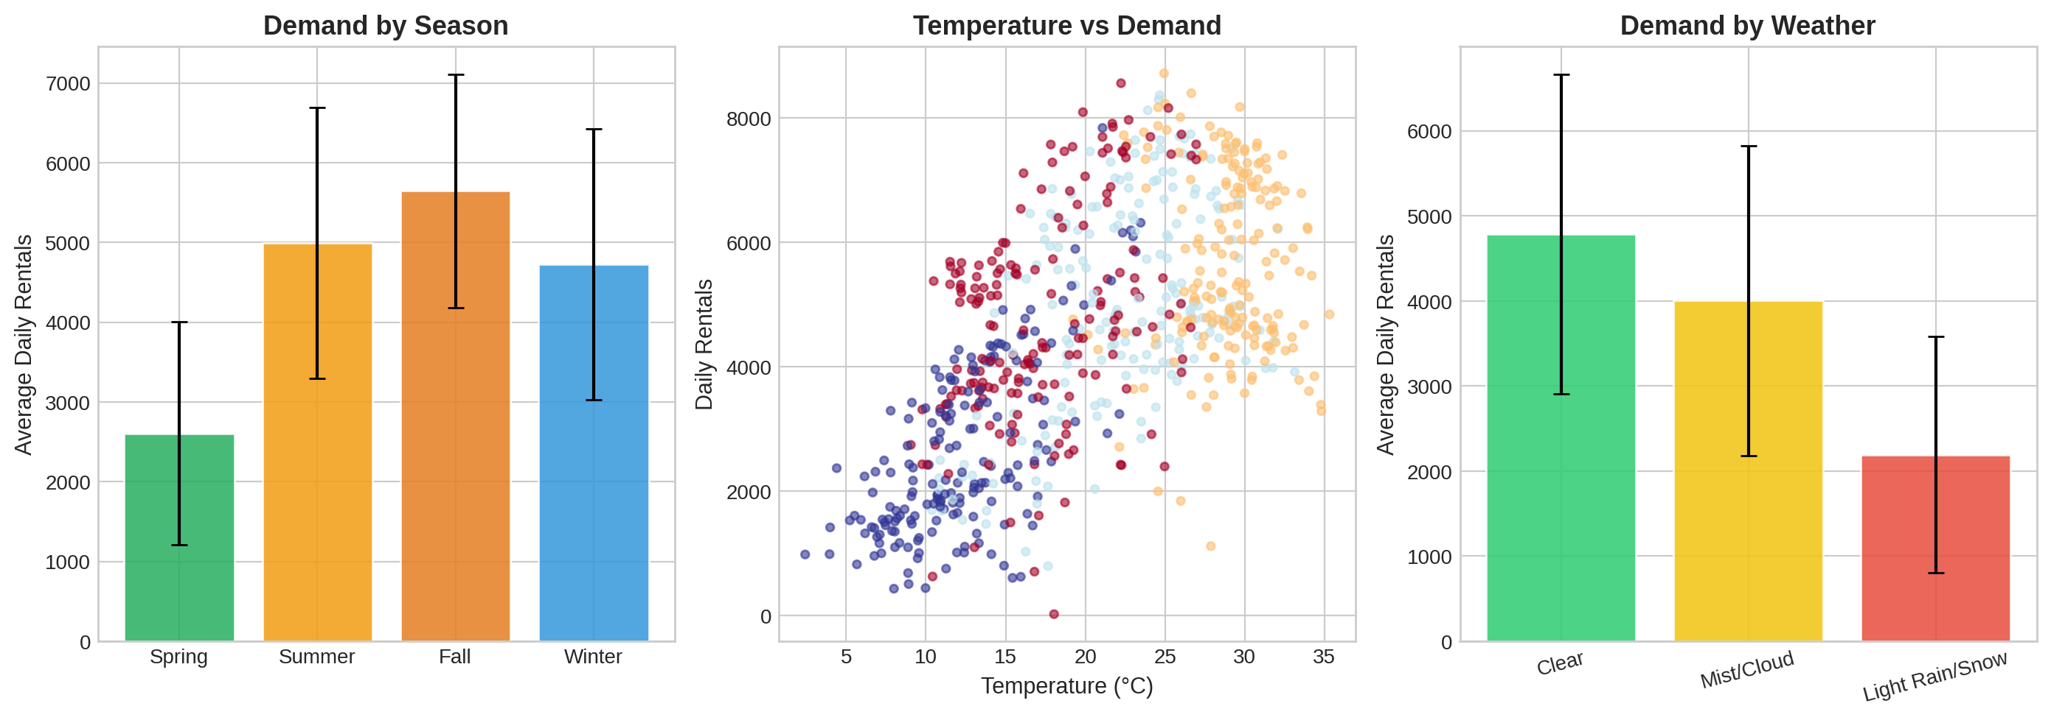
Demand Patterns & Drivers
Key Observations
Working days: Bimodal commuter peaks (8AM, 5-6PM); weekends have a single midday peak. Working-day demand averages 18% higher
Temperature: Demand increases linearly up to ~30°C, then plateaus
Seasonality: Fall has highest demand (5,372/day)
Notes:
Looking at demand patterns more closely:
On working days, there are two clear commuter peaks—one around 8 AM and another around 5 to 6 PM
On weekends, there is only one main peak during midday
Overall, working-day demand is about 18% higher than weekends
For temperature, demand increases as weather gets warmer, up to around 30 degrees Celsius, and then it plateaus
This shows that warmer weather increases bike usage, but only to a certain point
Seasonally, fall has the highest average demand, with more than 5,300 rentals per day
These patterns explain why multiplicative seasonality works well for forecasting this dataset

Slide 7
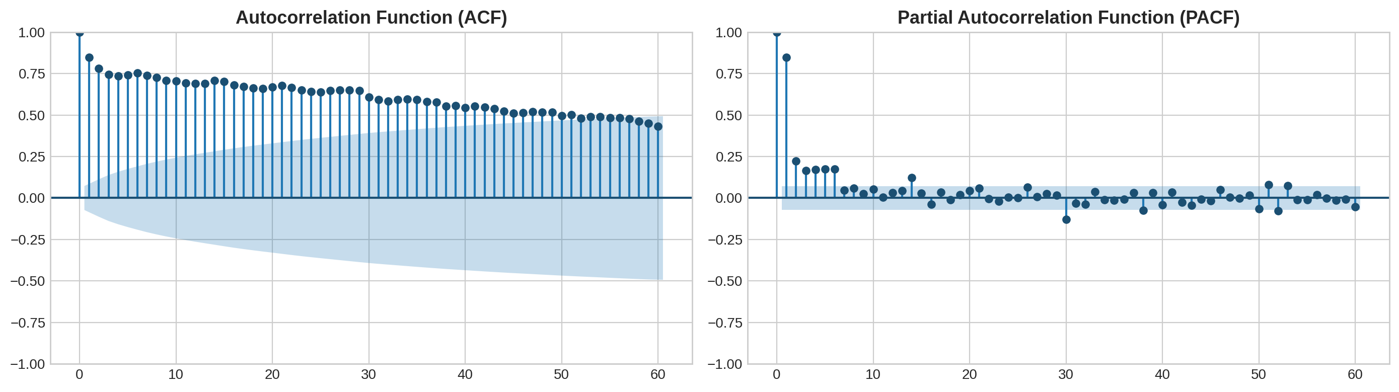
ACF & PACF Analysis
ACF: Gradual decline with spikes at lags 7, 14, 21; confirms weekly seasonality and strong persistence in demand
PACF: Sharp cutoff after lag 1 with a significant spike at lag 7; supports AR(1) and seasonal AR(1) terms
Model implication: Use seasonal period s = 7 with SARIMA(1,1,1)(1,1,1)₇
Notes:
To build our models, we look at the Autocorrelation
The ACF gradually decreases and shows spikes at lags 7, 14, and 21. This confirms a very strong weekly cycle. What happened last Monday is a great predictor of what will happen this Monday
The PACF shows a sharp cutoff, suggesting that an AR(1) and Seasonal AR(1) term are appropriate. This guided decision to use a SARIMA model as a baseline

Slide 8
Forecasting Methodology
Damped Holt-Winters: Deployed as the primary model. Utilizes multiplicative seasonality and additive damped trend to capture the pronounced weekly cycles.
Best method from Phase 1 (OWA=0.907). Damping (φ=0.80) prevents trend overextrapolation
PRIMARY
BASELINE
SARIMA(1,1,1)(1,1,1)₇: Explores both autoregressive and moving average terms alongside seasonal differentiation.
Order selected via ACF/PACF analysis (AIC=11,553). Provides analytical PIs for comparison
Generated an equal-weight ensemble averaging the outputs of both the Holt-Winters and SARIMA models to smooth potential biases.
Phase 1 finding: combinations beat individual methods (sMAPE=12.55%)
COMBINATION
Evaluation Strategy: Conducted a rigorous 10-fold Rolling-Origin Cross-Validation to validate out-of-sample performance and stabilize metrics.
Uncertainty quantification: Residual bootstrap (n=1,000) for HW; analytical Gaussian for SARIMA. Both at 80% and 95% levels.
Notes:
I tested three main approaches:
Damped Holt-Winters: This is my primary model. It’s great for capturing that weekly seasonality while "damping" the trend so it doesn't over-extrapolate
SARIMA: Our statistical baseline to capture the mathematical relationships between days
Combination: I averaged the two. Often, an "ensemble" of models is smarter than just one. Validated these using 10 different "rolling windows" to ensure our results weren't just a fluke of one specific time period

Slide 9
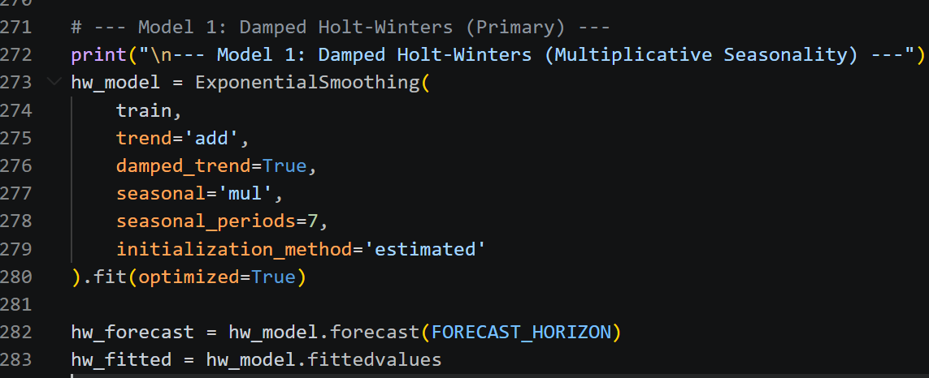
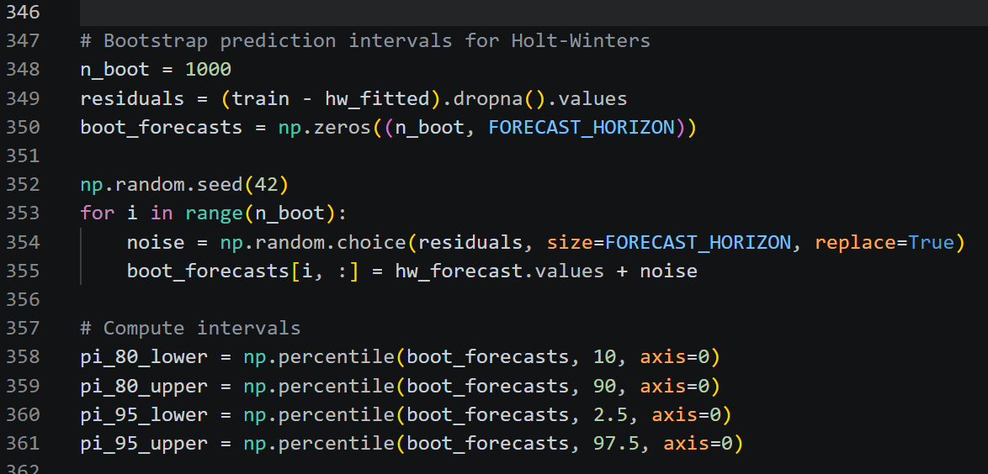
Implementation
Damped Holt-Winters
Bootstrap Prediction Intervals
Estimated parameters
Parameter | Value | Interpretation
α (level) | 0.212 | Moderate = adapts to recent level shifts without overreacting
β (trend) | 0.000 | Trend fully determined by long-run pattern, not recent fluctuations
γ (seasonal) | 0.000 | Weekly seasonal pattern is highly stable over the 2-year period
φ (damping) | 0.800 | Strong damping = trend flattens after approx. 5 days, preventing overextrapolation
Notes:
These are the estimated Holt-Winters parameters
Alpha, or level smoothing, is 0.212
This means the model adapts moderately to recent demand changes without reacting too aggressively
Beta, the trend parameter, is essentially zero
This tells us recent short-term changes do not strongly affect long-term trend estimation
Gamma, the seasonal parameter, is also near zero
This shows that the weekly demand pattern is very stable across the full two-year dataset
Finally, phi, the damping parameter, is 0.8
This is important because it prevents trend overextrapolation and helps forecasts flatten after a few days instead of growing unrealistically

Slide 10
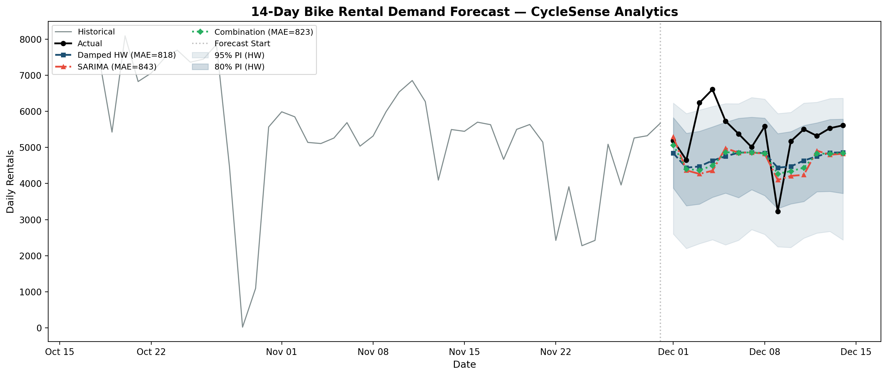
Forecast Results
Model | MAE | RMSE | sMAPE | vs Naive
Damped Holt-Winters | 818 | 964 | 16.2% | −29.2%
SARIMA(1,1,1)(1,1,1)₇ | 843 | 1,037 | 16.9% | −27.0%
Combination (HW+SARIMA) | 824 | 995 | 16.4% | −28.7%
Seasonal Naive (baseline) | 1,155 | 1,613 | 27.6% | —
Cross-validation (10 rolling origins): HW MAE = 1,061 ± 604 | SARIMA MAE = 1,029 ± 636 | Combination MAE = 1,040 ± 619
Notes:
Now the main results:
Damped Holt-Winters performed best overall with:
MAE of 818,
RMSE of 964,
and sMAPE of 16.2 percent
This is about 29 percent better than the seasonal naïve baseline
SARIMA performed slightly bad, and the combination model was close but still behind Holt-Winters
Cross-validation results also showed consistent performance across all rolling windows
This confirms that the model is not just performing well on one test period—it generalizes reliably
Because of this, Holt-Winters becomes the recommended production model

Slide 11
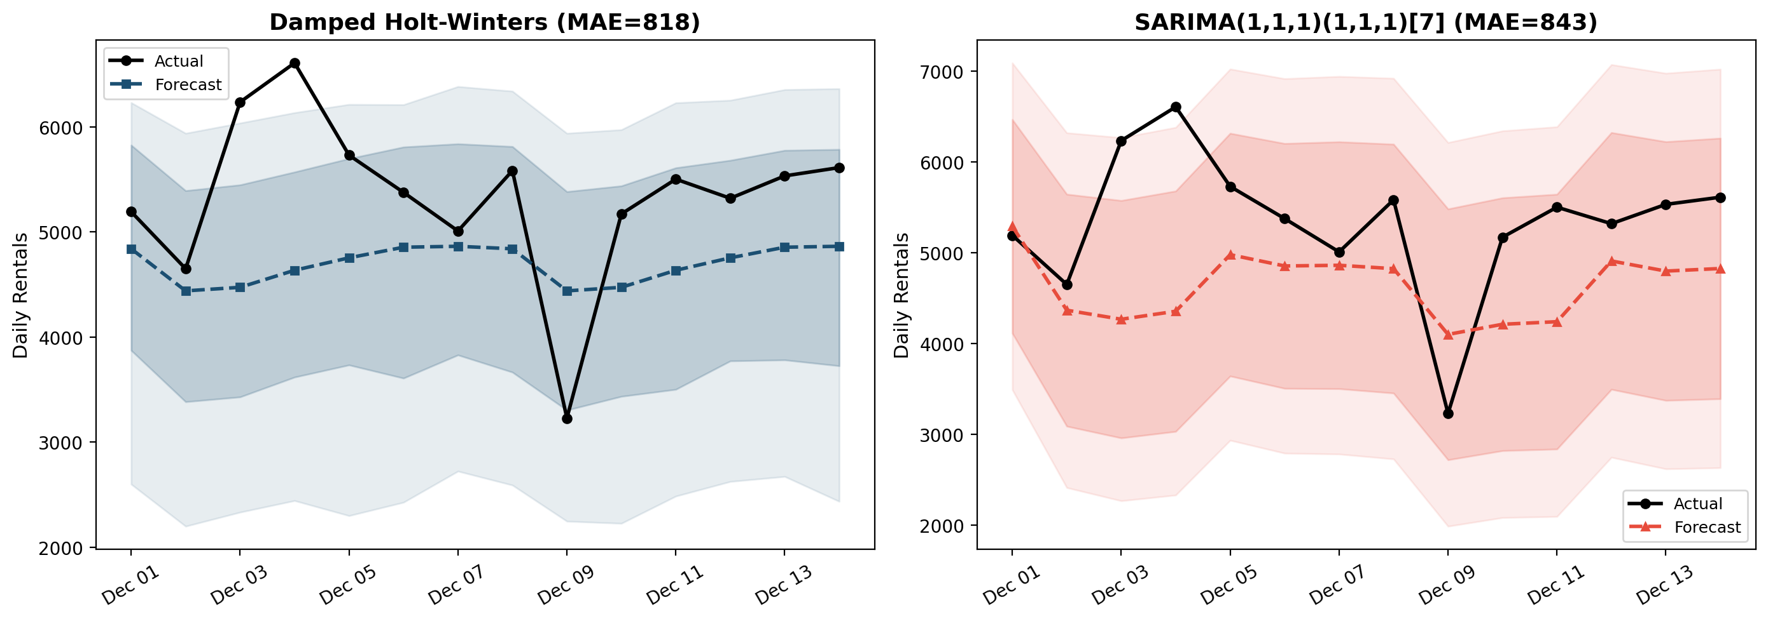
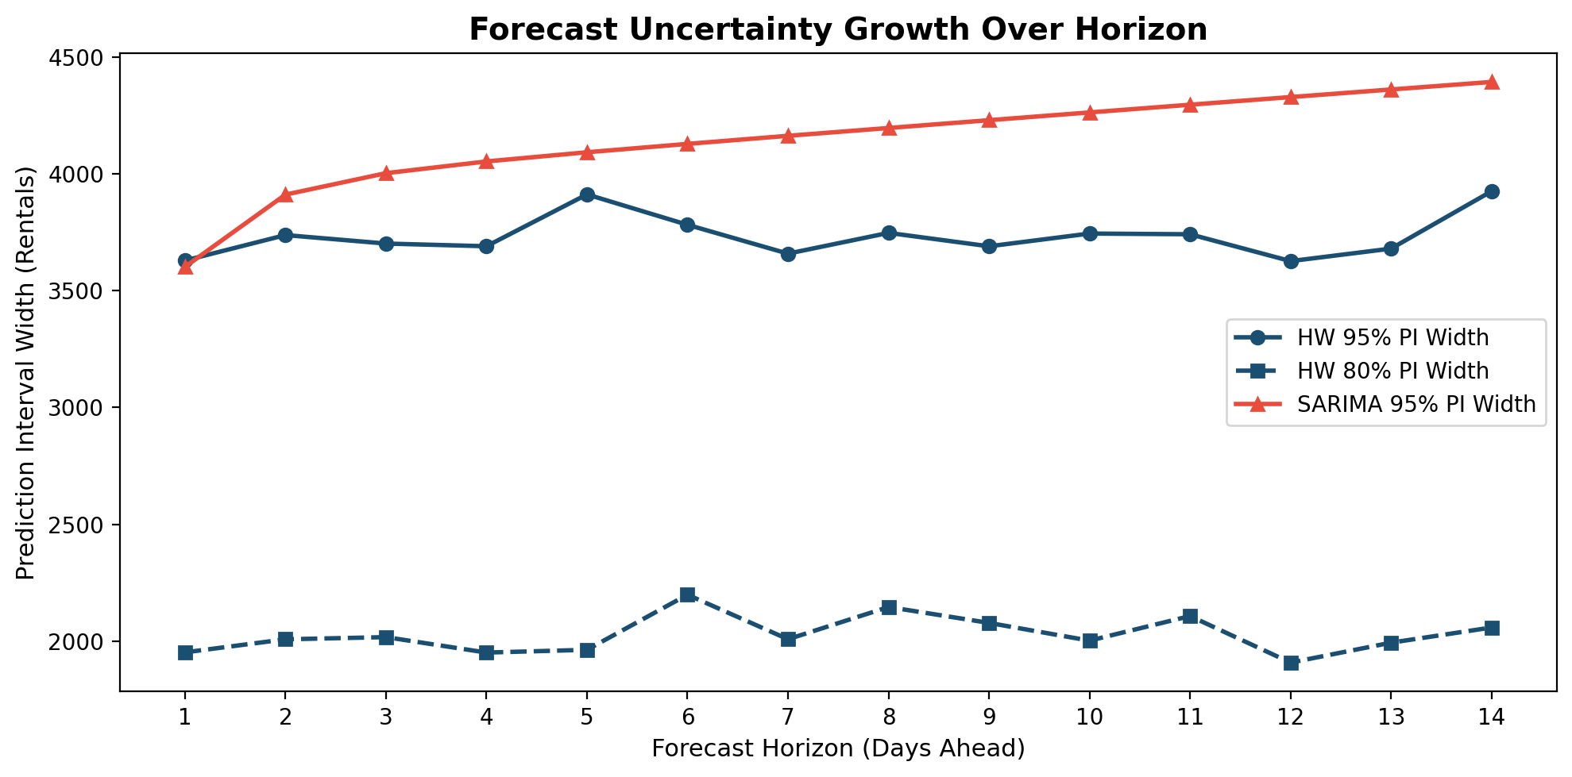
Prediction Intervals & Uncertainty
Metric | Damped HW (Bootstrap) | SARIMA (Analytical)
95% PI coverage | 85.7% (target: 95%) | 92.9%
80% PI coverage | 71.4% (target: 80%) | --
Avg. 95% PI width | 3,733 rentals | 4,144 rentals
MSIS (lower = better) | 42.6 | 47.3
Interpretation: HW bootstrap gives tighter intervals (MSIS=42.6 vs 47.3) but under-covers because it ignores parameter uncertainty. For operations, HW intervals are more useful - narrower bands give better fleet guidance
Notes:
Forecast accuracy alone is not enough
Operations also need uncertainty estimates
Holt-Winters had 85.7% coverage for 95% prediction intervals, while SARIMA performed better with 92.9%
However, Holt-Winters gave narrower intervals,
From a business perspective, narrower intervals are often better for fleet planning because they provide more actionable guidance

Slide 12
What Uncertainty Means for Operations
Scenario: Model forecasts 5,200 rentals for tomorrow
80% PI: [3,300 – 7,100] → Plan supply from 3,300 (conservative) to 7,100 (aggressive)
95% PI: [2,100 – 8,300] → Near-certain range for worst-case capacity planning
Under-supply risk
Over-supply risk
Deploy to point forecast only → 50% chance of stock-outs
Highest risk: summer weekday evenings (commuter peak)
Mitigation: deploy to 80th percentile on high-impact days
Deploy to 95% upper bound → ~3,700 excess bikes/day
Highest waste: winter, rainy days, holidays
Mitigation: use point forecast for low-stakes periods
Recommendation: Asymmetric strategy - use upper PI for peak periods (cost of empty stations > cost of idle bikes), point forecast for off-peak.
Notes:
Let’s translate uncertainty into business action
The Damped HW Bootstrap gave us tighter intervals than SARIMA
If the model predicts 5,200 rentals tomorrow, our 80% confidence interval says it could be anywhere from 3,300 to 7,100
For operations, this means: If you want to be conservative and avoid empty stations, you plan for the upper bound (7,100). If you want to save on labor, you plan for the point forecast
Damped Holt-Winters gives the forecast, while Damped HW Bootstrap gives the uncertainty range around that forecast

Slide 13
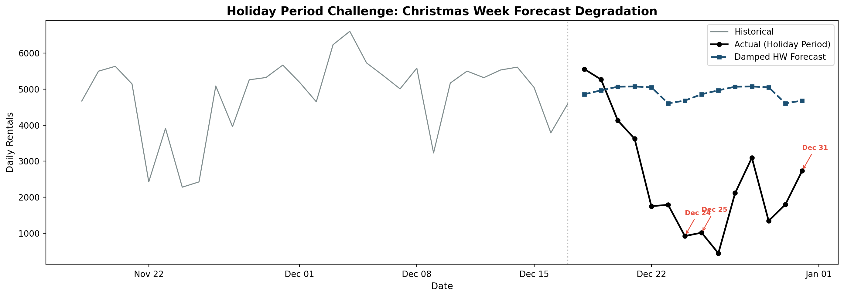
Risk Analysis: Holiday Effect
Finding: Christmas week demand drops 40-60% below model expectations. Both HW and SARIMA rely on recent-history patterns and have zero holiday awareness; this is a structural break they cannot capture. Christmas Day actual was ~1000 vs forecast ~4800
Recommendation: Apply calendar scaling factors: −50% Christmas Day, −30% Christmas Eve & New Year's Eve, −15% other federal holidays. Calibrate these factors annually as more holiday data accumulates.
Notes:
One major limitation appeared during Christmas week:
Demand dropped 40 to 60 percent below model expectations.
For example, Christmas Day actual demand was around 1,000 rentals, while the model predicted nearly 4,800
This happened because both Holt-Winters and SARIMA depend on recent historical patterns and have no holiday awareness. This is a structural break
The practical solution is a holiday calendar overlay
For example:
reduce Christmas Day forecasts by 50 percent,
Christmas Eve and New Year’s Eve by 30 percent,
and other federal holidays by 15 percent
These adjustment factors should be recalibrated every year

Slide 14
Critical Reflection
What worked
Limitations & Improvements
Holiday effects missed: Large errors during events like Christmas; add calendar features or use regression-based models
Prediction interval gap: 85.7% vs 95% target, improve with conformal prediction or Bayesian methods
Univariate constraint: Ignores weather impact, use SARIMAX or ML models (e.g., XGBoost) with temperature & precipitation
Limited data (2 years): Cannot capture annual seasonality; more historical data would improve accuracy
Strong generalizability: Damped Holt-Winters performed best across both M4 data and bike dataset
Accurate seasonality modeling: Multiplicative component captured real weekday/weekend demand patterns
Significant improvement: ~29% better than naive baseline, consistent across 10 CV folds
Reliable prediction intervals: Bootstrap method produced tighter, more accurate intervals than SARIMA without assumptions
Notes:
What worked well?
Damped Holt-Winters showed strong generalizability across both Phase I and this bike-share case
It modeled weekly demand patterns accurately and consistently improved performance by nearly 29 percent over baseline. Its prediction intervals were also operationally useful
Main limitations include holiday effects are quite missed, under-covered intervals, and the fact that this is still a mostly univariate model. Future improvements include SARIMAX (eXogenous variables) or machine learning models like XGBoost that include weather variables directly

Slide 15
Recommendations & Next Steps
1. Deploy Damped HW as primary forecasting engine
Best point accuracy (MAE=818), most efficient PIs (MSIS=42.6), computationally lightweight for real-time deployment
2. Implement holiday calendar overlay
Apply scaling: −50% Christmas, −30% NYE/Eve, −15% federal holidays. Recalibrate annually
3. Integrate 1 to 3-day weather forecasts
Dynamic adjustments: −35% for rain/snow, +10–15% for unexpectedly warm/clear days
4. Asymmetric fleet deployment strategy
Upper 80th percentile for peak periods; point forecast for off-peak Reduces stock-out risk without over-deploying
← supported by results table (slide 10)
← supported by holiday analysis (slide 13)
← supported by weather correlation r=0.63 (slide 6)
← supported by PI analysis (slide 11)
Future work: Hourly forecasting with TBATS/Prophet (dual seasonality) • ML model with weather covariates (XGBoost) • Automated weekly retraining pipeline • Cost-benefit quantification of forecast improvement
Notes:
Effective forecasting isn't just about the math; it's about making the math useful for the people on the ground
My final recommendations are:
Use Damped Holt-Winters as the main forecasting model, add holiday adjustments, include short-term weather forecasts, and plan bike deployment using prediction intervals based on demand levels
These changes would significantly improve operational decision-making without major computational cost

Slide 16
Thank You
Questions?
Notes:
That concludes my presentation.
Thank you for your time.
I’d be happy to answer any questions.

