Slide 1
IPR reporting dataを見つめる
5JW 飯星 陽平

Slide 2
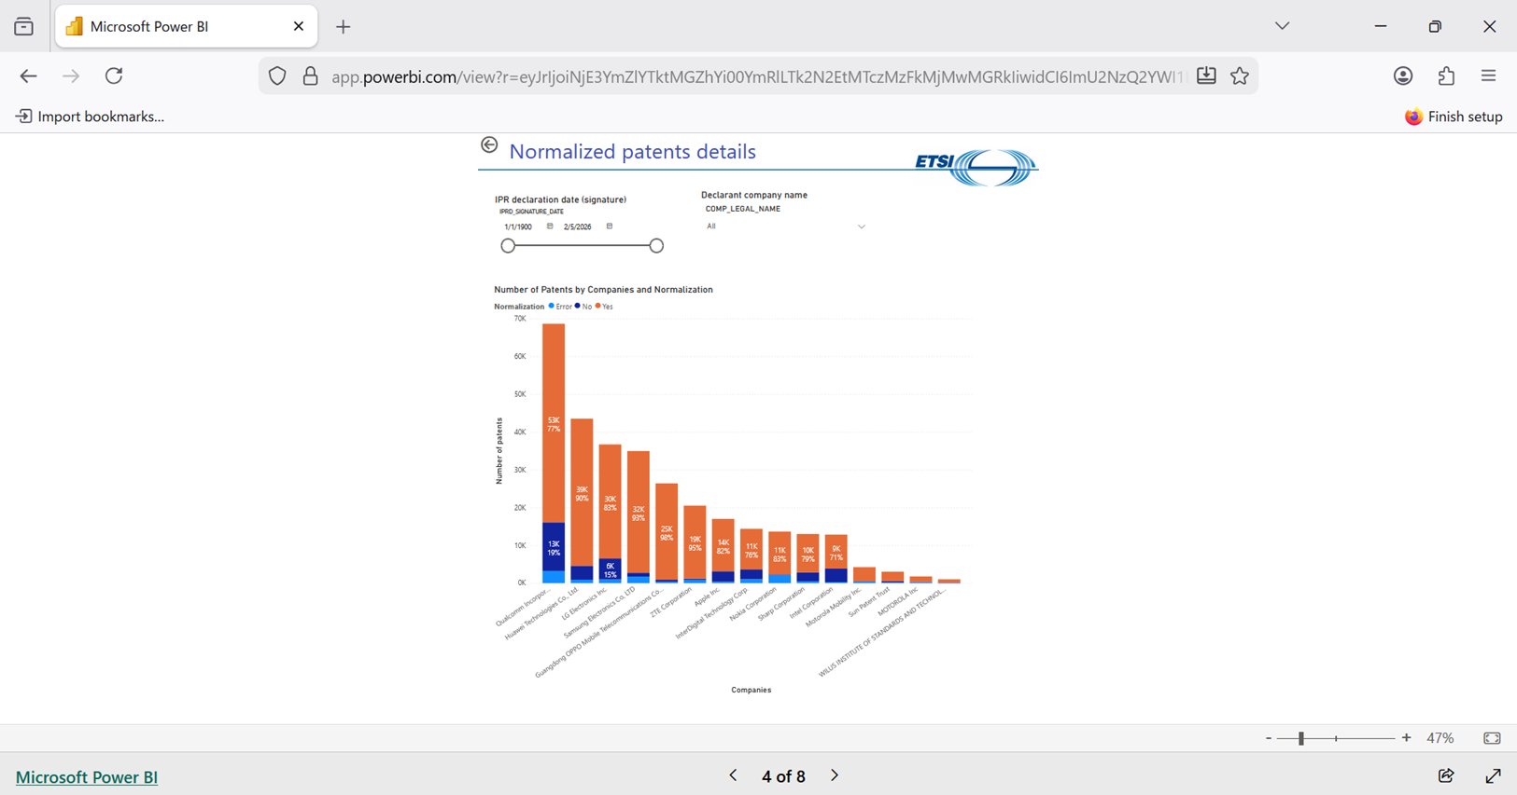
公式の分析ツール
ETSI Power BI reportから、企業毎の宣言数が確認可能である。

Slide 3
IPR reporting dataにおける各レコードの内容
IPRD_ID | 2381 | WOIT_REFERENCE | RTS/TSGR-0236300vc40 | Illustrative_Part | Section 4.9, 6.1.2.2, 6.1.3.2, 6.5, 7.6, 10.1.2.8.1
IPRD_REFERENCE | ISLD-201608-010 | WOIT_VERSION | 12.4.0 | DIPG_PATF_ID | 20438
IPRD_SIGNATURE_DATE | 2016/8/31 | 3GPP_Type | TS | Original_Application_Number | -1
Reflected_Date | 2016/10/6 | TGPP_NUMBER | 36.3 | Original_Publication_Number | -1
COMP_LEGAL_NAME | NTT DOCOMO INC | TGPV_VERSION | 12.4.0 | Explicitely_Disclosed | 1
DECL_IS_PROP_FLAG | 1 | Patent_Type | Family Member | Normalized_Patent | 1
LICD_DEC_PREP_TO_GRANT_FLAG | 1 | PATT_APPLICATION_NUMBER | CN2013832490 | 2G | 0
LICD_REC_CONDI_FLAG | 1 | PUBL_NUMBER | CN104396293 A | 3G | 0
DIPG_ID | 43483 | PBPA_TITLEEN | Radio communication system and base station | 4G | 1
DIPG_DISPLAY_NUMBER | 1 | PBPA_PRIORITY_NUMBERS | |JP20120140900|WO2013JP63391| | 5G | 0
DIPG_EXTERNAL_ID | -1 | Country_Of_Registration | CN CHINA
Standard | TS 136 300 (RTS/TSGR-0236300vc40) version 12.4.0 -- 3GPP TS 36.300 version 12.4.0 | PBPA_APP_DATE | 2013/5/14
Ess_To_Standard | 1 | ETPR_ID | 876
WI_Type | TS | ETPR_ACRONYM | 3GPP-Release-12 | GSM Phase 2+ and UMTS/LTE/LTE-Advanced release 12
WOIT_ETSI_DELIVERABLE_NUMBER | 136 300 | Ess_To_Project | 1
IPR宣言の番号（IPRD_REFERENCE）、特許文献の番号（PUBL_NUMBER）、優先権を主張している文献番号（PBPA_PRIORITY_NUMBERS）なども確認可能。

Slide 4
分析の基準を考える
IPRD_ID | 2381 | 2381 | 2381 | 2381
IPRD_REFERENCE | ISLD-201608-010 | ISLD-201608-010 | ISLD-201608-010 | ISLD-201608-010
IPRD_SIGNATURE_DATE | 2016-08-31 | 2016-08-31 | 2016-08-31 | 2016-08-31
COMP_LEGAL_NAME | NTT DOCOMO INC | NTT DOCOMO INC | NTT DOCOMO INC | NTT DOCOMO INC
DIPG_ID | 43483 | 43483 | 43483 | 43483
Patent_Type | Family Member | Family Member | Basis Patent | Family Member
PATT_APPLICATION_NUMBER | CN2013832490 | WO2013JP63391 | JP20120140900 | US201314406757
PUBL_NUMBER | CN104396293 A | WO2013190929 A1 | JP2014007500 A | JP5758352 B2 | US2015172963 A1 | US9344922 B2
PBPA_PRIORITY_NUMBERS | |JP20120140900|WO2013JP63391| | |JP20120140900| | |JP20120140900| | |JP20120140900|WO2013JP63391|
Country_Of_Registration | CN CHINA | WO Patent Cooperation Treaty | JP JAPAN | US UNITED STATES
PBPA_APP_DATE | 2013-05-14 | 2013-05-14 | 2012-06-22 | 2013-05-14
ETPR_ID | 876 | 876 | 876 | 876
DIPG_PATF_ID | 20438 | 20438 | 20438 | 20438
DIPG_ID（IPRデータベースにおける開示特許グループの一意の数値識別子）を基準に、分析する。（宣言書の付属書における1つの開示「ブロック」に対応する。）

Slide 5
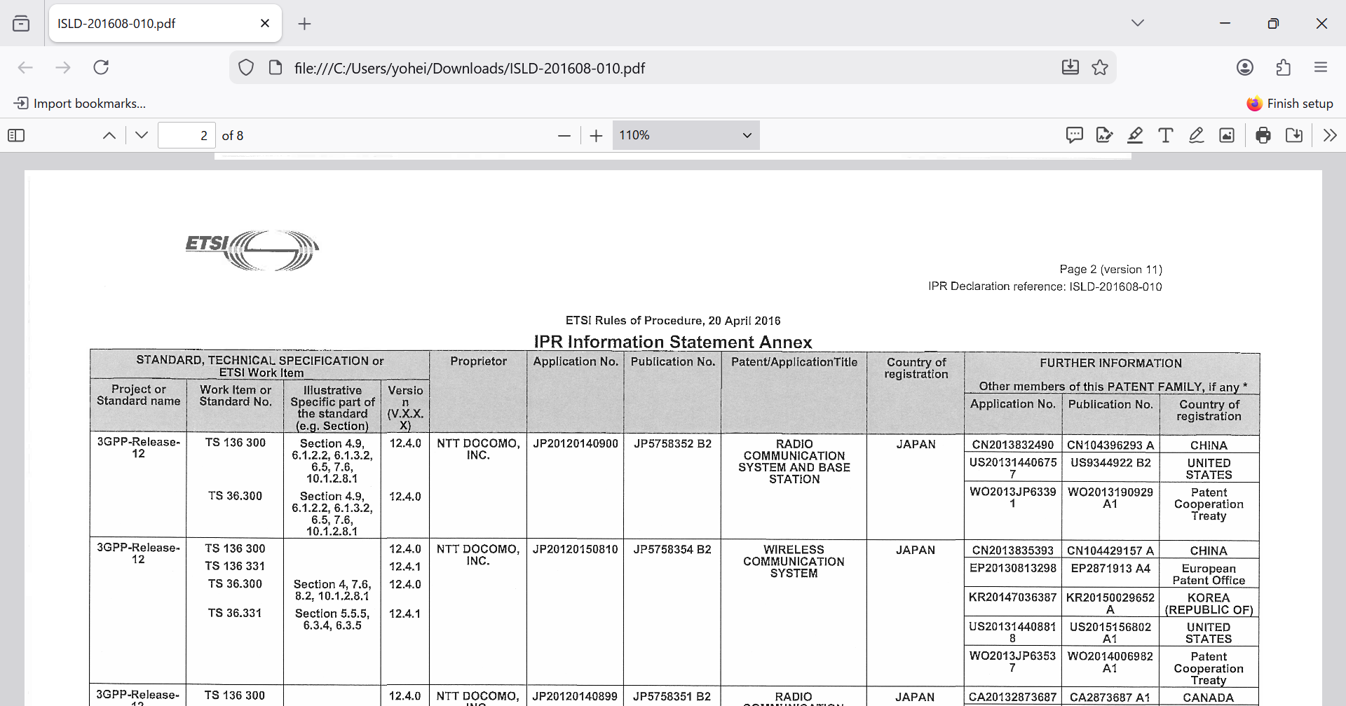
IPR INFORMATION STATEMENT AND LICENSING DECLARATIONの内容
ISLD-201608-010という宣言を実際に確認する。

Slide 6
分析の基準を考える
IPRD_ID | 2381 | 2381 | 2381 | 4213 | 4301 | 4252 | 4252 | 4213
IPRD_REFERENCE | ISLD-201608-010 | ISLD-201608-010 | ISLD-201608-010 | ISLD-201906-021 | ISLD-201907-041 | ISLD-201907-008 | ISLD-201907-008 | ISLD-201906-021
COMP_LEGAL_NAME | NTT DOCOMO INC | NTT DOCOMO INC | NTT DOCOMO INC | NTT DOCOMO INC | NTT DOCOMO INC | NTT DOCOMO INC | NTT DOCOMO INC | NTT DOCOMO INC
DIPG_ID | 43483 | 43483 | 43483 | 83279 | 90289 | 87420 | 87420 | 83279
PATT_APPLICATION_NUMBER | CN2013832490 | WO2013JP63391 | JP20120140900 | JP20120140900 | JP20120140900 | US201314406757 | WO2013JP63391 | CN2013832490
PUBL_NUMBER | CN104396293 A | WO2013190929 A1 | JP2014007500 A | JP5758352 B2 | JP2014007500 A | JP5758352 B2 | JP2014007500 A | JP5758352 B2 | US2015172963 A1 | US9344922 B2 | WO2013190929 A1 | CN104396293 A
PBPA_TITLEEN | Radio communication system and base station | RADIO COMMUNICATION SYSTEM AND BASE STATION | RADIO COMMUNICATION SYSTEM AND BASE STATION | RADIO COMMUNICATION SYSTEM AND BASE STATION | RADIO COMMUNICATION SYSTEM AND BASE STATION | RADIO COMMUNICATION SYSTEM AND BASE STATION | RADIO COMMUNICATION SYSTEM AND BASE STATION | Radio communication system and base station
PBPA_PRIORITY_NUMBERS | |JP20120140900|WO2013JP63391| | |JP20120140900| | |JP20120140900| | |JP20120140900| | |JP20120140900| | |JP20120140900|WO2013JP63391| | |JP20120140900| | |JP20120140900|WO2013JP63391|
Country_Of_Registration | CN CHINA | WO Patent Cooperation Treaty | JP JAPAN | JP JAPAN | JP JAPAN | US UNITED STATES | WO Patent Cooperation Treaty | CN CHINA
ETPR_ID | 876 | 876 | 876 | 1228 | 1228 | 1228 | 1228 | 1228
Illustrative_Part | Section 4.9, 6.1.2.2, 6.1.3.2, 6.5, 7.6, 10.1.2.8.1 | Section 4.9, 6.1.2.2, 6.1.3.2, 6.5, 7.6, 10.1.2.8.1 | Section 4.9, 6.1.2.2, 6.1.3.2, 6.5, 7.6, 10.1.2.8.1 | -1 | Section 10.2.1 | -1 | -1 | -1
DIPG_PATF_ID | 20438 | 20438 | 20438 | 20438 | 20438 | 20438 | 20438 | 20438
次頁へ続く。

Slide 7
分析の基準を考える
IPRD_ID | 4213 | 4213 | 4301 | 4301 | 4252 | 2381 | 4252 | 4301
IPRD_REFERENCE | ISLD-201906-021 | ISLD-201906-021 | ISLD-201907-041 | ISLD-201907-041 | ISLD-201907-008 | ISLD-201608-010 | ISLD-201907-008 | ISLD-201907-041
COMP_LEGAL_NAME | NTT DOCOMO INC | NTT DOCOMO INC | NTT DOCOMO INC | NTT DOCOMO INC | NTT DOCOMO INC | NTT DOCOMO INC | NTT DOCOMO INC | NTT DOCOMO INC
DIPG_ID | 83279 | 83279 | 90289 | 90289 | 87420 | 43483 | 87420 | 90289
PATT_APPLICATION_NUMBER | US201314406757 | WO2013JP63391 | US201314406757 | WO2013JP63391 | JP20120140900 | US201314406757 | CN2013832490 | CN2013832490
PUBL_NUMBER | US2015172963 A1 | US9344922 B2 | WO2013190929 A1 | US2015172963 A1 | US9344922 B2 | WO2013190929 A1 | JP2014007500 A | JP5758352 B2 | US2015172963 A1 | US9344922 B2 | CN104396293 A | CN104396293 A
PBPA_TITLEEN | RADIO COMMUNICATION SYSTEM AND BASE STATION | RADIO COMMUNICATION SYSTEM AND BASE STATION | RADIO COMMUNICATION SYSTEM AND BASE STATION | RADIO COMMUNICATION SYSTEM AND BASE STATION | RADIO COMMUNICATION SYSTEM AND BASE STATION | RADIO COMMUNICATION SYSTEM AND BASE STATION | Radio communication system and base station | Radio communication system and base station
PBPA_PRIORITY_NUMBERS | |JP20120140900|WO2013JP63391| | |JP20120140900| | |JP20120140900|WO2013JP63391| | |JP20120140900| | |JP20120140900| | |JP20120140900|WO2013JP63391| | |JP20120140900|WO2013JP63391| | |JP20120140900|WO2013JP63391|
Country_Of_Registration | US UNITED STATES | WO Patent Cooperation Treaty | US UNITED STATES | WO Patent Cooperation Treaty | JP JAPAN | US UNITED STATES | CN CHINA | CN CHINA
ETPR_ID | 1228 | 1228 | 1228 | 1228 | 1228 | 876 | 1228 | 1228
Illustrative_Part | -1 | -1 | Section 10.2.1 | Section 10.2.1 | -1 | Section 4.9, 6.1.2.2, 6.1.3.2, 6.5, 7.6, 10.1.2.8.1 | -1 | Section 10.2.1
DIPG_PATF_ID | 20438 | 20438 | 20438 | 20438 | 20438 | 20438 | 20438 | 20438
DIPG_PATF_ID （ IPR データベース内の開示の ETSI 特許ファミリの一意の数値識別子）を基準に、分析する。

Slide 8


データベースの構造
Basis Patent
Family Member
1レコード(1行分)
LICENSING DECLARATION
JP20120140900
JP20120140900
JP20120150810
ISLD-201608-010
JP20120140900
JP20120140899
JP20120201344
JP20120140900

Slide 9













データベースの構造
$${IPRD_ID}_{1}$$
$${IPRD_ID}_{2}$$
$${IPRD_ID}_{3}$$
LICENSING DECLARATION
LICENSING DECLARATION
LICENSING DECLARATION
複数を1つ
にしている場合もある
$${DIPG_ID}_{3}$$
$${DIPG_ID}_{2}$$
$${DIPG_ID}_{5}$$
$${DIPG_ID}_{5}$$
$${DIPG_ID}_{1}$$
$${DIPG_ID}_{4}$$
Basis Patent
Basis Patent
Basis Patent
Basis Patent
$${DIPG_PATF_ID}_{1}$$
$${DIPG_PATF_ID}_{2}$$
$${DIPG_PATF_ID}_{3}$$
$${DIPG_PATF_ID}_{4}$$

Slide 10
データベースの構造
宣言数
LICENSING DECLARATION
LICENSING DECLARATION
LICENSING DECLARATION
グループ数
ファミリー数
Basis Patent
Basis Patent
Basis Patent
Basis Patent

Slide 11
データ分析をしよう

Slide 12
データの信ぴょう性について
company | LICD_REC_CONDI_FLAG | DIPG_PATF_ID | PUBL_NUMBER | PBPA_APP_DATE | TGPP_NUMBER | TGPV_VERSION | Standard | Gen_2G | Gen_3G | Gen_4G | Gen_5G | Ess_To_Standard | Ess_To_Project | Illustrative_Part
Ericsson | 34.68 | 8.13 | 19.04 | 13.09 | 34.67 | 53.16 | 31.74 | 34.74 | 34.74 | 34.74 | 34.74 | 31.74 | 0.02 | 64.95
Huawei | 0.39 | 9.04 | 12.27 | 8.69 | 2.26 | 99.81 | 0.08 | 2.28 | 2.28 | 2.28 | 2.28 | 0.08 | 0.32 | 99.85
NEC | 0 | 2.46 | 5.79 | 4.25 | 5.42 | 16.58 | 0.03 | 5.42 | 5.42 | 5.42 | 5.42 | 0.03 | 0.01 | 11.02
NTT Docomo | 0 | 1.84 | 6.74 | 1.97 | 0.81 | 0.96 | 0.51 | 0.84 | 0.84 | 0.84 | 0.84 | 0.51 | 2.63 | 34.27
Toyota | 0.97 | 0 | 3.73 | 0 | 0 | 0.24 | 0 | 0 | 0 | 0 | 0 | 0 | 0.97 | 0.97
企業間によって、データがNULL（未記入）である割合が異なる。

Slide 13
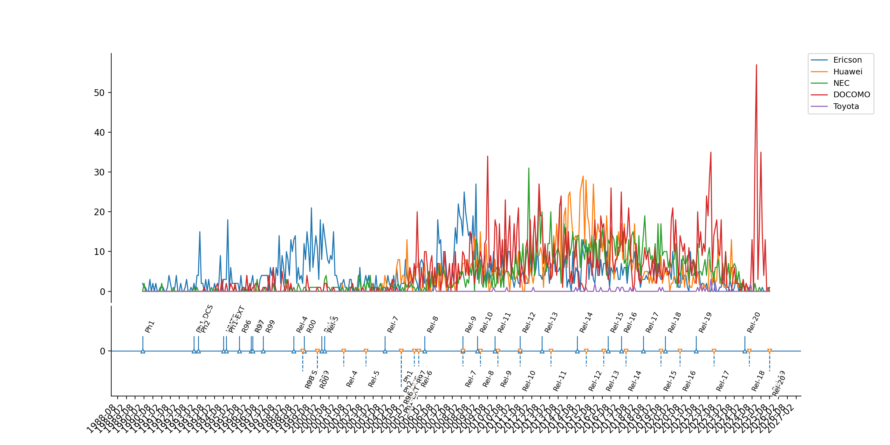
各releaseと出願件数の増減
JPへの出願件数について、releaseとの相関があるか無いかがいまいちよくわからない。

Slide 15
【参考】分析例
日本における5Gの出願に占める、ETPR_IDの割合。

Slide 16
【参考】分析例
3GPP-Release-12 | GSM Phase 2+ and UMTS/LTE/LTE-Advanced release 12に関連する宣言をした企業の割合を分析する。（ETPR_ID ＝ 876）

Slide 17
参考文献
ETSI, IPR CSV export file, https://docbox.etsi.org/IPR/Open
ETSI, ETSI IPR Reporting Solutions, https://help.etsi.org/index.php?title=ETSI_IPR_Reporting_Solutions
ETSI, IPR INFORMATION(ISLD-201608-010), https://ipr.etsi.org/IPRDetails.aspx?IPRD_ID=2381&IPRD_TYPE_ID=2&MODE=2

