Slide 1
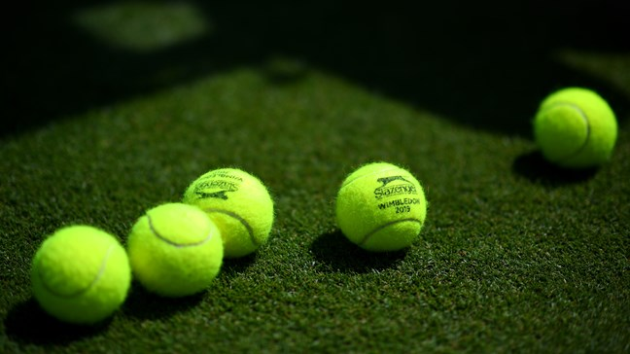
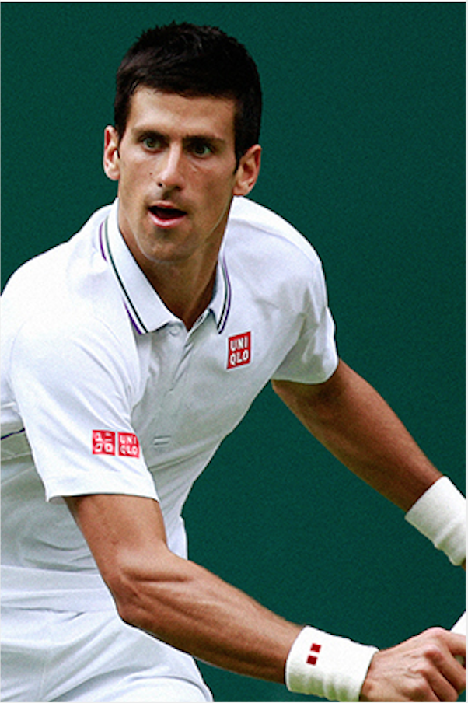

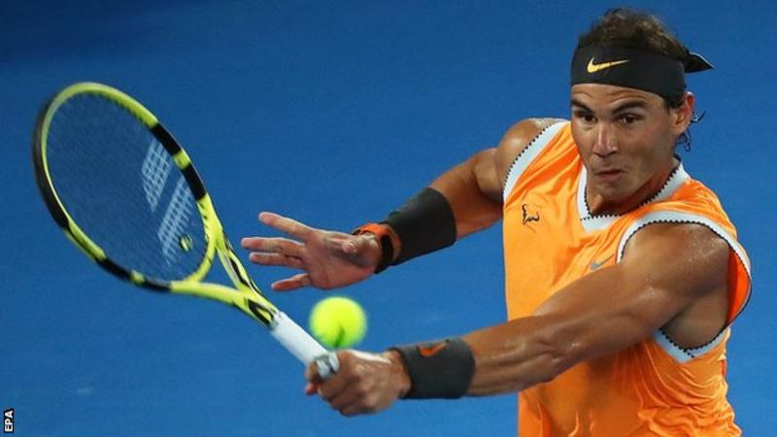
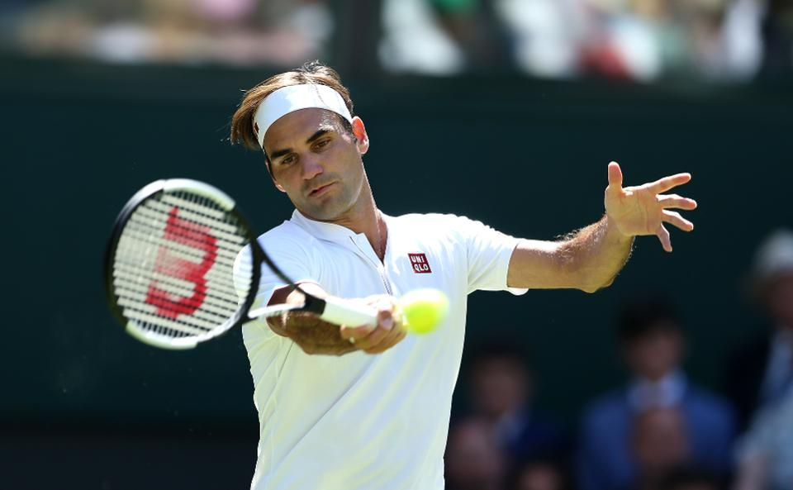
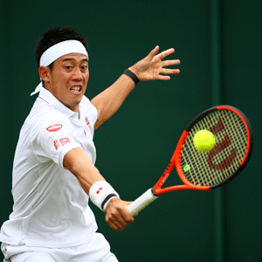
Novak Djokovic: The ultimate choice for Lacoste’s next ambassador
GROUP NINE MARKETING INC.
Ronald Matten
Xinyi Li
My Vien

Slide 2


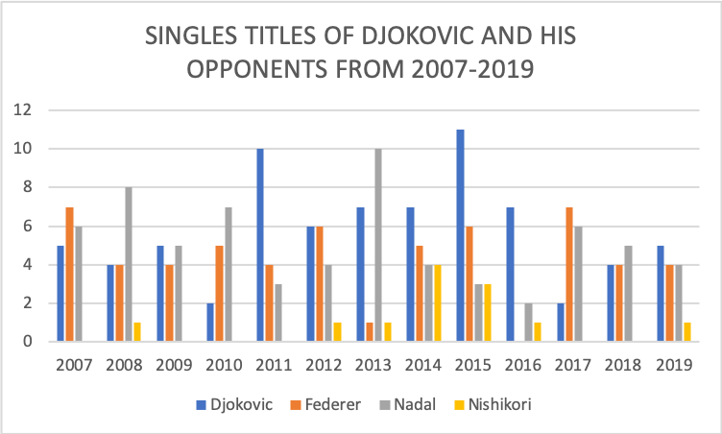
NUMBER 1 POSITION AND CONSISTENTLY EXCEEDING HIS OPPONENTS IN ACHIEVING HIGHEST RANK AND RECORDS
Djokovic:
Djokovic has been ranked at the top of Men’s Tennis since 2010.
Except the 2017 injury, Djokovic continuously beat other players in winning the Singles Titles.
After the incident, he quickly recovered his performance.
Consistence in earnings and high win percentage.
However, this could lead to probability of being less dependent on sponsorship and increased revenues.
2017 INJURY
Other Candidates:
Nadal is statistically same player with Djokovic but cannot match Djokovic’s earnings. The big chance that he may depend on sponsorship revenues.
Federer is oldest and nearing the end of his career and has not shown the same consistency.
Nishikori is the youngest of the group but failed to break past the number five position.
Group 9 Marketing Inc. 2

Slide 3
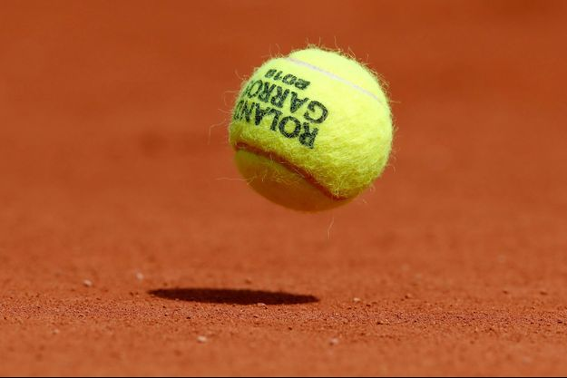
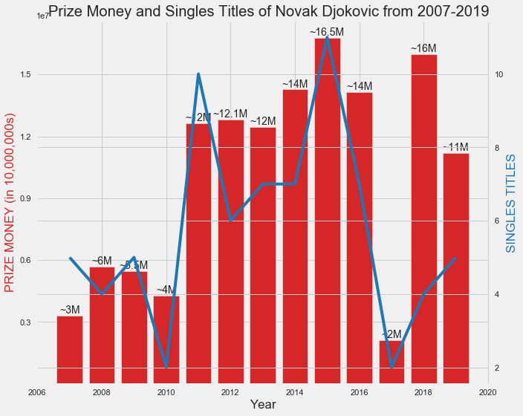
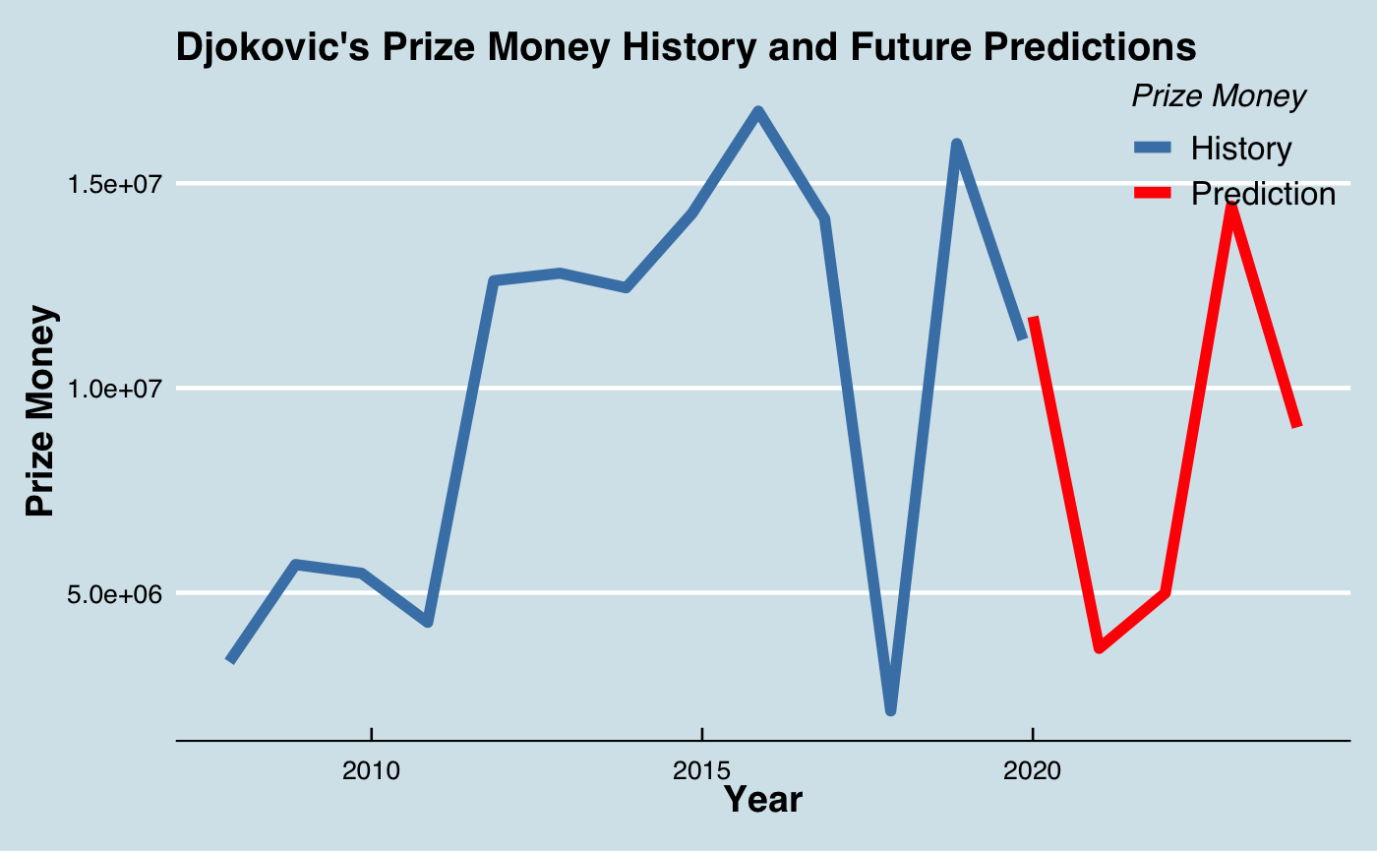
FUTURE EARNINGS PREDICTIONS OF DJOKOVIC BASED ON HISTORICAL DATA OF SINGLES TITLES
Conclusion:
We should expect some injury in his future play.
His risk of injury is greater than Nadal’s and less than Federer’s.
Even though future injury plays an insignificant role in this current contract, we do not recommend sponsorship behind this five year contract.
Group 9 Marketing Inc. 3

Slide 4
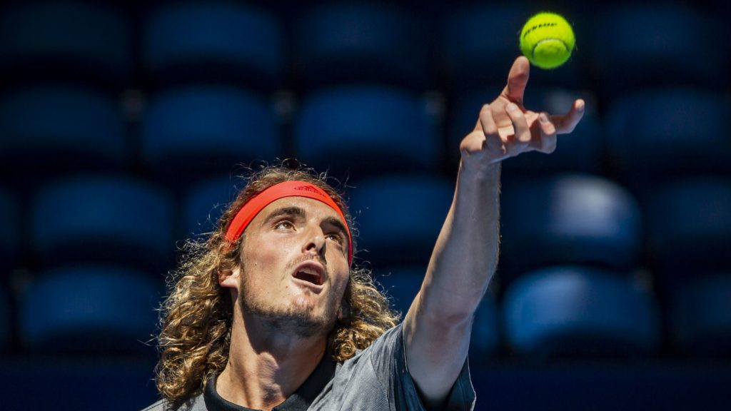
ANOTHER ALTERNATIVE
Stefanos Tsitsipas is the youngest of top 10 players, and currently ranked number six.
Long career ahead for his name recognition.
Potential of becoming one of the MUPPYs.
Group 9 Marketing Inc. 4

