Slide 1
LITERATURE REVIEW Bird song identification
Thanyaporn Phinthuphan
3 Sep 2018

Slide 2
Outline
Bird song classification in field recordings (Mario, 2013)
Bird identification from audio recordings (Rafael, 2013)
Clusterized MFCC & SVM for bird song identification (Olivier, 2013)

Slide 3
Bird Song Classification in Field Recordings Introduction
author: Mario Lasseck
the winning Solution for NIPS4B 2013 Competition
starting point is the solution for the MLSP 2013 Competition
87 sound classes of birds (call/song)
687 audio file (WAV format) in the training set

Slide 4
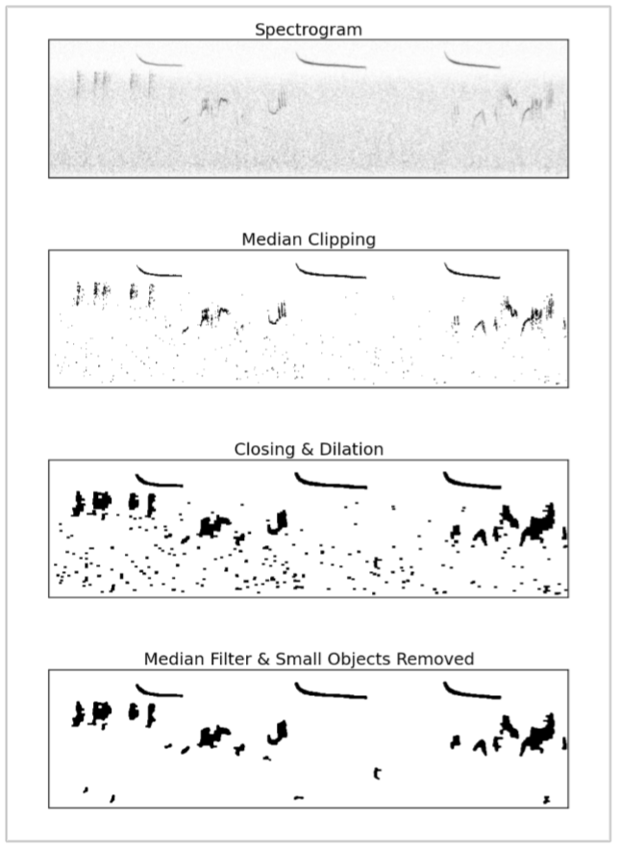
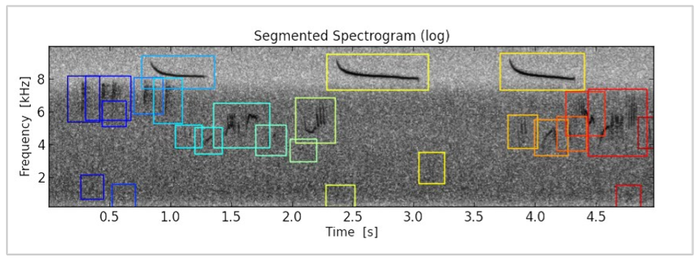
Bird Song Classification in Field Recordings Preprocessing and Segmentation
STFT using hanning window → normalized
reducing background noise with median clipping
closing & dilation → segmentation (size/position)

Slide 5
Bird Song Classification in Field Recordings Feature Extraction
File-statistics
max, min, mean, std for all values of spectrogram + 16 divided spectrogram
Segment-statistics
count + max, min, mean, std for weight, height, frequency position
Segment-probabilities
highest matching all segments using normalized cross-correlation
68 + 13 + 9,198 (number of segments in training) features per file

Slide 6
Bird Song Classification in Field Recordings Feature Selection
multi-label classification problem → 87 individual classification problems
select seg-prob features from files which include same class only
selected features for each class ~ 300 – 500 features

Slide 7
Bird Song Classification in Field Recordings Classification
using random forest (scikit-learn library)
possible without file/seg-stat features and test recording segmentation
score of 91.6% AUC
performance for each class depends on character of importance segments

Slide 8


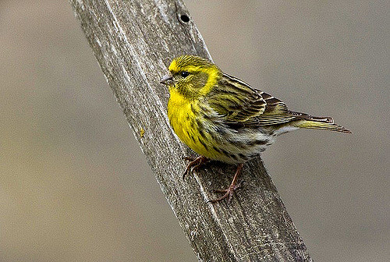
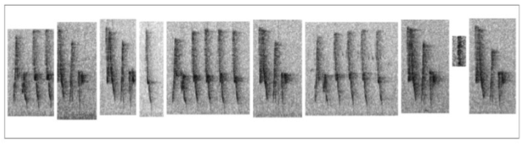
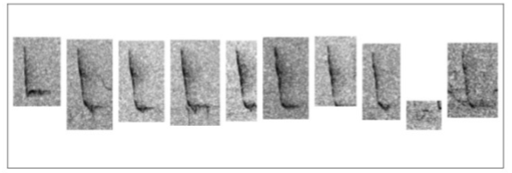
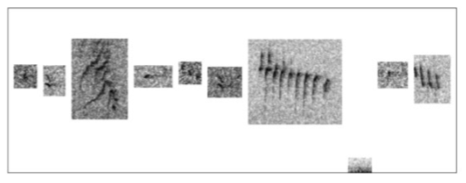
Bird Song Classification in Field Recordings Classification
song of Cettia cetti
song of Phylloscopus collybita
call of Serinus serinus

Slide 9
Bird Song Classification in Field Recordings Conclusion
Pros
can see the important segments for each class →
good for visualization and manually error checking
Cons
too many features → may apply dimension reduction

Slide 10
Bird identification from audio recordings Introduction
author: Rafael Murcia & Victor Paniagua (Spain)
rank 1 for the ICML 2013 Bird Challenge
train data: 35 audio recordings labeled with single species (30 sec)
test data: 90 audio recordings (150 sec) with possibly none or multiple species

Slide 11
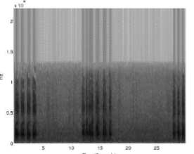
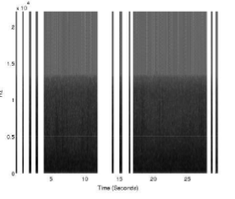
Bird identification from audio recordings Syllable Segmentation
signal spectrogram using Kaiser-window
10th-order Butterworth band-pass filter
syllable segmentation algorithm

Slide 12
Bird identification from audio recordings Feature Extraction & Dimensionality Reduction
features using the MFCCs & Delta-MFCCs
group variables of adjacent samples into vector using sliding window
to exploit the temporal relationship between the same class
LDA for reducing dimension (using the train projection in test set too)

Slide 13
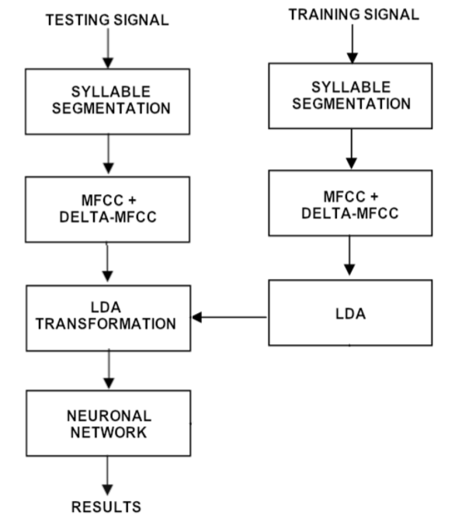
Bird identification from audio recordings Classification
35 binary simultaneous classification problems
using neural network
which bird, if any, sings in instant T?
answer using maximum score achieved during time instant
score of 69.45% AUC

Slide 14
Bird identification from audio recordings Conclusion
Pros
can extract some features that cannot be extracted by human
Cons
very hard algorithm

Slide 15
Clusterized MFCC & SVM for bird song identification Introduction
author: Oliver Dufour and team
rank 4 for the ICML 2013 Bird Challenge

Slide 16
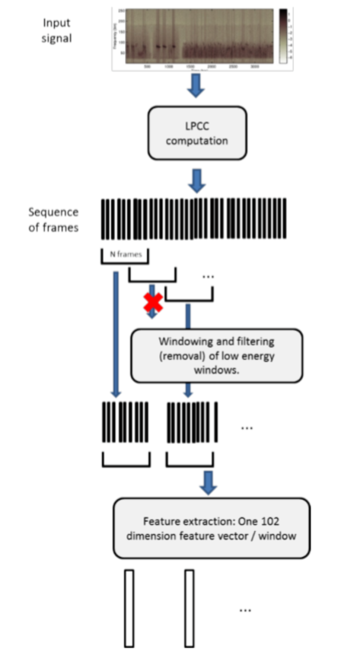
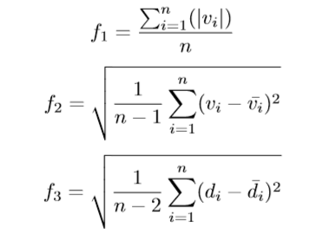
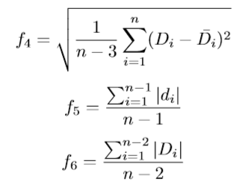
Clusterized MFCC & SVM for bird song identification Preprocessing
17 MFCC feature vectors, including energy per frame
windowing → representative of longer segments
silence removal using clustering by average energy of frames
6 math features for17-MFCC → 102 features

Slide 17
Clusterized MFCC & SVM for bird song identification Classification
clustering to split call and sound for each species
classification problem with 2K classes (K species)
SVM in a one-versus-all fashion
score of 64.64% AUC

Slide 18
Clusterized MFCC & SVM for bird song identification Conclusion
Pros
unsupervised learning (clustering) to handle noise
Cons
too many step to implement

Slide 19
Q&A

