Slide 1
PROGRESS 1: Mario method Bird song identification
Thanyaporn Phinthuphan
1 Oct 2018

Slide 2
Outline
Recap about the paper
Preprocessing
Segmentation
Feature generation
Classification & Result
Problem & Next step

Slide 3
Bird Song Classification in Field Recordings Introduction
author: Mario Lasseck
the winning Solution for NIPS4B 2013 Competition
87 sound classes of birds (call/song)
687 audio file (WAV format) in the training set (length 1-5 sec)
1,000 test file

Slide 4
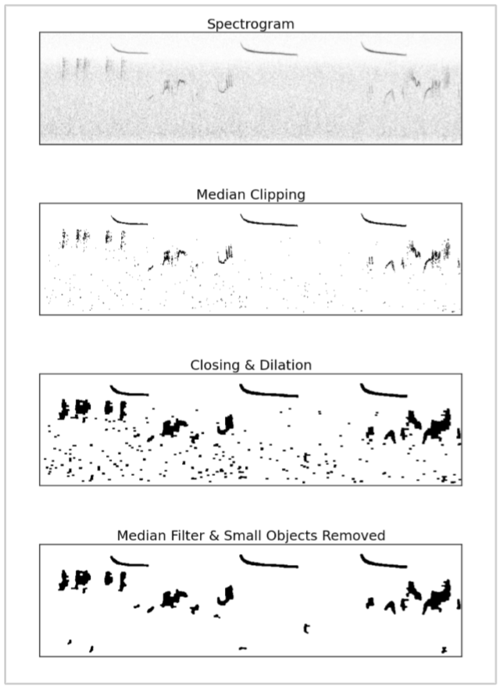
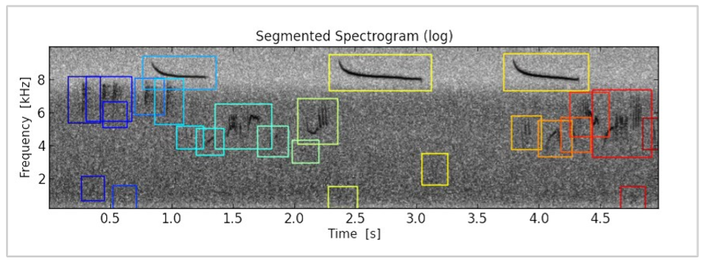
Preprocessing and Segmentation Bird Song Classification in Field Recordings
STFT using hanning window → normalized
reducing background noise with median clipping
closing & dilation → segmentation (size/position)

Slide 5
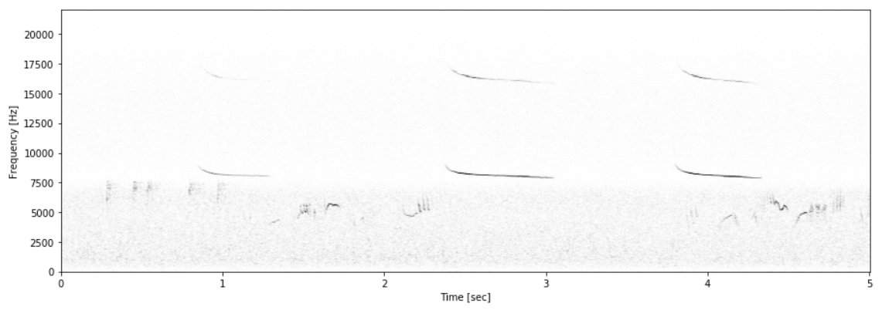
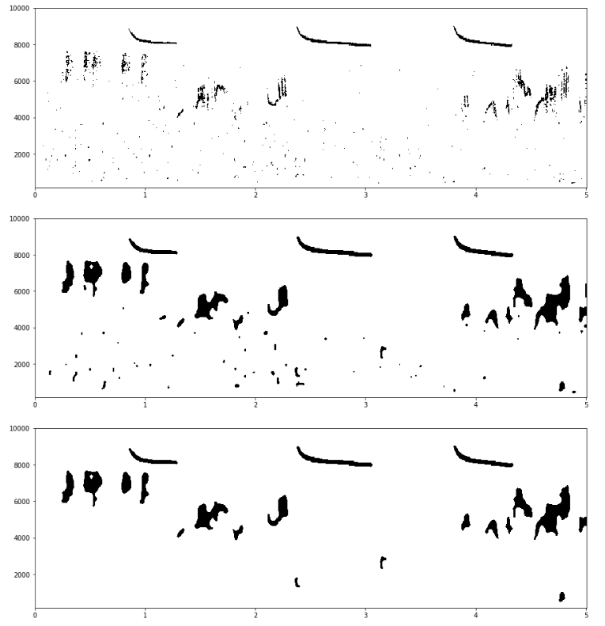
Preprocessing
using OpenCV
only tune parameter for closing, dilation, blur

Slide 6
Preprocessing
paper
tm

Slide 7
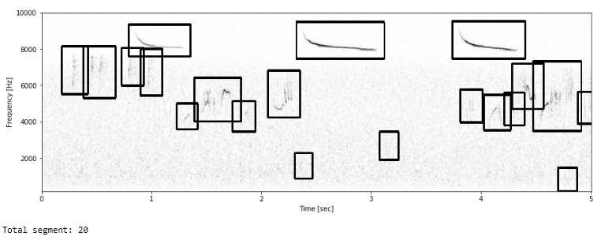
Segmentation
7,821 segments (paper has 9,198 segments)

Slide 8
Feature Generation Bird Song Classification in Field Recordings
File-statistics
max, min, mean, std for all values of spectrogram + 16 divided spectrogram
Segment-statistics
count + max, min, mean, std for weight, height, frequency position
Segment-probabilities
highest matching all segments using normalized cross-correlation
68 + 13 + 9,198 (number of segments in training) features per file

Slide 9
Feature Generation
File-statistics
max, min, mean, std for all values of spectrogram + 16 divided spectrogram
Segment-statistics
count + max, min, mean, std for weight, height, frequency position
Segment-probabilities
highest matching all segments using normalized cross-correlation
7,821 (number of segments in training) features per file

Slide 10
Bird Song Classification in Field Recordings Feature Extraction
File-statistics
max, min, mean, std for all values of spectrogram + 16 divided spectrogram
Segment-statistics
count + max, min, mean, std for weight, height, frequency position
Segment-probabilities
highest matching all segments using normalized cross-correlation
68 + 13 + 9,198 (number of segments in training) features per file

Slide 11
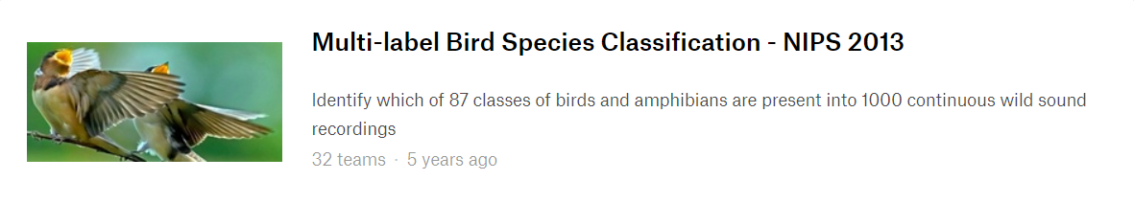
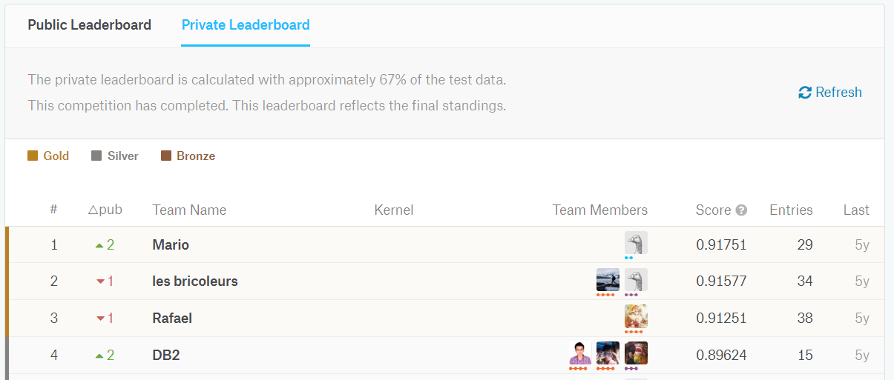
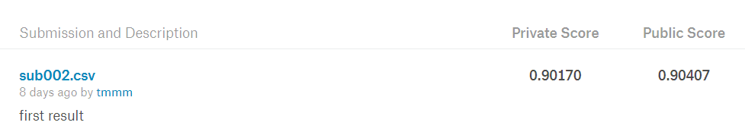
Classification & Result
using 87 random forest
score of 90.17% AUC

Slide 12
Problem
Runtime ~12 hours !!!
(Including generate train/test feature (seg-prob)

Slide 13
Next Step
Try to use these feature/method on my dataset
Find the way to identify on continuous sound
Extract only important features to reduce runtime

Slide 14
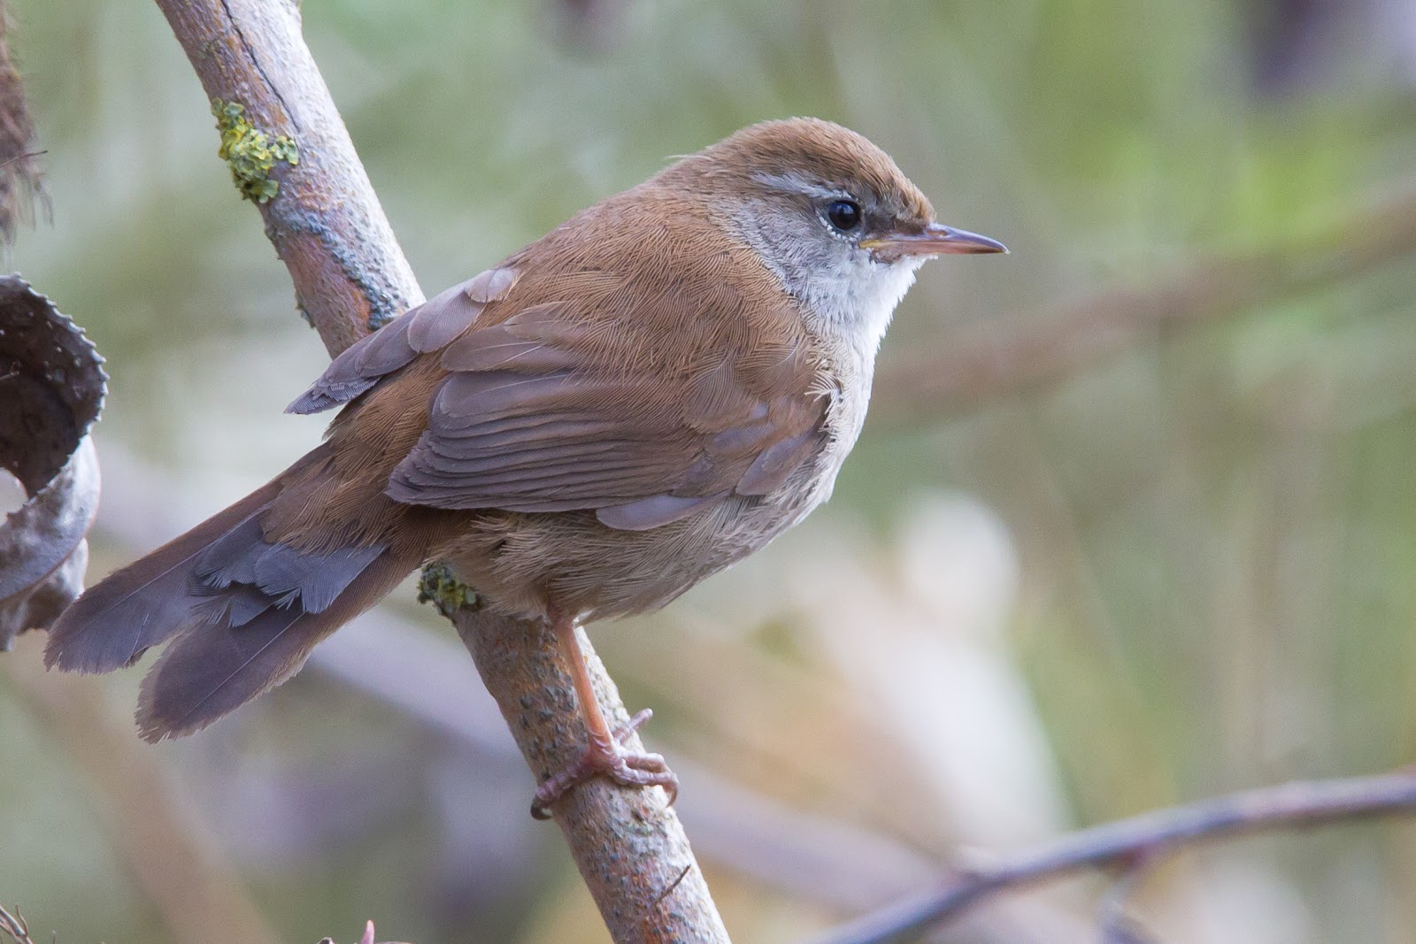
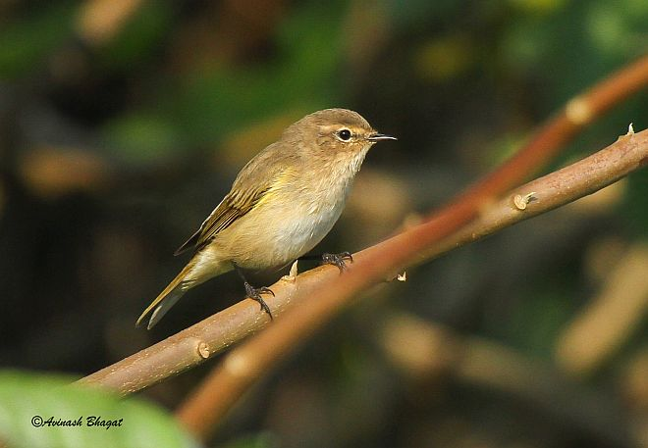
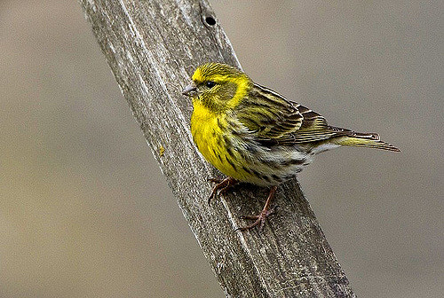
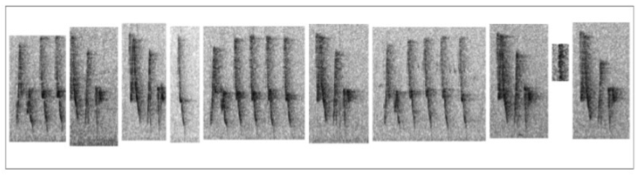
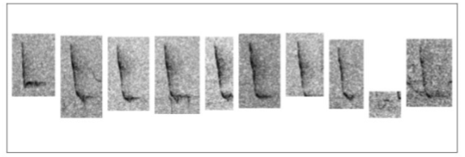
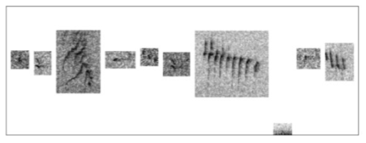
Bird Song Classification in Field Recordings Classification
song of Cettia cetti
song of Phylloscopus collybita
call of Serinus serinus

Slide 15
Q&A

