Slide 1
WELCOME TO OUR PRESENTATION!

Slide 2
E-commerce Platform

Slide 3
Group 8
Dinh Thi Thanh Hang ITDSIU21083
Dinh Vu Ngoc Linh ITDSIU21095
Le Thi Tuyet My ITDSIU21005
Trinh Le Bich Hang ITDSIU21084
Nguyen Mai Phuong ITDSIU20105
Nguyen Huu Thuy ITCSIU22141

Slide 4
Table Of Contents
I. Introduction
II. ERD-EERD
III. Database Normalization
IV. Relational Schema
V. Create Table & Insert Data
VI. Demo
VII. Conclusion

Slide 5
Part I: Introduction

Slide 6

Part I: Introduction
Background
- Traditional markets does not cater to everyone
- Both the sellers, and buyers require an online platforms

Slide 7

Part I: Introduction
Goals
- New Account Register
- Auto Generated User ID
- Pays through banking
- Purchase one or many
- Invoices displayed

Slide 8
Part II:ERD- EERD

Slide 9
Entity & Attributes
Part 2: ERD-EERD
Customer( CID, UID, Bname, Baccount, Phone, CPassWord, Address)
Admin(AID, Aname, Email, PassWord)
Seller(Sname,SID, SPassWord)
Product(PID, Pname, Price, Quantity)
Order(OID, TransactionDate, Total, DeliveryFee)
OrderItems(Subtotal, Qunantity, ItemNo)

Slide 10
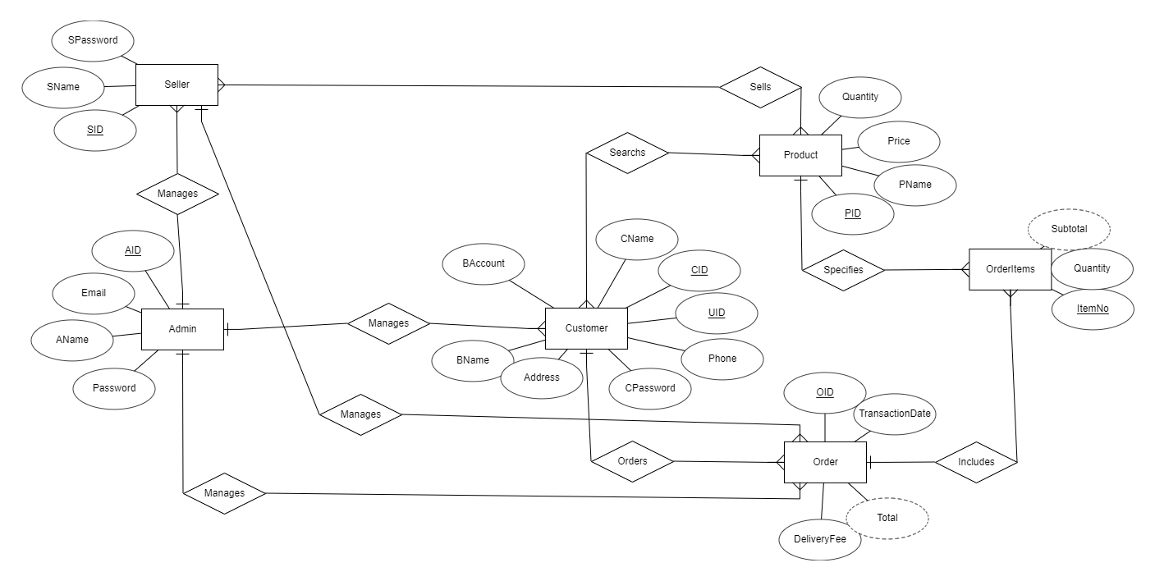
Relationship
Part 2: ERD-EERD

Slide 11
Cardinality
Part 2: ERD-EERD

Slide 12
Part III: Database Normalization

Slide 13
Normalization
1NF
2NF
3NF
First Normal Form
Second Normal Form
Third Normal Form

Slide 14
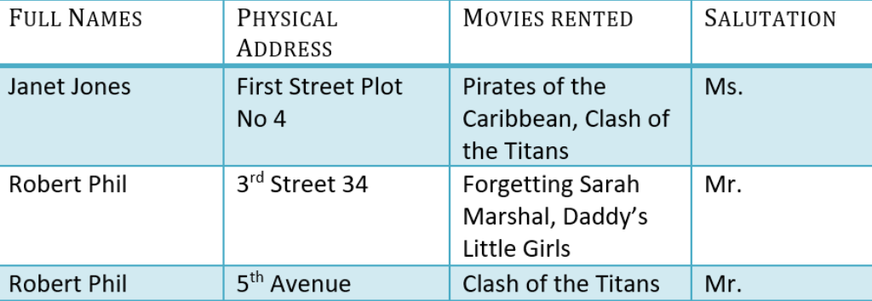
First Normal Form

Slide 15
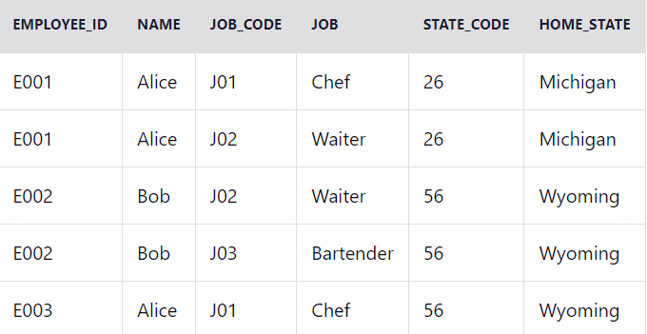
Second Normal Form

Slide 16
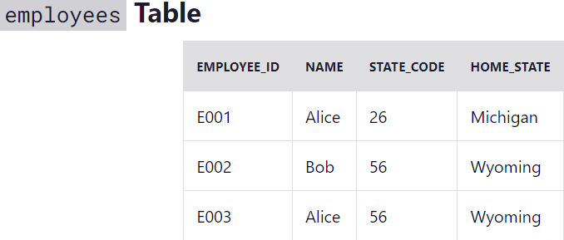
Third Normal Form

Slide 17
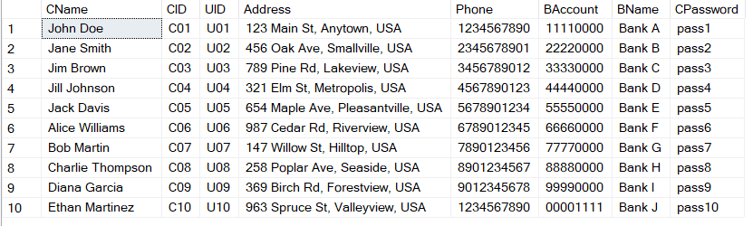
Apply into the project

Slide 18
Part IV: Relational Schema

Slide 19
General Steps
01
02
03
Strong Entity Types
Binary
1-to-1
Binary
1-to-N
04
05
Binary
M-to-N
Multivalued Attributes

Slide 20
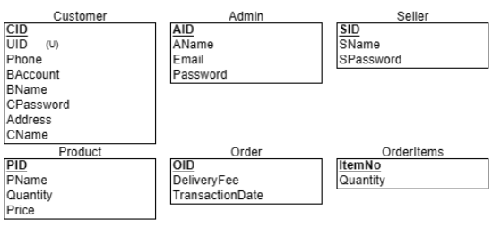
Relational Model
04
Step 1: Strong Entity Types
Relations with attributes
Primary keys
Unique keys

Slide 21
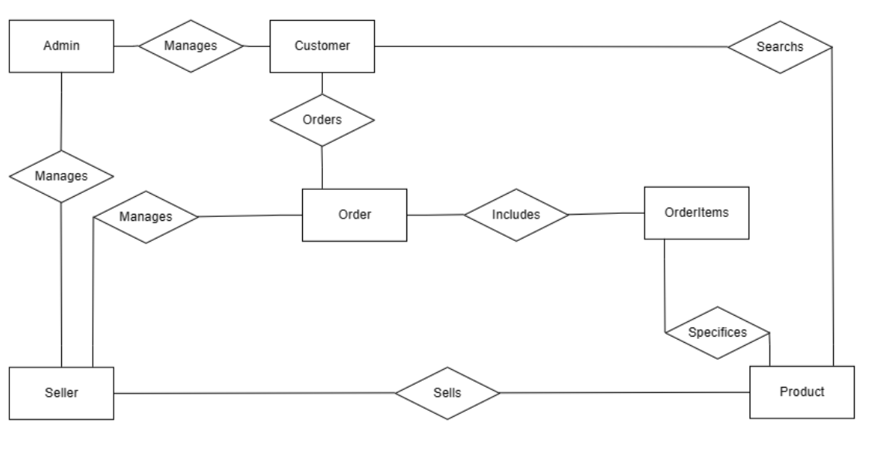
Relational Model
04
No 1-to-1 relationship in the ERD model.
Step 2: Binary 1-to-1

Slide 22
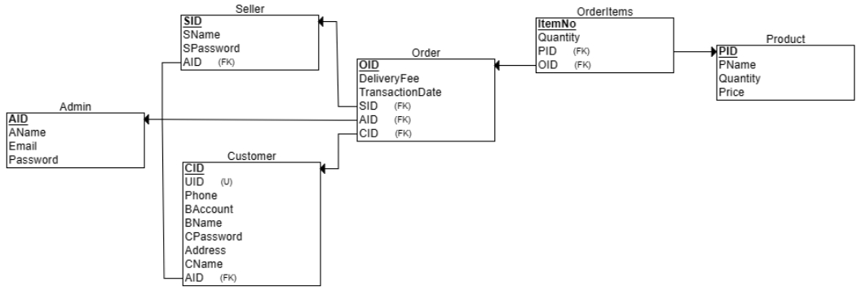
Relational Model
04
Add foreign keys.
Step 3: Binary 1-to-N

Slide 23
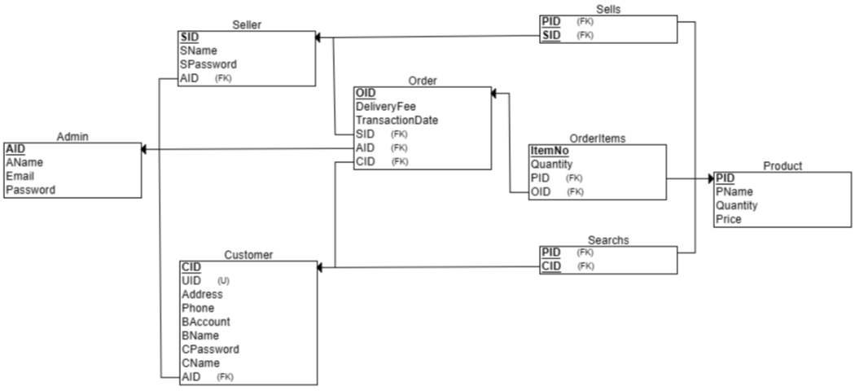
Relational Model
04
Create relation for many-to-many relationships
Step 4: Binary M-to-N

Slide 24
Part V: Create Table & Insert Data

Slide 25
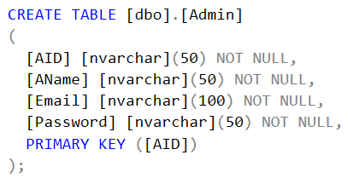
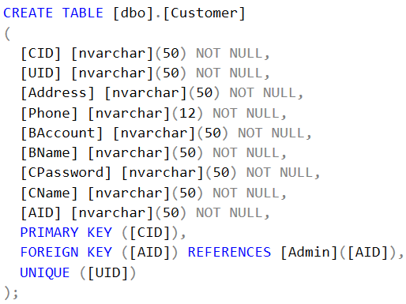
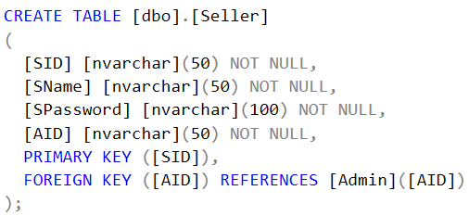
05
Create Table

Slide 26
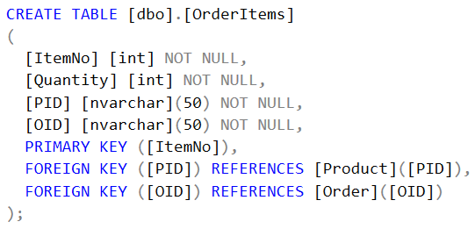
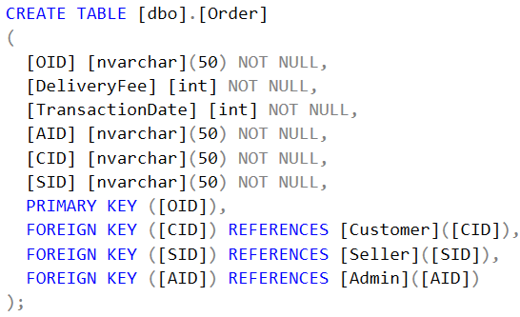
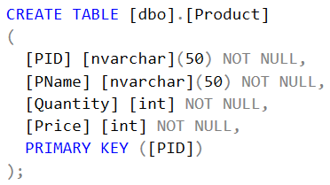
05
Create Table

Slide 27
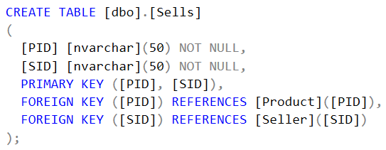
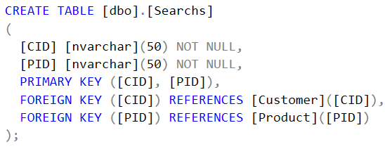
05
Create Table

Slide 28
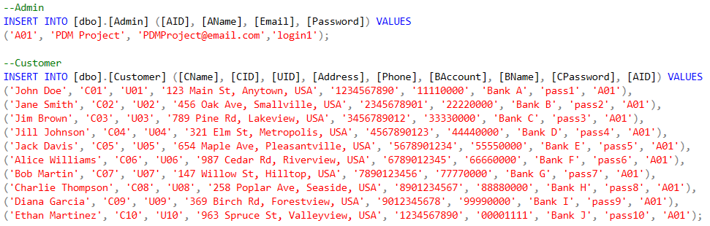
05
Insert Data

Slide 29
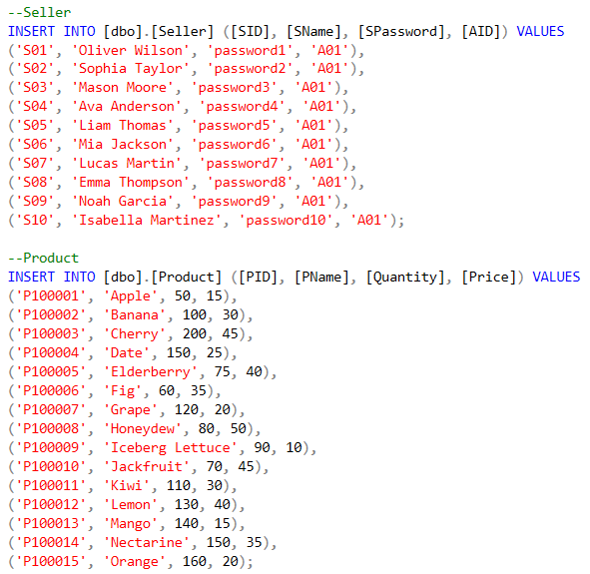
05
Insert Data

Slide 30
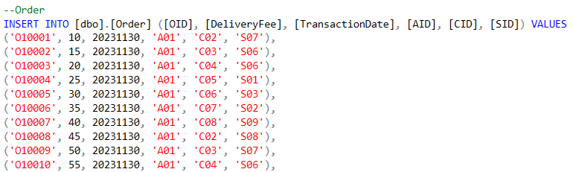
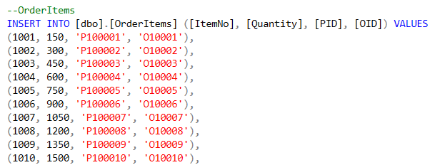
05
Insert Data

Slide 31
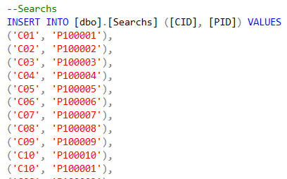
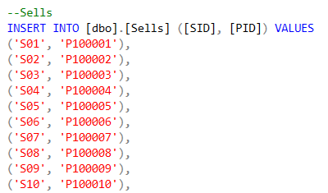
05
Insert Data

Slide 32
Part VI: Demo

Slide 33
E-commerce platform in which:
Customer
System
Generate unique user ID
Register a new account
Login
Search product list
Purchase items

Slide 34
CONCLUSION
Learned Lessons
Project Outcomes
A robust ERD and relational model
Methodologies from course
Utilizing SQL Server and Java
Collaborative skills
Effective communication
Task distribution
Conflict resolution

Slide 35
REFERENCES
Hoffer, J. A., Ramesh, V., & Topi, H. (2016, January 1). Modern Database Management. Pearson.
Elmasri, R., & Navathe, S. (2013, July 23). Fundamentals of Database Systems.

Slide 36
Thank you for listening!

